Slide 1
A
B
C
D

Slide 2
A
B

Slide 3
A
B
C

Slide 4
A
B
C

Slide 5
A
B

Slide 6
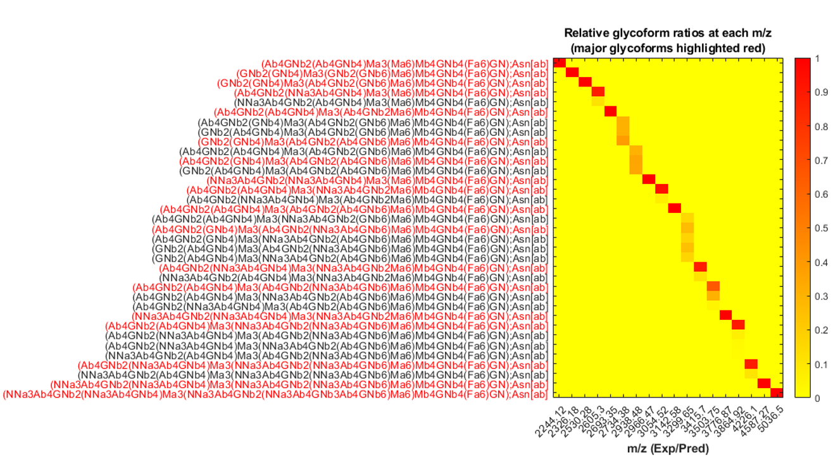
C
m/z (numbering)

Slide 7
D

