Slide 1
Data.xlsx
Glycomics data needs to be preprocessed. Materials needed include:
Signal intensities at each m/z (raw MS)
Glycan compositions at each m/z
Partial or all annotation (optional but highly recommended to have at least a few annotations of major signals)
Raw MS data, glycan monosaccharide compositions, and glycan annotations must be organized in the format specified by Data.xlsx in order to be properly loaded into MATLAB. Alternatively, you may organize the data directly into MATLAB variables in the same format as specified by those obtained from running the script “Step1_Load_Preprocessed_Data.m”.
Format data in accordance with the formats specified on slide 1 and slide 2.
Note:
Regardless of annotations, both sheets must be present.
Format of all the cells should be “General”, which is usually by default in Excel.

Slide 2
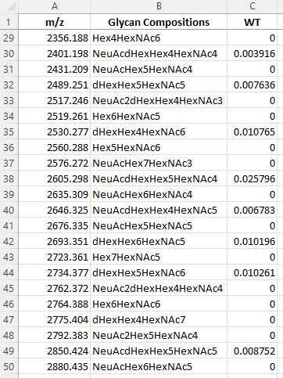
Sheet 1: MS Raw
Raw data used for fitting
Columns
m/z: all measured m/z values or numerical indexes (1,2,3,4… etc.)
Glycan Compositions: glycan compositions corresponding to the m/z values. If you do not have the model-compatible glycan compositions but only the glycan structures, Sup1_Get_compositions_from_linearcodes.m in the Supplemental Steps folder can be used to obtain corresponding glycan compositions from user-provided linear codes. If you prefer to manually enter glycan compositions, slide 3 specifies the format recognizable by the pipeline.
WT (a profile name): relative intensities measured at the corresponding m/z values
Elements of m/z values and Glycan Compositions must be unique.
Additional profiles can be appended to the right of the table, with the top cell as the profile names (like column WT), and the WT column can be deleted.
The profile name WT is preferred for naming a wild type profile in order to smoothly run all functions of the pipeline.

Slide 3
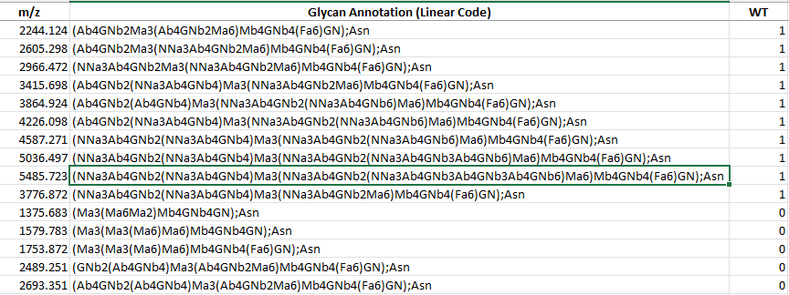
Sheet 2: Annotation
Annotation restriction used for fitting
Columns
Glycan Annotation: glycan annotations
m/z: m/z values or numerical indexes corresponding to Glycan Annotation. The values may not be unique due to glycan isoforms.
WT (a profile name): logical flag (1 or 0) indicating whether specific glycan isoforms are annotated for the glycoprofile. Elements of Glycan Annotation are unique.
Additional profiles can be appended to the right of the table, with the top cells as the profile names (like column WT), and the WT column can be deleted. If no annotations are applicable to the profile, assign 0 to all the element in the column. Otherwise, assign 1 to annotated glycan isoforms. If no annotations exist for any profiles, delete all the rows in the sheet except for the headers.
The profile name WT is preferred for naming a wild type profile in order to smoothly run all functions of the pipeline.
Notes:
增加 ambiguous annotation 的例子
Refer to Glycompare CT https://www.biorxiv.org/content/10.1101/2022.05.31.494178v1

Slide 4
Glycan Compositions
The pipeline-compatible glycan composition has the following format:
NeuAc#d1dHex#d2Hex#d3HexNAc#d4
#d1: the number of sialic acid (NeuAc)
#d2: the number of fucose (dHex)
#d3: the number of galactose and mannose (Hex)
#d4: the number of N-Acetylglucosamine (HexNAc)
Rules
If a number is 0, the string representing the specific monosaccharide(s) and the number should be dropped. For example, dHex0Hex7HexNAc8 should be Hex7HexNAc8 instead
If a number is 1, the number should be dropped. For example, dHex1Hex7HexNAc8 should be dHexHex7HexNAc8 instead.

Slide 5
Common Issues
Linear codes should be formatted according to BJOC - A consensus-based and readable extension of Linear Code for Reaction Rules (LiCoRR) (beilstein-journals.org)
Due to potentially alternative fragmentation patterns of monosaccharides (e.g. dehydration) and adducts from ionization, signal intensities at different m/z values but representing the same glycan composition should be combined. m/z value corresponding to the composition without any modifications should be used.

