Slide 1

Abnormal Traffic Detection System for Wireless Devices
113064514 劉姿妤
113064558 謝育葦

Slide 2
Project Target
To determine if our own host is behaving like a botnet member
By detecting outbound TCP flood attack patterns (SYN, ACK, FIN, RST)
Using a deep learning model (CNN-LSTM) to analyze traffic features
Identify and list suspicious processes responsible for abnormal traffic behavior

Slide 3
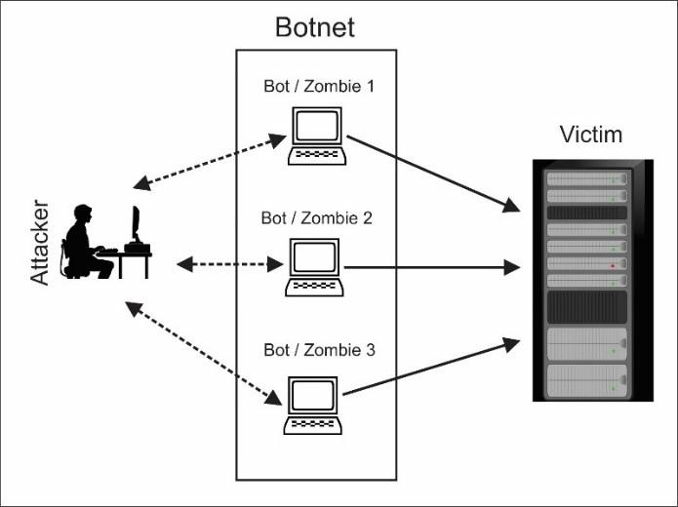
Introduction to Botnets
A botnet is a network of compromised devices controlled by an attacker. These devices can include PCs, servers, IoT devices, etc.
Used for malicious activities like:
DDoS attacks
Spam distribution
Malware propagation
Crypto mining
Often used in coordinated DDoS attacks

Slide 4
Why Being Part of a Botnet Is Dangerous
1. Used for Illegal Activities
Your device may participate in DDoS attacks, spam campaigns, or malware distribution.
2. Decreased Performance
Bot malware consumes CPU, memory, and bandwidth, making your system slow or unstable.
3. Privacy Risks
Potential data leaks, including passwords, browsing history, and personal files.

Slide 5
Detecting Botnet Behavior via CNN-LSTM
If the traffic shows patterns of SYN, ACK, FIN, or RST flood attacks,
the model flags the host as potentially part of a botnet.
Attack Type | Attack Behavior | Impact
SYN Flood | Many SYN packets, little or no ACK replies | Exhaust connection table & memory
ACK Flood | Many ACK packets | Forcing the server to check connection states, causing high CPU usage
FIN Flood | Many fake FIN packets | Try closing non-existent connections, consuming TCP resources.
RST Flood | Many RST packets | Forcefully terminate existing connections and disrupt stability.

Slide 6
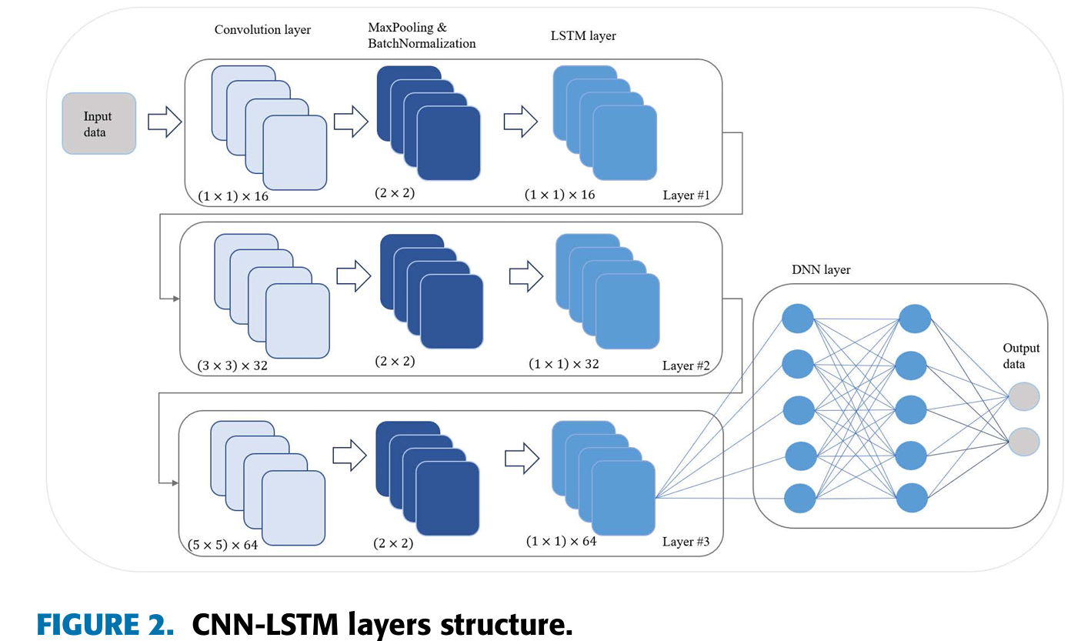
CNN-LSTM Model [1]
(1) Convolution Layer
(2) MaxPooling and BatchNormalization
(3) LSTM Layer
Input data

Slide 7
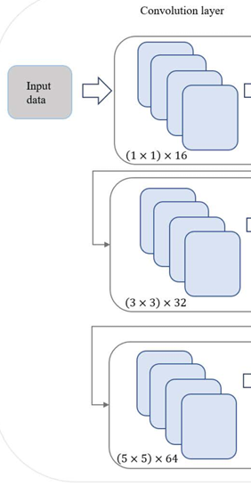
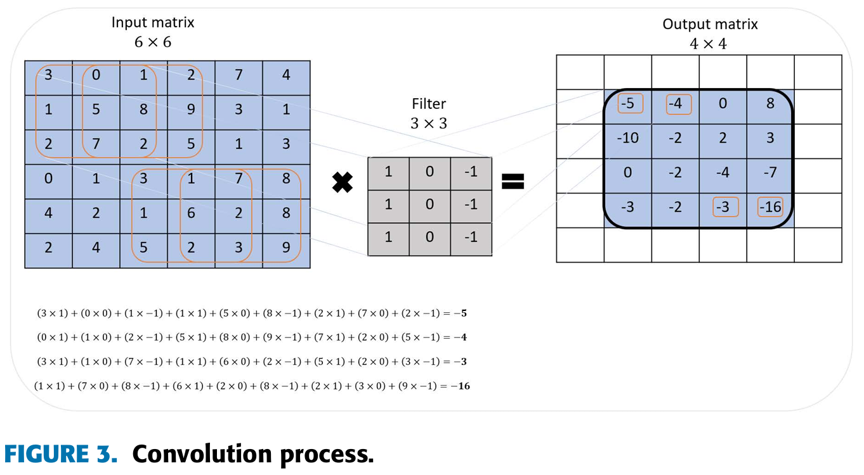

Convolution layer

Slide 8
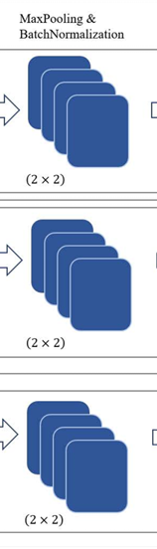
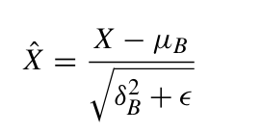

MaxPooling and Batch Normalization
To avoid the covariance shift caused by using the output of the previous layer as the input to the next layer in deep neural networks.

Slide 9
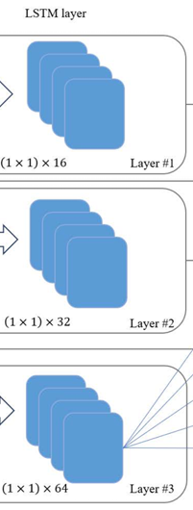
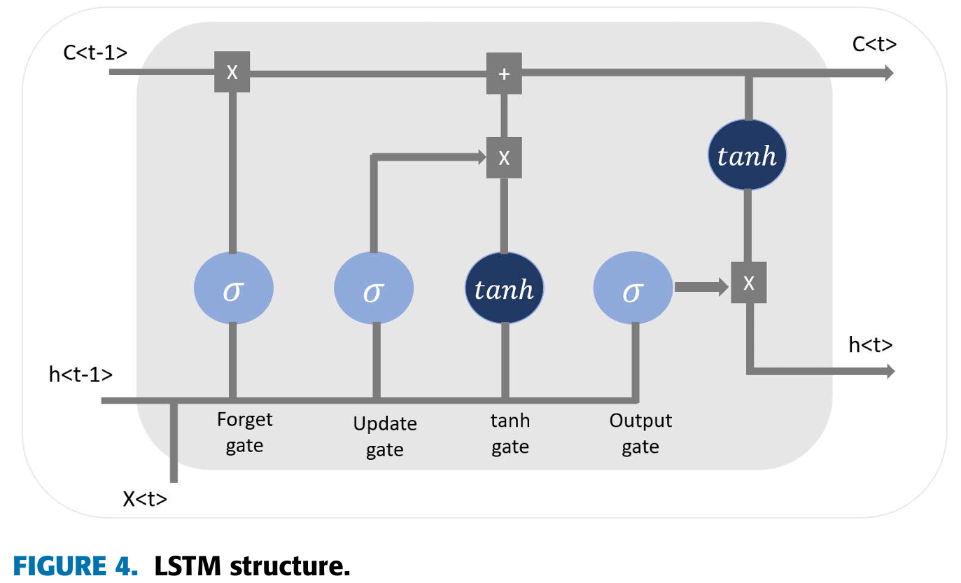
LSTM Layer
Decide how much information should be updated.
Weight of the input state.
Weight of the hidden state.
Decide how much of the past memory to retain.
Determine the newly added content.

Slide 10
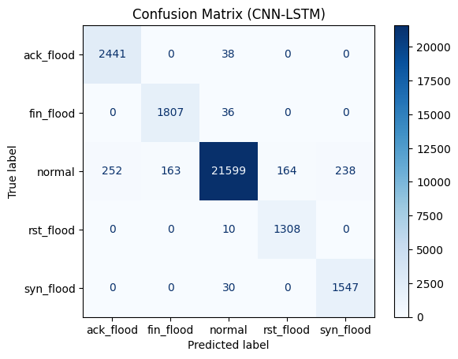
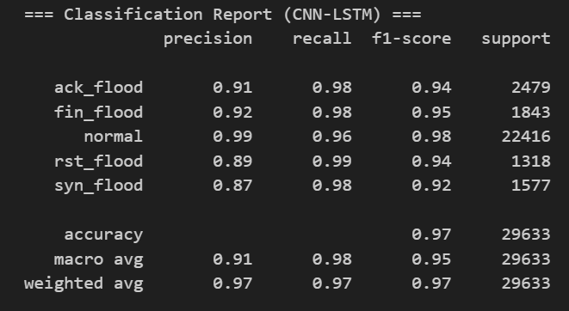
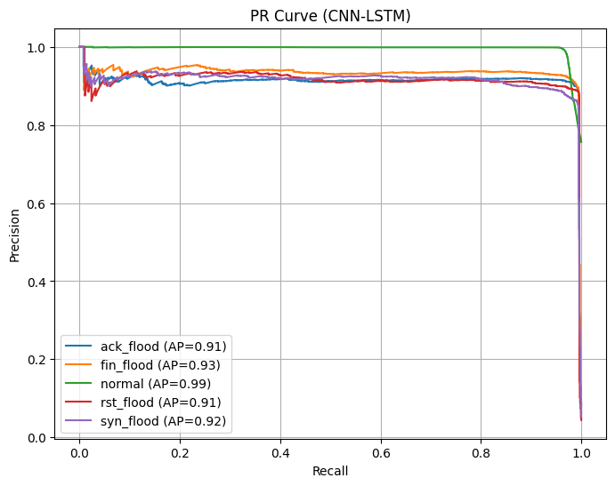
CNN-LSTM report
The model achieves high accuracy, has an intuitive architecture, and is highly practical.

Slide 11
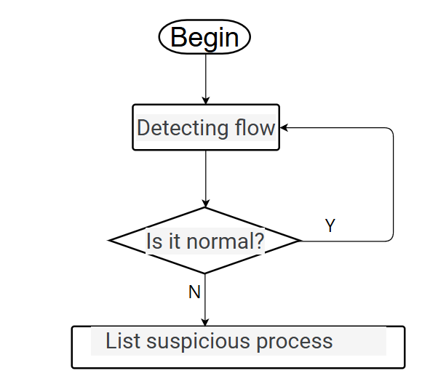
Flow Chart

Slide 12
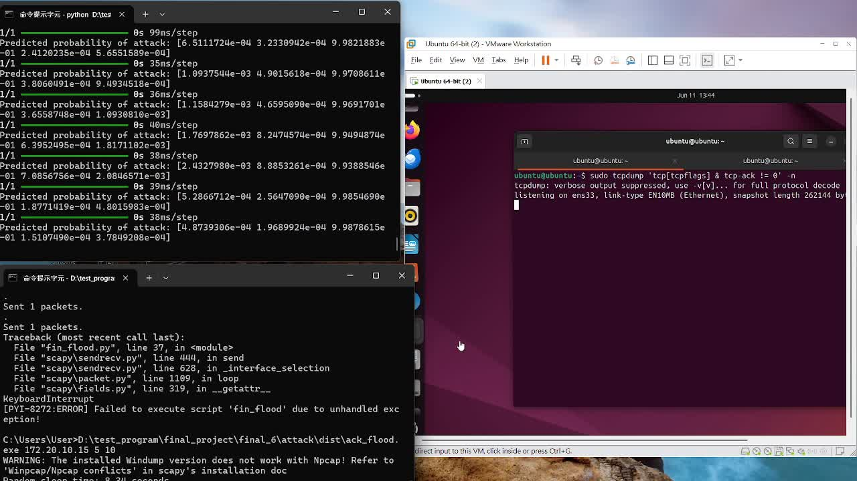
DEMO - ACK flood

Slide 13
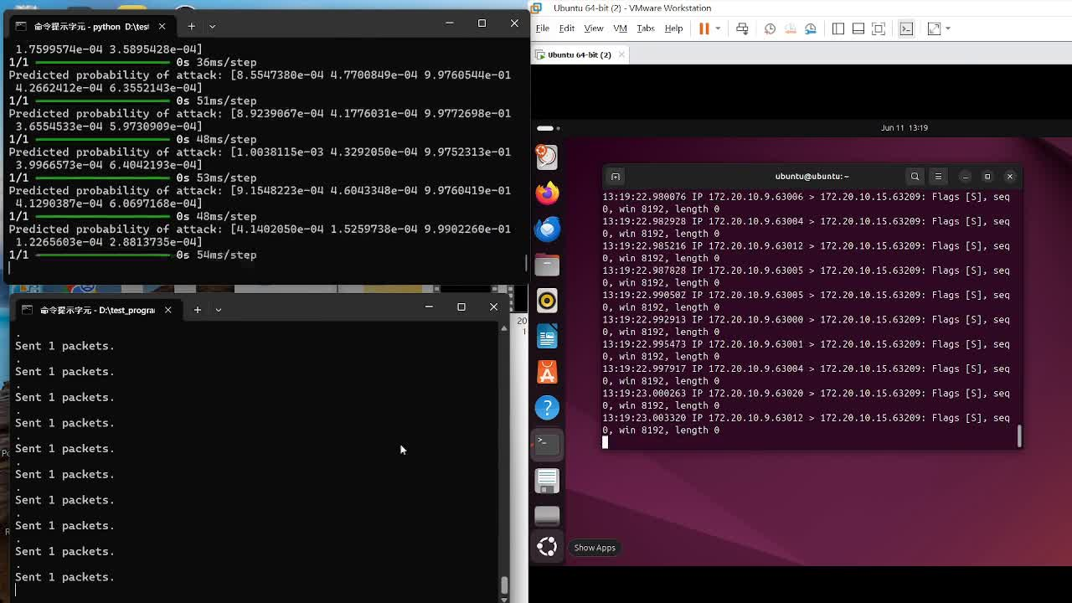
DEMO - SYN flood

Slide 14
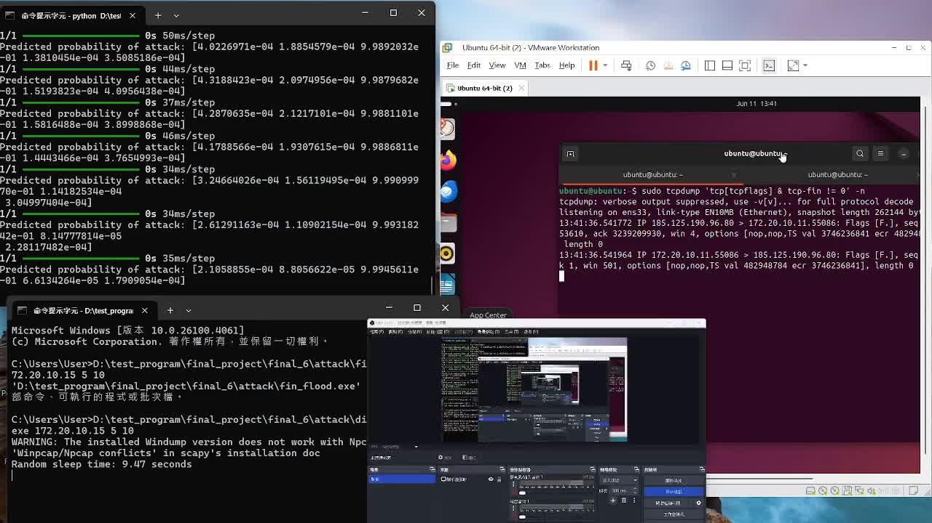
DEMO - FIN flood

Slide 15
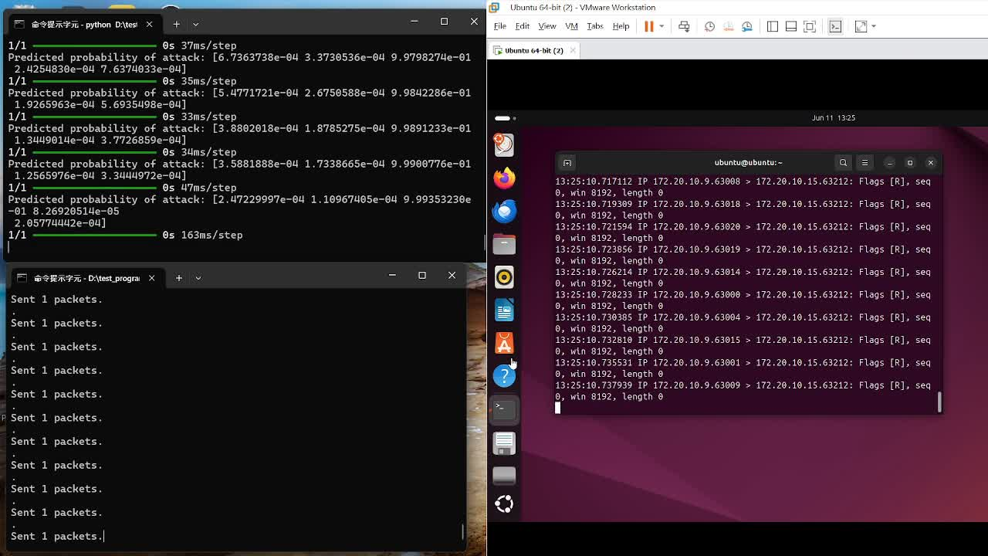
DEMO - RST flood

Slide 16
CONCLUSION AND FUTURE WORK
Propose a hybrid CNN-LSTM model for real-time detection of abnormal wireless network traffic.
Successfully detects SYN, FIN, ACK, and RST flood attacks in real time and sends alerts to the client.
Future work aims to expand detection capabilities to cover a wider range of attack types.

Slide 17
Reference
[1] Halbouni, A., Gunawan, T. S., Habaebi, M. H., Halbouni, M., Kartiwi, M., & Ahmad, R. (2022). CNN-LSTM: hybrid deep neural network for network intrusion detection system. IEEE Access, 10, 99837-99849.

Slide 18
Thank you

