Slide 1

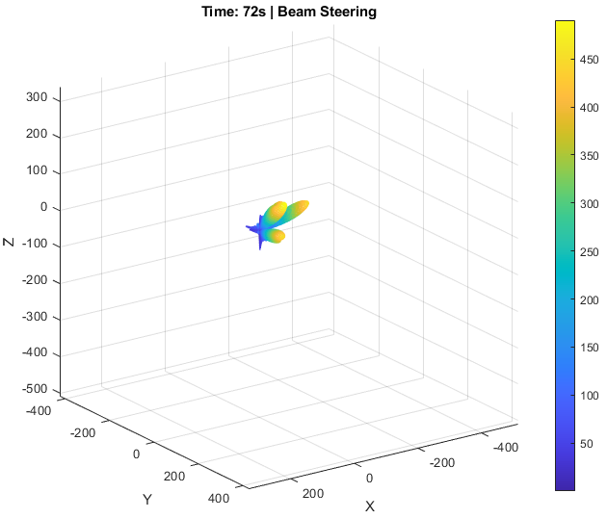
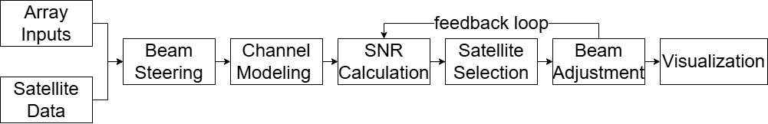
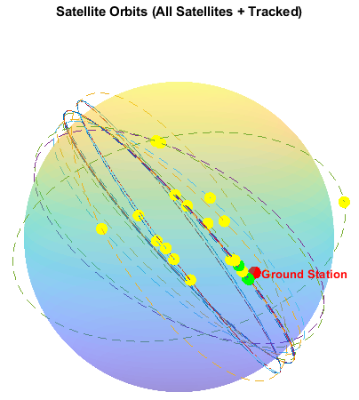


School of Computing, Engineering & Built Environment
MEng/BEng (Hons) Electrical, Electronic and Energy Engineering
Simulation of Multi-beam Antenna Array
By Lewis Mitchell
Supervisor: Sinan Sinanovic
1. Introduction
Modern satellite networks increasingly rely on low Earth orbit (LEO) systems, which move quickly across the sky. Tracking these satellites is challenging, especially for ground antennas that use mechanical movement. Electronic beam steering with phased arrays offers a faster, more reliable alternative.
This project simulates a phased antenna array system designed for LEO satellite tracking.
Aims and Objectives
Real-time beam steering using phase shifts across array elements
Configurable inputs for frequency, array size, and element spacing
Single and multi-beam tracking modes for dynamic satellite selection
Satellite orbit prediction using Two-Line Element (TLE) data
4. Antenna Array
Enables electronic beam steering—no mechanical movement needed.
Array size and spacing control beamwidth and direction.
Phase shifts steer beams, based on array geometry and frequency.
Figure 1 – Beamforming Simulation
Proper spacing avoids grating lobes and boosts gain.
High resolution improves satellite separation and tracking accuracy.
Variable | Description | Value/ Formula
f | Frequency of operation | 14e9 (14 GHz)
lambda | Wavelength | 3e8 / f
K | Wavenumber | 2 * pi / lambda
M,N | Array size | 20, 20
Dx, dz | Element spacing | lambda / 2
numBeams | Number of beams formed | 3
2. System Flow Overview
Array settings and satellite data are used to steer beams toward predicted positions.
Signal quality is estimated using a simple channel model and Signal-to-Noise Ratio (SNR) calculation.
A feedback loop selects the best targets and adjusts beams in real time.
The output includes beam patterns and satellite tracking visuals.
Table 1 – Antenna Array Inputs (with examples)
5. Results
The simulation takes user-defined inputs for array size, element spacing, frequency, and satellite data, allowing easy adaptation to different tracking scenarios.
The simulation uses real orbital data to dynamically track the satellites with the strongest signal (SNR).
Beam steering adjusts in real time to maximize link quality, accounting for distance and beam alignment.
Example:
In this run, 3 beams were used to track satellites from a group of 5 Starlink spacecraft, using real TLE data.
Figure 2 – Flow Diagram
3. Satellite Positioning
This TLE tells you:
٠Who the satellite is (ID + name) ٠When it was observed (epoch time)
٠Where it is in its orbit (orbital elements) ٠How it's moving (mean motion, drag)
Satellite positions are computed using TLE data, a standard format for orbital elements.
TLEs provide real-time orbital information, enabling accurate prediction of satellite trajectories.
In this simulation, satellite positions are continuously updated using the TLE dataset to track motion over time.
Figure 3 – Satellite Simulation
Figure 4 – TLE File Example (single satellite)
Figure 5 – Satellite SNR Graph
6. Conclusion
The simulation demonstrates that phased arrays can effectively track LEO satellites with high accuracy.
Results aligned with theoretical expectations, confirming correct beam patterns, resolution, and signal variations over time.
The system dynamically selected satellites based on SNR and adjusted beams in real time.
This simulation serves as a practical tool for designing antenna arrays tailored to LEO satellite communication systems.
7. Future Work
Future updates should include real-world signal effects like Doppler shift and atmospheric loss.
Tracking very low Earth orbit (VLEO) satellites testing fast beam switching and signal handover.
Adding adaptive null steering to reduce interference when tracking multiple satellites.

