Slide 1
Purpose — one portal for how GSQ plants run DD&T
The room still stitches Jira, SPOT, Power Apps, Power BI, and PowerPoint. The cost is leadership time and inconsistent answers.
WHY
WHAT
WHO
RECORD
Run the review from a maintained system of record — not a slide factory.
One site-aware Glass. Ten views. Reuse what exists; add Budget, Review, and Site input.
Joel Vincent, sponsor. Dean Santoro, product. Thousand Oaks first.
SPOT 1063647 is already live. Do not open a second project.
THIS IS
THIS IS NOT
A single pane of glass for 18 GSQ M&L sites.
Site is a drop-down. Money and dates sit on one row. Site Heads type commentary in the same portal. The TO business review runs from here.
A new strategy, a second Jira, or a second SPOT.
The portal does not overwrite dates or money. The $42k / 6-week figure is a thin shell and cannot prove Jira + SPOT + EDB.
Private and confidential. For internal use only.

Slide 2
Business case — hours back, proven first at Thousand Oaks
9,000
42
$168k
30,000
HOURS / YEAR
HRS / SITE / MONTH
BAND B ENVELOPE
HOURS TOTAL
Filed value · 18 sites
Deck + status chasing
10–12 weeks · ~2.5 FTE
On the SPOT record
Recommend Band B. Do not fund Band A ($42k) if the test is “executives stop building decks.” §9 of the business case is a thin shell only.
A Thin shell
B Recommended
C Full case
$42k · 6 weeks
$155–168k · 10–12 weeks
$196k · 12 weeks
Wrap today’s tabs. No SPOT, no EDB, no Site Head input.
Live Jira + SPOT, Gantt+Budget, Capability, Site input, TO freeze.
Band B + EDB data-product + production network roadmap.
Private and confidential. For internal use only.

Slide 3
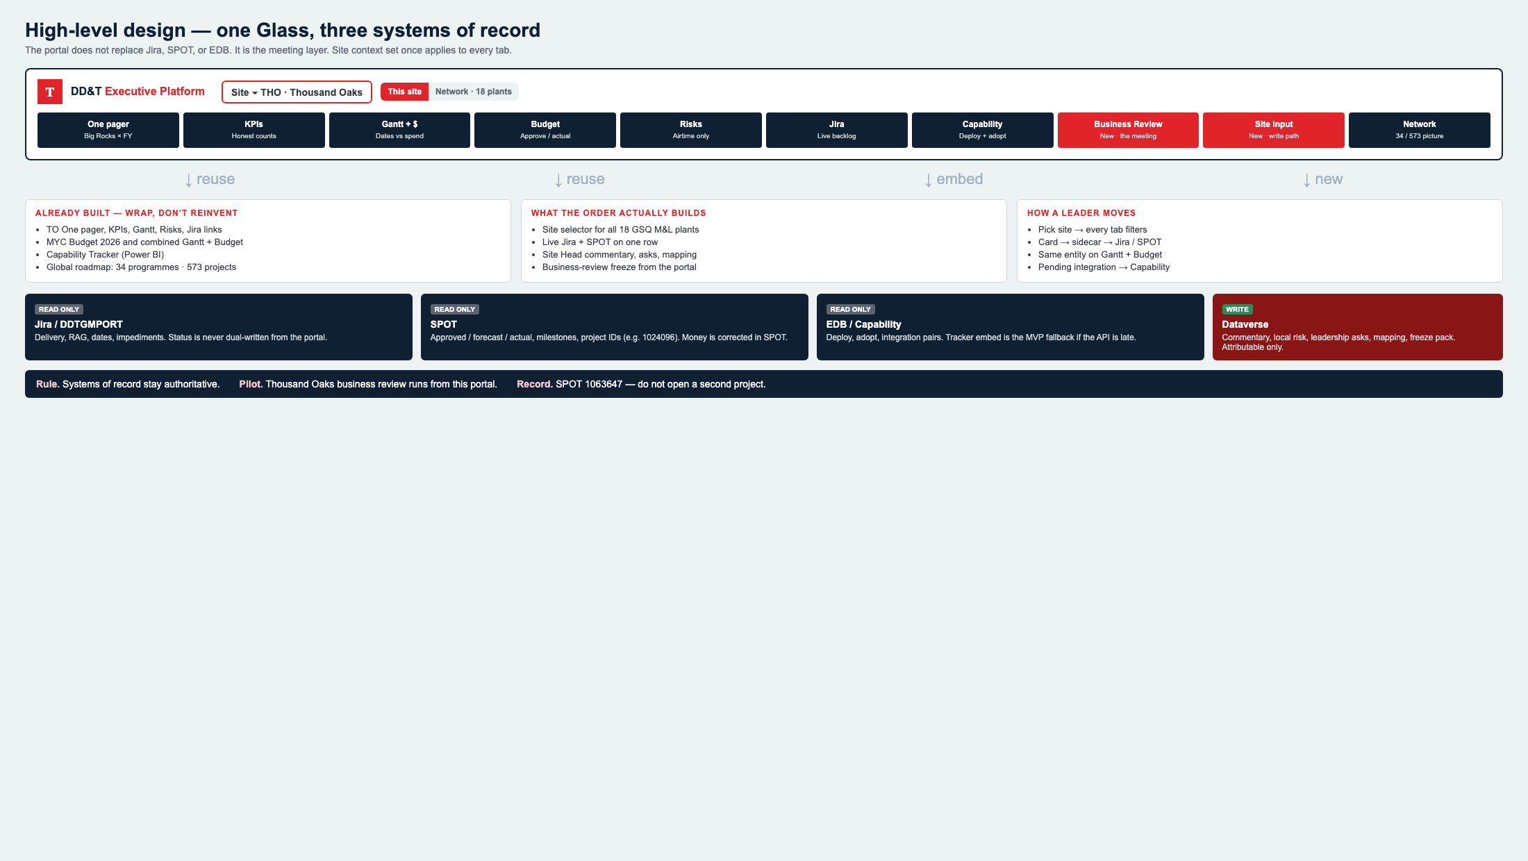
Design schematic — one Glass, three systems of record
Private and confidential. For internal use only.

Slide 4
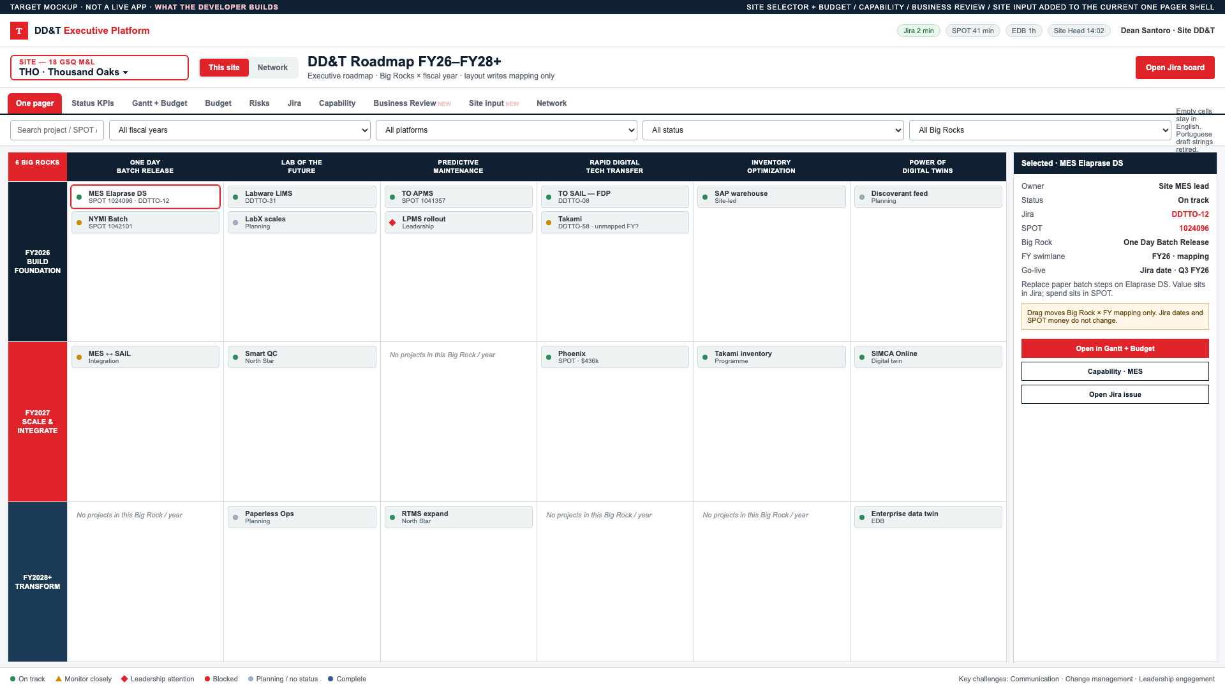
What leaders see — site set once, the meeting runs here
Private and confidential. For internal use only.

Slide 5
Decision — Band B, Thousand Oaks, one SPOT
Approve ~$168k / 10–12 weeks. Name Thousand Oaks as the first business-review system of record. Keep SPOT 1063647.
01
02
03
04
Fund Band B
Pilot Thousand Oaks
Keep SPOT 1063647
Authorize onboarding
$155–168k · 10–12 weeks
to the design blueprint.
First review system of record.
Site Head UAT in weeks 9–10.
File the funding request here.
Align header CAPEX to one number.
AIDPG Initiative → 1063647.
Pattern-Fit, token line, Intake.
GO / NO-GO FOR RELEASE 2
One TO business review runs from the portal.
Site Head commentary is attributable.
Jira, SPOT, and Capability match in the room.
Leadership agrees the pattern scales.
Private and confidential. For internal use only.

