Slide 1


TactiHelm: A Vibrotactile Helmet for Cycling Safety
Lewis Trundle
Level 5 MSci Project
Supervised by Stephen Brewster

Slide 2
Motivation
41,000 cyclists are fatally injured annually worldwide [1].
Leading cause of fatalities is collisions with other vehicles approaching from behind [2, 3].
Technologies such as bike radars provide unique alerting methods, utilising visual, auditory, and vibrotactile feedback.
Yet to be explored is how the cycling helmet can be used.
Introduction
TactiHelm System
Lab Study
User Study
Conclusions

Slide 3
Objective
“Develop a vibrotactile helmet-based hazard notification system to effectively warn a cyclist of an approaching vehicle.”
What hazard information is most useful for warning cyclists?
How can this information be encoded using vibrotactile feedback?
How can this be incorporated into a helmet-based display?
Introduction
TactiHelm System
Lab Study
User Study
Conclusions

Slide 4
Background Survey
An online survey was conducted (N=110) to understand the requirements of such a system.
73% had suffered an injury whilst cycling
80% said that they regularly wear a helmet
10% responded that they own a bike radar.
40% stated that close passes from cars were a top safety challenge while cycling.
Introduction
TactiHelm System
Lab Study
User Study
Conclusions

Slide 5
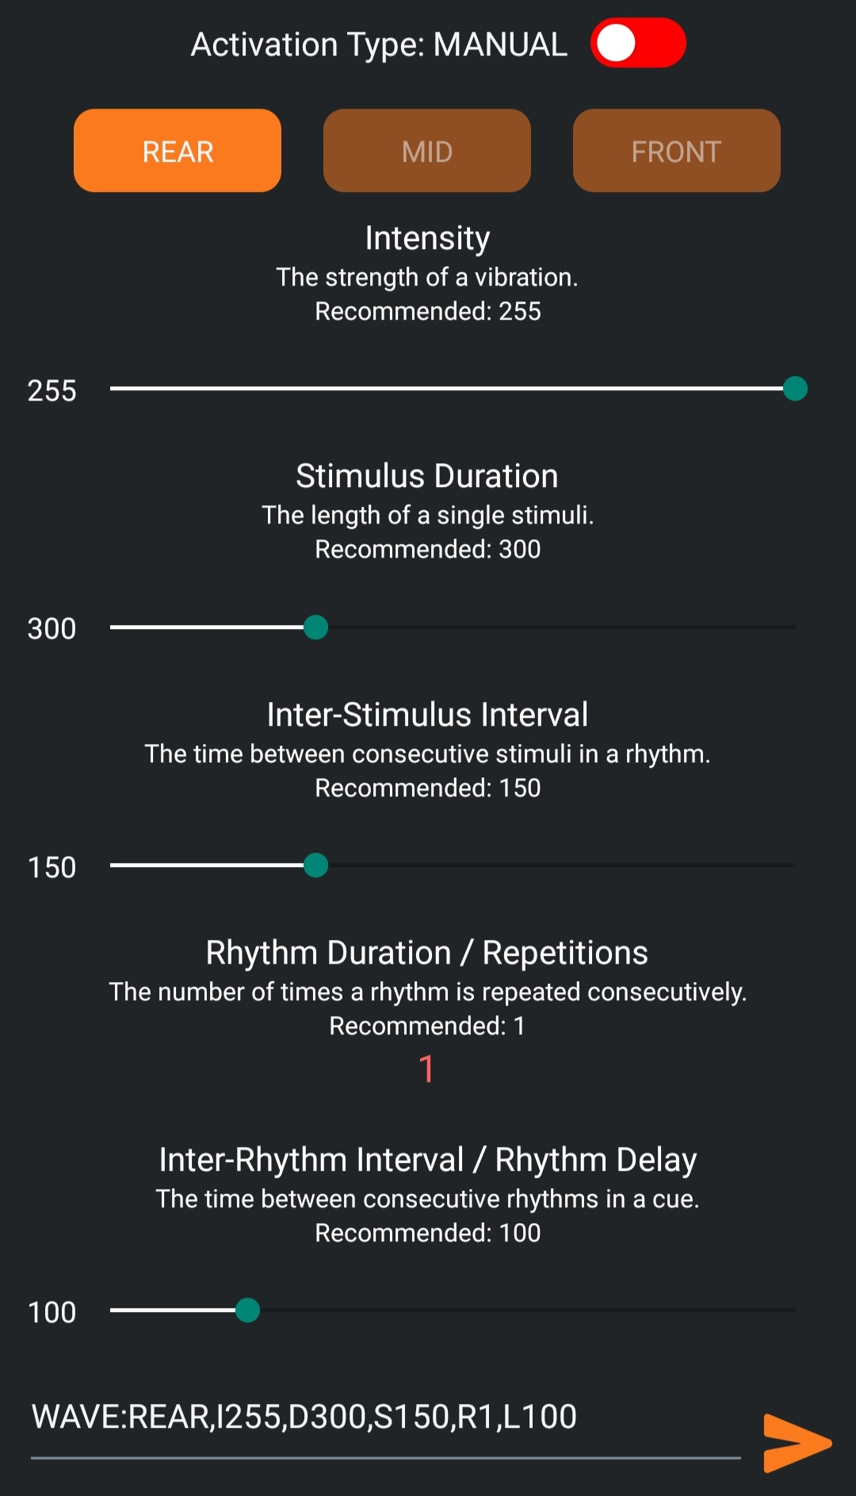
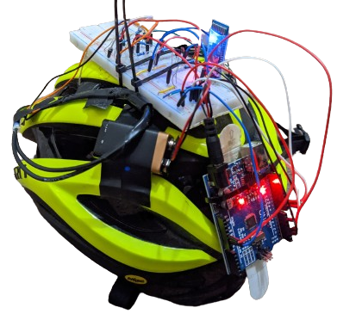
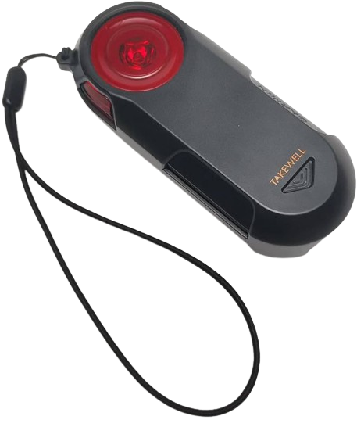
The TactiHelm System
Helmet
Controller
Bike Radar
Introduction
TactiHelm System
Lab Study
User Study
Conclusions

Slide 6
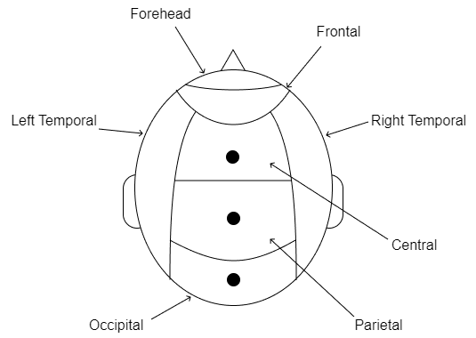
Helmet
Extends a standard cycling helmet.
3 internal tactile actuators along sagittal midline.
Controlled by an Arduino microcontroller.
Remotely operated via a mobile app.
Introduction
TactiHelm System
Lab Study
User Study
Conclusions

Slide 7

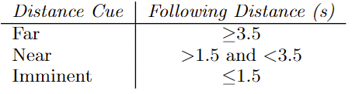
Bike Radar
Bike radar detects approaching vehicles’ distance and speed.
Info sent to the controller app, which calculates the following distance.
Following distance encoded into vibrational cues: far, near and imminent.
Following distance thresholds found through preliminary testing.
Introduction
TactiHelm System
Lab Study
User Study
Conclusions

Slide 8
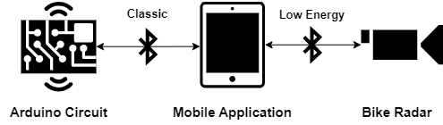
Controller
Controller app connects to the helmet and radar – allowing communication between them.
Parses info received from the radar into relevant instructions for the Arduino.
Provides manual control over attributes of vibrations, such as location, intensity, etc.
Introduction
TactiHelm System
Lab Study
User Study
Conclusions

Slide 9
Lab Study: Investigating Vibrotactile Distance Encodings
Goal:
To investigate how distance can be effectively encoded using vibrotactile cues delivered from a helmet.
RQ1. Is the sagittal plane of the scalp a suitable location for vibrotactile stimulation, for a helmet-based display?
RQ2. Which combination of location- and duration-based encodings are most usable?
RQ3. Which combination of location- and duration-based encodings helps participants make the fewest amount of perception/interpretation errors?
Questions:
Introduction
TactiHelm System
Lab Study
User Study
Conclusions

Slide 10
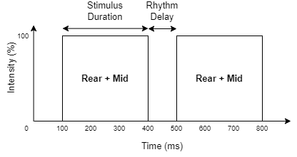
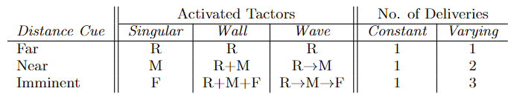
Independent Variables: Encoding Schemes
Six encoding schemes were evaluated
Singular Constant
Singular Varying
Wall Constant
Wall Varying
Wave Constant
Wave Varying
Vibration Location
Singular
Wave
Vibration Duration
Constant
Varying
Wall
Example: Wall Varying (Near)
Introduction
TactiHelm System
Lab Study
User Study
Conclusions

Slide 11
Experiment Design
Participants evaluated every scheme (within-subjects), in lab-based environment.
For each scheme, participants received a randomised series of 24 vibrations (8 far, 8 near, 8 imminent) delivered every 5 seconds, followed by post-evaluation questions.
Dependent measures:
Cue Perception: For each vibration, participants recorded the distance cue they believed was conveyed.
Stat tests: Two-way repeated-measures ANOVA, followed by pairwise t-tests.
Usability: For each scheme, usability was measured using 5-point Likert questions, regarding its: usefulness, distinguishability, interpretability, intuitiveness, and length.
Stat test: Friedmans’ ANOVA, followed by pairwise Wilcoxon.
Introduction
TactiHelm System
Lab Study
User Study
Conclusions

Slide 12
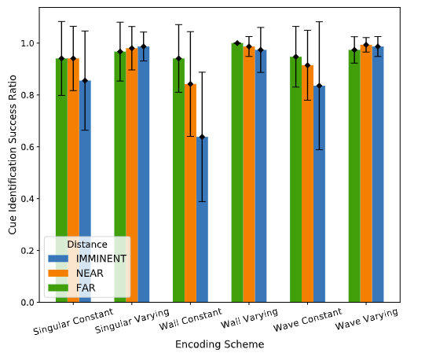
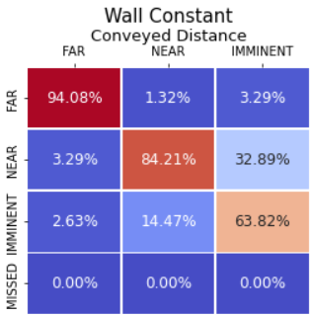
Results: Usability & Cue Perception
Constant vs Varying: All Varying outperformed Constant counterparts for usability and perception.
Within Constant: For usability and perception, Wall was the worst, and Wave was the best.
Within Varying: All varying schemes performed similarly well, with no significant differences.
Perception across cues:
Far: similar across all schemes.
Near & Imminent: Varying schemes performed significantly better than Constant schemes.
Introduction
TactiHelm System
Lab Study
User Study
Conclusions

Slide 13
Lab Study: Conclusions
RQ1 (suitability of the head as a vibrotactile display):
Linear configuration of tactors along midline of head worked well.
Participants wanted a larger gap between the front and middle tactors.
RQ2&3 (most effective encoding scheme):
For both usability and cue perception, all Varying conditions were better than Constant conditions.
Likely due to being able to easily count the number of vibrations, from which it is cognitively easier to infer a distance, compared to using an on-body location.
The dominant effect of duration makes the location irrelevant, however, there are still notable differences across location schemes.
Introduction
TactiHelm System
Lab Study
User Study
Conclusions

Slide 14
User Study: Effectiveness of TactiHelm in the Real World
Goal:
Evaluate our developed TactiHelm system in the real-world.
RQ1. Can participants accurately perceive and interpret vibrotactile signals on the scalp whilst cycling?
RQ2. Does the use of TactiHelm improve participants' perceived safety?
RQ3. Is the 3-level categorisation of following distance, suitable for alerting participants of an approaching vehicle?
Questions:
Introduction
TactiHelm System
Lab Study
User Study
Conclusions

Slide 15
Experiment Design
We asked commuter cyclists to perform a think-aloud evaluation during their morning commute, using TactiHelm.
After their commute, they would complete a short questionnaire, followed by an interview.
System Usability Scale (SUS)
NASA-RTLX
Qualitative comments
Introduction
TactiHelm System
Lab Study
User Study
Conclusions

Slide 16
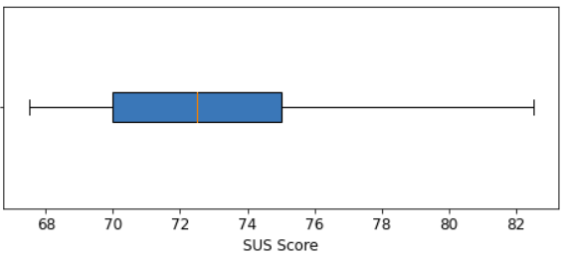
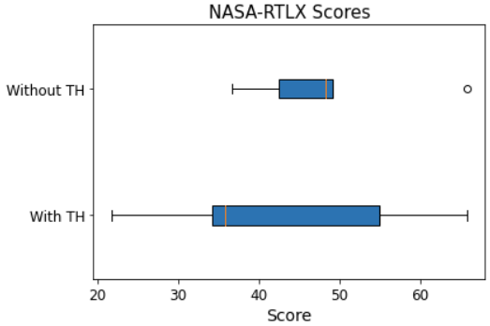
Results so Far: SUS & NASA-RTLX Totals
SUS
NASA-RTLX
M=73.5, SD=5.76
t-test reveals no significant difference from typical benchmark of 68.
With TH: (M=42.5, SD=16.67)
Without TH: (M=48.5, SD=10.92)
t-test reveals no significant difference
Introduction
TactiHelm System
Lab Study
User Study
Conclusions

Slide 17
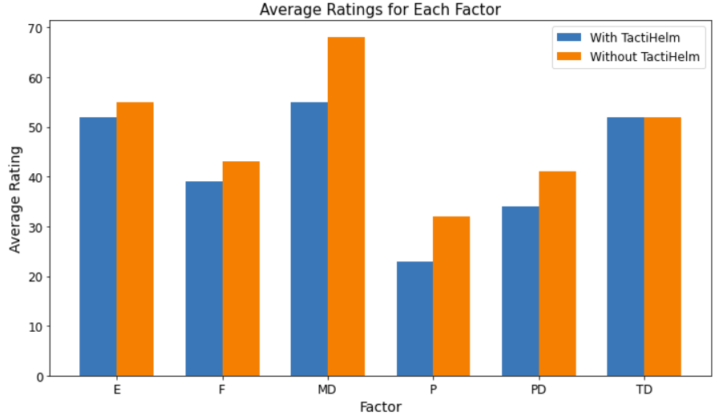
Results so Far: NASA-RTLX Factors
‘With TH’ had lower workload across all factors
However, no differences were statistically significant.
Introduction
TactiHelm System
Lab Study
User Study
Conclusions

Slide 18
Results so Far: Qualitative Comments
Design of the cues made a vehicle really seem like it was approaching
Imminent cue was often delivered too late, and the far cue too early
Sometimes required more cognitive effort to interpret
Cue Design
Cue Delivery
Effort
Reminded you that a vehicle was still there
Could focus more on your surroundings
Potential to aid accessibility or to be used for cycling education
Sometimes stopped working
Effort and Safety
Additional Comments
Introduction
TactiHelm System
Lab Study
User Study
Conclusions

Slide 19
Conclusions and Future Work
TactiHelm has the potential to improve perceived cycling safety, by giving timely alerts, without distracting the user. However, further work is needed refining the delivery of cues and making the system more robust.
Improve current system: integrate with different bike radars and helmets.
Multimodal: integrate visual and audio cues.
Improve detection and alerting system to be omnidirectional.
Decrease cost by integrating smartphone.
Introduction
TactiHelm System
Lab Study
User Study
Conclusions

Slide 20
Thank You
Questions?
References:
World Health Organization. Global status report on road safety 2018. World Health Organization, 2018
Michal Bil, Martina Bilova, and Ivo Muller. Critical factors in fatal collisions of adult cyclists with automobiles. Accident Analysis Prevention, 42(6):1632–1636, 2010.
Dovile Adminaite, Richard Allsop, and Graziella Jost. Making walking and cycling on europe’s roads safer. 2015.

Slide 21
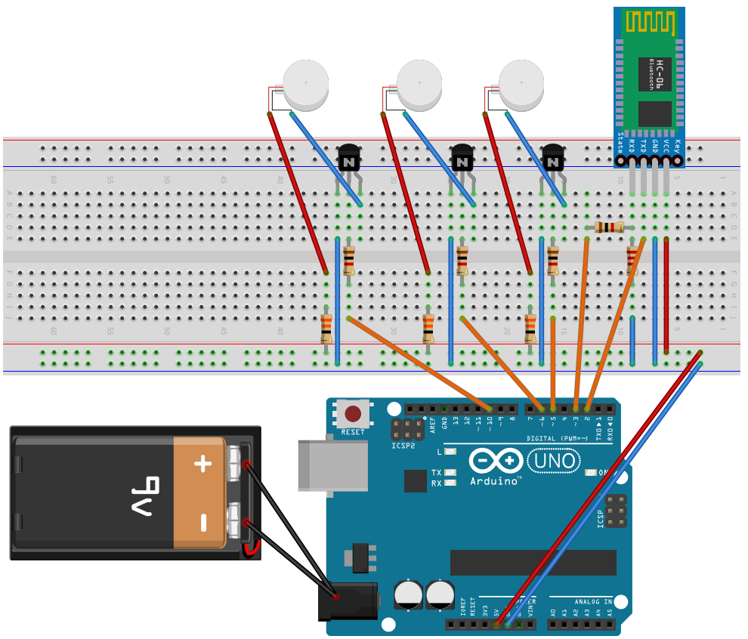
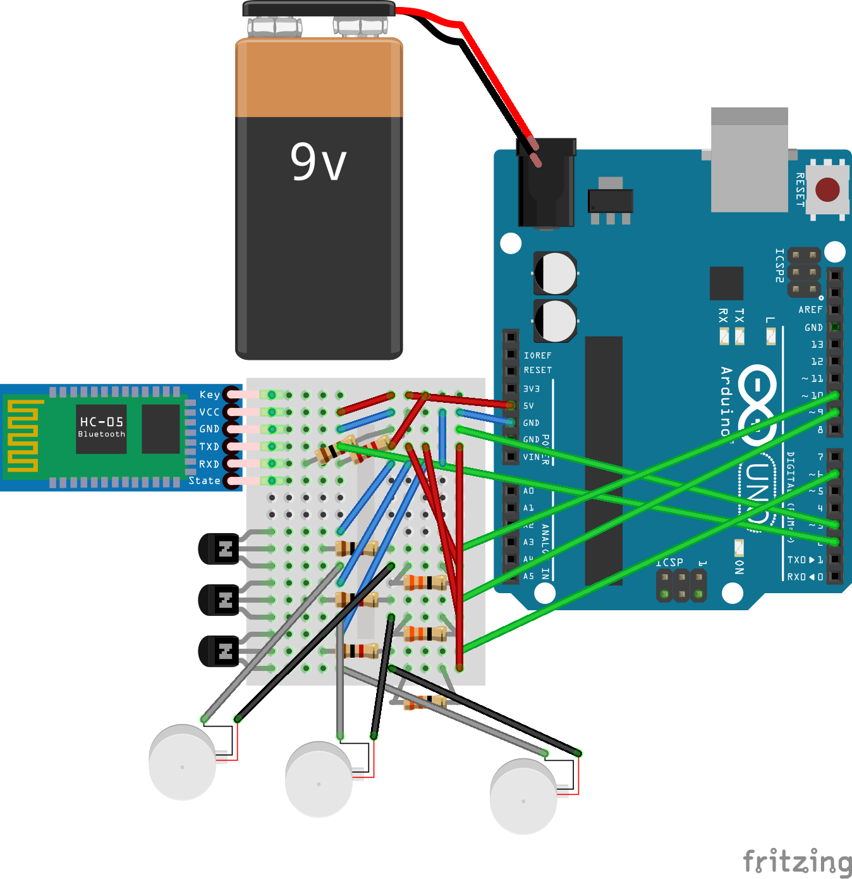
Circuit
Version 1
Version 2

Slide 22
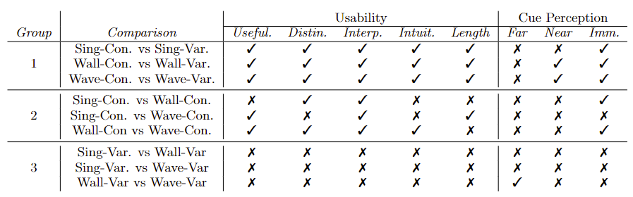
Lab Study: Stats Tests

Slide 23
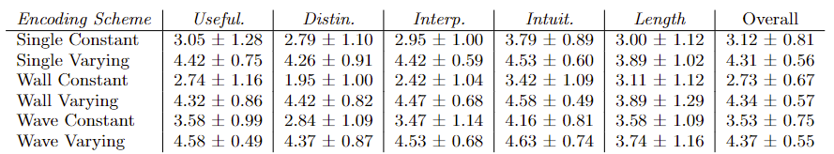
Lab Study: Usability

Slide 24
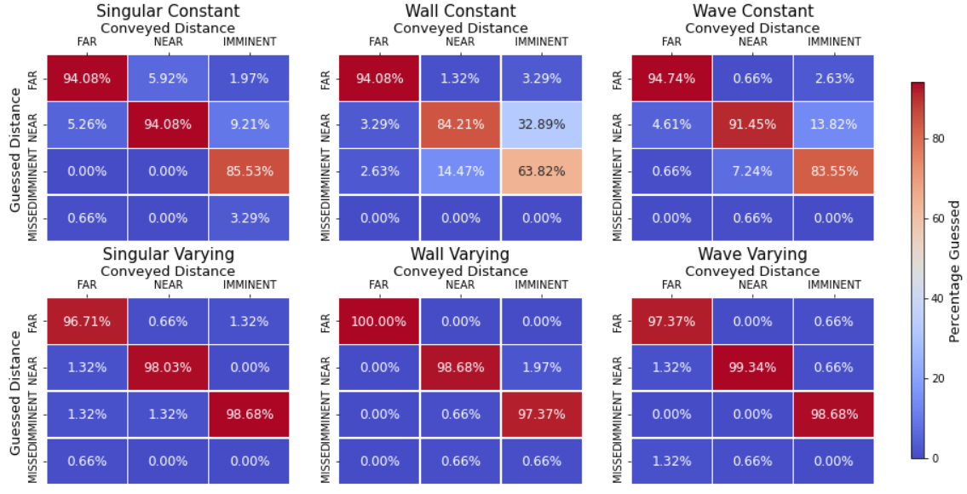
Lab Study: Recognition Errors

Slide 25
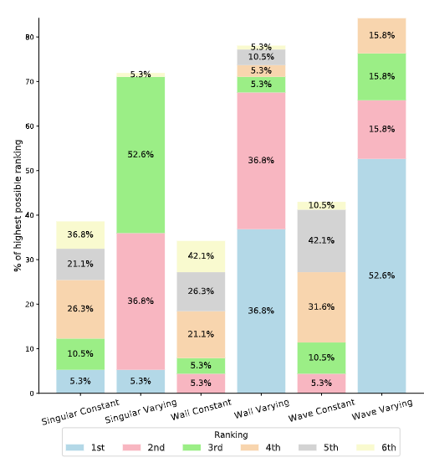
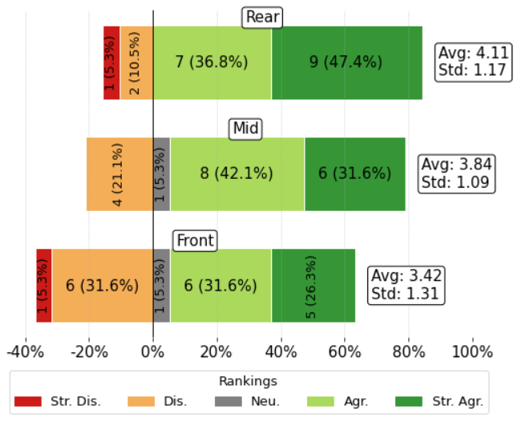
Lab Study: Additional Results
M=7.17/10, SD=2.08
Comments regarding uncomfortable pressure points
Helmet Comfort
Only 25% knew it was a measure of time and guessed an imminent cue would represent 1-5 seconds.
Scheme Preference
Tactor Perception
Understanding of Fol. Dis.

Slide 26
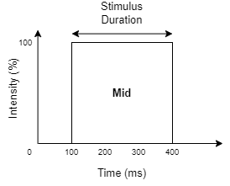
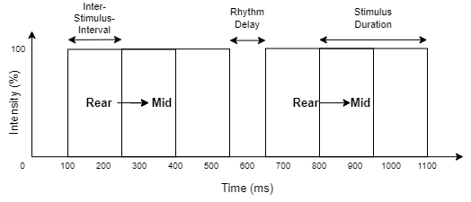
Example: Near
Wall Varying
Singular Constant
Wave Varying

