Slide 1

Maven
Rondus Technologies

Slide 2

Introduction to Apache Maven
Apache Maven is a powerful build automation tool and project management tool.
It simplifies the process of building and managing Java-based projects.
Maven provides a comprehensive set of features for project organization, dependency management, and continuous integration.

Slide 3
What is Maven?
Maven is a build tool that helps in project management. The tool helps in building and documenting the project,
Build tool is essentially for the process of building. It is needed for the following processes:
Generating source code
Generating documentation from the source code
Compiling of the source code
Packaging of the completed codes in JAR files
Installing the packed code in local repository, server or central repository

Slide 4
What is Maven?
Maven is written in Java and C# and is based on the Project Object Model (POM)
POM is an XML file that has all the information regarding project and configuration details
When we tend to execute a task, Maven searches for the POM in the current directory
The tool is used to build and manage any Java-based project.

Slide 5
What is Maven?
A project management tool such as Maven provides a superset of features found in a build tool.
In addition to providing build capabilities, Maven can also run reports, generate a web site, and facilitate communication among members of a working team

Slide 6
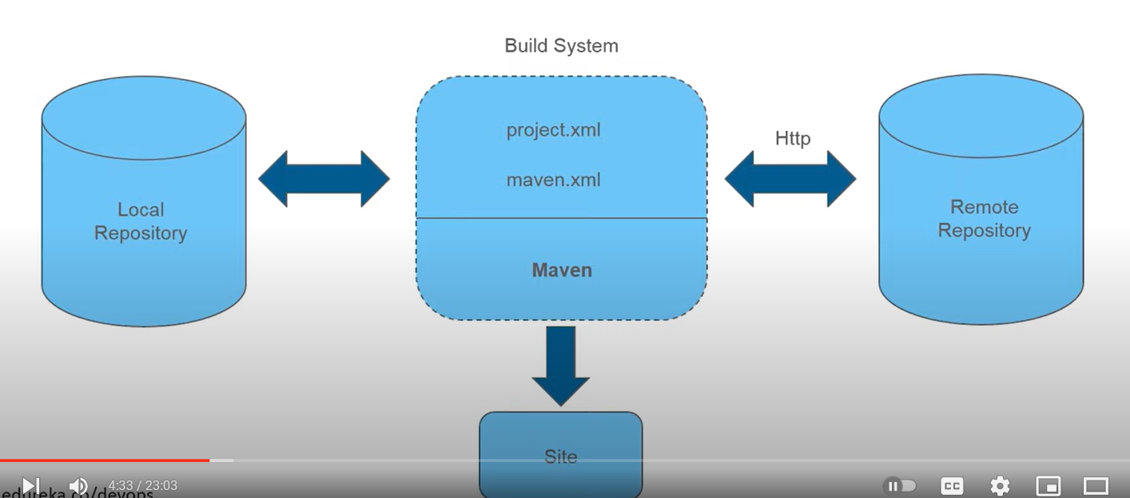
What Architecture

Slide 7
Different Build Tools
There are several build tools available for various programming languages and frameworks. Each tool often comes with its own build script format. Here's a list of some popular build tools and the corresponding build script formats:
1. **Apache Maven:**
- **Build Tool:** Apache Maven
- **Build Script:** `pom.xml` (Project Object Model)
2. **Gradle:**
- **Build Tool:** Gradle
- **Build Script:** `build.gradle` (Groovy DSL or Kotlin DSL)
3. **Apache Ant:**
- **Build Tool:** Apache Ant
- **Build Script:** `build.xml` (XML-based)

Slide 8
Different Build Tools
4. **Make:**
- **Build Tool:** Make
- **Build Script:** `Makefile`
5. **MSBuild:**
- **Build Tool:** MSBuild (Microsoft Build Engine)
- **Build Script:** `.csproj` files for .NET projects
6. **npm:**
- **Build Tool:** npm (Node Package Manager)
- **Build Script:** `package.json` (JavaScript)
7. **yarn:**
- **Build Tool:** Yarn
- **Build Script:** `package.json` (JavaScript)

Slide 9
Different Build Tools
8. **Apache Ivy:**
- **Build Tool:** Apache Ivy (often used with Apache Ant)
- **Build Script:** `ivy.xml`
9. **SBT (Simple Build Tool):**
- **Build Tool:** SBT
- **Build Script:** `.sbt` files (Scala Build Tool)
10. **CMake:**
- **Build Tool:** CMake
- **Build Script:** `CMakeLists.txt`
11. **Rake:**
- **Build Tool:** Rake (Ruby Make)
- **Build Script:** `Rakefile`

Slide 10
Different Build Tools
12. **Grunt:**
- **Build Tool:** Grunt
- **Build Script:** `Gruntfile.js` (JavaScript)
13. **Gulp:**
- **Build Tool:** Gulp
- **Build Script:** `gulpfile.js` (JavaScript)
14. **Bazel:**
- **Build Tool:** Bazel
- **Build Script:** BUILD files
15. **Buck:**
- **Build Tool:** Buck
- **Build Script:** BUCK files
16. **Apache Buildr:**
- **Build Tool:** Apache Buildr
- **Build Script:** `Buildfile`

Slide 11
Different Build Tools
17. **Rust:**
- **Build Tool:** Cargo
- **Build Script:** `Cargo.toml`
18. **Leiningen:**
- **Build Tool:** Leiningen (for Clojure)
- **Build Script:** `project.clj`
19. **Dub:**
- **Build Tool:** Dub (for D programming language)
- **Build Script:** `dub.json`
20. **Dubbo:**
- **Build Tool:** Dubbo (for Java applications)
- **Build Script:** Not applicable; configuration is often done programmatically.
The choice of a build tool often depends on the programming language, project requirements, and developer preferences.

Slide 12
Comparing between different build tools (Ants, Maven, Gradle)
Apache Ant:
XML-Based Configuration:
Ant uses XML for build script configuration.
Build scripts are declarative and may be verbose.
Flexibility:
Ant is highly flexible and allows for fine-grained control over the build process.
Developers have to explicitly define each step in the build.
Dependency Management:
Ant does not have built-in dependency management.
External tools or manual processes are needed for managing dependencies.
Plugins:
Ant relies on external plugins for extending functionality.
Users need to find and include appropriate plugins.
Learning Curve:
Ant requires a steeper learning curve due to its flexibility.
Developers need to understand the intricacies of XML configuration.
Build Speed:
Ant builds from scratch each time, which can lead to slower build times.

Slide 13
Comparing between different build tools (Ants, Maven, Gradle)
Apache Maven:
Convention over Configuration:
Maven follows a convention-over-configuration approach.
Standardized project structures and build lifecycles reduce configuration.
Dependency Management:
Maven has robust built-in dependency management.
Centralized repository management simplifies dependency resolution.
Plugins:
Maven has a wide range of built-in plugins.
Customization is possible, but less flexible compared to Ant.
Build Lifecycle:
Maven defines a standard build lifecycle (clean, compile, test, package, etc.).
Users can bind plugins to specific phases in the lifecycle.
Learning Curve:
Maven has a moderate learning curve, especially for developers familiar with conventions.
Build Speed:
Maven caches dependencies, improving build speed for subsequent builds.

Slide 14
Comparing between different build tools (Ants, Maven, Gradle)
Gradle:
Groovy DSL:
Gradle uses Groovy DSL (Domain Specific Language) for build scripts.
Build scripts are concise and expressive.
Flexibility:
Gradle provides a balance between convention and configuration.
Developers can customize builds extensively.
Dependency Management:
Similar to Maven, Gradle has strong built-in dependency management.
Supports transitive dependency resolution.
Plugins:
Gradle has a powerful and flexible plugin system.
Users can easily apply and customize plugins.
Build Lifecycle:
Gradle allows for custom build lifecycles.
Developers can define their tasks and dependencies.
Learning Curve:
Gradle has a moderate learning curve.
Groovy syntax may be unfamiliar to some developers.
Build Speed:
Gradle is known for its incremental build feature, reducing build times.

Slide 15
The problem that Maven Solves
Getting the right JAR files for each project as there may be different versions of separate packages
We can download dependencies by just visiting “mvnrepository.com”
Helps to create the right project structure which is essential for execution

Slide 16
Dependency Management
Maven manages project dependencies automatically.
It retrieves dependencies from local or remote repositories and ensures consistent and reliable resolution of dependencies.
Maven simplifies the process of adding, updating, and resolving dependencies, making it easier to manage complex projects.

Slide 17
Build Lifecycle Plugins
Maven defines a standard build lifecycle with predefined phases (e.g., compile, test, package, install).
Plugins provide the functionality for each phase of the build lifecycle.
Maven's extensive plugin ecosystem allows customization and integration with various tools and technologies.

Slide 18
Consistent Project Structure
Maven enforces a standardized project structure, promoting best practices and easy navigation within projects.
By following conventions, developers can quickly understand the project's layout and locate important resources.

Slide 19
Integration with Continuous Integration (CI) Tools:
Maven integrates seamlessly with CI tools like Jenkins, Travis CI, and Bamboo.
CI servers can execute Maven commands for building, testing, and deploying applications automatically.

Slide 20
Benefits of Apache Maven
Simplified Dependency Management: Maven handles dependency resolution and ensures consistent builds across environments.
Build Automation: Maven automates the build process, reducing manual effort and minimizing errors.
Modular and Scalable: Maven supports modular project structures, enabling the development of large-scale applications with ease.
Continuous Integration: Maven integrates smoothly with CI tools, enabling automated builds, tests, and deployments.
Extensive Plugin Ecosystem: Maven's vast plugin ecosystem provides a wide range of functionalities and integrations.

Slide 21
Summary
Apache Maven is a popular build automation and project management tool for Java-based projects.
It simplifies the development process by managing dependencies, defining project structure, and automating builds.
With its extensive features, Maven improves project organization, promotes best practices, and enhances collaboration.
Maven's integration with CI tools and large plugin ecosystem makes it a valuable tool in the software development lifecycle.

Slide 22
Maven terminology
1. **Project:**
- In Maven, a project is a software project that is built and managed using Maven.
- It represents the entire software development effort and may consist of multiple modules.
2. **POM (Project Object Model):**
- The POM is an XML file named `pom.xml` that resides in the base directory of the project.
- It contains configuration information for Maven and serves as the fundamental unit of work in Maven.
- The POM includes details such as project dependencies, plugins, goals, and other project-related settings.
3. **Goal:**
- A goal in Maven represents a specific task or operation that can be executed during the build process.
- Examples of goals include compiling source code (`compile`), running tests (`test`), packaging artifacts (`package`), and more.
- Goals are executed by running Maven commands, and multiple goals can be executed in sequence to achieve a specific outcome.

Slide 23
Maven terminology
4. **Plugin:**
- A plugin in Maven is a collection of one or more goals.
- Plugins extend Maven's functionality by providing additional tasks that can be executed during the build process.
- Plugins are configured in the POM file, and Maven uses them to perform various build tasks.
5. **Repository:**
- A repository in Maven is a storage location for project artifacts and dependencies.
- There are two types of repositories: local and remote.
- **Local Repository:** Stores artifacts on the developer's machine.
- **Remote Repository:** Hosted repositories that Maven uses to download dependencies not found in the local repository.
6. **Lifecycle:**
- A lifecycle in Maven represents a series of well-defined phases that a project goes through during the build process.
- Each phase is a sequence of goals, and the lifecycle defines the order in which these phases and goals are executed.
- Common Maven lifecycles include `clean`, `validate`, `compile`, `test`, `package`, `install`, and `deploy`.

Slide 24
Maven: creates packages (jar, war and ear)
jar: Standalone Applications
ebay.jar
paypal.jar
rbc.jar
war: web Applications
boa.war
rbc.war
ear: Enterprise Applications
aa.ear
boa.ear
td.ear
Archieves:
file.zip = unzip
file.gz.tar
td.ear
td.jar
td.war

Slide 25
Standalone Applications – *.jar Java Archieve
java code ONLY
contains only java classes
jar = .classfiles
maven-stanalone-application.jar

Slide 26
Web Applications – .war web Archieve
Java code +
web content (HTML, CSS, JS, images…,)
Backend code - frontend code
maven-web-application.war

Slide 27
Enterprise applications – .ear
Enterprise Archieve
Multiple Modules
Java code + web content
Ear = war(s) + jar(s)
Banking applications
maven-web-application.war
maven-enterprise-application.ear

Slide 28
What are we building?
We are building java codes:
src-- source code (raw code)
Unit-Test-Cases
JAVA --> JUnit test cases
Dependencies
buildScripts: pom.xml

Slide 29
XML vs HTML:
html = hyperText mark-up language
comes with pre-define tags that can't be changed
TAGS: h1 h2 h3 p
<h1>code</h1>
<h1>Welcome to Rondus Technologies</h1>
<server>Welcome to Rondus Technologies</server> error
pom.xml = extensible mark-up language
It does not come with pre-define tags that. It's dynamic
<id>12457ih</id>
<name>Itoro</name>
<name>Ukpe</name>

Slide 30
Anatomy of the POM file
Basic Structure:
The POM file is an XML file named pom.xml located in the base directory of the Maven project. It has the following basic structure:
<project xmlns="http://maven.apache.org/POM/4.0.0"
xmlns:xsi="http://www.w3.org/2001/XMLSchema-instance"
xsi:schemaLocation="http://maven.apache.org/POM/4.0.0
http://maven.apache.org/xsd/maven-4.0.0.xsd">
<!-- POM configuration goes here -->
</project>

Slide 31
Key Elements: POM.xml
1. **`<modelVersion>`:**
- Specifies the version of the POM model. Always set to `"4.0.0"` for Maven 2 and later.
```xml
<modelVersion>4.0.0</modelVersion>
```
2. **`<groupId>`:**
- Identifies the group or organization that the project belongs to.
```xml
<groupId>com.example</groupId>
```
3. **`<artifactId>`:**
- Identifies the artifact, such as a JAR or WAR file, produced by the project.
```xml
<artifactId>my-project</artifactId>
```

Slide 32
Key Elements: POM.xml
4. **`<version>`:**
- Specifies the version of the project.
```xml
<version>1.0.0</version>
```
5. **`<packaging>`:**
- Specifies the packaging type for the project (e.g., JAR, WAR, EAR).
```xml
<packaging>jar</packaging>
```
6. **`<dependencies>`:**
- Lists the dependencies required by the project. Each dependency is defined within a `<dependency>` element.
```xml
<dependencies>
<!-- Dependency definitions go here -->
</dependencies>
```

Slide 33
Key Elements: POM.xml
7. **`<build>`:**
- Contains build-related configuration, including plugins and their configurations.
```xml
<build>
<!-- Build configuration goes here -->
</build>
```
8. **`<plugins>`:**
- Lists the plugins used in the build process. Each plugin is defined within a `<plugin>` element.
```xml
<build>
<plugins>
<!-- Plugin definitions go here -->
</plugins>
</build>
```

Slide 34
Key Elements: POM.xml
### Example POM File:
Here's a simplified example of a POM file:
```xml
<project xmlns="http://maven.apache.org/POM/4.0.0"
xmlns:xsi="http://www.w3.org/2001/XMLSchema-instance"
xsi:schemaLocation="http://maven.apache.org/POM/4.0.0
http://maven.apache.org/xsd/maven-4.0.0.xsd">
<modelVersion>4.0.0</modelVersion>
<groupId>com.example</groupId>
<artifactId>my-project</artifactId>
<version>1.0.0</version>
<packaging>jar</packaging>
<dependencies>
<!-- Dependency definitions go here -->
</dependencies>
<build>
<plugins>
<!-- Plugin definitions go here -->
</plugins>
</build>
</project>
```
This is a basic representation, and the POM file can include additional configurations for properties, repositories, profiles, and more based on the project's needs. Understanding and configuring the POM file is essential for effective Maven project management.

Slide 35
Installing Maven
Maven can be installed in Any platform
Linux --
RedHat / Ubuntu / CentOS
Windows
server2012/2016/2019
windows XP/7/8/10 /11
MacOS
Solaris
2. Java is a pre-requisite for maven to run
JRE --> JAVA RUNTIME ENVIRONMENT
JDK --> JAVA DEVELOPMENT KIT 1.8+
JVM will also be installed
3. sudo yum install maven

Slide 36
Installing Maven
package-management/Maven-installation at master · itoroukpe/package-management (github.com)

Slide 37
Maven Home Directory
Maven Home Directory = MHD (/opt/maven) = /app/maven)
This is where maven software is downloaded and extracted
wget https://dlcdn.apache.org/maven/maven-3/3.8.3.zip
uzip
MHD = /opt/maven
==========
bin -- binary files / commands
mvn
conf -- configuration files
settings.xml
lib -- jar files
LICENSE
NOTICE
README.txt

Slide 38
Clone the standalone project:
Git clone itoroukpe/maven-standalone-application (github.com)

Slide 39
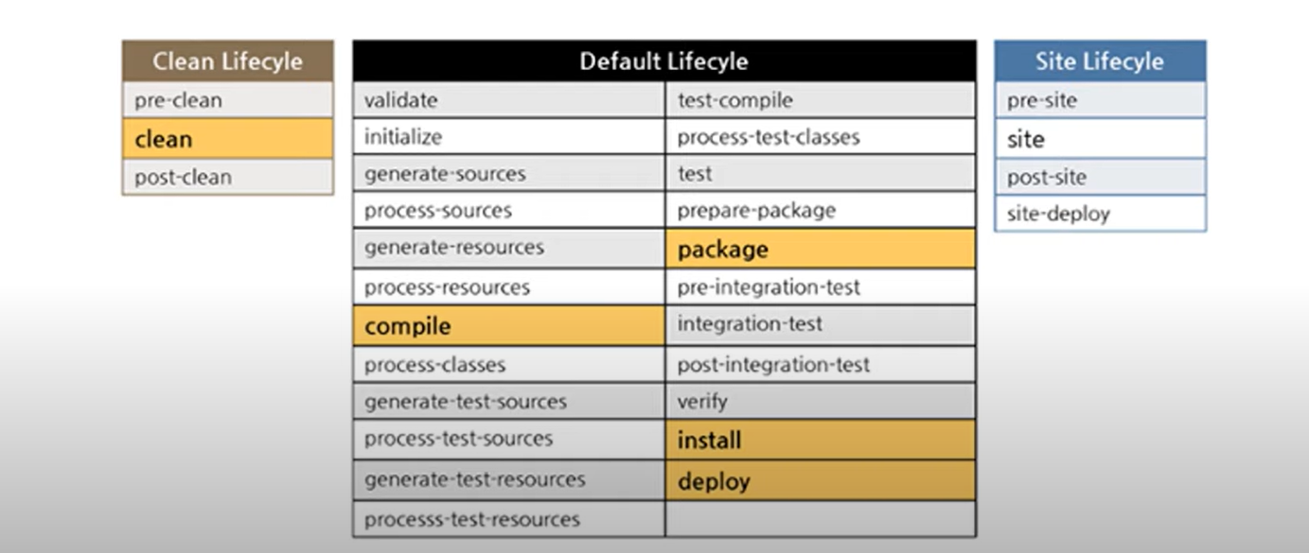
Build Lifecycle Plugins

Slide 40
MAVEN LIFECYCLE
default
mvn validate:
It will validate the project structure and resource files
mvn compile:
It will compile all java classes and test cases
mvn test:
It will run the unit test cases (JUNit)
mvn package:
It will create packages in target directory
(*.jar/*.war/*ear) app.war
mvn install:
It will store the build artifacts in MAVEN LOCAL REPO
default location: .m2/repository
mvn deploy: NEXUS
It will upload the build artifacts into maven-remote-repo

Slide 41
MAVEN LIFECYCLE
mvn package:
validate
compile
testing
packages

Slide 42
Maven uses plugins/dependencies in the build Process.
Where will maven get plugins in the build process?
FROM repositories
Maven local repository
~/.m2/repository = default
ls ~/.m2/repository
Maven remote repository
Maven central repository
mvn package:
LOCAL--->Remote --->Central (MCR)
LSS LSS apache-maven

Slide 43




Thank you
Presenter name
Email address
Website

