Slide 1
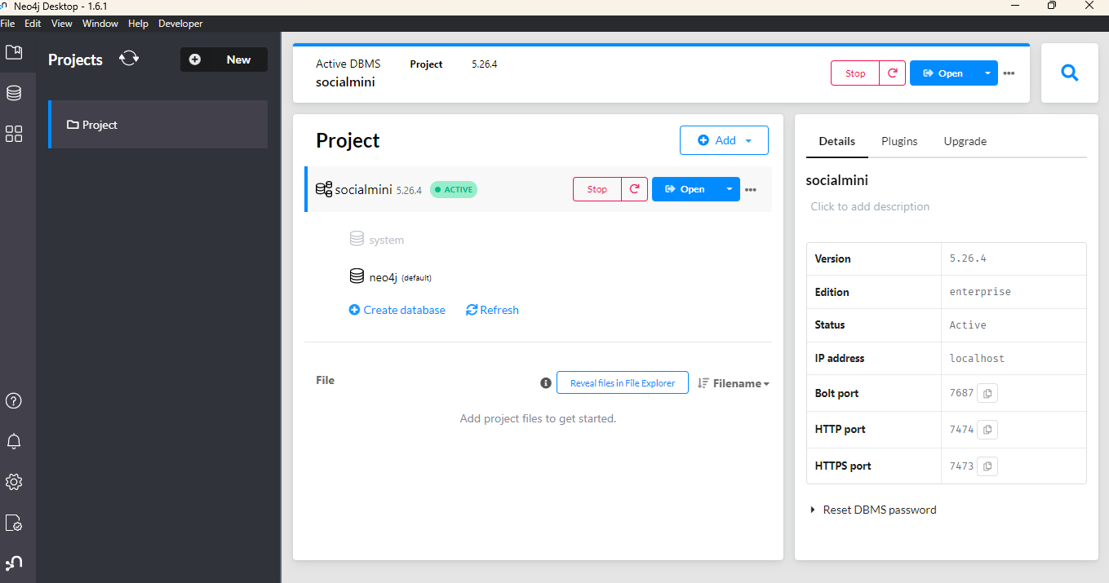
Database(Neo4j). Graph database

Slide 2
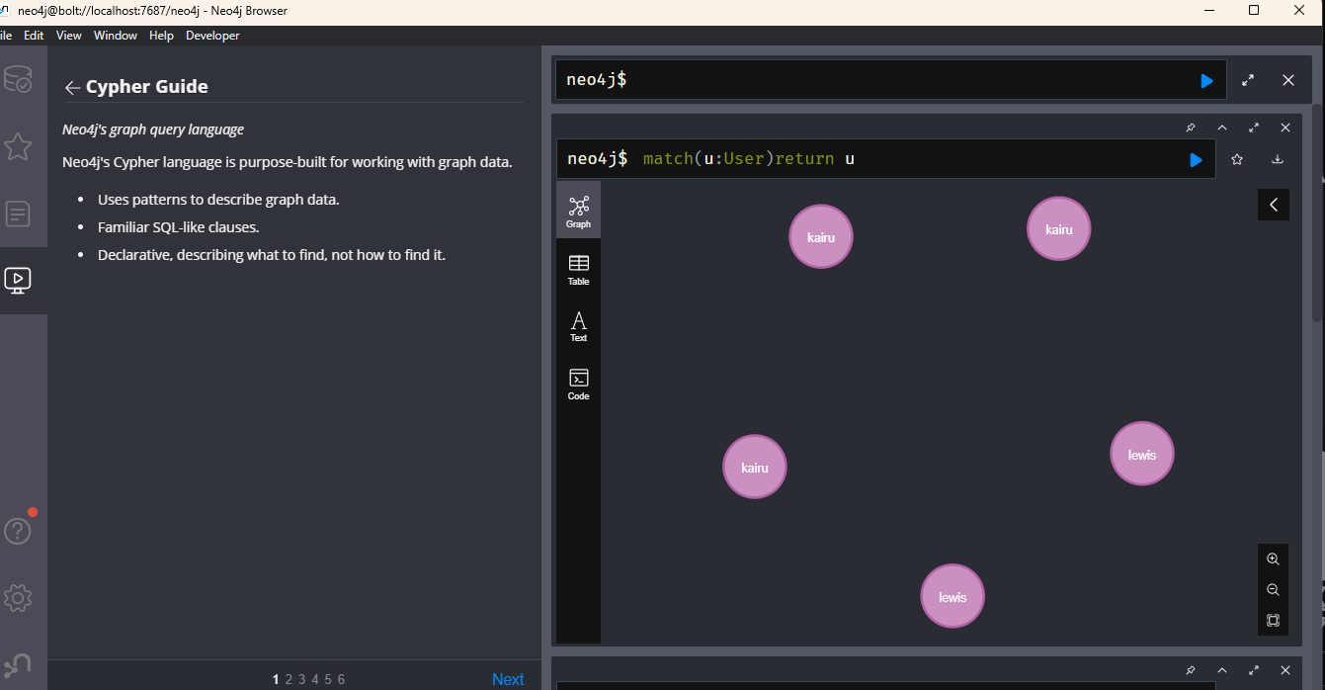
Query

Slide 3
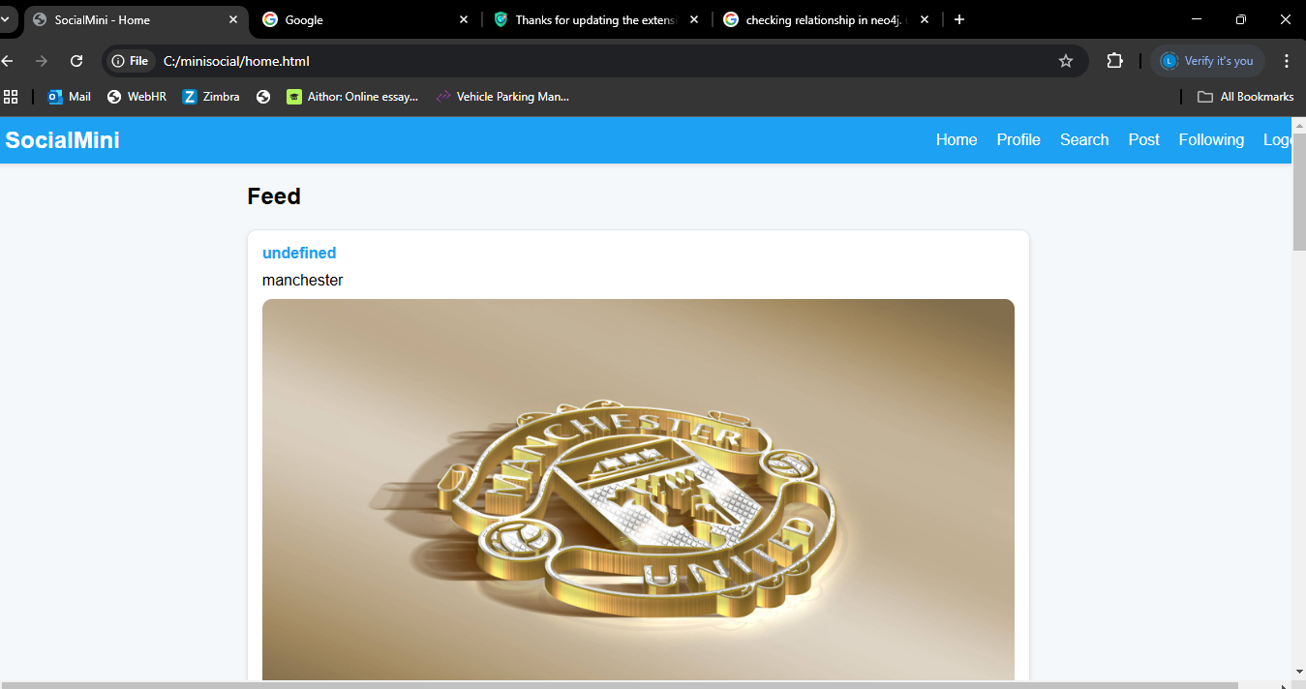
Ui design for minisocial media site

Slide 4
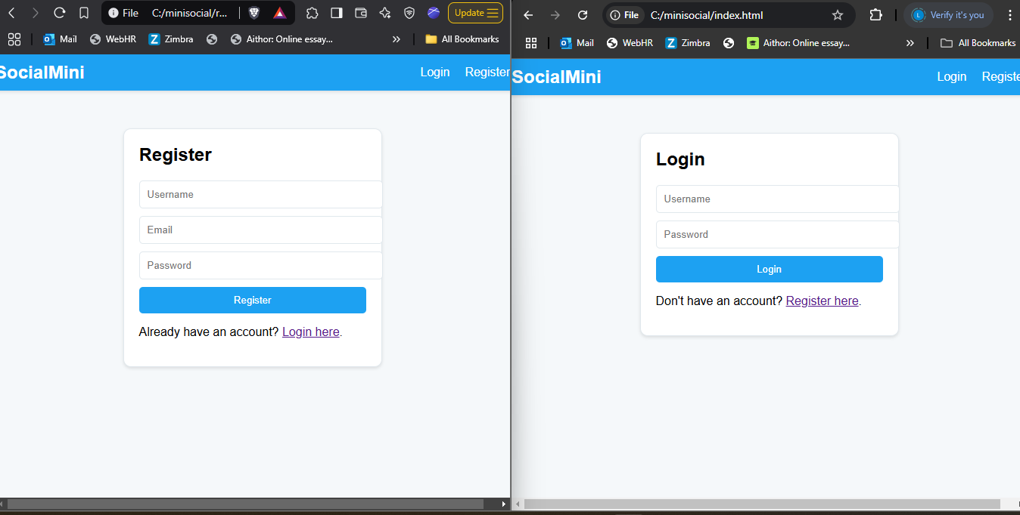
Ui design for login page and register page

Slide 5
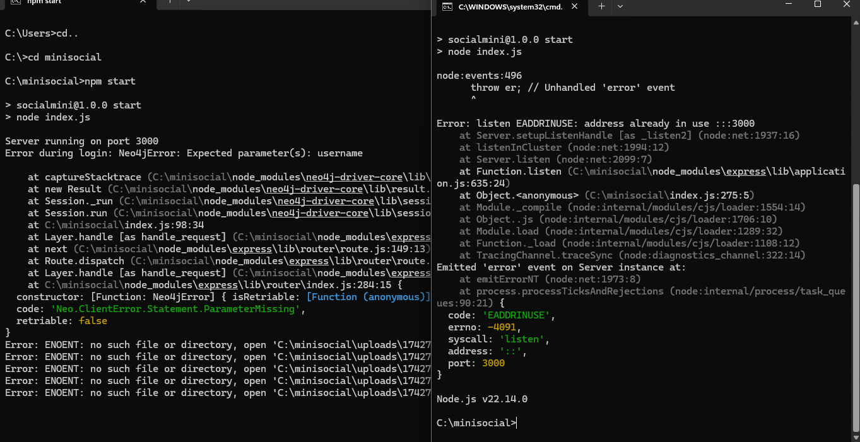
Back end access to start node js

