Slide 1
Is the Price Right for Your Listing in Ames?
By Alex Lau

Slide 2
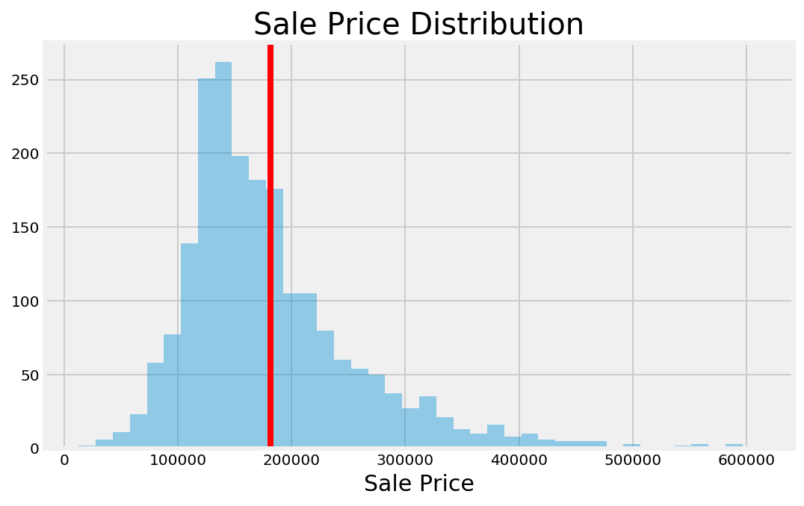
Ames Housing Sale Prices 2006-2010

Slide 3
Our Tried and Trusted Methodology
2,000 home sales
78 data points
Elastic Net Regression
Optimal Sale Price Predictor

Slide 4
What Features Drive Home Sale Prices?

Slide 5
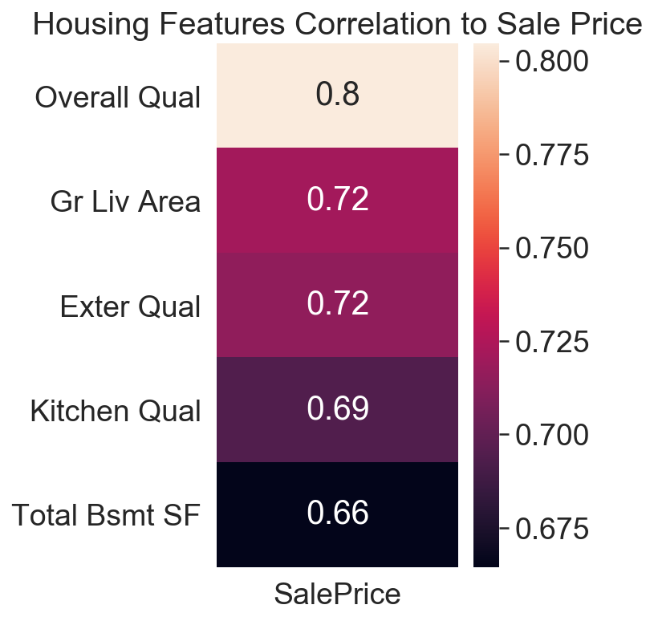
Top 5 Correlated Features
Overall Quality
Above Ground Living Area Square Feet
Exterior Quality
Kitchen Quality
Total Basement Square Feet

Slide 6
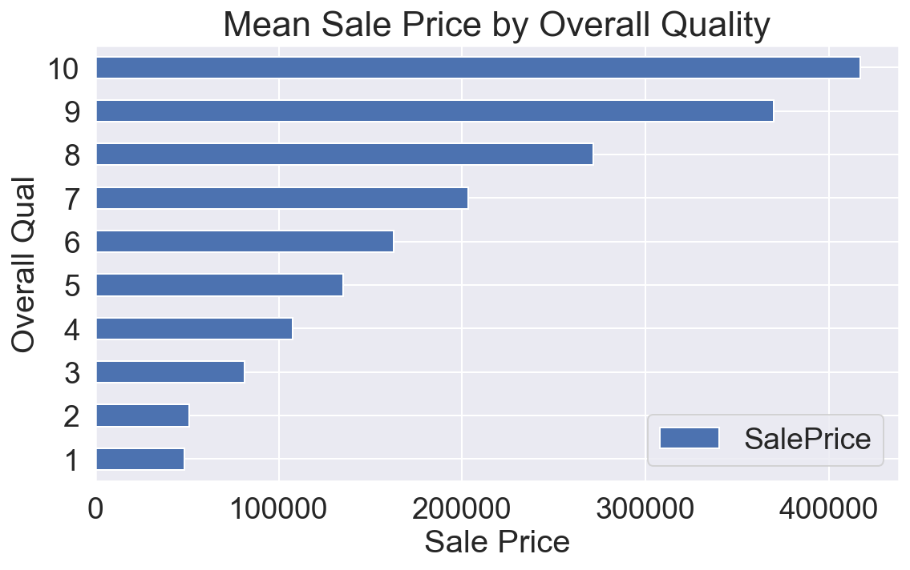
Material and Finish of the House

Slide 7
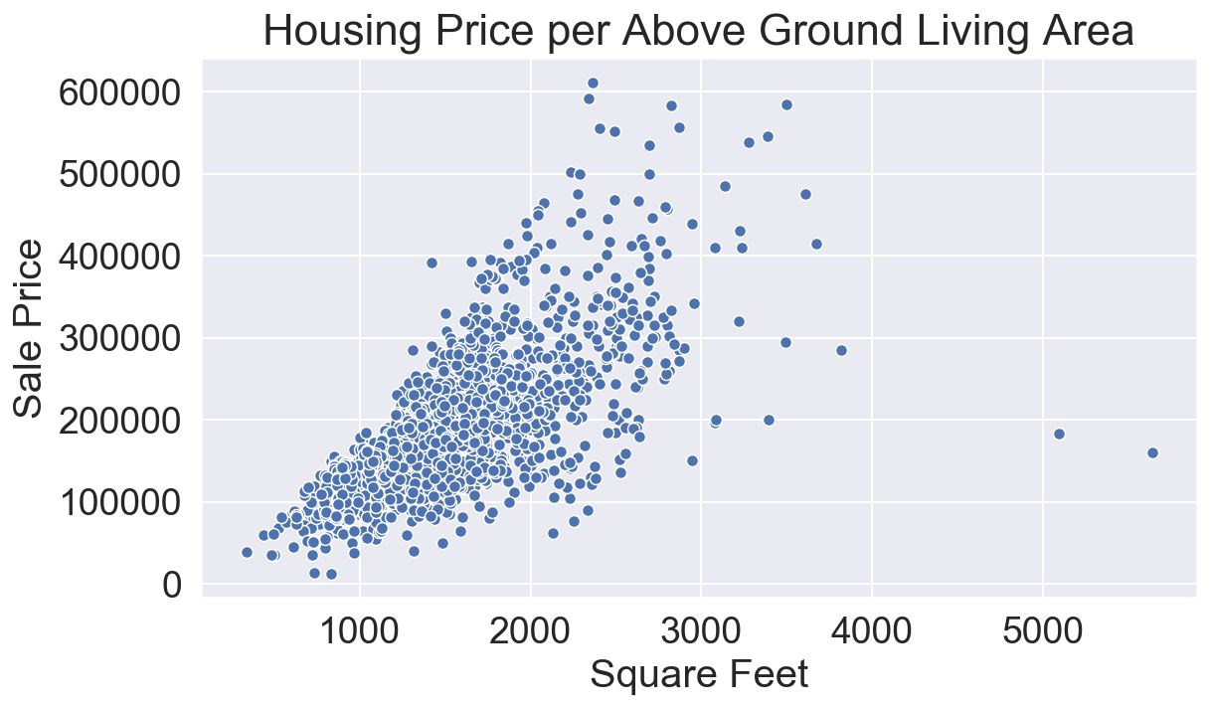
Living Space

Slide 8
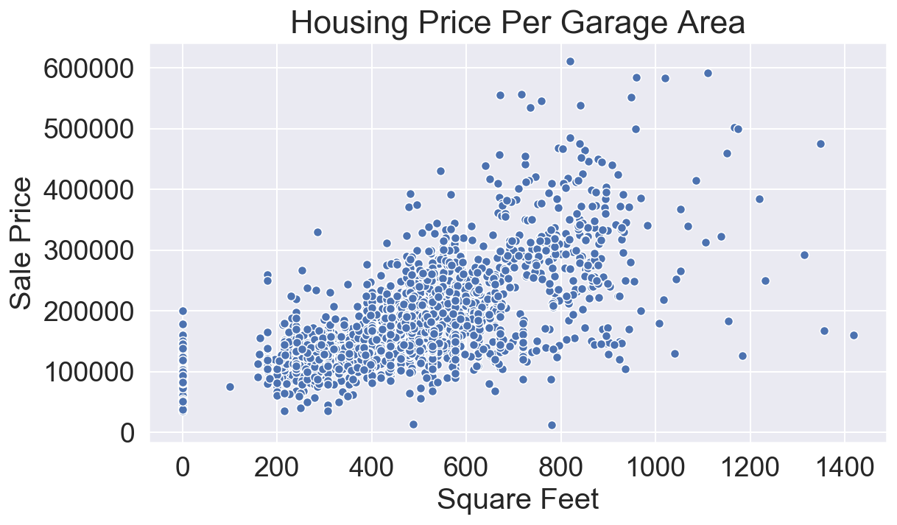
Garage Area

Slide 9
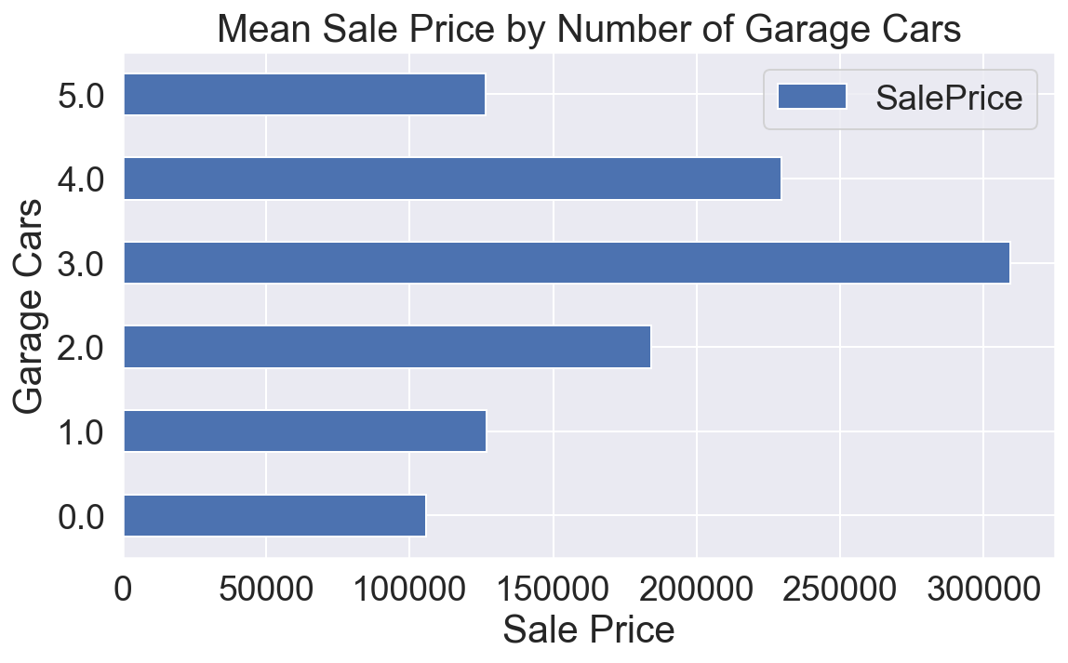
Size of Garage by Car Capacity

Slide 10
How effective is our tool?

Slide 11
92%
Of observed variation can be explained by our model's inputs

Slide 12
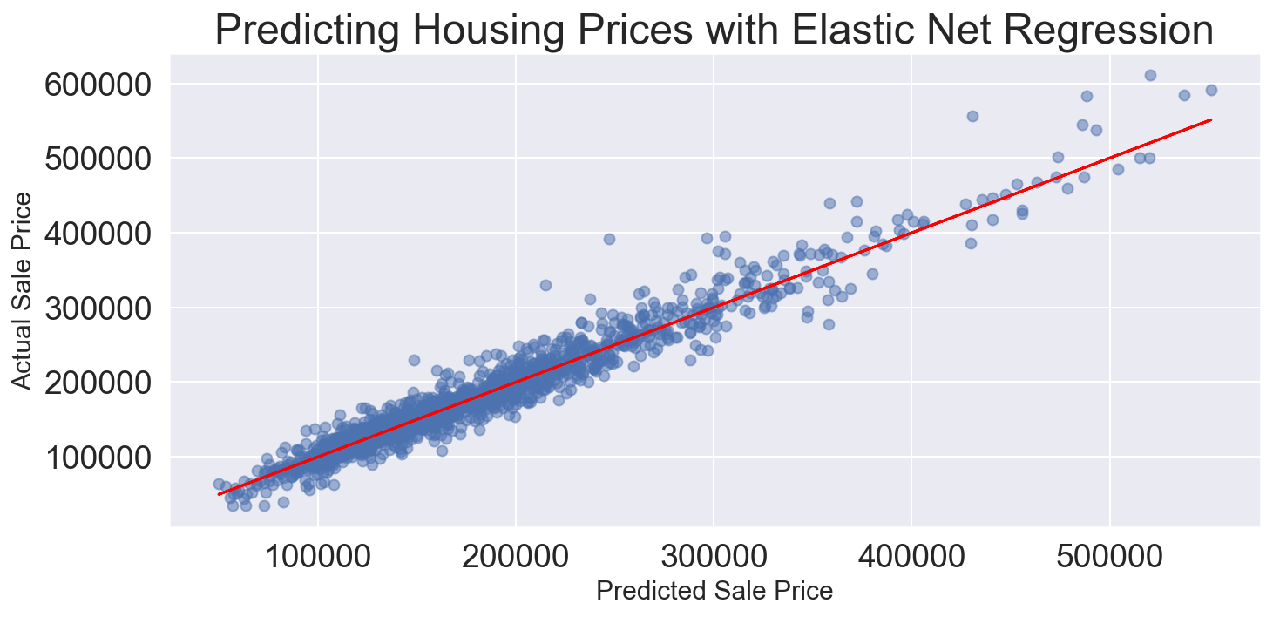

Slide 13
Know your target sale price before you sell!

