Slide 1

Predicting Loan Defaults on
By Alex Lau
March 2020

Slide 2



Consequences of defaulting on loans
Severe damage to your credit report
Seizure of assets like home, car, or bank accounts
Cancellation, revocation or non-renewal of a professional license
Withholding of state and federal tax refunds
Lenders will lose some or all of their investment

Slide 3
Problem Statement
We seek to improve sensitivity/recall metrics for completed 2019 loans from Lending Club while maintaining or exceeding the existing 87.55% Accuracy rate, representing fully paid loans
We will utilize a series of models such as logistic regression, random forest, extra trees, adaptive boosting, and gradient boost classifiers to predict whether applicants will default on loans

Slide 4
Approved Loan Statuses in 2016-2019

Slide 5
Individual vs Joint Statistics for 2019
87.87% of loans were Individual
12.13% of loans were Joint
12.19% of Individual loans defaulted
14.33% of Joint loans defaulted
Loan Status | Individual | Joint | Total
Fully Paid | 34,081 | 4,591 | 38,672
Charged Off/Default | 4,731 | 768 | 5,499
Total | 38,812 | 5,359 | 44,171

Slide 6
Individual vs Joint Statistics for 2019 (continued)
Individuals were approved for amounts that were on average 15.74% of their income
Join applicants were approved for amounts equivalent to only 13.9% of their combined income, but their debt to income ratio suggested riskier loans with higher proportions of external debt
Features | Individual | Joint
Loan Amount | $14,072 | $19,321
Income | $89,393 | $138,906
Debt to Income | 17.47% | 18.56%

Slide 7
Data Cleaning
150 original features
50 features removed
33 features with missing values
16 conditional features
9 Categorical features
Step 1 Remove unnecessary features
Step 2 Fill in missing data
Step 3 Convert strings into numerical values
Data retrieved post loan approval
Same or drastically different across observations
Features conditional to defaulted loans
Features conditional to joint applications
Grade and subgrade
Member IDs and hidden zip codes are unhelpful
Dates
Step 4 Convert categorical data into indicators
Separate categories into individual columns

Slide 8
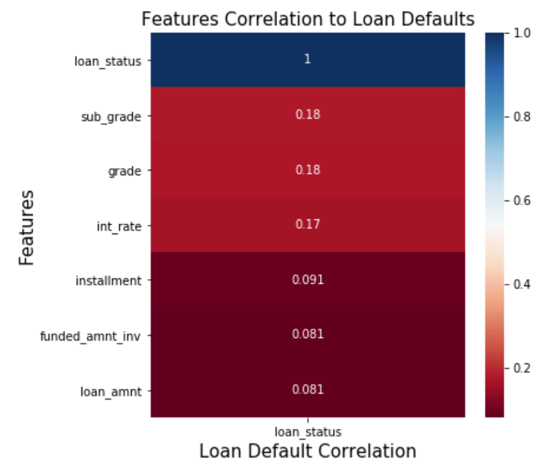
Most Correlated features
Sub Grade, Grade assigned by LC
Interest Rate
Installment – monthly payment
Loan amount

Slide 9
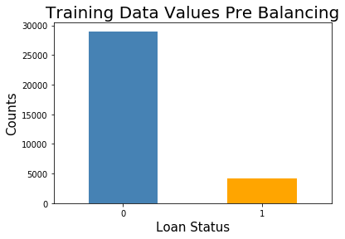
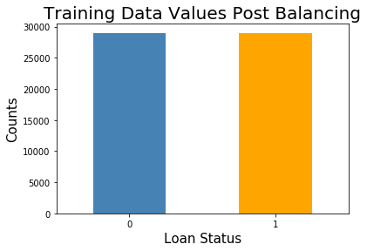
Handling Imbalanced Data with SMOTE
Before
Fully Paid: 29,004
Defaulted: 4,124
After
Fully Paid: 29,004
Defaulted: 29,004

Slide 10
Comparing Models
Baseline
Random Forest Classifier
Accuracy: 87.55%
Train Recall: 0
Train Accuracy: 100%
Test Accuracy: 87.53%
Train Recall: 100%
Test Recall: 2.18%

Slide 11
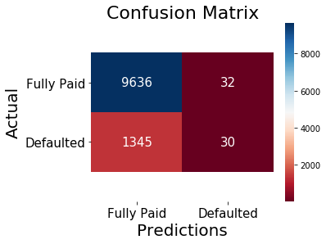
Random Forest Classifier
In our test size of 11,043, our model correctly identified 30 loan defaults at the cost of 32 loans that were actually repaid
Given a mean 13% interest rate, the repayment from the 32 successful loans may not be enough to cover the losses of the 30 defaulted loans that defaulted within 1 year

Slide 12
Conclusion
Our models were able to identify some true loan defaults that Lending Club approved, but at the cost of rejecting more fully paid loans
Incorporating additional loan observations may improve performance
Suggest converting employment title, or any free form text value to a dropdown list of less values
Request additional data such as assets, if possible

Slide 13
Resources
Lending Club Logo: https://www.lendingclub.com/
No home image: https://depositphotos.com/137317474/stock-illustration-no-home-silhouette-illustration.html
No car image: https://www.vectorstock.com/royalty-free-vector/no-car-sign-vector-13874883
No bank image: https://toughnickel.com/personal-finance/How-to-Cash-a-Check-Without-a-Traditional-Bank-Account
Default consequences: https://www.debt.org/credit/loans/default/
Lending Club Data: https://www.lendingclub.com/info/statistics.action

