Slide 1
MGIS3315 Programming for Business

Slide 2
Fundamental concepts
Language is a means (and a tool) for expressing and recording thoughts.
A natural language is a language people use to communicate with each other in everyday life. English, Russian, German, Spanish, and Hindi are examples of natural languages.
A programming language is a language developed by humans and used to communicate with computers. A programming language has a set of means to instruct a computer what to do and how.
Programming languages establish and compile a series of instructions intended for the Central Processing Unit (CPU) to execute specific tasks. Each programming language is equipped with a distinct set of keywords and syntax, utilized in the formulation of instructions.
A high-level programming language is a programming language that operates on a high level of abstraction, thereby allowing the developer to ignore the physical details of the computer's hardware, for example, the CPU type, memory size, and organization, etc. Python, JavaScript, and C/C++ are all examples of high-level programming languages.

Slide 3
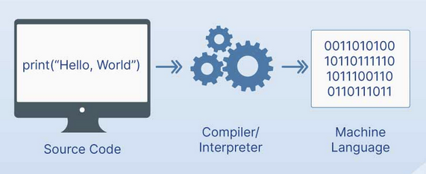
Fundamental concepts
A machine language is a language placed at the lowest level of computer programming. It's a sequence of bits (binary digits usually recognized as 0 and 1) that directly forces the CPU to execute the desired elementary operations.
A source code is a text encoded in any programming language (regardless of the language's level). Usually, the source code is put inside a text file that resides inside the developer's computer filesystem, while the file name's extension reveals the programming language used to write the code (for example, files with names that end with .py contain Python source code, while the .cpp extension marks files which hold C++ (usually pronounced as see-plus-plus) source code.

Slide 4
Fundamental concepts
A source code cannot be directly executed by a computer. To make it possible the source code has to be translated into a machine code accepted by a target computer and its CPU. This task can be done using two different techniques:
Compilation is performed by a one-time translation of the source program; an executable binary file is created in effect – the file can be run at any time without the need to have the source code; the program that performs the above translation is called a compiler or translator.
Interpretation involves a dedicated program designed to translate the source program on the fly each time it has to be run; the program performing this task is called an interpreter; this means that the interpreter is needed whenever the source code has to be executed.
A specific programming language is designed to be the object of either compilation or interpretation (this choice imposes certain distinctive features onto the language). For example, Python is an interpreted programming language, while C++ is a compiled one.
The interpreter and its environment, created and distributed by the Python Software Foundation (PSF) is written mostly in the C programming language. It allows Python to be easily ported and migrated to all platforms providing the ability to compile and run C language programs. This is also why the PSF implementation is often referred to as CPython. CPython is the most widely used implementation of Python.

Slide 5
Computer Program
A program is a sequence of instructions that specifies how to perform a specific task/computation. The computation might be something mathematical, such as solving a system of equations or finding the roots of a polynomial, but it can also be a symbolic computation, such as searching and replacing text in a document or something graphical, like processing an image or playing a video. The details look different in different languages, but a few basic instructions appear in just about every language:
Input: Get data from the keyboard, a file, the network, or some other device.
Output: Display data on the screen, save it in a file, send it over the network, etc.
Math/logic: Perform basic mathematical operations like addition and multiplication.
Conditional execution: Check for certain conditions and run the appropriate code.
Repetition: Perform some action repeatedly, usually with some variation.

Slide 6
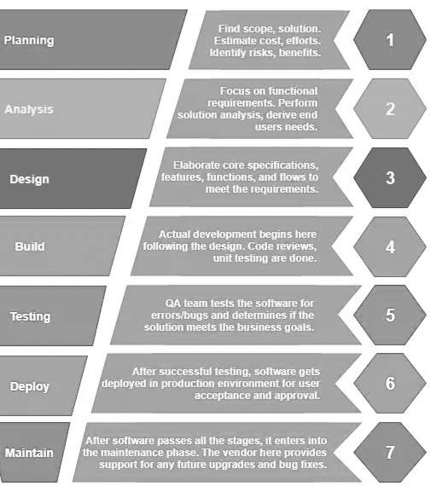
SDLC
Software development life cycle (SDLC) consists of many different phases. Broadly speaking, some phases in SDLC are:

Slide 7
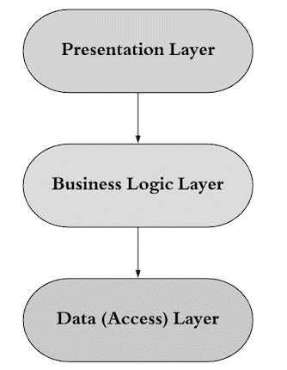
Three-tier architecture
According to this architecture, the codebase is divided into three separate layers with distinctive responsibilities:
Presentation layer: This is the application’s user interface that presents the application’s features and data to the user.
Business logic (or Application) layer contains the business logic that drives the application’s core functionalities. Like making decisions, calculations, evaluations, and processing the data passing between the other two layers.
Data access layer (or Data) layer: This layer is responsible for interacting with databases to save and restore application data.
HTML, JS, CSS
Python, Java, C#
Databases, SQL

Slide 8
Python Introduction
Guido van Rossum invented the Python programming language in the early 1990s.
Python is a high-level, general-purpose programming language for solving problems
Python is implemented in many different flavors:
Cpython: C implementation of Python
Jython: Java implementation of Python
Ironpython: DotNet implementation of Python
You can download Python, its documentation, and related materials from www.python.org. We will use Python 3 (3.7, 3.8)
Read more about Python
How to check Python version:
import sys print(sys.version) | from platform import python_version print(python_version())

Slide 9
Python Features
Easy to read and learn: Python has a simple and easy-to-read syntax, making it a great language for beginners to learn.
High-level language: Python is a high-level programming language, which means it abstracts away many of the low-level details of computer systems, making it easy to write and understand code.
Interpreted language: Python is an interpreted language, which means that it does not need to be compiled before it is executed, making it more convenient for developers to test and debug their code.
Object-oriented: Python supports object-oriented programming, which is a programming paradigm that organizes data and logic into objects and classes.
Rich libraries: Python has very good libraries for data science & general-purpose programming.
Dynamically typed: In Python, variables do not need to be declared with a specific data type, and the type of a variable can change at runtime.
Cross-platform & Platform Independent: Python can run on a wide variety of operating systems, including Windows, macOS, and Linux, making it a versatile language for developing cross-platform applications.
Case sensitive: Python is a case sensitive language. For example, ”A” is not same as “a”
Free and Open Source
Large community support: Python has a large and active community of developers who contribute to the language, its libraries, and its development tools, making it easy to find help and resources online. More about Python features

Slide 10
Python Libraries
NumPy :It provides some advance math functionalities to python. It help you to manage multi-dimensional arrays very efficiently. Without Numpy you won’t be able to use Pandas, Matplotlib, Scipy
Matplotlib :It is most well-known Python data visualization library. Used to create charts, scatter plots etc.
Pandas : Pandas is the library that will help us to handle two-dimensional data tables in python
Scikit-learn : It is library for machine learning.
SciPy (pronounced “Sigh Pie”): It is a Python-based ecosystem of open-source software for mathematics, science, and engineering. Core packages includes numpy, matplotlib, pandas, iPython etc.
Scrapy: An open source and collaborative framework for extracting the data you need from websites.
Tensorflow: TensorFlow is an open source software library for high performance numerical computation.
Keras : Keras is a high-level neural networks API, written in Python and capable of running on top of TensorFlow, CNTK, or Theano.
TkInter : Graphic User Interface (GUI) programming

Slide 11
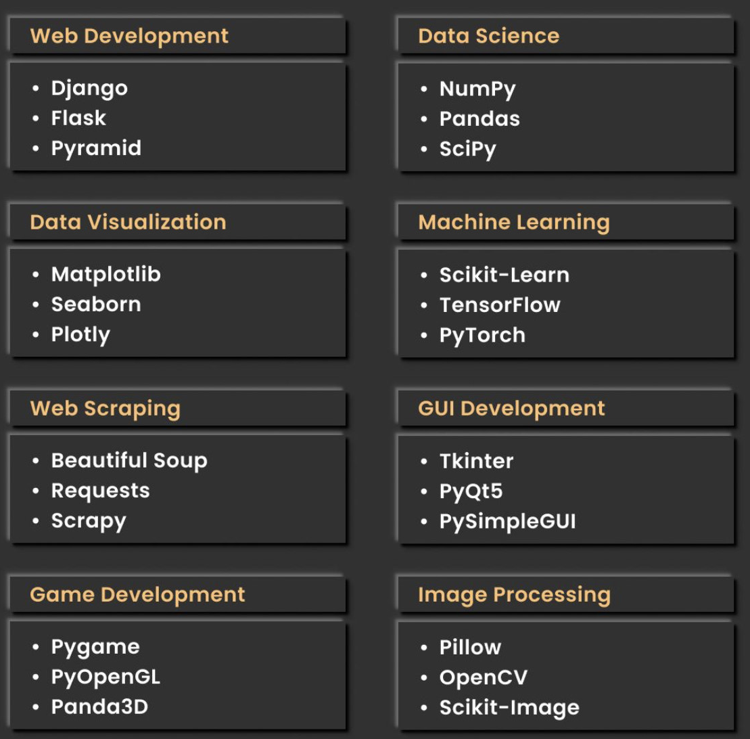
Useful Python Libraries

Slide 12
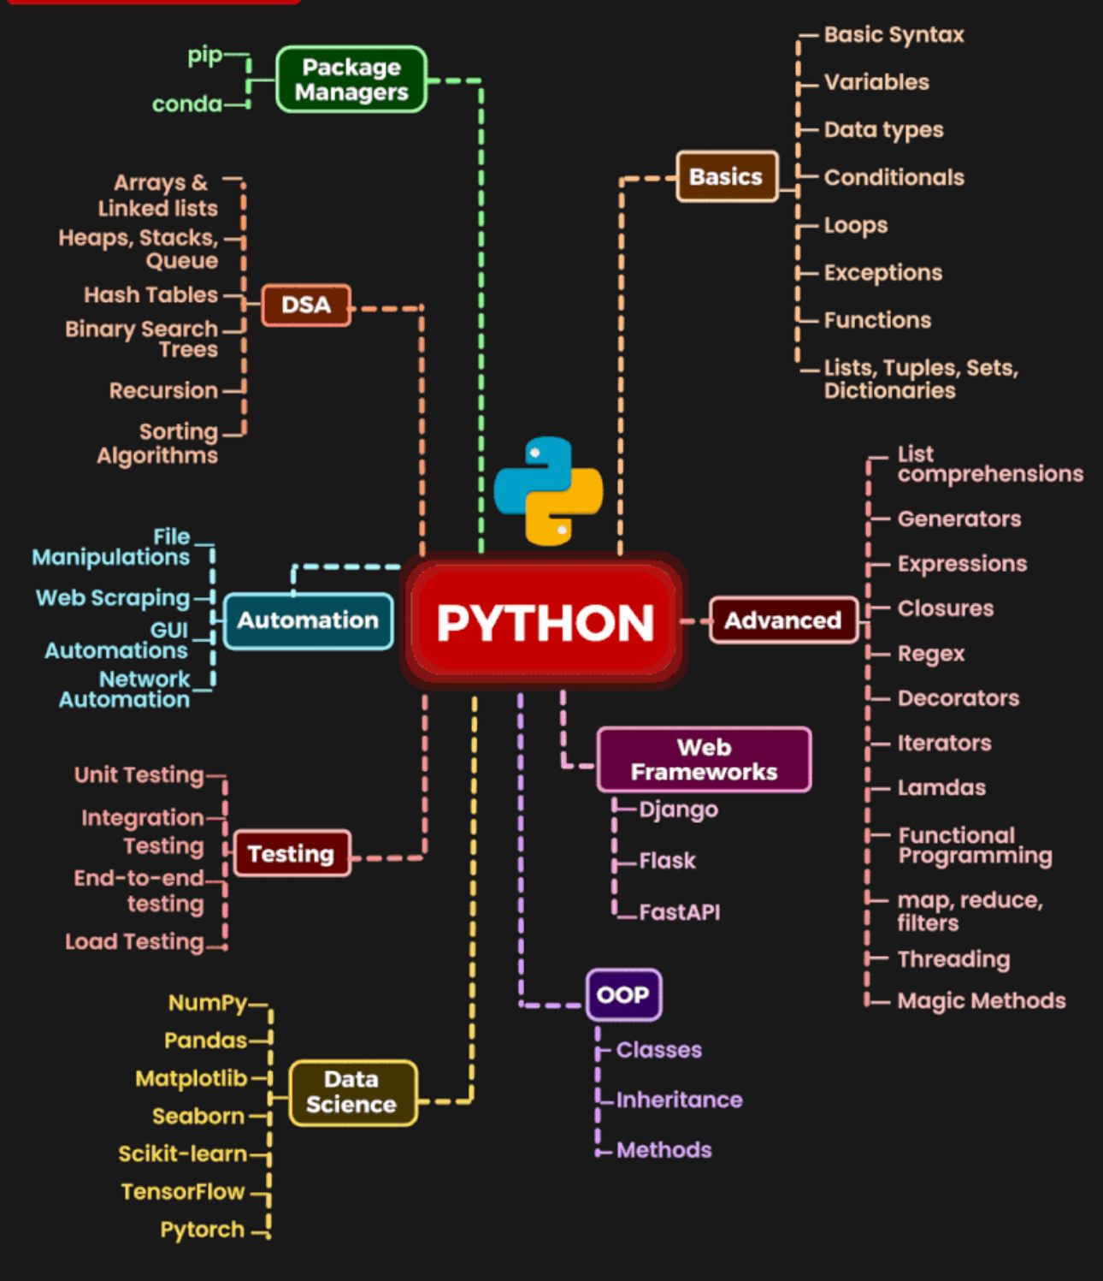
Python Roadmap

Slide 13
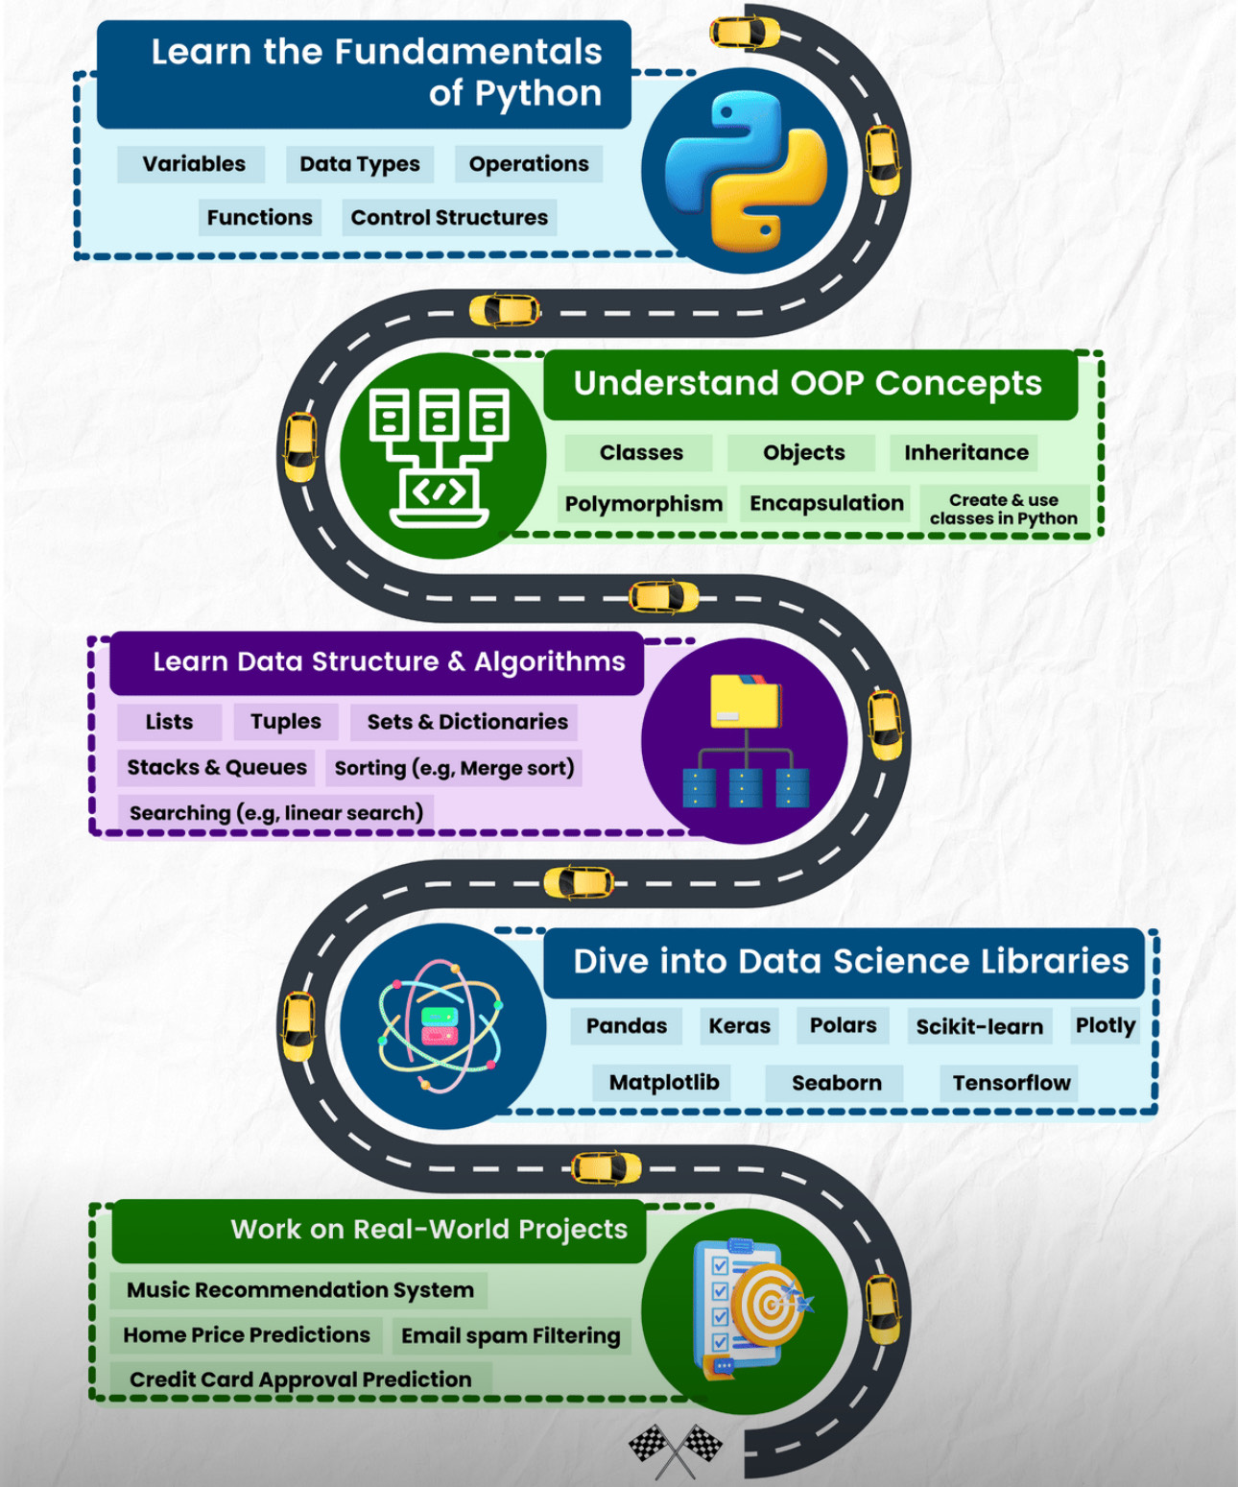
Python Roadmap

Slide 14
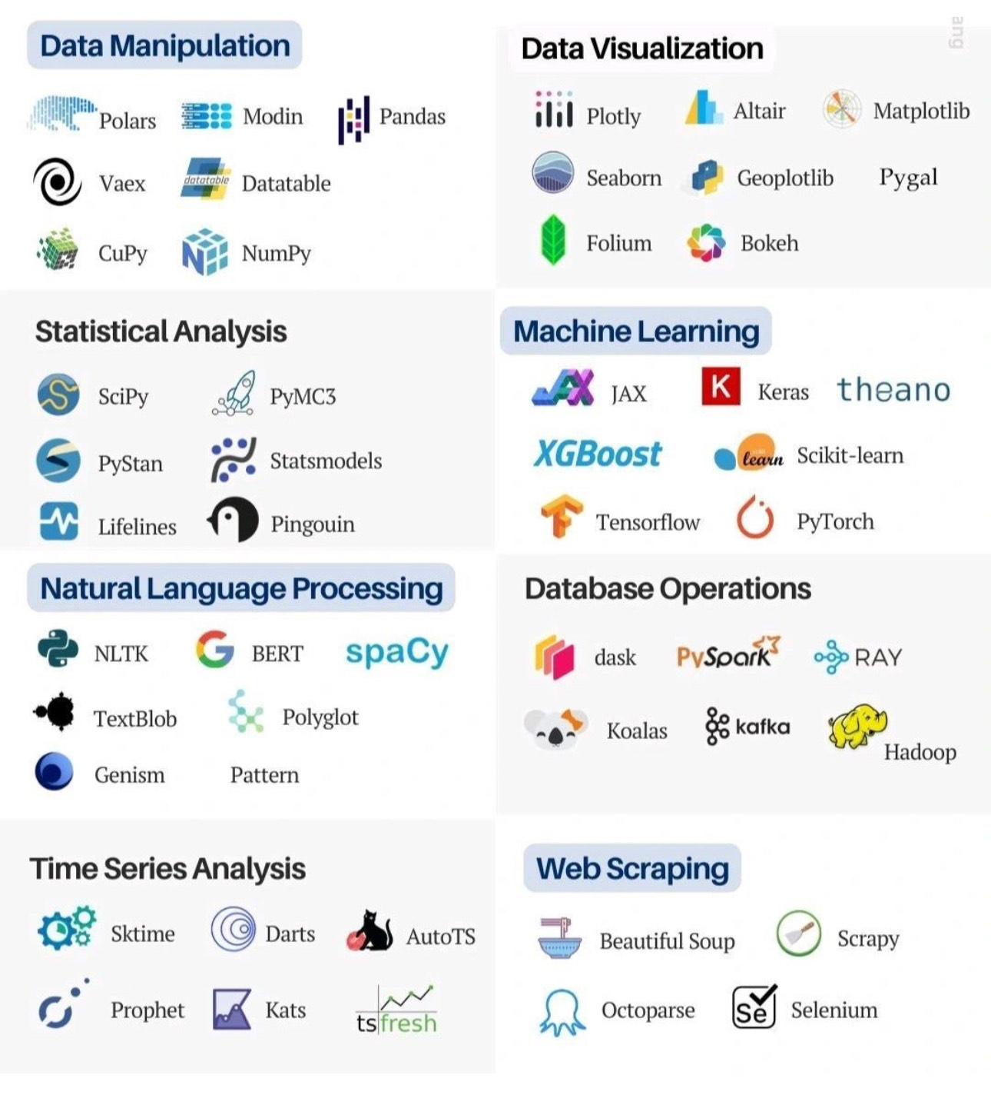
Python Roadmap

Slide 15
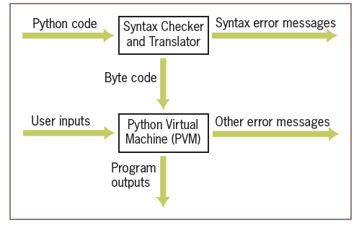
How Python Works?
Picture Source: Lambert's Fundamentals of Python: First Programs, 2nd Edition

Slide 16
How Python Works?
1. The interpreter reads a Python expression or statement, also called the source code, and verifies that it is well formed. In this step, the interpreter behaves like a strict English teacher who rejects any sentence that does not adhere to the grammar rules, or syntax, of the language. As soon as the interpreter encounters such an error, it halts translation with an error (e.g., Syntax) message.
2. If a Python expression is well formed, the interpreter then translates it to an equivalent form in a low-level language called byte code. When the interpreter runs a script, it completely translates it to byte code.
3. This byte code is next sent to another software component, called the Python virtual machine (PVM), where it is executed. If another error occurs during this step, execution also halts with an error message.

Slide 17
How Python Works?
Python is an interpreted language, but it uses a compilation process to convert the source code into bytecode before execution.
When you run a Python script, the Python interpreter first compiles the source code into bytecode (an intermediate form of code).
This bytecode is then interpreted by the Python Virtual Machine (PVM).
This compilation into bytecode allows Python to optimize code execution while retaining the benefits of an interpreted language.

Slide 18
Running Python
You can also run Python using online platform:
Jupyter Notebook: https://jupyter.org/try
Google Collaborator : https://colab.research.google.com
You can use package manager for Data Science
https://www.anaconda.com/products/individual
You can use a Python shell by using the IDE (Integrated Development Environment). Few popular IDEs are: For example,
PyCharm: https://www.jetbrains.com/pycharm/
Spyder : https://www.spyder-ide.org/

Slide 19
Jupyter Notebook/Lab
Python’s Jupyter kernel uses the IPython system for its underlying behavior. Ipython is an enhanced Python interpreter.
Easy to install and use
Interactive and Web-based
Use it by installing Anaconda

Slide 20
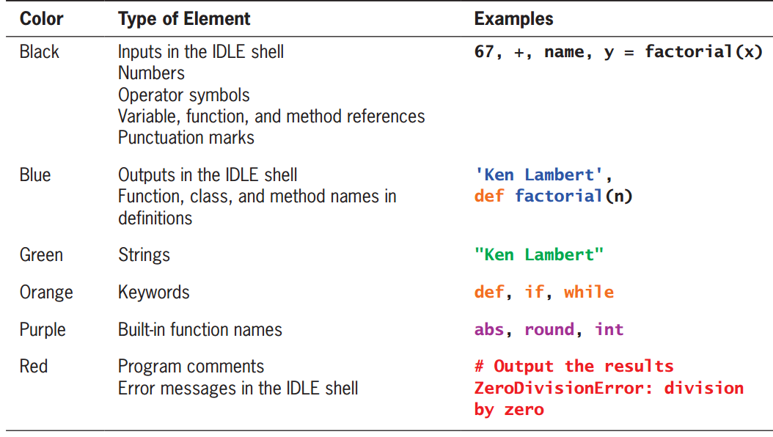
Color Coding in IDE
Various programming environment uses color coding to help the reader pick out different elements in the code
Picture Source: Lambert's Fundamentals of Python: First Programs, 2nd Edition

Slide 21
References
Python for Everyone
Think python, 2nd edition by Allen Downey
Python Cookbook, 3rd Edition by David Beazley, Brian K. Jones.
Lambert's Fundamentals of Python: First Programs, 2nd Edition
https://www.python.org/

