Slide 1

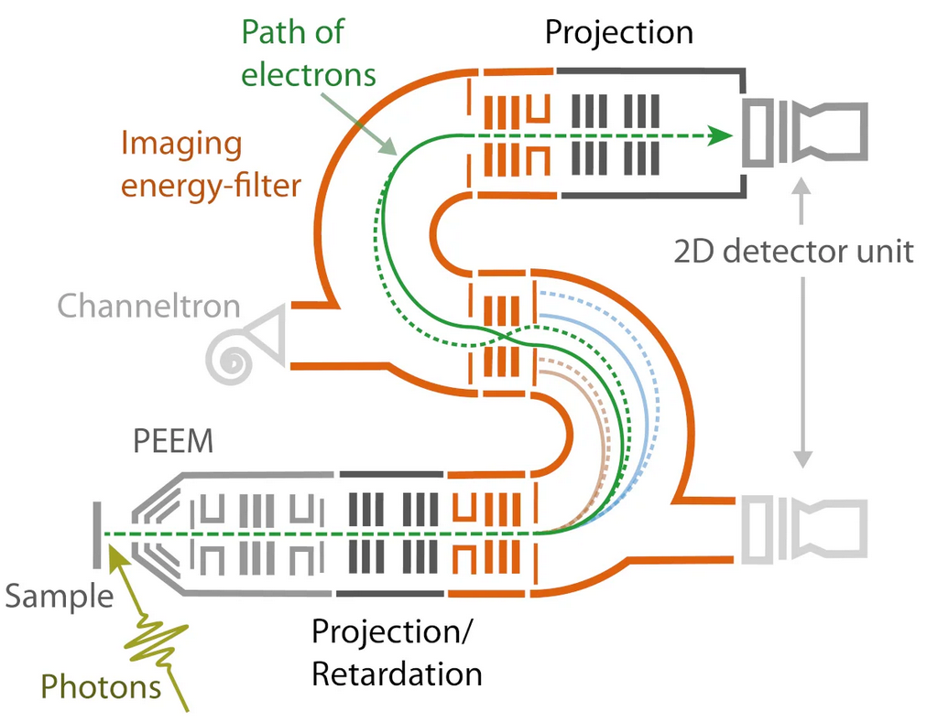
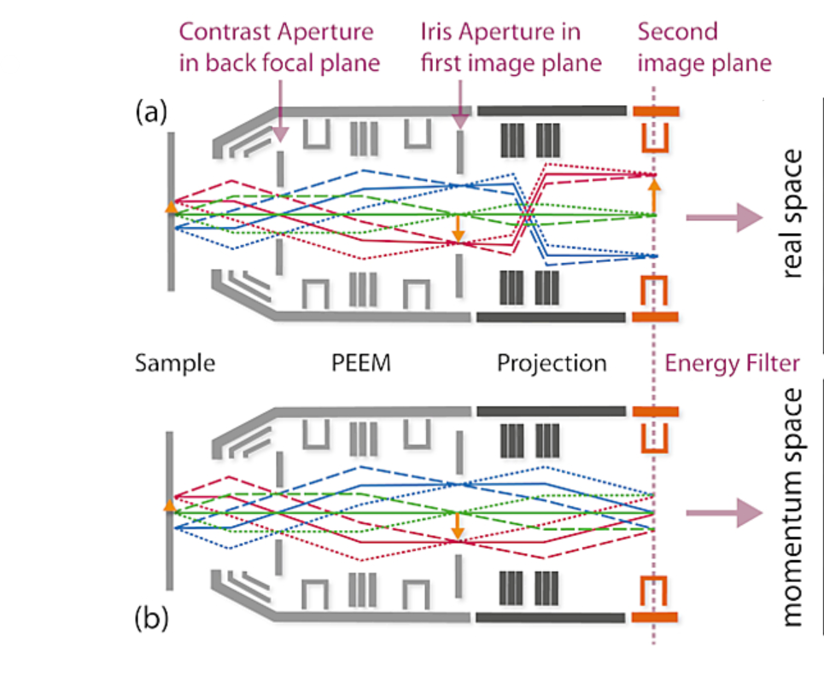
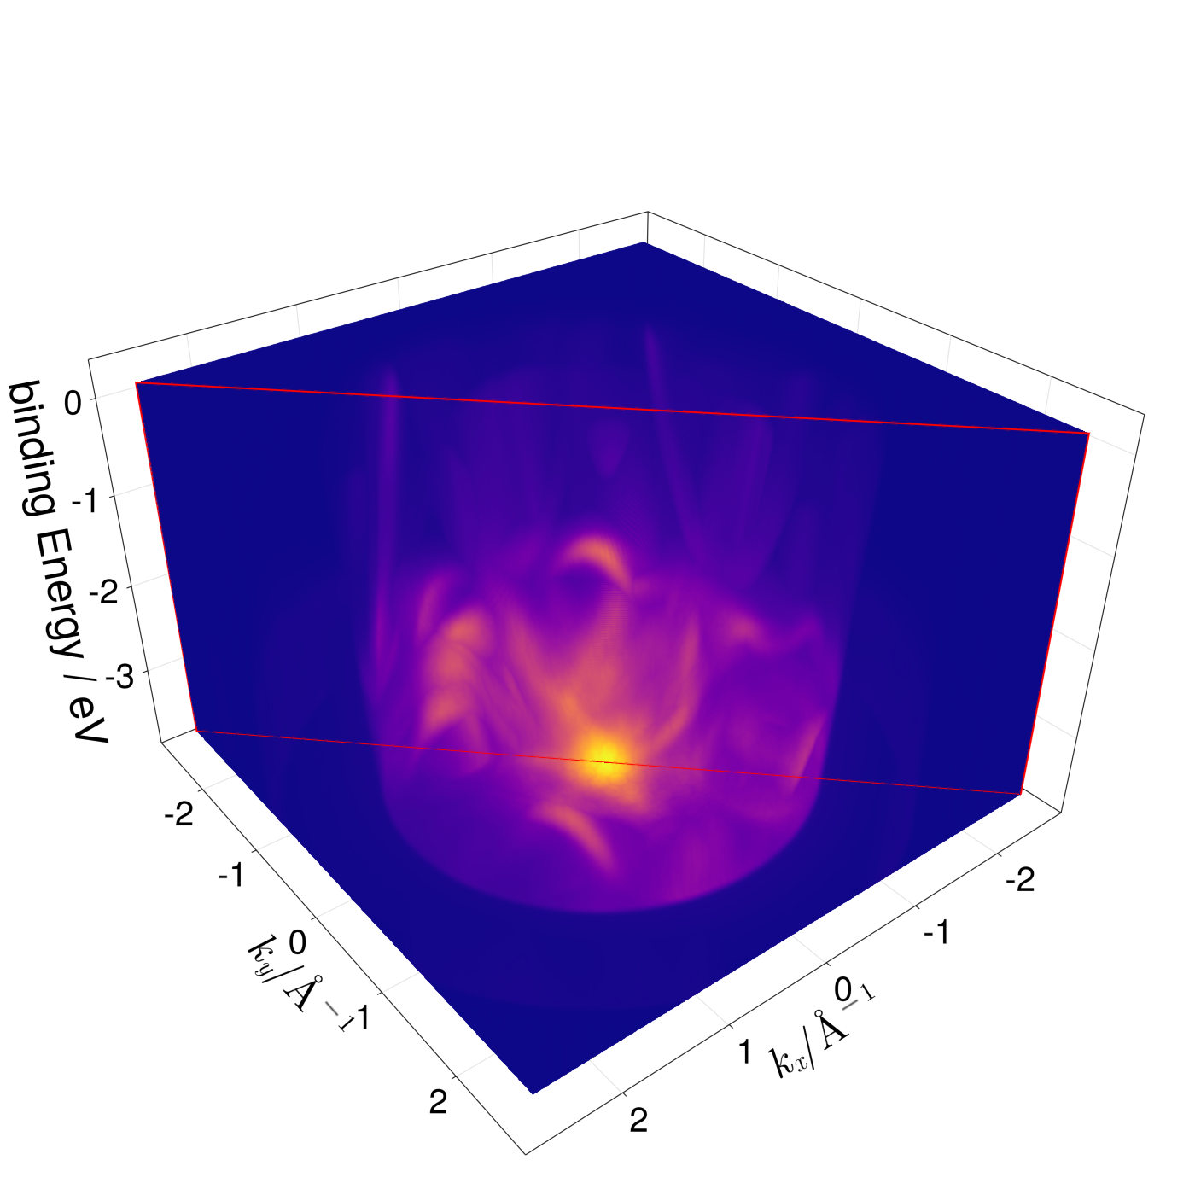
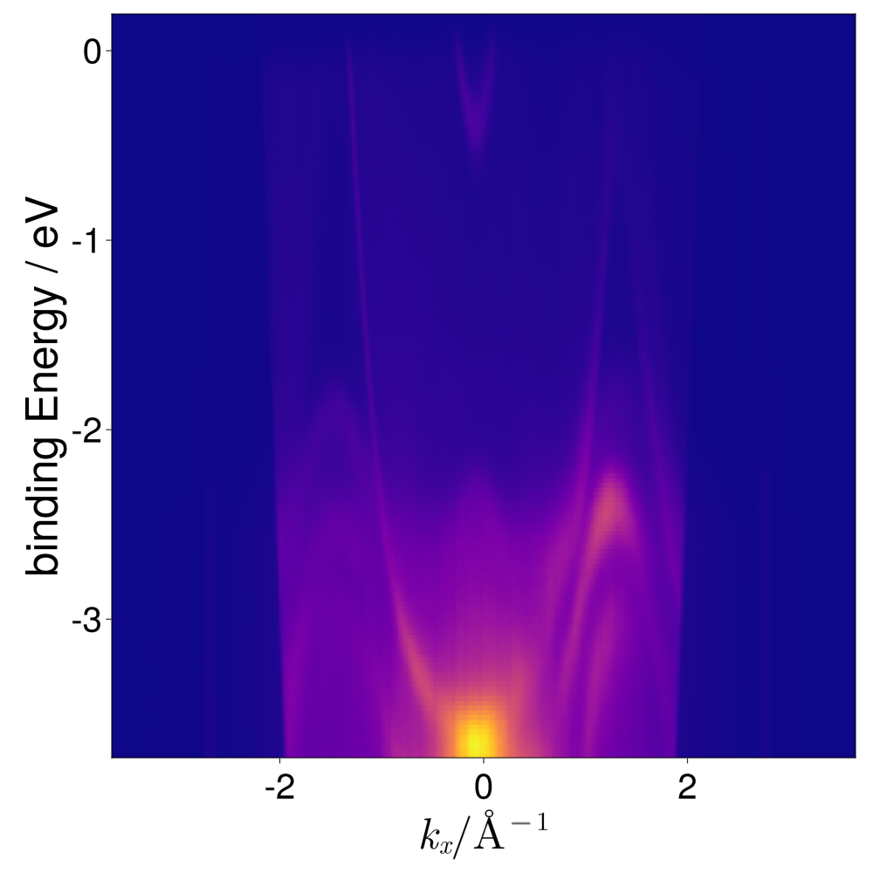
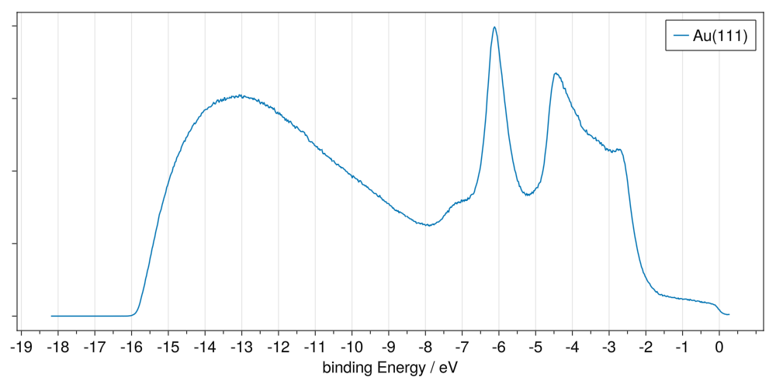
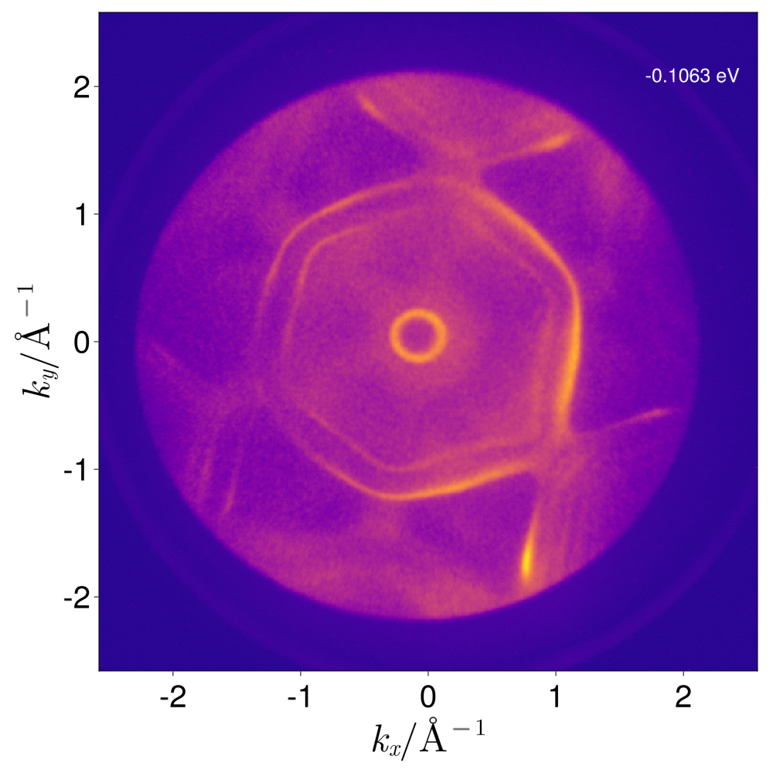
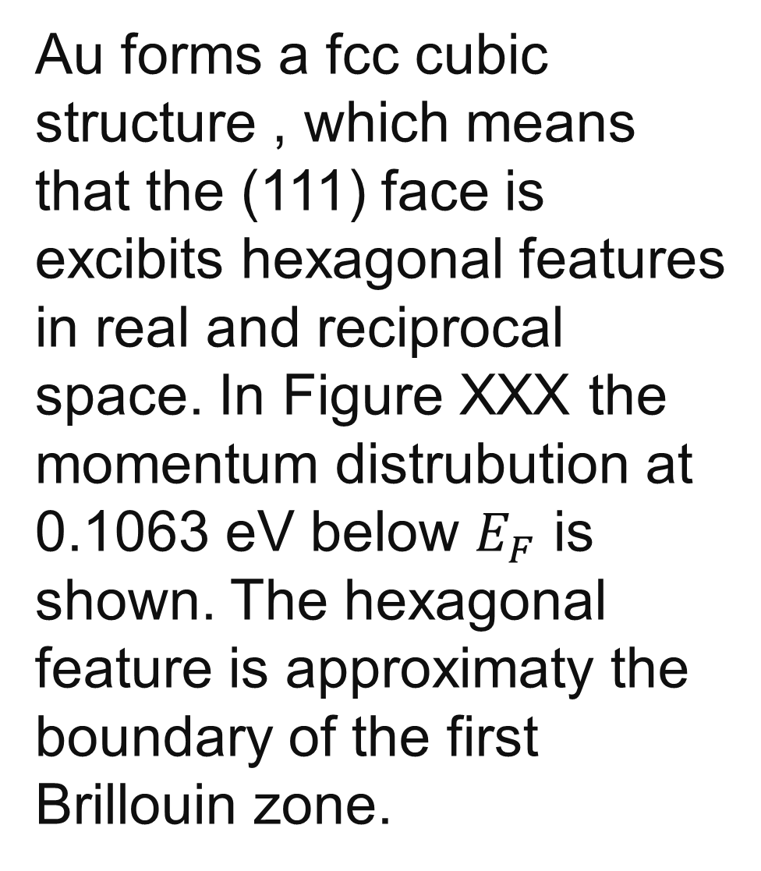
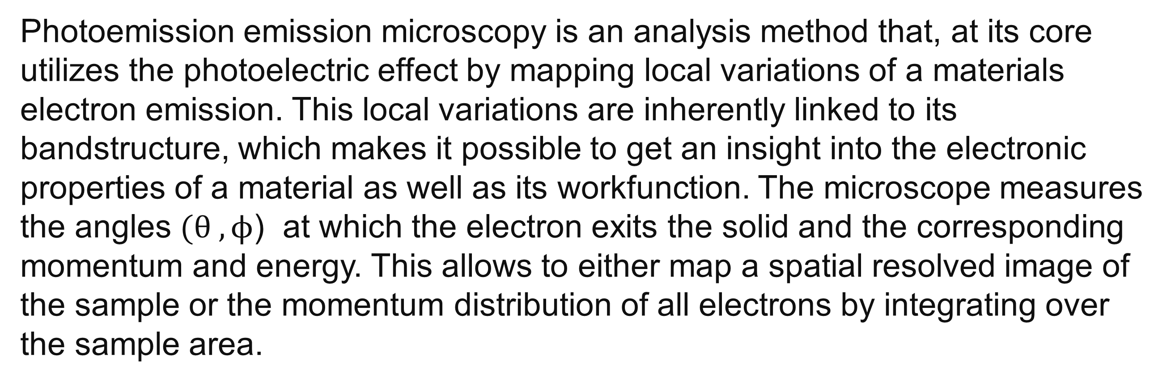

Measurement Techniques and Probe Analysis
Energy filtered photoemission electron microscopy (EF-PEEM)
of Au(111) single crystal
Aleksey Sokolov
Introduction
UV Photoelectron Spectroscopy (UPS)
Photoemission emission microscopy is an analysis method that, at its core utilizes the photoelectric effect by mapping local variations of a materials electron emission. This local variations are inherently linked to its bandstructure, which makes it possible to get an insight into the electronic properties of a material as well as its workfunction. The microscope measures the angles $(θ , ϕ$) at which the electron exits the solid and the corresponding momentum and energy. This allows to either map a spatial resolved image of the sample or the momentum distribution of all electrons by integrating over the sample area.
Figure 1: NanoESCA setup 1]
Figure 2 Image source: [1]
UV Photoelectron Spectroscopy (UPS)
Momentum Microscopy
UPS provides a possibility to get an insight into the Density of states (DOS) near the valence band edge of a material. A He lamp (21.21 eV) is used to excite electrons up to a binding energy equivalent to the insident photon energy. This electrons will have different kinetic energies depending on the state they are exiting. A energy filter, consisting of two hemispherical sector analyzers in a pointsymmetrical configuration, is employed to relate the kinetic energy of the electron to its corresponding state. In the Figure below DOS of Au(111) is shown. Below the Fermi Energy a small plateau is observed with a low density. This is expected as gold is inert in nature hence the absence of states near $E_{F}$.
Figure 3
By changing the mode of the microscope to momentum space imaging one can obtain the momentum and the corresponding angle of the exiting electron. This is done for energies in the range from 17.5 to 21.4 eV with a step of 25 meV. in Figure 3 the energy and momentum resolved bandstructure of a Au(111) surface ist shown. In Figure 4 the slice along the diagonal indicated by the red window in Fig. 3 is shown.
In the lower bound of the image, most likely bands formed by the 5d orbitals are seen.
Au 5d
Au 6s
secondaries
Figure 3: Density of States as a function of the binding energy.
Figure 3
Figure 4
Au forms a fcc cubic structure , which means that the (111) face is excibits hexagonal features in real and reciprocal space. In Figure XXX the momentum distrubution at 0.1063 eV below $E_{F}$ is shown. The hexagonal feature is approximaty the boundary of the first Brillouin zone.
Figure 3
[1]: https://scientaomicron.com/en/products-solutions/electron-spectroscopy/NanoESCA

