Slide 1

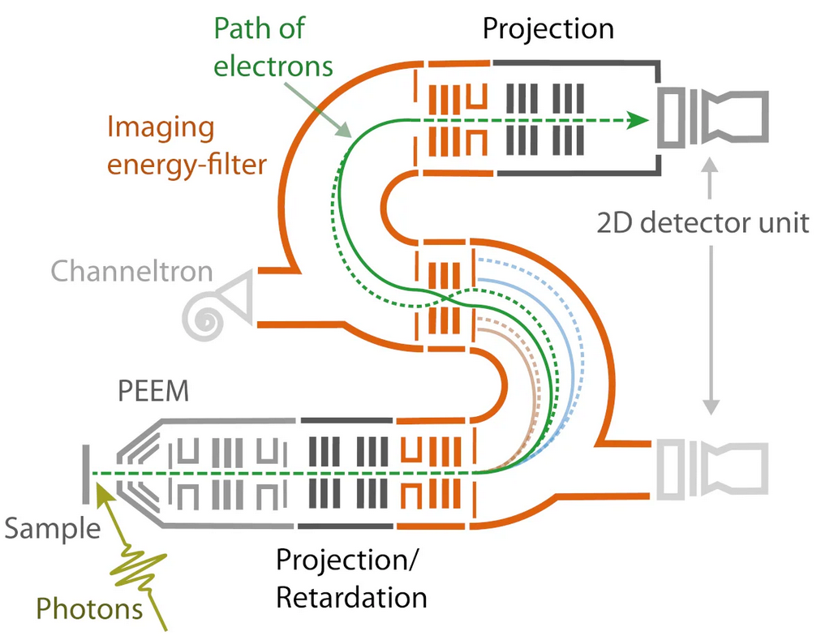
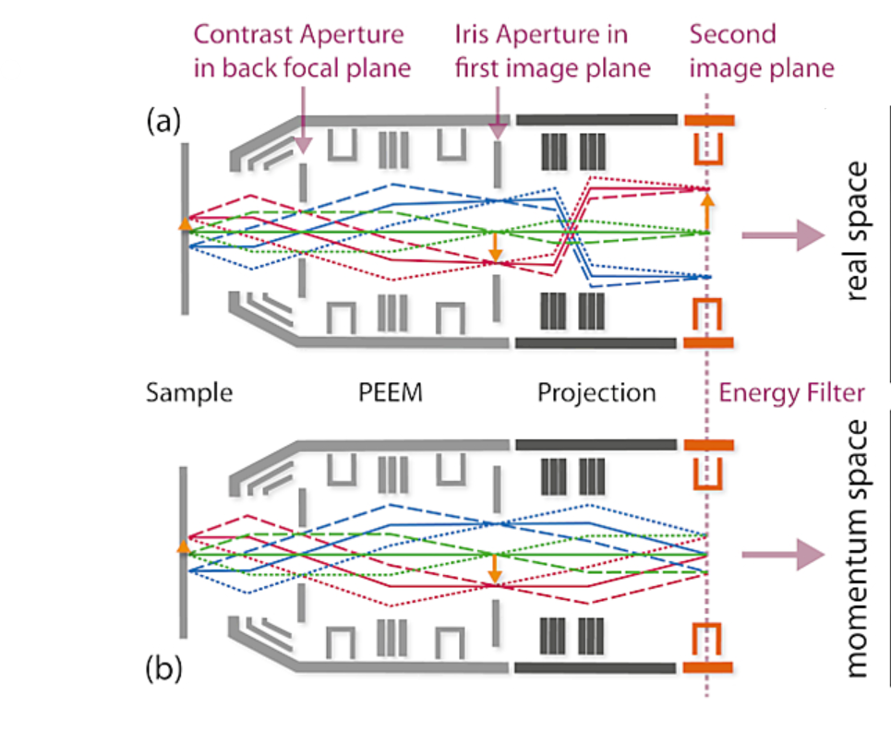

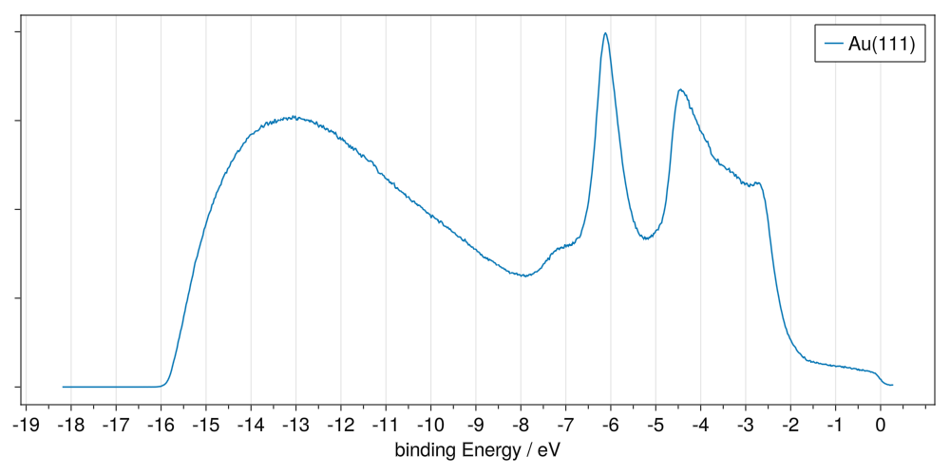
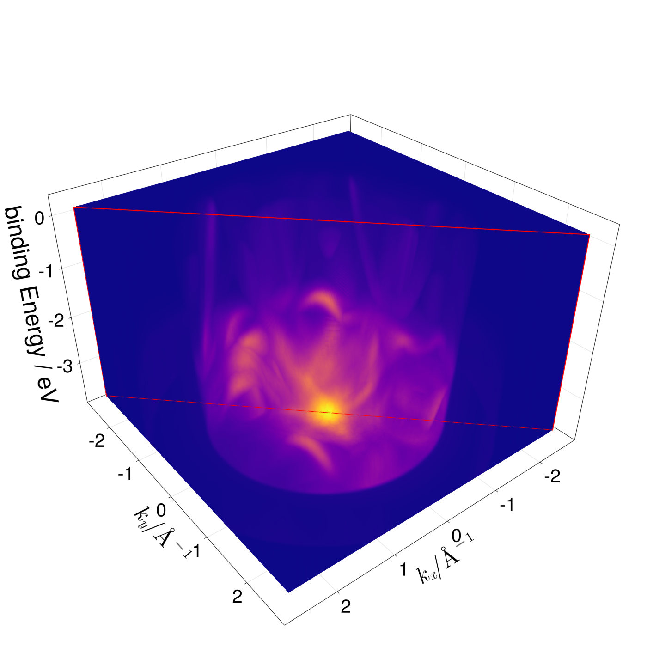
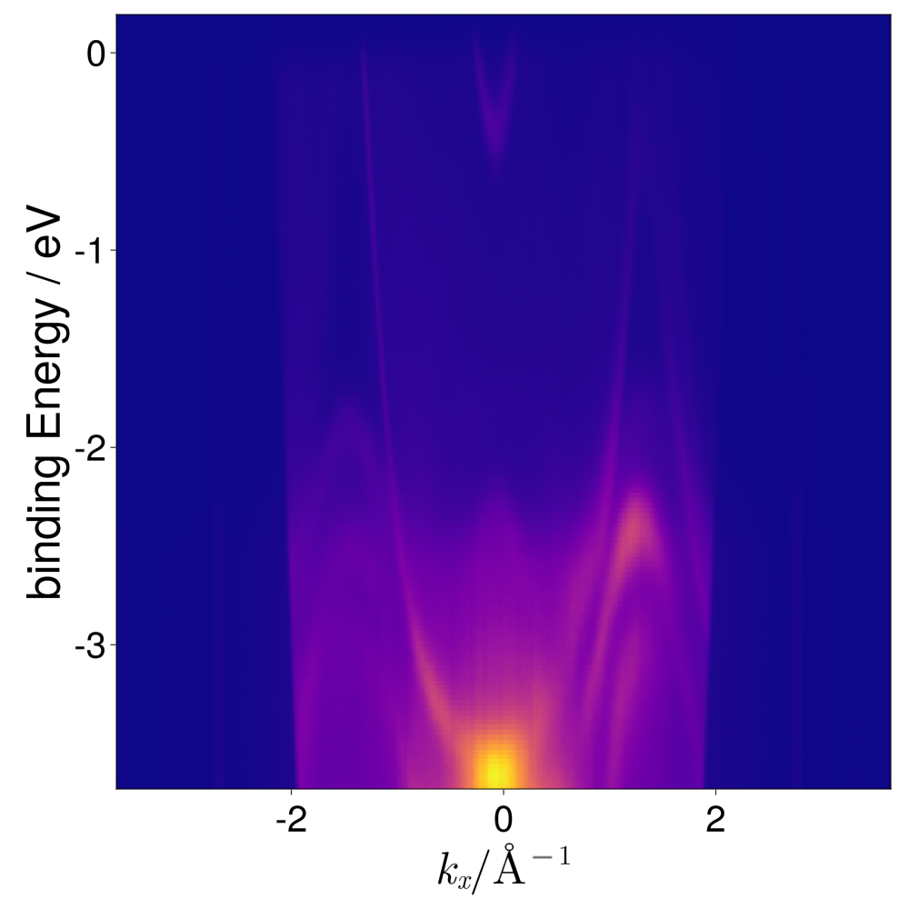
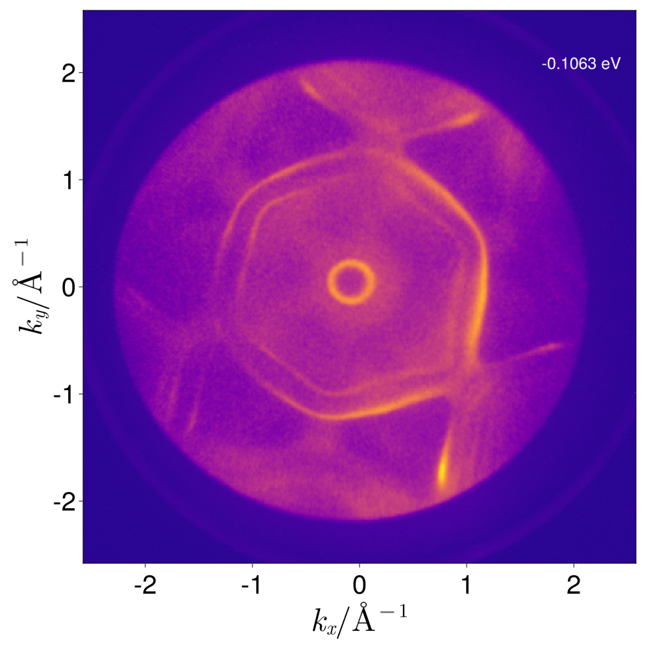

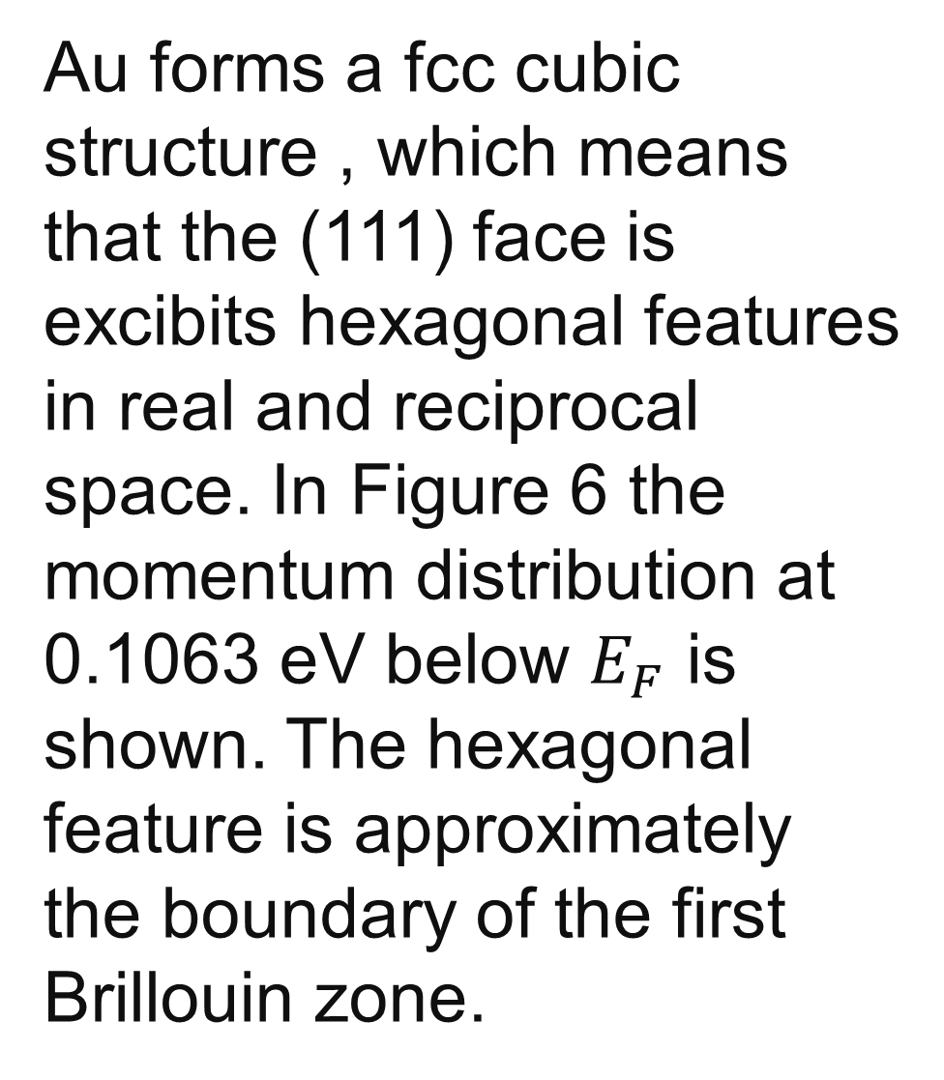
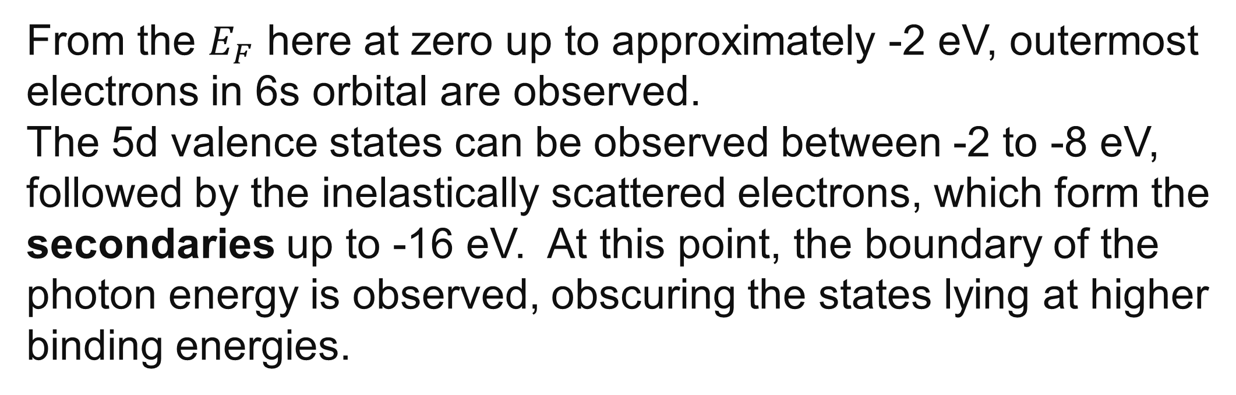
Measurement Techniques and Probe Analysis
Energy filtered photoemission electron spectroscopy (EF-PEEM)
of Au(111) single crystal
Aleksey Sokolov
Introduction
UV Photoelectron Spectroscopy (UPS)
Photoemission spectroscopy (PES) is a powerful analysis method that, at its core, utilizes the photoelectric effect by mapping local variations of a material’s electron emission after exciting it with photons. Tese local variations are inherently linked to its bandstructure, which makes it possible to get an insight into the electronic properties of a material as well as its work function. Therefore, PES is a frequently employed method in the realm of condensed matter physics.
It is possible to switch between real space and momentum space imaging by
changing the configuration of the lens system. For momentum space imaging the correct angular distribution must be maintained, hence why an additional transfer lens is used behind the objective lens. The projection lens serves in this case as a Fourier lens which maps the reciprocal image on to the second image plane. By changing the projection lens one can retrieve the reals space image.
Figure 1: NanoESCA setup, for UPS only the first energy filtering hemisphere is used [1]
After the Projection/Retardation section, the energy filtering is performed by the first hemisphere, which can be directly utilized for the UPS spectra. The second hemisphere compensates for the spherical aberrations induced by the first one.
Figure 2: Schematic of the two operational modes of the microscope. [1]
UV Photoelectron Spectroscopy (UPS)
Momentum Microscopy
UPS provides a possibility to get insight into the density of states (DOS) near the valence band edge of a material. A He lamp (21.21 eV) is used to excite electrons up to a binding energy equivalent to the incident photon energy. This electrons will have different kinetic energies depending on the state they are in. A energy filter is employed to relate the kinetic energy of the electron to its corresponding state. In the figure 3 the DOS of Au(111) is shown. Below the Fermi energy a small plateau is observed with a low density. This is expected as gold is inert in nature, hence the absence of states near $E_{F}$.
Figure 3
By changing the mode of the microscope to momentum space imaging, one can obtain the momentum and the corresponding angle of the exiting electron. This is done for energies in the range of 17.5 to 21.4 eV with a step of 25 meV. In figure 4 the energy and momentum resolved bandstructure of a Au(111) surface is shown. In Figure 5, the slice along the diagonal indicated by the red window in Figure 4 is shown.
In the lower bound of the image, most likely bands formed by the 5d orbitals are seen.
Au 5d
Au 6s
secondaries
Figure 3: Density of States as a function of the binding energy.
Figure 4: Photoemission pattern of Au(111) aus a function of energy.
Figure 5: Diagonal slice of the photoemission pattern.
Au forms a fcc cubic structure , which means that the (111) face is excibits hexagonal features in real and reciprocal space. In Figure 6 the momentum distribution at 0.1063 eV below $E_{F}$ is shown. The hexagonal feature is approximately the boundary of the first Brillouin zone.
From the $E_{F}$ here at zero up to approximately -2 eV, outermost electrons in 6s orbital are observed.
The 5d valence states can be observed between -2 to -8 eV, followed by the inelastically scattered electrons, which form the secondaries up to -16 eV. At this point, the boundary of the photon energy is observed, obscuring the states lying at higher binding energies.
Figure 6: Logarithmic plot of the momentum distribution at -0.1063 eV
[1]: https://scientaomicron.com/en/products-solutions/electron-spectroscopy/NanoESCA

