Slide 1
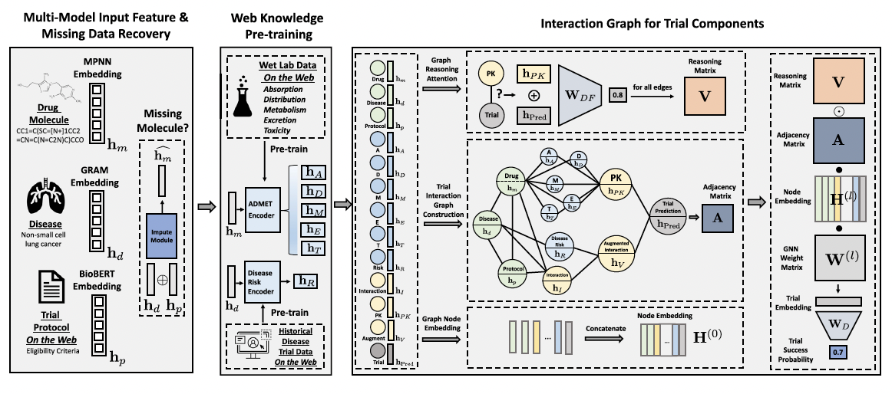

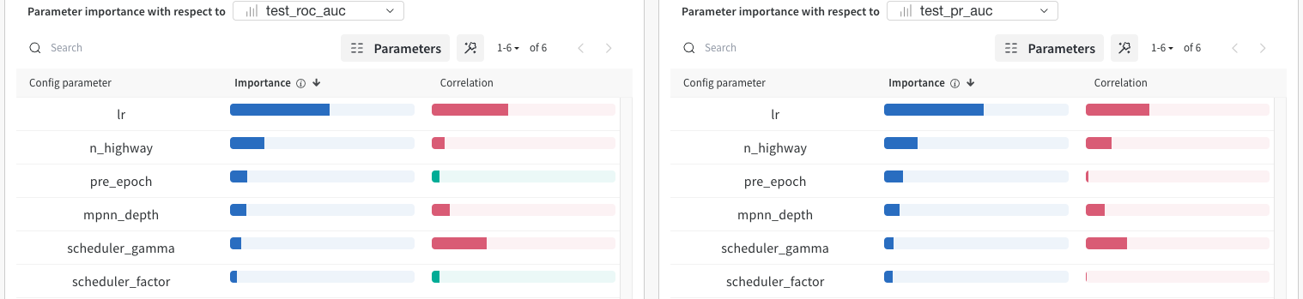
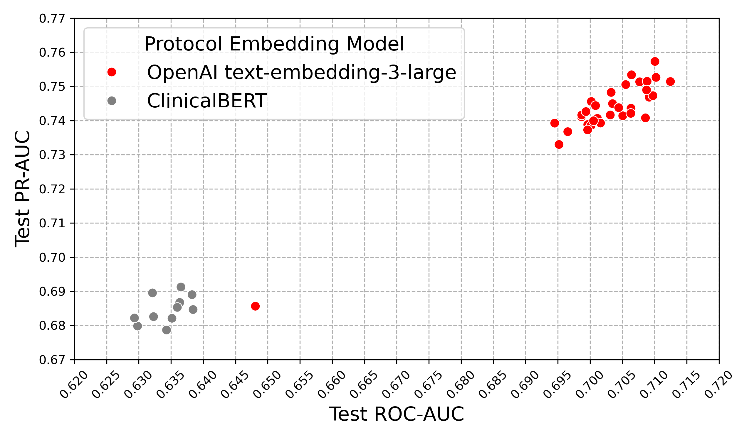
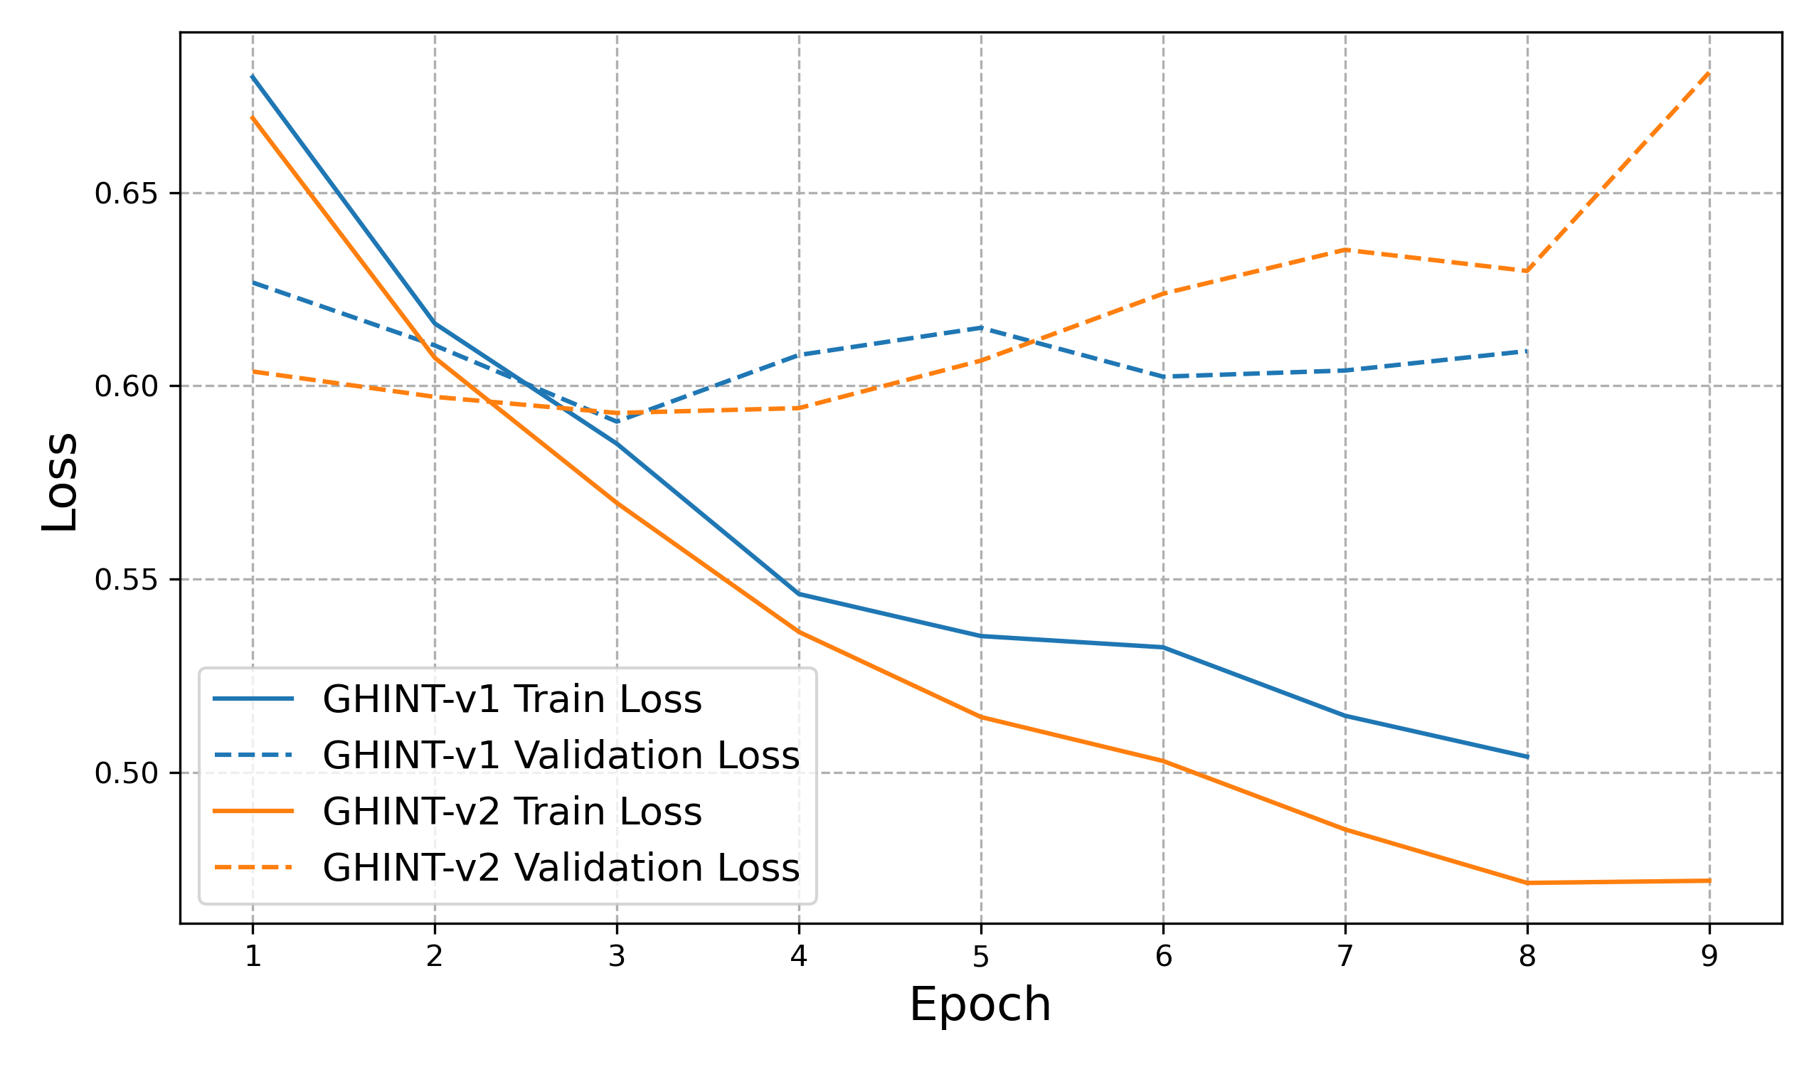
GHINT: GPT-enhanced Hierarchical Interaction Network for Multimodal Clinical Trial Outcome Prediction
Sean Xu, Natalie Yang, Lexa Zhong
Carnegie Mellon University, 11-711 Advanced Natural Language Processing, Spring 25
Why It Matters?
High Cost & Long Timelines: Clinical trials often exceed $100 million and take over a decade to complete.
Smarter Resource Allocation: Early outcome forecasts help sponsors focus on the most promising compounds, optimize site selection, and streamline patient recruitment.
Enhanced Patient Safety: Predicting likely failures ahead of time reduces participant exposure to ineffective or unsafe interventions.
Deeper Protocol Insights: Leveraging advanced embeddings (e.g., LLM‑based) on trial protocols uncovers nuanced design details that traditional models miss, boosting prediction accuracy and accelerating decision‑making.
Methods
GPT-enhanced HINT (GHINT)
Results
Model Performance
Through the ablation tests, two GPT text-embedding-enhanced models are significantly outperform the baseline HINT and LIFTED (Zheng et al., 2024) on the Phase II dataset.
Structure Supremacy
GPT-based embeddings outperform BioBERT by capturing richer semantic and contextual information, which is crucial for understanding nuanced clinical trial text
Unlike HINT’s 50-dimension embeddings, our models use 256 dimensions, allowing for more expressive and informative representations.
Beyond eligibility criteria, we also include sponsor, trial design, etc., as input features to capture more comprehensive trial context.
Model | ROC-AUC | PR-AUC | F1
HINT | 0.645 | 0.629 | 0.620
GHINT–v1 | 0.712 | 0.751 | 0.714
GHINT–v2 | 0.710 | 0.757 | 0.704
LIFTED | 0.651 | 0.698 | 0.662
{
SponsorModule: …,
descriptionModule: {
briefSummary： “This phase IIIb trial…”
,
conditionModule: {
conditions: ['Alzheimer Disease’, …],
keywords: ['Mild cognitive impairment’, …]
}
designModule: …,
armsInterventionModule: {
interventions: …,
eligibilityModule: {
eligibilityCriteria: “Inclusion Criteria: …”
outcomeModule: {
primaryOutcomes: [{'measure': 'Proportion of patients…}]
,
secondaryOutcomes: …
…
}
ClinicalBERT
Embedding
Method 1
Table 4: Performance Comparison of Models for Predicting Phase II Clinical Trial Outcome
Trial Protocol Data
Dim=768
Included only eligibility criteria
BioBERT Embedding
OpenAI
Text-embedding-3-large
Baseline Model
Hierarchical Interaction Network (HINT)
HINT (Fu et al., 2022), a benchmark model for clinical trail outcome prediction, first encodes drug molecules, target diseases, and trial eligibility criteria into vector embeddings, then constructs a hierarchical interaction graph to capture their cross‐modal relationships, and finally applies a dynamic, attentive GNN to predict trial success probabilities.
Method 2
Dim=3072
Figure 2: GHINT Framework
Additional Training Pipeline Enhancements
Optimizer: Adam → AdamW
Activation: ReLU → GELU
Added scheduler to dynamically decay learning rates
Streamlined Dataset and DataLoader for higher throughput
Ablation
We conducted ablation study using TOP phase II dataset：# train: 4,004; # valid: 445; # test: 1,653
It is the most critical to determine which protocol embedding model—text-embedding-3-large from OpenAI API or ClinicalBERT—works better. Besides, we experiment with different hyperparameters for optimization and HINT Architecture. Notably, we expect a larger embedding output dimension—into which different modalities are encoded—would boost the model performance.
Discussion
Hyperparameter Impact Assumptions
Our hyperparameter ablation study provides the following insights when using text-embedding-3-large:
Learning Rate Sensitivity: A higher learning rate for AdamW tends to negatively impact performance, likely due to overshooting optimal minima.
Highway Network Depth: The Highway layer serves as a learnable gating mechanism to control feature transformation across layers. However, increasing the number of Highway layers degrades performance, suggesting that added complexity may lead to overfitting or redundancy, particularly when the input embeddings are already semantically rich.
Effect of Pretraining Epochs on ADMET encoder: Increasing the number of pretraining epochs on external web lab data improves performance. Longer pretraining provides the encoder with stronger domain-invariant representations, improving downstream generalization to prediction tasks
Bootstrap-Based Performance Evaluation
We propose to adopt bootstrap resampling like HINT to reduce evaluation variance, particularly important for small-sample clinical trial dataset.
Unified Dataset and Phase Integration
Unlike previous researches training models separately on clinical trials of different phases, we propose to train on the full dataset across all trial phases, allowing the model to capture cross-phase relationships, and enables learning from a more diverse training set.
Figure 1: HINT Framework (credit to the original HINT paper)
Hyperparameter | Search Space
embeddings | [OpenAI, ClinicalBERT]
embedding_output_dim | [64, 128, 256]
n_highway | DiscreteUniform(2, 6)
mpnn_depth | DiscreteUniform(2, 10)
epoch | 10
pre_training_epoch | DiscreteUniform(10, 30)
lr | Uniform(1e-4, 1e-3)
scheduler | [StepLR, ReduceLROnPlateau]
scheduler_gamma | [0.3, 0.5, 0.8]
Figure 5: Hyperparameter Importance of Ablation Study
 | PR-AUC | F1 | ROC-AUC
Phase I | 0.567 ± 0.010 | 0.665 ± 0.010 | 0.576 ± 0.008
Phase II | 0.629 ± 0.009 | 0.620 ± 0.008 | 0.645 ± 0.006
Phase III | 0.811 ± 0.007 | 0.847 ± 0.009 | 0.723 ± 0.006
Table 1: HINT Results for Phase-level Outcome Predictions on Test Sets
Table 2: Search Space of Ablation Study
Figure 3: Performance of 44 Ablation Experiments
What Can Be Improved?
Richer Data Inputs
Go beyond eligibility criteria, SMILES strings and ICD‑10 codes by adding additional protocol fields on ClinicalTrials.gov, e.g. outcome measures, allocation methods, intervention arms—so the model can leverage nuances of trial design​.
Advanced Embeddings
Experiment with promising text embedding models, such as ClinicalBERT, which is tailored for clinical text, and OpenAI’s state-of-the-art text-embedding-3-large.
Hyperparameter | GHINT-v1 | GHINT-v2
embeddings | OpenAI | OpenAI
embedding_output_dim | 256 | 256
n_highway | 6 | 5
mpnn_depth | 4 | 3
epoch | 10 | 10
pre_training_epoch | 10 | 22
lr | 2.45E-04 | 5.33E-04
scheduler | StepLR | StepLR
scheduler_gamma | 0.5 | 0.5
Table 3: Hyperparameters of the 2 Best Models
Figure 4: Loss Plot of the 2 Best Models

