Slide 1
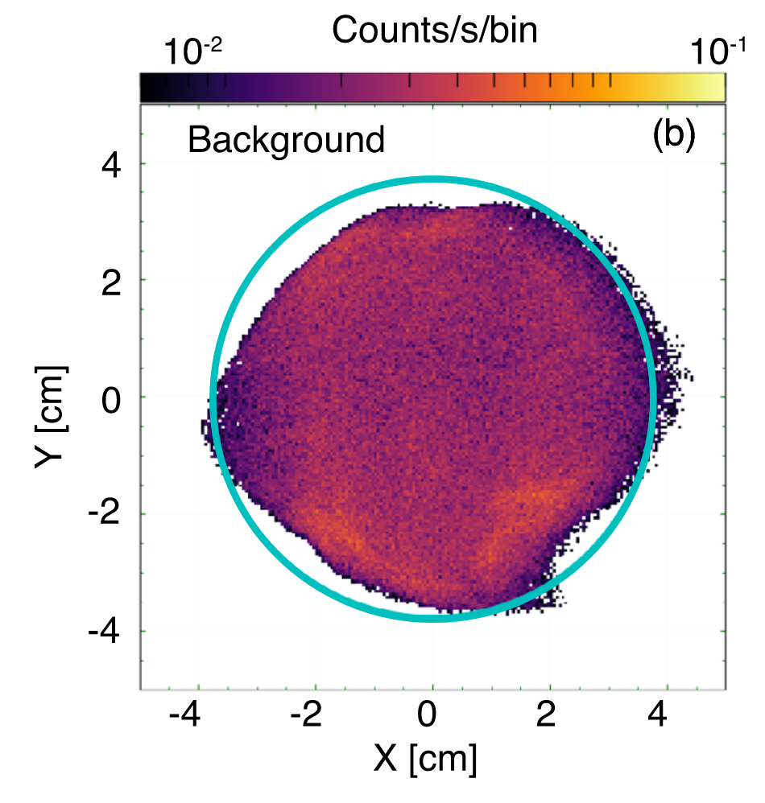
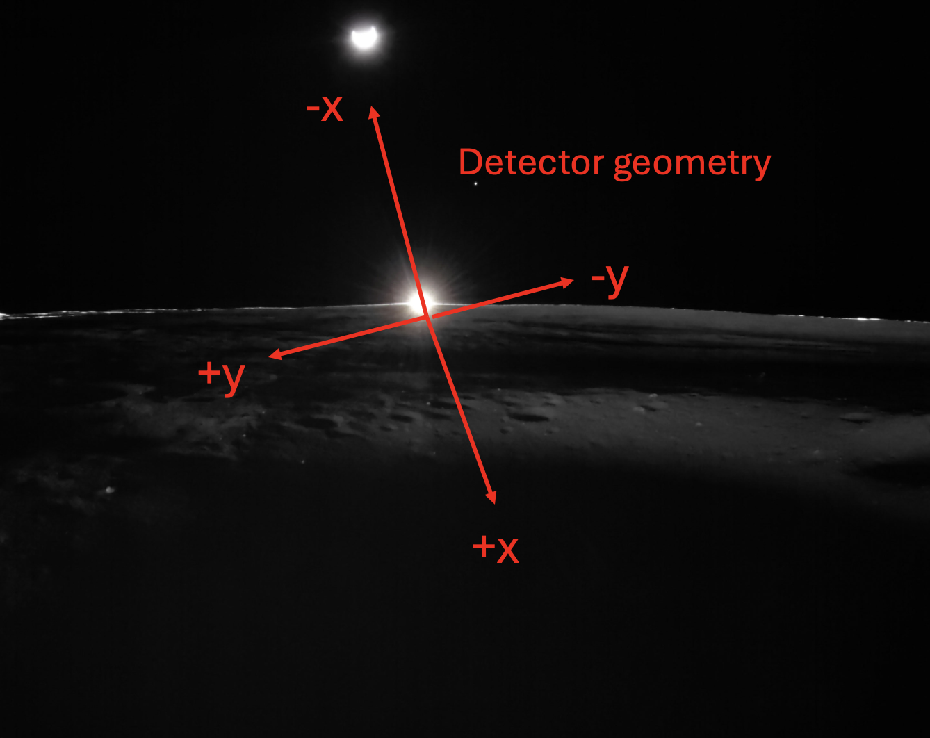

Slide 2
Transformation
This math below rotates counterclockwise, so need to use negative angle or theta = -18.6deg
Xtmp = X*cos(theta)+Y*sin(theta)
Ytmp = -X*sin(theta)+Y*cos(theta)
Now create Ys, Xs where Xs is perpendicular to the lunar surface with +Xs being away from the surface and Ys is parallel to surface
Xs = -Xtmp
Ys = -Ytmp

