Slide 1
Chapter 9 · The physics stage
Stage 3: Energy Minimization
Relaxing docked TF–DNA poses without losing the bound geometry · engine: stage3_minimize.py (OpenMM, v5) · runs in the bioemu env on endeavour
Notes:
Chapter 9 is the pipeline's one physics-based refinement stage, and it earns a long chapter because how we relax the docked poses shapes every downstream feature and label.
The one-sentence framing to open with: Stage 2 hands us poses that are geometrically plausible but energetically strained, and Stage 3's whole job is to relax that strain WITHOUT letting the structure wander off the bound geometry we trust. Everything in this deck is a variation on that single tension — 'relax the strain, preserve the pose.'
Orientation for the audience: the engine is stage3_minimize.py, 409 lines of OpenMM, and it processes one BioEmu frame per invocation. It runs in the bioemu conda env, one SLURM array task per frame. Every number in this deck is read from that actual source, not paraphrased.

Slide 2
Where Stage 3 sits in the pipeline
• Input — from Stage 2: a BioEmu conformer Kabsch-fit onto the crystal DNA
– right global placement, but a strained new interface (clashes, stretched bonds)
• Stage 3 — this chapter: one physics-based minimization per frame
• Output — to the fnat gate (Ch. 8) and, for survivors, Stage 4 featurization
– output/stage3_min/<tf>/<pdb>_state_NNN.pdb + per-pilot <pdb>_fnat.csv
• The contract, stated once and returned to on every slide:
– “relax the strain, preserve the pose” — remove clashes, keep the docked frame's identity
Notes:
Situate the stage before diving into mechanics.
Upstream: Stage 2 docks each independently-sampled protein conformer onto the crystal DNA by a Kabsch fit. The protein never saw that DNA during sampling, so the interface it lands on has atomic clashes and strained contacts — the placement is right but the local geometry is wrong.
Downstream: two consumers. First the fnat gate (Chapter 8), which is scored AFTER minimization — that ordering matters and we'll see why. Second, for states that pass, Stage 4 featurization turns them into the tensors DeepPBS reads.
Why you can't skip it: DeepPBS reads interface geometry. Featurize a raw clashy pose and the model learns simulation artifacts instead of recognition chemistry. Minimization exists to make each frame physically self-consistent at the interface — locally clean, without moving the pose globally.

Slide 3
9.0
The per-state flow
One BioEmu frame per invocation, six steps — the skeleton every later slide hangs detail on.
Notes:
Quick roadmap slide. The engine's own docstring lists six steps per state; the next slide walks them. Keep this short — it's the map, not the territory.

Slide 4
9.0 · Six steps per state (from the engine docstring)
• 1. PDBFixer repair — AND record every structural metal + its coordinating side-chain atoms, before stripping heterogens
• 2. Add hydrogens (Modeller; forcefield = ff14SB + GB-Neck2)
• 3. Phase 0 — hydrogen-only minimization, heavy atoms frozen (mass = 0)
• 4. Phase 1 — vdW ramp σ = 0.1→1.0, with backbone + metal-cage restraints active
• 5. Phase 2 — final minimization at full vdW
• 6. Strip hydrogens, write the minimized PDB
• Idempotent & array-parallel:
– one SLURM array task per frame; skips if output exists or input missing → re-submit fills gaps
– N_FRAMES in the pilot config sets the array size (tbp = 99, egr1 = 98)
Notes:
Walk the six steps at a measured pace — this is the skeleton for the whole chapter.
Step 1 is the subtle one and gets its own section later (9.4): the metal detection has to happen BEFORE removeHeterogens wipes the ion, because you need the ion's position to know which side-chain atoms were coordinating it.
Steps 3-4-5 are the three-phase minimization — the heart of the stage. Phase 0 fixes hydrogens against a frozen heavy-atom frame; Phase 1 is the gentle clash-resolving ramp; Phase 2 is the long final settle.
The operational point at the bottom: each state is an independent SLURM array task, and the task is idempotent — it skips any state that already has output. So if a batch partially fails, you just re-submit and it fills only the gaps. N_FRAMES drives how many array tasks get launched.

Slide 5
9.1
Why minimize a docked pose at all?
The docked interface is strained; DeepPBS would read that strain as chemistry.
Notes:
Transition: we've seen the flow; now the motivation for each piece. Start with the most basic question a skeptic asks — why touch the pose at all?

Slide 6
9.1 · The problem minimization solves
• Stage 2's docked pose has the right global placement but a strained interface
– atomic clashes, stretched bonds, strained contacts at DNA the protein never sampled against
• DeepPBS reads interface geometry → un-relaxed clashes become features, not chemistry
• The exact clash diagnostic (from count_clashes in the engine):
– heavy-atom protein–DNA pairs closer than 0.24 nm (2.4 Å)
– protein = 20 standard residues (+ HID/HIE/HIP); DNA = DA/DG/DC/DT; H excluded
– printed at Initial, after every ramp stage, and at Final — plus the min protein–DNA distance
• Caveat: PDBFixer is told missingResidues = {} → repairs missing atoms, NOT whole missing residues
Notes:
This slide defines the target precisely, using the engine's own clash metric so the audience knows exactly what 'clash' means here.
count_clashes() counts heavy-atom protein–DNA pairs closer than 2.4 angstroms — that's the working definition of a steric clash in this pipeline. It excludes hydrogens and only looks at protein-vs-DNA pairs (not internal protein clashes), because the interface is what DeepPBS features. It's printed at every phase so you get a full trajectory, which is the next figure.
The caveat is worth stating out loud because it surprises people: the engine sets missingResidues = {} deliberately. That means PDBFixer repairs missing ATOMS within residues that are present, but does NOT rebuild whole missing residues — a disordered loop absent in the crystal stays absent. Also removeHeterogens drops waters. So Stage 3 is not a homology-modeling step; it takes the structure as given and relaxes it.

Slide 7
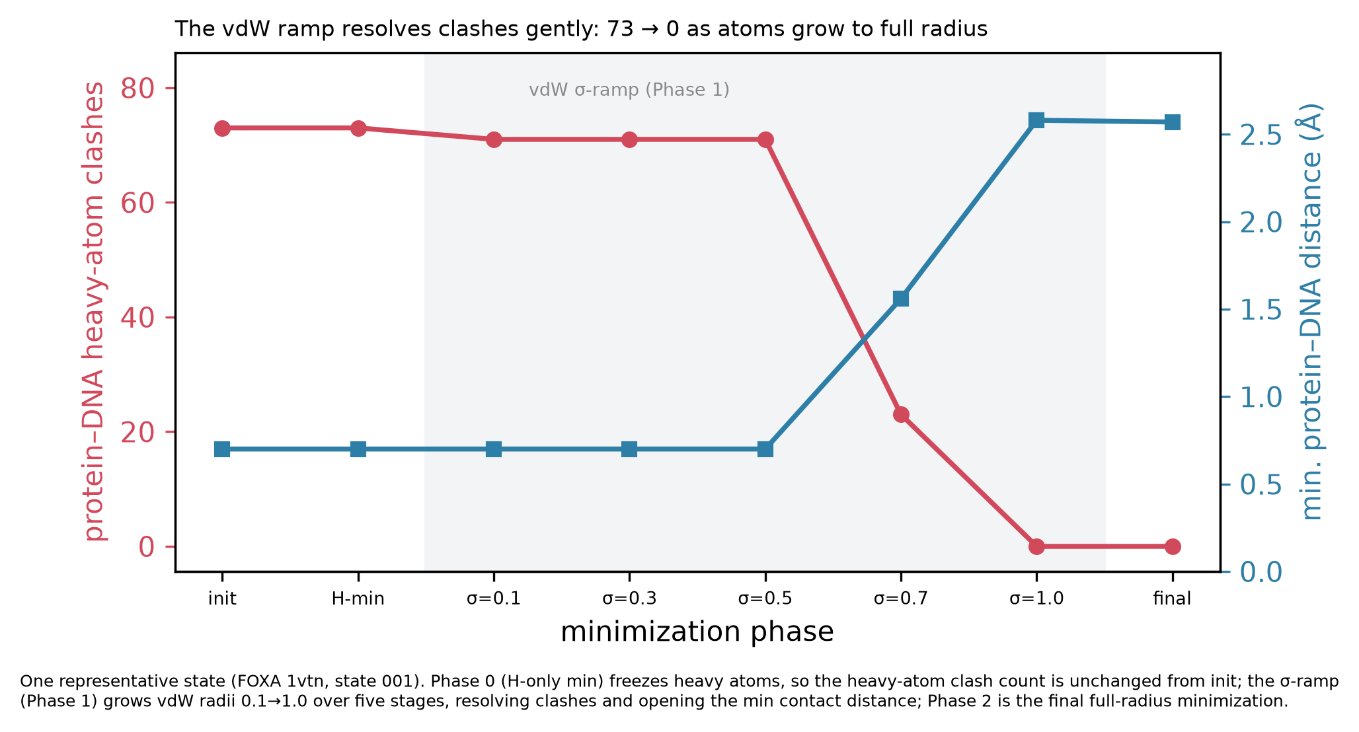
9.1 / 9.5 · The clash trajectory — clashes 73 → 0
• Clashes flat through Phase 0
– heavy atoms frozen → nothing moves yet
• Collapse happens at σ ≥ 0.5
– 73 → 0 as atoms 'swell' to full radius
• Min distance opens 0.7 → 2.6 Å
• This is the single best 'it worked' diagnostic per state
FOXA (1vtn) state 001. Red = protein–DNA heavy-atom clashes; blue = minimum protein–DNA distance. Phase 0 (H-min) freezes heavy atoms, so the clash count is unchanged from init; the σ-ramp (shaded, Phase 1) grows vdW radii 0.1→1.0, resolving clashes and opening the min contact distance; Phase 2 is the final full-radius minimization.
Notes:
This is the money figure for the stage — narrate it slowly, it appears again in 9.5.
Read the two curves. Red (left axis) is the protein–DNA clash count; blue (right axis) is the minimum contact distance. Follow left to right through the phases.
At 'init' and 'H-min' the clash count is flat at 73 — that's Phase 0, where every heavy atom is frozen, so of course the heavy-atom clashes can't change. Only hydrogens moved.
Then the vdW ramp (the shaded band). Nothing dramatic happens at σ = 0.1, 0.3, 0.5 — the atoms are still small. The collapse happens between σ = 0.5 and σ = 1.0: as the atoms grow back to full radius the minimization has room to slide them apart gently, and clashes fall 73 → 0 while the minimum distance opens from about 0.7 Å (essentially overlapping) to 2.6 Å (a clean contact).
The teaching point, which sets up 9.5: this gentle resolution is ONLY possible because we grew the atoms slowly. A single hard minimization at full radius on a 73-clash start would see enormous repulsive forces and diverge. This is FOXA state 001, one representative state — every state prints its own trajectory to the log.

Slide 8
9.2
The force field & solvent model
What 'downhill' means — and the one scientific caveat that originates here.
Notes:
Transition to the energy function. Two lines of code, but one of them is the source of a caveat that echoes all the way into Part III.

Slide 9
9.2 · Energy function (verbatim from the engine)
• ForceField("amber14-all.xml", "implicit/gbn2.xml")
– AMBER ff14SB for protein AND DNA; GB-Neck2 implicit solvent (water = continuous dielectric)
• nonbondedMethod = NoCutoff
– implicit solvent has no periodic box → all pairwise interactions computed exactly
• Constraints differ by phase:
– Phase 0 system: constraints = None · Phase 1/2 system: constraints = HBonds
• Platform: CUDA (mixed precision) if available, else CPU fallback — printed per run
• ⚠ The load-bearing caveat — GBSA over-compaction
– no explicit counter-ions → over-stabilizes close ion pairs → a charged protein–DNA interface can relax artificially compact
Notes:
Two lines of code define the whole energy landscape; read them off the slide.
ff14SB is the AMBER protein/nucleic force field — bonded springs, torsions, non-bonded electrostatics and van der Waals. GB-Neck2 is a generalized-Born implicit solvent: instead of thousands of explicit water molecules, water is a continuous dielectric. That's dramatically cheaper and standard for minimization. NoCutoff follows from implicit solvent — no periodic box, so every pairwise interaction is computed exactly rather than truncated.
A small but real detail: Phase 0's system is built with no constraints, while the Phase 1/2 system constrains H-bond lengths (HBonds). And the platform is CUDA with mixed precision when a GPU is present, CPU otherwise — worth recording because it affects reproducibility at the margins.
Now the caveat, and this is the one to emphasize because it resurfaces in Part III as a scientific limitation. GB-Neck2 has no explicit counter-ions. Without ions screening the charges, it tends to over-stabilize close ion pairs. At a protein–DNA interface — which is a dense stack of positive side chains against a negative backbone — that means the relaxed geometry can come out artificially compact. It's not a bug; it's a known property of implicit solvent, and it originates right here in the solvent-model choice. Flag it now so that when it comes back in the caveats chapter, the audience already knows where it came from.

Slide 10
9.3
Restraints: hold what you trust
Backbone pinned, side chains free — how you relax locally without losing global placement.
Notes:
Transition. We have an energy function that, left alone, would happily slide the protein off the DNA. Restraints are the leash.

Slide 11
9.3 · Restraints — the leash on minimization
• Without restraints, minimizing under GBSA can slide the whole protein OFF the DNA
– the energy minimum is not the bound pose — the docked backbone IS the frame's identity
• Harmonic positional restraint (a CustomExternalForce):
– 0.5 * k * ((x−x0)² + (y−y0)² + (z−z0)²)
• What is pinned:
– protein backbone (N, CA, C) + by default DNA backbone (P, C1′), at k = 10 kcal/mol/Å²
– reference = post-Phase-0 coords, which (heavy atoms frozen) equal the docked coords
• What is free: side chains + everything else — they carry recognition chemistry and must repack
• Net: relax LOCALLY (clashes, repacking) without losing GLOBAL placement
Notes:
Explain the restraint as a physical object first, then the specific choice.
A harmonic positional restraint is a virtual spring: the energy is one-half k times the squared displacement from a reference position x0. The stiffness k, in kcal per mole per angstrom squared, sets how hard it resists being moved. In the engine it's implemented as a CustomExternalForce with exactly that expression.
The design decision: pin the backbone, free the side chains. Protein backbone atoms N, CA, C — and by default the DNA backbone P and C1-prime — are restrained at k = 10. Side chains are left completely free. The reasoning is that the backbone IS the docked pose we trust from Stage 2; if you let it float, you throw away the specific conformer identity that the whole augmentation experiment is built on varying. But side chains carry much of the recognition chemistry and genuinely need to repack against their new DNA neighbor, so they must be free.
One implementation nuance: the reference positions are the post-Phase-0 coordinates. But since Phase 0 froze all heavy atoms, those heavy-atom coordinates are identical to the docked coordinates — so in effect the backbone is pinned to exactly where Stage 2 placed it.
The general principle, worth stating as the takeaway: restraints are how you relax locally without losing global placement. It's the mechanism that makes 'preserve the pose' physically enforceable.

Slide 12
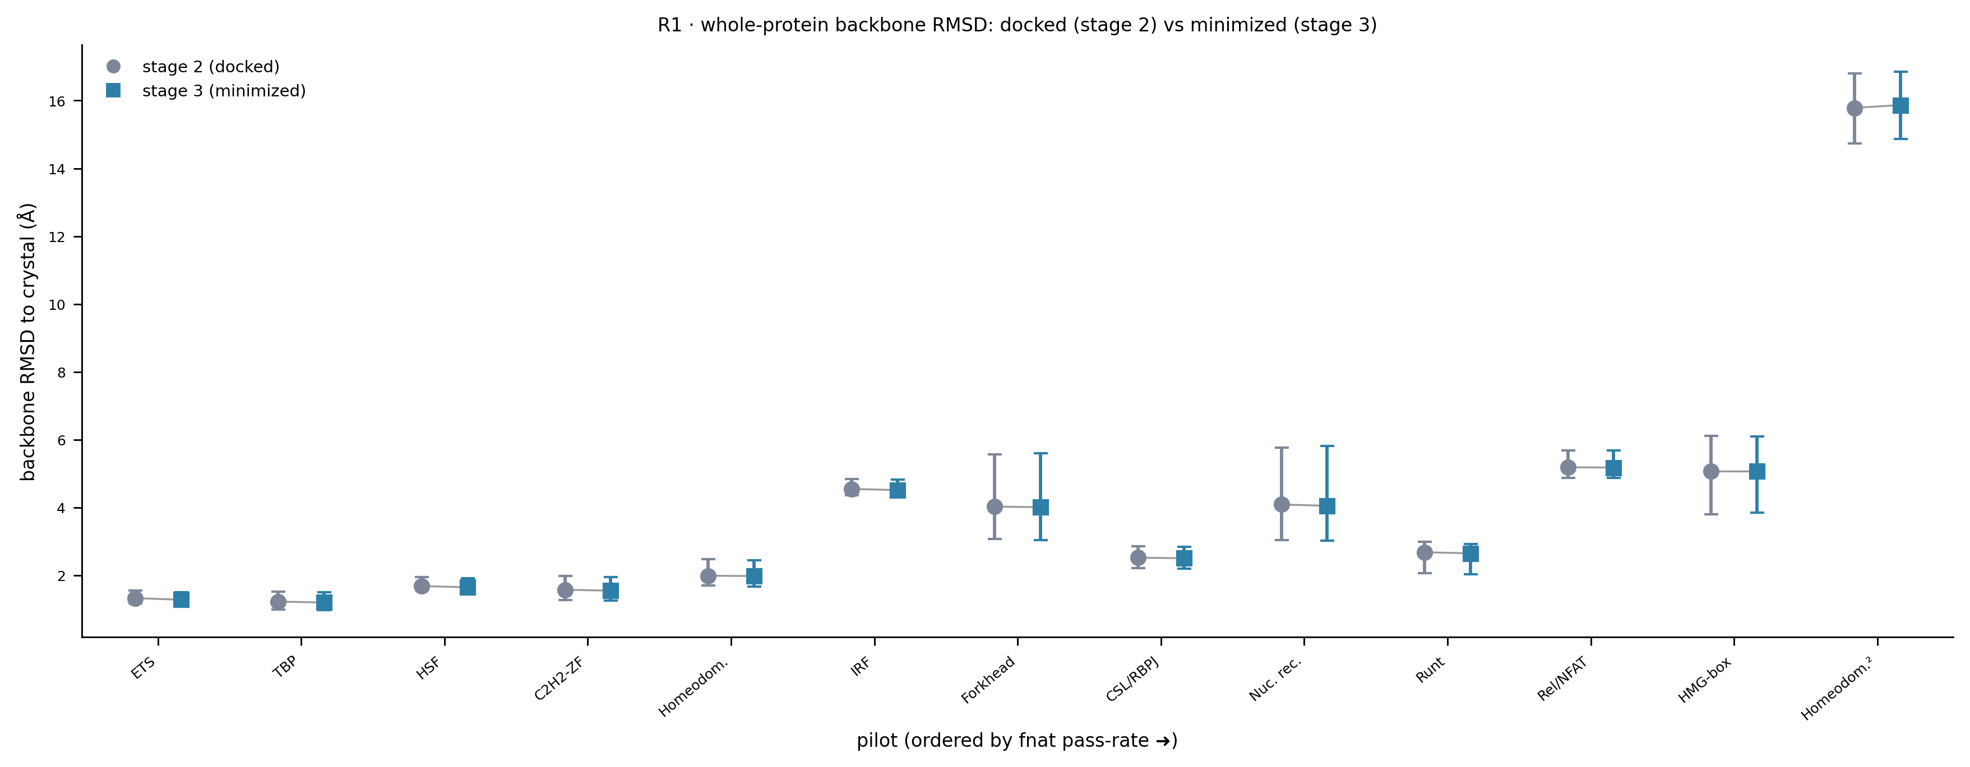
9.3 · Evidence the restraints hold — R1
Whole-protein backbone RMSD to crystal, docked (Stage 2, grey ●) vs minimized (Stage 3, teal ■), per pilot, ordered by fnat pass-rate. The two arms sit nearly on top of each other at every pilot — minimization barely moves the global backbone. (Backbone N,Cα,C,O used as the Cα proxy; the tandem homeodomain² at right sits at ~16 Å, the excluded dimer.)
Notes:
This figure is the receipt for 'preserve the pose.'
Each pilot has two markers: grey circle = the docked pose's backbone RMSD to the crystal, teal square = the minimized pose's. If minimization were dragging structures around, the two would separate. They don't — at every pilot the docked and minimized values are essentially identical, the markers overlap.
Note the x-axis ordering, which we'll reuse throughout Part IV: pilots are sorted by fnat pass-rate, which turns out to track recognition-module rigidity. ETS and TBP on the left are rigid and hug the crystal at ~1-1.5 Å; the floppier folds spread out to the right. The far-right outlier at ~16 Å is the tandem homeodomain (DUX4), the dimer that's excluded from the monomer benchmark.
The reason it's the backbone RMSD and not pure Cα: the per_state_rmsds table doesn't carry a pure-Cα column, so R1/R3 use backbone (N, CA, C, O) as the Cα proxy and label it as such.

Slide 13
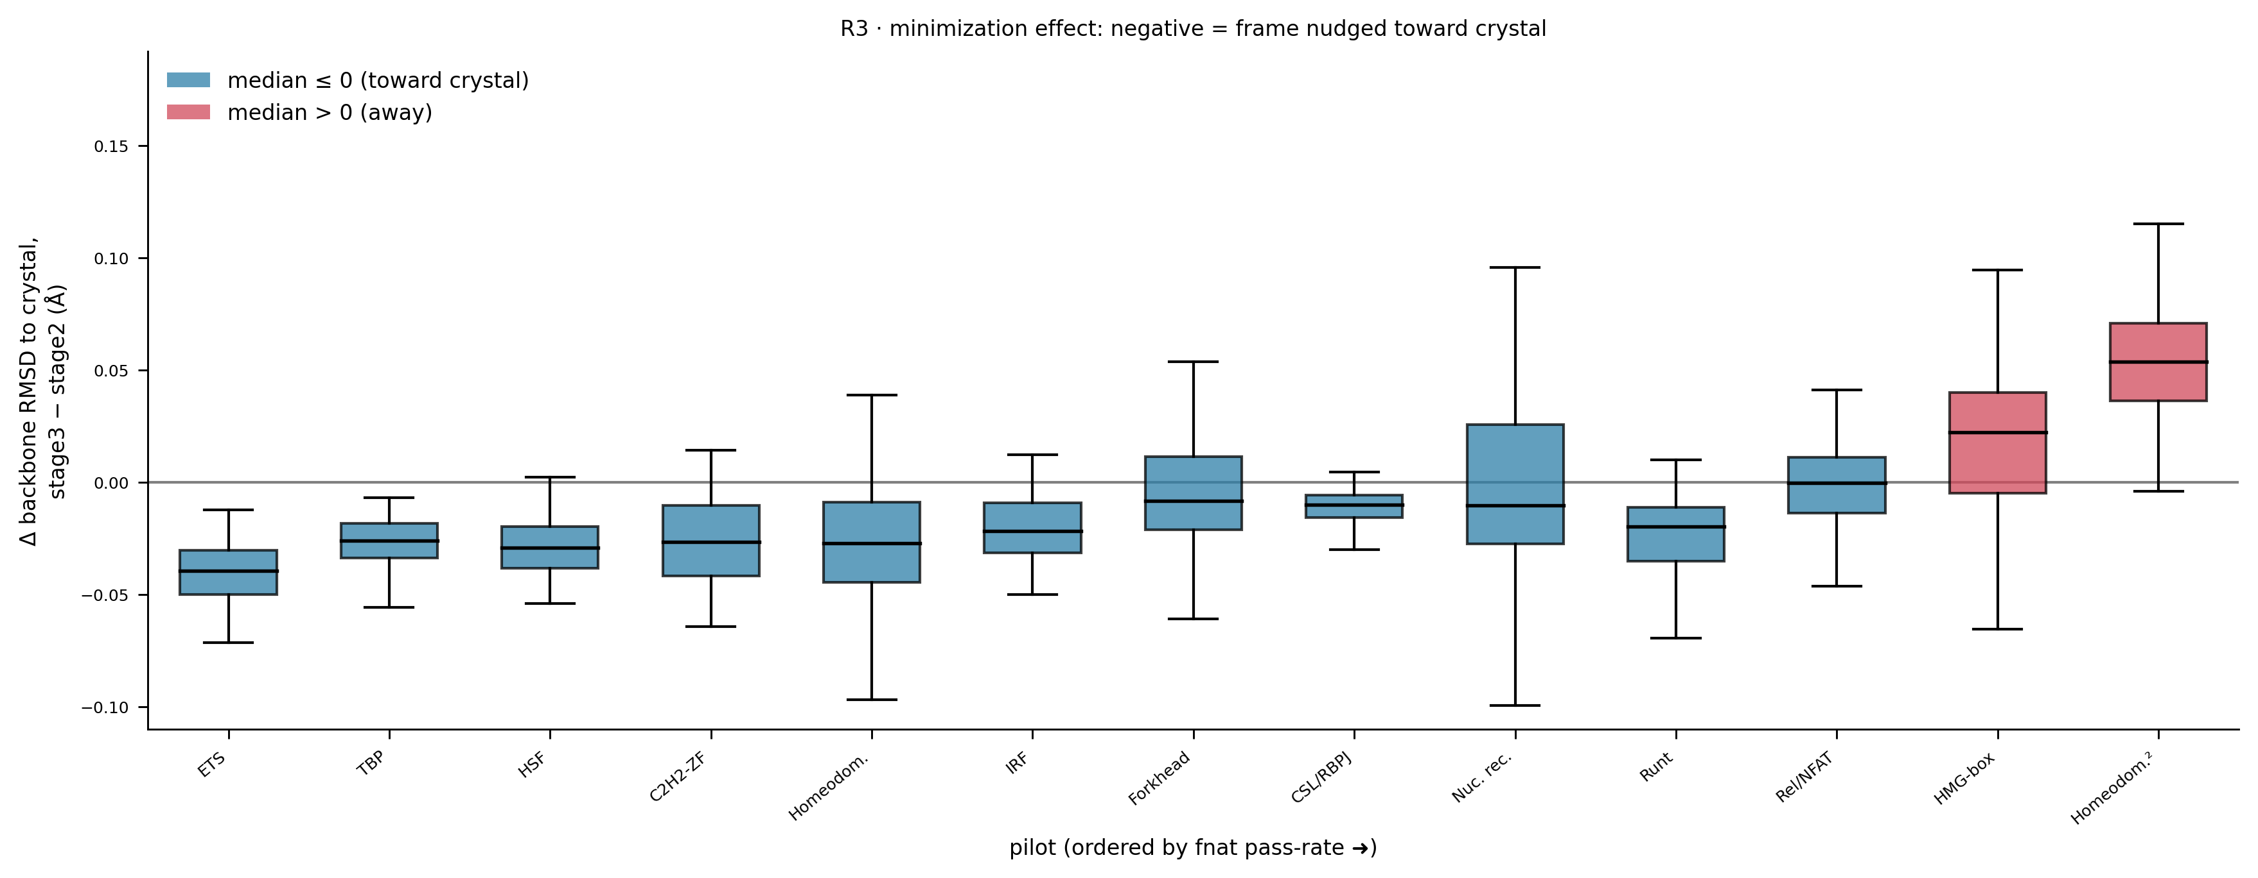
9.3 · Which direction does it nudge? — R3
Per-state signed change in backbone RMSD to crystal, Stage 3 − Stage 2. Negative (teal) = minimization nudged the frame TOWARD the crystal; positive (red) = away. Most pilots have a median ≤ 0. The two red boxes — HMG-box (LEF1) and the tandem homeodomain² — are the floppy folds where minimization can walk frames slightly off the bound pose.
Notes:
R1 showed the magnitude is tiny; R3 shows the DIRECTION of what little movement there is.
This plots the per-state change: Stage 3 minus Stage 2 backbone RMSD to crystal. Negative means the minimized frame ended up closer to the crystal than the docked frame was — minimization nudged it toward the bound truth. Teal boxes are median-negative, red boxes median-positive.
The headline: most pilots are teal — minimization is a local relaxation that, if anything, pulls marginally toward the crystal, never systematically away. That's the strongest possible evidence that the stage isn't corrupting the pose.
The two exceptions are honest and worth pointing at: HMG-box (LEF1) and the tandem homeodomain both go slightly positive. These are the floppiest folds — LEF1 has only a 19 percent fnat pass rate — and in those cases the unrestrained side chains and the softer core let a few frames drift a hair off the bound pose. It's a diagnostic flag: if a pilot's R3 median is clearly positive, minimization is walking frames off the pose and you should investigate before featurizing. For the rigid folds that carry the augmentation signal, it's firmly negative.

Slide 14
9.4
The metal-coordination cage
Many DBDs need a structural Zn²⁺ the force field can't describe. The trick: keep no metal in the system.
Notes:
This is the most novel piece of engineering in the stage and the part most worth teaching as a reusable pattern. Slow down here.

Slide 15
9.4 · The problem, and the trick
• Many DBDs depend on a STRUCTURAL Zn²⁺/Mg²⁺ (C2H2 zinc fingers, GATA, homeodomain-Zn)
– e.g. EGR1 / 1aay has three ZN in the crystal (chains D–F)
• Two problems collide:
– removeHeterogens strips ALL non-standard residues — silently including the metal
– ff14SB can't parameterize a bare metal ion anyway
– → do nothing and the coordination shell collapses into an unphysical apo-Zn fold
• The trick — keep NO metal in the simulated system:
– detect metals BEFORE stripping; record which side-chain atoms coordinate each
– then restrain the GEOMETRY the metal imposes — not the metal itself
Notes:
Set up the problem as a collision of two facts before revealing the trick.
Fact one: a large fraction of DNA-binding domains are held together by a structural metal — the classic case is the C2H2 zinc finger, where a Zn ion clamps together the beta-hairpin and the recognition helix. EGR1, our reference pilot, has three zinc ions in the crystal. Take the zinc away and the fold falls apart.
Fact two, the collision: the pipeline's cleanup step, removeHeterogens, strips every non-standard residue — and a metal ion is a non-standard residue, so it gets silently deleted. And even if you kept it, AMBER ff14SB has no parameters for a bare metal ion, so OpenMM couldn't simulate it anyway.
So a naive minimization of a zinc finger deletes the zinc and then relaxes the now-unsupported coordination shell into a collapsed, unphysical apo-zinc fold — and that wrong structure gets featurized.
The trick, which is genuinely elegant: you never put the metal in the simulated system at all. Instead, before stripping it, you look at where it was and which side-chain atoms were holding it. Then you freeze the GEOMETRY those atoms formed — the shape the metal imposed — using ordinary harmonic restraints. The metal's job was geometric; you replicate the geometry directly. Next slide has the exact recipe.

Slide 16
9.4 · The cage recipe (verbatim from the engine)
• 1. Detect — STRUCTURAL_METALS = {ZN, MG, MN, FE, CA, CO, NI, CU}, before removeHeterogens
• 2. Record the shell — ligand atoms within --metal-coord-cutoff = 3.0 Å of the metal
– ligand atoms: SG, ND1, NE2, OD1, OD2, OE1, OE2, OG, OG1, OH (Cys/His/Asp/Glu/Ser/Thr/Tyr)
– keep a cluster only if ≥ 2 ligands; recorded by (chain, residue, atom) to survive re-indexing
• 3. Cage it — one HarmonicBondForce; a bond between EVERY pair of coordinating atoms
– pinned at that pair's original separation, at k = 20 kcal/mol/Å² (--metal-cage-k)
• Diagnostics printed per run: # metals, # clusters, ligand lists, and CAGE DRIFT (mean/max Å)
• Off switch: --ignore-metals (config STAGE3_IGNORE_METALS=1) → the 'legacy' / cage-OFF arm
• Reusable pattern: for any cofactor a force field can't describe, restrain its imposed geometry
Notes:
This is the exact algorithm — read the parameters off the slide, they're all verbatim from the source.
Step 1, detection: the engine looks for eight structural metal elements, and crucially does this BEFORE removeHeterogens runs, because afterward the metal is gone.
Step 2, recording the shell: for each metal, it finds side-chain heavy atoms within 3.0 angstroms — that's the --metal-coord-cutoff. The candidate atoms are the usual metal ligands: cysteine sulfur, histidine nitrogens, the carboxylate and hydroxyl oxygens. It keeps a cluster only if at least two ligands coordinate the same metal — a single contact isn't a coordination shell. And it records each ligand by chain/residue/atom name, not by index, so the identification survives PDBFixer and Modeller renumbering the atoms.
Step 3, caging: it builds one HarmonicBondForce and adds a bond between every PAIR of coordinating atoms in a cluster — so a 4-ligand zinc site becomes six pairwise bonds — each pinned at the distance those atoms currently sit at, with stiffness k = 20. That's the answer to 'what k was the cage' — 20 kcal per mol per angstrom squared, the stiffest restraint in the whole stage, stiffer than the backbone's 10 and far stiffer than the DNA tether's 1.5.
It prints diagnostics: how many metals and clusters it found, the ligand list per cluster, and after minimization the cage drift — how far the pinned pairs moved. Low drift means the cage held.
You can turn it all off with --ignore-metals, which is the cage-OFF arm we test on the next slide. And the closing line is the transferable lesson: whenever a force field can't describe a cofactor, restrain the geometry the cofactor imposes rather than the cofactor itself.

Slide 17
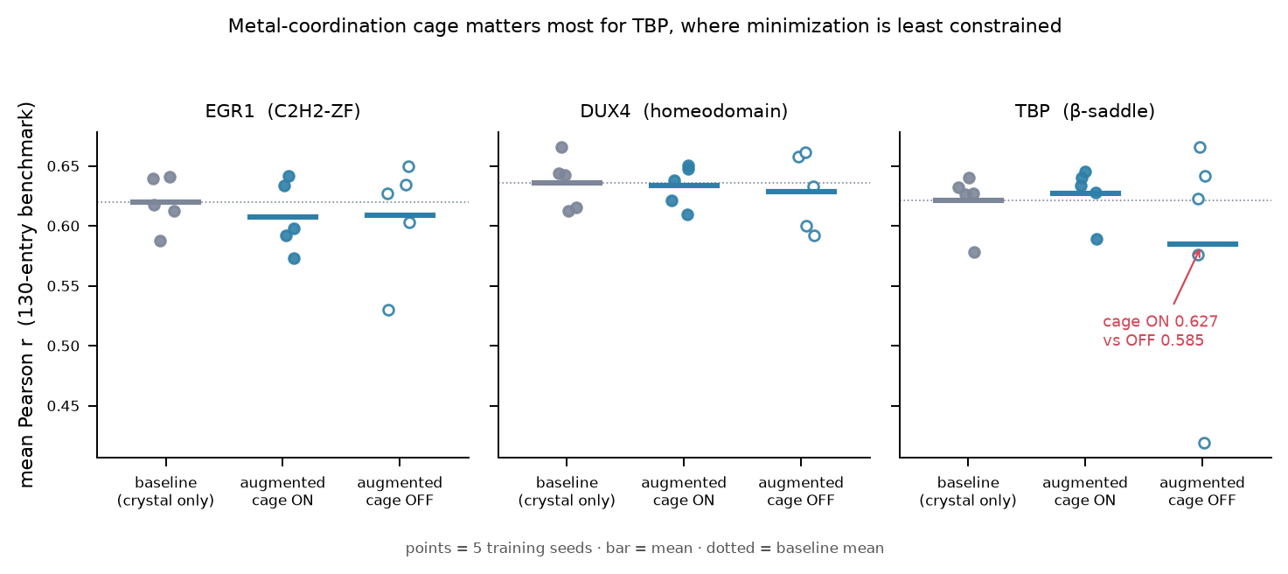
9.4 · Does the cage change the answer? — the A/B
Mean Pearson r on the 130-entry benchmark: baseline (crystal only) vs augmented cage-ON vs augmented cage-OFF, for three zinc/metal-relevant pilots. Points = 5 training seeds, bar = mean, dotted = baseline mean. The cage matters most for TBP, where minimization is otherwise least constrained: cage-ON augmented 0.627 vs cage-OFF 0.585. EGR1 and DUX4 are comparable ON vs OFF.
Notes:
The cage is a strong intervention, so the fair question — and this is a genuine result, not just a design story — is whether it actually moves the downstream prediction or is invisible to DeepPBS. This is the Chapter 19 A/B, previewed here at its source.
Three pilots, five training seeds each, three arms: baseline (crystal only), augmented with the cage ON, augmented with the cage OFF (via --ignore-metals). The dotted line is the baseline mean.
Read the three panels. EGR1 and DUX4: cage ON and cage OFF are basically comparable — the cage doesn't change much there. But TBP on the right is the clean signal: cage-ON augmented reaches 0.627, cage-OFF drops to 0.585, with the cage-OFF seeds scattering much lower.
The interpretation is the nice part: the cage matters MOST where minimization is otherwise LEAST constrained. TBP's beta-saddle sits on the DNA with relatively little else pinning it, so whether the coordination geometry is held or allowed to collapse has a visible downstream effect. In tightly-packed folds the rest of the structure constrains things anyway and the cage is redundant. So the cage isn't cosmetic — it's a measurable design decision, and this panel is its robustness receipt. One caveat for reproducibility: this A/B lives only in the May-2026 predecessor results tree.

Slide 18
9.5
The three-phase ramp
Why not just minimize once? Because a 73-clash start diverges under one hard minimization.
Notes:
Transition. We've referenced 'the ramp' repeatedly; now the full mechanism and the reason it's three phases, not one.

Slide 19
9.5 · Softening-then-growing (verbatim from the engine)
• Phase 0 — hydrogens only: freeze heavy atoms (mass=0), minimize H (≤ 2000 iters)
– fixes H placement before it can perturb the heavy-atom frame
• Phase 1 — vdW ramp: σ scaled 0.1 → 0.3 → 0.5 → 0.7 → 1.0, 500 iters each
– rescales each particle's σ on the NonbondedForce (charge & ε untouched)
– backbone + cage restraints active throughout; PE/clashes/min-dist printed per stage
• Phase 2 — final minimization at full vdW: ≤ 10,000 iters, then strip H & write
• Why gently? Overlapping atoms → enormous vdW repulsion → one hard min DIVERGES
• Failure handling: a failed ramp stage → sys.exit(2); a failed final → sys.exit(3)
– a hard-failing state writes NO output PDB → drops from the denominator (feeds the pass-rate spread)
Notes:
This slide is the mechanism behind the clash-trajectory figure from 9.1 — you can flip back to it if the audience wants the visual.
Phase 0: freeze every heavy atom by setting its mass to zero, and minimize only the newly-added hydrogens, up to 2000 iterations. This settles hydrogen placement without letting it nudge the heavy-atom frame we care about.
Phase 1 is the key move. It scales the van der Waals radius sigma of every atom through five values — 0.1, 0.3, 0.5, 0.7, 1.0 — running 500 minimization iterations at each. Implementation detail: it rescales sigma on the NonbondedForce, leaving charge and epsilon alone, and pushes the update into the running context. Backbone and cage restraints stay active the whole time. And it prints the energy, clash count, and min distance at each stage — that's the data behind the trajectory figure.
Phase 2: at full radius, a long final minimization up to 10,000 iterations, then strip the hydrogens and write the PDB.
Why bother with all this instead of one minimization? Because the start is clashy — 73 overlapping-atom pairs in our example — and overlapping atoms at full radius feel astronomically large repulsive forces. Hand that to a single hard minimization and it diverges numerically. Shrinking the atoms first makes those forces finite; growing them back slowly lets the clashes resolve smoothly. This softening-then-growing schedule is the standard soft-core trick.
Failure handling, which matters for the coverage numbers later: a stage that fails exits with code 2, a failed final with code 3. Either way that state produces no output PDB and simply drops out of the denominator downstream — which is part of why pass rates vary. The recovery path on the next figure catches those.

Slide 20
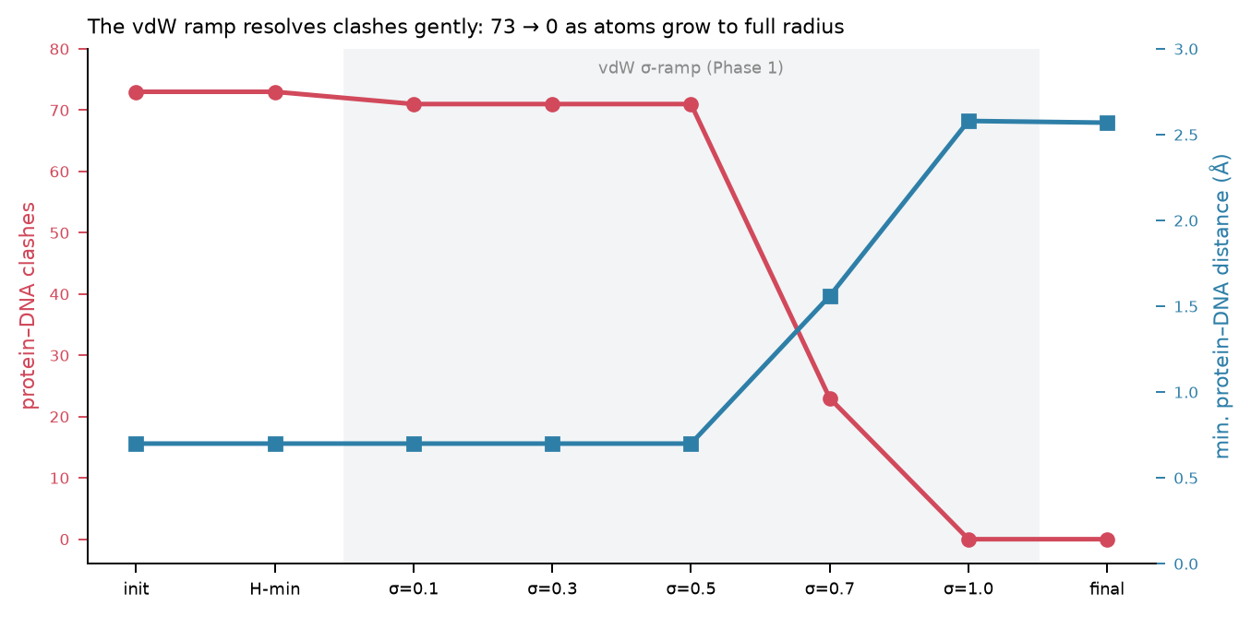
9.5 · The ramp in action — the same collapse, re-read
• σ ≤ 0.5: atoms too small to 'feel' each other → clashes flat
• σ 0.7 → 1.0: the resolution window
• Backbone + cage restraints on throughout
• Contrast: 1 hard min → numerical blow-up
The vdW σ-ramp view: clashes (red) hold flat while atoms are small (σ ≤ 0.5), then collapse to 0 as σ → 1.0, with the min protein–DNA distance (blue) opening in lockstep. The alternative — one hard minimization at full σ on this 73-clash start — diverges. The gentle descent is the whole point of Phase 1.
Notes:
This is the same physics as the 9.1 figure, framed explicitly as the ramp argument — use whichever of the two you prefer live; you don't need both if time is short.
The story in one sentence: while the atoms are shrunk down (sigma up to 0.5) they barely overlap in energy terms, so the clash count sits flat — the minimizer has nothing to push against. As sigma grows from 0.7 to 1.0, the atoms reach full size, the minimizer now feels the contacts and gently separates them, and clashes fall to zero while the minimum distance climbs to a clean 2.6 angstroms.
The counterfactual is the teaching point: if you skipped the ramp and ran one minimization at full sigma on this 73-clash start, the initial repulsive forces would be so large the integrator diverges. The ramp is not a nicety — it's what makes minimizing a docked pose possible at all.

Slide 21
9.5 · When a state fails — the gentler recovery ramp
• Failed states are re-run with a gentler, longer 6-stage ramp:
– RECOVERY_RAMP_STAGES = 0.05, 0.1, 0.2, 0.4, 0.7, 1.0 · RECOVERY_STEPS_PER_STAGE = 1000
– finer low-σ approach (starts at 0.05, adds 0.2 & 0.4 rungs) + double the iters per rung
• Two drivers:
– stage3_recover.sh — walks all N_FRAMES states SERIALLY in one job
– stage3_recover_array.sh — one SLURM array task per missing state (PARALLEL)
• Why the array version exists:
– the serial recover wall-clocked (4 h) on the DUX4 dimer — 7 stragglers × ~30 min each
• Both are idempotent + best-effort: a still-failing state logs loudly and exits 0
– → never blocks the downstream afterok gate
Notes:
This is a piece of hard-won operational knowledge that the outline never captured — it comes straight from reading the recovery scripts, and a successor will thank you for it.
When a state fails its normal ramp, it gets retried with a gentler recovery ramp: six stages instead of five, starting all the way down at sigma 0.05 and adding intermediate 0.2 and 0.4 rungs, with double the iterations — 1000 per rung. The finer, slower approach rescues states that the standard ramp couldn't settle.
There are two drivers for this, and the reason there are two is a real war story. The original stage3_recover.sh walks all N_FRAMES states serially in a single job. That's fine until several states each need the expensive gentle ramp — then the serial job hits its 4-hour wall clock and dies. That's exactly what stalled the DUX4 dimer: seven stragglers, each about 30 minutes on the gentle ramp, ran past the limit. The fix was stage3_recover_array.sh, which runs each missing state as its own SLURM array task, in parallel, so one slow state can't sink the batch.
Both are idempotent — they skip states that already succeeded — and both are best-effort: a state that STILL can't be minimized after recovery logs loudly and exits 0, on purpose, so that a single stuck state never blocks the downstream afterok dependency gate. The pipeline would rather train on 92 states than halt on 1.

Slide 22
9.6
DNA treatment: frozen vs relaxed
The single most consequential knob — it decides what the augmentation experiment even tests.
Notes:
This is the conceptual climax of the chapter. The DNA restraint stiffness is not just a parameter; it defines the scientific question. Give it room.

Slide 23
9.6 · The knob that defines the experiment
• DNA restraint stiffness decides what we are augmenting:
– stiff DNA → an ensemble of protein poses AROUND A FIXED binding site
– soft DNA → an ensemble of GENUINE BINDING MODES (protein + DNA co-adapt)
• Frozen (default, --dna-restraint-k omitted):
– protein + DNA backbone share ONE force at k = 10 — byte-for-byte the original behavior
• Relaxed (_dnarelax, --dna-restraint-k given):
– DNA split onto its OWN force (global param k_dna). k_dna=1.5 = soft tether; k_dna=0 = fully free
• Late release (--dna-release-stage 5): DNA held at protein k through ramp stages 1–4,
– dropped to k_dna=1.5 only for the last ramp rung + the final minimization (protein settles first)
Notes:
Frame this as the chapter's most important idea. Every other knob tunes HOW we minimize; this one decides WHAT the whole augmentation experiment is testing.
Here's the logic. If we hold the DNA rigid at its crystal pose while the protein relaxes around it, then our ensemble is 'many protein poses against one fixed binding site.' If instead we let the DNA deform too, the ensemble becomes 'genuine binding modes' where protein and DNA co-adapt. Those are two different scientific claims, and the DNA restraint stiffness is the dial between them.
Implementation, verbatim from the engine. Frozen is the default: protein and DNA backbone share ONE restraint force at k = 10 — this reproduces the original frozen-DNA pipeline exactly. The relaxed variant, triggered by passing --dna-restraint-k, splits the DNA onto its OWN separate force with its own global parameter k_dna. Two flavors: k_dna = 1.5 is a soft tether, k_dna = 0 releases the DNA entirely.
And the clever scheduling piece — late release. With --dna-release-stage 5, the DNA is held at the stiff protein k of 10 through ramp stages 1 through 4 — those are the violent clash-resolving stages, where you do NOT want the DNA thrashing around — and only dropped to the soft 1.5 at stage 5, the last ramp rung, plus the final minimization. So the protein settles against a held DNA first, then they co-relax gently at the end. Note that stage 5 IS the last of the five ramp stages, so the DNA effectively only relaxes for the final settling.

Slide 24
9.6 · The relaxed arm — config & why baselines don't compare
• The whole delta from tbp.sh → tbp_dnarelax.sh is two lines:
– source "${_here}/tbp.sh" # inherits TF_NAME, PDB_ID, chains, ramp, N_FRAMES, FOLD
– export STAGE3_DNA_RESTRAINT_K=1.5
– export STAGE3_DNA_RELEASE_STAGE=5
• TF_NAME stays 'tbp' → Stage 1 + Stage 2 are REUSED; common.sh appends _dnarelax to Stage 3+ paths
– launch: run_pilot.sh tbp_dnarelax 3 5 (start at stage 3 — stage 2 docked is shared)
• Two INDEPENDENT seed-paired experiments:
– frozen & relaxed each retrain their OWN baseline → absolute Pearson NOT comparable across them
– the only cross-treatment quantity is the within-pipeline, seed-matched ΔPearson
– figure convention: grey = baseline · teal = augmented·frozen · green = augmented·relaxed
Notes:
Two operational points here, both from the actual configs.
First, how cheap the relaxed arm is to set up: the entire difference between the frozen config and the relaxed config is two exported variables — the DNA restraint k of 1.5 and the release stage of 5. Because TF_NAME stays 'tbp,' the expensive upstream stages — the BioEmu ensemble in Stage 1 and the docked frames in Stage 2 — are reused as-is; common.sh just appends a _dnarelax suffix so Stage 3 and beyond write to a parallel tree without overwriting the frozen baseline. You launch it starting at stage 3.
Second, and this is a statistical trap to flag clearly: the frozen and relaxed pipelines each retrain their OWN baseline. That means you canNOT compare absolute Pearson values across the two pipelines — a 0.62 in the frozen experiment and a 0.62 in the relaxed experiment are not the same thing. The only legitimate cross-treatment quantity is the within-pipeline, seed-matched delta-Pearson: augmented minus baseline, seed by seed, within one pipeline. The figure color convention encodes this — grey baseline, teal augmented-frozen, green augmented-relaxed — and you should never subtract a teal from a green.

Slide 25
9.6 · Caveats on the relaxed variant
• k_dna = 1.5 is a deliberate stiffness FLOOR, not a principled value
– a floor against GBSA-driven B-DNA melting; the on-ramp to a Tier-2 cgDNA+ stiffness prior
– the principled per-sequence replacement is Ch. 20 — this flat number is the interim
• GBSA fraying risk is exactly why the floor exists
– releasing DNA toward k_dna=0 under implicit solvent (no counter-ions) risks the duplex fraying
• Coverage is partial — treat all DNA-relaxation results as directional / preliminary:
– 7 pilots have _dnarelax data · 2 trained · 1 evaluated (tbp_dnarelax, slightly worse than frozen tbp)
– eval JSONs confirm: 10 standard vs 9 _dnarelax (csl has no relaxed run)
• Validation tooling: stage3_minimize/validation/ (analyze_dna_relax.py, smoke tests, fnat rescore)
• Forward links: structural consequences → Ch. 18 · principled priors → Ch. 20
Notes:
Be honest about the limits — this is a book for successors, and overselling the relaxed variant would mislead them.
First, the 1.5 value. It is NOT a physically-derived stiffness. The config comment is explicit: it's a floor, chosen to keep the DNA from melting under GBSA — recall the implicit solvent has no counter-ions, so an unrestrained charged DNA backbone can literally come apart. 1.5 is stiff enough to prevent that while still letting the duplex deform toward the protein. It's also deliberately non-zero because that makes it the natural on-ramp to the Tier-2 plan in Chapter 20, a sequence-dependent cgDNA-plus stiffness prior. So it's a placeholder with a purpose, not a tuned optimum.
Second, coverage. This is the most important honesty point: the relaxed variant is early-stage. Seven pilots have the data, only two have trained models, and exactly one — tbp_dnarelax — has a benchmark evaluation, and that one is actually slightly WORSE than frozen TBP. The eval JSON counts confirm the asymmetry: ten standard benchmark files versus nine relaxed. So every DNA-relaxation result in this book is directional, not settled. The structural consequences — DNA bending toward the bound pose — are Chapter 18; the principled stiffness priors are Chapter 20. There's validation tooling in the validation subfolder if a successor wants to extend it.

Slide 26
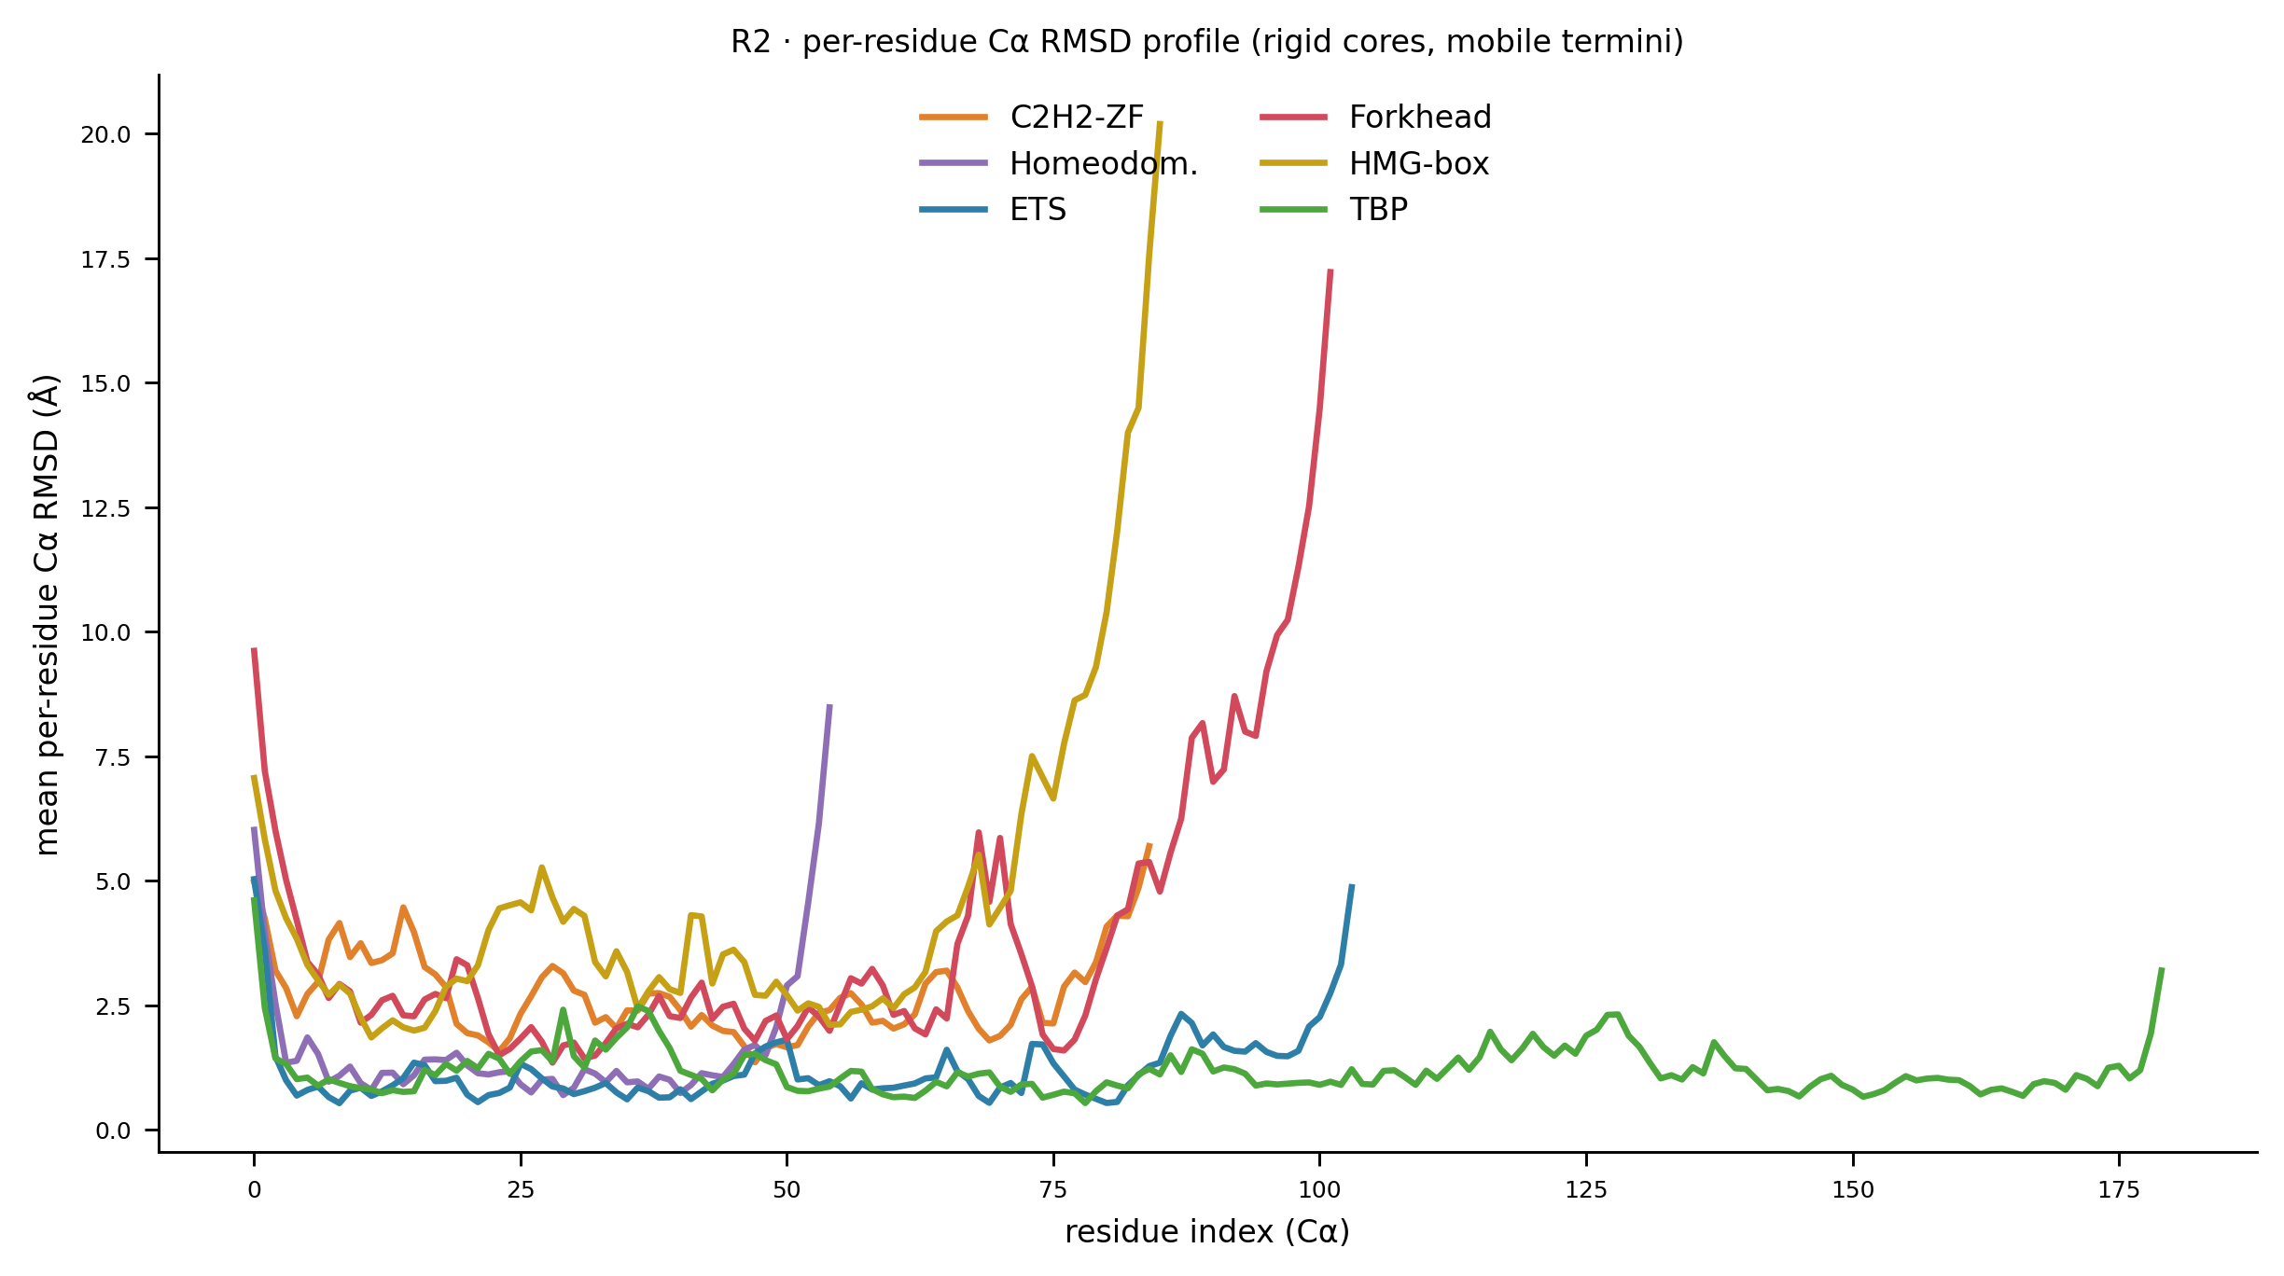
Bonus · Where the motion lives — R2 per-residue profile
Mean per-residue Cα RMSD to crystal, per pilot. The universal signature: rigid cores (low, flat interiors) with mobile termini (the spikes at chain ends). Minimization and the ensemble spread concentrate in the same floppy regions the rigidity ordering predicts — the interface cores that carry recognition are the parts that stay put.
Notes:
A bonus structural slide — include it if the audience is structurally-minded, skip it for time otherwise.
This is the per-residue breakdown of where the deviation from crystal actually lives. Each curve is one pilot's mean per-residue Cα RMSD. The universal pattern across every TF: the cores are rigid — low, flat — and the mobility is concentrated at the chain termini, the spikes.
Why it matters for this chapter: it confirms that minimization's local relaxation and the ensemble's conformational spread happen in the SAME places — the floppy termini — while the recognition-bearing interface cores stay put. That's reassuring, because it means the augmentation is varying the parts of the protein that are genuinely mobile, not scrambling the business end. It also foreshadows the rigidity axis that organizes all of Part IV.

Slide 27
What a green Stage-3 result looks like
• Clashes resolved — per-state log: heavy-atom clashes (<2.4 Å) hundreds → near-zero, min dist opens
• Pose preserved — R1: Stage2≈Stage3 backbone RMSD; R3: per-state median Δ ≤ 0 (toward crystal)
– a clearly positive R3 median = minimization walking frames OFF the pose → investigate
• Cage held — small mean/max cage drift; render shows intact coordination, not collapsed apo-Zn
• Reachability sanity — compute_reachability.py --source stage3 reproduces the anchors:
– ets1 d_min ≈ 0.87 · tbp d_min ≈ 0.59 · dux4 ≈ 10 Å (far-unreachable, 0 fnat survivors)
– the script prints a VALIDATION line — mismatch = wrong --source or broken correspondence
• Non-empty pass list into the fnat gate — an empty one exits non-zero & halts the DAG by design
Notes:
This is the successor's checklist — the five things to verify before trusting a pilot's minimized ensemble. Frame it as 'if you run this stage on a new TF, here's how you know it worked.'
One: clashes resolved — pull the per-state log and confirm the count fell from hundreds to near-zero, which the clash-trajectory figure visualizes.
Two: pose preserved — R1 shows the docked and minimized RMSDs coincide, and R3's per-state median is at or below zero. If R3 goes clearly positive for a pilot, that's your red flag that minimization is dragging frames off the bound pose.
Three: cage held — for any metal fold, check the printed cage drift is small and the coordination geometry renders intact rather than collapsed.
Four, and this is the strongest single sanity check: run compute_reachability with source stage3 and confirm it reproduces the known anchors — ETS1's closest approach to the crystal at about 0.87 angstroms, TBP at 0.59, and DUX4 far out at about 10 angstroms, which is why DUX4 has zero fnat survivors and never reaches training. The script literally prints a VALIDATION line against these; a mismatch tells you the correspondence broke or you used the wrong ensemble source.
Five: the pass list into the fnat gate is non-empty. An empty one is designed to exit non-zero and halt the whole DAG — fail-loud, so you never silently train on nothing.

Slide 28
Runbook · every engine flag with its true default
flag | default | controls
--restraint-k | 10.0 | protein backbone harmonic restraint (kcal/mol/Å²)
--dna-restraint-k | None → uses --restraint-k | DNA backbone split onto own k_dna force; 1.5 = tether, 0 = free
--dna-release-stage | None | 1-based ramp stage k_dna drops to target (needs --dna-restraint-k)
--metal-cage-k | 20.0 | coordination-cage HarmonicBondForce stiffness
--metal-coord-cutoff | 3.0 | Å within which a side-chain atom counts as coordinating
--ramp-stages | 0.1,0.3,0.5,0.7,1.0 | vdW σ soft-core ramp schedule
--steps-per-stage | 500 | minimization iters per ramp stage
--final-iterations | 10000 | Phase-2 final minimization iters
--ignore-metals | off | disable the cage (Ch.19 A/B 'cage-OFF' / legacy arm)
--scratch-dir | /scratch1/shewchuk/deeppbs_min_tmp | scratch workdir
Notes:
This is the reference table — you won't read it out, it's for the slides-as-document use. Point at the three that matter most and move on.
The three load-bearing knobs: metal-cage-k at 20 is the cage stiffness — that's the answer if anyone asks 'what k for the metal cage.' restraint-k at 10 is the backbone. dna-restraint-k defaults to None, meaning DNA rides the protein's 10; set it to 1.5 and you get the relaxed variant. Everything else is the default every standard pilot uses.

Slide 29
Runbook · config knobs, I/O, and the cluster
• Pilot-config knobs (<tf>.sh):
– RAMP_STAGES · STEPS_PER_STAGE · N_FRAMES (array size)
– RECOVERY_RAMP_STAGES=0.05,0.1,0.2,0.4,0.7,1.0 · RECOVERY_STEPS_PER_STAGE=1000
– relaxed: STAGE3_DNA_RESTRAINT_K / STAGE3_DNA_RELEASE_STAGE · cage-off: STAGE3_IGNORE_METALS=1
• I/O:
– in: output/stage2_docked/<tf>/<pdb>_state_NNN.pdb
– out: output/stage3_min[_dnarelax]/<tf>/<pdb>_state_NNN.pdb + <pdb>_fnat.csv
– variants tracked downstream: metal_cage (canonical) & legacy (cage-off) in per_state_rmsds.csv
• Cluster: endeavour · rohs / rohs_102 · --gres=gpu:rtx5000:1 · env = bioemu
– login-node gotcha: cap BLAS threads (OPENBLAS/OMP/MKL_NUM_THREADS=1) before login-node python
Notes:
The operational companion to the flag table — config variables, paths, cluster specifics.
Most Stage-3 behavior is set by exported variables in the pilot .sh: ramp schedule, per-stage steps, N_FRAMES for array size, the recovery ramp. The relaxed and cage-off arms are pure config opt-ins — no code changes.
I/O: reads docked states from stage2_docked, writes to stage3_min (or _dnarelax), plus the fnat CSV. Downstream the RMSD analysis tracks metal_cage vs legacy variants so the cage's structural effect stays auditable.
Cluster: endeavour, rohs partition, rohs_102, rtx5000 GPU, bioemu env — that's where OpenMM/PDBFixer live. The gotcha that bites successors: cap BLAS threads to 1 before any login-node numpy import or it fails against the process cap.

Slide 30
Coverage — 13 pilots discovered on disk
• csl · dux4 · egr1 · engrailed · err · ets1 · foxa · hsf · irf · lef1 · nfat · runx · tbp
• Structural fidelity (R1/R2/R3, reachability): all 13
– dux4 has 0 fnat survivors — the excluded dimer, shown as the 0% reference
• Benchmark accuracy (baseline vs augmented): 12 pilots (all but dux4 — no eval)
• DNA-relaxed Stage-3 output: 7 pilots have data · 2 trained · 1 evaluated
– tbp_dnarelax — itself slightly worse than frozen tbp; the relaxation story is directional
Notes:
The honest coverage picture — what exists versus what's still to do.
Thirteen pilots discovered. Structural fidelity covers all thirteen, including DUX4 as the zero-percent reference (excluded dimer, no fnat survivors). Benchmark accuracy covers twelve — all but DUX4. The DNA-relaxed variant is the frontier: seven have data, two are trained, one is evaluated. The frozen pipeline is mature; the relaxed one is an early, promising extension.

Slide 31
Chapter 9 in one slide
• Stage 3 relaxes docked strain WITHOUT losing the bound pose — 'relax the strain, preserve the pose'
• Force field: ff14SB + GB-Neck2 implicit solvent (→ the over-compaction caveat)
• Restraints: backbone pinned at k=10, side chains free → local relaxation, global placement held
• Metal cage: restrain the geometry, not the ion — pairwise bonds at k=20, no metal in the system
• Three-phase ramp: H-only → vdW σ 0.1→1.0 → final; gentle where one hard min diverges
• DNA knob: frozen (k=10) vs relaxed (k_dna=1.5, late release) — defines what augmentation tests
• All verified against stage3_minimize.py; engine + wrappers saved as reference artifacts
Notes:
The recap — hit the six load-bearing facts and land the closing point.
Contract: relax-the-strain-preserve-the-pose. Force field ff14SB + GB-Neck2, whose missing counter-ions cause the over-compaction caveat. Restraints pin the backbone at 10 and free side chains. The metal cage restrains coordination geometry at 20 rather than simulating an unparameterizable ion. The three-phase ramp resolves clashes gently where one hard minimization diverges. And the DNA stiffness — 10 frozen vs 1.5 relaxed with late release — is the knob that defines what augmentation tests.
Close on provenance: everything here is verified against the actual 409-line stage3_minimize.py from endeavour, saved as reference artifacts alongside the slides. Ground truth, not paraphrase.

