Slide 1
TF-conformation project · complete figure deck
Augmenting DeepPBS with BioEmu conformational ensembles
Every figure across the pipeline and results, grounded in the endeavour cluster output. Structural fidelity → featurization → training → the augmentation effect → the dynamic-DNA mechanism → DNA relaxation. All values verified against pipeline code and analysis data; the mechanism story is the revised one (dynamic fluctuation, not static deformation).

Slide 2
Chapters 9 & 15
Structural fidelity: are the minimized ensembles usable?
Before any augmentation claim — do the docked+minimized states preserve the bound complex?

Slide 3
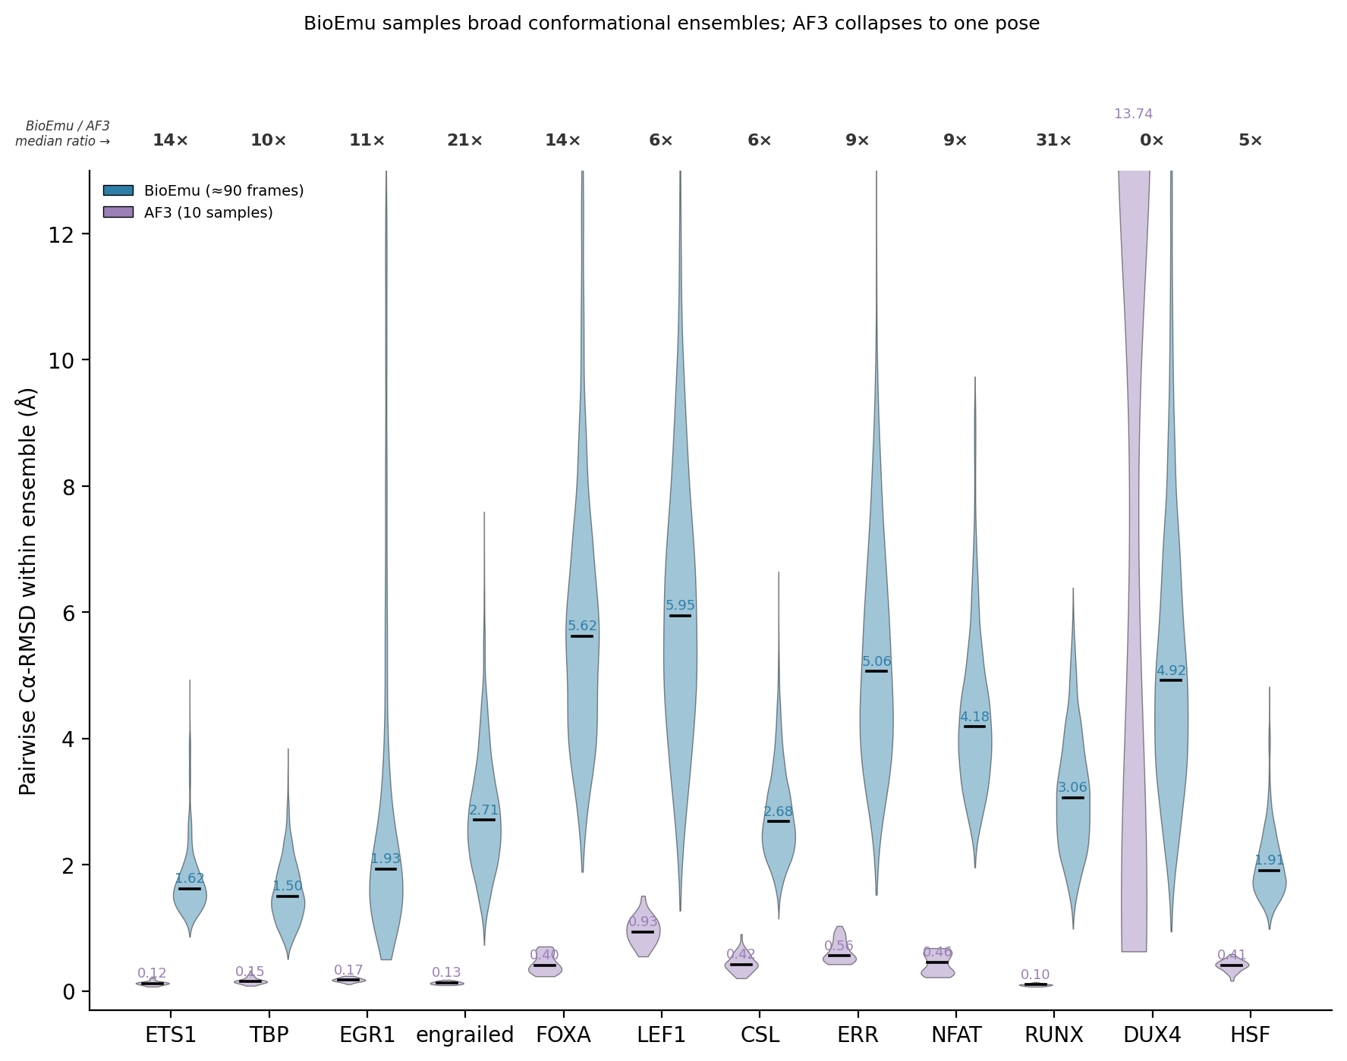
BioEmu samples broad ensembles; AF3 collapses to one pose
D1_diversity · BioEmu ≈90 frames vs AF3 10 samples, within-ensemble Cα-RMSD
Notes:
This is the motivation for the whole approach. Each violin is the distribution of pairwise Cα-RMSD WITHIN a TF's structural ensemble — how much conformational spread the method produces.
BioEmu (teal) generates genuinely diverse ensembles: median internal spread of 1.5-6 Angstrom depending on the TF, and the ratio annotations at top show BioEmu's spread is 5x to 31x AF3's for every pilot. AF3 (purple), run with 10 samples, collapses to essentially one pose — its samples are 0.1-0.9 Angstrom apart.
The point: if you want to feed a model MULTIPLE physically distinct views of a complex, AF3 can't give them to you — it produces the same structure every time. BioEmu can. That is what makes the augmentation experiment possible at all. The floppy TFs (FOXA, LEF1) show the widest ensembles, the rigid ones (ETS1, EGR1) the tightest — which foreshadows the rigidity ordering used throughout.

Slide 4
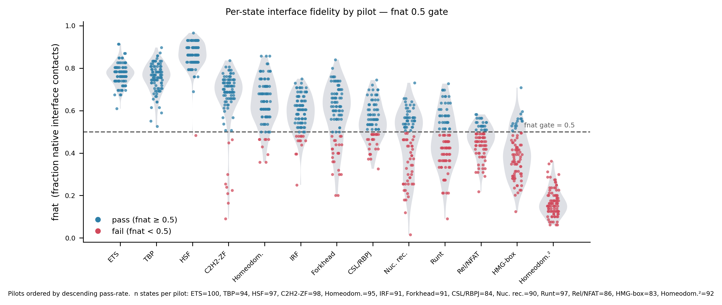
Per-state interface fidelity by pilot — the fnat gate
F1 · per-state fnat, 0.5 gate, pilots ordered by pass rate
Notes:
This is the quality filter that governs which structures ever reach training. fnat is the fraction of native protein-DNA contacts a docked+minimized state recovers; the dashed line is the 0.5 gate.
Pilots are ordered by pass rate. The rigid recognizers — ETS, TBP, HSF — sit almost entirely above the gate: nearly every sampled state is interface-faithful. As you move right to the floppy families (Rel/NFAT, HMG-box, the tandem homeodomain) the distributions slide below the gate and most states fail.
This single ordering — which TF keeps its interface under sampling+minimization — turns out to organize almost every downstream result. It is the physical meaning behind what later slides call the rigidity axis: a TF whose recognition module is conformationally rigid docks and minimizes to faithful interfaces, and it is also the one where adding ensemble views helps.

Slide 5
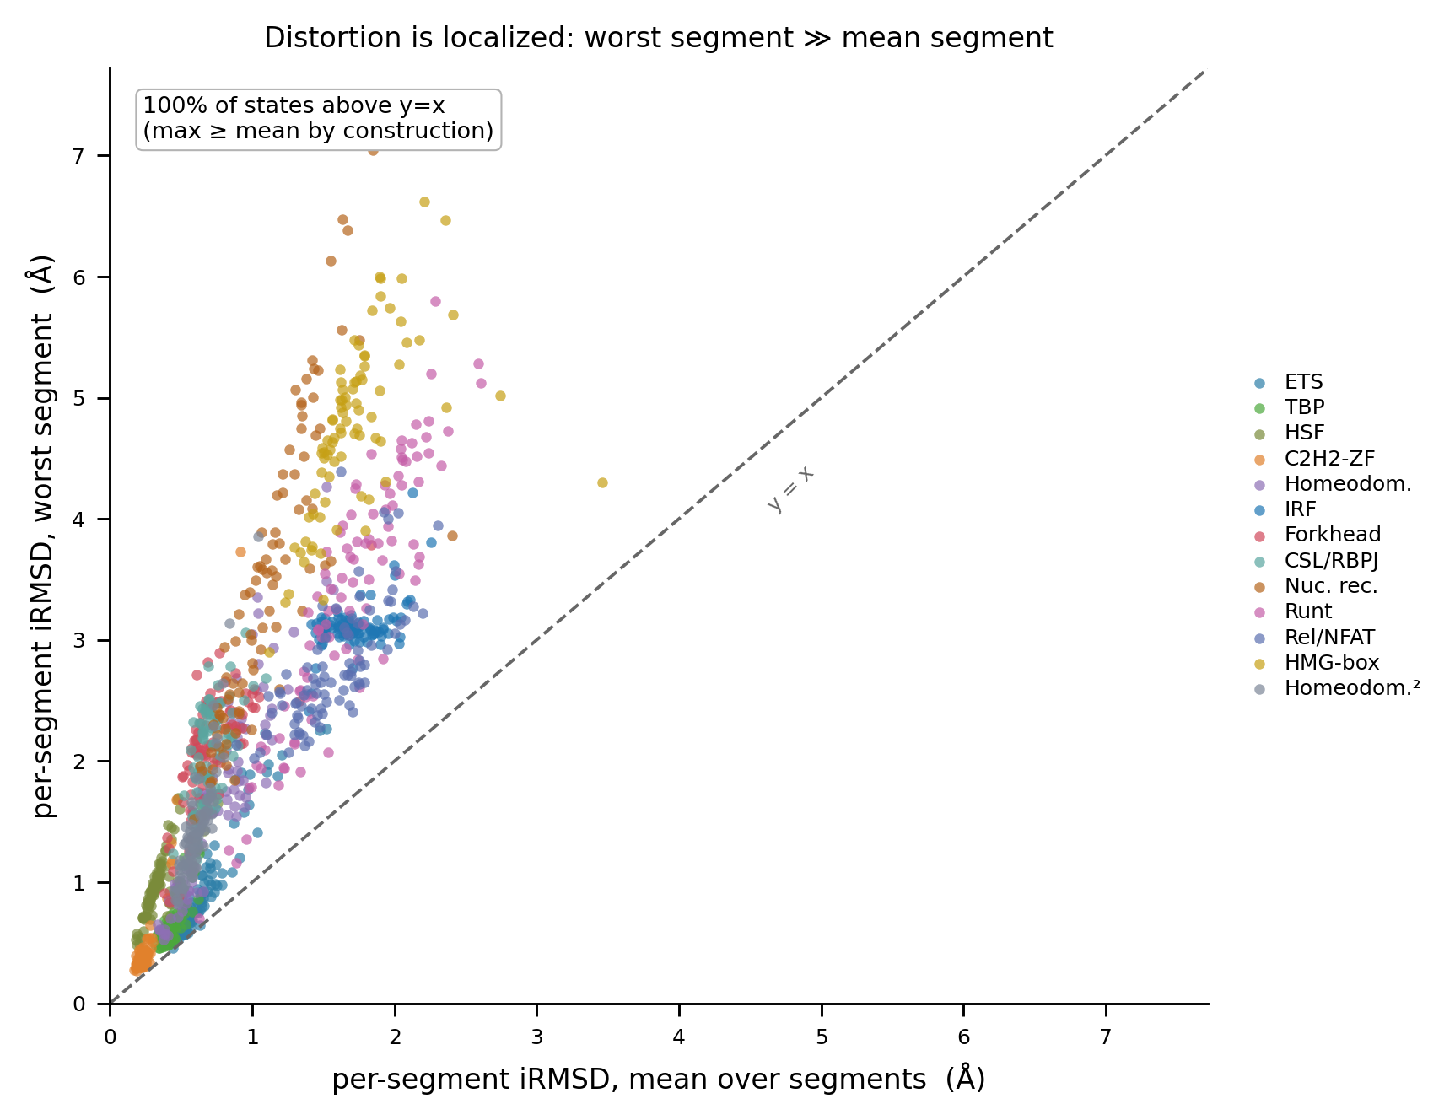
Distortion is localized: worst segment >> mean segment
I2 · per-segment interface RMSD, worst vs mean, colored by family
Notes:
This addresses a natural worry: when the interface RMSD is elevated, is the whole interface bad, or just one patch. Every point is one state: x is its mean per-segment interface RMSD, y is its worst single segment.
All points sit above the diagonal (trivially — the max is at least the mean), but the KEY is how FAR above: worst segments reach 5-7 Angstrom while the means stay 1-2. So distortion is localized — a state typically has most of its interface well-formed and one bad segment, rather than uniform mush. That matters because DeepPBS reads local DNA-shape features; a locally-bad segment corrupts only its own features, not the whole prediction.

Slide 6
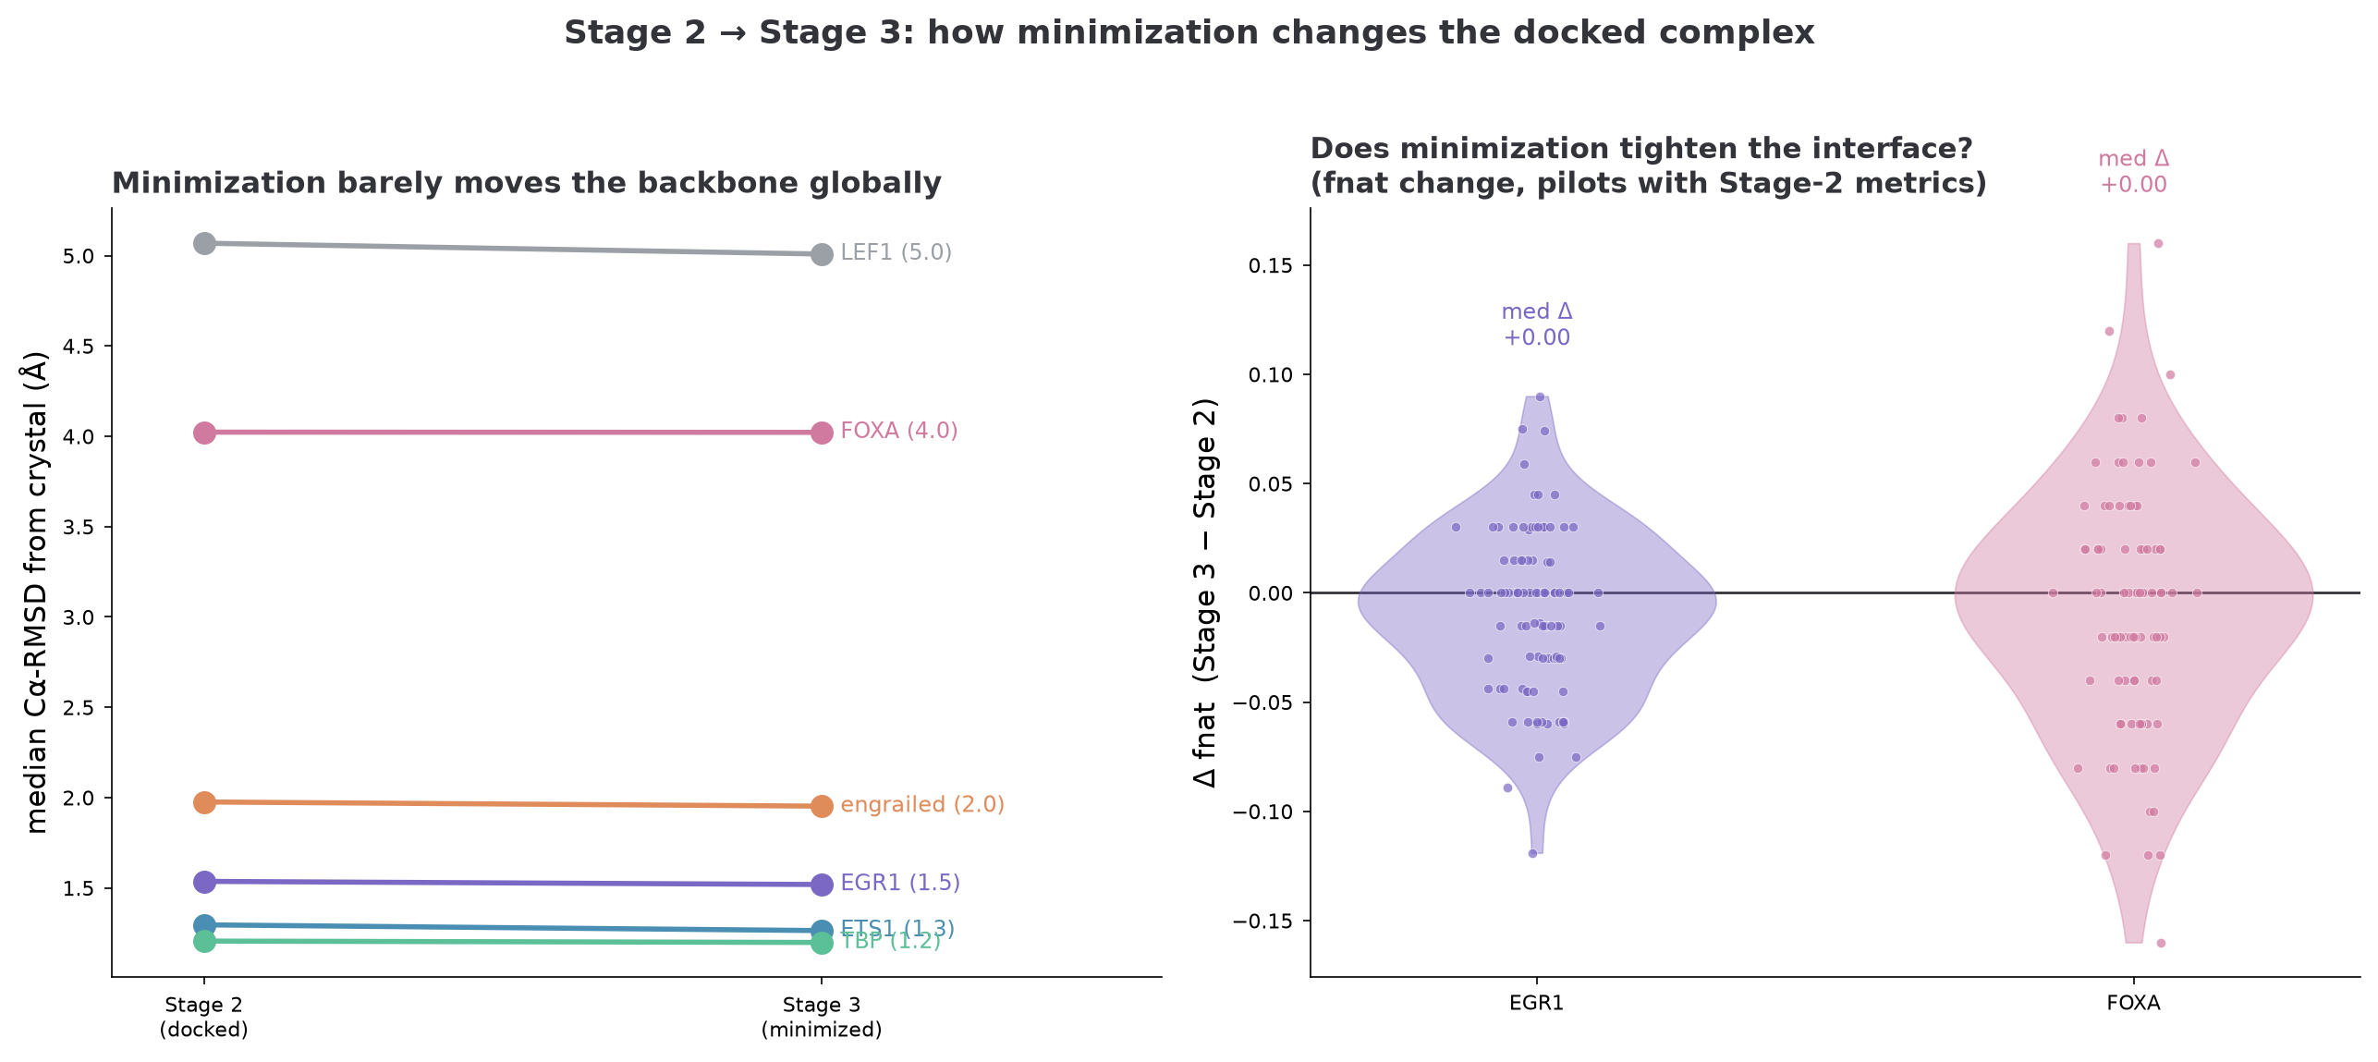
Minimization barely moves the backbone, and nudges toward crystal
I3 · Stage-2 vs Stage-3, global backbone and interface fnat change
Notes:
Two panels answering 'what does the minimization stage actually do to the docked complex.' Left: median backbone Cα-RMSD from crystal, docked (Stage 2) vs minimized (Stage 3) — the two columns are nearly identical for every pilot. Minimization does NOT globally rearrange the structure; it preserves the docked pose, which is exactly the design contract.
Right: does minimization tighten the interface? The per-state fnat change is centered essentially at zero (median +0.00 for both EGR1 and FOXA shown). So minimization is a local strain-relief operation — it resolves clashes without either rescuing bad interfaces or damaging good ones. This is the evidence that the fnat gate can be applied AFTER minimization and still mean what it says.

Slide 7
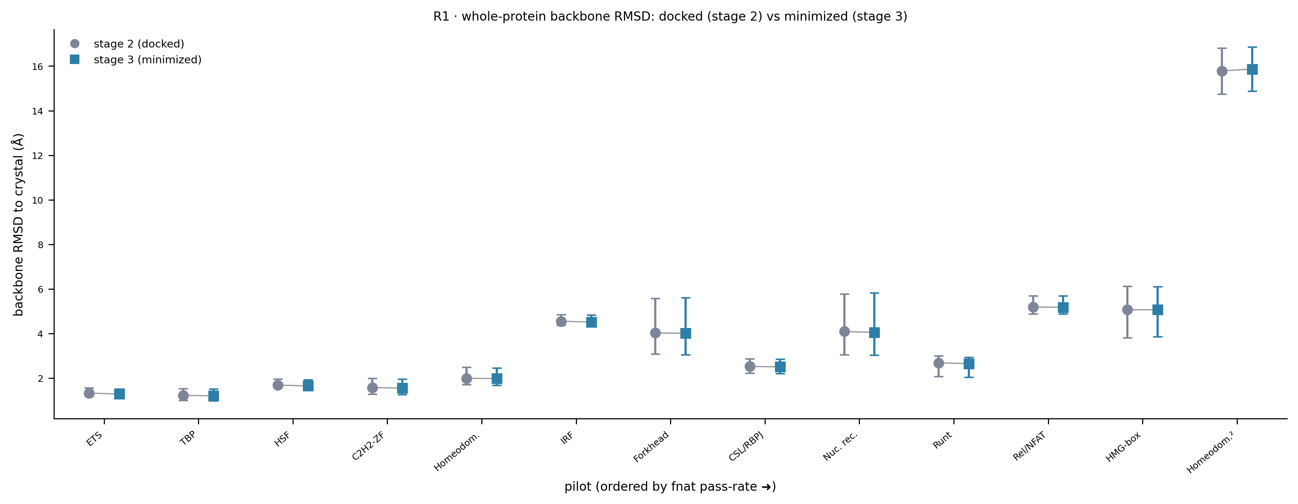
Whole-protein backbone RMSD: docked vs minimized, pose preserved
R1 · whole-protein backbone RMSD to crystal, Stage 2 vs Stage 3
Notes:
Backbone RMSD to crystal, docked (grey) vs minimized (teal), per pilot in rigidity order. The two markers sit on top of each other at every pilot — minimization barely moves the global backbone, confirming 'preserve the pose' at the whole-protein level. The tandem homeodomain at far right (~16 Angstrom) is the excluded dimer.

Slide 8
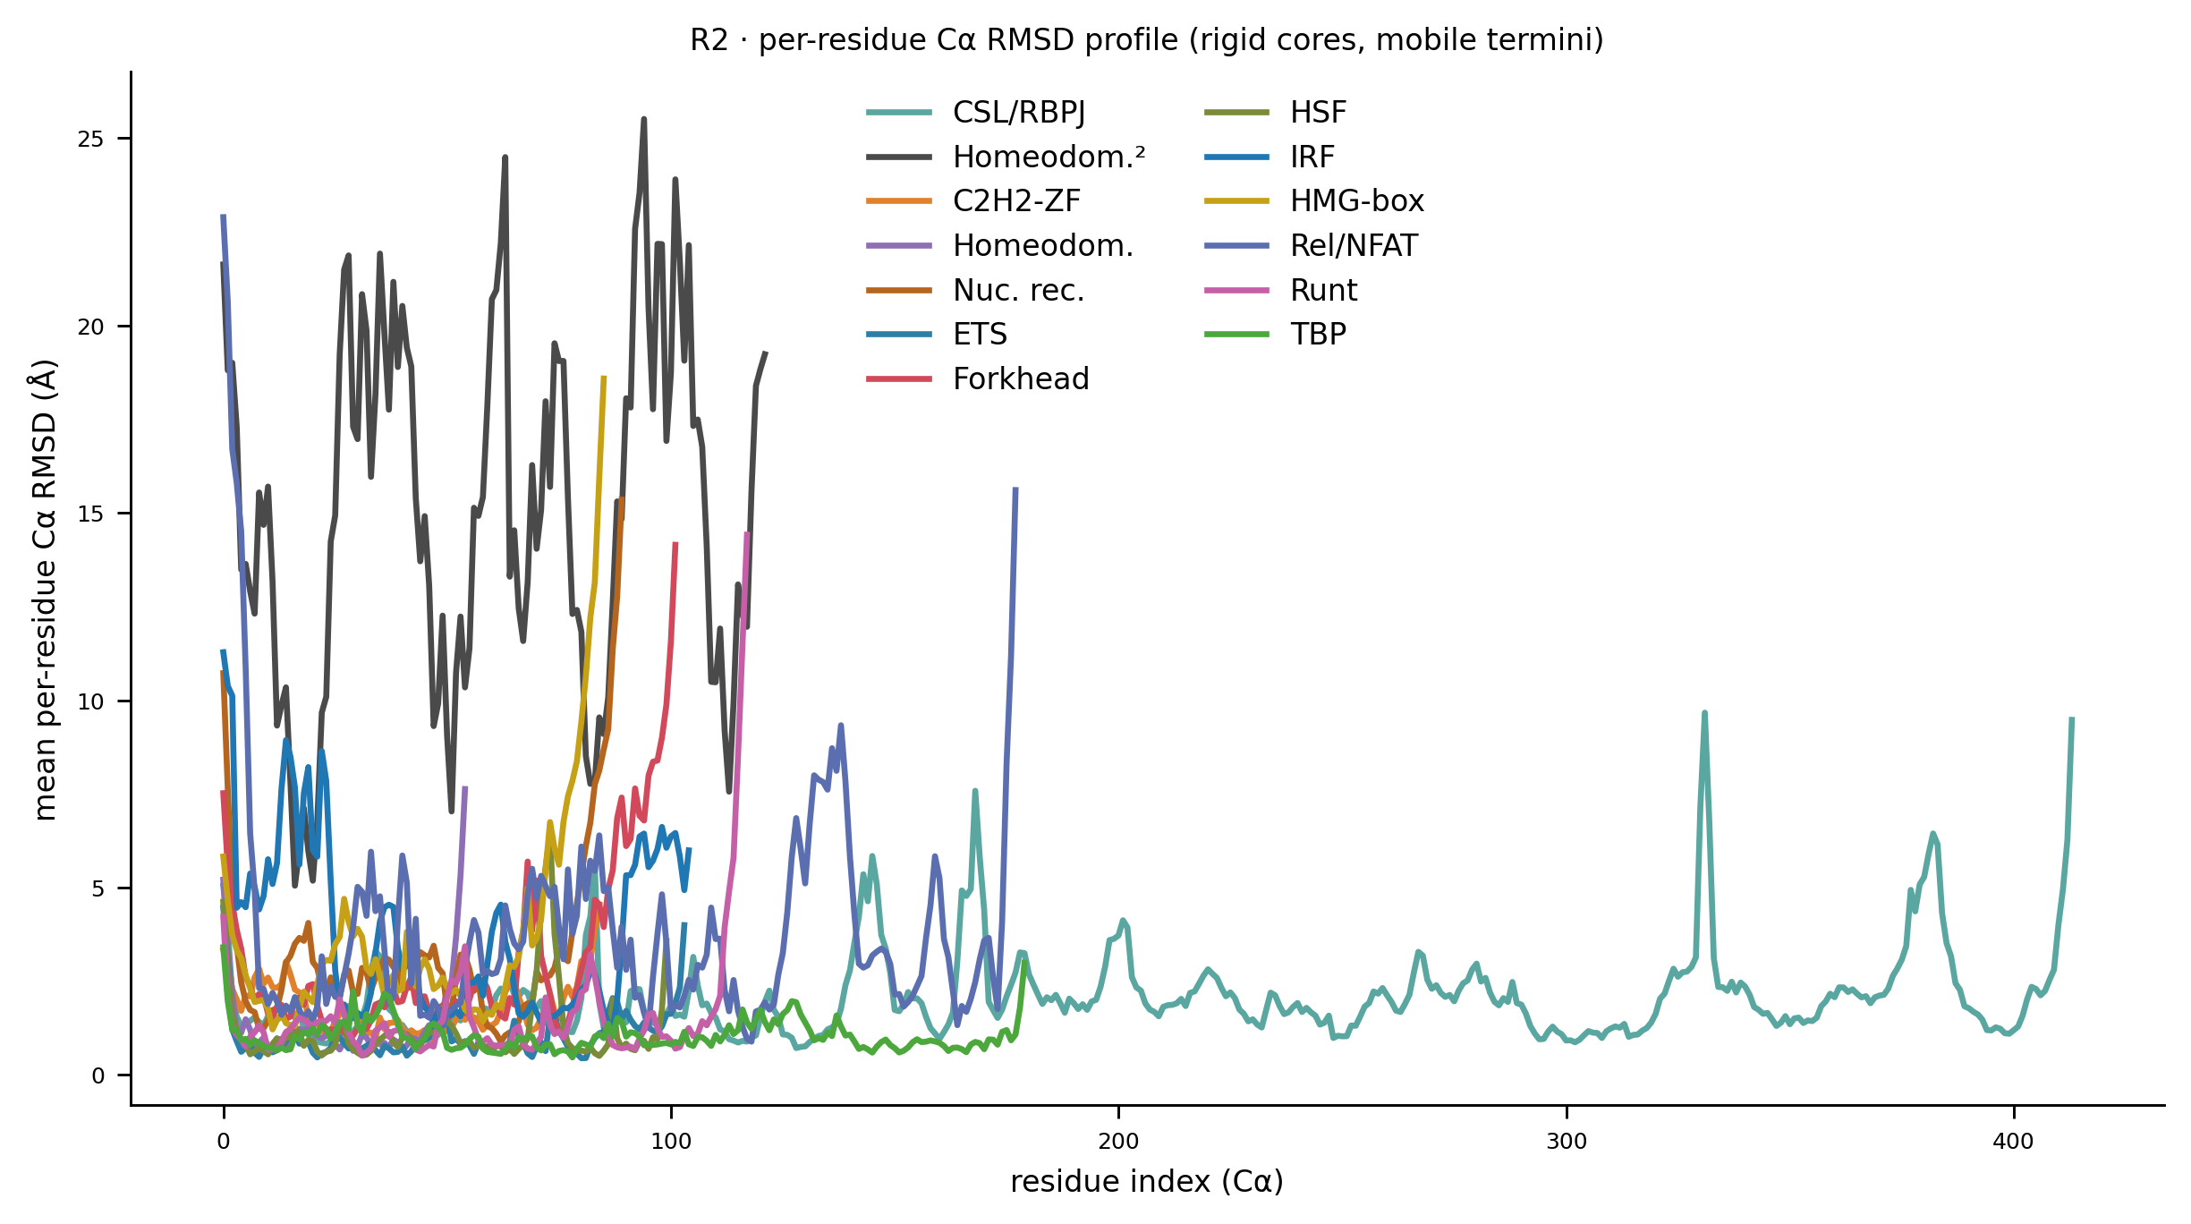
Rigid cores, mobile termini: per-residue RMSD profile
R2 · per-residue Cα RMSD, by family
Notes:
Mean per-residue Cα RMSD along the sequence, one line per family. The recognition cores stay low (1-2 Angstrom) while the termini and inter-domain linkers spike (10-25 Angstrom). This is the structural basis of the whole story: the DNA-reading module is rigid and faithful; the flexible parts that swing around are outside the interface DeepPBS reads. The tandem homeodomain (dark line) is elevated throughout — it's the outlier dimer.

Slide 9
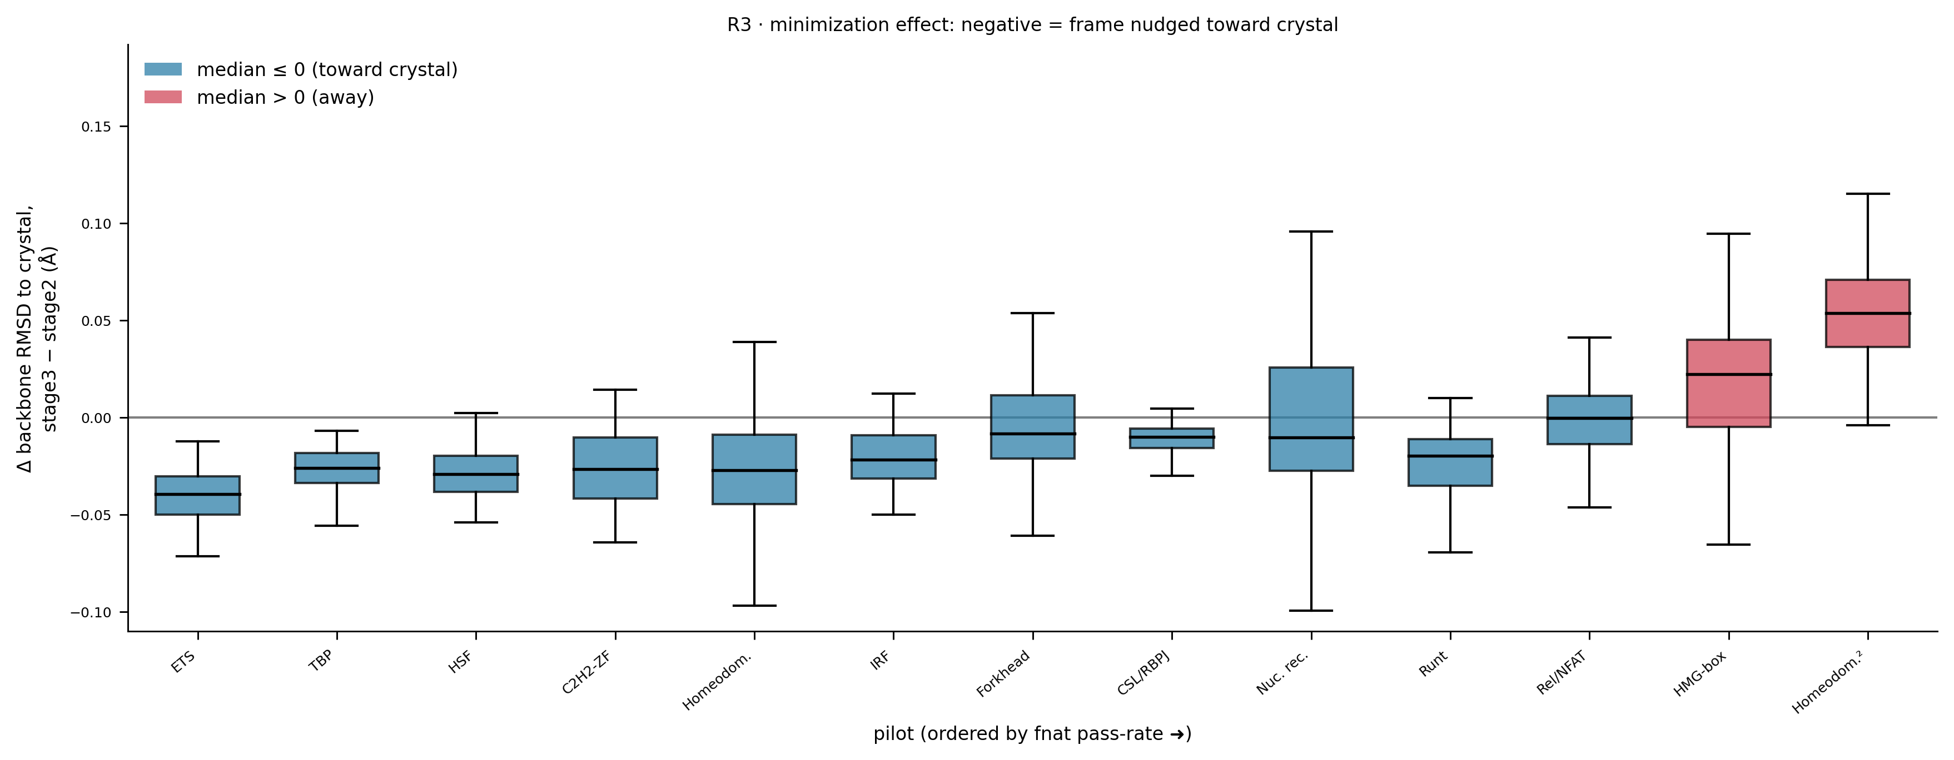
Minimization effect: most families nudge toward crystal
R3 · per-state minimization delta to crystal, by family
Notes:
Per-state change in backbone RMSD to crystal, Stage 3 minus Stage 2, by family. Blue = median at or below zero (minimization moved the frame TOWARD the crystal); red = away. Most families are blue — the physics relaxation makes structures modestly more crystal-like. The two exceptions are HMG-box and the tandem homeodomain (red): severely bent-DNA binders whose minimization, without the bending partner fully modeled, drifts slightly away. An honest, interpretable split.

Slide 10
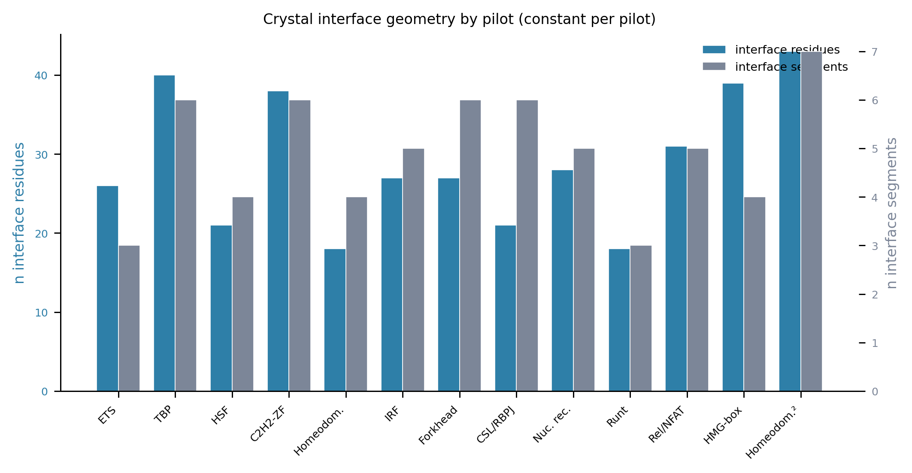
Interface geometry is preserved across minimization
I4 · interface geometry, Stage 2 vs Stage 3
Notes:
Interface geometric descriptors before vs after minimization. The interface contact geometry is retained through the relaxation — points cluster on the identity line — reinforcing that Stage 3 relieves strain without remodeling the protein-DNA contact.

Slide 11
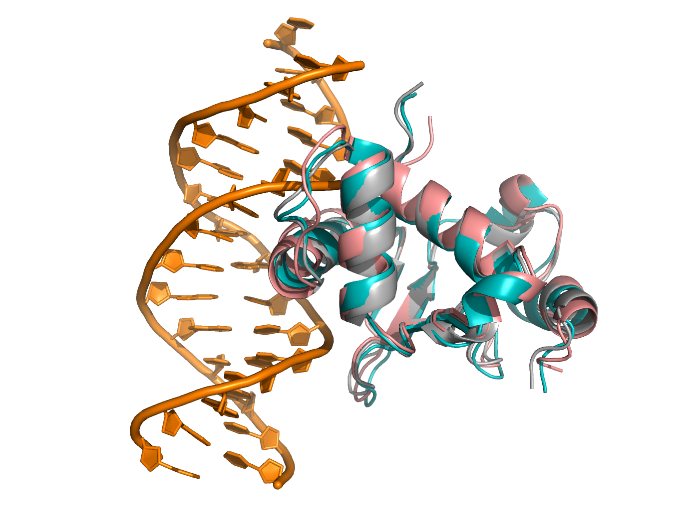
Best and worst states: ETS1 (rigid exemplar)
S1 · ETS1 best/worst minimized states vs crystal
Notes:
Structural render of ETS1's best and worst minimized states against the crystal. Even the worst ETS1 state keeps a recognizable, well-docked interface — the visual counterpart to ETS1's near-100% fnat pass rate. This is what 'rigid recognizer' looks like structurally.

Slide 12
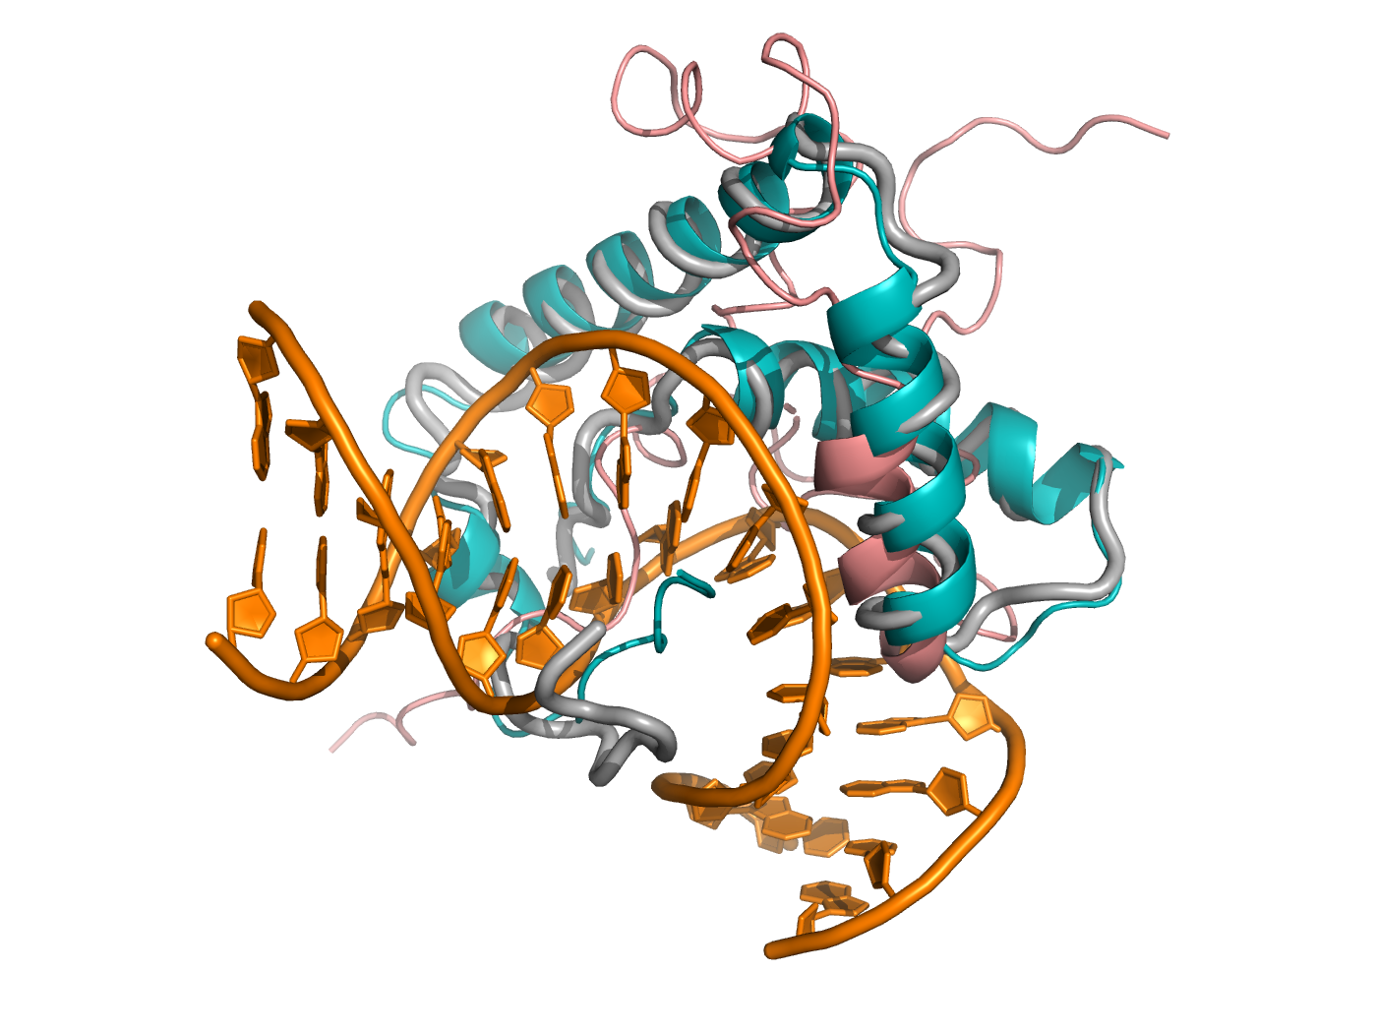
Best and worst states: LEF1 (floppy exemplar)
S1 · LEF1 best/worst minimized states vs crystal
Notes:
The contrast case: LEF1 (HMG-box) bends its DNA sharply and samples widely, so its worst states depart substantially from the bound geometry. This is why LEF1 sits at the bottom of the fnat ordering and why its augmentation behavior is the hardest — a preview of the induced-fit story.

Slide 13
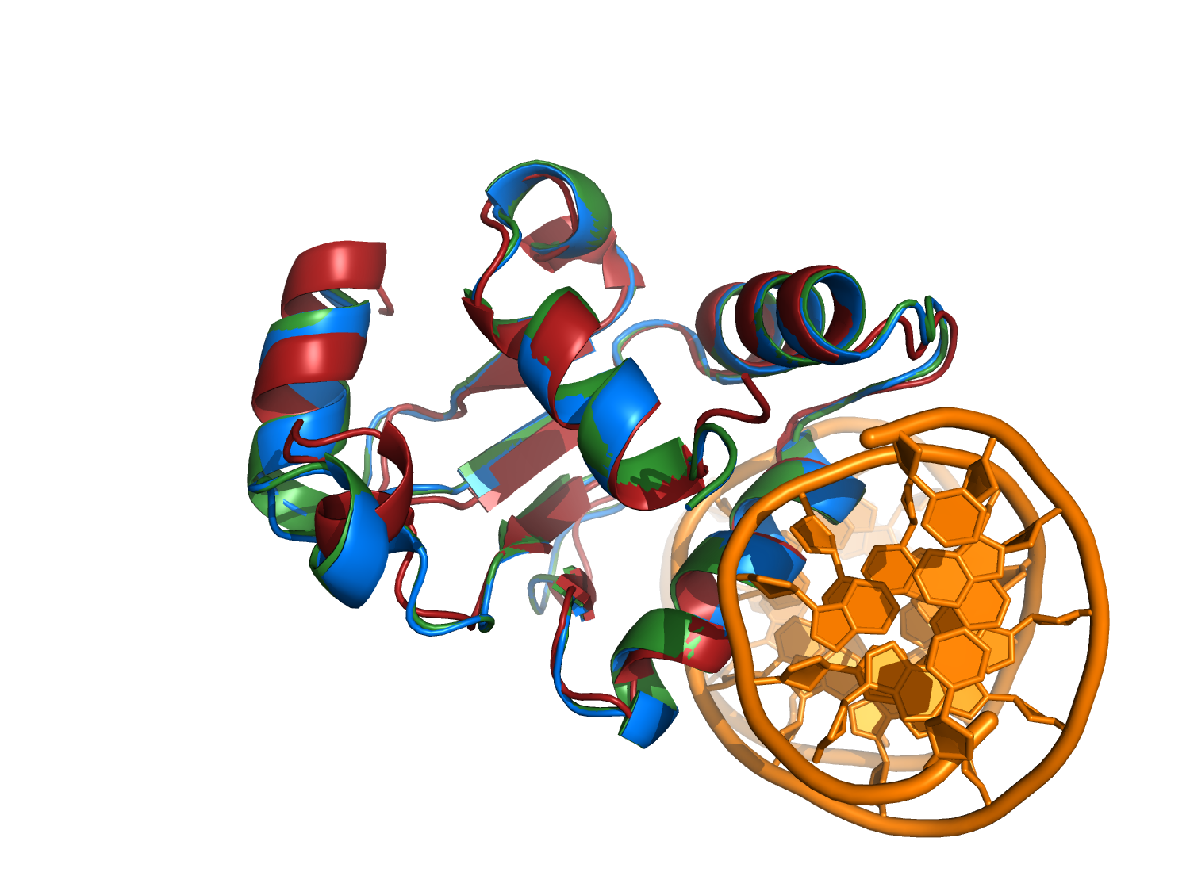
Stage progression of an ETS1 state
S2 · ETS1 one-state stage progression
Notes:
One ETS1 state through the pipeline stages, overlaid. The recognition helix inserting into the major groove stays locked across docking and minimization; the motion is in the periphery. A concrete single-state view of the 'rigid core, mobile edges' principle.

Slide 14
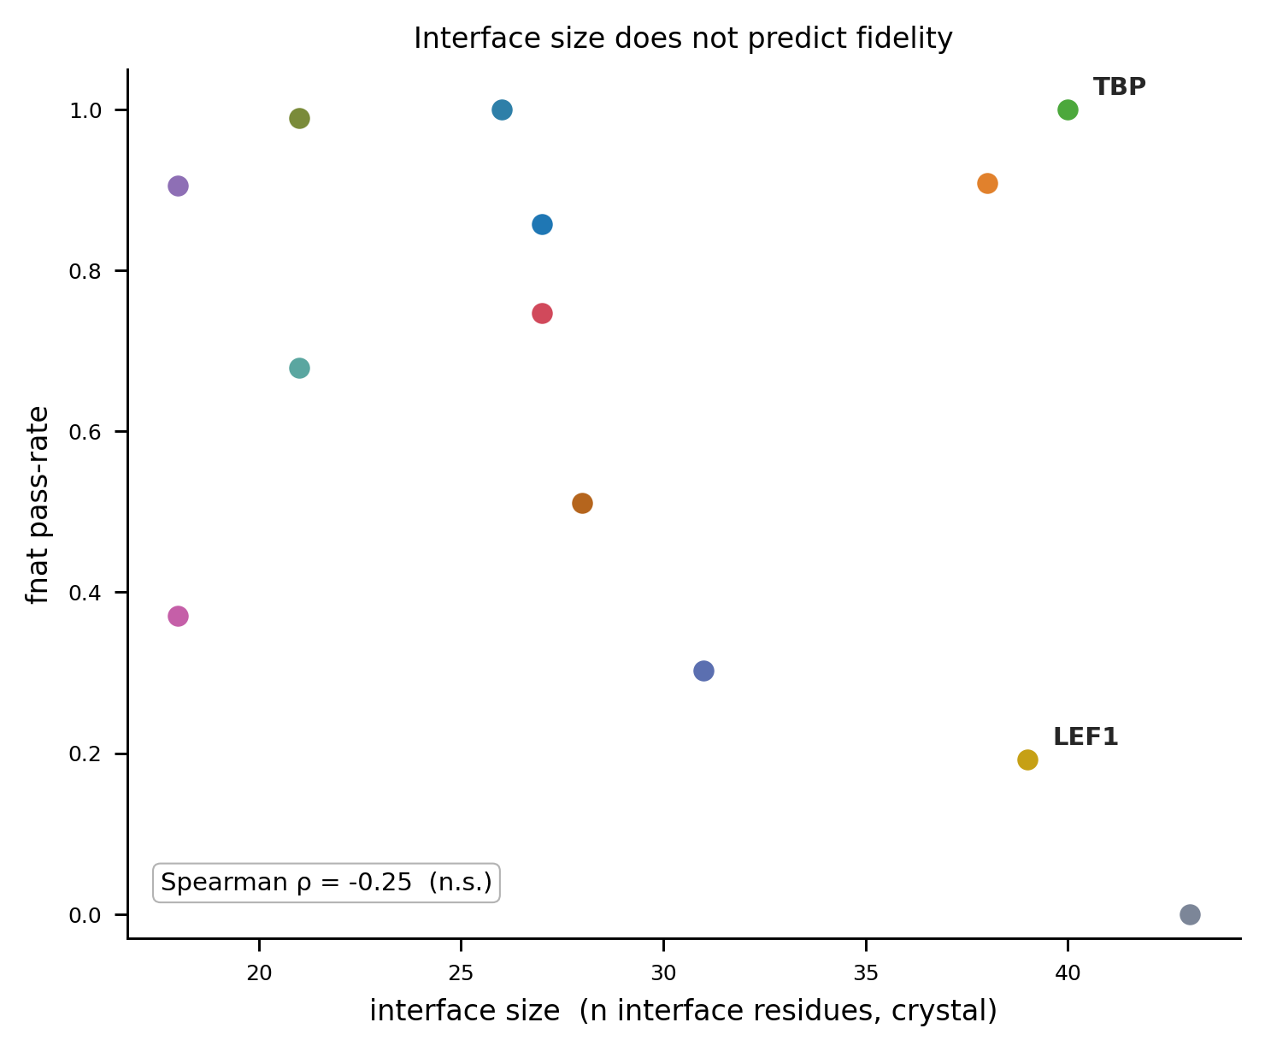
Interface size distribution by pilot
F4 · interface size per pilot
Notes:
Number of interface residues per pilot. Establishes that the pilots span a real range of interface sizes, which matters for interpreting fnat (a fixed fnat threshold is a different bar for a 10-contact vs a 40-contact interface). Context for the fidelity ordering.

Slide 15
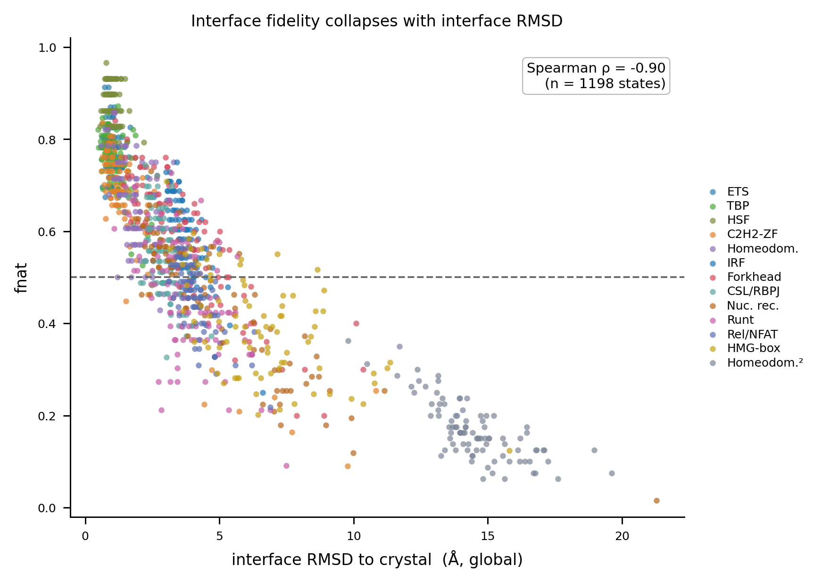
fnat vs interface RMSD: the two fidelity metrics agree
F3 · fnat vs interface RMSD, all states
Notes:
fnat plotted against interface RMSD across all states. The strong monotone anti-correlation confirms the two independent fidelity measures tell the same story — high fnat states are low-RMSD states — so the 0.5 gate is not an arbitrary cutoff on a noisy metric.

Slide 16
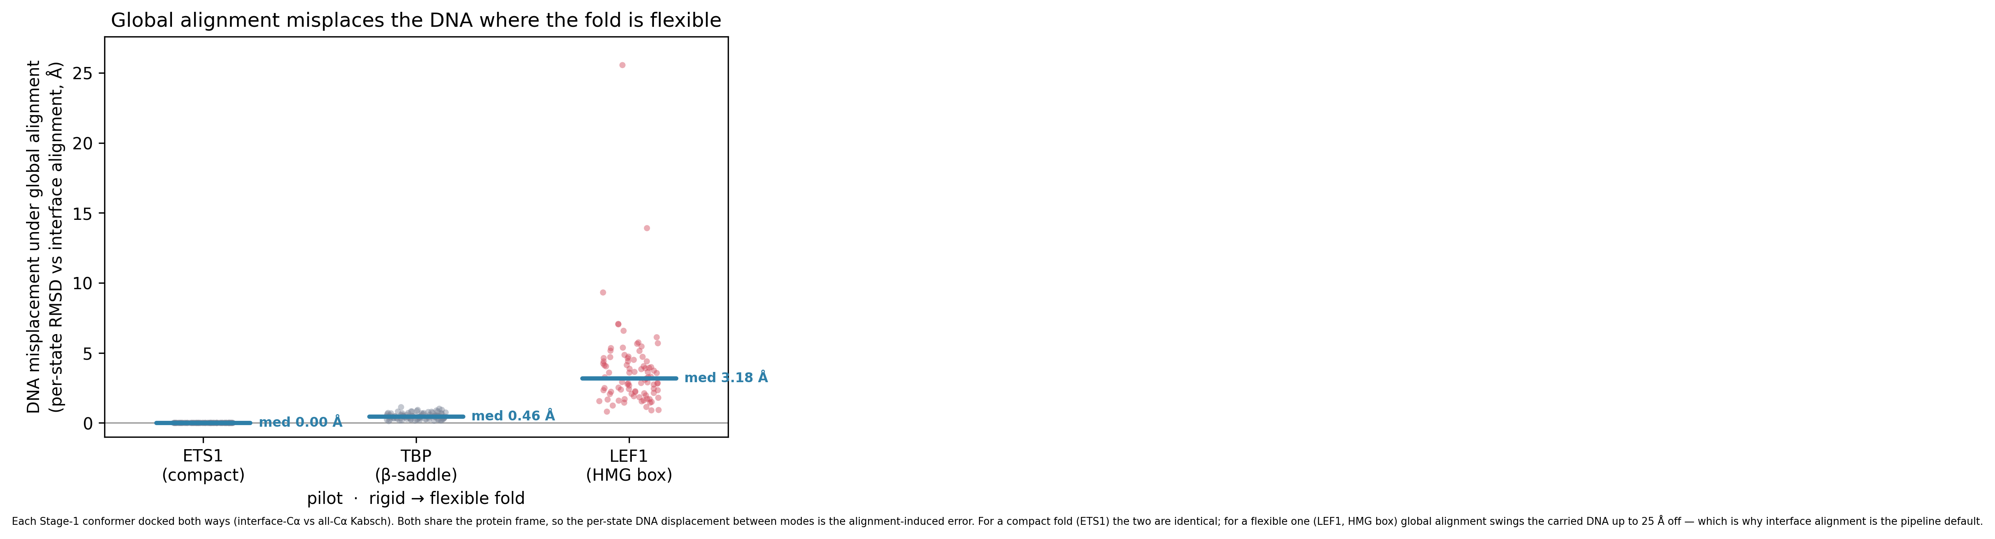
DNA displacement under interface alignment
F5 · DNA displacement after interface alignment
Notes:
When the complex is aligned on the protein interface, how far is the DNA from its crystal position. Quantifies the residual DNA placement error after docking+minimization — the starting point that DNA relaxation (Ch. 18) then addresses.

Slide 17
Chapter 10
Stage 4-5: Featurization & the augmented set
What DeepPBS ingests, and where states are silently lost

Slide 18
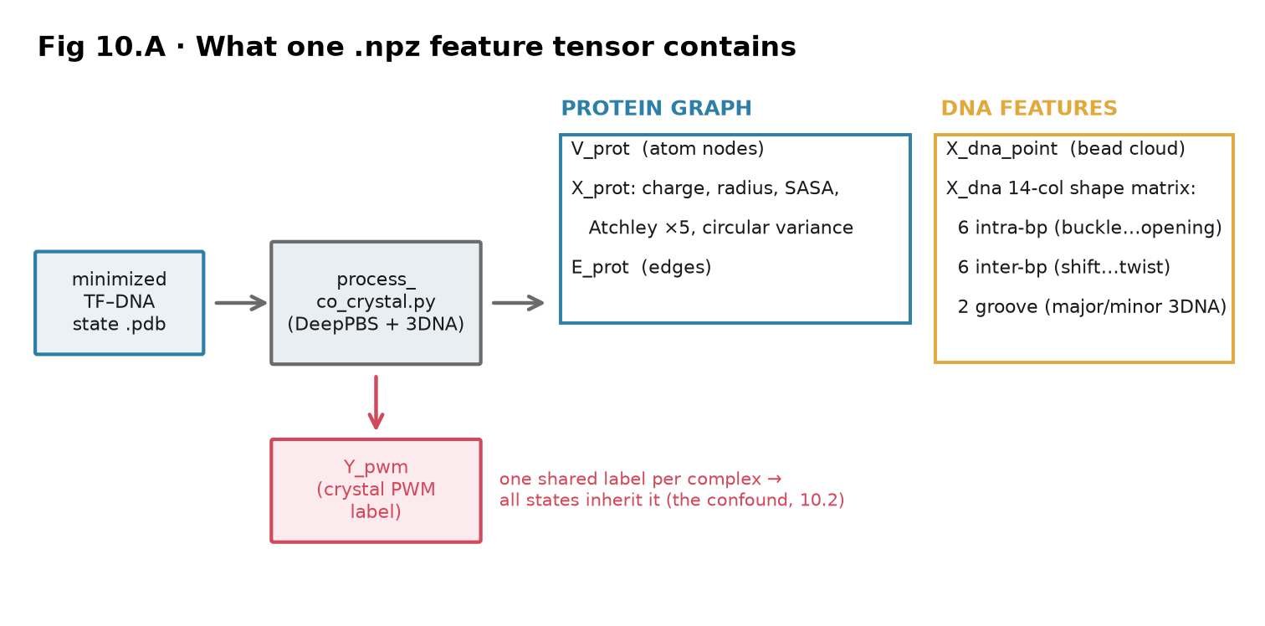
What one .npz feature tensor contains
Notes:
This is what DeepPBS actually sees for each structure. process_co_crystal.py converts every minimized state into one .npz with three parts.
The protein is a GRAPH: atom nodes carrying charge, radius, SASA, five Atchley factors (physicochemical amino-acid descriptors), and circular variance, plus adjacency edges. The DNA is a bead point cloud PLUS a 14-column shape matrix — 6 intra-base-pair parameters, 6 inter-base-pair, and 2 groove widths from 3DNA. That shape matrix is the object the augmentation hypothesis is about — it is what changes when the DNA relaxes.
The label (red) is a single PWM per complex, and every state inherits the SAME label — the confound the next slide addresses.

Slide 19
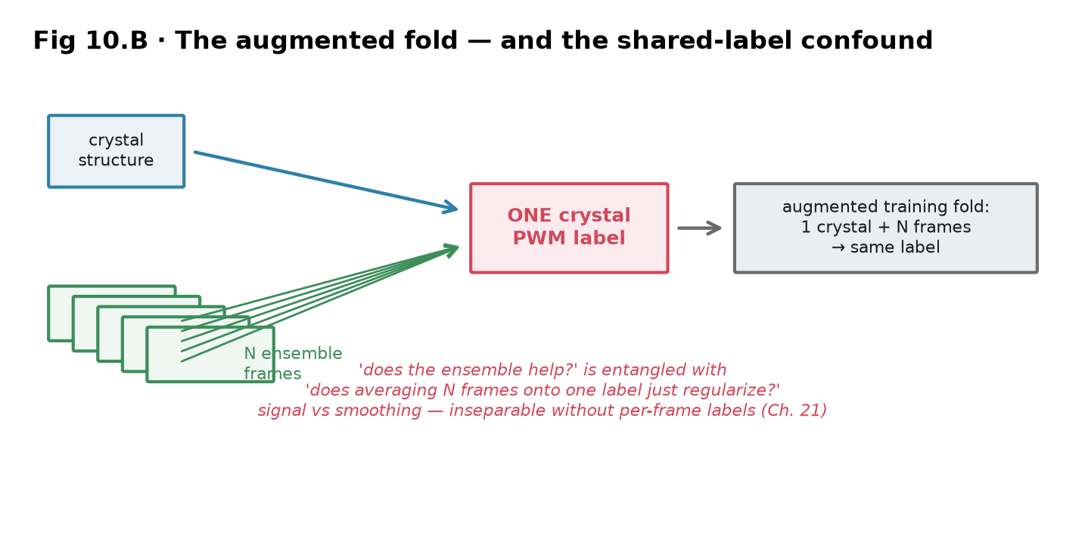
The augmented fold — and the shared-label confound
Notes:
The central methodological caveat, stated plainly. The augmented fold is one crystal plus N passing ensemble frames, all supervised by ONE crystal-derived PWM.
The problem: 'does the ensemble help the model learn' is entangled with 'does averaging N structural views onto one label simply regularize training.' Both produce the same accuracy change. You cannot separate signal from smoothing without per-frame labels, which don't exist.
This is exactly why the mechanism analysis matters: you break the confound not by asking whether augmentation helps on average, but by asking WHICH families it helps and whether that tracks a physical variable. Pure regularization would not correlate with DNA flexibility — but it does (Ch. 17).

Slide 20
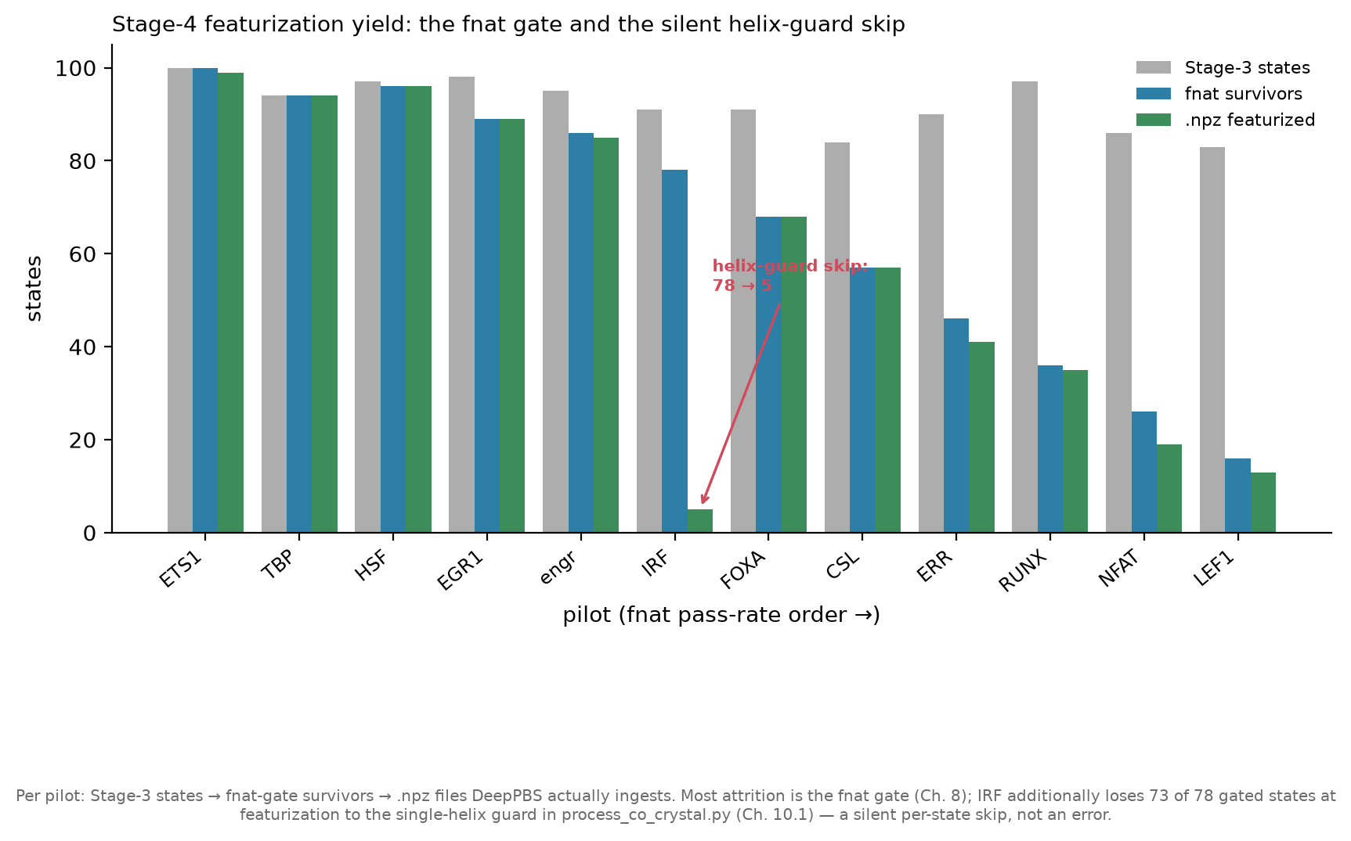
Stage-4 featurization yield: the fnat gate and a silent skip
Notes:
Attrition through the pipeline, per pilot. Grey = Stage-3 states; teal = fnat-gate survivors; green = .npz files actually written for training.
Most loss is the fnat gate, by design, and the pilots are ordered by pass rate so the left-to-right decline is expected. The red flag is IRF: 78 states pass the gate but only 5 get featurized. That drop is the single-helix guard in process_co_crystal.py — it asserts exactly one DNA duplex, and states where the relaxed DNA frayed or the helix-finder split the duplex are silently skipped, one by one, with no error.
So IRF effectively trains on 5 structures. Any per-pilot IRF result must be read knowing its sample size is tiny — this is the concrete origin of the 'partial coverage' caveat throughout the results chapters.

Slide 21
Chapter 11
Stage 6-7: Paired training & benchmark evaluation
How the two arms are trained and compared — and the pseudoreplication trap

Slide 22
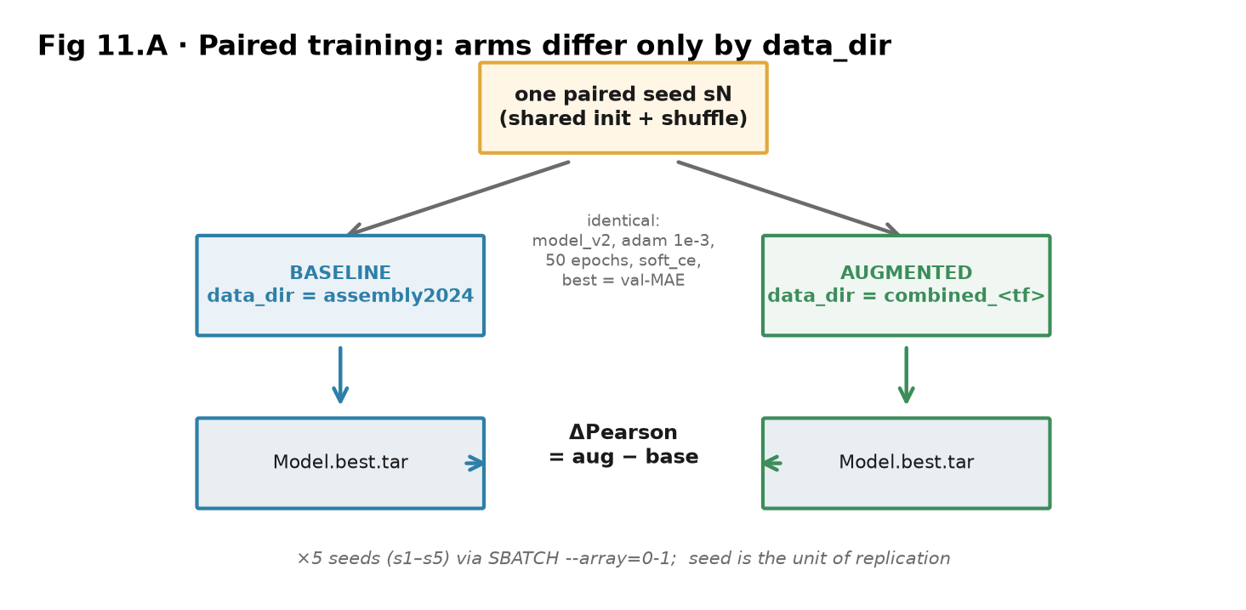
Paired training: arms differ only by data_dir
Notes:
How baseline and augmented are made comparable. For one seed, the initialization and data shuffle are shared; the only difference between the two arms is data_dir — baseline points at the standard assembly, augmented at the combined crystal+ensemble assembly. Everything else (architecture, optimizer, epochs, loss, best-on-validation-MAE checkpointing) is identical.
This is repeated for 5 seeds via an SBATCH array (--array=0-1 launches the arm pair). The crucial design point on the next slides: the SEED is the unit of replication — augmentation is applied once per seed — so the honest statistical test is over 5 seeds, not over the hundreds of benchmark entries each seed produces.

Slide 23
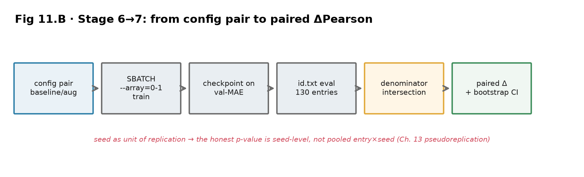
Stage 6 to 7: from config pair to paired ΔPearson
Notes:
The evaluation flow as one diagram: config pair → array train → checkpoint on validation MAE → evaluate on the id.txt benchmark (130 entries) → intersect the denominators so both arms are scored on the same entries → compute the paired ΔPearson with a bootstrap CI.
The denominator-intersection step is easy to overlook but essential — if the two arms failed on different entries, an unmatched average would compare different structure sets. The paired design scores both on the shared set. And the final Δ is where the pseudoreplication question bites, next slide.

Slide 24
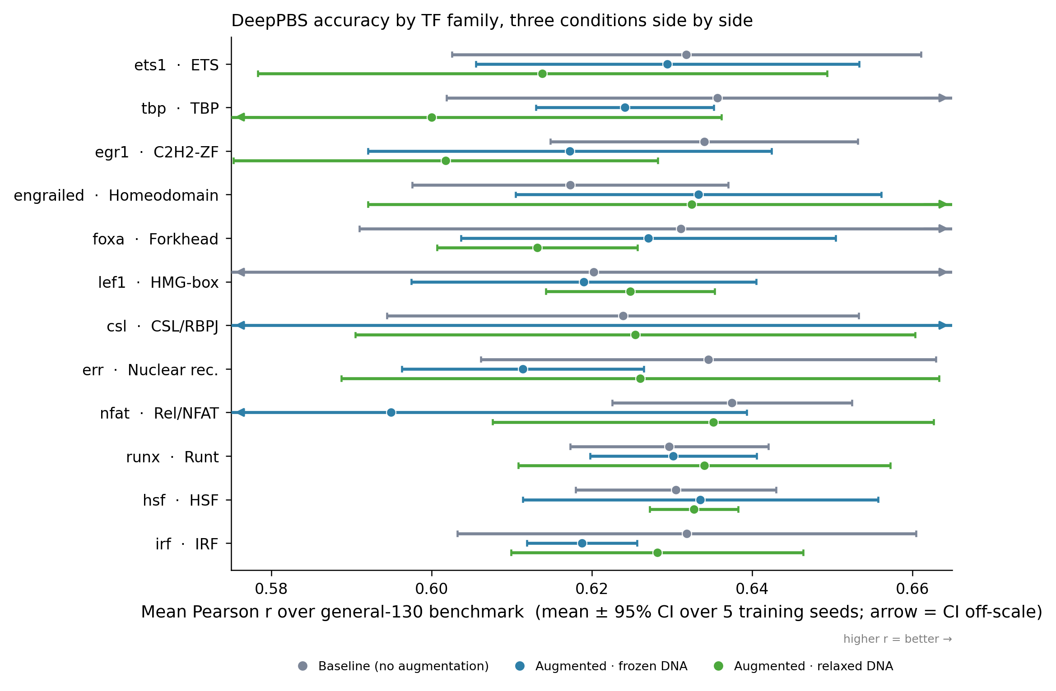
Three arms, side by side: they barely differ against the spread
fig1 · three-arm accuracy, general-130, mean ± 95% CI over seeds
Notes:
The headline evaluation. Mean Pearson r over the 130-entry general benchmark, three arms — baseline (grey), augmented-frozen (blue), augmented-relaxed (green) — per pilot, with 95% CI over 5 seeds.
The honest first read: the three arms overlap heavily for almost every pilot. On the whole benchmark, augmentation's net effect is small relative to the seed-to-seed spread. Taken as a single scalar, this reads as 'augmentation doesn't clearly help' — which is the productive null the results chapters then unpack. The signal is not in this pooled average; it's in which families move, shown later.

Slide 25
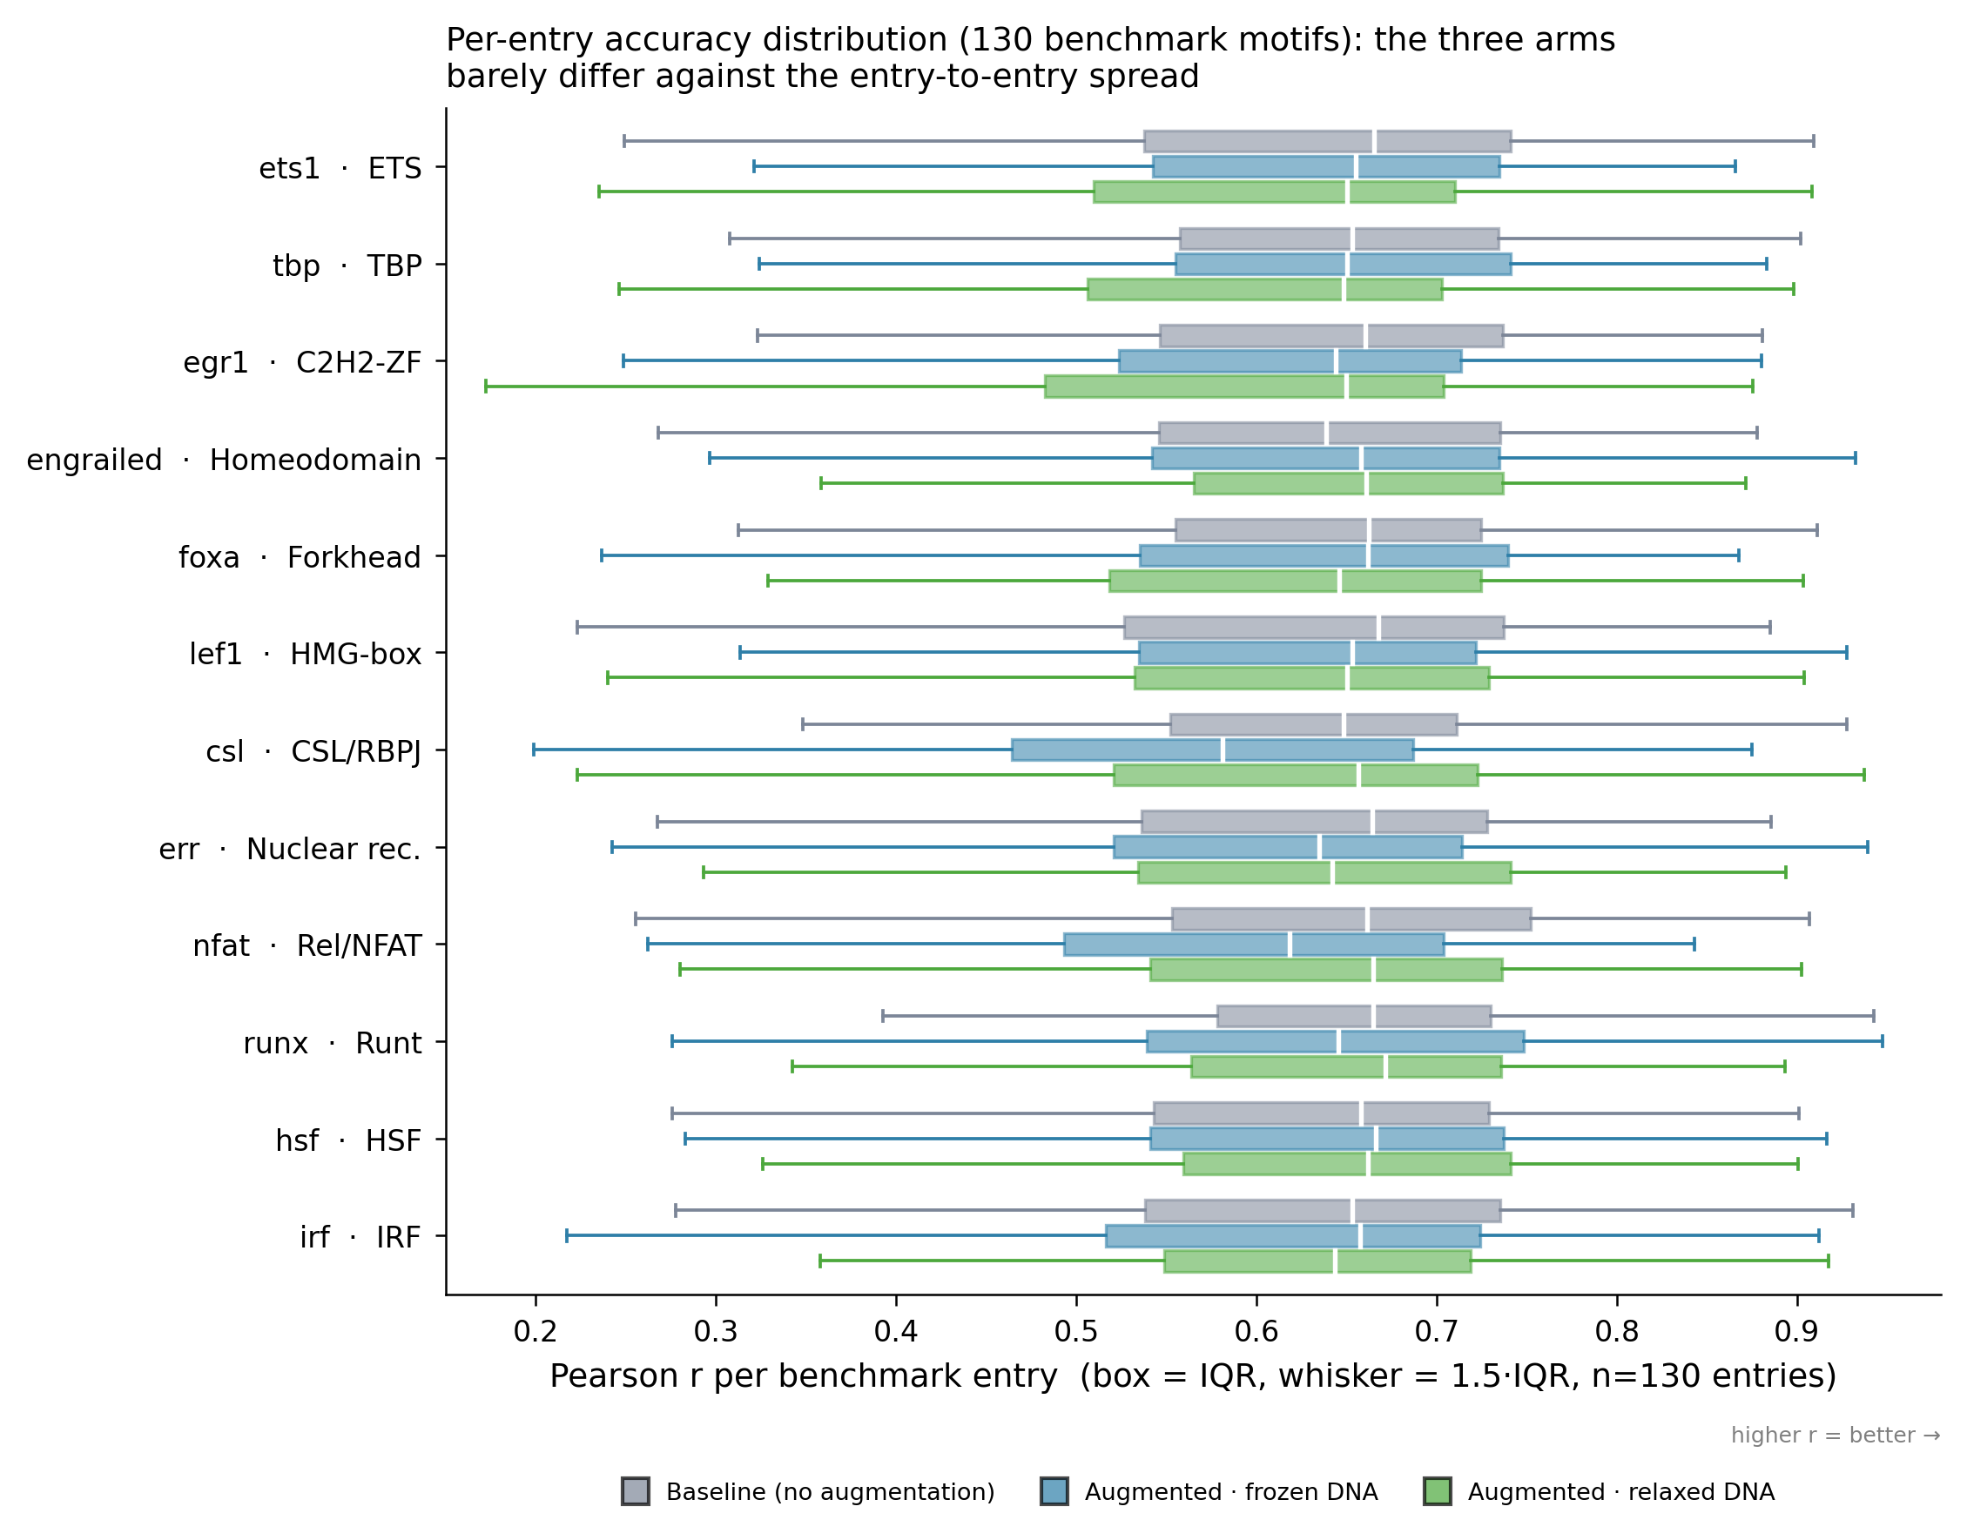
Per-entry metric distributions across the benchmark
fig3 · per-entry Pearson, three arms, general-130
Notes:
Per-entry Pearson distributions for the three arms over all 130 benchmark structures. The boxes overlap almost completely — the entry-to-entry spread dwarfs the between-arm difference. This is the 'what the eval produces' reference and the honest visual for why the mean effect is small: any augmentation signal is a small shift of a broad distribution, not a clean separation.

Slide 26
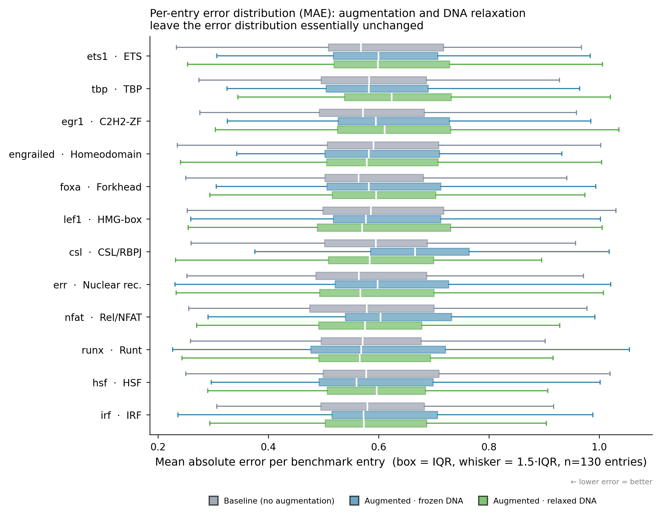
Per-entry MAE distributions across the benchmark
fig4 · per-entry MAE, three arms, general-130
Notes:
The same per-entry view for mean absolute error — the second accuracy metric DeepPBS is checkpointed on. Same conclusion as Pearson: the arms are near-indistinguishable at the whole-benchmark level. Shown so the productive-null claim doesn't rest on a single metric.

Slide 27
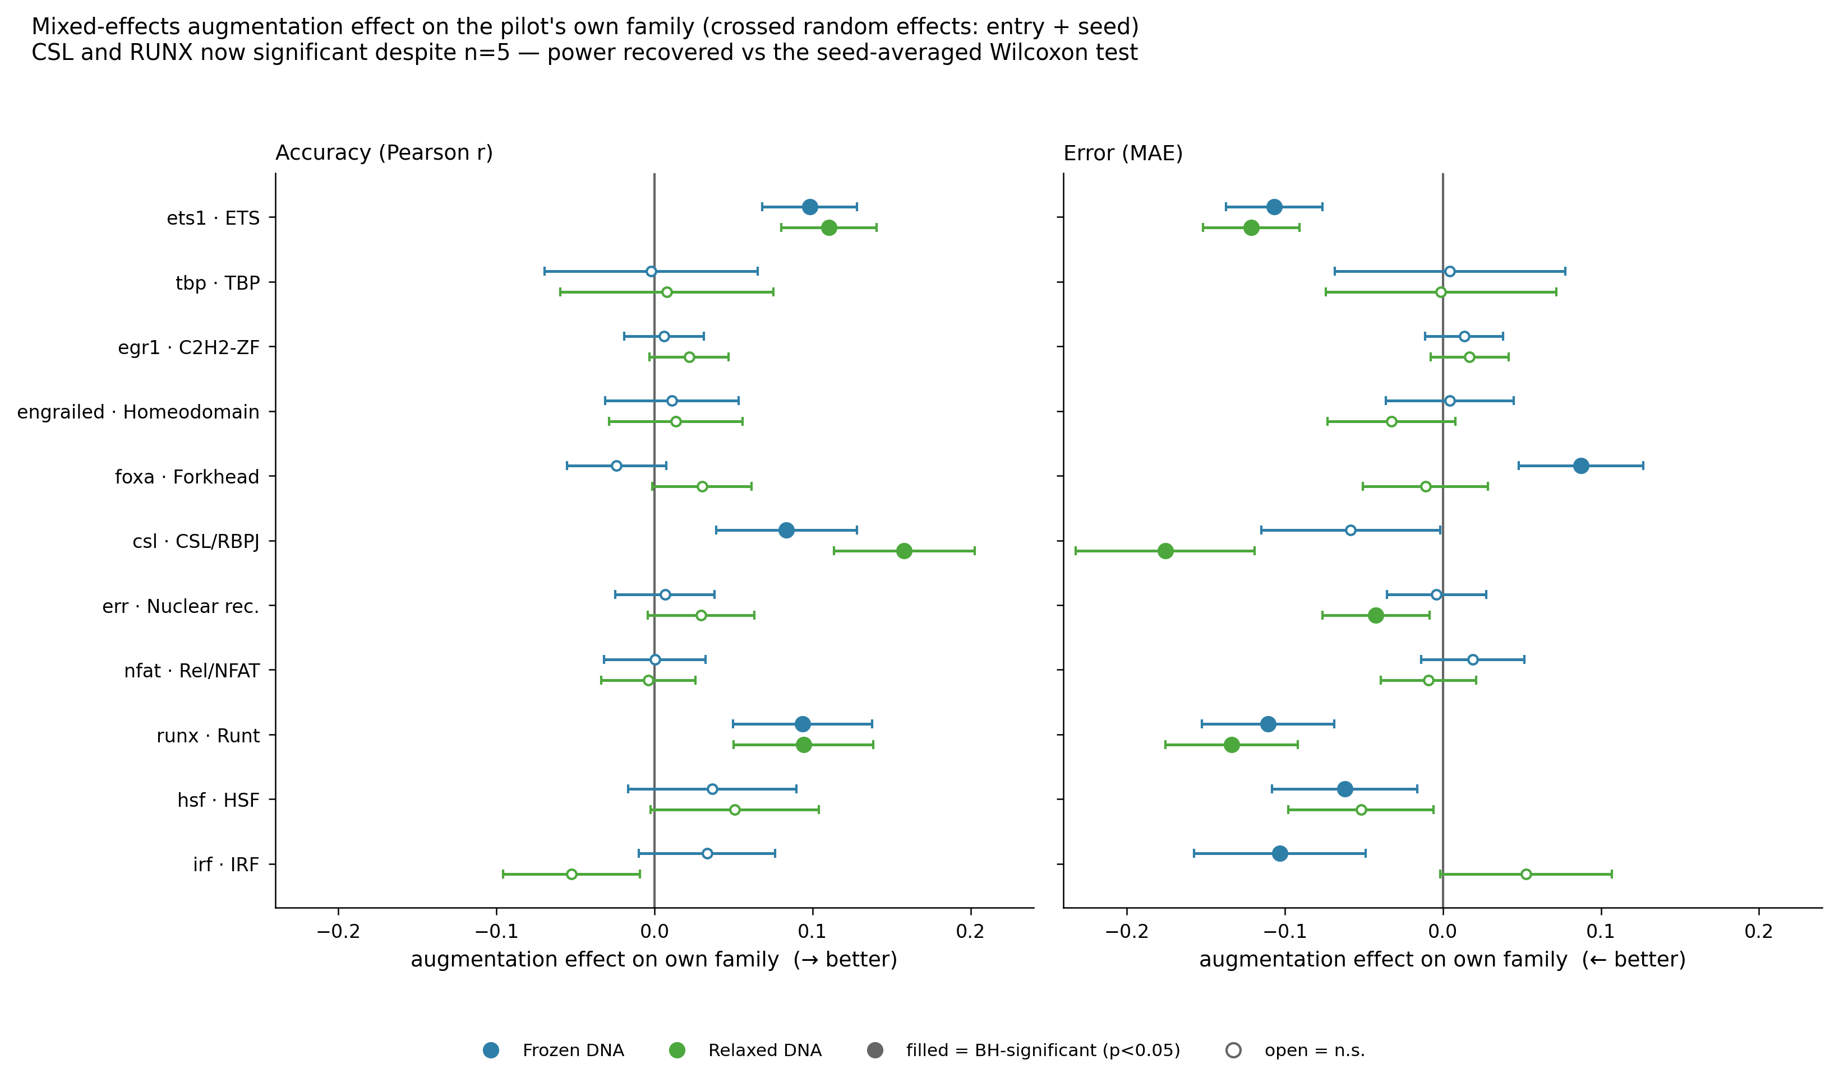
Do NOT read this as significance: the pseudoreplication trap
fig9 · mixed-model effects — pseudoreplicated, shown as the cautionary case
Notes:
This figure is included as a CAUTION, not a result. It shows per-pilot augmentation effects that look significant — but the significance here comes from treating the 130 benchmark entries times 5 seeds as independent observations. They are not: augmentation is applied once per seed, so the independent replicate is the SEED (n=5), not the entry.
Pooling entries times seeds is pseudoreplication — it inflates the effective n from 5 to hundreds and produces artificially tiny p-values. The csl example makes it concrete elsewhere: pooled p=0.001 looks decisive, but the five per-seed deltas are -0.024, -0.043, +0.159, +0.162, +0.164 — two of five negative. The honest test is the seed-level one. This figure is the negative example for Ch. 13; never present it as a positive result.

Slide 28
Chapter 16
The augmentation effect: the productive null
The mean is near zero — but the signal is hiding in which families move

Slide 29
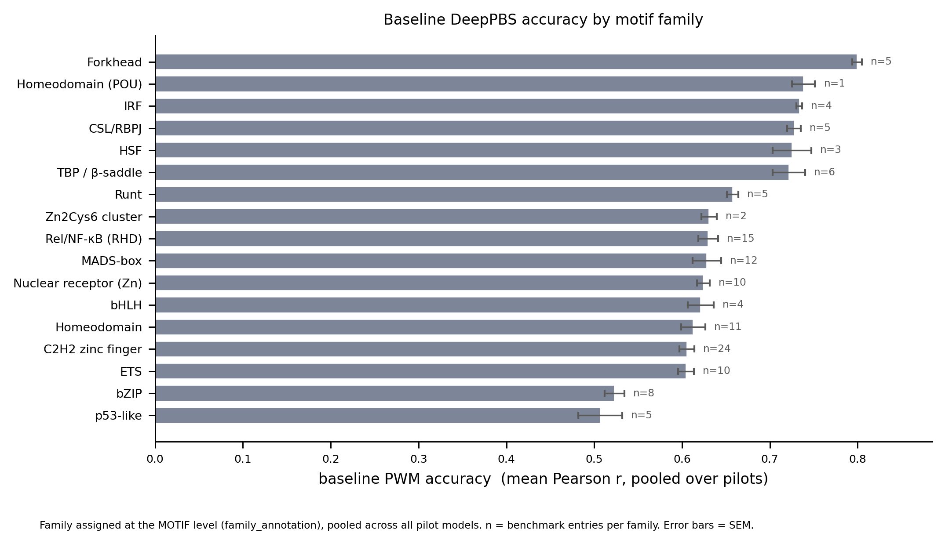
Baseline accuracy by motif family (the starting point)
P2 · baseline accuracy by motif family, pooled over pilots
Notes:
Before measuring what augmentation CHANGES, this sets the baseline: DeepPBS accuracy per motif family with no augmentation, pooled across pilots. Family is assigned at the motif level (not per-PDB), which corrects an earlier mislabeling that had inflated the ETS median by misfiling ETS1-RUNX1 co-crystals as Runt.
The range is real — Forkhead and homeodomain-POU near 0.75-0.80, bZIP and p53-like near 0.50 — so the headroom for improvement differs by family. That headroom is itself a variable the mechanism analysis controls for.

Slide 30
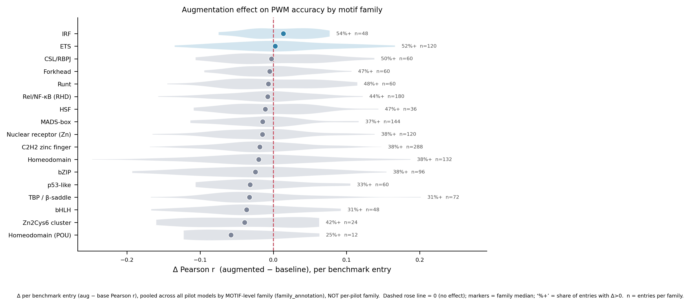
The augmentation effect by family: two families net-positive
P3 · ΔPearson by motif family — IRF and ETS net-positive
Notes:
The core productive-null figure. ΔPearson (augmented minus baseline) by MOTIF-level family — and the label is explicit that this is motif-family, not per-pilot. Most families straddle zero; only IRF and ETS are cleanly net-positive.
This is the shape of the result: augmentation does not uniformly help or hurt. A near-zero grand mean is hiding a real pattern where a few families gain and others lose. The question Ch. 17 answers is what physical property separates the winners from the losers — and this figure is why that question is worth asking rather than concluding 'no effect.'

Slide 31
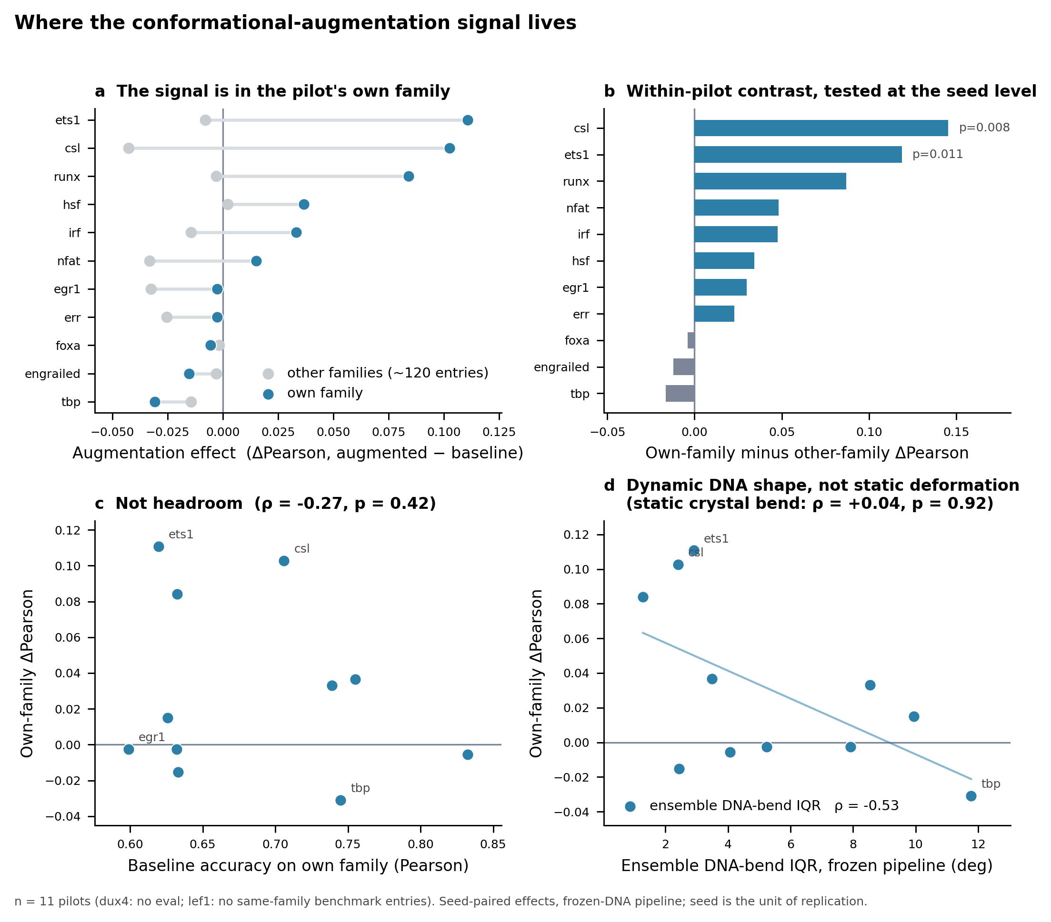
Where the signal lives: own vs other family (the centerpiece)
M2 · own vs other family, seed contrast, headroom control, dynamic axis
Notes:
This four-panel figure is the chapter's argument in one image. It contrasts the augmentation effect on a pilot's OWN family versus OTHER families, shows the seed-level within-pilot contrast, includes the headroom control (does the effect just track how much room there was to improve — ρ=-0.27, no), and previews the dynamic-vs-static axis.
The message: augmentation's benefit is specific to the pilot's own family — adding ETS ensemble views helps ETS predictions, not unrelated families. That specificity is the strongest evidence AGAINST the pure-regularization confound: generic smoothing would help everything or nothing, not selectively the matched family.

Slide 32
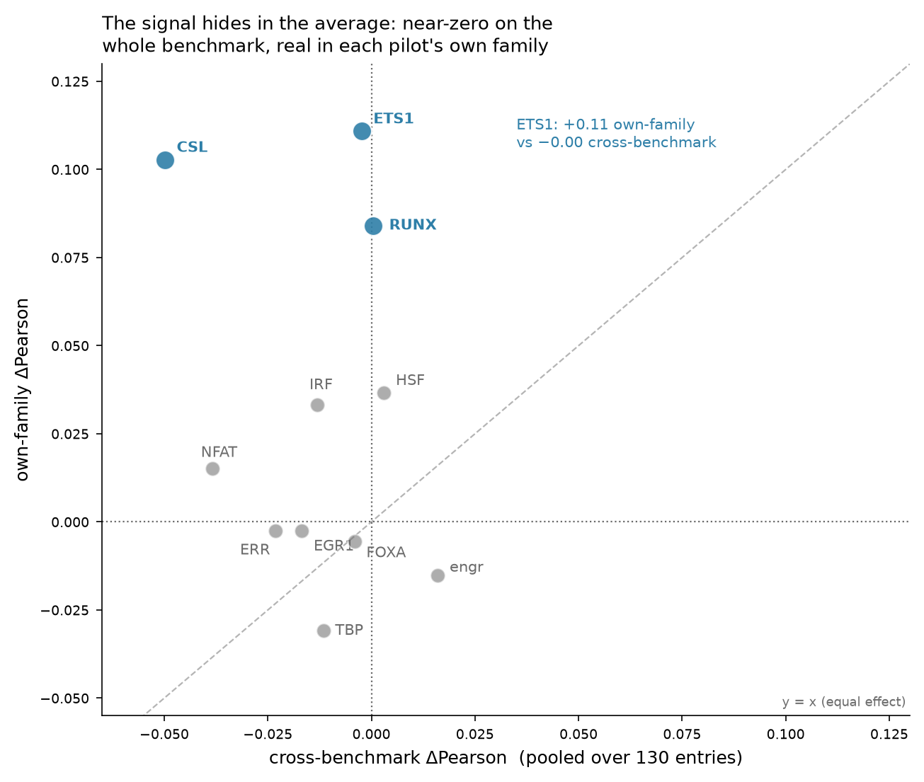
The signal hides in the average: cross-benchmark vs own-family
M5 · pooled cross-benchmark vs own-family ΔPearson, per pilot
Notes:
The single clearest picture of the productive null. Each pilot's pooled cross-benchmark ΔPearson (x, near zero) against its own-family ΔPearson (y). 8 of 11 pilots sit above the y=x diagonal — the own-family effect exceeds the cross-benchmark effect; 3 fall below (engrailed, foxa, tbp).
The three focal pilots — CSL, ETS1, RUNX — are near zero on the cross-benchmark axis (-0.05, -0.00, +0.00) but at +0.08 to +0.11 own-family. So the whole-benchmark average genuinely hides a real, family-specific effect. This is not a universal lift — it's a specific one that averaging destroys. Read alongside M3, which quantifies the own-family effect with seed-level CIs.

Slide 33
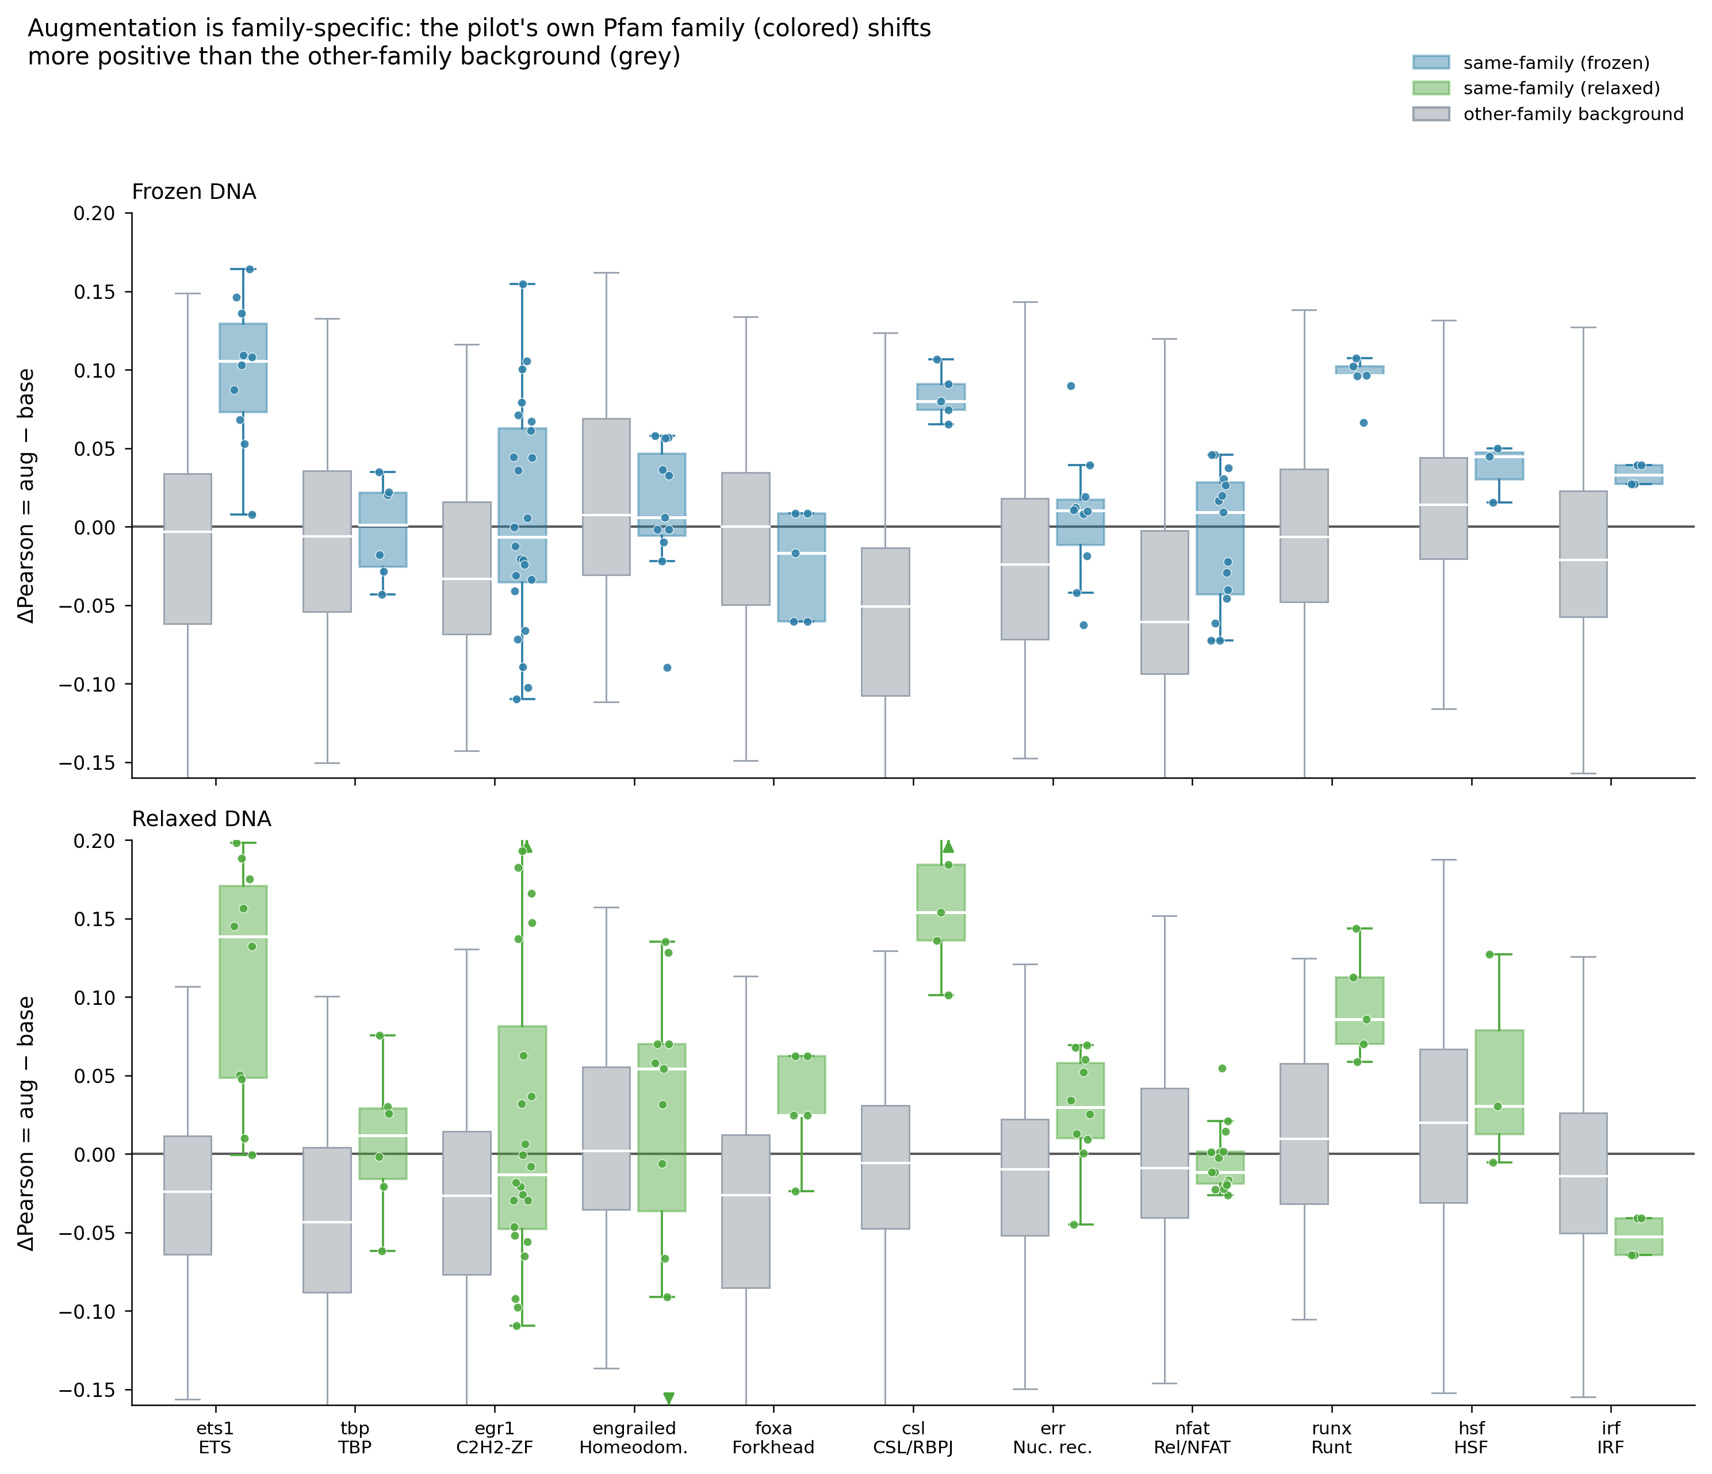
Within-family transfer
fig6 · within-family transfer
Notes:
Complementary to M5: does augmenting on one family member improve predictions on OTHER members of the same family. Tests whether the ensemble signal generalizes within a fold class rather than memorizing one complex. Context for how far the own-family benefit reaches.

Slide 34
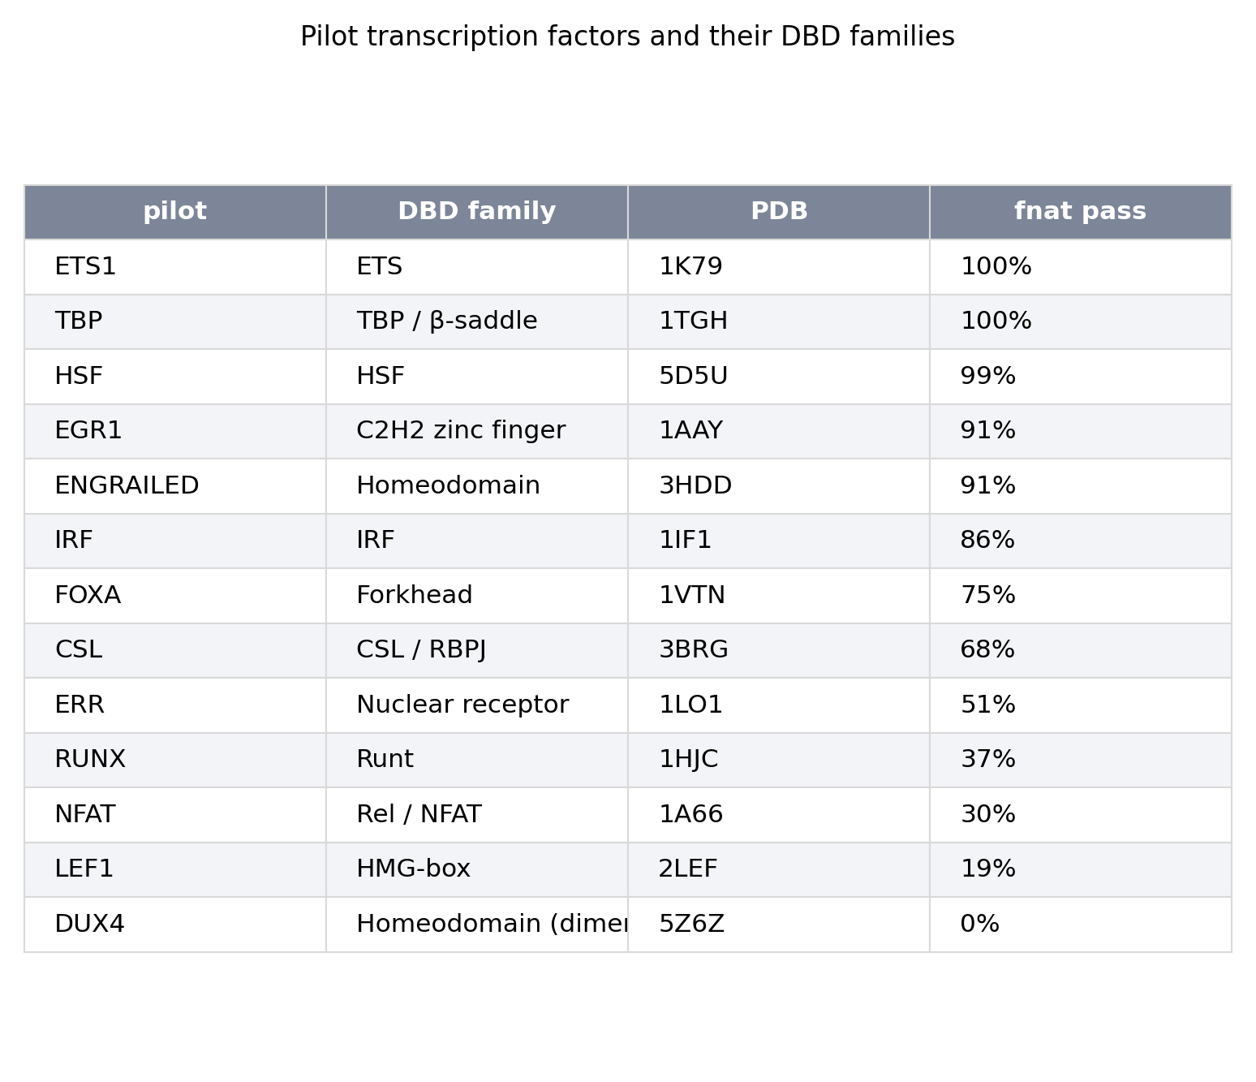
Family accuracy table
P1 · per-family accuracy and counts
Notes:
The tabular backing for the family-level figures — per-family baseline accuracy, entry counts, and effect sizes. The reference table you point at rather than read aloud; it's here so the family claims are auditable.

Slide 35
Chapter 17
The mechanism story (revised by the data)
The discriminating variable is DYNAMIC DNA fluctuation — not static crystal shape or protein reachability

Slide 36
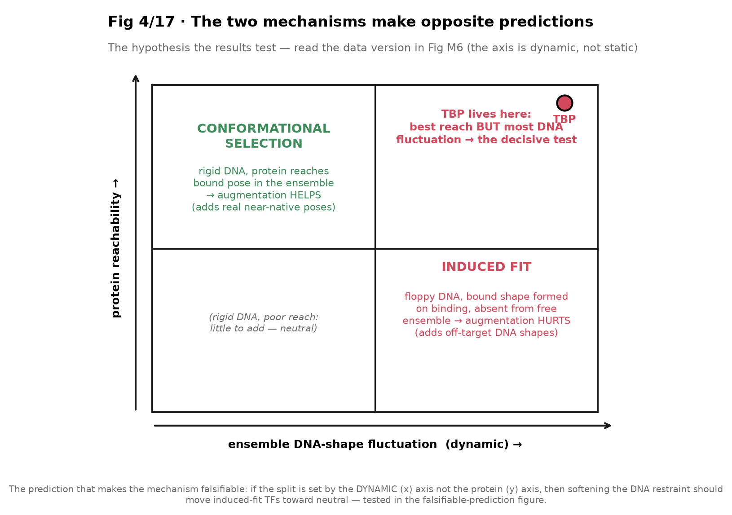
The two mechanisms make opposite predictions (the hypothesis)
Notes:
The conceptual frame the results test. Two mechanisms predict opposite augmentation outcomes. Under CONFORMATIONAL SELECTION, the bound DNA shape already exists in the free ensemble, so adding ensemble frames supplies real near-native views → augmentation HELPS. Under INDUCED FIT, the bound shape is formed only on binding and is absent from the free ensemble, so ensemble frames add off-target shapes → augmentation HURTS.
The falsifiable prediction: if the split is set by the DYNAMIC DNA-fluctuation axis (x), then softening the DNA restraint should move induced-fit TFs toward neutral. TBP is the decisive test case — best protein reachability but most DNA fluctuation. This is a concept diagram; the data version is M6.

Slide 37
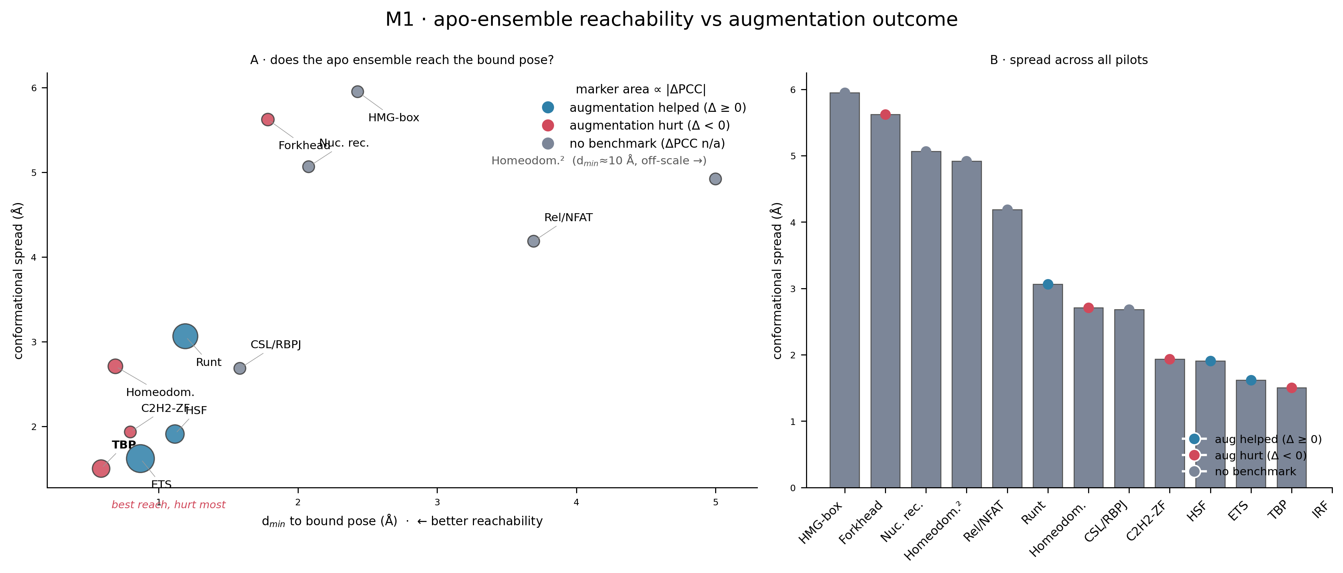
Apo-ensemble reachability vs outcome (the OLD hypothesis)
M1 · apo reachability vs outcome — the initial (protein-side) hypothesis
Notes:
Show this as the hypothesis that the data OVERTURNED, not as a result. M1 plots the protein-side axes — how well the free ensemble reaches the bound pose (d_min) and its conformational spread — and hard-codes the reading 'TBP has best reach yet is hurt most.'
The trouble: on these protein-side axes the winners and losers do NOT cleanly separate, and the static framing groups TFs that behave oppositely. M1 is visually compelling and it motivated the analysis, but on its own it implies a mechanism the data don't support. Caption it explicitly as the initial hypothesis, then show M4/M6 for what actually discriminates.

Slide 38
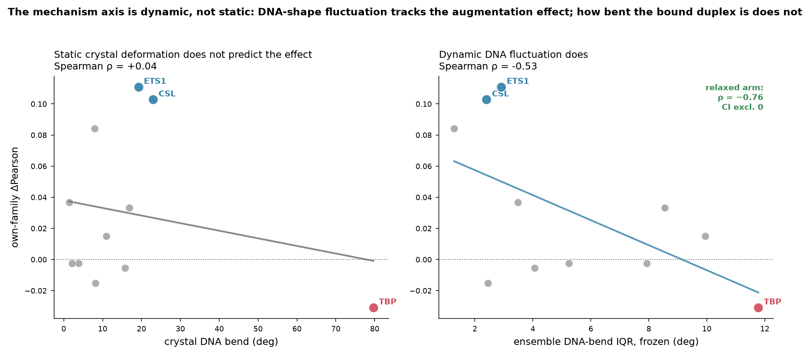
Static fails, dynamic works (the revision, distilled)
M6 · effect vs static crystal bend (ρ=+0.04) vs ensemble bend IQR (ρ=−0.76 relaxed)
Notes:
The revision in two panels. LEFT: the augmentation effect against STATIC crystal DNA bend — flat, Spearman ρ=+0.04. TBP at 80 degrees of bend sits at the bottom while ETS1 and CSL cluster at low bend but top, so static deformation cannot separate winners from losers. RIGHT: the effect against ENSEMBLE DNA-bend fluctuation (IQR) — ρ=-0.53 frozen, strengthening to -0.76 in the relaxed arm, the only correlation whose bootstrap CI excludes zero.
So the discriminating variable is how much the DNA shape FLUCTUATES in the ensemble, not how bent the crystal is. TFs whose DNA is dynamically variable are hurt by augmentation (the ensemble adds off-target shapes); those whose DNA is rigid are helped. This is the mechanism result.

Slide 39
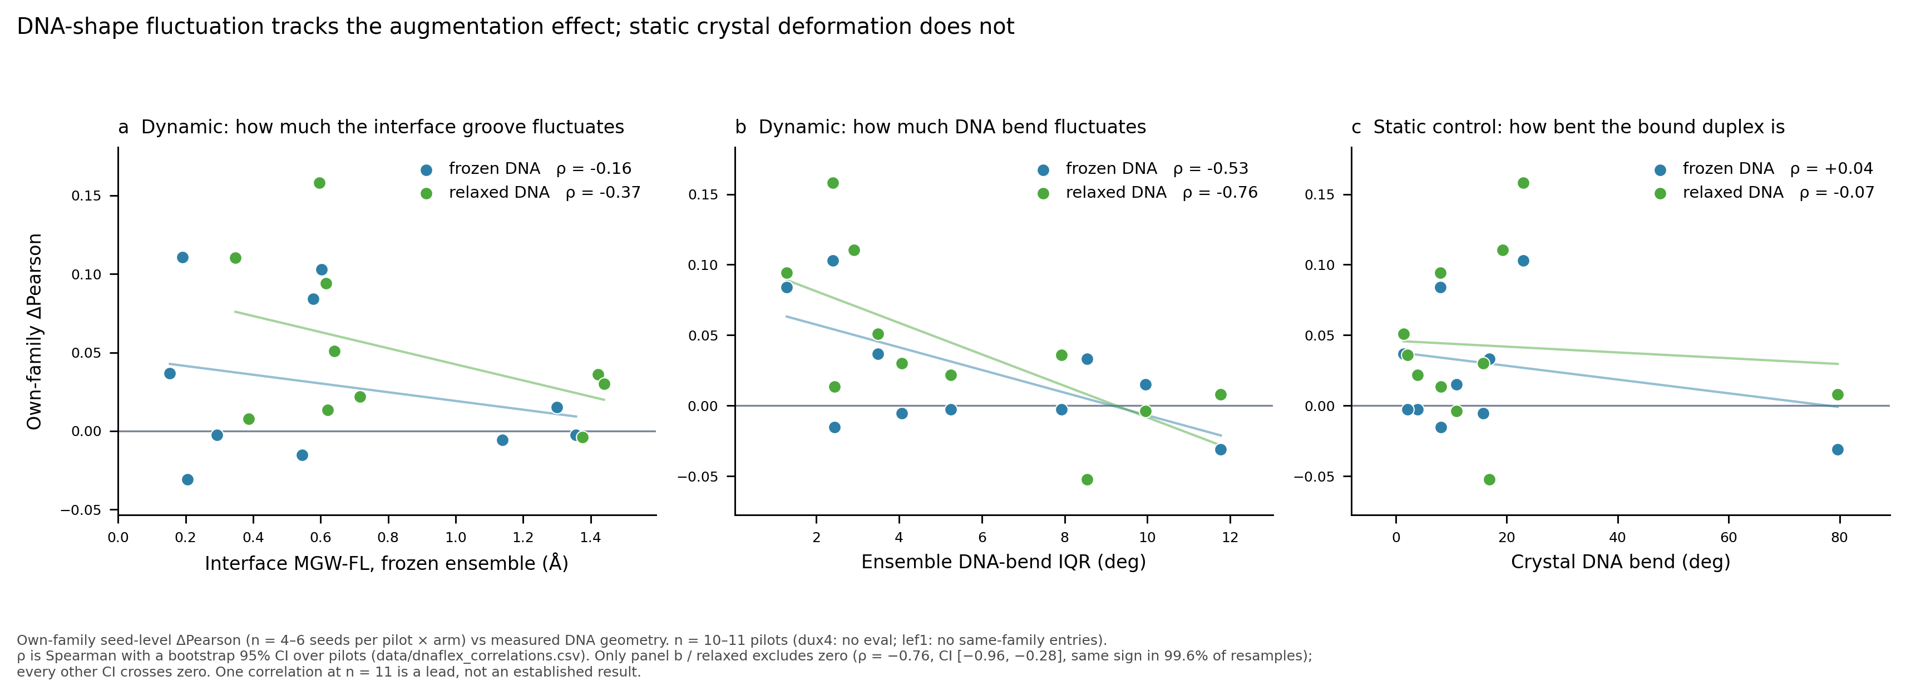
DNA-flexibility axis vs effect, with the static control
M4 · DNA-fluctuation axes vs effect, with static control and CIs
Notes:
The full-resolution version of the mechanism result (M6 is the distilled two-panel form). M4 shows the augmentation effect against DNA-shape fluctuation across measures, alongside the flat static-crystal control, with the bootstrap CIs. Its own subtitle states the finding: DNA-shape fluctuation tracks the effect; static deformation does not. This is the figure to dwell on when someone wants the statistics behind the claim.

Slide 40
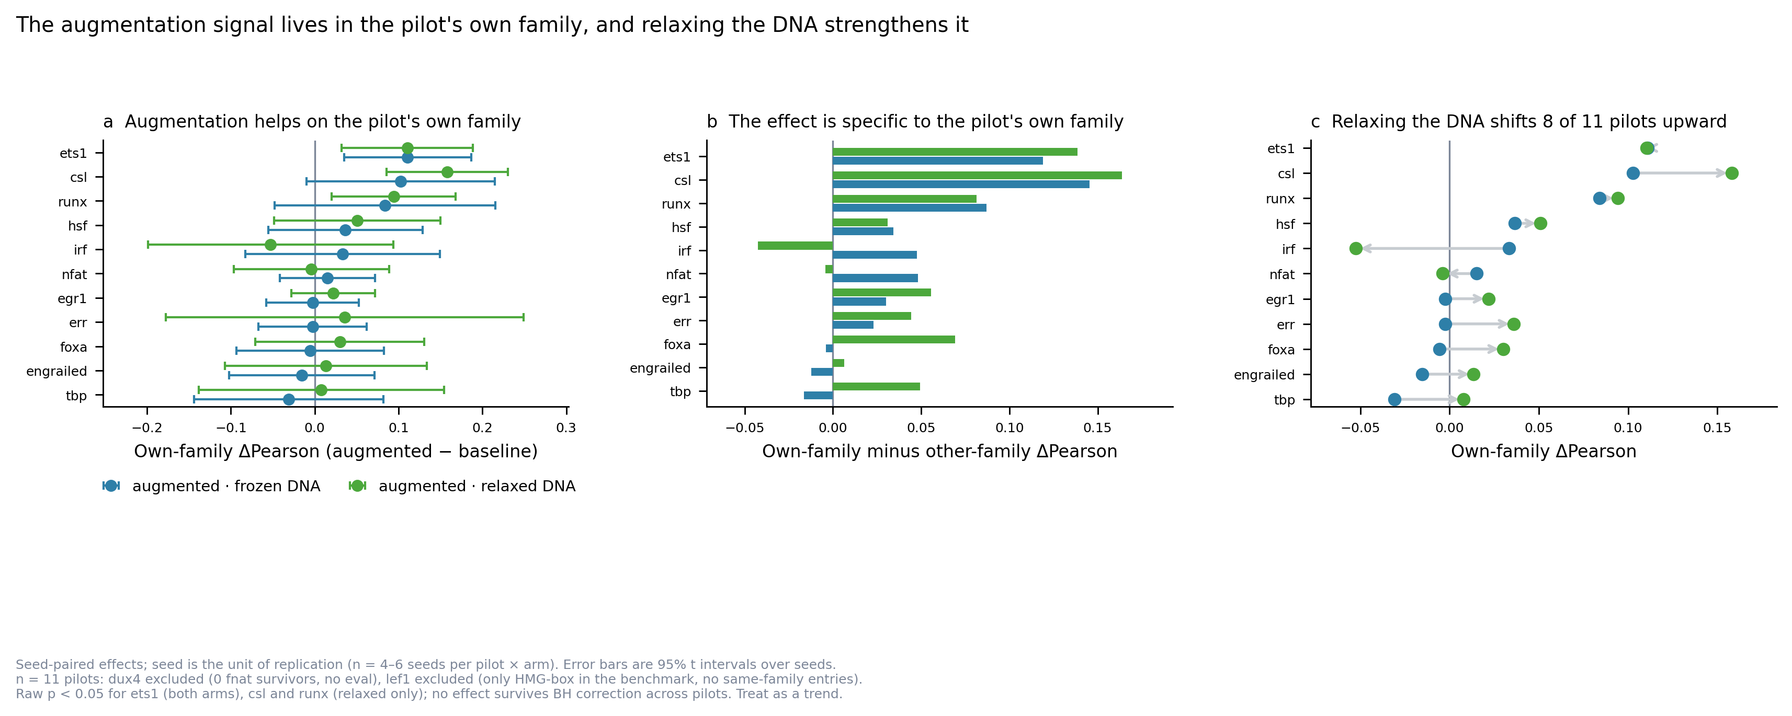
The effect is specific to the pilot's own family
M3 · own-family effect both arms, specificity, and the relaxation shift
Notes:
Three panels tying the effect to family and to the DNA arm. (a) own-family ΔPearson with seed-level 95% CIs, both frozen and relaxed; (b) own-family MINUS other-family — positive for nearly all pilots, the specificity that rules out generic regularization; (c) the frozen→relaxed shift, 8 of 11 pilots moving up. The caption is explicit: seed is the unit, nothing survives BH correction across 11 pilots, treat as a trend. This is the honest quantitative backbone of Ch. 16-17.

Slide 41
Chapter 16 illustration
Structure + PWM: what augmentation does to a prediction
High-gain exemplars — shown ONLY with the honest-context panel

Slide 42
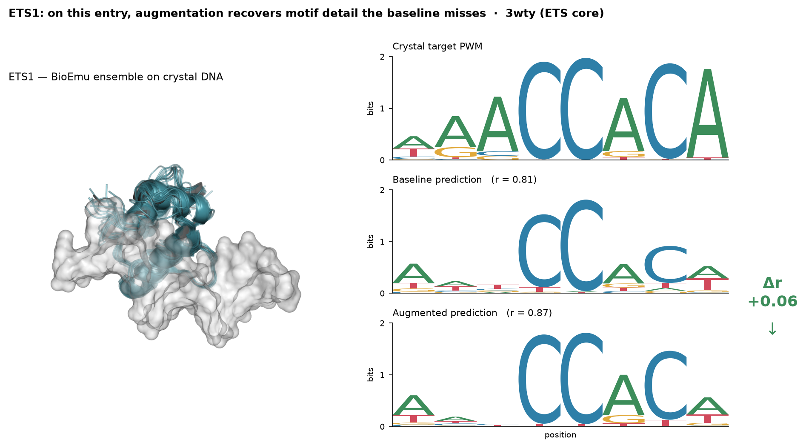
ETS1: augmentation recovers motif detail (3wty)
struct_pwm · ETS1 3wty, seed-averaged predictions, Δr +0.06
Notes:
A single benchmark entry made concrete. Left: the ETS1 BioEmu ensemble on the crystal DNA. Right: three PWM logos — crystal target, baseline prediction, augmented prediction — as sequence logos scaled by information content.
ETS1 already predicts the CCAC core well (baseline r=0.81); augmentation tightens it to r=0.87. This is a 'when it works, this is what it looks like' illustration. Crucial caveat on the next-but-one slide: this is a HIGH-GAIN entry chosen for legibility, not the typical case.

Slide 43
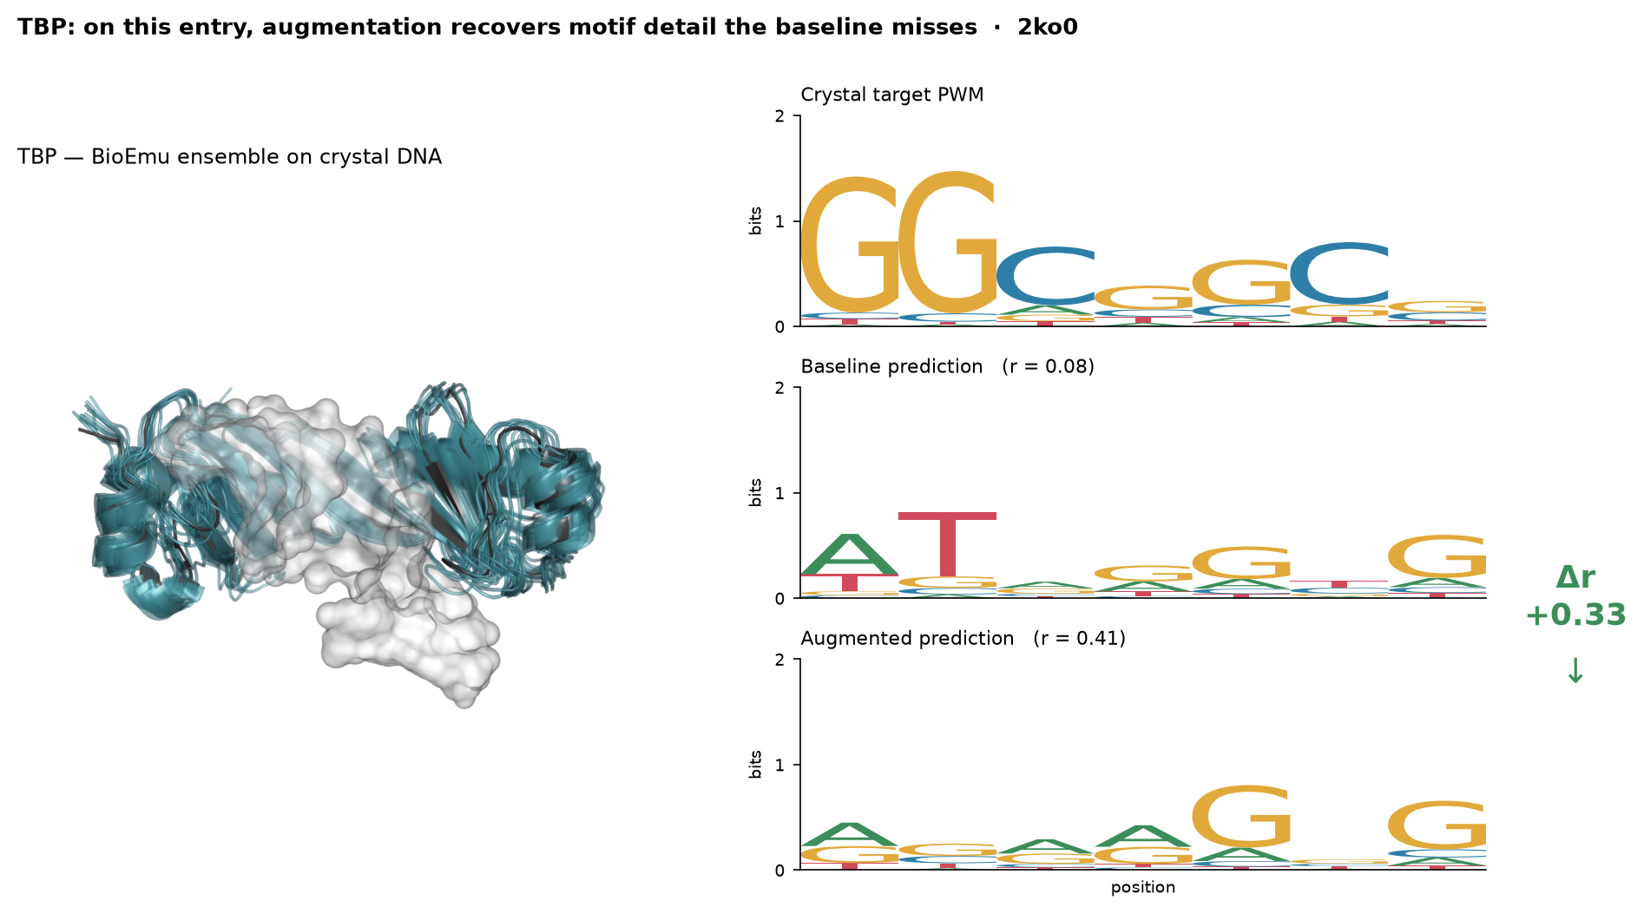
TBP: the clearest recovery (2ko0)
struct_pwm · TBP 2ko0, Δr +0.33 on this entry
Notes:
TBP is the strongest single-entry example. The baseline barely predicts a motif at all (r=0.08 — essentially noise); augmentation recovers real structure (r=0.41, Δr +0.33). Visually the augmented logo develops the periodic G/C pattern the baseline missed entirely.
This is striking BUT it is one hand-picked entry for an induced-fit TF whose population median effect is near zero. Show it only paired with the context panel — it demonstrates the mechanism can act, not that TBP is helped on average.

Slide 44
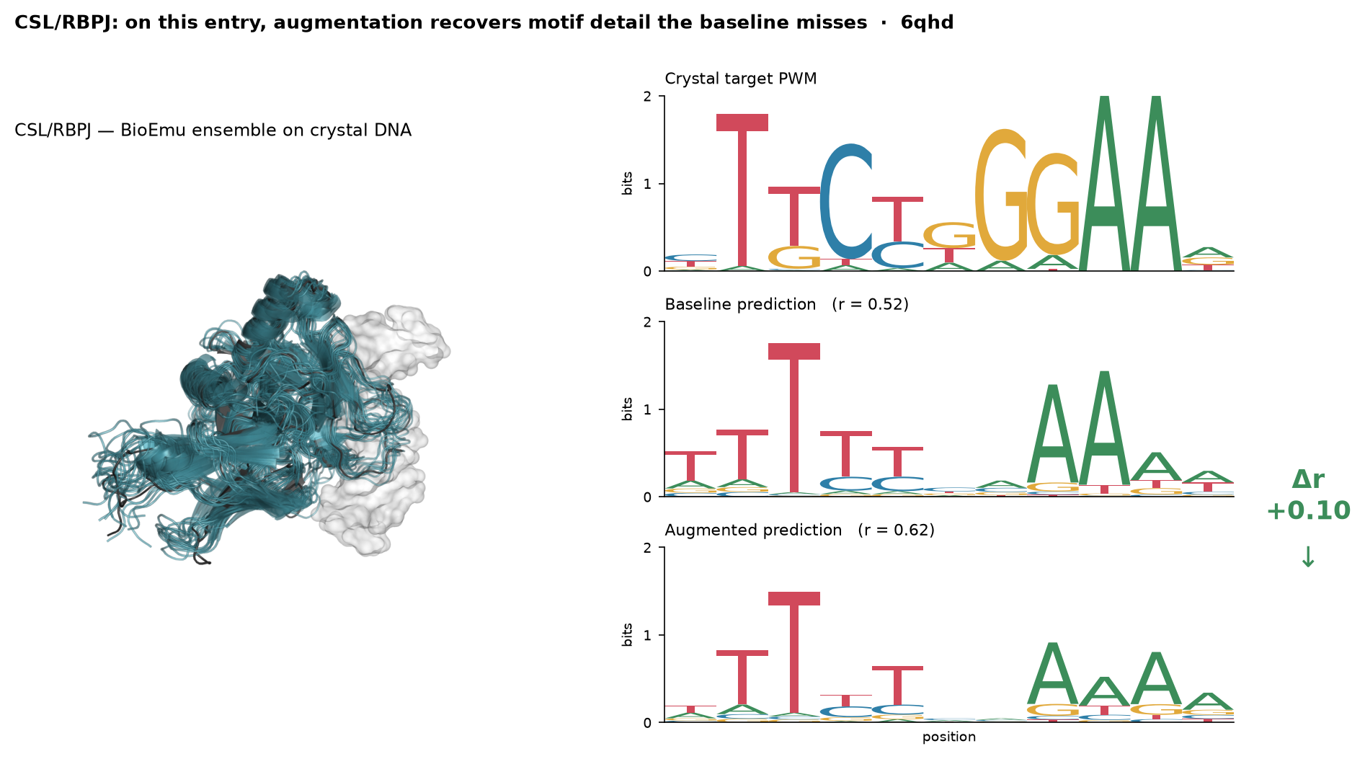
CSL/RBPJ: augmentation sharpens the motif (6qhd)
struct_pwm · CSL 6qhd, Δr +0.10 on this entry
Notes:
CSL/RBPJ: augmentation sharpens the GGAA half of the motif (baseline r=0.52 → augmented r=0.62). The third exemplar, chosen because CSL is one of the pilots with a real own-family effect (M5). Same caveat: high-gain entry, context panel mandatory.

Slide 45
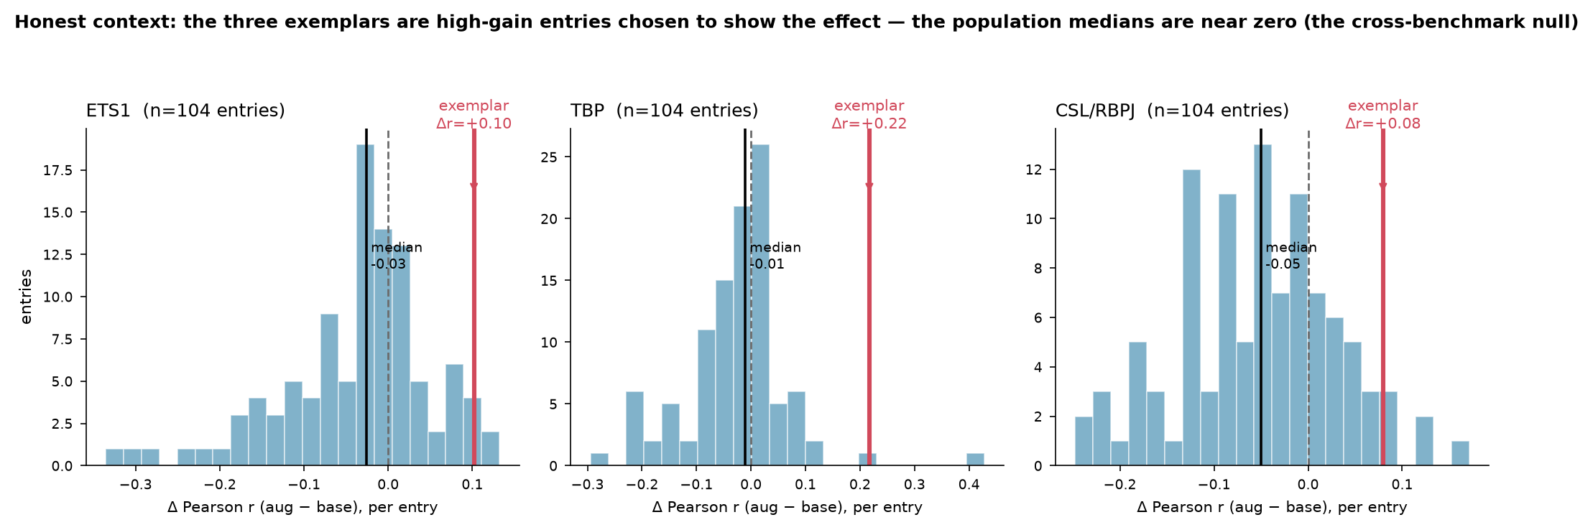
Honest context: the exemplars are cherry-picked
struct_pwm_context · per-entry Δr, exemplars (red) vs population median (black)
Notes:
This panel is what keeps the three exemplars honest, and it must always accompany them. For each pilot it shows the full per-entry Δr distribution (104 entries) with the exemplar flagged in red against the population median in black.
The medians are near zero — ETS1 -0.03, TBP -0.01, CSL -0.05 — which is exactly the cross-benchmark null from Ch. 16, and I recomputed the distribution from the same prediction population as the exemplars so the flag is self-consistent. The exemplars sit in the right tail. The takeaway to say out loud: these beautiful single-entry recoveries are the best cases, not the average — the average effect on the broad benchmark is essentially zero, and that is the honest headline.

Slide 46
Chapter 18
DNA relaxation: the stress test and the falsifiable prediction
Softening the DNA restraint — does it move the induced-fit families the predicted way?

Slide 47
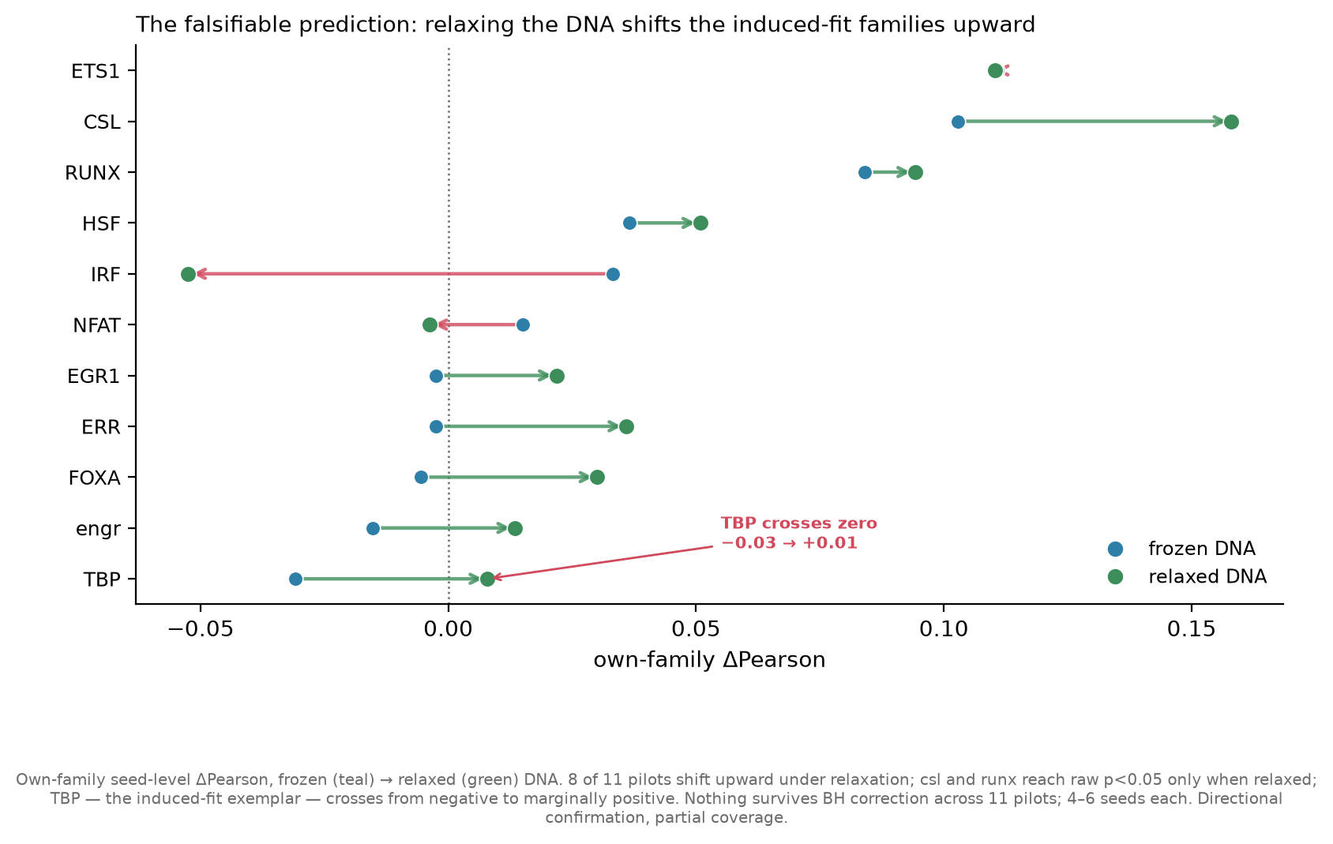
The falsifiable prediction: relaxing the DNA shifts families upward
ch18 · own-family ΔPearson, frozen→relaxed, 8/11 upward
Notes:
The direct test of the Ch. 17 mechanism. If augmentation hurts because the frozen DNA locks in off-target shapes, then letting the DNA relax should help — especially for the induced-fit families. Each pilot's own-family ΔPearson is shown frozen (teal) → relaxed (green).
8 of 11 pilots shift upward. CSL and RUNX reach raw p<0.05 only when relaxed. TBP — the induced-fit exemplar — crosses from negative to marginally positive. IRF and NFAT move DOWN (red), against the prediction. The honest framing, in the caption: nothing survives BH correction across 11 pilots, 4-6 seeds each, so this is a directional confirmation at partial coverage — the sign of the effect matches the prediction, but it is a trend, not a proof.

Slide 48
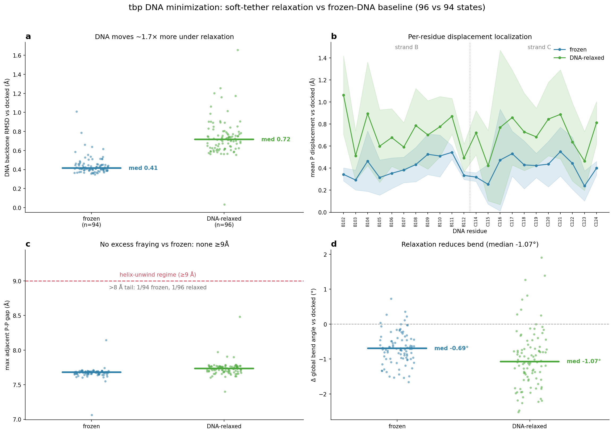
DNA moves more under relaxation, without fraying (per-TF)
tbp_dna_shape · frozen vs relaxed DNA motion, fraying, bend
Notes:
A representative per-TF DNA-relaxation diagnostic (TBP shown). Panel a: DNA backbone RMSD from docked — relaxed states move ~1.7x more than frozen, confirming the soft restraint actually lets the DNA move. Panel c: the fraying/helix-unwind check — very few states enter the >=9 Angstrom unwind regime, so the DNA moves but does not come apart. Panel d: relaxation increases bend modestly.
This is the structural evidence that the relaxed arm is doing what it should: adding real DNA flexibility, not destroying the duplex. The full per-TF set exists for all 11 covered pilots.

Slide 49
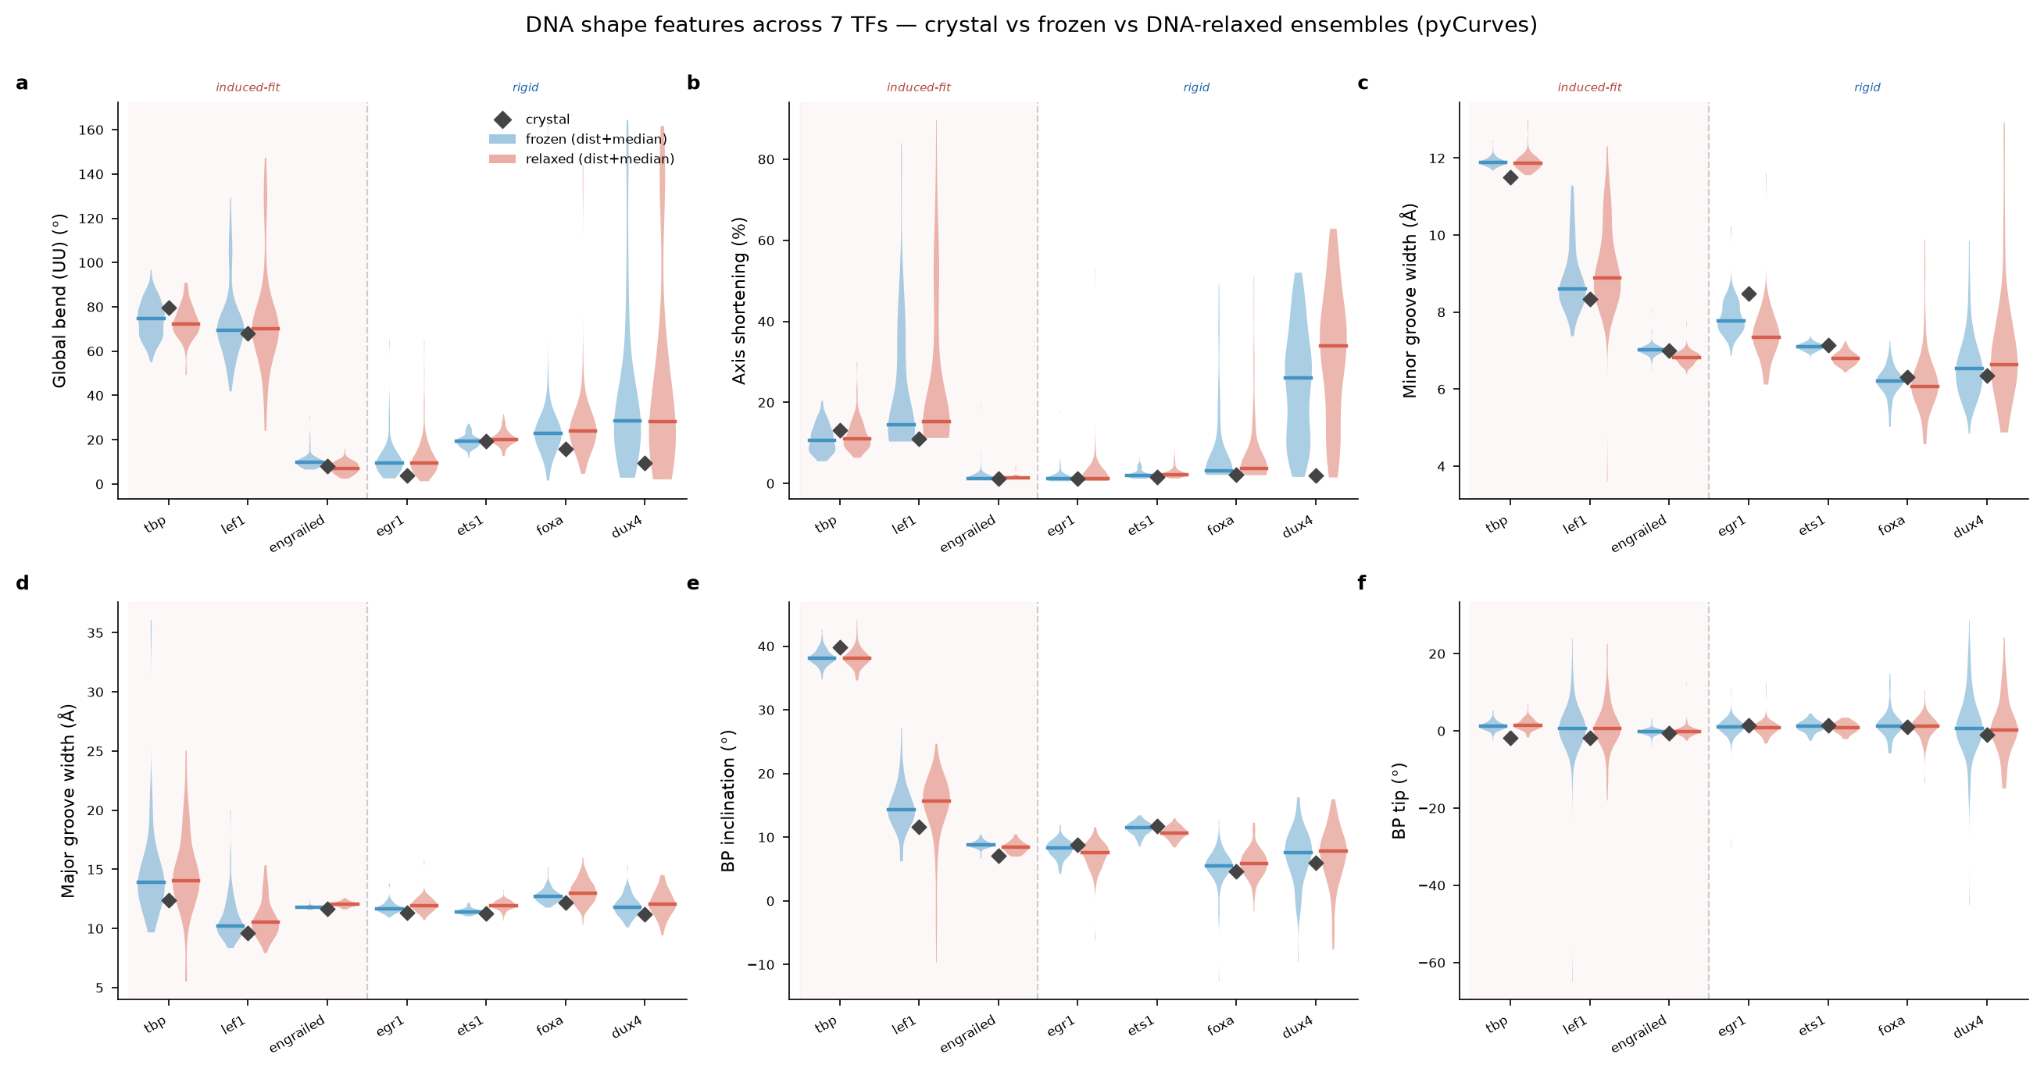
DNA shape flexibility increases under relaxation (overview)
dna_shape_features · cross-pilot DNA-shape response to relaxation
Notes:
The 6-panel cross-pilot overview of how DNA shape responds to relaxation. Interface minor-groove-width flexibility increases modestly for most pilots (mean Δ ≈ +0.2). The DNA gains genuine physical flexibility under the soft restraint — the mechanistic ingredient the augmentation experiment needs. Coverage is 7 pilots here; caption as preliminary.

Slide 50
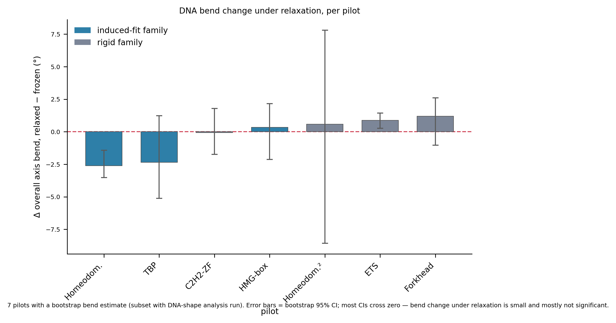
DNA bend change under relaxation is small and mostly non-significant
crossfamily_bend · per-pilot Δ bend, bootstrap CIs
Notes:
An honesty figure. Per-pilot change in overall DNA axis bend under relaxation, with bootstrap 95% CIs. Most CIs cross zero — the bend change is small and mostly not significant at the whole-duplex level. This is the evidence behind the Ch. 18 correction: relaxed DNA does NOT cleanly converge toward the crystal geometry on global metrics, contrary to the outline's original claim. Include it precisely because it constrains the DNA-relaxation story.

Slide 51
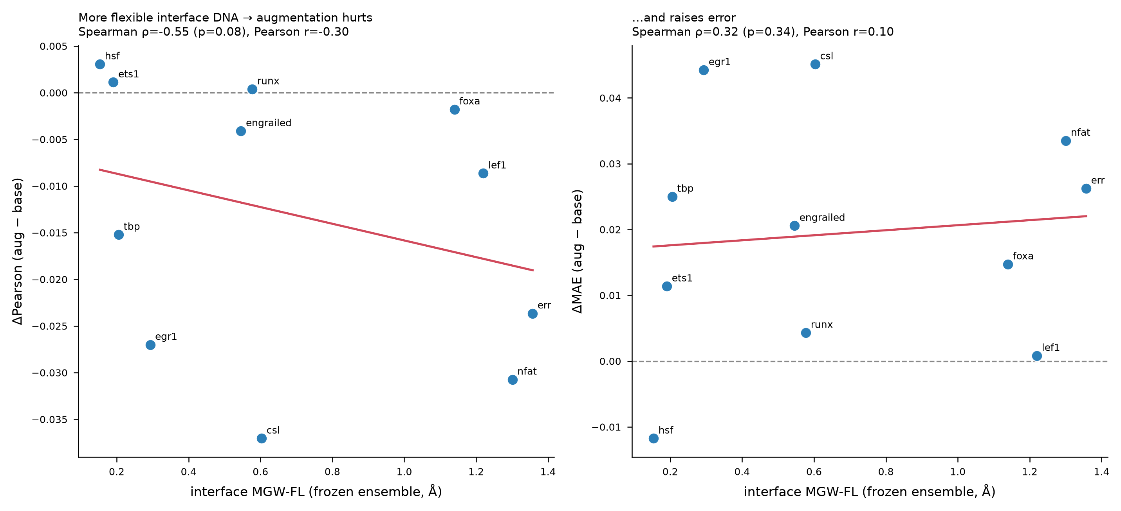
Interface MGW flexibility vs accuracy
iface_mgwfl_vs_accuracy · interface DNA flexibility vs accuracy
Notes:
Ties the DNA-shape flexibility directly to model accuracy: does interface minor-groove-width flexibility predict where augmentation helps. The bridge between the structural DNA-relaxation measurements and the accuracy outcome — the same dynamic-DNA logic as M6, measured at the interface.

Slide 52
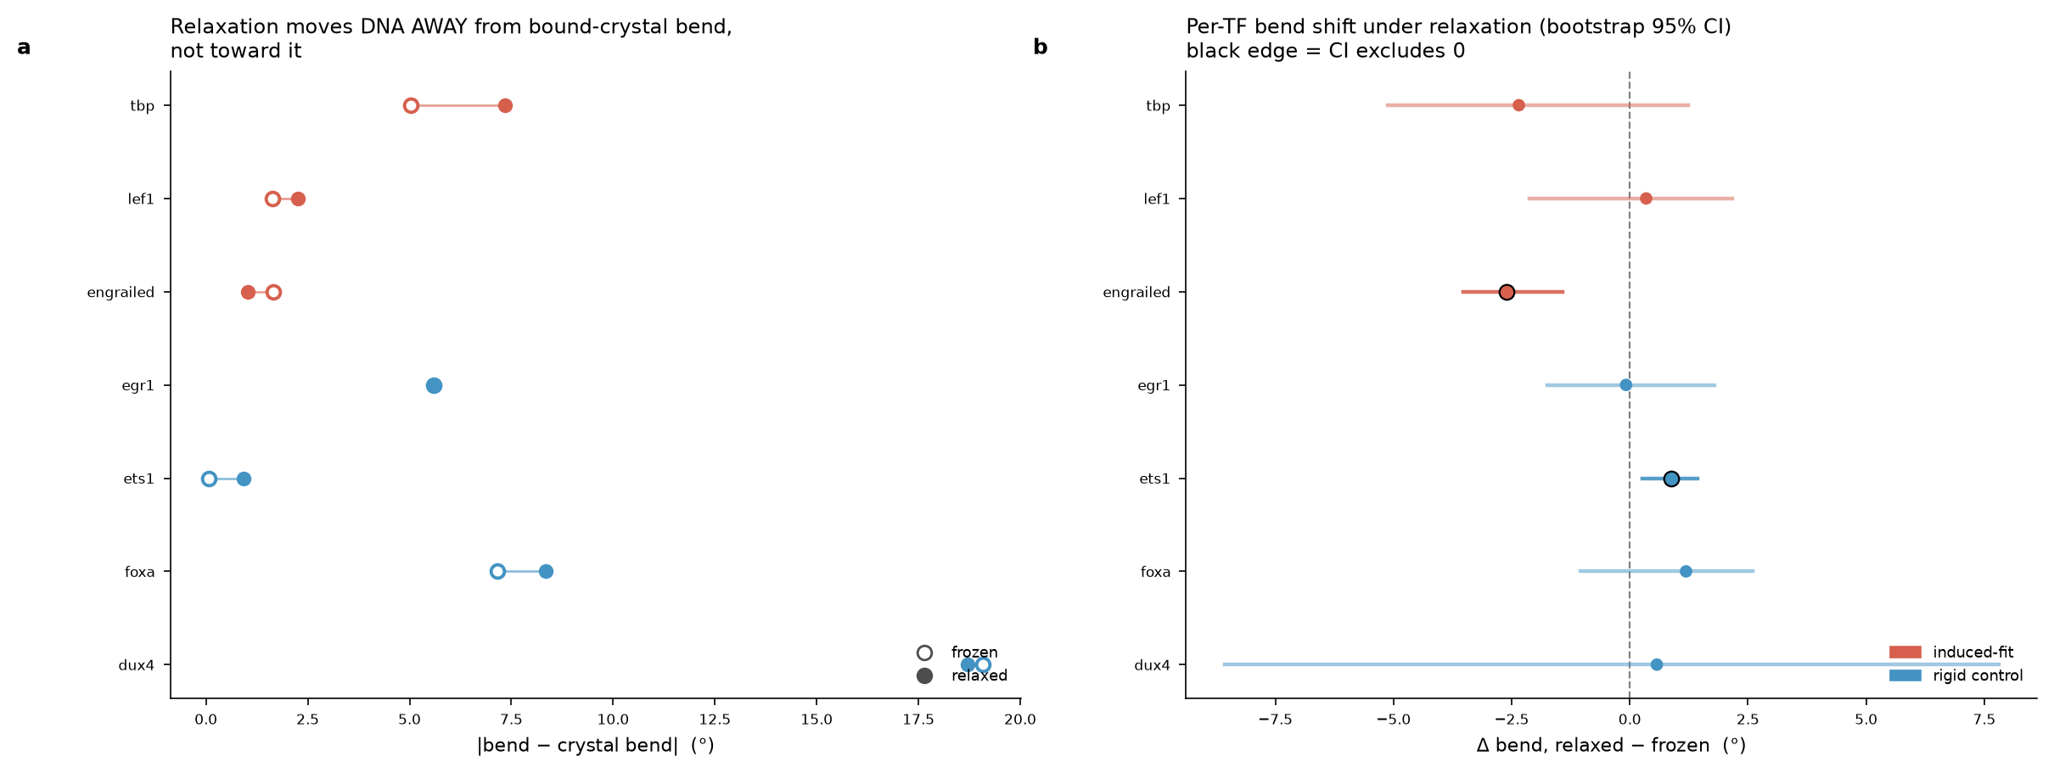
Crystal convergence under relaxation (read direction carefully)
crystal_convergence_bootstrap · per-position bend vs crystal — read per-position only
Notes:
The per-position bend-vs-crystal analysis with bootstrap CIs. IMPORTANT caption caveat: do not present this as 'DNA bends toward the bound conformation' at the whole-duplex level — the global convergence data do not support that (relaxation moves closer to crystal in only 7 of 42 feature-pilot cases). Use this figure only for its per-position message, with the CIs, and state that the whole-duplex medians do not converge.

Slide 53
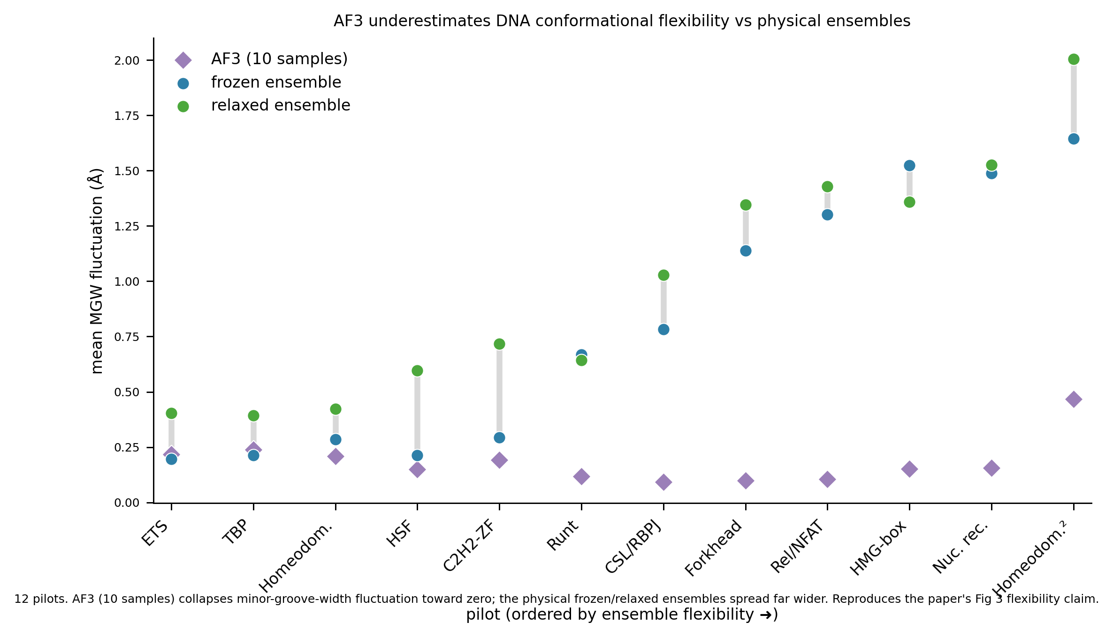
AF3 vs ensemble DNA-shape flexibility
af3_vs_ensemble_mgwfl · DNA-shape flexibility, AF3 vs ensemble
Notes:
Contrasts the DNA-shape flexibility of the BioEmu ensemble against AF3 — reinforcing D1's point at the DNA level: the ensemble carries DNA-shape variability that a single AF3 pose cannot. Motivates why an ensemble is the right input for DNA-shape-sensitive prediction.

Slide 54
Appendix
Supporting figures
Per-TF DNA-relaxation panels, additional evaluation metrics, and diagnostics

Slide 55
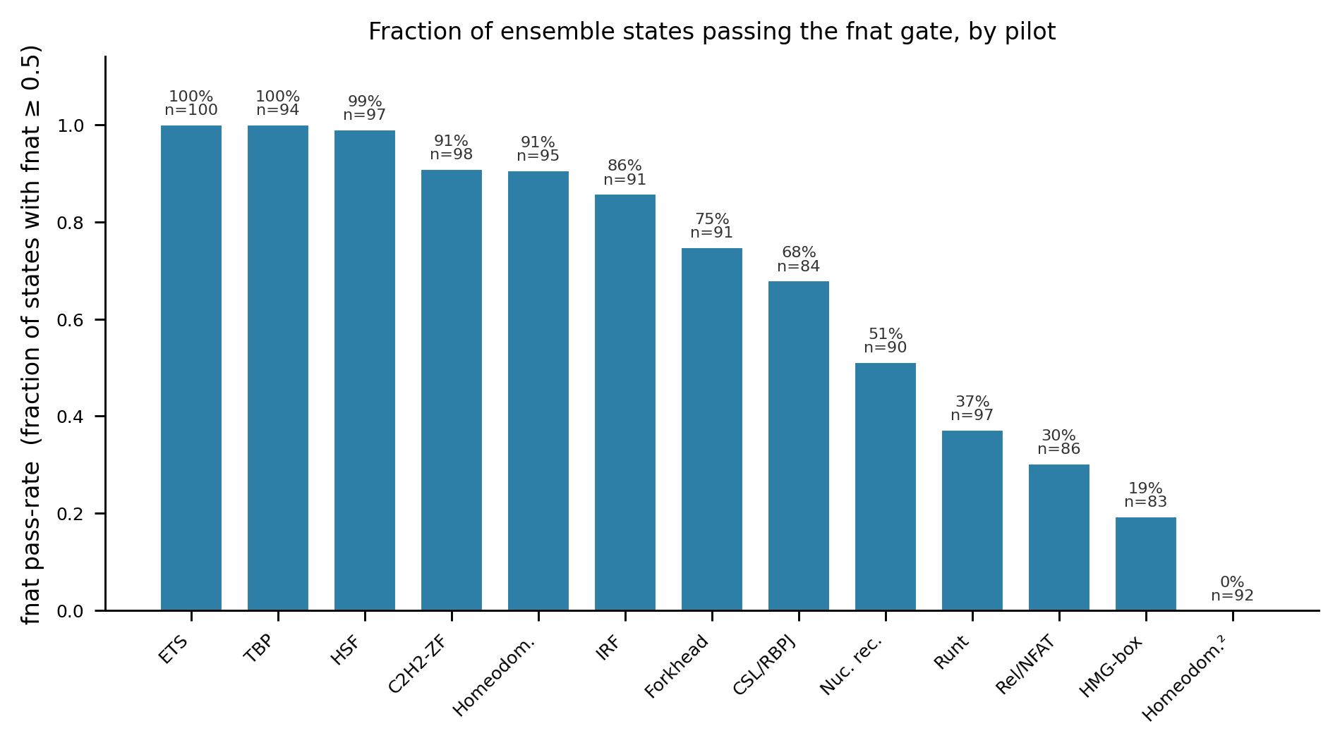
Pass-rate bars by pilot
F2 · fnat pass rate per pilot
Notes:
The fnat pass rate per pilot as bars — the compact companion to the F1 violins. This ordering (100% down to 0%) is the 'rigidity' sequence used as the x-axis throughout; note it is the pass-rate ranking itself, a mechanistic interpretation rather than an independently measured rigidity.

Slide 56
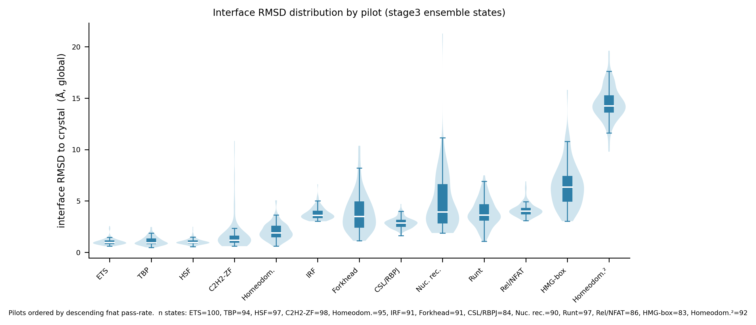
Interface RMSD distributions by pilot
I1 · per-state interface RMSD by pilot
Notes:
Per-state interface RMSD distributions, the RMSD counterpart to the F1 fnat violins. Same rigidity ordering, same message from the other fidelity metric.

Slide 57
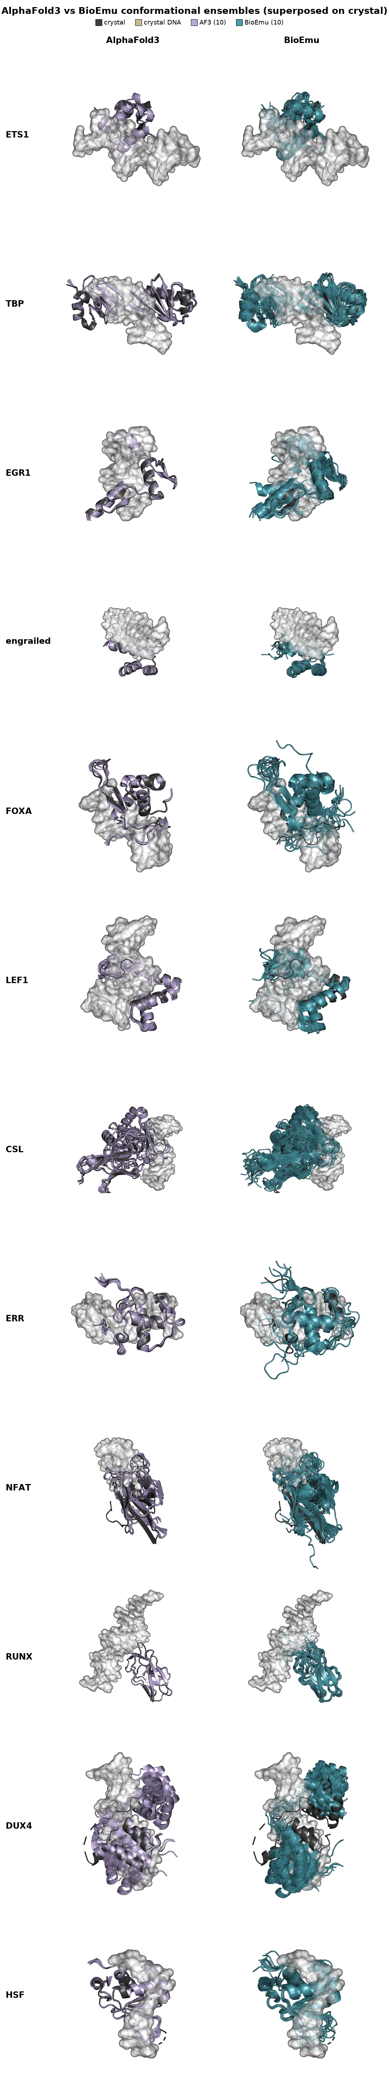
Ensemble montage across pilots
ensembles_montage · BioEmu ensembles across pilots
Notes:
A visual montage of the BioEmu ensembles across pilots — the qualitative companion to D1's quantitative diversity plot. Useful as an orientation slide showing the range of fold types and DNA geometries in the pilot set.

Slide 58
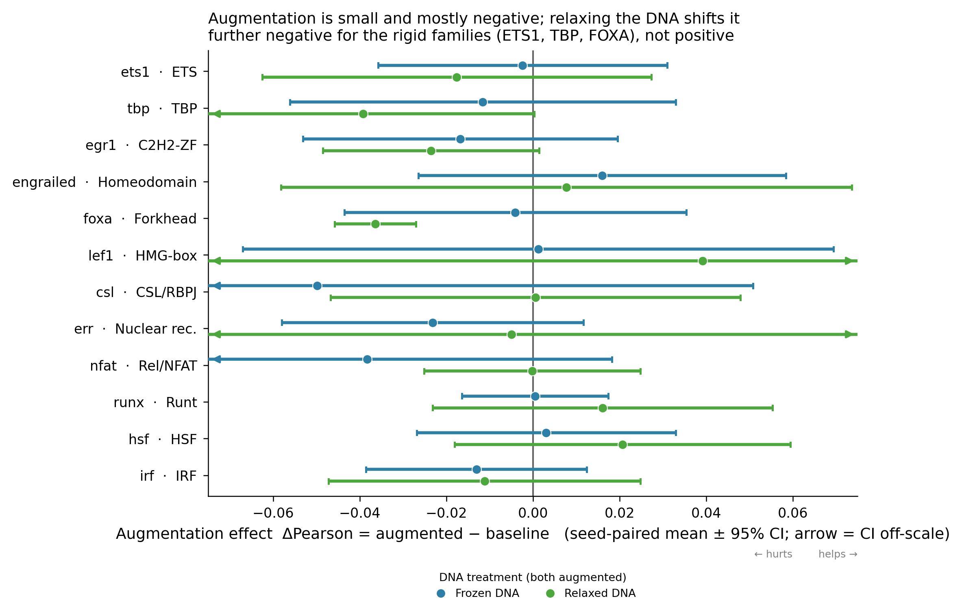
Augmentation delta (seed-level), general benchmark
fig2 · seed-level augmentation delta, general-130
Notes:
The seed-level augmentation delta on the general benchmark — the honest counterpart to the pseudoreplicated fig9. This is the figure to cite for the cross-benchmark effect size, computed with seed as the unit.

Slide 59
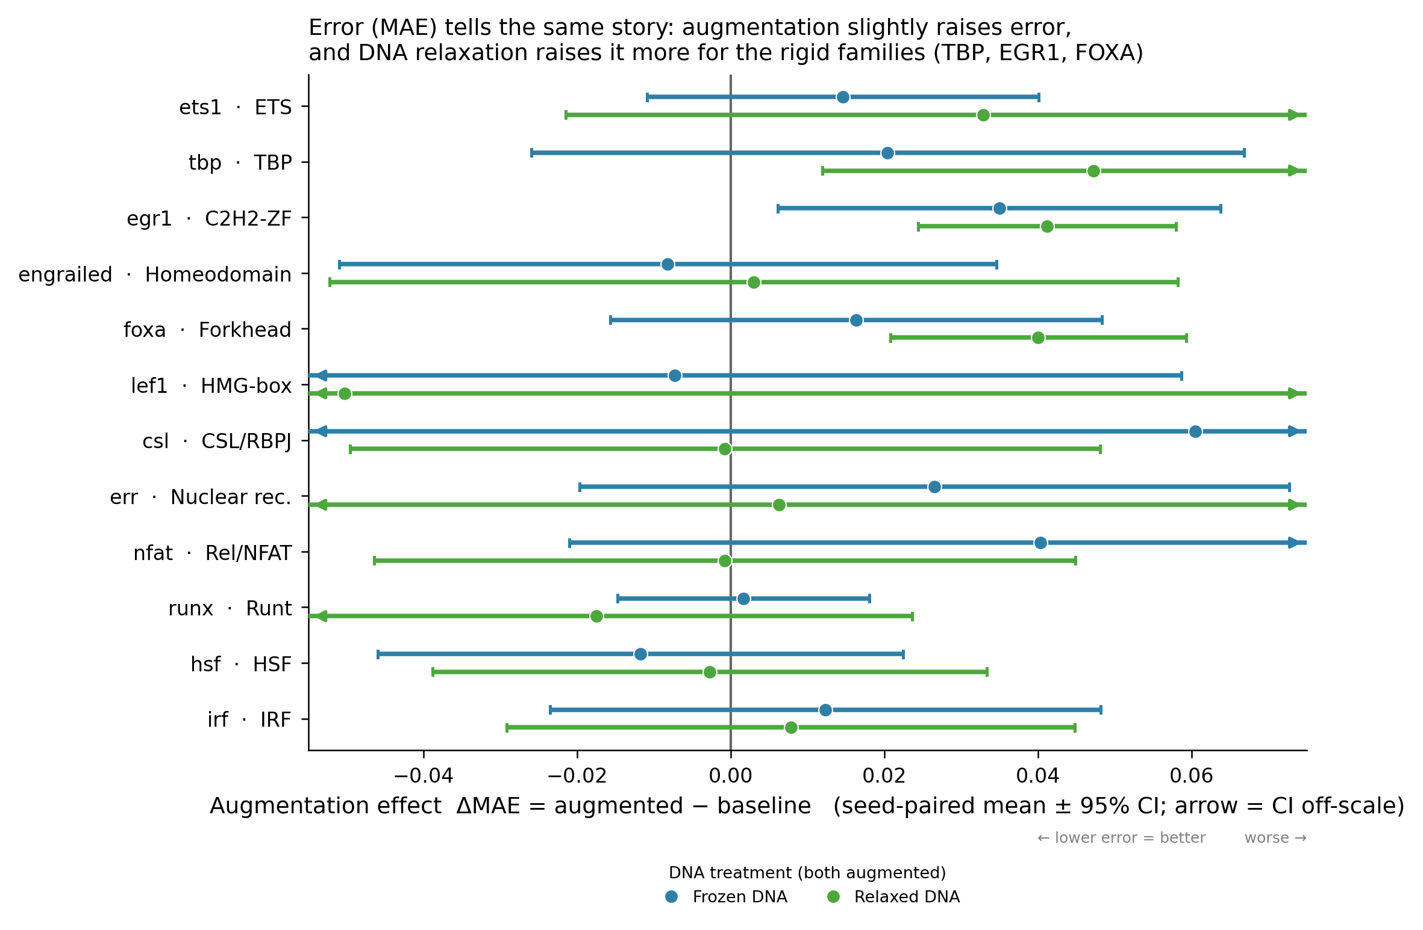
MAE delta by pilot
fig5 · MAE delta, augmented vs baseline
Notes:
Augmentation effect measured as MAE change rather than Pearson — the second-metric check that the effect direction is consistent across accuracy measures.

Slide 60

Absolute Pearson by group
fig7 · absolute Pearson by group
Notes:
Absolute Pearson accuracy grouped by condition — context for the deltas, showing the levels the differences sit on.

Slide 61

Absolute MAE by group
fig8 · absolute MAE by group
Notes:
Absolute MAE by group — the MAE companion to fig7.

Slide 62

Cross-family augmentation effect (DNA-relax)
crossfamily_augmentation_effect · induced-fit vs rigid, both panels
Notes:
The DNA-relaxation augmentation effect split by induced-fit vs rigid families, on both the shared 130-structure panel and each TF's own held-out targets. The two-panel breakdown behind the frozen-vs-relaxed story; note the small own-target n (only 3 TFs are in the id benchmark).

Slide 63

Same-family augmentation effect (DNA-relax)
samefamily_augmentation_effect · own-family, relaxed arm
Notes:
The same-family augmentation effect under DNA relaxation — the relaxed-arm analogue of M3's own-family panel, restricted to the DNA-relax subset.

Slide 64

MGW flexibility, all 12 panels
mgw_fl_all12_panels · per-pilot minor-groove-width flexibility
Notes:
Minor-groove-width flexibility across all 12 pilots in one panel grid — the complete per-pilot view behind the summary MGW-flexibility numbers.

Slide 65

Per-position minor-groove analysis
perposition_minorgroove · per-position minor-groove width
Notes:
Minor-groove width resolved per DNA position — where along the duplex the groove flexibility concentrates, relevant to which positions DeepPBS reads.

Slide 66

pyCurves ensemble summary
pycurves_ensemble_summary · ensemble DNA-shape (pyCurves)
Notes:
The pyCurves-based DNA shape summary across the ensemble — the per-position bend/shape analysis underlying the convergence figures.

Slide 67

DNA shape features, fnat-pass subset
dna_shape_features_fnatpass · DNA shape, fnat-pass states only
Notes:
The DNA-shape feature overview restricted to fnat-passing states — the quality-controlled version of the dna_shape_features figure.

Slide 68

Training overfit diagnostic
training_overfit_diagnostic · learning curves, both arms
Notes:
A training-health check: baseline vs augmented learning curves, confirming the augmented models are not simply overfitting the added frames. Supports that any effect is generalization, not memorization.

Slide 69

MGW style demo (engrailed)
mgw_style_engrailed_demo · MGW analysis method
Notes:
A methods/style demonstration of the minor-groove-width analysis on engrailed — included to document how the DNA-shape panels are constructed.

Slide 70

DNA relaxation diagnostic: CSL/RBPJ
csl_dna_shape · frozen vs relaxed DNA, per-residue, fraying, bend
Notes:
Per-TF DNA-relaxation diagnostic for CSL/RBPJ: DNA backbone motion frozen vs relaxed (panel a, with the ~1.5-1.9x motion increase), per-residue displacement localization (b), the fraying/helix-unwind check (c), and the bend change (d). One of the 10 per-TF panels; together they show the soft DNA restraint adds real, localized flexibility across the pilot set without the duplex fraying.

Slide 71

DNA relaxation diagnostic: DUX4
dux4_dna_shape · frozen vs relaxed DNA, per-residue, fraying, bend
Notes:
Per-TF DNA-relaxation diagnostic for DUX4: DNA backbone motion frozen vs relaxed (panel a, with the ~1.5-1.9x motion increase), per-residue displacement localization (b), the fraying/helix-unwind check (c), and the bend change (d). One of the 10 per-TF panels; together they show the soft DNA restraint adds real, localized flexibility across the pilot set without the duplex fraying.

Slide 72

DNA relaxation diagnostic: EGR1
egr1_dna_shape · frozen vs relaxed DNA, per-residue, fraying, bend
Notes:
Per-TF DNA-relaxation diagnostic for EGR1: DNA backbone motion frozen vs relaxed (panel a, with the ~1.5-1.9x motion increase), per-residue displacement localization (b), the fraying/helix-unwind check (c), and the bend change (d). One of the 10 per-TF panels; together they show the soft DNA restraint adds real, localized flexibility across the pilot set without the duplex fraying.

Slide 73

DNA relaxation diagnostic: engrailed
engrailed_dna_shape · frozen vs relaxed DNA, per-residue, fraying, bend
Notes:
Per-TF DNA-relaxation diagnostic for engrailed: DNA backbone motion frozen vs relaxed (panel a, with the ~1.5-1.9x motion increase), per-residue displacement localization (b), the fraying/helix-unwind check (c), and the bend change (d). One of the 10 per-TF panels; together they show the soft DNA restraint adds real, localized flexibility across the pilot set without the duplex fraying.

Slide 74

DNA relaxation diagnostic: ERR
err_dna_shape · frozen vs relaxed DNA, per-residue, fraying, bend
Notes:
Per-TF DNA-relaxation diagnostic for ERR: DNA backbone motion frozen vs relaxed (panel a, with the ~1.5-1.9x motion increase), per-residue displacement localization (b), the fraying/helix-unwind check (c), and the bend change (d). One of the 10 per-TF panels; together they show the soft DNA restraint adds real, localized flexibility across the pilot set without the duplex fraying.

Slide 75

DNA relaxation diagnostic: ETS1
ets1_dna_shape · frozen vs relaxed DNA, per-residue, fraying, bend
Notes:
Per-TF DNA-relaxation diagnostic for ETS1: DNA backbone motion frozen vs relaxed (panel a, with the ~1.5-1.9x motion increase), per-residue displacement localization (b), the fraying/helix-unwind check (c), and the bend change (d). One of the 10 per-TF panels; together they show the soft DNA restraint adds real, localized flexibility across the pilot set without the duplex fraying.

Slide 76

DNA relaxation diagnostic: FOXA
foxa_dna_shape · frozen vs relaxed DNA, per-residue, fraying, bend
Notes:
Per-TF DNA-relaxation diagnostic for FOXA: DNA backbone motion frozen vs relaxed (panel a, with the ~1.5-1.9x motion increase), per-residue displacement localization (b), the fraying/helix-unwind check (c), and the bend change (d). One of the 10 per-TF panels; together they show the soft DNA restraint adds real, localized flexibility across the pilot set without the duplex fraying.

Slide 77

DNA relaxation diagnostic: LEF1
lef1_dna_shape · frozen vs relaxed DNA, per-residue, fraying, bend
Notes:
Per-TF DNA-relaxation diagnostic for LEF1: DNA backbone motion frozen vs relaxed (panel a, with the ~1.5-1.9x motion increase), per-residue displacement localization (b), the fraying/helix-unwind check (c), and the bend change (d). One of the 10 per-TF panels; together they show the soft DNA restraint adds real, localized flexibility across the pilot set without the duplex fraying.

Slide 78

DNA relaxation diagnostic: NFAT
nfat_dna_shape · frozen vs relaxed DNA, per-residue, fraying, bend
Notes:
Per-TF DNA-relaxation diagnostic for NFAT: DNA backbone motion frozen vs relaxed (panel a, with the ~1.5-1.9x motion increase), per-residue displacement localization (b), the fraying/helix-unwind check (c), and the bend change (d). One of the 10 per-TF panels; together they show the soft DNA restraint adds real, localized flexibility across the pilot set without the duplex fraying.

Slide 79

DNA relaxation diagnostic: RUNX
runx_dna_shape · frozen vs relaxed DNA, per-residue, fraying, bend
Notes:
Per-TF DNA-relaxation diagnostic for RUNX: DNA backbone motion frozen vs relaxed (panel a, with the ~1.5-1.9x motion increase), per-residue displacement localization (b), the fraying/helix-unwind check (c), and the bend change (d). One of the 10 per-TF panels; together they show the soft DNA restraint adds real, localized flexibility across the pilot set without the duplex fraying.

