Slide 1
Conformational Ensembles for DNA-Binding Specificity
Integrating BioEmu dynamics into DeepPBS — motivation, process, caveats, results, next directions
Figure walkthrough of the book
Notes:
Figure-by-figure walkthrough of the TF-conformation book. Each slide carries a figure with short on-slide bullets; the full narrative is in these speaker notes. Runbook / how-to-run material is excluded by design.

Slide 2
Part I
Motivation — why conformation should matter for specificity
A transcription factor is not one shape — it is an ensemble of poses.
DeepPBS reads a single crystal and treats the DNA as fixed.
The question: does adding the free-state conformational ensemble help?
Notes:
Section divider. Part I motivates the whole project: PWMs and structure-based predictors like DeepPBS take one frozen structure, but proteins and DNA live as ensembles. The motivation chapters build to a single hypothesis — augmentation should help under conformational selection and hurt under induced-fit.

Slide 3
Ch. 1
The specificity problem
• A PWM encodes per-position base preference — and flattens away shape and context.
• DeepPBS maps structure → specificity, but takes the DNA as fixed.
• A crystal is one frozen pose of a molecule that lives as an ensemble.
Notes:
A position weight matrix (PWM) records how strongly each base is preferred at each position, assuming positions act independently — it carries no readout of DNA shape or sequence context. Protein structure encodes binding preference through base readout (direct H-bonds to the edges) and shape readout (sensing groove geometry) at the interface. DeepPBS sits in this landscape as a structure→specificity model that takes the DNA conformation as given. The gap this project attacks: the input is a single crystal — one frozen snapshot of a molecule that in solution samples many conformations.

Slide 4
Ch. 2
The rigid-structure blind spot
• DeepPBS is constitutively blind to DNA deformation and induced-fit rearrangement.
• That blindness, reframed, is a clean instrument: it isolates the protein-side question.
• BioEmu ensemble = computational apo (free); crystal = holo (bound).
Notes:
Because DeepPBS reads one fixed structure, it cannot see DNA deformation on binding, nor induced-fit rearrangement of the protein. Reframed, that limitation is useful: it isolates a clean question — does the free-state protein ensemble alone carry binding-relevant information? The key conceptual move of the book is to treat the BioEmu-sampled ensemble as a computational apo (unbound) state and the crystal as the holo (bound) state — the apo/holo contrast is the lever every later chapter pulls on.

Slide 5
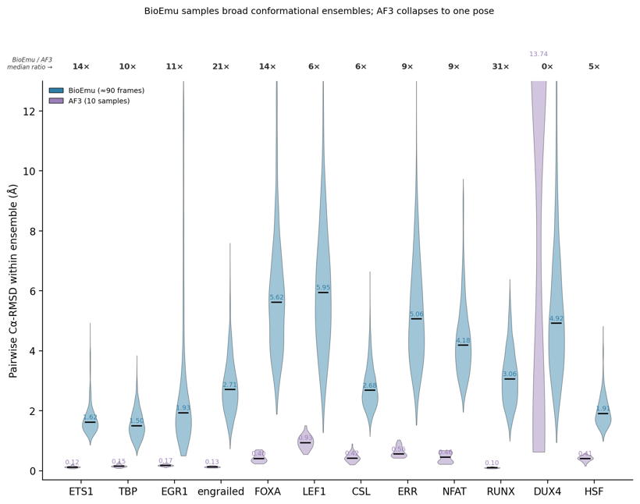
Ch. 3
Why free-state ensembles, and why BioEmu not AlphaFold3
• Current predictors don't reliably model protein–DNA complexes — hence dock + minimize.
• AF3 collapses to ~one pose (median pairwise 0.1–0.9 Å); BioEmu spreads 1.5–6 Å — 10× more.
• To populate an ensemble you need a sampler, not a single high-confidence structure.
• DUX4 is the exception that proves the rule: its AF3 'diversity' is dimer placement, not sampling.
Notes:
The first question a successor asks: why not predict the TF–DNA complex directly with AlphaFold3 and skip sampling + docking? Two reasons. (1) The complex-modeling gap — current structure predictors don't reliably model protein–DNA complexes, which is why the pipeline docks a sampled protein onto crystal DNA and leans on liberal cutoffs and energy minimization. (2) The diversity gap, the decisive argument — even as a free-protein predictor, AF3 collapses to essentially one pose. Across 2 seeds × 5 samples, AF3's median pairwise Cα-RMSD is ~0.1–0.9 Å for the monomeric pilots (runx 0.10, ets1 0.12, engrailed 0.13, tbp 0.15, egr1 0.17 … lef1 0.93), while BioEmu spreads 1.5–6 Å — an order of magnitude more (ets1 1.62, tbp 1.50, foxa 5.62, lef1 5.95). The premise is to populate the free-state ensemble; a model returning one high-confidence structure cannot. The DUX4 caveat proves the rule: AF3's only large apparent diversity (median 13.7 Å) is assembly-placement variance between the two dimer copies, not conformational sampling — reinforcing the monomer-only scope. D1 shows the per-pilot spread; the companion DNA-side figure (af3_vs_ensemble_mgwfl) makes the same point for minor-groove-width fluctuation.

Slide 6
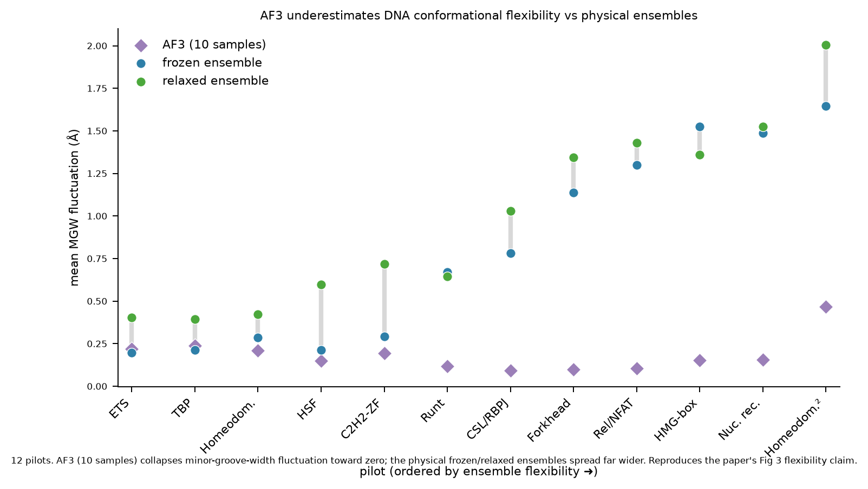
Ch. 3 (DNA side)
AF3 underestimates DNA flexibility too
• Same argument, DNA side: AF3 collapses minor-groove-width fluctuation toward zero.
• Physical frozen/relaxed ensembles spread far wider, across 12 pilots.
• Reproduces the paper's Fig-3 flexibility claim on our pilots.
Notes:
The DNA-side version of the diversity argument. AF3 (10 samples) collapses minor-groove-width (MGW) fluctuation toward zero, while the physical frozen and relaxed ensembles spread much wider — pilots ordered rigid→flexible left to right. This reproduces the flexibility claim of the source paper's Figure 3 on our 12 pilots. Together with D1 (protein side), it makes the full case for a physical ensemble sampler over a single-structure predictor, on both the protein and the DNA.

Slide 7
Ch. 4
The core idea and the hypothesis
• Augmentation: train DeepPBS on the ensemble, not just the crystal.
• The reframe isolates whether free-state conformers are binding-relevant.
• Hypothesis: help under conformational selection, hurt under induced-fit-on-DNA.
• Every results chapter is a test of this one claim.
Notes:
The augmentation idea: train DeepPBS on the conformational ensemble rather than the single crystal. The reframe — does a free-state protein ensemble improve prediction? — isolates whether free-state conformers are binding-relevant. The central hypothesis, stated up front: augmentation should help under conformational selection (the free protein already samples binding-competent geometry) and hurt under induced-fit-on-DNA (the free frames carry no information about the DNA distortion DeepPBS holds fixed). The 2×2 hypothesis schematic (protein reachability × DNA deformation) is the figure the mechanism chapter, Ch. 17, later fills with measured data.

Slide 8
Part II
Process — the pipeline, stage by stage
A per-TF SLURM DAG: BioEmu → HPacker → re-dock → fnat gate → minimize → featurize → train → eval.
Each stage relaxes one assumption or produces one training input.
The physics stage (Stage 3 minimization) gets the most attention — it is where the biology lives.
Notes:
Section divider. Part II walks the seven pipeline stages plus the fnat gate. The throughline: each stage turns a raw sampled conformer into a physically self-consistent, gated, featurized training pair. The energy-minimization stage is expanded into its own sub-chapters because that is where the modeling choices that determine the science are made.

Slide 9
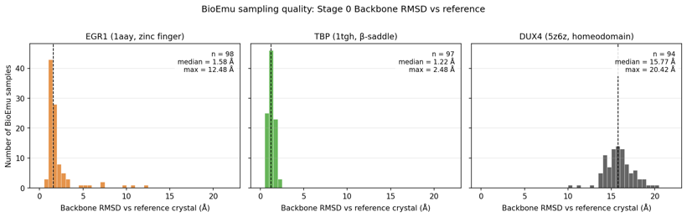
Ch. 6
Stage 1 — backbone ensembles + side chains
• BioEmu samples the backbone ensemble; HPacker rebuilds full-atom side chains — for every chain.
• Sampling breadth is TF-specific: rigid TBP stays tight, mobile DUX4 spreads wide.
• Per-chain output library, resumable (existing chains are skipped).
Notes:
Stage 1 combines BioEmu backbone sampling with HPacker full-atom side-chain reconstruction in a single stage, run for every protein chain of the structure. The output is a per-chain conformation library (topology.pdb / samples.xtc / side-chain-reconstructed trajectories). The refactor to a per-chain library was necessary because the old single-monomer path could not handle multi-chain complexes or do sampling and reconstruction together. It is resumable — a chain whose reconstructed trajectory already exists is skipped, so re-submitting fills only gaps. The sampling-quality figure shows how broadly BioEmu samples per TF: EGR1 (zinc finger) median 1.58 Å, TBP (β-saddle) tight at 1.22 Å, DUX4 (homeodomain dimer) very broad at 15.8 Å — an early hint of the rigidity axis the results chapters build on.

Slide 10
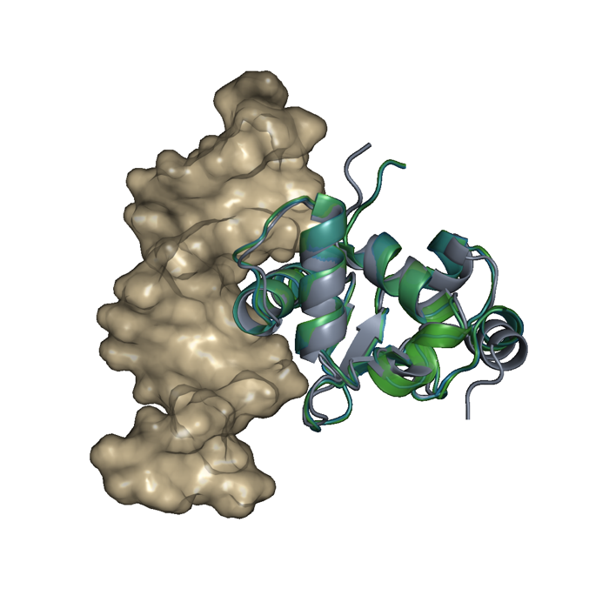
Ch. 7
Stage 2 — interface-aligned re-dock
• Each conformer is Kabsch-docked onto the crystal DNA, carrying DNA + metals in the protein frame.
• Interface-Cα alignment is canonical: global alignment caps fnat ~0.47; interface reaches ~0.72.
• For a rigid module, crystal / docked / minimized overlap tightly (shown).
Notes:
Stage 2 docks each sampled conformation onto the crystal DNA by a per-frame Kabsch fit, carrying the DNA and structural metals in the protein's coordinate frame (frame preservation, invariant 1). Why interface-Cα alignment is canonical rather than global all-Cα: global alignment averages placement error over the whole protein and caps fnat at ~0.47; aligning on the interface raises it to ~0.72 (invariant 2). A monomer guard and binding-chain selector ensure the right chain's ensemble docks against the right reference chain. per_domain docking is a diagnostic-only mode (invariant 3) — valid for independent C2H2 subsites, dangerous for cooperative binders. The S2 figure shows crystal vs docked vs minimized for ETS1, a rigid module where all three overlap tightly.

Slide 11
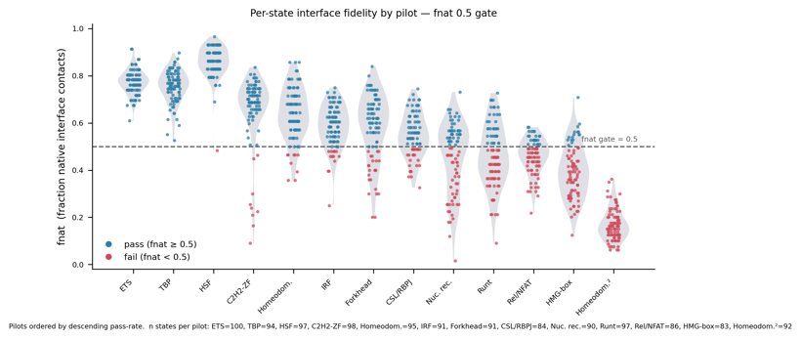
Ch. 8
The fnat gate
• One structural-quality filter: fraction of native interface contacts, floor 0.5.
• Runs post-minimization — minimization moves fnat both ways.
• Per-pilot survival ranges 100% → 19%; an empty pass-list halts the DAG (fail-loud).
Notes:
The fnat gate is the single structural-quality filter: fraction of native contacts against the model's own DNA, dropping wrong-register states before they become training pairs. It runs post-minimization (Stage 3), not at dock time, because minimization moves per-state fnat both ways — it can lift a near-miss over the floor or loosen a good pose. It builds a pass-only symlink mirror that Stage 4 reads exclusively. Fail-loud: an empty pass-list exits non-zero and the afterok edge halts the DAG — no training on an ungated set. The one knob is FNAT_FLOOR = 0.5. The figure shows per-state fnat by pilot with the 0.5 floor, pass/fail colored, pilots ordered by descending pass-rate — from ETS1/TBP/HSF near the top to the Homeodomain dimer at the bottom.

Slide 12
Ch. 9.1
Stage 3 — why minimize a docked pose at all?
• Stage 2 hands over a right-placed pose with atomic clashes and strained contacts.
• DeepPBS reads interface geometry — un-relaxed clashes would encode artifacts.
• Minimization drops clashes from hundreds to near-zero. Contract: relax the strain, preserve the pose.
Notes:
Stage 3 is the physics stage. Stage 2 hands over a BioEmu conformer Kabsch-fit onto crystal DNA — correct global placement, but with atomic clashes, stretched bonds, and strained contacts at the new interface. These cannot be featurized directly: DeepPBS reads interface geometry, and un-relaxed clashes would encode artifacts rather than recognition chemistry. Minimization removes clashes and relieves local strain (the engine's clash count drops from hundreds to near-zero; minimum heavy-atom protein–DNA distance opens up), producing a physically self-consistent structure. The one-sentence contract that governs every choice below: relax the strain, preserve the pose.

Slide 13
Ch. 9.2
The force field and the solvent model
• AMBER ff14SB — the energy function (bonded springs + torsions + non-bonded terms).
• GB-Neck2 implicit solvent — water as a continuous dielectric; cheap, standard for minimization.
• Caveat: implicit solvent has no counter-ions → GBSA over-stabilizes close ion pairs.
• NoCutoff non-bonded: all pairwise interactions computed exactly.
Notes:
The energy function is AMBER ff14SB (amber14-all.xml) for protein and DNA — bonded springs and torsions plus non-bonded electrostatic and van der Waals terms. Solvent is implicit (GB-Neck2, gbn2.xml): instead of explicit water molecules, water is modeled as a continuous dielectric, which is dramatically cheaper and standard for minimization. The caveat, stated here at its source: implicit solvent carries no explicit counter-ions, so GBSA tends to over-stabilize close ion pairs — a charged protein–DNA interface can relax artificially compact (this is the Part III scientific caveat). Non-bonded interactions use NoCutoff — with implicit solvent there is no periodic box, so all pairwise terms are computed exactly rather than truncated; hydrogen-bond lengths are constrained in the ramped phases. Platform: CUDA mixed precision on GPU, CPU fallback otherwise.

Slide 14
Ch. 9.3
Restraints — hold what you trust, relax what you don't
• A harmonic restraint is a virtual spring ½k(x−x₀)² pulling an atom toward a reference.
• Pinned: protein backbone (N,Cα,C) and DNA backbone (P,C1′) at k=10; side chains free.
• Restraints relax locally without losing the global docked placement.
Notes:
A harmonic restraint is a virtual spring — energy ½k(x−x₀)² — pulling an atom back toward a reference position x₀; the stiffness k (kcal/mol/Å²) sets how hard it resists moving. This pipeline pins protein backbone atoms (N, Cα, C) and, by default, DNA backbone atoms (P, C1′) to their docked positions at k = 10 kcal/mol/Å²; side chains and everything else are free. Why restrain backbone but not side chains: the backbone is the docked pose we trust from Stage 2 — letting it float would discard the frame's identity — while side chains carry much of the recognition chemistry and genuinely need to repack. Why it matters generally: without restraints, minimizing a strained complex can slide the whole protein off the DNA to a lower-energy but biologically meaningless pose. Restraints are how you relax locally without losing global placement.

Slide 15
Ch. 9.4
The metal-coordination cage
• Many DBDs need a structural Zn²⁺/Mg²⁺, but removeHeterogens strips it and ff14SB can't parameterize it.
• Trick: detect metal-coordinating side-chain atoms (≤3.0 Å) before stripping.
• Add pairwise harmonic bonds between them at k=20 — a cage that holds the shell, no ion simulated.
Notes:
Many DNA-binding domains (C2H2 zinc fingers, GATA, homeodomain-Zn) depend on a structural Zn²⁺/Mg²⁺. But removeHeterogens strips all non-standard residues, and AMBER ff14SB cannot parameterize a bare metal ion anyway — so a naive minimization collapses the coordination shell into an unphysical apo-Zn fold. The trick simulates no metal at all: before stripping heterogens, detect each structural metal (ZN, MG, MN, FE, CA, CO, NI, CU) and record which side-chain heavy atoms coordinate it (ligand atoms within 3.0 Å; clusters of ≥2 kept). Geometry is preserved by adding pairwise harmonic bonds between every pair of coordinating side-chain atoms, pinned at their original separations, at k = 20 kcal/mol/Å² — a cage that holds the coordination shell in place without ever simulating the ion. Turning the cage off (--ignore-metals) is the A/B tested in Ch. 19.

Slide 16
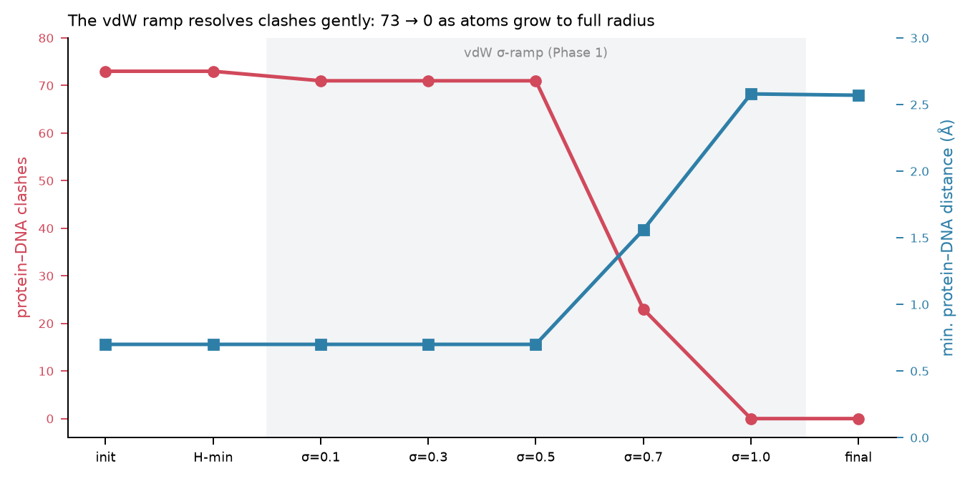
Ch. 9.5
The three-phase ramp — why not minimize once
• Phase 0: freeze heavy atoms, minimize only added hydrogens.
• Phase 1: van der Waals σ ramped 0.1→1.0 over five stages — clashes resolve gently.
• Phase 2: full-vdW final minimization settles the structure.
• Softening-then-growing avoids the blow-ups a single hard minimization hits on docked poses.
Notes:
Minimization runs in three phases. Phase 0 (hydrogens only): freeze every heavy atom (mass = 0) and minimize just the newly added hydrogens, fixing their placement before it can perturb the heavy-atom frame. Phase 1 (van der Waals ramp) is the key move for clashy starts: overlapping atoms feel enormous repulsive forces that can explode a minimization, so their vdW radii σ are scaled down and grown back over five stages (σ = 0.1 → 0.3 → 0.5 → 0.7 → 1.0, 500 steps each), letting clashes resolve gently as atoms swell to full size — with backbone and cage restraints active throughout. Phase 2 (final minimization): at full vdW, a long relaxation (up to 10,000 iters) settles into the minimum. Why it matters generally: softening-then-growing (a soft-core-like schedule) is the standard way to bring a badly clashing model to a stable state without numerical blow-ups; one hard minimization frequently diverges on docked poses. The trajectory shown is a representative state (FOXA 1vtn): clashes 73→0, minimum distance 0.70→2.58 Å across the ramp.

Slide 17
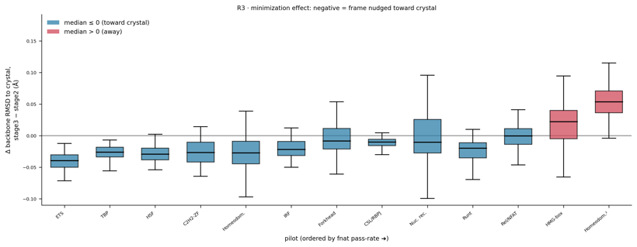
Ch. 9.6
DNA treatment — frozen default vs relaxed variant
• Frozen DNA (default): held at k=10 with the protein — the 'rigid-DNA ceiling' the mechanism story diagnoses.
• Relaxed variant (_dnarelax): DNA on its own soft tether k=1.5, released late (stage 5).
• The DNA stiffness knob IS the book's central question, made physical.
• Minimization nudges frames marginally toward the crystal, never away.
Notes:
DNA treatment is the single knob that decides what the pipeline augments. Frozen DNA (default): the DNA backbone shares the protein's k = 10 restraint, so the duplex is held at its crystal pose while the protein relaxes around it — the baseline, and the source of the rigid-DNA ceiling the mechanism story diagnoses. The relaxation variant (_dnarelax) splits the DNA onto its own restraint force so it can be tuned independently: a soft tether at k = 1.5 kcal/mol/Å² lets the duplex deform toward the protein-preferred geometry while paying an elastic cost that stops it fraying. Late release holds the DNA stiff for the early ramp stages so the protein settles first, then relaxes it at stage 5. Why it matters: this stiffness is the physical embodiment of the book's central question — 'ensemble around a fixed pose' vs 'ensemble of genuine binding modes.' R3 shows that minimization is a local relaxation: per-state backbone change nudges marginally toward the crystal (negative = toward), never systematically away. Structural consequences of relaxation are Ch. 18; principled stiffness priors are Ch. 20.

Slide 18
Ch. 10
Stages 4–5 — featurization and the augmented training set
• Stage 4: each passing state → per-state .npz features (3DNA via vendored lib).
• Stage 5: build the augmented fold — 1 crystal + N passing frames.
• The confound seeded here: all frames of a complex inherit the ONE crystal PWM label.
Notes:
Stage 4 turns each passing state into per-state .npz features via DeepPBS process_co_crystal.py (using the vendored 3DNA toolchain) — the protein-shape and DNA groove/shape channels DeepPBS reads. This is also where the self-complementary-DNA failure ('helix count problem 0') surfaces, when only one strand of a palindromic duplex is present. Stage 5 builds the augmented training fold: one crystal plus N passing frames, combined assembly, and paired train configs. The crucial detail — and the confound both Part III and Part V return to — is that all frames of a complex inherit the single crystal PWM label. That entangles 'does the ensemble help' with 'does averaging N frames onto one label just regularize.'

Slide 19
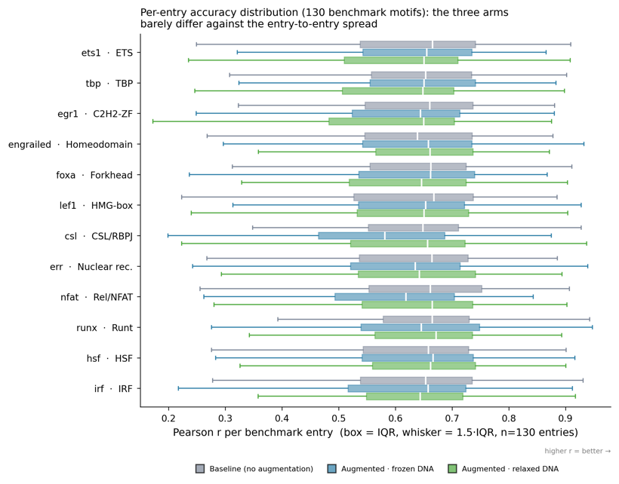
Ch. 11
Stages 6–7 — paired training and benchmark evaluation
• Baseline (crystal only) vs augmented (crystal + ensemble), always a matched pair.
• Multi-seed: single-seed vs 5 paired seeds; general-130 held-out benchmark.
• Metrics: Pearson, Spearman, AUROC, IC-weighted PCC, MAE; paired stats; ΔPearson>0 = 'helps'.
Notes:
Stages 6–7 train and evaluate. Baseline (crystal only) and augmented (crystal + ensemble) are always trained as a matched pair. The multi-seed design runs either a single seed or 5 paired seeds (s1–s5), depending on the pilot. Evaluation is on the general-130 held-out benchmark, reporting Pearson, Spearman, AUROC, IC-weighted PCC, and MAE, with paired statistics (bootstrap / t-test) and the convention that ΔPearson > 0 means augmentation helps. The box figure shows per-entry metric distributions over the 130-entry benchmark across the three arms — the 'what the eval produces' reference; the interpretation figures (Δ by family, mechanism) come in Part IV.

Slide 20
Part III
Caveats — what the pipeline assumes and where it can mislead
Scientific: rigid DNA, metal stripping, implicit-solvent compaction, the shared-label confound.
Statistical: no fixed seed, wrong-distribution checkpointing, denominator drift, pseudoreplication.
Read this before trusting any single number in Part IV.
Notes:
Section divider. Part III is the honest-limits section: the scientific assumptions baked into the modeling and the statistical hazards in the evaluation. It is placed before the results so the reader interprets Part IV with the caveats already in hand.

Slide 21
Ch. 12
Scientific caveats
• Rigid DNA carried from the crystal: the interface is perturbed, not truly augmented.
• Metal/cofactor stripping can silently produce unphysical apo-Zn folds (hence the cage).
• GBSA over-stabilizes close ion pairs → artificially compact interface.
• Confound #1: every augmented frame shares one crystal PWM — signal vs smoothing inseparable.
Notes:
The scientific caveats. (1) Rigid DNA carried from the crystal: the protein's Kabsch transform is applied to the reference DNA and the backbone is then restrained, so the interface is perturbed, not augmented — closer to 'ensemble around a fixed binding pose' than 'ensemble of binding modes.' (2) Metal/cofactor stripping: removeHeterogens can silently drop structural Zn²⁺/Mg²⁺; without the cage, zinc-finger / GATA / homeodomain-Zn folds minimize into an unphysical apo-Zn state. (3) GBSA implicit solvent over-stabilizes close ion pairs at a charged protein–DNA interface, so the relaxed interface can be artificially compact. (4) The shared-PWM-label confound (confound #1): every augmented frame shares one crystal PWM, so 'does the ensemble help' is entangled with 'does averaging N frames onto one label just regularize' — signal vs smoothing, currently inseparable. This is the single most important caveat; Ch. 21 proposes the control that resolves it.

Slide 22
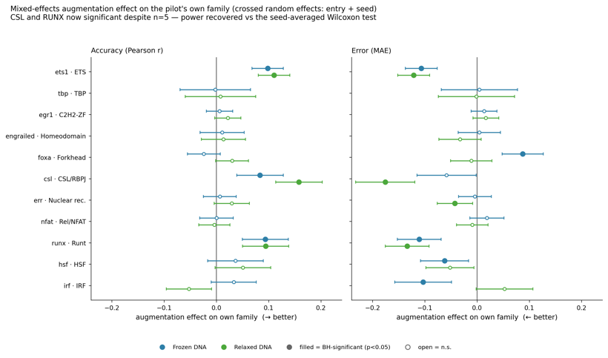
Ch. 13
Statistical caveats
• No fixed seed: baseline vs augmented differ in augmentation AND init AND shuffle order.
• Checkpoint chosen on a general-TF validation set, not the target TF.
• The fig9 cautionary case: mixed-model 'power' is pseudoreplication.
• Correct seed-level tests: csl p=0.16, runx p=0.20 (not p<0.005).
Notes:
The statistical caveats. No fixed random seed in generated configs — baseline and augmented differ in augmentation and initialization and shuffle order, so with few seeds the augmentation effect is not cleanly separable from noise. The best-state checkpoint is selected on the wrong distribution (MAE on a general-TF validation set, not the target TF) — fair across arms, but the absolute numbers are not 'the best for TF X.' Per-condition denominator drift: an npz that fails or returns NaN for one condition shrinks that condition's n, so the Δ compares means over different subsets. Effect-size pairing is by regex; conditions not matching baseline|augmented are silently dropped. The fig9 cautionary case shown here: the mixed-model 'power-recovered' result (csl p=0.003, runx p<0.001) is pseudoreplication — it treats entry×seed rows as independent when augmentation is applied once per seed (n=5); correct seed-level tests give csl p=0.16, runx p=0.20. A worked example of how a plausible model overstates significance. The companion coin-flip and training-diagnostic figures make the honest version visible.

Slide 23
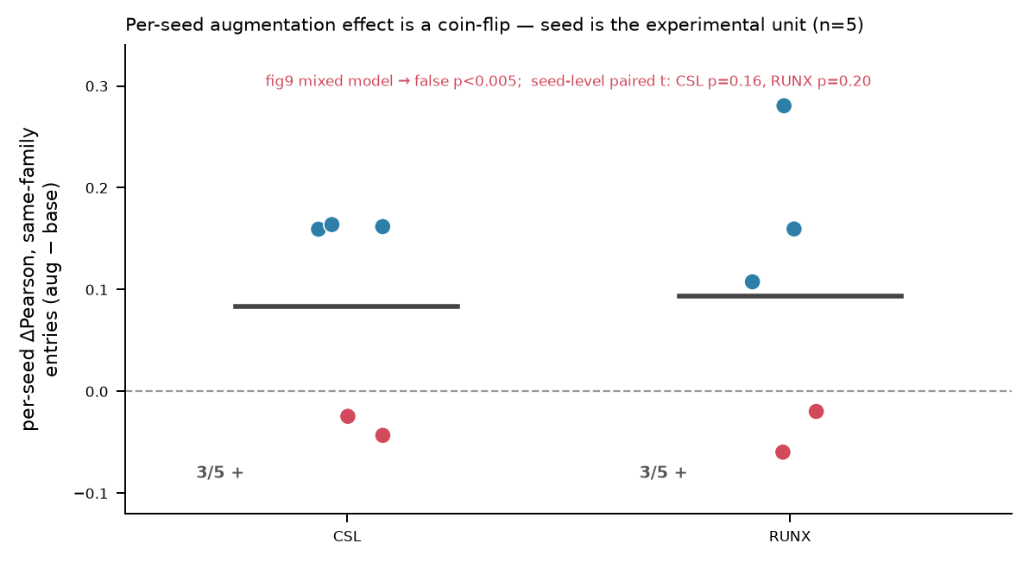
Ch. 13 (contrast)
The coin-flip — seed is the experimental unit
• Same data, honest test: per-seed ΔPearson on same-family entries.
• csl and runx are each 3/5 positive — a coin-flip, not a significant effect.
• This is what fig9's forest plot hides by pooling entry×seed rows.
Notes:
The honest counterpart to fig9. Plotting the per-seed ΔPearson (augmented − baseline) on each pilot's own-family benchmark entries shows csl and runx are each 3 of 5 seeds positive — a genuine coin-flip. The mixed model's p<0.005 came from treating entry×seed rows as independent replicates; at the correct seed level the effect is not significant (csl p=0.16, runx p=0.20). This pairing — the overconfident forest plot next to the honest per-seed spread — is the chapter's teaching contrast.

Slide 24
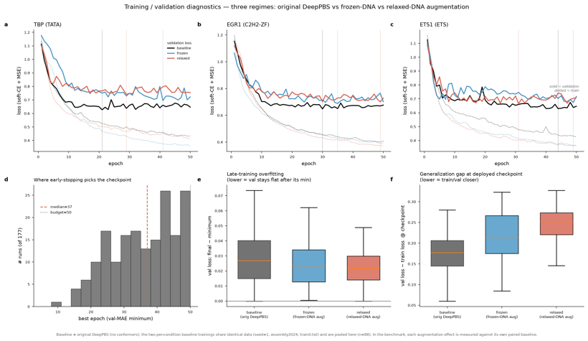
Ch. 13 (diagnostic)
Training / validation diagnostics
• Loss curves, early-stopping histogram, late-training overfit, generalization gap — three arms.
• A caveats figure, not a results figure.
• Confirms the arms are trained comparably; differences are small relative to seed noise.
Notes:
A caveats figure rather than a results figure. It shows training/validation loss curves, the early-stopping epoch histogram, late-training overfitting, and the generalization gap across the three arms (baseline, frozen-augmented, relaxed-augmented). It supports the statistical-caveats argument: the arms are trained comparably, and the augmentation differences are small relative to seed-to-seed variation — which is why the seed-level analysis, not the pooled one, is the correct lens.

Slide 25
Ch. 14
Engineering debt and the fix spec
• Root cause: Stage 1 refactored to per-chain, but common.sh / Stage 2 / configs kept the old layout.
• Invariants that must never regress: frame preservation, interface alignment, per_domain diagnostic-only, monomer scope.
• Special cases: self-complementary DNA ('helix count problem 0') and the DUX4 dimer exclusion.
Notes:
The engineering-debt chapter, behind PIPELINE_FIXES.md. The root problem: Stage 1 was refactored to a per-chain library, but common.sh, the Stage-2 wrapper, and pilot configs still encoded the old single-monomer layout — the two halves were disconnected. The invariants that must never regress: frame preservation, interface-canonical alignment, per_domain diagnostic-only, and monomer-only scope. Blockers B1–B7 read as a worked debugging narrative from the Stage-1/Stage-2 break through the fnat-gate placement. Two special cases: self-complementary / symmetry-mate DNA (only one strand in the ASU) triggers 'helix count problem 0,' fixed by regenerating the biological-assembly duplex before featurization; and the DUX4 dimer exclusion — the monomer guard, because a dimer has no place in a monomer benchmark. Largely a text/table chapter (B1–B7 as a table).

Slide 26
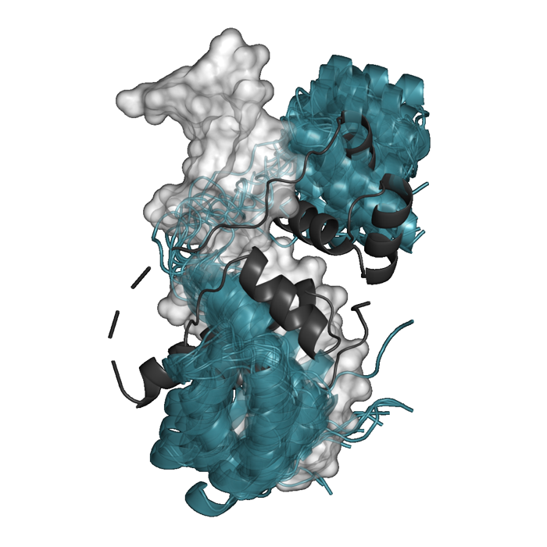
Ch. 14½
Dead ends and things not to repeat
• The two-docker foot-gun: legacy global cmd.align caps fnat ~0.47; stage2_redock is the sole production docker.
• DUX4 dimer (shown): 0 fnat survivors, never reached training.
• The wt1 two-seed sign-flip: seed0 says hurts, seed1 says helps — beware single-seed conclusions.
• Many conditions exist as capability, never run (alignment baselines, ablations, folds≠0).
Notes:
The successor's chapter of dead ends. The two-docker foot-gun: the legacy PyMOL cmd.align global dock caps fnat at ~0.47; stage2_redock.py is the sole production docker. Stage-2 fnat rejection was removed because filtering at dock time shrank the denominator before minimization could rescue near-misses — the gate moved to post-minimization. The DUX4 dimer (shown, 0 fnat survivors) and dux4_dnarelax (also 0) are tandem/multi-chain pilots that never reached training. The sign-unstable wt1 two-seed pilot in the predecessor tree: seed fold0 says augmentation hurts, seed1 says it helps — a caution against single-seed conclusions. And a set of conditions that exist only as capability, never run: alignment baselines (all / per_domain), feature ablations (shape-only / groove / dnaseqInfo), folds ≠ 0, fnat floors ≠ 0.5. The DUX4 render is the illustrative 'why it fails' — two homeodomain copies whose ensemble never registers on one duplex.

Slide 27
Part IV
Results — building toward the mechanism map
Ch. 15 establishes the ensembles are trustworthy (unequally).
Ch. 16 shows the net effect is a productive null — setup, not verdict.
Ch. 17 is the climax: the mechanism map. Ch. 18–19 stress-test it.
Notes:
Section divider. Read Part IV as one argument. Structural fidelity (Ch. 15) establishes the ensembles are trustworthy but unequally so; the augmentation effect (Ch. 16) is a productive null that stages the question; the mechanism story (Ch. 17) resolves it into a conformational-selection vs induced-fit map and is the climax; DNA relaxation (Ch. 18) and the metal-cage A/B (Ch. 19) stress-test that map.

Slide 28
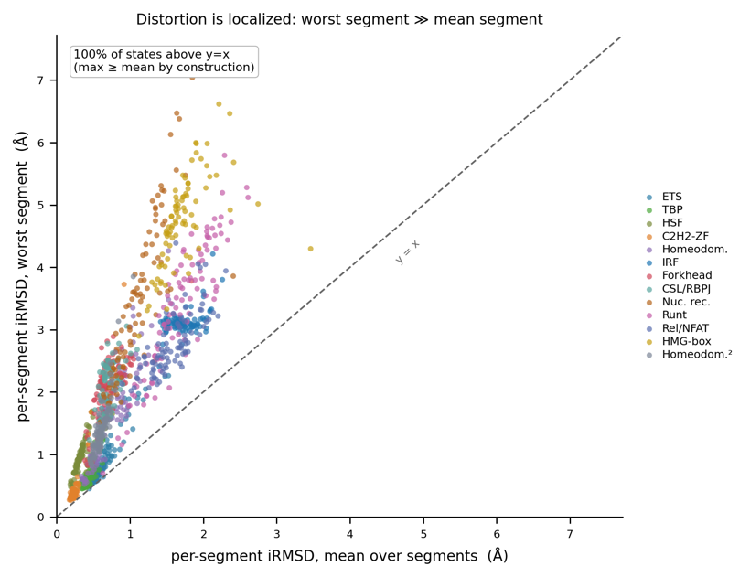
Ch. 15
Structural fidelity — trustworthy, unequally
• Rigidity ordering: ETS1, TBP (100% pass) → EGR1, engrailed (~91%) → FOXA (~75%) → LEF1 (19%).
• Fidelity tracks module rigidity, NOT interface size (TBP 40 residues vs LEF1 39, opposite fidelity).
• fnat and iRMSD co-vary tightly (ρ ≈ −0.84); distortion is localized to one segment.
Notes:
Structural fidelity across pilots via fnat, interface-RMSD, and Cα-RMSD, with a recurring rigidity ordering: ETS1 and TBP (100% pass) → EGR1 and engrailed (~91%) → FOXA (~75%) → LEF1 (19%). Fidelity tracks recognition-module rigidity, not interface size: TBP (40 interface residues) and LEF1 (39) are near-identical in size but opposite in fidelity. fnat and iRMSD co-vary tightly (Spearman ρ ≈ −0.84), and pilots cluster along the curve by rigidity. Distortion is localized — one interface segment always moves more than the rest — and the per-residue signature is universal: rigid cores, floppy termini. Minimization is a local relaxation; the global backbone barely moves and per-state changes nudge marginally toward the crystal, never away. This sets up the rigidity axis the mechanism chapter splits on. Companion figures: I1 (iRMSD distributions), I4 (interface geometry), R1/R2/R3 (Cα-RMSD, per-residue profiles, minimization delta), and the S1/S2 structural renders (rigid hugs crystal, mobile flings off).

Slide 29
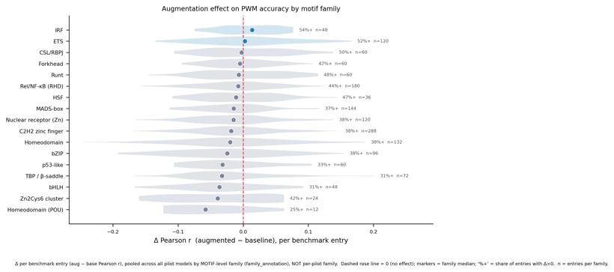
Ch. 16
The augmentation effect — the productive null
• Net effect across 11 pilots is small and mostly negative on the general-130 benchmark.
• ETS (median ΔPearson +0.042, 60% improve) and IRF (+0.039) are the ONLY net-positive families.
• A flat/negative mean is not 'it doesn't work' — it is a hidden variable splitting the families.
• Second axis: more flexible interface DNA → augmentation hurts (ρ≈−0.55).
Notes:
The headline empirical result, staged explicitly as setup. Baseline vs augmented across 11 pilots: the net effect is small and mostly negative on the general-130 benchmark (most-negative egr1 −0.027, err −0.026, tbp −0.015; net-positive csl +0.027, nfat +0.015, ets1 +0.001). The motif-level family map corrected an earlier per-PDB mislabeling — ETS1–RUNX1 co-crystals were misfiled as Runt, inflating the ETS median. ETS (median ΔPearson +0.042, 60% of entries improve) and IRF (+0.039) are the only net-positive families; every other family is net-negative. The ETS1 gain is echoed by its ERG/FLI1 paralogs, not confined to one structure. Framed explicitly as setup: a flat/negative mean is not 'it doesn't work' — it is the signal that a hidden variable is splitting the families. The companion iface_mgwfl_vs_accuracy figure adds a second, DNA-side axis: more flexible interface DNA → augmentation hurts (ρ ≈ −0.55), a hint the hidden variable is the DNA — the exact claim the mechanism chapter makes.

Slide 30
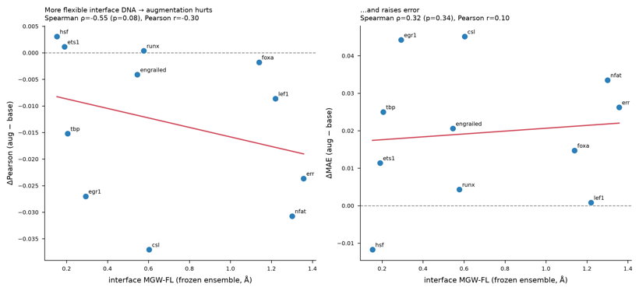
Ch. 16 (2nd axis)
A second axis — interface DNA flexibility
• More flexible interface DNA → augmentation hurts (Spearman ρ ≈ −0.55).
• A DNA-side companion to M1's protein-reachability axis.
• Points toward the hidden variable being the DNA, not the protein sampling.
Notes:
A companion to the mechanism figure, on the DNA side. Plotting each pilot's ΔPearson against the flexibility of its interface DNA (frozen-ensemble minor-groove-width fluctuation) shows a negative relationship (Spearman ρ ≈ −0.55): the more flexible the interface DNA, the more augmentation hurts. This is orthogonal to M1's protein-reachability axis and points at the same conclusion — the missing variable the shared-label, frozen-DNA pipeline cannot capture is the DNA deformation, not the protein ensemble.

Slide 31
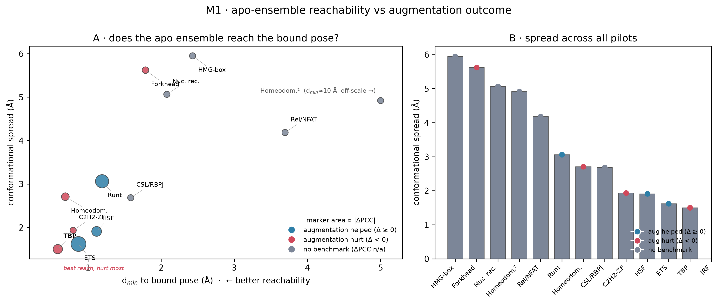
Ch. 17
The mechanism story — the climax
• Apo/holo test: BioEmu = computational apo, crystal = holo, scored on reachability + spread.
• No single protein-side axis predicts the sign (all |ρ|<0.5, n.s.) — the protein is not the problem.
• Conformational selection (ETS1, EGR1 helped) vs induced-fit-on-DNA (TBP, LEF1 hurt).
• TBP is the decisive control: best reachability (0.59 Å) yet hurt most — the missing variable is the DNA.
Notes:
The climax. The apo/holo test treats the BioEmu ensemble as computational apo and the crystal as holo, scoring each pilot on two protein-side axes (free-state spread, reachability d_min) against qualitative DNA deformation. No single protein-side axis predicts the sign of the augmentation effect (all |ρ| < 0.5, n.s., n=6) — the protein ensemble is not the problem. The map splits into two regimes: conformational selection (ETS1, EGR1 helped — the free protein already samples binding-competent geometry and needs little DNA deformation) and induced-fit-on-DNA (TBP kink, LEF1 bend, hurt — free-protein frames carry no information about the DNA distortion DeepPBS holds fixed, so they add noise). TBP is the decisive negative control: best protein reachability (0.59 Å) yet hurt most (−0.26), so the missing variable is the DNA, not the protein sampling. Honest limits: n=6, single-seed, correlations not significant, DNA-deformation axis still qualitative — a hypothesis with a clean story and a decisive control, not a settled result. In the figure, panel A is the reachability–spread map (all 13 pilots, TBP flagged, dux4 off-scale) and panel B is spread across all pilots with the augmentation-sign dot.

Slide 32
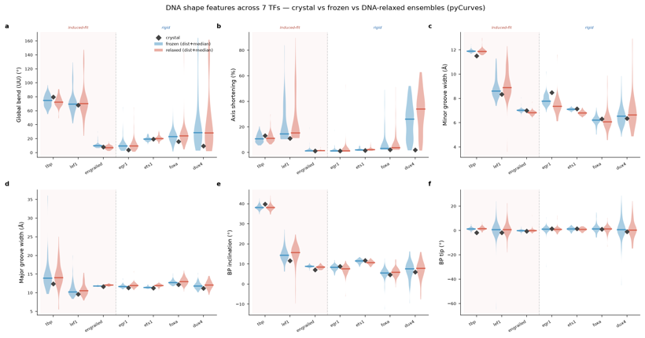
Ch. 18
DNA relaxation
• The _dnarelax variant lets protein and DNA co-relax into each frame.
• TBP DNA moves ~1.7× more (0.72 vs 0.41 Å) without excess fraying; bends toward the bound pose.
• Falsifiable prediction: flexible DNA should recover exactly the families augmentation hurts today.
• Preliminary / partial coverage: 7 pilots have shape data, 2 trained, 1 evaluated.
Notes:
DNA relaxation stress-tests the mechanism map. The _dnarelax variant (soft tether k=1.5, released at ramp stage 5) lets protein and DNA co-relax into each frame. TBP DNA moves ~1.7× more under relaxation (median backbone RMSD 0.72 Å vs 0.41 Å frozen) without excess fraying — the stiffness floor holds the duplex batch-wide. Displacement localizes to the central TATA bases (the kink region), and relaxed DNA bends toward the bound conformation (pyCurves: relaxed PP-bend lands closest to crystal; frozen underbends). The falsifiable prediction that ties it back to the mechanism map: flexible DNA should recover exactly the families augmentation hurts today (TBP, LEF1, homeodomain). Status stated honestly: data for 7 pilots, trained for 2, evaluated for 1 (tbp_dnarelax, itself slightly worse than frozen tbp) — the prediction is not yet tested at scale. COVERAGE CAVEAT for the whole chapter: the DNA-shape analysis has not been run on all 13 pilots (overview 7, per-TF panels 11 without hsf/irf, bend bootstrap 7, AF3/interface comparisons 12) — every DNA-relaxation figure is preliminary / partial-coverage. The lead figure is the 6-panel DNA-shape overview across 7 TFs (global bend, axis shortening, groove widths, base-pair inclination/tilt), crystal vs frozen vs relaxed. Companions: tbp_dna_shape (4-panel TBP ensemble), crossfamily_bend (Δ bend per pilot with bootstrap CIs, most crossing zero), crystal_convergence_bootstrap.

Slide 33
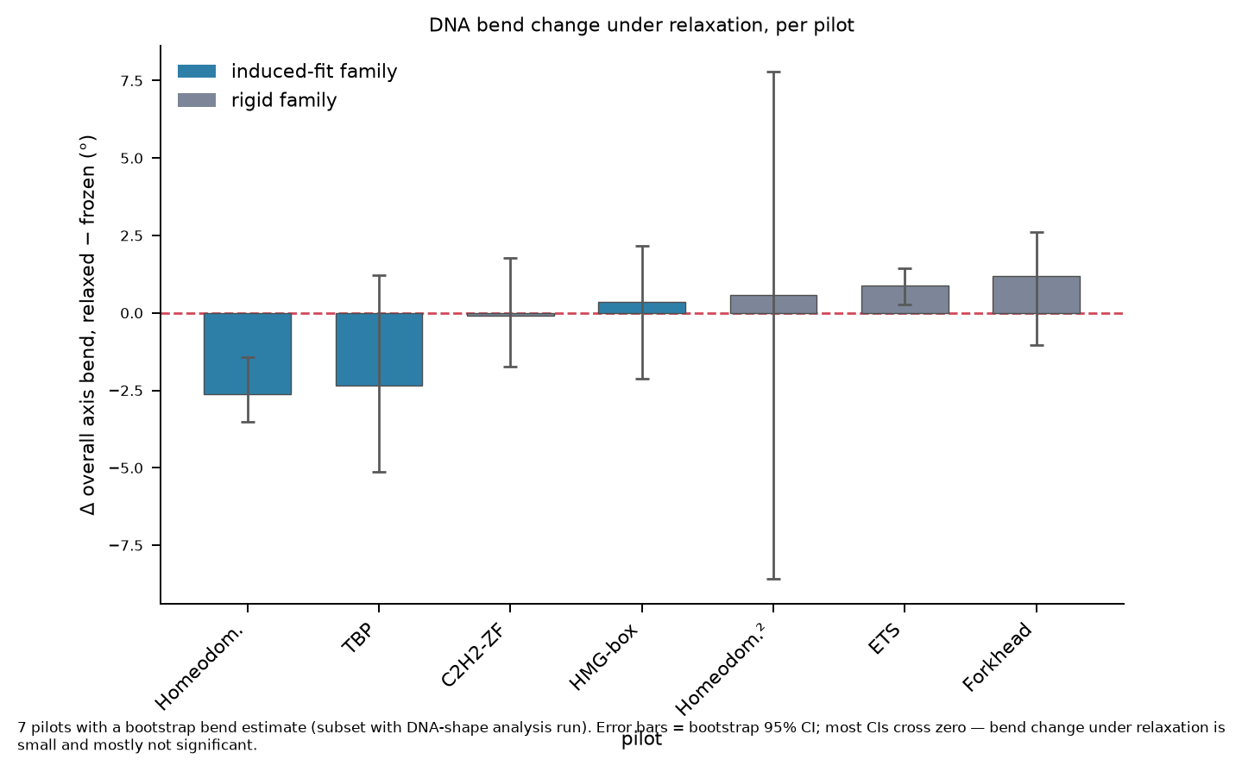
Ch. 18 (bend)
DNA bend change under relaxation
• Δ axis bend (relaxed − frozen) per pilot, bootstrap 95% CI.
• Most CIs cross zero — bend change is small and mostly not significant.
• 7 pilots only (the DNA-shape subset). Directional, not conclusive.
Notes:
The per-pilot bend-change figure, made honest. It plots Δ overall axis bend (relaxed − frozen, degrees) for the 7 pilots with a bootstrap bend estimate, colored by induced-fit vs rigid family, with 95% confidence intervals. Most intervals cross zero, so the bend change under relaxation is small and mostly not significant on current data — the story is directional (induced-fit families tend to lose bend, relaxing toward the bound pose) but not yet conclusive across the pilot set. This is a partial-coverage figure and should be captioned as preliminary.

Slide 34
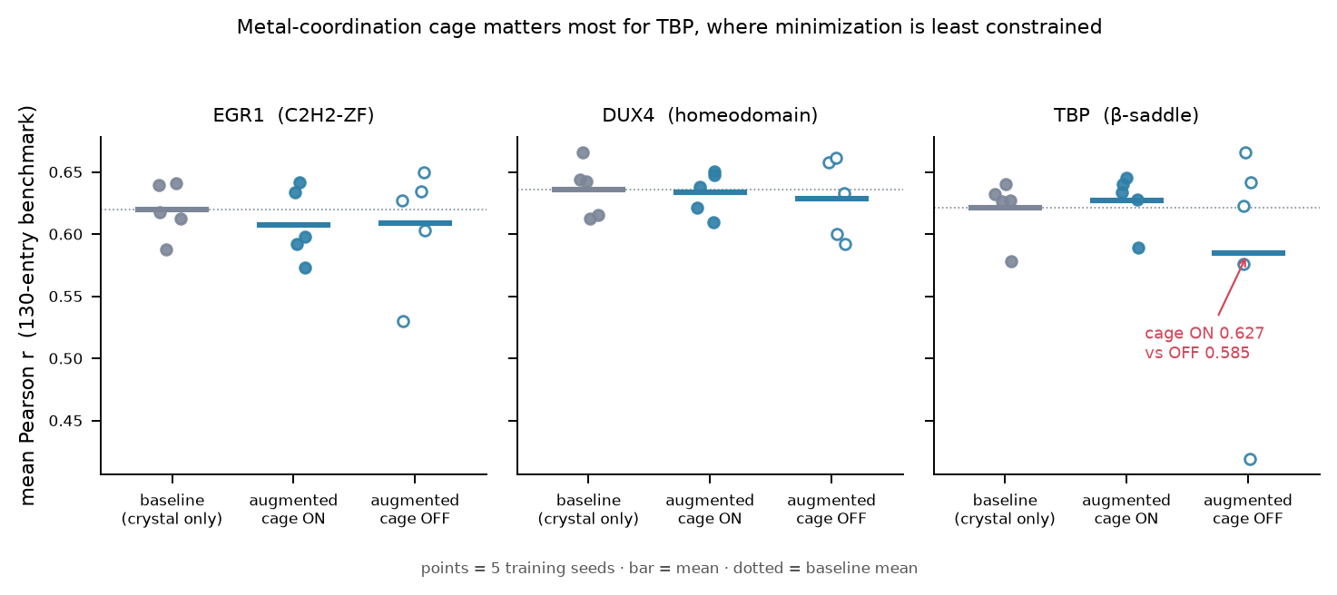
Ch. 19
The metal-cage A/B
• Does turning the metal cage on/off move the downstream augmentation result?
• A/B from the predecessor tree: dux4, egr1, tbp; 5 seeds each; --ignore-metals = cage OFF.
• Cage matters most where minimization is least constrained: TBP cage-ON 0.627 vs cage-OFF 0.585.
• For dux4/egr1 the two are comparable — all still ≈ baseline.
Notes:
The metal-cage control. The coordination cage (Ch. 9.4) is a strong intervention on zinc-dependent folds — does turning it on/off move the downstream augmentation result, or is it invisible to DeepPBS? The A/B comes from the predecessor old_results tree (dux4, egr1, tbp; 5 seeds each; --ignore-metals = cage OFF). The cage matters most where minimization is least constrained: for TBP, cage-ON augmented (0.627) clearly beats cage-OFF (0.585); for dux4/egr1 the two are comparable — all still ≈ baseline. The figure shows per-seed means with the ON/OFF distinction; the TBP cage-OFF spread (a 0.42 outlier seed dragging the mean down) is visible. Note: the AF3-vs-BioEmu diversity comparison that once sat here moved to Ch. 3 — it is a motivation for the method, not a result of it.

Slide 35
Part V
Next directions
Flexible DNA, done principledly (the ceiling the mechanism result identified).
Per-frame PWM labels — the decisive control that resolves the confound.
Scaling, completeness, and the broader mechanism-map vision.
Notes:
Section divider. Part V lays out what the mechanism result implies for the next iteration: relax the DNA with a principled stiffness prior, give each frame its own label to resolve the signal-vs-smoothing confound, scale the pilot set, and ultimately reframe augmentation-sign as a mechanism map of the TF universe.

Slide 36
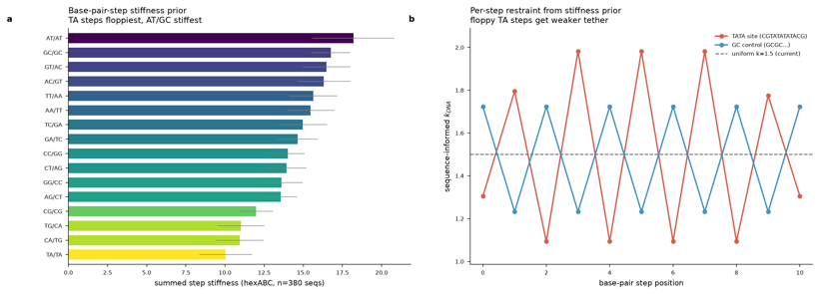
Ch. 20
Flexible DNA, done principledly
• Thesis: the rigid-DNA assumption is the ceiling, not the protein sampling.
• Tier 1: relax DNA in the existing minimization (built) — risk of fraying under GBSA.
• Tier 2: cgDNA+ sequence-dependent stiffness prior as a harmonic restraint.
• Tier 3: Deep DNAshape as a learned sequence→shape prior.
Notes:
The main forward direction. The thesis from the mechanism result: the rigid-DNA assumption is the ceiling, not the protein sampling. Three tiers of increasing principledness. Tier 1 — relax DNA in the existing Stage-3 minimization (cheapest; the _dnarelax variant is already built), with the risk that unrestrained B-DNA frays under GBSA. Tier 2 — a cgDNA+/cgNA+ sequence-dependent stiffness prior as a harmonic restraint: DNA free to deform toward the protein-preferred geometry but paying a sequence-dependent elastic cost (a per-hexamer stiffness lookup; the principled hexABC connection). Tier 3 — Deep DNAshape as a learned prior: predicted sequence→shape used as the relaxation target so frames carry DNA geometry consistent with intrinsic preferences. Why not use hexABC trajectories directly: they characterize free B-DNA, whereas recognition is protein-induced deformation. The figure demonstrates the sequence-dependent stiffness concept; companions perposition_minorgroove and mgw_fl_all12_panels show the per-position groove profiles the prior would target.

Slide 37
Ch. 21
Per-frame PWM labels — the decisive control
• The confound: all frames of a complex share one crystal PWM — signal and smoothing inseparable.
• The idea: give each frame its own structure-derived per-frame PWM.
• Decides it: per-frame labels help → real signal; wash out the gain → it was regularization.
• Decisive for ETS specifically (lowest baseline of the helped families).
Notes:
The decisive control. The confound restated: all frames of a complex currently share one crystal PWM, so signal and smoothing are inseparable. The idea: give each frame its own label — a structure-derived per-frame PWM from that frame's protein–DNA contacts (even predicted per-frame labels suffice for the control). What it decides: if per-frame labels help where shared labels didn't, there is real conformation→specificity signal; if they wash out the gain, the benefit was regularization. It is decisive for ETS specifically because ETS has the lowest baseline of the helped families, so per-frame labels separate 'genuinely conformationally selected' from 'low baseline = most improvable by any regularizer.' Sequencing: run the 5-seed control first (error bars), then per-frame PWM (the sharper question), then DNA relaxation.

Slide 38
Ch. 22
Scaling and completeness
• More seeds: error bars on the per-family effects.
• More TFs and families to fill out the map.
• Close coverage gaps: folds≠0, feature ablations, fnat-floor sensitivity (all capability, none run).
• DNA-relax eval for the 5 pilots with data but no evaluation.
Notes:
The completeness agenda. More seeds: put error bars on the per-family effects (the 5-seed re-run for 6 pilots, single-seed for the rest). More TFs and families: extend beyond the 11 pilots to fill out the family map. Coverage gaps to close: folds beyond 0, feature ablations (shape-only / groove / dnaseqInfo), and fnat-floor sensitivity — all present as capability, none exercised. And DNA-relax evaluation for the 5 pilots that have data and configs but never reached evaluation. Read as a to-do map of what remains.

Slide 39
Ch. 23
The broader vision
• From 'does augmentation help' to 'augmentation sign as a mechanism map' of the TF universe.
• A flexible-DNA, per-frame-labeled DeepPBS could make recognition-mechanism a first-class output.
• The falsifiable through-line: co-relaxing DNA should flip TBP from negative toward neutral/positive.
Notes:
The closing vision. The reframe taken to its conclusion: from 'does augmentation help' to augmentation-sign as a mechanism map of the TF universe. A flexible-DNA, per-frame-labeled DeepPBS would enable recognition-mechanism classification as a first-class output. The falsifiable through-line: if co-relaxing DNA flips TBP from negative toward neutral/positive, the mechanism hypothesis is confirmed and the method is fixed by the same change. This connects to the broader DNA-recognition and structural-ML programs — families placed on the conformational-selection ↔ induced-fit axis, with the pilots as measured anchors and the rest of the universe as the frontier.

