Slide 1
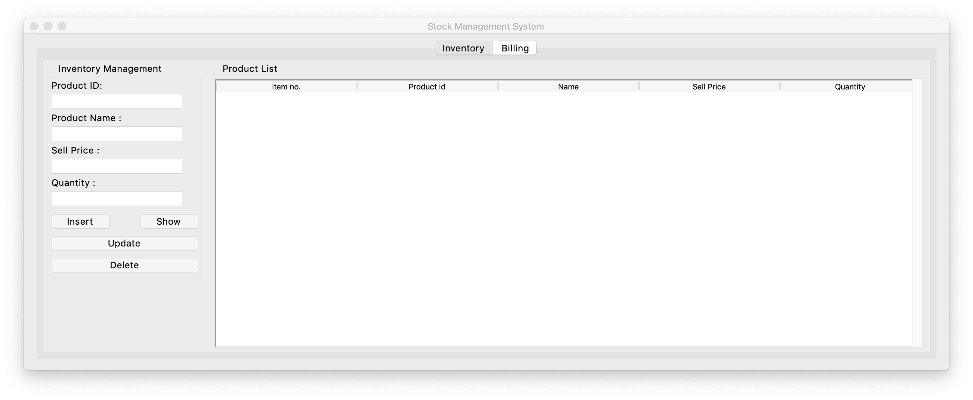
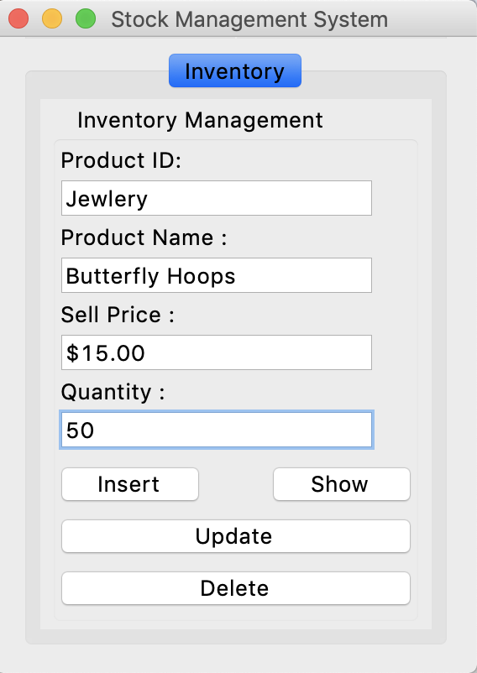
Inventory Managing
This program allows users to search database for products available. They will be able to see product name, type of product, style of product, and amount in stock. As well as billing information which will include the price of item and amount sold. This will allow people to easily keep track of inventory and know what items need replenishing and which are low in demand.
Coded by: Sydnee Gage

