Slide 1
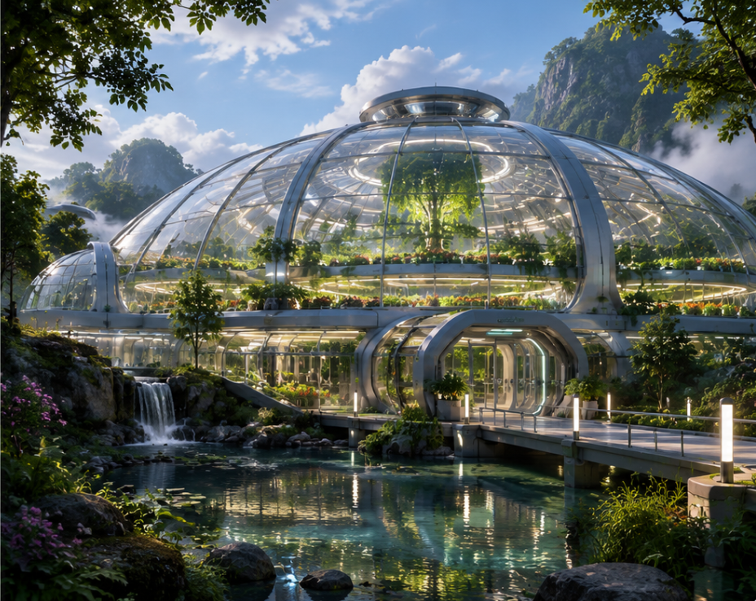
GREENWARD
FIELD GUIDE
Offline illustrated guide for Sana Vey’s garden crew
Tutorial Presentation
Kairova Tech Department → Greenward
Route • Prototype • XAML/C# • Testing • Team Roles
Windows WPF application • Designed to work when the network drops
GREENWARD FIELD GUIDE • WEEK 7
1

Slide 2
OVERVIEW
Project Mission & Story Context
What the Greenward crew needs and what the application is designed to accomplish.
MISSION
USER STORY
Give Sana Vey’s garden crew a simple field guide that still works on an ordinary Windows computer when the network is unavailable.
As a reader, I want to move through Sana’s story and field route, so I can identify the garden area and understand the overgrown surroundings.
Story setting
Reader goal
• Beyond the protected pods, the forest has consumed roads and buildings.
• The guide helps the reader identify the route and important locations.
• This is a different team from Malik’s earlier unresolved experience.
• Start the guide.
• Follow the Greenward route.
• Read the Garden Area information.
• Reach the Overgrown Area and identify the route.
GREENWARD FIELD GUIDE • WEEK 7
2

Slide 3
FLOW
Reader Route: Home → Map → Garden → Forest
The page number is the application’s state.
PAGE 0
PAGE 1
PAGE 2
PAGE 3
HOME
→
MAP
→
GARDEN
→
FOREST
Welcome to Greenward
Greenward Route
Garden Area
Overgrown Area
Navigation rule
Start Guide sets page = 1. Next increments. Back decrements. Home resets to 0.
Boundary guards keep the reader between page 0 and page 3.
GREENWARD FIELD GUIDE • WEEK 7
3

Slide 4
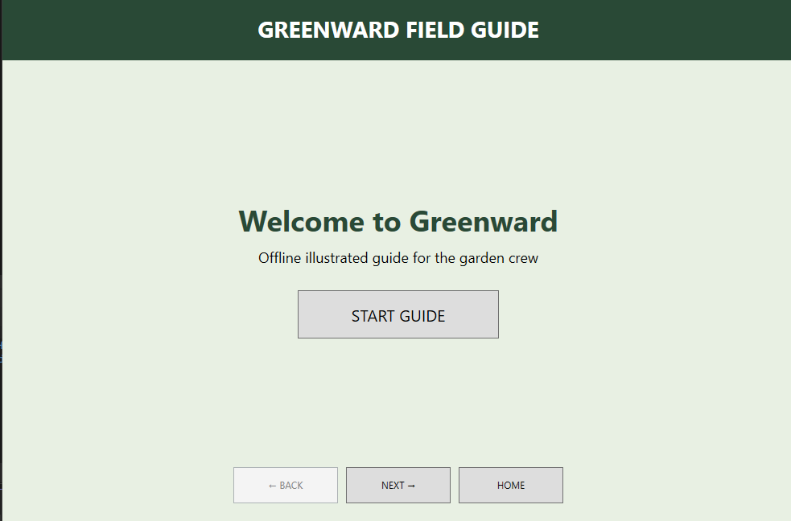
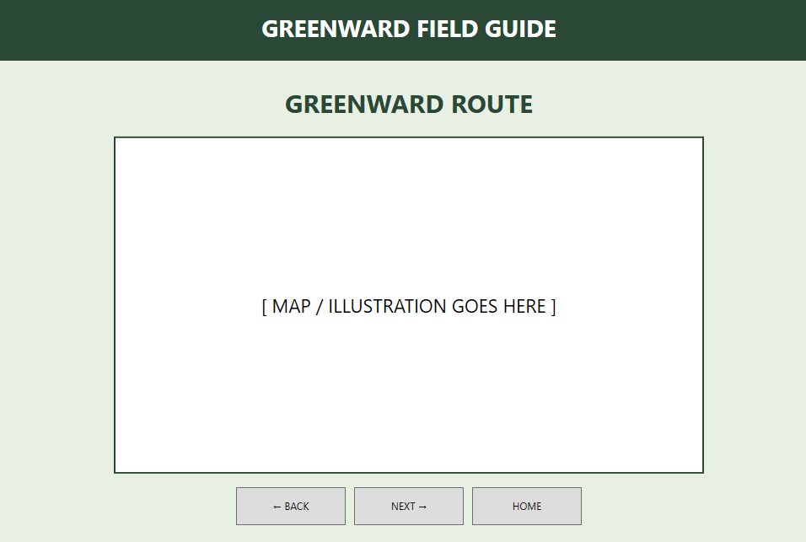
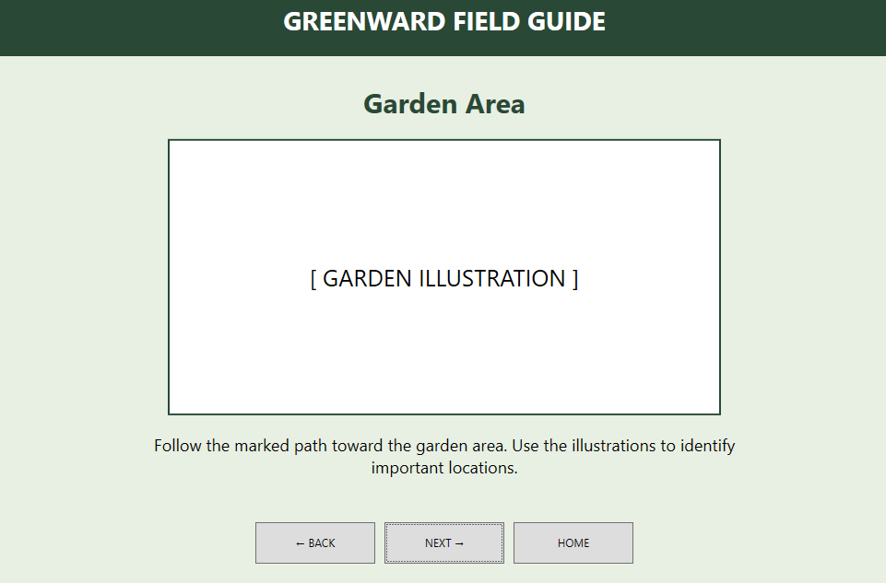
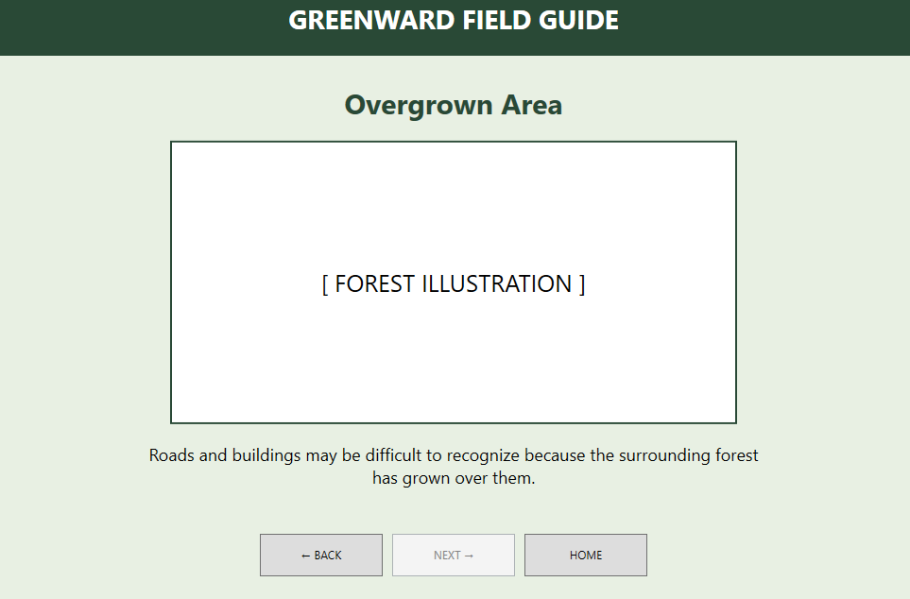
UI
Prototype Evidence
1 • Welcome / Start Guide
2 • Greenward Route
3 • Garden Area
4 • Overgrown Area
GREENWARD FIELD GUIDE • WEEK 7
4

Slide 5
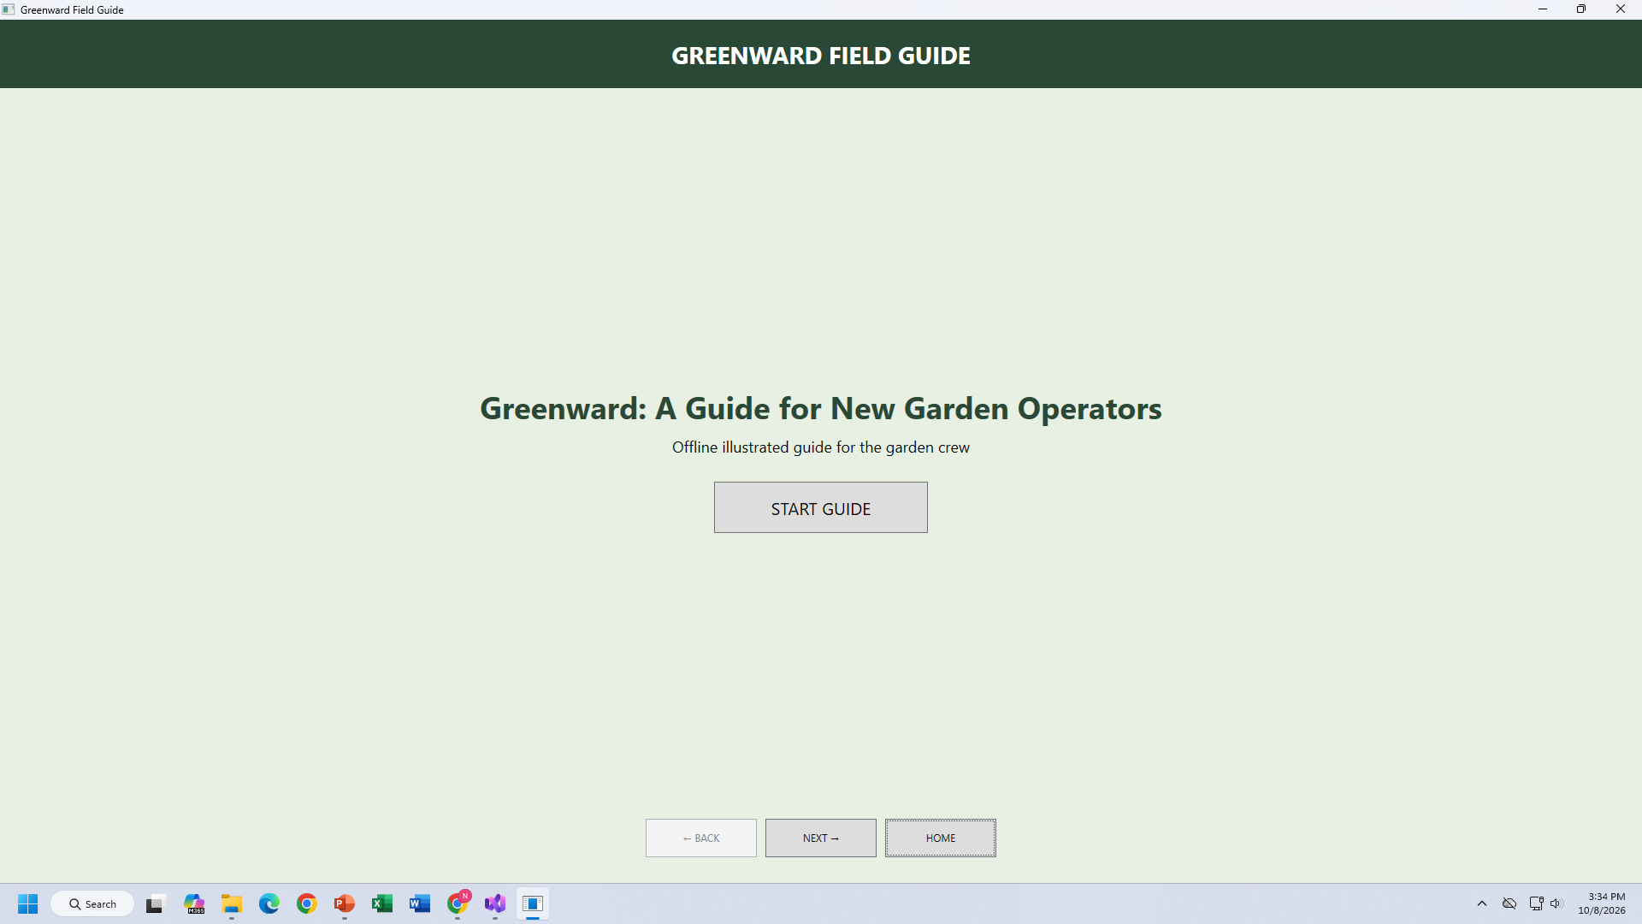
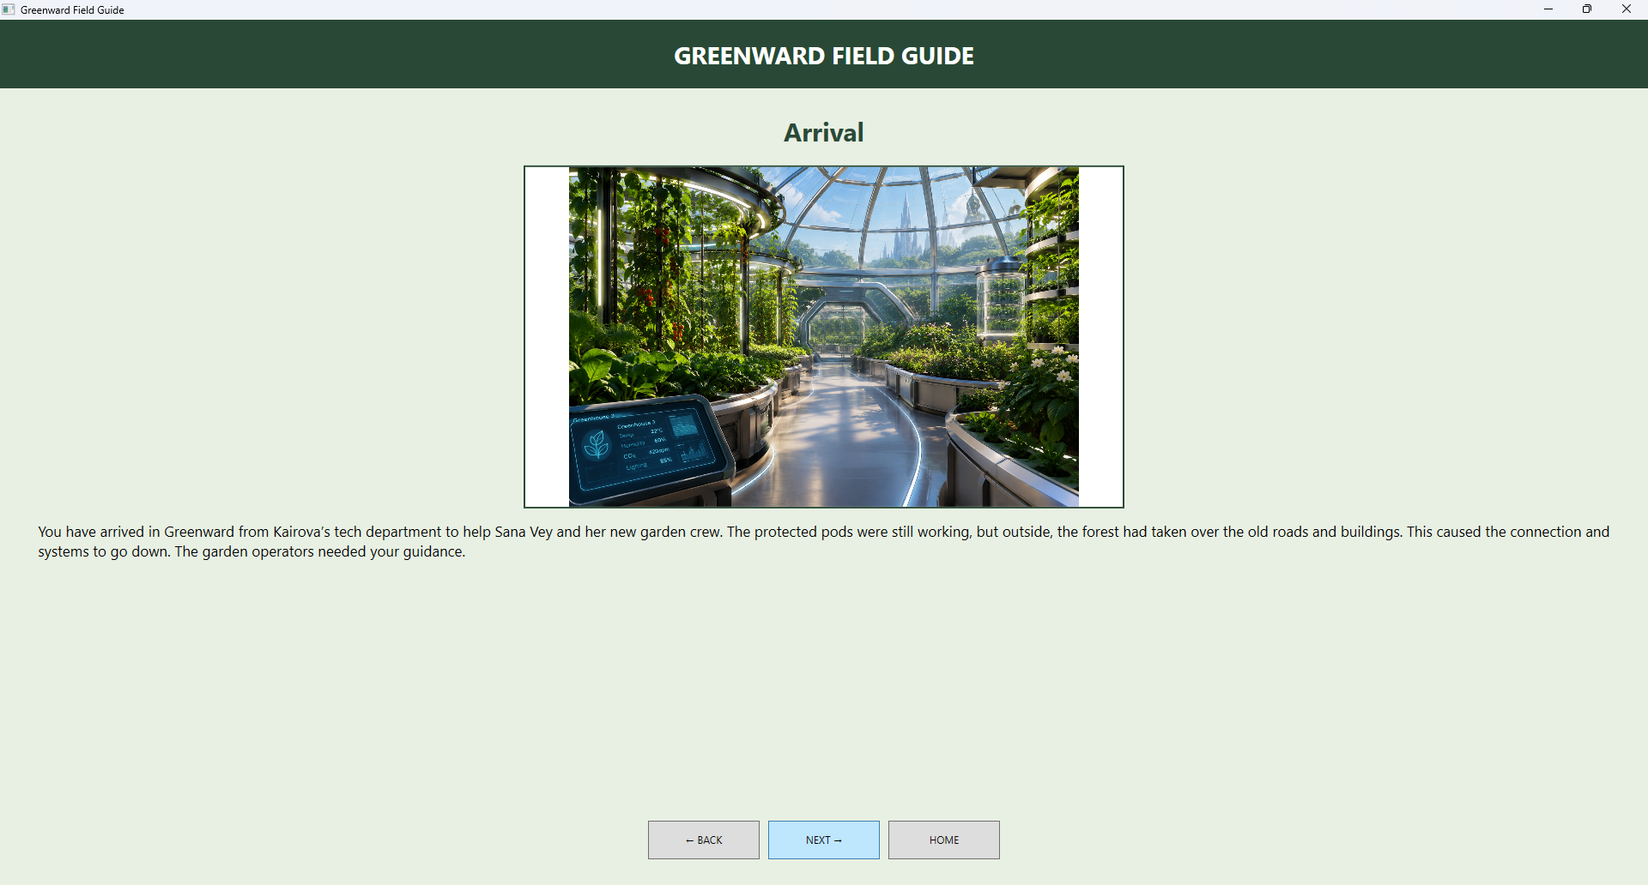
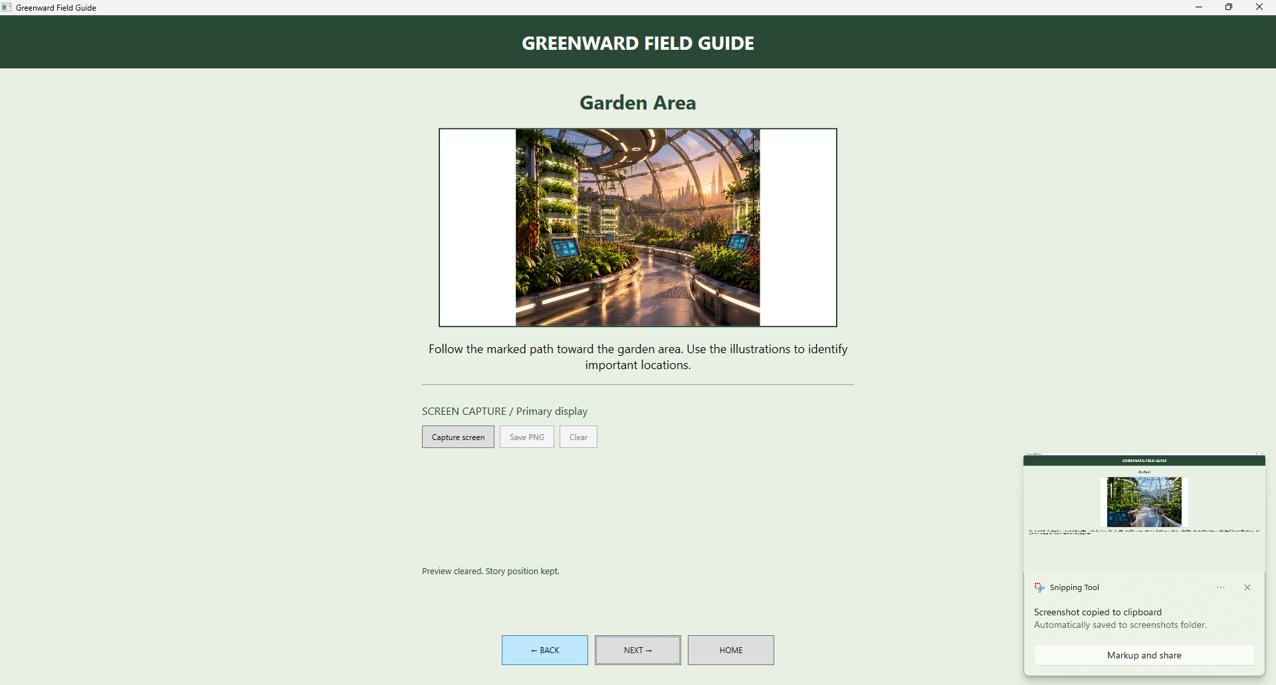
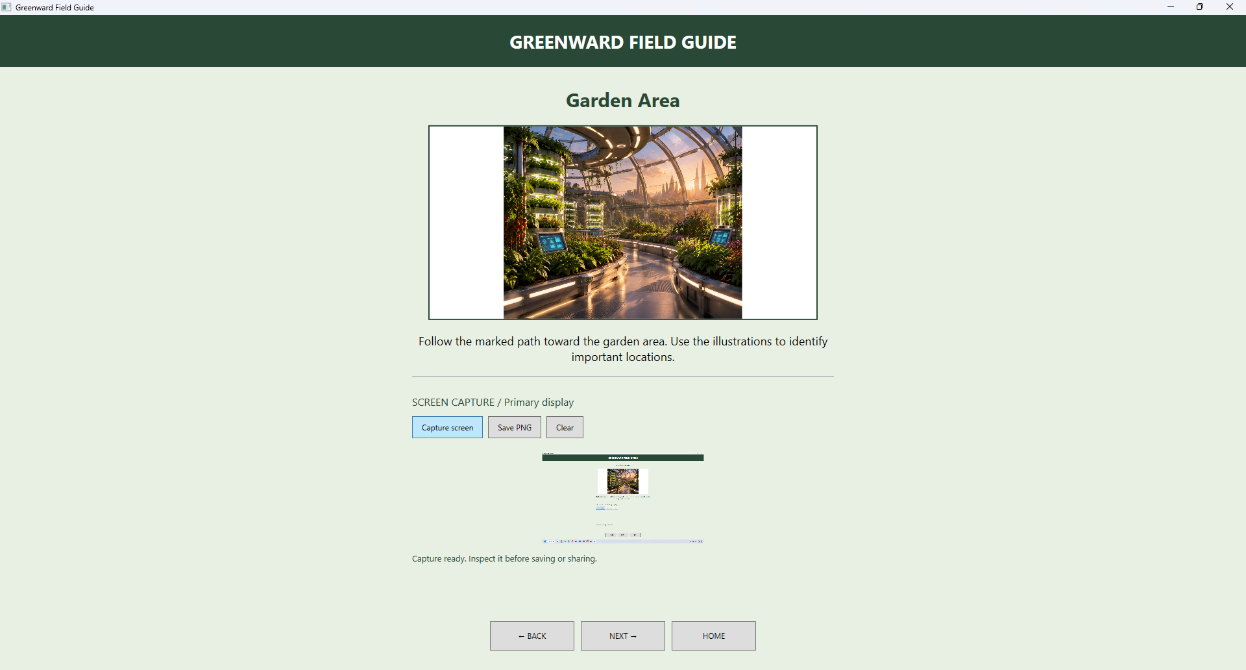
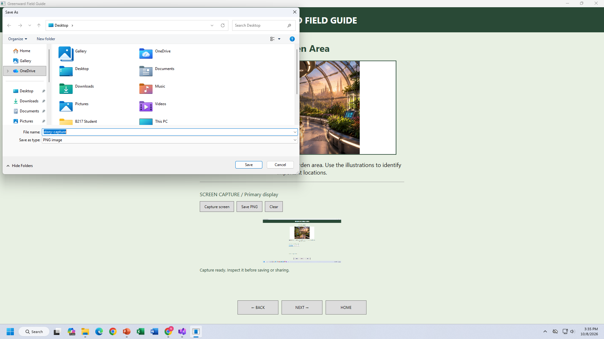
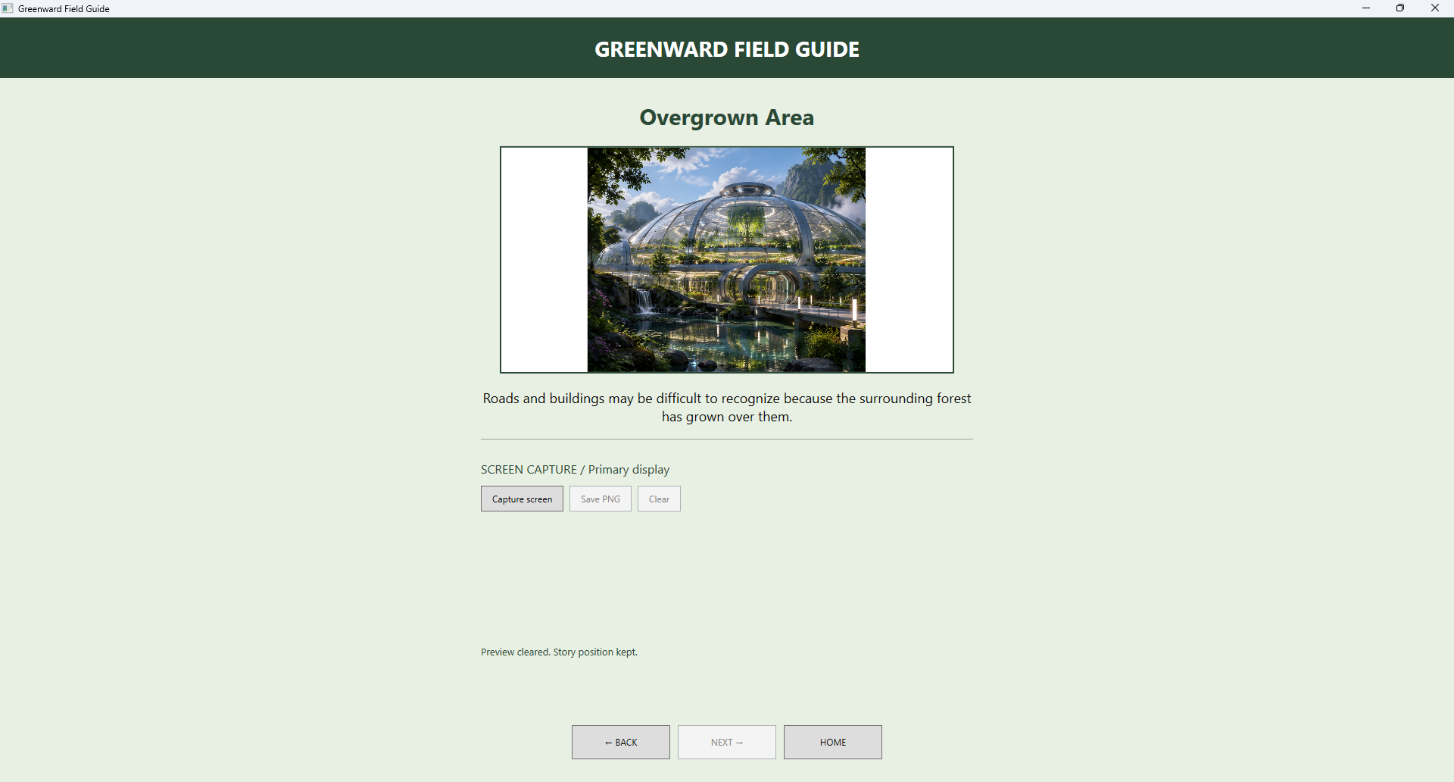
UI
Final UI Evidence
1 • Welcome / Start Guide
2 • Greenward Route
3 • Garden Area
c
c
4 • Garden Area (Function 1)
5 • Garden Area (Function 2)
6 • Overgrown Area
c
c
c
GREENWARD FIELD GUIDE • WEEK 7
4

Slide 6
CODE
XAML: Building the Screen
XAML defines the visual controls; x:Name lets C# access them.
MAIN STRUCTURE
XAML → C#
The names in XAML are the connection points used by C#.
XAML is used to design the visual layout of our Greenward Field Guide. It creates the buttons, text, colors, and different pages, such as Home, Map, Garden Area, and Overgrown Area.
HomePage
→
Visibility
MapPage
→
Visibility
GuidePage
→
Visibility
GuideTitle
→
Text
GuideImage
→
Text
GuideDescription
→
Text
Navigation controls
BackButton • NextButton • HOME
BackButton / NextButton
→
IsEnabled
GREENWARD FIELD GUIDE • WEEK 7
5

Slide 7
CODE
C#: The Page State
One variable keeps track of where the reader is.
CURRENT PAGE
NAVIGATION METHODS
C# controls the application's behavior when the user interacts with the buttons. The currentPage variable tracks which screen the reader is viewing, while the ShowPage() method displays the correct page. Methods like NextButton_Click(), BackButton_Click(), and HomeButton_Click() allow users to navigate through the guide.
StartGuide_Click
currentPage = 1
Home → Map
NextButton_Click
if < 3, then ++
Next page
Page states
BackButton_Click
if > 0, then --
Previous page
0
Home
1
Map
HomeButton_Click
currentPage = 0
Return Home
2
Garden
3
Overgrown
Every navigation event finishes by calling ShowPage().
GREENWARD FIELD GUIDE • WEEK 7
6

Slide 8
CODE
ShowPage(): The Controller Method
It hides every page first, then displays the correct one.
STEP 1
STEP 2
Hide everything
Choose the page using currentPage
The code hides the HomePage, MapPage, and GuidePage by setting their visibility to Collapsed. This ensures only the correct screen is displayed.
The currentPage variable determines which screen appears. Page 0 shows Home, page 1 shows the Map, page 2 shows the Garden Area, and page 3 shows the Overgrown Area. The code also updates the guide text and controls the Back and Next buttons.
This prevents multiple screens from being visible at once.
Finally: BackButton.IsEnabled and NextButton.IsEnabled use the page boundaries.
GREENWARD FIELD GUIDE • WEEK 7
7

Slide 9
FLOW
Complete Event Flow
This is how a user action travels from the XAML button to the visible screen.
1
2
3
4
5
USER CLICKS
→
EVENT HANDLER
→
UPDATE STATE
→
SHOW PAGE
→
UI UPDATES
START / NEXT / BACK / HOME
C# method runs
currentPage changes
ShowPage() runs
Visibility / Text changes
Example: NEXT on the Map page
currentPage = 1 → 2 → ShowPage() → Map hidden → GuidePage visible → “Garden Area” displayed
This same pattern is reused for every navigation button.
GREENWARD FIELD GUIDE • WEEK 7
8

Slide 10
TESTING
Demo & Functional Test Plan
What should be demonstrated with the current code.
1
Launch
Home page appears; START GUIDE is visible.
PASS when HomePage is visible.
2
Start Guide
Click START GUIDE → Map page appears.
currentPage becomes 1.
3
Next
Map → Garden → Overgrown.
Pages 2 and 3 display correct text.
4
Back
Move back one page.
currentPage decreases.
5
Home
Return to Welcome screen.
currentPage becomes 0.
6
Boundary
Back disabled at 0; Next disabled at 3.
Reader cannot leave valid range.
Important: the supplied code does NOT yet include CaptureService / CaptureButton_Click. Those are 7B tasks to implement and test next.
GREENWARD FIELD GUIDE • WEEK 7
9

Slide 11
FINAL
Final Submission Checklist
Everything needed for a clean instructor review.
✓
APPLICATION
Release build runs successfully on Windows.
✓
PROJECT ROOT
StoryGameApp/ • Evidence/ • README.md
✓
CLEAN ZIP
Exclude bin/ • obj/ • .vs/ and keep package under 100 MB.
✓
EVIDENCE
7A + 7B evidence organized with screenshots and test decisions.
✓
README
Intended User • Purpose • Setup • Controls • Code Map • Limitations • Contributions.
✓
TUTORIAL
Editable .pptx plus PDF in Week7/Evidence/Final/.
✓
PEER VERIFY
Outside peer extracts release ZIP, runs README steps, and records verification notes.
✓
REPOSITORY
Instructor can access the repository and tested URL is submitted.
READY = working app + tested navigation + complete evidence + clear documentation + final package.
GREENWARD FIELD GUIDE • WEEK 7
12

Slide 12
ROLES
Member-by-Member Master Checklist
Clear ownership from 7A through final submission.
LEXXIE
Lead Developer & Git Manager
NICO
Logic Architect & Visual Designer
• ✓ 7A WPF project, XAML/C# alignment, Git checkpoint
• 7B CaptureService integration and clean build
• Final Release Build and clean ZIP
• Repository visibility/access and tested URL
• ✓ 7A narrative flow and digital prototype
• 7B capture logic trace and prototype update
• Final code/event walkthrough
• Co-verify UI scaling and alignment
PAULINA
Narrative Writer & Documentation Lead
RUDY
Asset Pipeline, QA Tester & AI Lead
• ✓ 7A Greenward storyline, user story, accessibility text
• 7B lecture notes and evidence organization
• Final README
• Final PPTX + PDF export
• ✓ 7A image assets and boundary testing
• 7B capture tests + Required AI Check
• Final source/image credits
• Independent peer verification
GREENWARD FIELD GUIDE • WEEK 7
11

