Slide 1
CTA Strategies in Natural Gas Futures Leveraging Carry and Momentum Factors
FRE-7841 Hedge Fund Strategies
Prof. James Conklin
By Shangqing Zhuang , Shiqi Ma, Angran Lyu

Slide 2
Introduction
Project Overview
Construct carry signals (NG1-NG2) using price differences and technical indicators (SMA, ROC, RSI, etc.).
Combine carry and technical signals using a dynamic weighting strategy based on historical signal performance.
Perform full-sample and recent-period backtesting across different holding periods (e.g., 1, 5, 10 days) to assess strategy robustness.
Summary of Results
Carry signal (NG1-NG2) dominated pre-2022, effectively capturing stable market conditions with predictable storage costs.
SMA crossover signal outperformed post-2022, adapting to increased volatility and market disruptions.
Holding period analysis showed optimal performance, balancing signal responsiveness and transaction costs.
The combined signal delivered consistent returns (in both full-sample and recent-period backtesting), balancing risk and reward across market conditions.

Slide 3
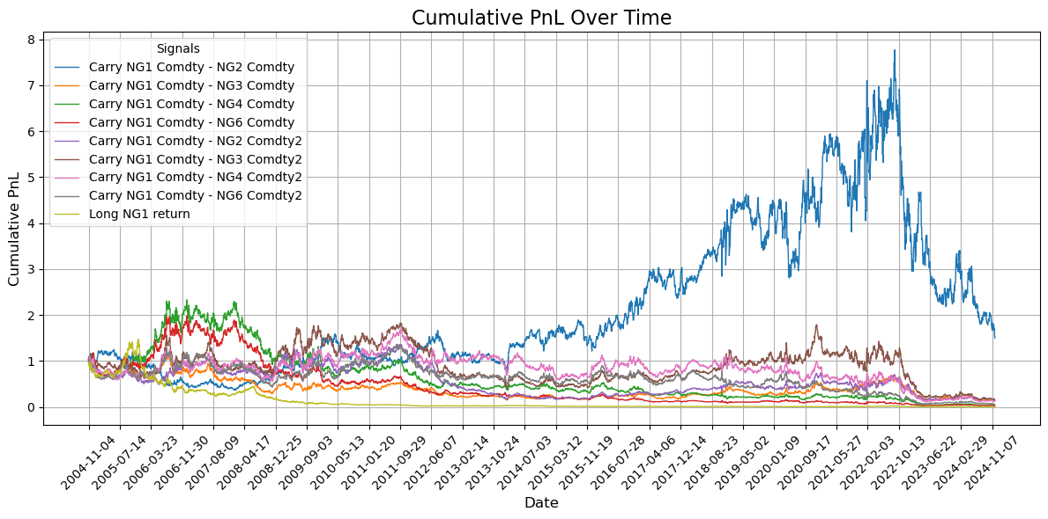

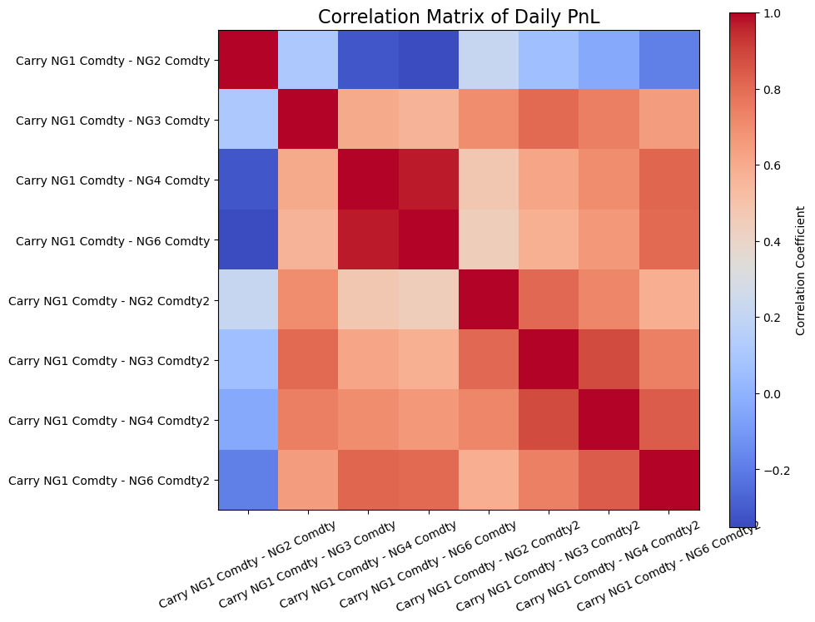

Carry signal construction & performance
We implement two ways to calculate carry signals:
Method 1: Price difference
Method 2: Rate difference normalized by interval
We also transform the signal with its Moving Average[1], convert the signal to (0,1) with quantile (in historical X days), and applied a linear function to ensure the signal to be in (-1,1).
Carry NG1-2 (method1) signal performs significantly better than others pre-2022, and its return correlation with other carrys are particularly low (-0.2~0.2). Therefore we pick up this one in following analysis.
Carry as a Strong Indicator for NG
Theory of Storage: Carry reflects the cost of holding inventories, driven by storage costs and convenience yields.
Market Impact: Hedging by inventory managers translates fundamental shifts into predictable price movements through the futures curve.
Predicts Supply and Demand: Contango (negative carry) signals incentivize supply, increasing storage and encouraging futures selling.
Seasonality and Constraints: Highly seasonal demand amplifies the role of carry in natural gas markets. Storage limitations lead to consistent and predictable hedging behaviors linked to the shape of the futures curve.
Pre-2022 Performance of carry NG1-2 (Method1) signal return
Annual Return: 10.6%
Cumulative Return: 5.8
Annual Sharpe: 0.45
[1] Bouchouev, I. (2023). Virtual Barrels: Systematic Risk Premia Strategies (Chapter 5). Springer Texts in Business and Economics.

Slide 4
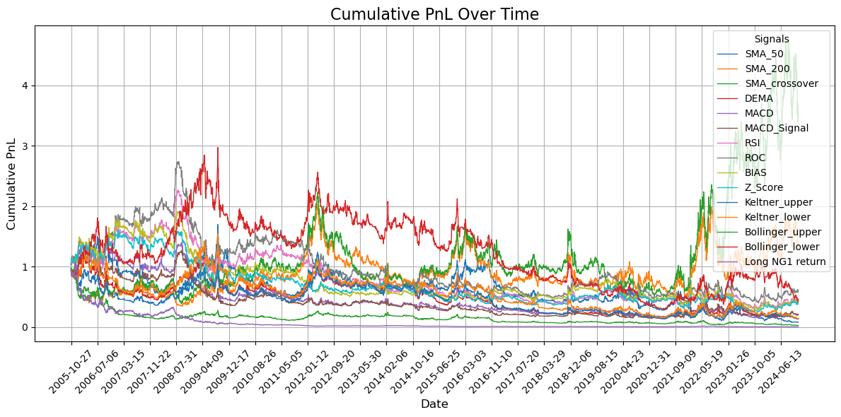
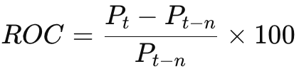

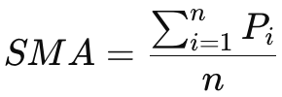

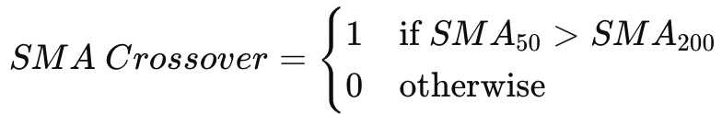
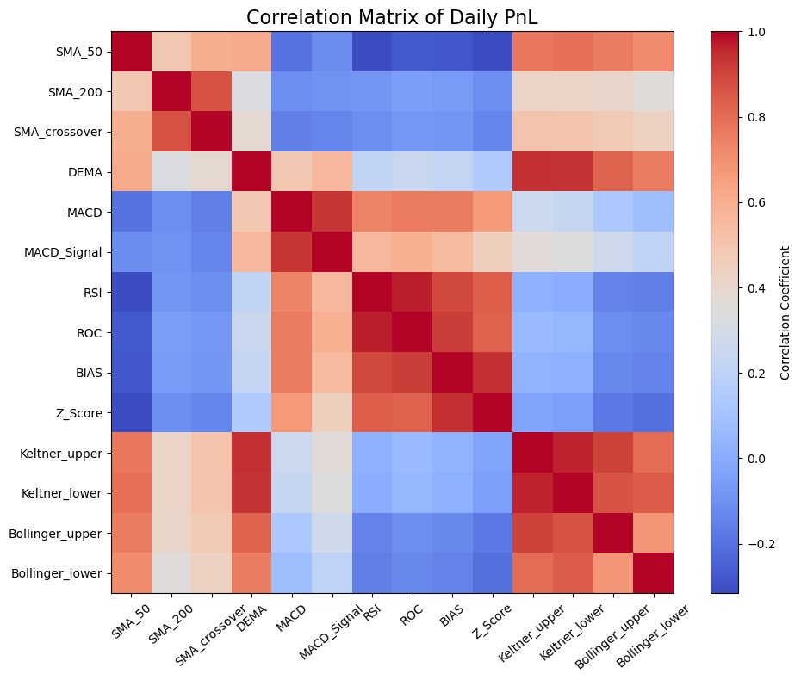



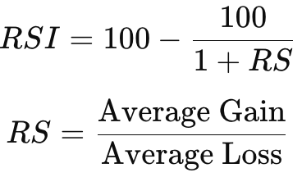
Technical signal construction & performance
Technical indicators identify trends, momentum, and reversals, enabling systematic trading to capture predictable price movements in NG. We construct 10 technical signals.
Trend Indicators
SMA
SMA crossover
DEMA
MACD
Oscillators
Relative Strength Index (RSI)
Rate of Change (ROC)
Bias
Z-Score
Channel Indicators
Keltner Channel
Bollinger Bands
SMA crossover signal outperformed others after 2022, with low return correlations to most technical signals (-0.2 to 0.5). Thus, we select it for further analysis.
Post-2022 Performance of SMA crossover signal return
Annual Return: 76.5%
Cumulative Return: 5.39
Annual Sharpe: 1.12

Slide 5
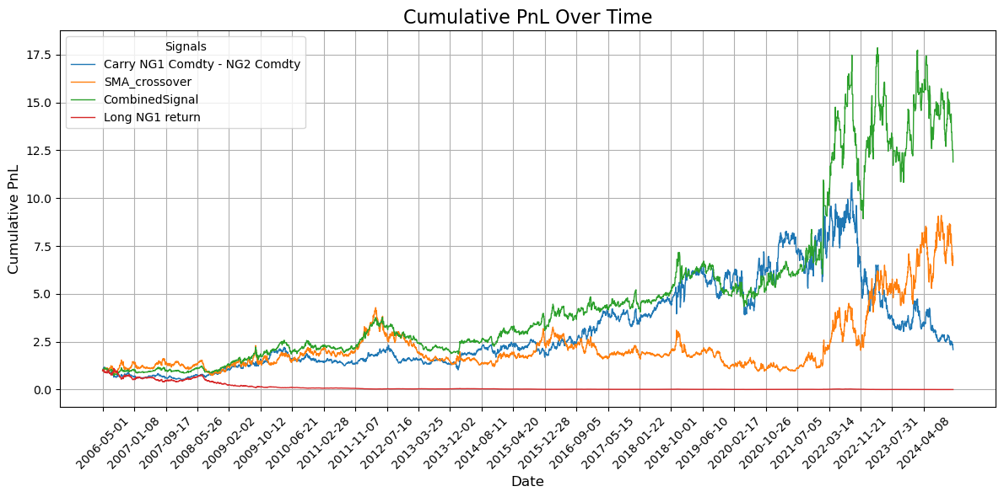
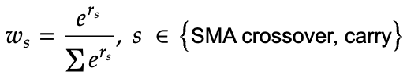
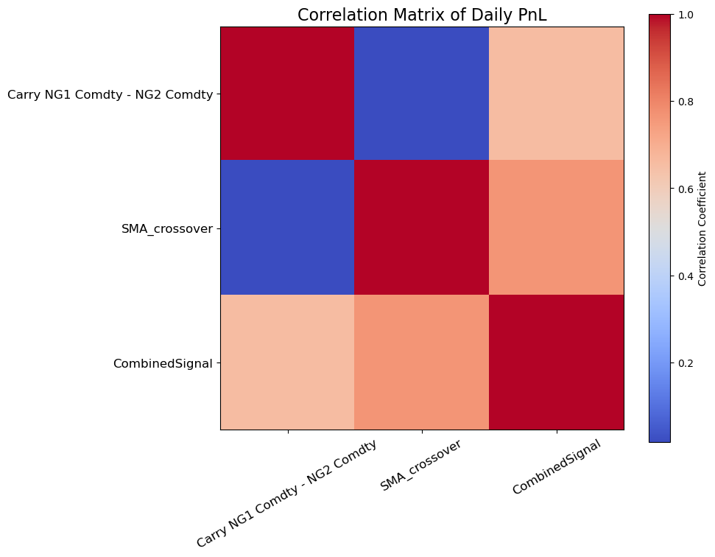
Signal Combination
Comparison of single/combined signal returns
We select SMA crossover and carry (NG1-NG2) signal to construct our final signal according to previous analysis.
We dynamically adjust weights to SMA crossover signal and carry signal according to their historical (6 months) signal return with a softmax function. We adjust weights every 22 days.
Signal returns of SMA crossover and carry signal are weakly-correlated. This combination method captures the better single signal in a certain period of time, highly adaptive to different market conditions.
Carry Signal Dominates Before 2022:
The market likely experienced periods of stable supply and demand dynamics with predictable storage costs and convenience yields. During such periods, the carry signal effectively captured the fundamental supply-demand balance.
SMA Crossover Dominates Post 2022:
Post-2022, the market might have seen increased volatility or structural changes (e.g., geopolitical events, regulatory shifts, or economic recovery). In such scenarios, trend-following strategies like the SMA crossover outperform by capturing momentum and reacting to large price moves.

Slide 6
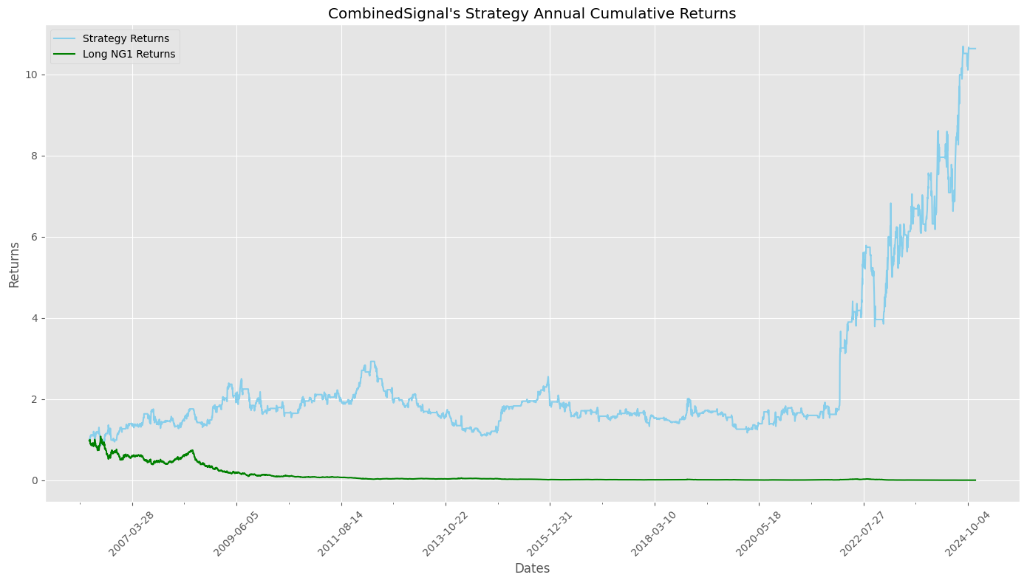
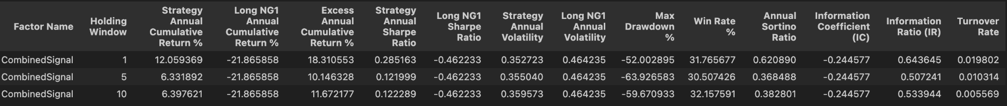
Full-sample Backtesting Performance:
Backtesting Period: 2006-05-29 to 2024-11-29.
Holding Logic: Hold positions for X days (1, 5, or 10) once a signal is detected, ignoring any signals during this period. After X days, adjust positions based on the latest signal. For this plot, we chose 10 days holding period.
Full-Sample Performance: This strategy achieves high full-sample returns with stable trend, balanced by low volatility and small maximum drawdown, effectively managing risk. The low turnover highlights cost efficiency, while the short holding window enables the strategy to respond quickly to market changes.

Slide 7
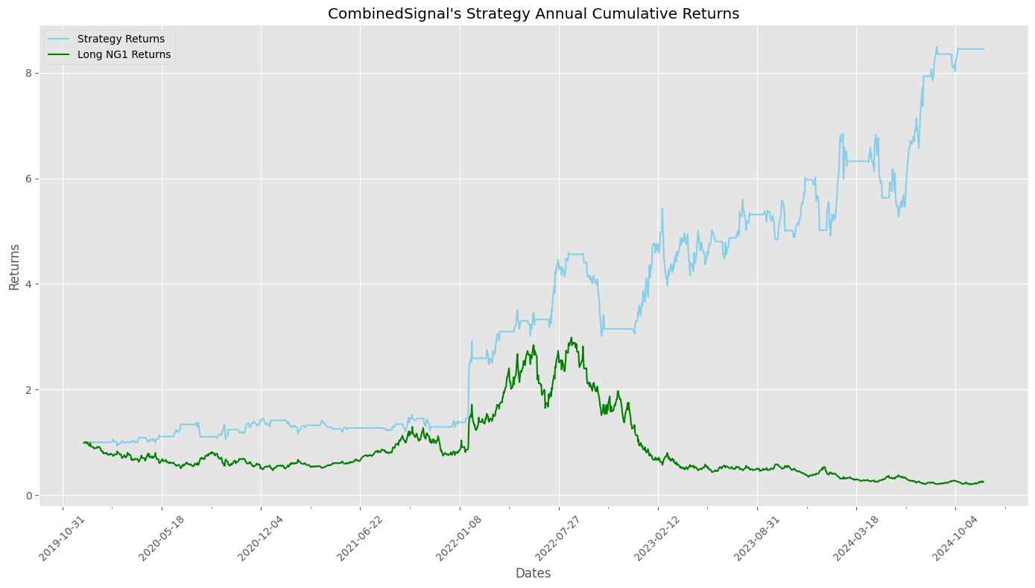
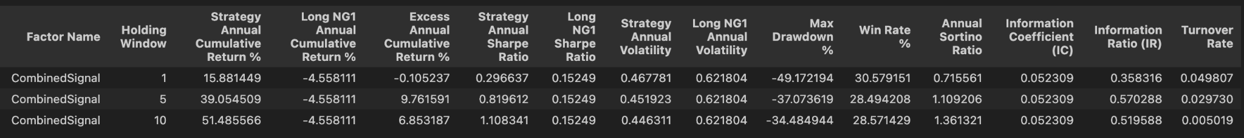
Recent-period Backtesting Performance:
Backtesting Period: 2019-10-29 to 2024-11-29.
Holding Logic: Hold positions for X days (1, 5, or 10) once a signal is detected, ignoring any signals during this period. After X days, adjust positions based on the latest signal. For this plot, we chose 10 days holding period.
Recent-period Performance: The strategy has performed well since 2020, especially during the COVID market disruptions, where it effectively captured several key signals. It outperformed the benchmark by achieving higher returns while keeping volatility and maximum drawdown lower, showcasing its strong ability to balance risk and reward during market stress.

Slide 8
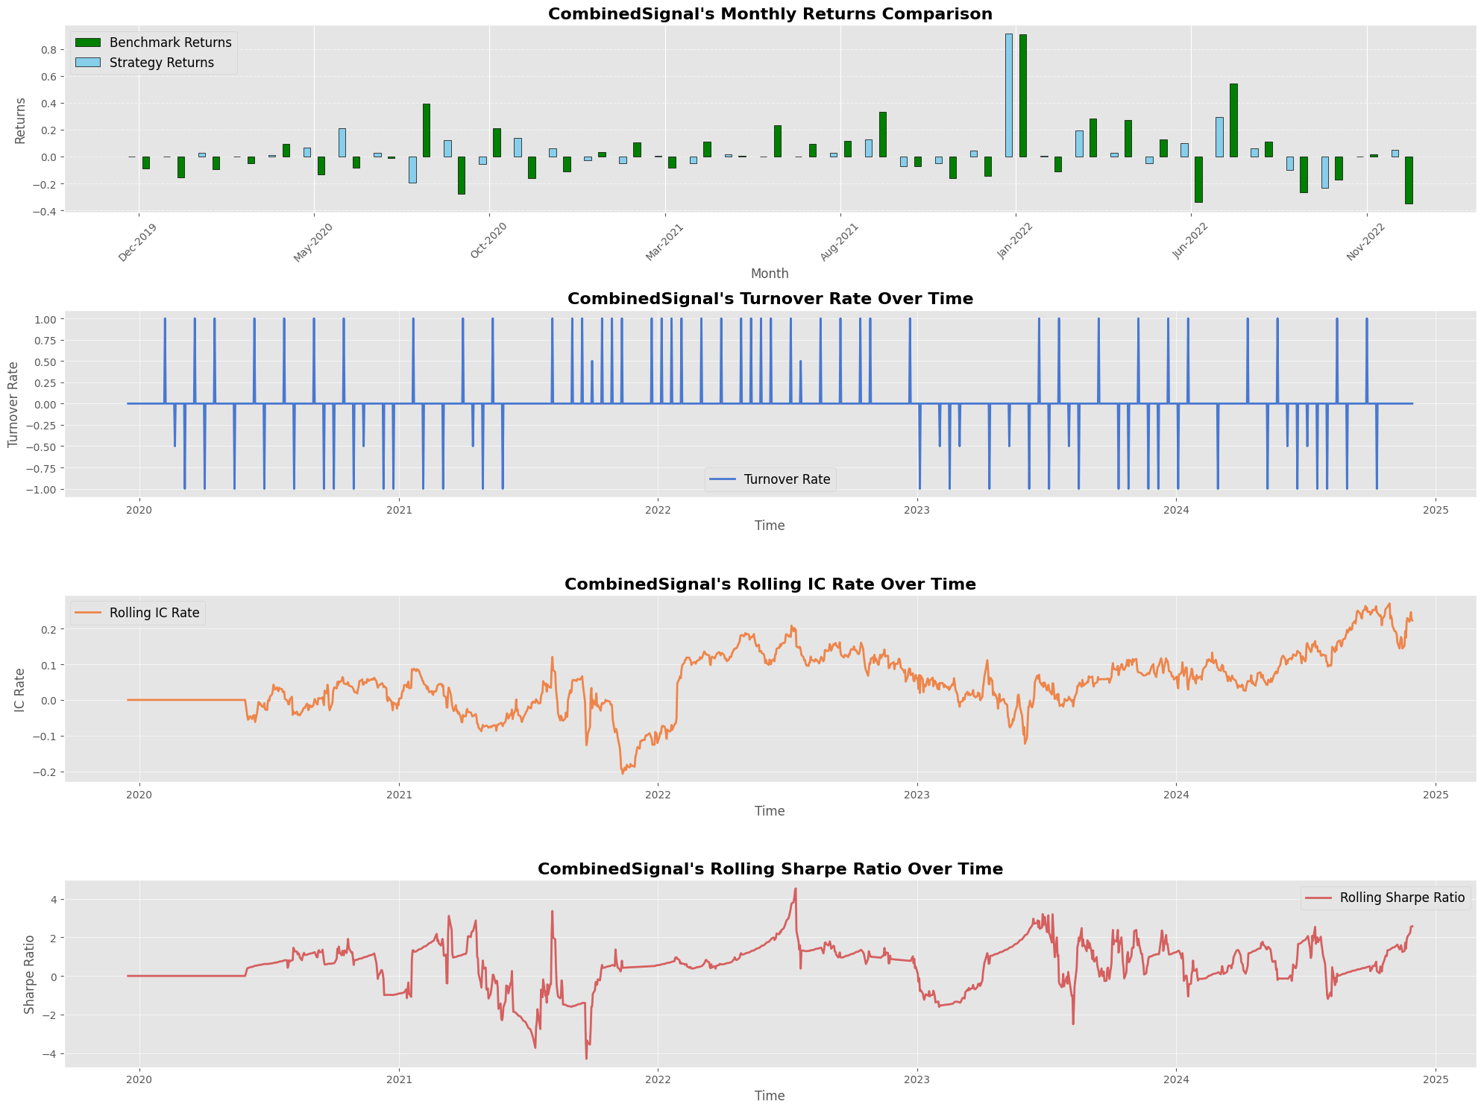
Recent-period Backtesting Performance:
Return Efficiency: The strategy outperformed the benchmark in 22 out of 37 months (59% win rate), excelling in both bearish and bullish markets. It delivered positive returns during most months when the benchmark was negative, showcasing strong short-selling signals, while also capturing gains in upward markets, demonstrating high adaptability and consistent profitability.
Turnover Rate: Setting transaction cost as 0.16%, Our position change is sparse.
Overall Performance: This strategy demonstrates long-term stability and consistent profitability. While it did not achieve strong returns prior to 2020, its performance improved significantly after 2020, making it particularly suited for volatile or bearish markets. Additionally, after 2020,after accounting for transaction costs, it achieved a Sharpe ratio of 1.1, highlighting its strong risk-adjusted profitability.

Slide 9
Conclusion
Construct and select carry (NG1-2) and SMA crossover signals by high signal return performances and low inter-signal correlation.
Softmax-weighted approach ensures optimal performance by emphasizing the best-performing (recent 6 months) signal component.
Backtest the signal on NG1 (apply the same signal to both full-sample and recent-period) with three holding periods (e.g., 1, 5, 10 days) to assess the robustness of our signal.
Key results
The full-sample backtesting (10 days holding period) demonstrates the strategy’s ability to deliver stable cumulative returns with low volatility, minimal drawdowns, and cost efficiency.
The recent-period backtesting (10 days holding period) achieved consistent returns with strong risk-adjusted metrics (Sharpe Ratio 1.1 post-2020) while managing transaction costs.

Slide 10
Appendix
Code
Generate Technical Signals: TechnicalSignal.ipynb
Generate Carry Signals: CarrySignal.ipynb
Select and Combine Signals: SelectCombine.ipynb
Backtesting Framework: Strategy_Backtest.ipynb
Data
Original NG Prices: NG1_data.xlsx
Technical Signals: NG1_Comdty_technical_indicators.csv
Carry Signals: carry1_data.xlsx, carry2_data.xlsx
Combined Signal: CombinedSignal.csv

