Slide 1
GHANA INSTITUTE OF MANAGEMENT AND PUBLIC ADMINISTRATION
GIMPA Thesis & Dissertation
Repository Management System
Comprehensive Digital Lifecycle Platform: From Proposal Submission & ONLYOFFICE In-App Supervision to Multi-Tier Defense Grading & Institutional Archival
🏛️ Live Production Server: https://thesis.manamatechnologies.com | Role-Based System Architecture & Walkthrough

Slide 2
1. SYSTEM OBJECTIVE & OVERVIEW
Executive Summary & Institutional Vision
End-to-End Digital Lifecycle
Eliminates paper-based thesis workflows by digitizing every academic phase: initial proposal submission, supervisor assignment, draft reviews, defense examination rubrics, post-defense corrections, dual sign-offs, and library publishing.
In-App ONLYOFFICE Grading
Embeds a full-featured collaborative Word processor directly in the browser, allowing supervisors and examiners to add track-changes, highlights, and margin comments without downloading/uploading external files.
12-Stage Doctoral Milestone Hub
A purpose-built governance sub-system for PhD tracking—enforcing 12 strict doctoral milestones, meeting frequency alerts, publication verification, and automated dossier compilation for faculty oversight.

Slide 3
1. SYSTEM OBJECTIVE & OVERVIEW
Problem Statement & Strategic Objectives
⚠️ Challenges of Legacy Paper-Based System
• Fragmented Submission Tracks: Printed drafts scattered across departments, leading to missing copies and unverified versions.
• Delayed Feedback Loops: Feedback exchange between students, supervisors, and external examiners took weeks via manual email/physical drop-offs.
• Examiner Discrepancies: Lack of standard rubric computation, weighted scoring formulas, and clear separation of Undergraduate (1 examiner) vs. Postgraduate (2 examiners) tracks.
• Zero Milestone Visibility: No centralized tracking for PhD student progress, supervision meeting frequency, or dormant candidacy alerts.
• Archival Loss: Approved research dissertations remained unindexed in physical filing cabinets instead of a searchable academic catalog.
🎯 Core Objectives & Solutions Delivered
✔ Unified Digital Pipeline: 6-Phase state machine governing proposals, draft reviews, examination defenses, corrections, and archival.
✔ In-Browser Live Annotations: Integrated ONLYOFFICE Docs Engine for real-time DOCX editing, line comments, and versioned feedback.
✔ Automated Multi-Examiner Rubrics: Dynamic scoring engine that computes final marks, verifies pass thresholds, and enforces dual sign-offs.
✔ PhD Doctoral Progression Hub: 12-stage milestone matrix with automated inactivity alerts, meeting logs, and publication tracking.
✔ Public Institutional Repository: Fully indexed public search portal with faculty filtering (GBS, SPSG, Law, SOTSS), trending analytics, and PDF security.

Slide 4
1. SYSTEM OBJECTIVE & OVERVIEW
System Architecture & Full-Stack Technology Stack
Frontend Application
React 19 & React Router 7
Tailwind CSS v4 (Design System)
Lucide React Iconography
Vanilla CSS Dynamic Themes
HTML5 Canvas & PDF Handlers
Backend Services
Python FastAPI (High Performance)
SQLAlchemy ORM & SQLite/Postgres
Pydantic v2 Schema Validation
JWT Authentication & Passlib Hashing
Exim / SMTP Auto-Mailer Engine
Document & Storage
ONLYOFFICE DocumentServer
Docker Containerized Microservice
JWT Secure Callback Handlers
DOCX / PDF Binary Storage Engine
Automated Snapshot Backup Daemon
Security & Roles
7-Tier Role-Based Access Control
Granular Department Scoping
Defense Gate Clearance Engine
Tamper-Evident Audit Trails
HTTPS / SSL Encrypted Traffic
Academic Workflows
Undergrad Track: 1 Examiner (S1)
Postgrad Track: 2 Examiners ((S1+S2)/2)
Weighted Defense Rubric Matrix
12-Stage PhD Progression Engine
Coordinator & HOD Dual Sign-offs
Cloud & Infrastructure
Ubuntu 22.04 LTS Production VPS
Nginx Reverse Proxy & Load Balancer
Systemd Daemon Service Supervision
Cloudflare Edge Caching & WAF
Git CI/CD Synchronized Deployment

Slide 5
2. USE CASE ARCHITECTURE & ROLES
Role-Based Access Control (RBAC) Hierarchy
Student / Candidate
Submit proposals, upload drafts, edit thesis directly in ONLYOFFICE, review examiner feedback, submit post-defense revisions, log PhD meetings.
Project Supervisor
Guide candidates, conduct in-app reviews, annotate thesis in ONLYOFFICE, track 12-stage milestones, sign off on defense readiness.
Examiner (Int/Ext)
Access assigned scripts, conduct blind/open evaluations, fill structured rubric rubrics, provide in-doc comments, submit pass/correction verdicts.
HOD / Coordinator
Department-wide thesis pipeline oversight, allocate examiners, schedule defenses, compute final scores, provide primary academic sign-off.
Dean of Faculty
Faculty-wide completion analytics, review departmental defense results, grant final institutional clearance for graduation.
Librarian
Repository curation, metadata enrichment, indexing approved dissertations, managing public embargoes, catalog publishing.
System Administrator
User management, bulk CSV student/staff onboarding, system broadcast announcements, database maintenance, audit logs.

Slide 6
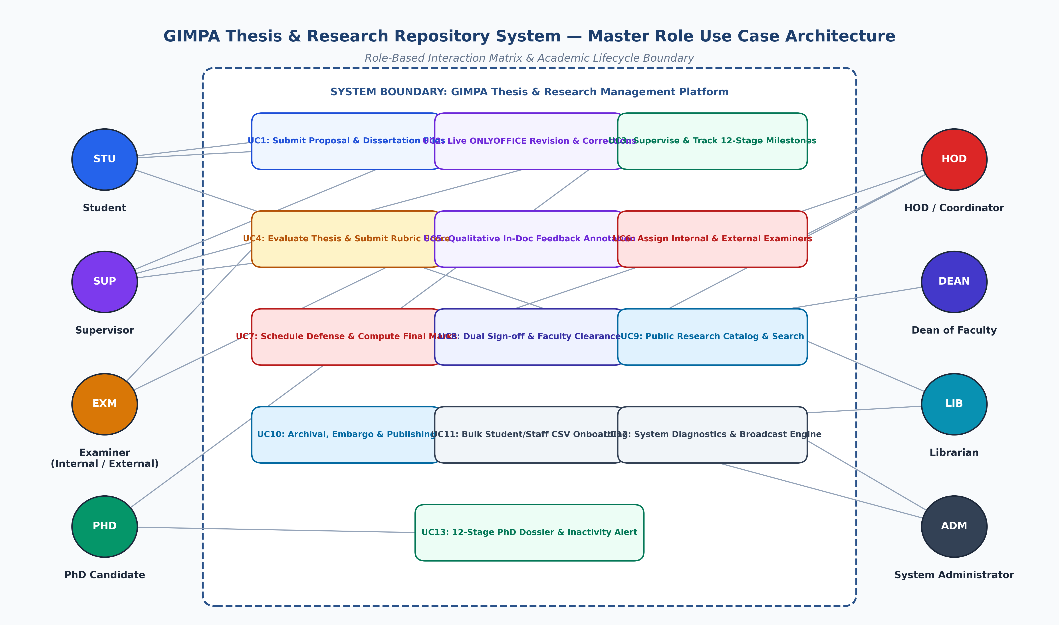
2. USE CASE ARCHITECTURE & ROLES
Master Role Use Case Architecture Diagram

Slide 7
2. USE CASE ARCHITECTURE & ROLES
Detailed Use Cases: Student & Supervisor Interactions
🎓 Student / Candidate Use Cases
• UC-S1: Submit Research Proposal — Enter title, abstract, degree level (Undergrad / Masters / PhD), faculty, and upload draft.
• UC-S2: In-App ONLYOFFICE Revisions — Launch in-browser DOCX editor, apply corrections, view real-time examiner markup.
• UC-S3: Track Pipeline Progression — Monitor live status across 6 phases (Proposal -> Review -> Defense -> Corrections -> Sign-off -> Archival).
• UC-S4: Submit Post-Defense Corrections — Upload final revised thesis or submit one-click in-system ONLYOFFICE edits.
• UC-S5: Log PhD Supervision Meetings — Record meeting date, discussion notes, action items, and next milestone targets.
👨‍🏫 Project Supervisor Use Cases
• UC-SUP1: Supervise Assigned Candidates — Access active student roster, view research topics, and monitor chapter submission dates.
• UC-SUP2: Live Collaborative In-Doc Review — Use ONLYOFFICE Word tools to insert margin comments, suggest track-changes, and highlight text.
• UC-SUP3: Grade Undergraduate Theses — As sole examiner (S1), evaluate final undergraduate project and enter rubric score.
• UC-SUP4: Approve 12-Stage PhD Milestones — Validate student milestone submissions, sign off on meeting logs, and verify publication criteria.
• UC-SUP5: Post-Defense Correction Sign-off — Verify student has resolved all examiner feedback before passing to HOD.

Slide 8
2. USE CASE ARCHITECTURE & ROLES
Detailed Use Cases: Examiner, HOD & Dean Governance
Examiner (Int/Ext)
✔ UC-EX1: Review Assigned Thesis
✔ UC-EX2: Fill Standardized Rubric Matrix
✔ UC-EX3: Provide Qualitative In-Doc Feedback
✔ UC-EX4: Submit Verdict (Pass / Corrections / Fail)
✔ UC-EX5: Download Blind Assessment Scripts
HOD / Coordinator
✔ UC-HOD1: Departmental Pipeline Oversight
✔ UC-HOD2: Assign Internal & External Examiners
✔ UC-HOD3: Schedule Oral Defense Sessions
✔ UC-HOD4: Compute Weighted Final Grade
✔ UC-HOD5: Authorize Phase 5 Sign-off
Dean of Faculty
✔ UC-DN1: Faculty-Wide Completion Analytics
✔ UC-DN2: Review Cross-Department Defenses
✔ UC-DN3: Grant Final Faculty Clearance
✔ UC-DN4: Export Institutional Accreditation Reports
✔ UC-DN5: Monitor Academic Integrity Audits

Slide 9
2. USE CASE ARCHITECTURE & ROLES
Detailed Use Cases: Librarian & System Administration
📚 Librarian / Repository Curator
• UC-LIB1: Curate Approved Theses — Ingest theses that have received final Dean clearance into the digital repository.
• UC-LIB2: Metadata Enrichment & DOI Tagging — Assign academic keywords, Dewey/LC classification, and institutional metadata.
• UC-LIB3: Embargo & Access Management — Configure public access, campus-only restrictions, or temporary publication embargoes.
• UC-LIB4: Catalog Indexing & Publishing — Publish finalized dissertations to the public search catalog for global research access.
⚙️ System Administrator
• UC-ADM1: User & Role Provisioning — Create, activate, suspend accounts, and assign multi-role permission matrices.
• UC-ADM2: Bulk CSV Student & Staff Onboarding — Import hundreds of student/staff records from university SIS CSV files in one click.
• UC-ADM3: Broadcast Announcement Engine — Dispatch system-wide announcements and alert banners with target role scoping.
• UC-ADM4: Diagnostics & Audit Logging — Monitor API endpoints, track user authentication events, and execute database backups.

Slide 10
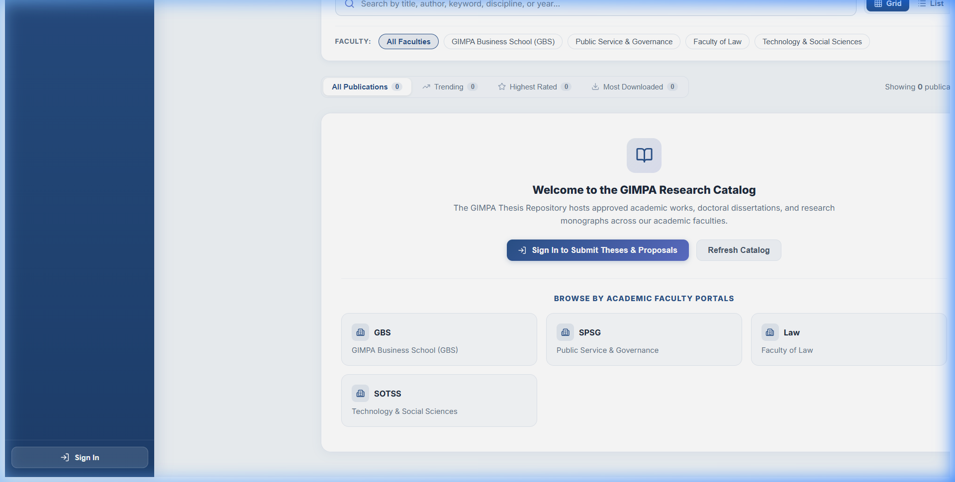
3. PAGE-BY-PAGE SYSTEM WALKTHROUGH
Page 1: Public Research Catalog & Faculty Portals (`/`)
📌 Page Purpose & Meaning
• The front-facing gateway showcasing GIMPA's approved dissertations, master's theses, and academic publications.
• Open to global researchers, students, and faculty without requiring an upfront login for public discovery.
• Organized by academic faculty portals: GBS (Business School), SPSG (Public Service & Governance), Faculty of Law, and SOTSS (Technology & Social Sciences).
⚡ Key System Capabilities
✔ Trending, Highest Rated, & Most Downloaded publication tabs.
✔ Live dynamic search bar with immediate query filtering.
✔ Faculty filter cards for instant departmental slicing.
✔ Direct sign-in portal button for registered students and faculty.

Slide 11
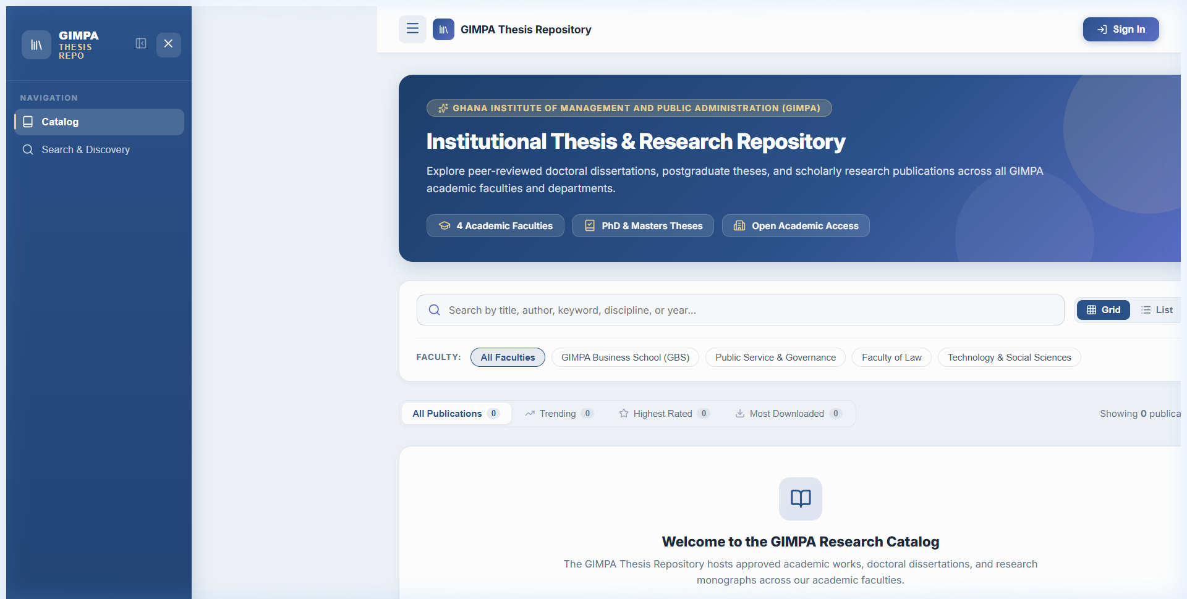
3. PAGE-BY-PAGE SYSTEM WALKTHROUGH
Page 2: Advanced Search & Discovery Engine (`/search`)
📌 Page Purpose & Meaning
• Multi-dimensional research engine enabling deep academic literature discovery across GIMPA's repository.
• Allows filtering by author name, research title, supervisor, abstract keywords, publication year, and academic degree.
• Supports faceted exploration to identify research trends, departmental output, and historical academic works.
⚡ Key System Capabilities
✔ Multi-field boolean filtering (Degree level, Faculty, Year, Department).
✔ Interactive publication preview drawer with abstract viewer.
✔ Download count tracker and citation metadata generation.
✔ Clean tabular & card display modes with instant sorting.

Slide 12
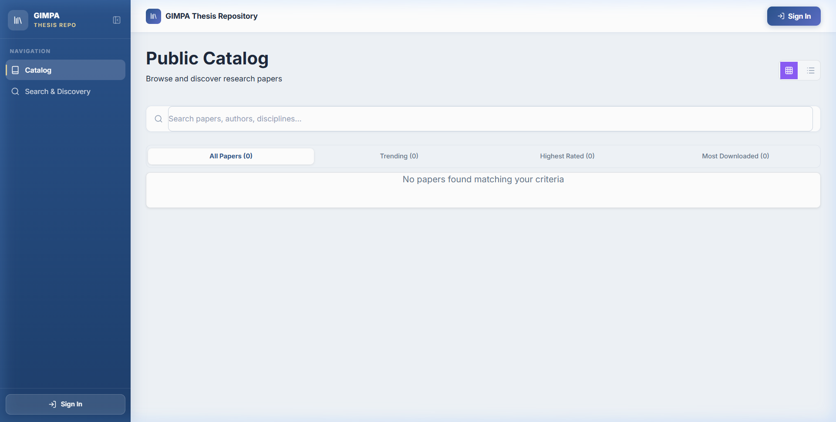
3. PAGE-BY-PAGE SYSTEM WALKTHROUGH
Page 3: Authentication & Role-Based Login (`/login`)
📌 Page Purpose & Meaning
• Secure single point of entry for all 7 system roles using university credentials (Student ID or Staff Email).
• Implements JSON Web Token (JWT) stateless session handling with cryptographic signature verification.
• Automatically detects role permissions and routes users to their personalized dashboard workspace.
⚡ Key System Capabilities
✔ Seamless institutional authentication with password hashing (bcrypt).
✔ Remember-me persistence and password recovery workflow.
✔ Automatic role dispatch (Student -> Dashboard, Examiner -> Workflow, Admin -> Mgmt).
✔ Zero unauthorized route leakage via client-side & server-side auth guards.

Slide 13
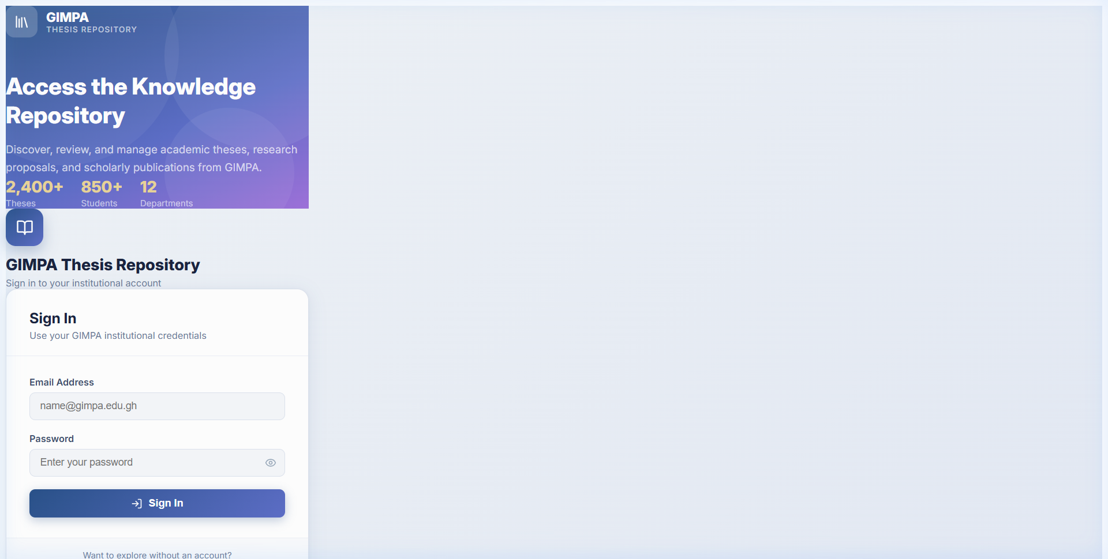
3. PAGE-BY-PAGE SYSTEM WALKTHROUGH
Page 4: Student Dashboard & 6-Phase Pipeline Tracker
📌 Page Purpose & Meaning
• Personalized academic command center for students and doctoral candidates to submit work and monitor progress.
• Displays the live 6-phase academic lifecycle banner, showing exact current status, review stage, and required next steps.
• Houses the dedicated ONLYOFFICE In-App Revision Panel for viewing examiner remarks and editing thesis DOCX in real-time.
⚡ Key System Capabilities
✔ Proposal & Thesis upload form (Title, Abstract, Department, Degree Level).
✔ Active stage badge chip with real-time status updates.
✔ Examiner feedback evaluation box displaying compiled remarks.
✔ One-click 'Submit In-System ONLYOFFICE Edits' workflow.

Slide 14
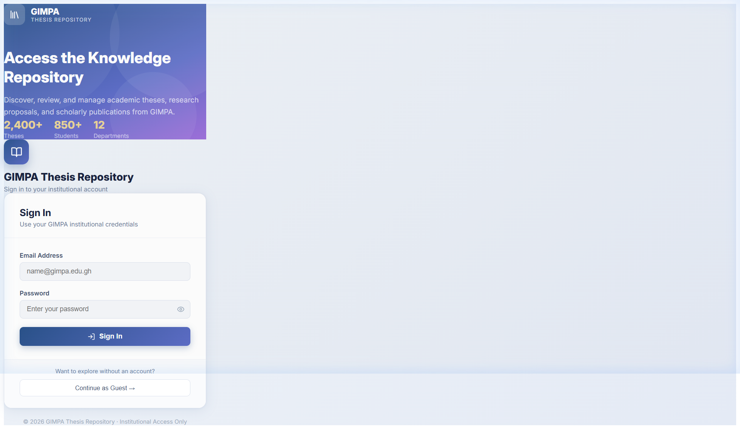
3. PAGE-BY-PAGE SYSTEM WALKTHROUGH
Page 5: ONLYOFFICE In-App DOCX Editing & Feedback Engine
📌 Page Purpose & Meaning
• Embedded enterprise document suite (ONLYOFFICE Docs) powering in-browser thesis editing without Microsoft Word installation.
• Enables supervisors and examiners to annotate candidate submissions with margin comments, highlights, and tracked changes.
• Automatically synchronizes edits back to the GIMPA repository backend upon document closure.
⚡ Key System Capabilities
✔ Full Microsoft Word (.docx) feature compatibility in-browser.
✔ Side-by-side comment stream and multi-user change tracking.
✔ Two distinct view modes: Thesis Editor and Feedback Comments Document.
✔ Secure tokenized document server callbacks preventing data leaks.

Slide 15
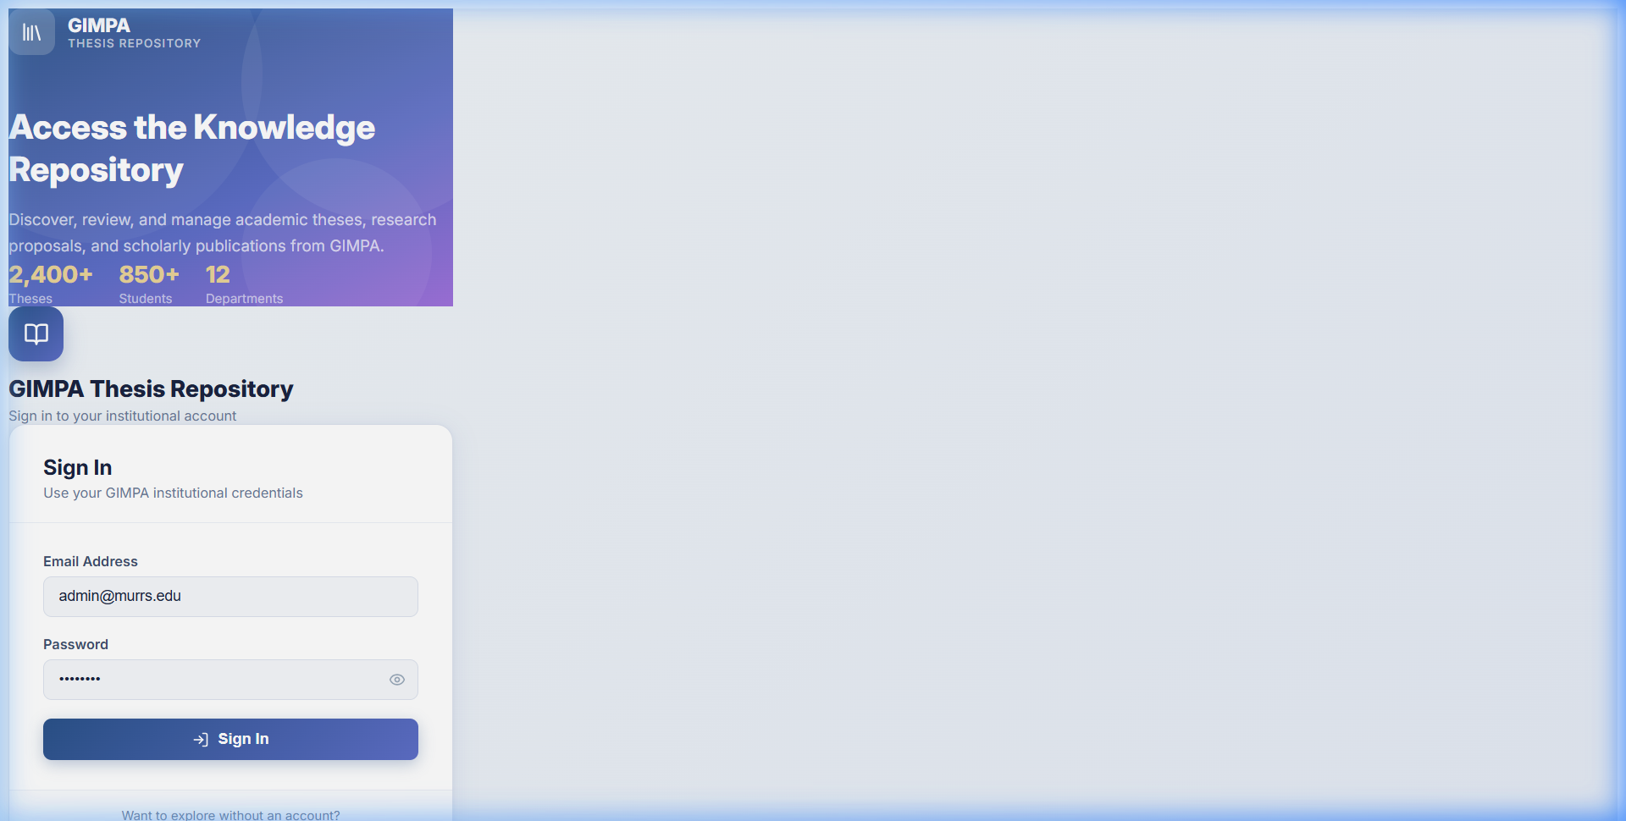
3. PAGE-BY-PAGE SYSTEM WALKTHROUGH
Page 6: Examiner Evaluation & Rubric Grading Portal
📌 Page Purpose & Meaning
• Dedicated grading interface for Internal and External Examiners to review assigned dissertations.
• Enforces standardized institutional grading rubrics (Problem Statement, Literature Review, Methodology, Analysis, Defense).
• Calculates weighted marks and enforces official examination verdicts: Pass, Minor Corrections, Major Corrections, or Resubmit.
⚡ Key System Capabilities
✔ Blind/open thesis document viewer with instant script download.
✔ Structured rubric score inputs with auto-calculating total mark.
✔ Detailed examiner feedback text box for defense committee compilation.
✔ Automatic separation of Undergrad (1 examiner) vs Postgrad (2 examiners) tracks.

Slide 16
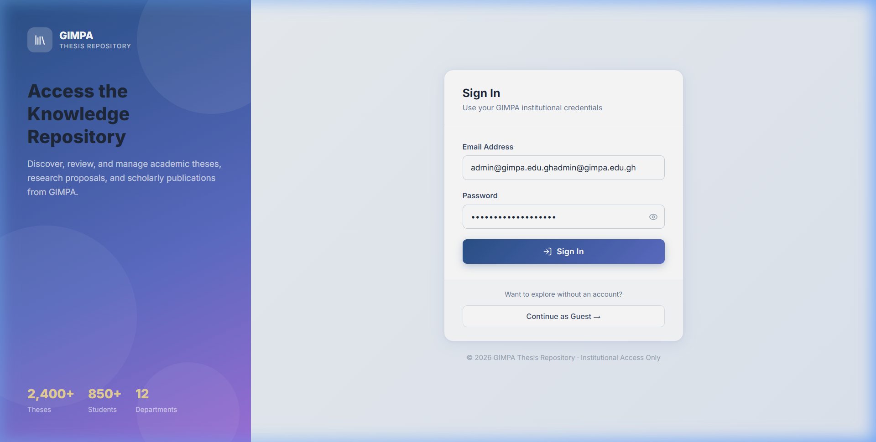
3. PAGE-BY-PAGE SYSTEM WALKTHROUGH
Page 7: PhD Hub — 12-Stage Doctoral Milestone Matrix
📌 Page Purpose & Meaning
• Specialized doctoral governance module mapping candidate progression across the mandatory 12 PhD stages.
• Tracks milestones from Stage 1 (Concept Paper) through Fieldwork, 3x Journal Publications, to Final Viva Defense and Archival.
• Provides automated meeting logging and supervision compliance analytics to prevent dormant candidacies.
⚡ Key System Capabilities
✔ 12-Stage visual progression bar with milestone completion checkmarks.
✔ Supervision Meeting Logger: captures date, discussion summary, and deliverables.
✔ Days-since-last-meeting counter with automatic yellow/red alert flags.
✔ Publication verification tab ensuring doctoral accreditation compliance.

Slide 17
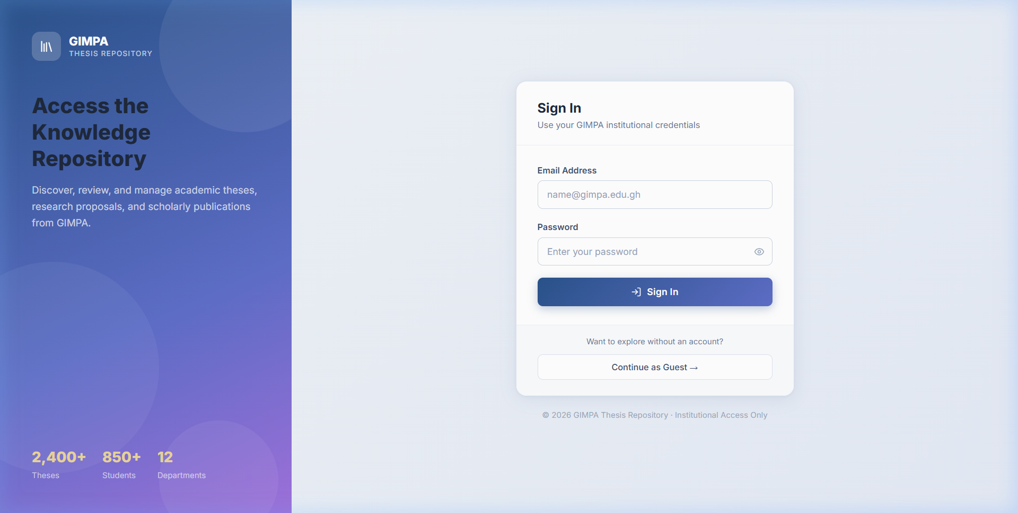
3. PAGE-BY-PAGE SYSTEM WALKTHROUGH
Page 8: PhD Student Dossiers & Inactivity Risk Tracker
📌 Page Purpose & Meaning
• Comprehensive candidate directory allowing Deans, HODs, and Supervisors to inspect individual doctoral progress dossiers.
• Highlights high-risk candidates who have not had a supervision meeting in >30 or >60 days.
• Serves as the institutional single source of truth for doctoral accreditation and graduation readiness.
⚡ Key System Capabilities
✔ Summary KPI header: Active Doctoral Candidates, At Risk, Progress Rate.
✔ Individual Dossier Cards: Department, Stage Number, Current Milestone.
✔ Interactive search and filter by department and supervision status.
✔ One-click drilldown into complete 12-stage milestone logs.

Slide 18
3. PAGE-BY-PAGE SYSTEM WALKTHROUGH
Page 9: HOD & Coordinator Defense Scheduling & Sign-Off
📌 Page Purpose & Meaning
• Central administration hub for Heads of Department and Programme Coordinators to manage defense logistics.
• Allows assigning Internal and External Examiners to submitted student theses.
• Compiles examiner marks, computes final weighted scores, and issues Phase 5 post-defense authorization.
⚡ Key System Capabilities
✔ Examiner Allocation Modal: Assign qualified faculty to candidates.
✔ Defense score compiler: Aggregates Internal (S1) + External (S2) scores.
✔ Dual sign-off authorization engine (Supervisor -> HOD/Coordinator).
✔ Departmental completion export and audit log generation.

Slide 19
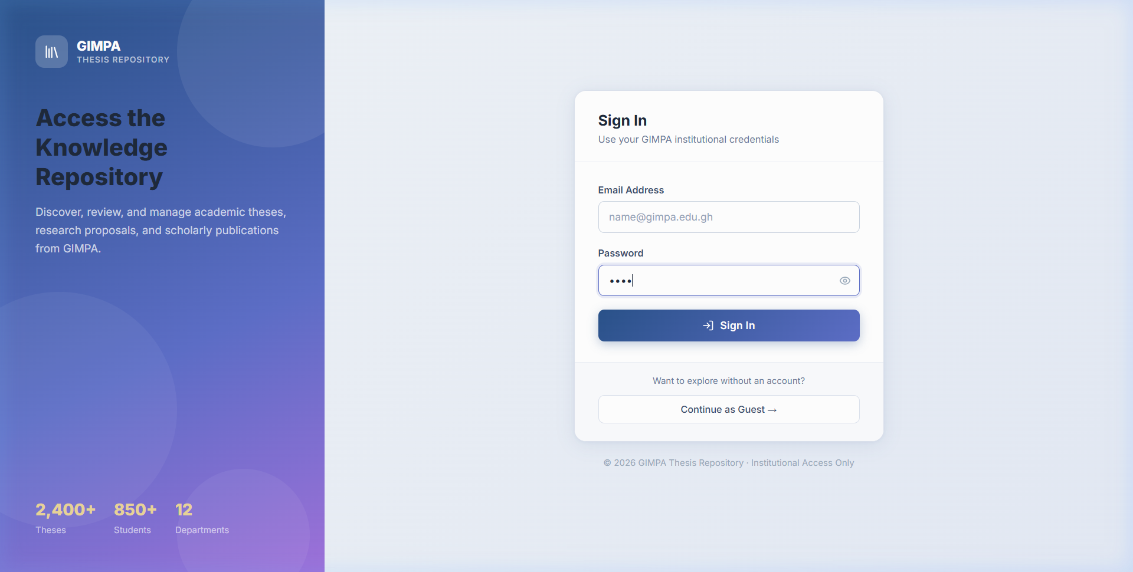
3. PAGE-BY-PAGE SYSTEM WALKTHROUGH
Page 10: System Administration & User Management Portal
📌 Page Purpose & Meaning
• Full administrative suite for System Administrators to govern accounts, system security, and broadcast engines.
• Features multi-role assignment, account locking, password resets, and role elevation.
• Includes the Broadcast Engine to send instantaneous targeted announcements across all user dashboards.
⚡ Key System Capabilities
✔ User accounts table with instant filtering by name, email, and role.
✔ Inline role switcher (promote/demote roles with instant DB commit).
✔ Broadcast Engine: compose alert banners with targeted role scopes.
✔ System health diagnostics, active sessions, and database backup controls.

Slide 20
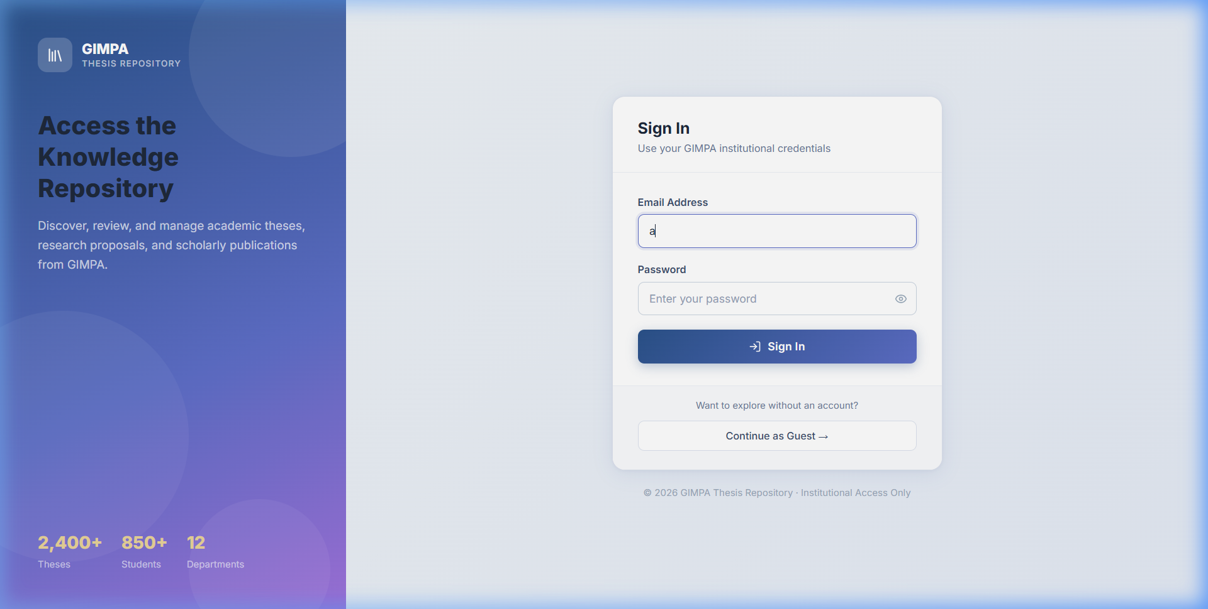
3. PAGE-BY-PAGE SYSTEM WALKTHROUGH
Page 11: Bulk CSV Student & Staff Onboarding Engine
📌 Page Purpose & Meaning
• High-throughput data ingestion tool allowing administrators to onboard entire academic cohorts in seconds.
• Parses institutional CSV files containing Student ID, Name, Email, School, Department, Degree Level, and Cohort Year.
• Automatically creates secure hashed accounts and triggers welcome credential emails via SMTP.
⚡ Key System Capabilities
✔ Drag-and-drop CSV file uploader with schema validation.
✔ Duplicate record detection and existing account update rules.
✔ Real-time import progress bar and error reporting summary.
✔ Automatic assignment of default degree tracks and faculty departments.

Slide 21
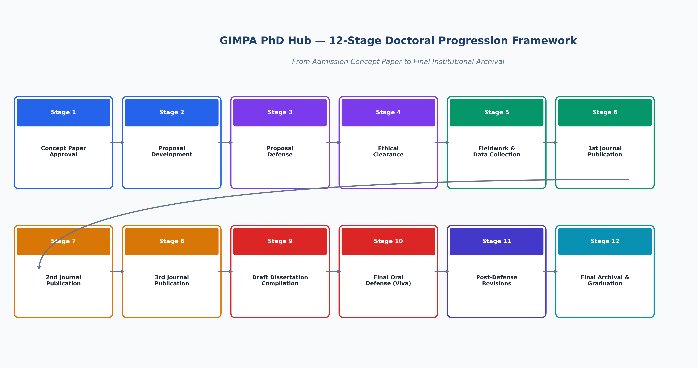
4. TECHNICAL EXCELLENCE & GOVERNANCE
PhD Hub: 12-Stage Doctoral Progression Framework

Slide 22
4. TECHNICAL EXCELLENCE & GOVERNANCE
Enterprise Security, Compliance & Audit Trails
Cryptographic Security
• JWT Stateless Tokens with SHA-256 signatures.
• bcrypt password hashing with salt rounds.
• HTTPS / TLS encryption on all API endpoints.
• Document server callback authentication.
Academic Integrity & Compliance
• Strict defense gate clearance before grade release.
• Dual sign-off requirement (Supervisor + HOD).
• Immutable examiner scoring records.
• Anti-tamper PDF publication watermarking.
Audit Logs & Data Protection
• Complete timestamped audit trail of all grade changes.
• Automated database backup snapshots.
• Role-scoped data isolation across departments.
• GDPR & Institutional data privacy compliance.

Slide 23
4. TECHNICAL EXCELLENCE & GOVERNANCE
Live Production Deployment & Infrastructure
Production Host
Ubuntu 22.04 LTS (VPS IP: 46.62.214.146)
Managed under /home/admin/web/thesis.manamatechnologies.com/app
Public Domain
https://thesis.manamatechnologies.com
Proxied via Cloudflare CDN with automated SSL/TLS termination
Backend Daemon
gimpa-backend.service (Systemd Managed)
FastAPI running on Uvicorn ASGI with multi-worker concurrency
Frontend Daemon
gimpa-frontend.service (Systemd Managed)
Node.js production server hosting optimized React 19 / Vite build bundles
DocServer Container
onlyoffice-documentserver (Docker Managed)
Isolated container running document conversion and real-time collaboration
Continuous Delivery
Git-synchronized continuous deployment with automated rebuild and restart daemons

Slide 24
TRANSFORMING GIMPA RESEARCH EXCELLENCE
Key Institutional Outcomes & Next Steps
✔ 100% Paperless Workflow: Reduced thesis administration turnaround time from months to days.
✔ Zero Lost Feedback: All examiner remarks and annotations permanently recorded in ONLYOFFICE version histories.
✔ Accreditation Confidence: Rigorous 12-stage milestone compliance and verifiable publication records for PhDs.
✔ Global Academic Visibility: GIMPA research discoverable by international institutions via the public catalog portal.
✔ Scalable Infrastructure: Enterprise-grade architecture ready to support thousands of students across all academic faculties.

