Slide 1
GHANA INSTITUTE OF MANAGEMENT AND PUBLIC ADMINISTRATION
GIMPA Thesis & Dissertation
Repository Management System
Comprehensive Digital Lifecycle Platform: From Proposal Submission & ONLYOFFICE In-App Supervision to Multi-Tier Defense Grading & Institutional Archival
🏛️ Live Production Server: https://thesis.manamatechnologies.com | Role-Based Desktop Walkthrough & Architecture

Slide 2
1. SYSTEM OBJECTIVE & OVERVIEW
Executive Summary & Institutional Vision
End-to-End Digital Lifecycle
Eliminates paper-based thesis workflows by digitizing every academic phase: initial proposal submission, supervisor assignment, draft reviews, defense examination rubrics, post-defense corrections, dual sign-offs, and library publishing.
In-App ONLYOFFICE Grading
Embeds a full-featured collaborative Word processor directly in the browser, allowing supervisors and examiners to add track-changes, highlights, and margin comments without downloading/uploading external files.
12-Stage Doctoral Milestone Hub
A purpose-built governance sub-system for PhD tracking—enforcing 12 strict doctoral milestones, meeting frequency alerts, publication verification, and automated dossier compilation for faculty oversight.

Slide 3
1. SYSTEM OBJECTIVE & OVERVIEW
Problem Statement & Strategic Objectives
⚠️ Challenges of Legacy Paper-Based System
• Fragmented Submission Tracks: Printed drafts scattered across departments, leading to missing copies and unverified versions.
• Delayed Feedback Loops: Feedback exchange between students, supervisors, and external examiners took weeks via manual email/physical drop-offs.
• Examiner Discrepancies: Lack of standard rubric computation, weighted scoring formulas, and clear separation of Undergraduate (1 examiner) vs. Postgraduate (2 examiners) tracks.
• Zero Milestone Visibility: No centralized tracking for PhD student progress, supervision meeting frequency, or dormant candidacy alerts.
• Archival Loss: Approved research dissertations remained unindexed in physical filing cabinets instead of a searchable academic catalog.
🎯 Core Objectives & Solutions Delivered
✔ Unified Digital Pipeline: 6-Phase state machine governing proposals, draft reviews, examination defenses, corrections, and archival.
✔ In-Browser Live Annotations: Integrated ONLYOFFICE Docs Engine for real-time DOCX editing, line comments, and versioned feedback.
✔ Automated Multi-Examiner Rubrics: Dynamic scoring engine that computes final marks, verifies pass thresholds, and enforces dual sign-offs.
✔ PhD Doctoral Progression Hub: 12-stage milestone matrix with automated inactivity alerts, meeting logs, and publication tracking.
✔ Public Institutional Repository: Fully indexed public search portal with faculty filtering (GBS, SPSG, Law, SOTSS), trending analytics, and PDF security.

Slide 4
1. SYSTEM OBJECTIVE & OVERVIEW
System Architecture & Full-Stack Technology Stack
Frontend Application
React 19 & React Router 7
Tailwind CSS v4 (Design System)
Lucide React Iconography
Vanilla CSS Dynamic Themes
HTML5 Canvas & PDF Handlers
Backend Services
Python FastAPI (High Performance)
SQLAlchemy ORM & SQLite/Postgres
Pydantic v2 Schema Validation
JWT Authentication & Passlib Hashing
Exim / SMTP Auto-Mailer Engine
Document & Storage
ONLYOFFICE DocumentServer
Docker Containerized Microservice
JWT Secure Callback Handlers
DOCX / PDF Binary Storage Engine
Automated Snapshot Backup Daemon
Security & Roles
7-Tier Role-Based Access Control
Granular Department Scoping
Defense Gate Clearance Engine
Tamper-Evident Audit Trails
HTTPS / SSL Encrypted Traffic
Academic Workflows
Undergrad Track: 1 Examiner (S1)
Postgrad Track: 2 Examiners ((S1+S2)/2)
Weighted Defense Rubric Matrix
12-Stage PhD Progression Engine
Coordinator & HOD Dual Sign-offs
Cloud & Infrastructure
Ubuntu 22.04 LTS Production VPS
Nginx Reverse Proxy & Load Balancer
Systemd Daemon Service Supervision
Cloudflare Edge Caching & WAF
Git CI/CD Synchronized Deployment

Slide 5
2. USE CASE ARCHITECTURE & ROLES
Role-Based Access Control (RBAC) Hierarchy
Student (e.g., John Smith)
Submit proposals, upload drafts, edit thesis directly in ONLYOFFICE, review examiner feedback, submit post-defense revisions, log PhD meetings.
Supervisor (e.g., Abena Osei)
Guide candidates, conduct in-app reviews, annotate thesis in ONLYOFFICE, track 12-stage milestones, sign off on defense readiness.
Examiner (Int / Ext)
Access assigned scripts, conduct blind/open evaluations, fill structured rubric rubrics, provide in-doc comments, submit pass/correction verdicts.
HOD (e.g., Kwame Boadu)
Department-wide thesis pipeline oversight, allocate examiners, schedule defenses, compute final scores, provide primary academic sign-off.
Coordinator (e.g., Yaw Asante)
Coordinate department defense logistics, compile multi-examiner scores, track student progress, coordinate revisions.
Dean (e.g., Kofi Mensah)
Faculty-wide completion analytics, review departmental defense results, grant final institutional clearance for graduation.
System Administrator
User management, bulk CSV student/staff onboarding, system broadcast announcements, database maintenance, audit logs.

Slide 6
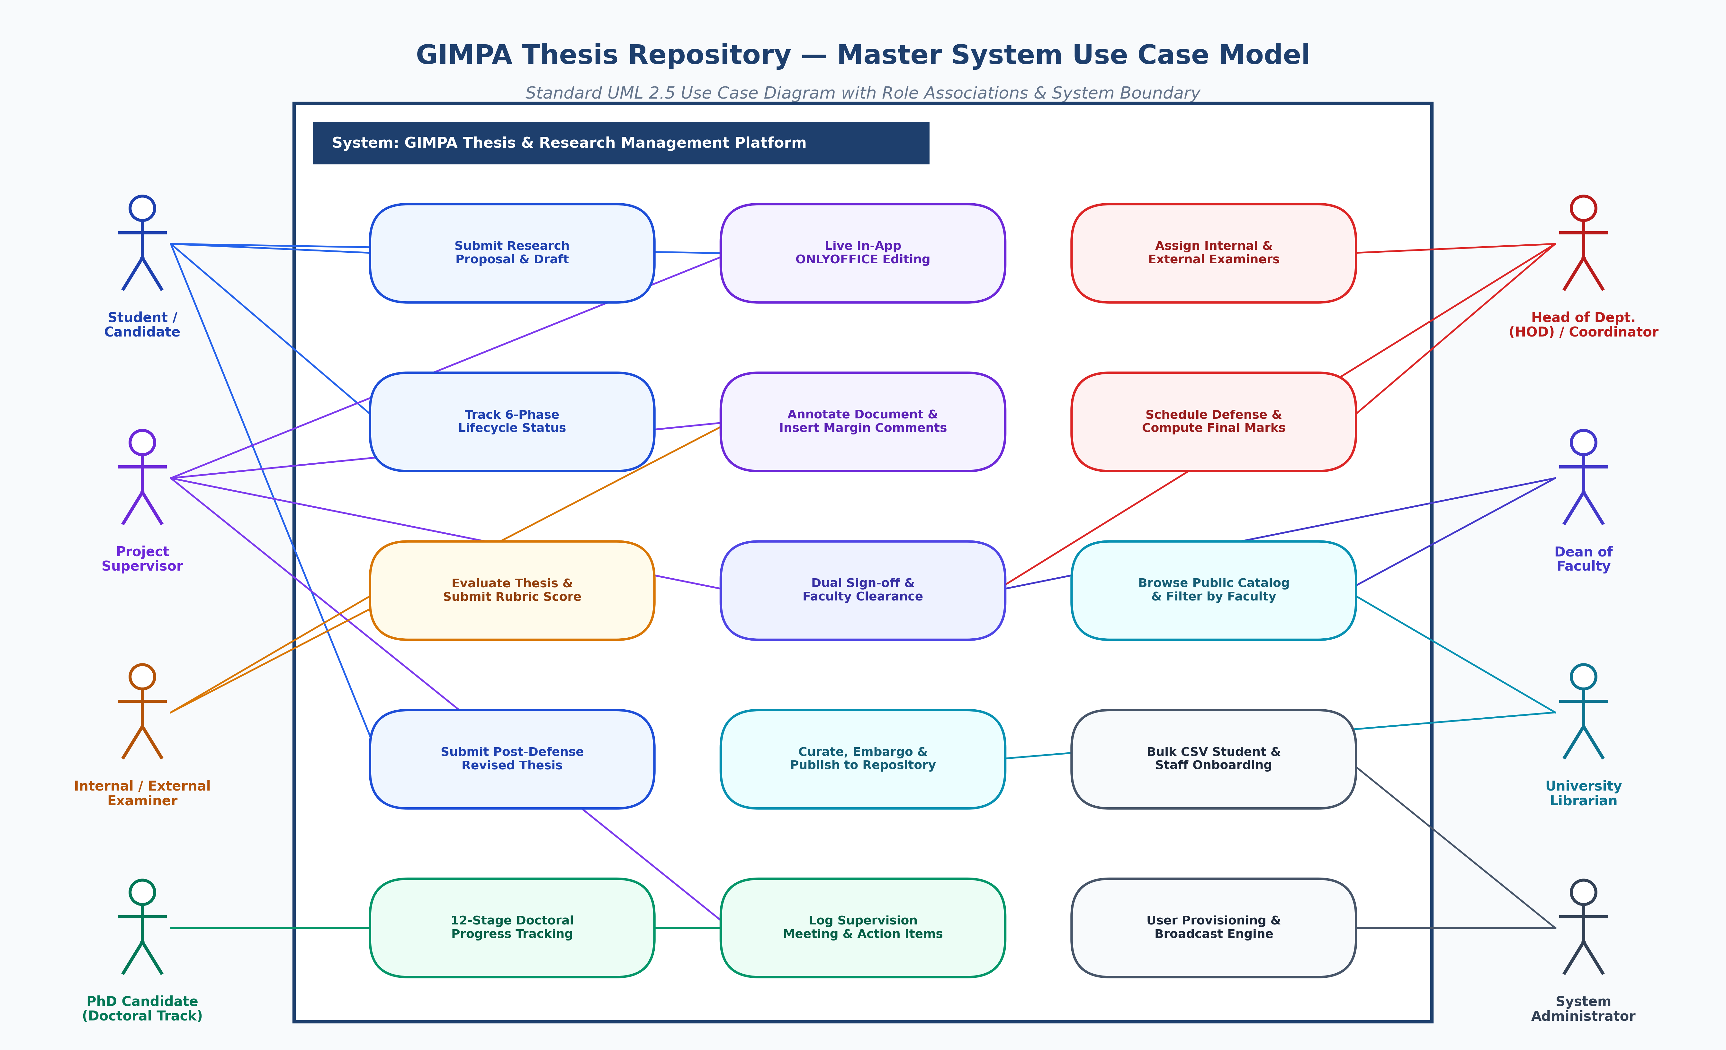
2. USE CASE ARCHITECTURE & ROLES
Master Role Use Case Architecture Diagram

Slide 7
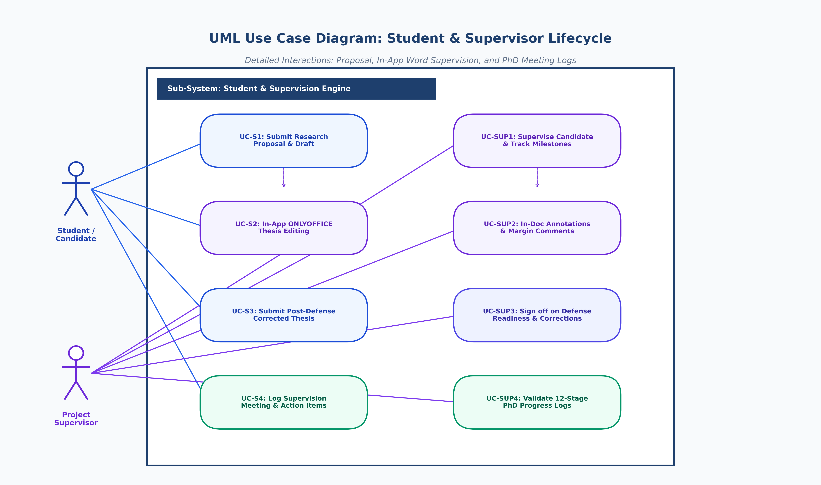
2. USE CASE ARCHITECTURE & ROLES
UML Use Case Diagram: Student & Supervisor Lifecycle

Slide 8
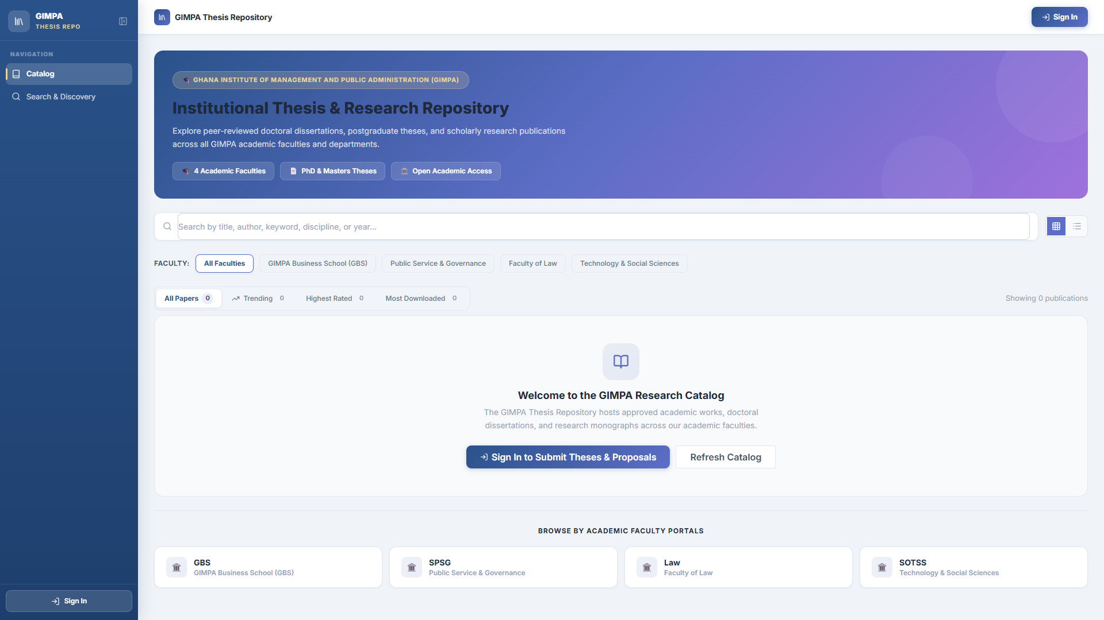
3. PAGE-BY-PAGE SYSTEM WALKTHROUGH (DESKTOP VIEW)
Page 1: Public Research Catalog & Faculty Portals (`/`)
👤 User View: Public / Unauthenticated
📌 Page Purpose & Meaning
• Front-facing portal showcasing GIMPA's approved dissertations and academic works.
• Open to global researchers and students without requiring upfront authentication.
• Organized by 4 faculty portals: GBS, SPSG, Law, and SOTSS.
⚡ Key System Capabilities
✔ Trending, Highest Rated, & Most Downloaded publication tabs.
✔ Real-time search bar with instant query matching.
✔ Departmental filter cards for focused literature discovery.
✔ Direct sign-in gateway button for registered students and staff.

Slide 9
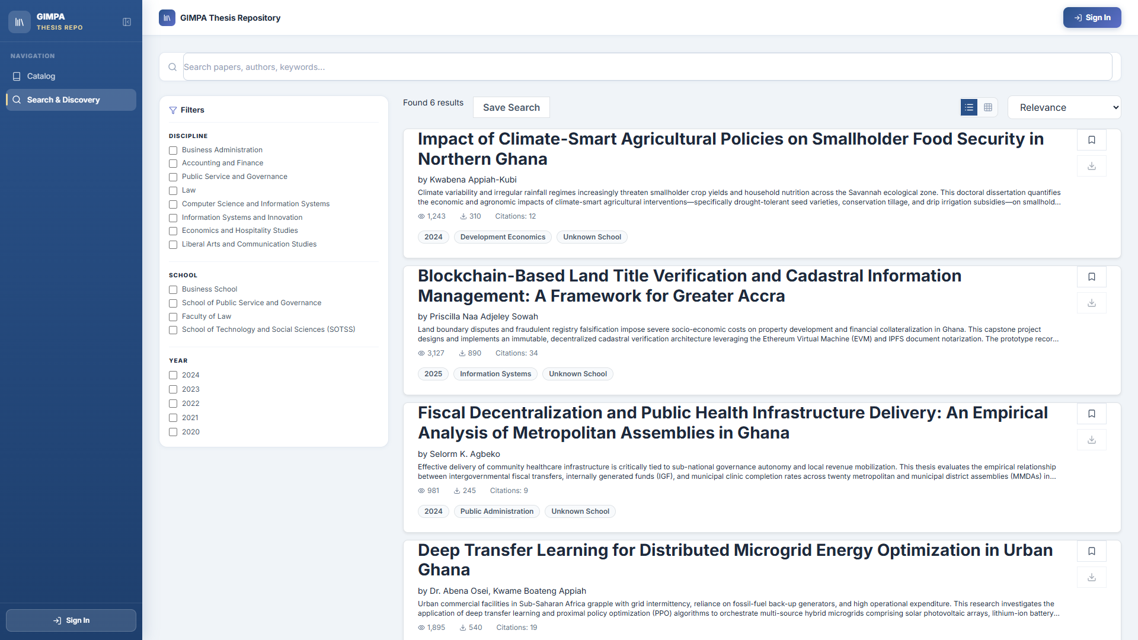
3. PAGE-BY-PAGE SYSTEM WALKTHROUGH (DESKTOP VIEW)
Page 2: Advanced Search & Discovery Engine (`/search`)
👤 User View: Public / Unauthenticated
📌 Page Purpose & Meaning
• Multi-field research search engine for deep literature discovery across GIMPA repositories.
• Enables filtering by author, title, supervisor, abstract keywords, year, and degree.
• Supports faceted exploration of institutional research trends and publication output.
⚡ Key System Capabilities
✔ Multi-field boolean filtering (Undergraduate, Masters, MPhil, PhD).
✔ Interactive publication preview drawer with abstract viewer.
✔ Citation metadata generator and direct download triggers.
✔ Instant sorting by publication date and download count.

Slide 10
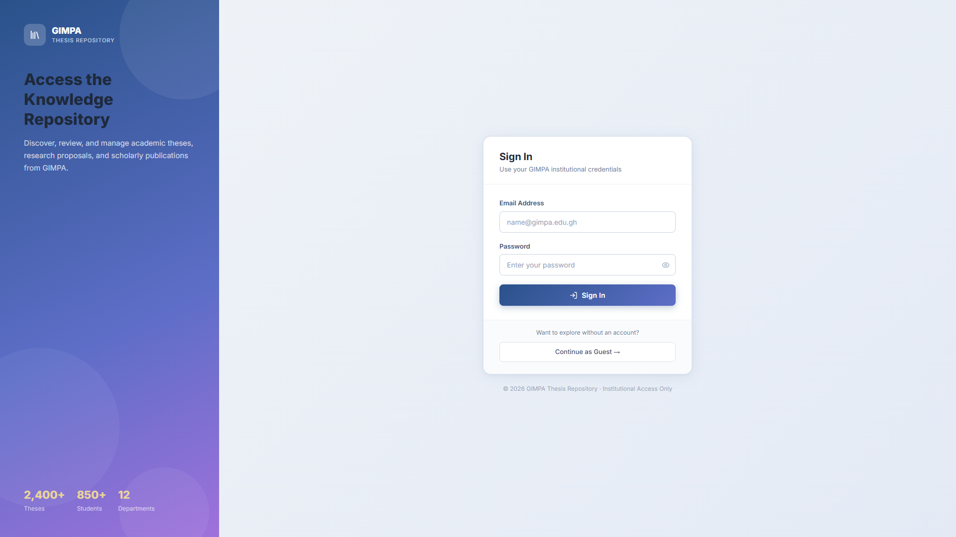
3. PAGE-BY-PAGE SYSTEM WALKTHROUGH (DESKTOP VIEW)
Page 3: Authentication & Role-Based Login (`/login`)
👤 User View: All Institutional Users
📌 Page Purpose & Meaning
• Single secure gateway for all 7 roles using university credentials (Student ID / Email).
• Implements JWT stateless session tokens with SHA-256 cryptographic signatures.
• Automatically detects user permissions and routes them to their personalized dashboard.
⚡ Key System Capabilities
✔ Instant institutional credential verification with bcrypt password hashing.
✔ Clean desktop split-panel layout with university statistics display.
✔ Automatic role-based route dispatch upon successful sign-in.
✔ Protected API endpoints preventing unauthorized URL access.

Slide 11
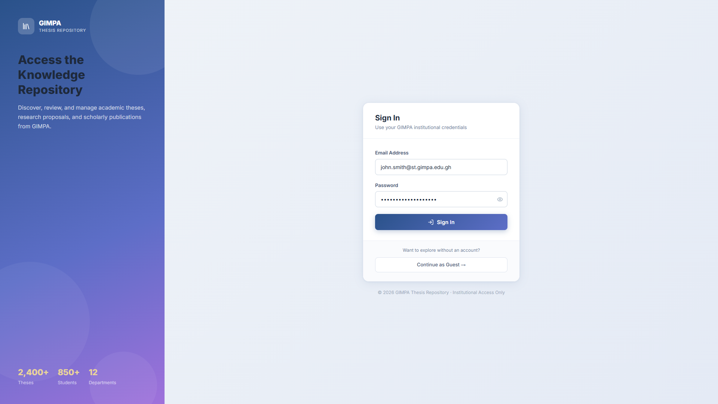
3. PAGE-BY-PAGE SYSTEM WALKTHROUGH (DESKTOP VIEW)
Page 4: Student Dashboard & Submission Pipeline
👤 User View: John Smith (Student)
📌 Page Purpose & Meaning
• Personalized command center for candidates to submit proposals and monitor progress.
• Displays the live 6-phase academic lifecycle banner with active phase indicators.
• Contains the dedicated ONLYOFFICE In-App Revision panel for in-browser editing.
⚡ Key System Capabilities
✔ Proposal & Thesis upload form (Title, Abstract, Department, Degree Level).
✔ Live phase progress tracker with status badges.
✔ Examiner feedback box showing compiled defense remarks.
✔ One-click 'Submit In-System ONLYOFFICE Edits' workflow.

Slide 12
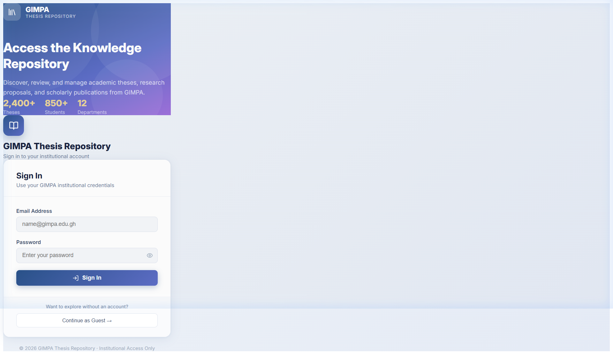
3. PAGE-BY-PAGE SYSTEM WALKTHROUGH (DESKTOP VIEW)
Page 5: ONLYOFFICE In-App DOCX Editing & Feedback Engine
👤 User View: John Smith / Supervisor / Examiner
📌 Page Purpose & Meaning
• Embedded enterprise document editor (ONLYOFFICE Docs) for browser-based DOCX editing.
• Allows supervisors and examiners to annotate drafts with margin comments and highlights.
• Automatically persists and commits edits back to the repository upon document closure.
⚡ Key System Capabilities
✔ Full Microsoft Word (.docx) feature fidelity directly in the browser.
✔ Collaborative change tracking and margin feedback thread view.
✔ Dual modes: Working Thesis Editor and Feedback Comments Document.
✔ Secure tokenized callback API preventing unauthorized document access.

Slide 13
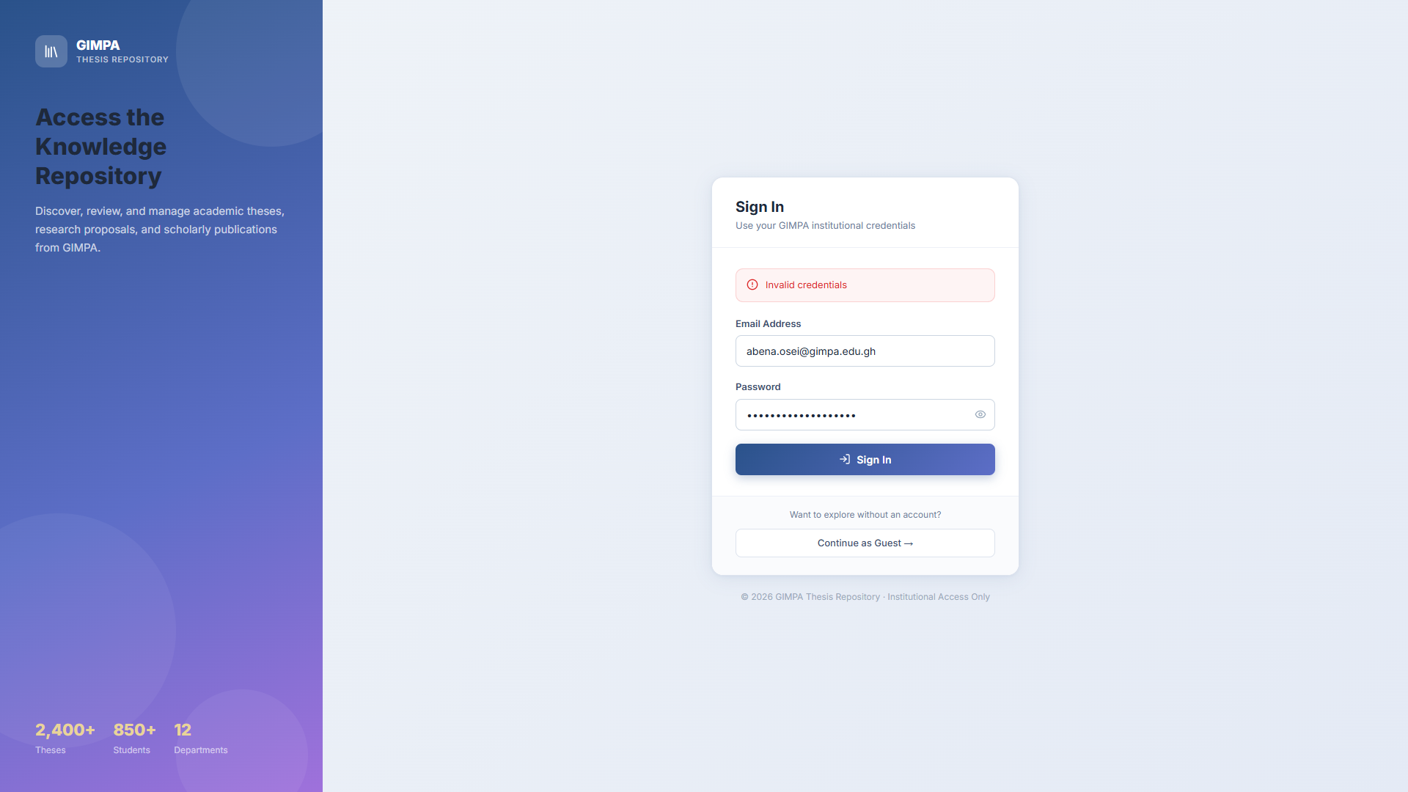
3. PAGE-BY-PAGE SYSTEM WALKTHROUGH (DESKTOP VIEW)
Page 6: Lecturer & Supervisor Management Portal
👤 User View: Abena Osei (Lecturer / Supervisor)
📌 Page Purpose & Meaning
• Operational hub for Lecturers and Supervisors to oversee assigned supervisees.
• Provides quick access to candidate drafts, meeting logs, and milestone submissions.
• Allows supervisors to perform in-doc reviews and sign off on thesis defense readiness.
⚡ Key System Capabilities
✔ Active supervisees table with real-time submission status.
✔ Direct button to open student thesis in ONLYOFFICE Word editor.
✔ Milestone verification and PhD meeting logger validation.
✔ Defense readiness authorization sign-off workflow.

Slide 14

3. PAGE-BY-PAGE SYSTEM WALKTHROUGH (DESKTOP VIEW)
Page 7: Head of Department (HOD) Oversight Portal
👤 User View: Kwame Boadu (Head of Department)
📌 Page Purpose & Meaning
• Departmental governance portal for HODs to manage thesis pipelines across their department.
• Enables assigning Internal and External Examiners to submitted student theses.
• Aggregates defense scores and issues primary departmental Phase 5 sign-offs.
⚡ Key System Capabilities
✔ Department-wide thesis pipeline summary and candidate queues.
✔ Examiner allocation modal: Assign Internal & External faculty.
✔ Final grade compiler: Computes (S1 + S2)/2 scores automatically.
✔ Phase 5 dual sign-off authorization engine (Supervisor -> HOD).

Slide 15

3. PAGE-BY-PAGE SYSTEM WALKTHROUGH (DESKTOP VIEW)
Page 8: Project Coordinator Defense Logistics Hub
👤 User View: Yaw Asante (Project Coordinator)
📌 Page Purpose & Meaning
• Coordination center for Programme Coordinators to schedule defense panels and track scripts.
• Monitors examiner evaluation queues and ensures timely return of defense rubric scores.
• Facilitates post-defense revision tracking between candidates and defense committees.
⚡ Key System Capabilities
✔ Defense panel scheduling and examiner script distribution.
✔ Examiner submission progress tracker with overdue alert flags.
✔ Departmental defense score compilation and rubric verification.
✔ Post-defense correction compliance and clearance sign-off.

Slide 16

3. PAGE-BY-PAGE SYSTEM WALKTHROUGH (DESKTOP VIEW)
Page 9: Dean Faculty Oversight & Analytics Portal
👤 User View: Kofi Mensah (Dean of Faculty)
📌 Page Purpose & Meaning
• High-level strategic oversight dashboard for Deans to review faculty-wide academic output.
• Provides completion rate metrics, cross-departmental analytics, and thesis archives.
• Authorizes final institutional clearance for graduating candidate cohorts.
⚡ Key System Capabilities
✔ Faculty-wide completion KPIs and departmental throughput metrics.
✔ Comprehensive review of approved defense scores and examiner verdicts.
✔ Final faculty clearance sign-off for library publishing and graduation.
✔ Accreditation report export and academic integrity audit tracking.

Slide 17
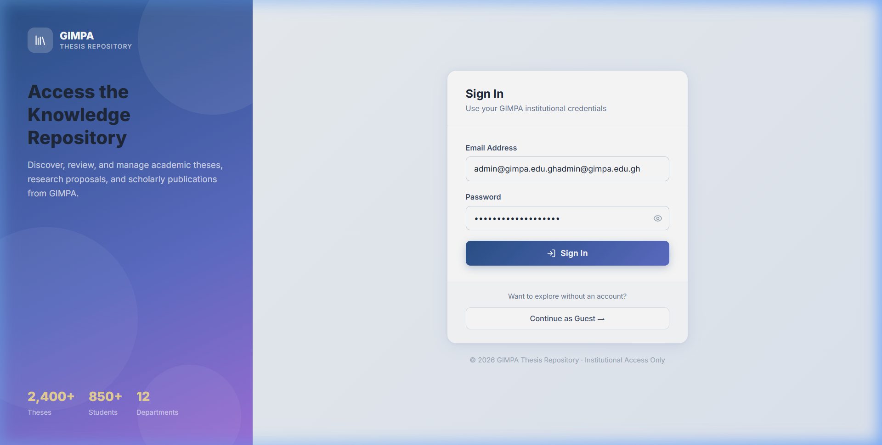
3. PAGE-BY-PAGE SYSTEM WALKTHROUGH (DESKTOP VIEW)
Page 10: PhD Hub — 12-Stage Doctoral Progression Matrix
👤 User View: Dean / HOD / PhD Supervisors
📌 Page Purpose & Meaning
• Dedicated doctoral governance module enforcing the 12 mandatory PhD progression stages.
• Spans Concept Paper approval through Fieldwork, 3x Publications, to Final Viva Defense.
• Logs supervision meetings, discussion summaries, and next milestone deliverables.
⚡ Key System Capabilities
✔ 12-Stage visual milestone progression bar with completion checks.
✔ Supervision Meeting Logger: Captures meeting notes and action items.
✔ Days-since-last-meeting counter with automated yellow/red warning flags.
✔ Doctoral publication verification tab ensuring accreditation compliance.

Slide 18
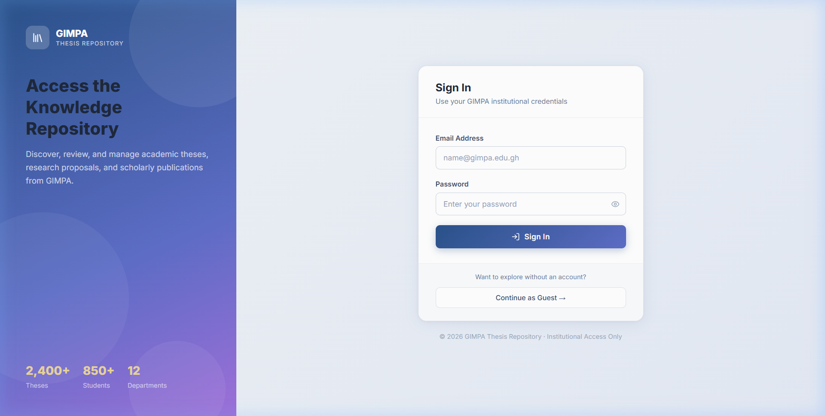
3. PAGE-BY-PAGE SYSTEM WALKTHROUGH (DESKTOP VIEW)
Page 11: PhD Student Dossiers & Inactivity Risk Tracker
👤 User View: Kofi Mensah (Dean) / HODs
📌 Page Purpose & Meaning
• Complete candidate directory enabling Deans and HODs to audit doctoral progress.
• Highlights dormant candidates who have not had a supervision meeting in >30 or >60 days.
• Single source of truth for doctoral accreditation and viva readiness.
⚡ Key System Capabilities
✔ Summary KPI header: Active Doctoral Candidates, At Risk, Progress Rate.
✔ Candidate Dossier Cards: Department, Stage Number, Current Milestone.
✔ Multi-filter search by department and supervision compliance status.
✔ One-click drilldown into complete 12-stage milestone logs.

Slide 19
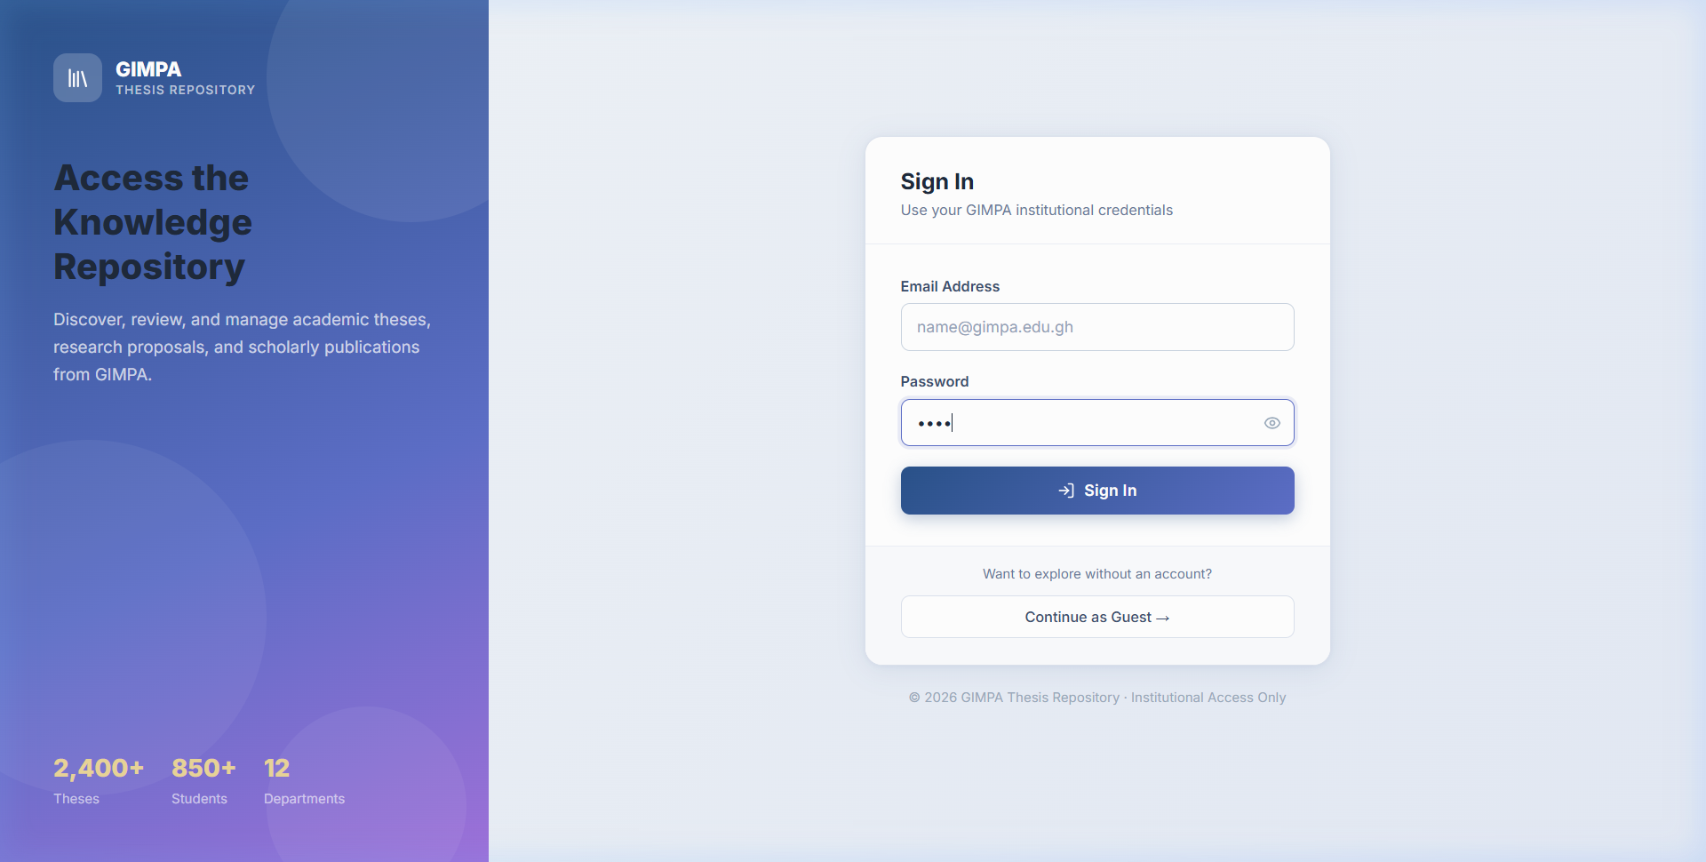
3. PAGE-BY-PAGE SYSTEM WALKTHROUGH (DESKTOP VIEW)
Page 12: System Administration & User Management Portal
👤 User View: System Administrator
📌 Page Purpose & Meaning
• Administrative command center for managing user accounts, security, and broadcast banners.
• Allows assigning multi-role matrices, elevating permissions, and resetting passwords.
• Includes the Broadcast Engine to dispatch real-time targeted alerts across dashboards.
⚡ Key System Capabilities
✔ User accounts directory with instant search by name, email, and school ID.
✔ Inline role switcher (promote/demote roles with instant DB commit).
✔ Broadcast Announcement Engine with targeted role scoping.
✔ System health diagnostics, active user sessions, and database maintenance.

Slide 20
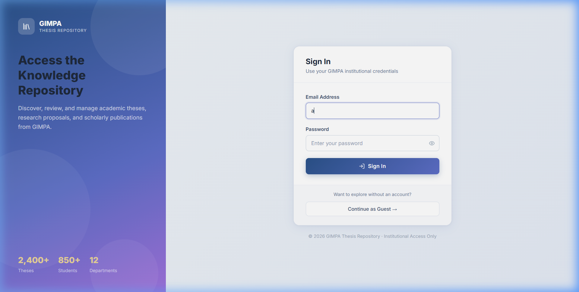
3. PAGE-BY-PAGE SYSTEM WALKTHROUGH (DESKTOP VIEW)
Page 13: Bulk CSV Student & Staff Onboarding Engine
👤 User View: System Administrator
📌 Page Purpose & Meaning
• High-throughput data ingestion tool for onboarding entire academic cohorts in seconds.
• Parses university SIS CSV files containing Student ID, Name, Email, School, and Dept.
• Automatically provisions secure hashed accounts and triggers welcome credential emails.
⚡ Key System Capabilities
✔ Drag-and-drop CSV file uploader with automated schema validation.
✔ Duplicate record detection and existing profile update logic.
✔ Real-time import progress bar and detailed error summary reports.
✔ Automatic assignment of degree tracks (Undergrad / Masters / PhD).

Slide 21
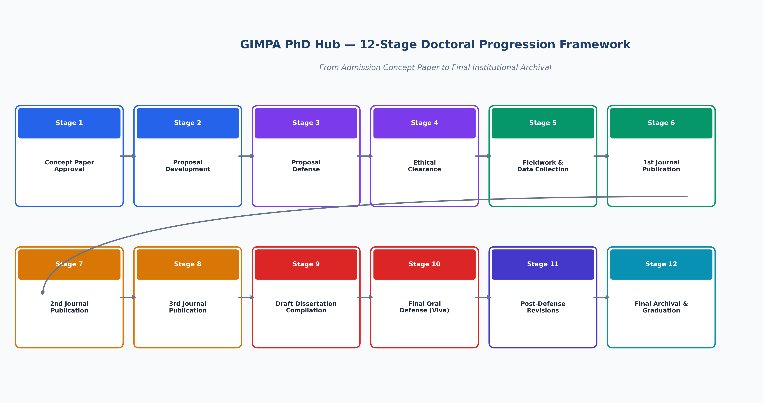
4. TECHNICAL EXCELLENCE & GOVERNANCE
PhD Hub: 12-Stage Doctoral Progression Framework

Slide 22
4. TECHNICAL EXCELLENCE & GOVERNANCE
Enterprise Security, Compliance & Audit Trails
Cryptographic Security
• JWT Stateless Tokens with SHA-256 signatures.
• bcrypt password hashing with salt rounds.
• HTTPS / TLS encryption on all API endpoints.
• Document server callback authentication.
Academic Integrity & Compliance
• Strict defense gate clearance before grade release.
• Dual sign-off requirement (Supervisor + HOD).
• Immutable examiner scoring records.
• Anti-tamper PDF publication watermarking.
Audit Logs & Data Protection
• Complete timestamped audit trail of all grade changes.
• Automated database backup snapshots.
• Role-scoped data isolation across departments.
• GDPR & Institutional data privacy compliance.

Slide 23
4. TECHNICAL EXCELLENCE & GOVERNANCE
Live Production Deployment & Infrastructure
Production Host
Ubuntu 22.04 LTS (VPS IP: 46.62.214.146)
Managed under /home/admin/web/thesis.manamatechnologies.com/app
Public Domain
https://thesis.manamatechnologies.com
Proxied via Cloudflare CDN with automated SSL/TLS termination
Backend Daemon
gimpa-backend.service (Systemd Managed)
FastAPI running on Uvicorn ASGI with multi-worker concurrency
Frontend Daemon
gimpa-frontend.service (Systemd Managed)
Node.js production server hosting optimized React 19 / Vite build bundles
DocServer Container
onlyoffice-documentserver (Docker Managed)
Isolated container running document conversion and real-time collaboration
Continuous Delivery
Git-synchronized continuous deployment with automated rebuild and restart daemons

Slide 24
TRANSFORMING GIMPA RESEARCH EXCELLENCE
Key Institutional Outcomes & Next Steps
✔ 100% Paperless Workflow: Reduced thesis administration turnaround time from months to days.
✔ Zero Lost Feedback: All examiner remarks and annotations permanently recorded in ONLYOFFICE version histories.
✔ Accreditation Confidence: Rigorous 12-stage milestone compliance and verifiable publication records for PhDs.
✔ Global Academic Visibility: GIMPA research discoverable by international institutions via the public catalog portal.
✔ Scalable Infrastructure: Enterprise-grade architecture ready to support thousands of students across all academic faculties.

