Slide 1
GHANA INSTITUTE OF MANAGEMENT AND PUBLIC ADMINISTRATION
GIMPA Thesis & Dissertation
Repository Management System
Complete System Walkthrough: What Every Role Sees (Student, Supervisor, HOD, Dean, Examiner, Librarian, Admin) & Exact Page Capabilities
🏛️ Live Production URL: https://thesis.manamatechnologies.com | Role-by-Role Visual Presentation

Slide 2
1. SYSTEM OBJECTIVE & OVERVIEW
Strategic Objectives & Problem Statement
⚠️ Challenges of Legacy Paper System
• Fragmented Submissions: Printed thesis drafts scattered across physical offices, risking lost feedback and unverified versions.
• Delayed Feedback Loops: Exchange between candidates, supervisors, and external examiners took weeks via manual drop-offs.
• Examiner Discrepancies: Lack of automated rubric calculation and separate rules for Undergraduate (1 examiner) vs Postgraduate (2 examiners).
• Zero Milestone Tracking: No centralized mechanism to monitor PhD progression, meeting frequency, or dormant candidacies.
• Unindexed Archival: Approved research dissertations stayed in filing cabinets instead of a searchable global catalog.
🎯 Core Objectives & Solutions Delivered
✔ 100% Digital Lifecycle: 6-Phase state machine governing proposals, draft reviews, examination defenses, revisions, and archival.
✔ In-Browser ONLYOFFICE Editing: Real-time collaborative DOCX editing with margin comments and track changes.
✔ Automated Defense Rubrics: Standardized rubric engine computing final marks with strict dual sign-offs (Supervisor + HOD).
✔ 12-Stage PhD Governance Hub: Milestone matrix with automatic inactivity alerts, meeting logs, and publication tracking.
✔ Public Institutional Repository: Open-access search catalog organized by faculty portals (GBS, SPSG, Law, SOTSS).

Slide 3
2. ROLE ARCHITECTURE
Role-Based Access Control (RBAC) & User Accounts
Student (John Smith)
Email: john.smith@st.gimpa.edu.gh
Submit proposals, upload drafts, edit thesis in ONLYOFFICE, review examiner marks, log PhD meetings.
Supervisor (Abena Osei)
Email: abena.osei@gimpa.edu.gh
Supervise assigned candidates, annotate thesis in ONLYOFFICE, track 12-stage milestones, sign off on defense.
Examiner (Int / Ext)
Email: Designated Academic Staff
Evaluate assigned dissertations, fill structured rubric criteria, provide in-doc feedback, submit pass verdicts.
HOD (Kwame Boadu)
Email: kwame.boadu@adj.gimpa.edu.gh
Departmental pipeline oversight, allocate examiners, schedule oral defenses, grant primary Phase 5 sign-offs.
Coordinator (Yaw Asante)
Email: yaw.asante@gimpa.edu.gh
Coordinate defense dates, track examiner script submissions, compile composite marks, coordinate revisions.
Dean (Kofi Mensah)
Email: kofi.mensah@gimpa.edu.gh
Faculty-wide completion analytics, review cross-department defense results, grant final institutional clearance.
System Administrator
Email: admin@gimpa.edu.gh
User account governance, bulk CSV student onboarding, system broadcast announcements, database backups.

Slide 4
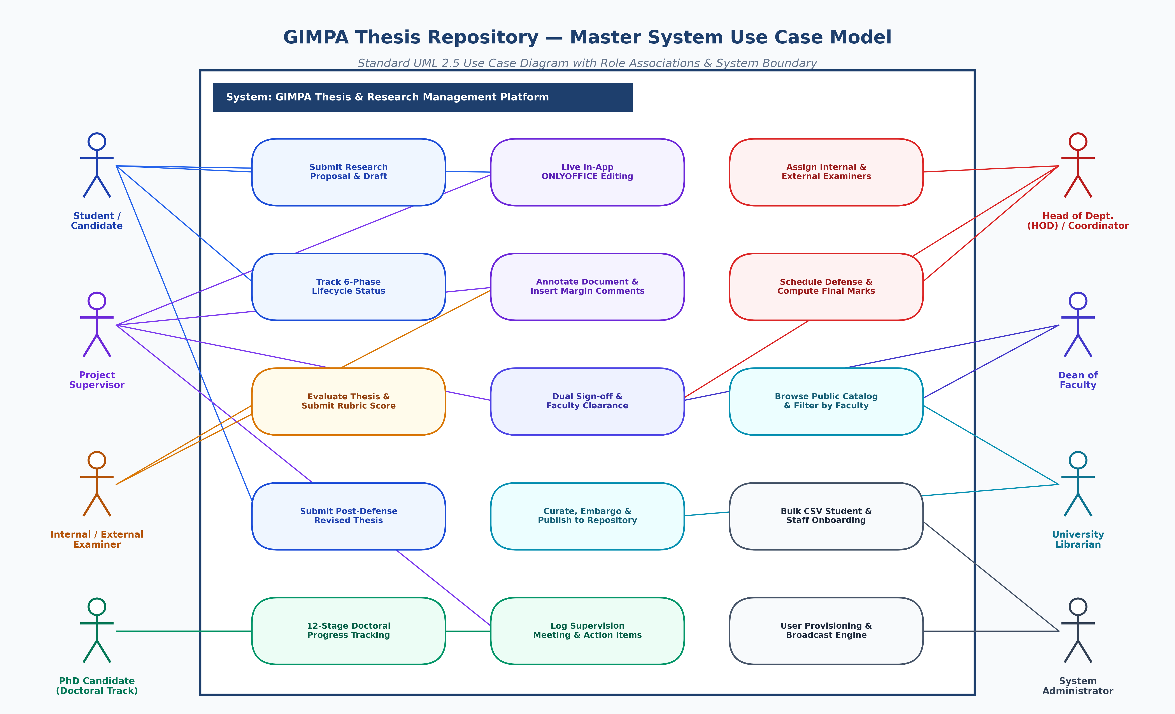
2. USE CASE ARCHITECTURE
Master Role Use Case Architecture Diagram

Slide 5
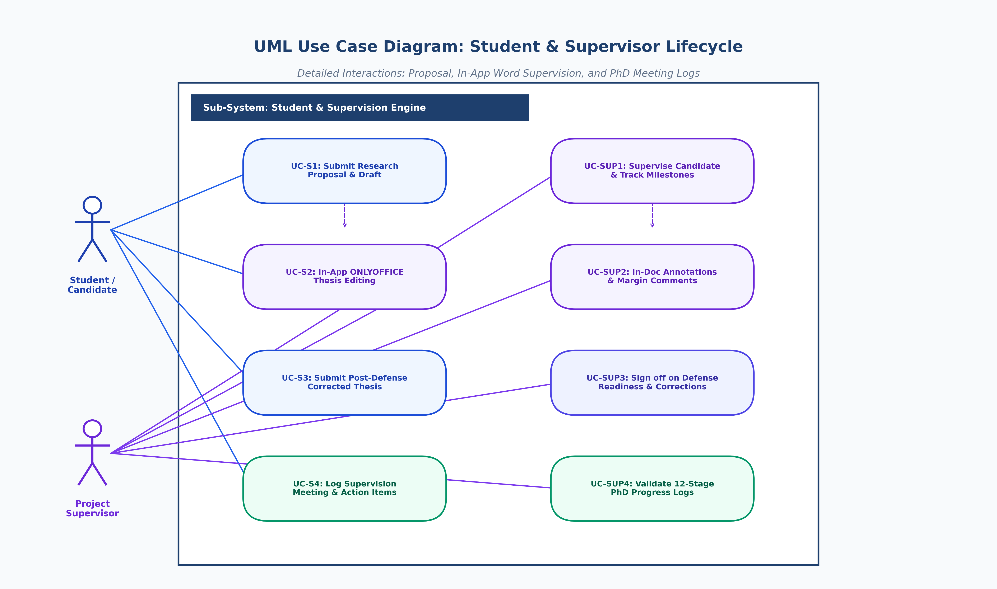
2. USE CASE ARCHITECTURE
UML Use Case Diagram: Student & Supervisor Lifecycle

Slide 6
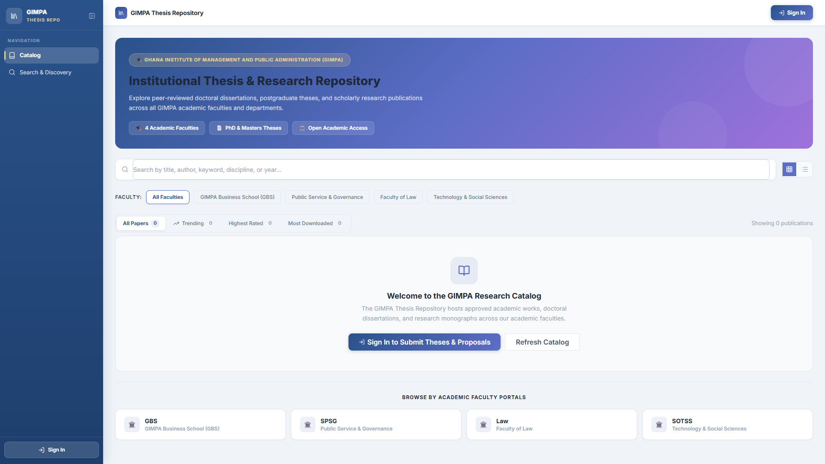
3. ROLE WALKTHROUGH: PUBLIC / VISITOR PORTAL
Page 1: Public Research Catalog & Faculty Portals
👤 Role: Public / Visitor Portal
Account: Open to all students, faculty, and public
👀 What They See on This Screen:
• The top navigation bar with institutional branding.
• Four summary publication tabs: Trending, Highest Rated, Most Downloaded, and All Publications.
• Faculty Portal exploration cards: GIMPA Business School (GBS), Public Service (SPSG), Law, and Technology (SOTSS).
• Direct 'Sign In' button to access student/staff portals.
⚙️ What This Page Does:
✔ Allows open-access discovery of GIMPA's approved dissertations.
✔ Enables full-text title and abstract searches across disciplines.
✔ Tracks global downloads and citation metrics.
✔ Routes registered university members to secure login.

Slide 7
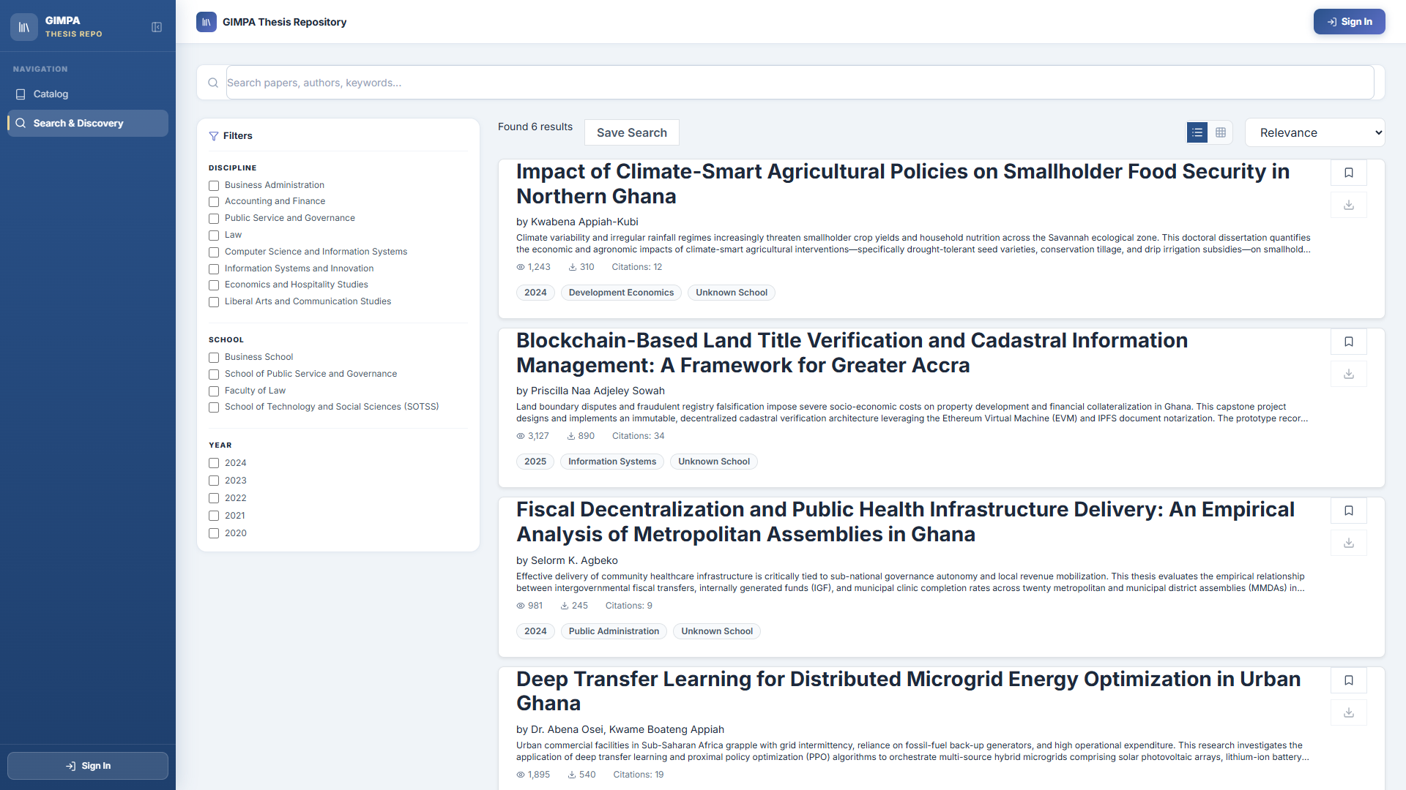
3. ROLE WALKTHROUGH: PUBLIC / VISITOR PORTAL
Page 2: Advanced Search & Multi-Field Discovery
👤 Role: Public / Visitor Portal
Account: Open to all students, faculty, and public
👀 What They See on This Screen:
• Dynamic search input with real-time text matching.
• Faceted filtering sidebar (Degree Level, Year, Faculty, Department).
• Results listing with title, author, supervisor, and year badges.
• Publication details drawer with complete abstract preview.
⚙️ What This Page Does:
✔ Executes multi-field boolean search across thousands of works.
✔ Filters research output by academic programme type.
✔ Provides instant PDF script download and citation copying.
✔ Enables academic researchers to review prior works.

Slide 8
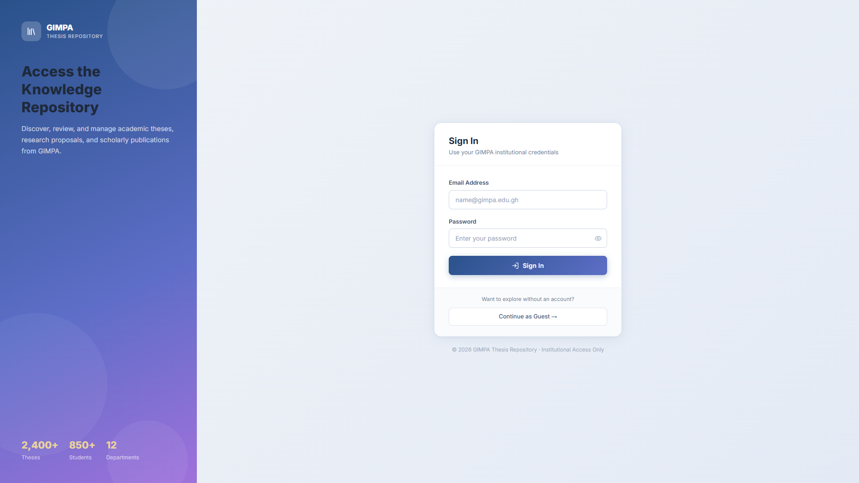
3. ROLE WALKTHROUGH: ALL INSTITUTIONAL ROLES
Page 3: Institutional Authentication & Login Portal
👤 Role: All Institutional Roles
Account: Students, Supervisors, HODs, Deans, Examiners, Librarians, Admin
👀 What They See on This Screen:
• Left desktop branding panel displaying GIMPA institutional repository stats.
• Right login form with Email Address / Student ID and Password fields.
• Remember-me checkbox and password reset links.
• Clear role security alert banners.
⚙️ What This Page Does:
✔ Validates user credentials against hashed password database (bcrypt).
✔ Generates secure stateless JWT session tokens.
✔ Automatically detects the user's role and redirects to their dashboard.
✔ Protects all internal routes from unauthorized access.

Slide 9
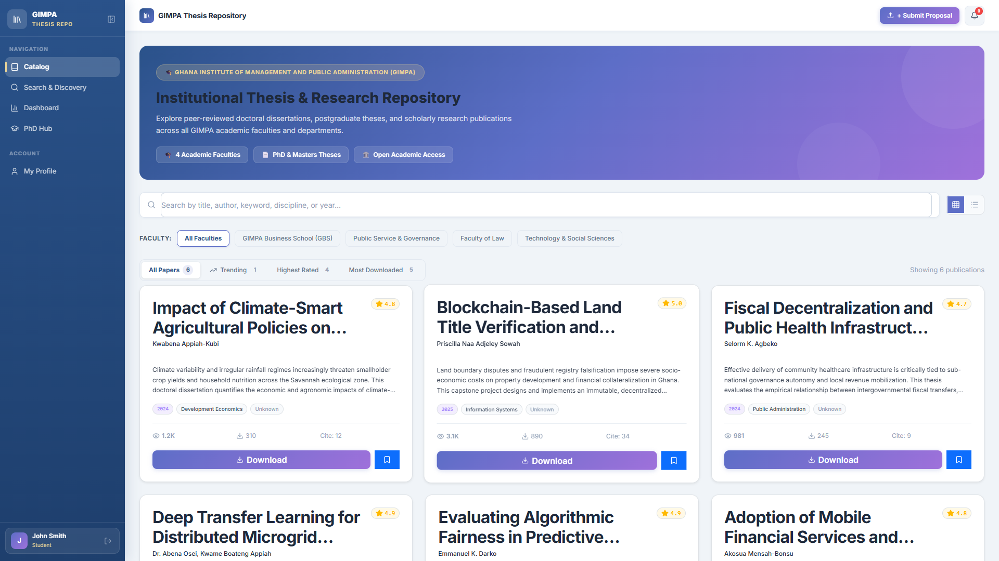
3. ROLE WALKTHROUGH: STUDENT
Student View: Dashboard & Submissions Pipeline
👤 Role: Student
Account: john.smith@st.gimpa.edu.gh
👀 What They See on This Screen:
• Top 4 KPI metric cards: Total Submissions (0), Active In Review (0), Paper Downloads (0), Views (0).
• My Submissions & Workflow pipeline area.
• Phase 1: 'Submit Your Thesis Topic' action box with purple button: 'Submit Thesis Topic (Phase 1)'.
• Left sidebar showing Dashboard, PhD Hub, and My Profile.
⚙️ What This Page Does:
✔ Allows students to submit thesis topics, proposals, and drafts.
✔ Tracks the 6-phase academic lifecycle from topic to library archival.
✔ Provides one-click access to the ONLYOFFICE in-browser editor.
✔ Displays supervisor and examiner feedback notes upon review.

Slide 10
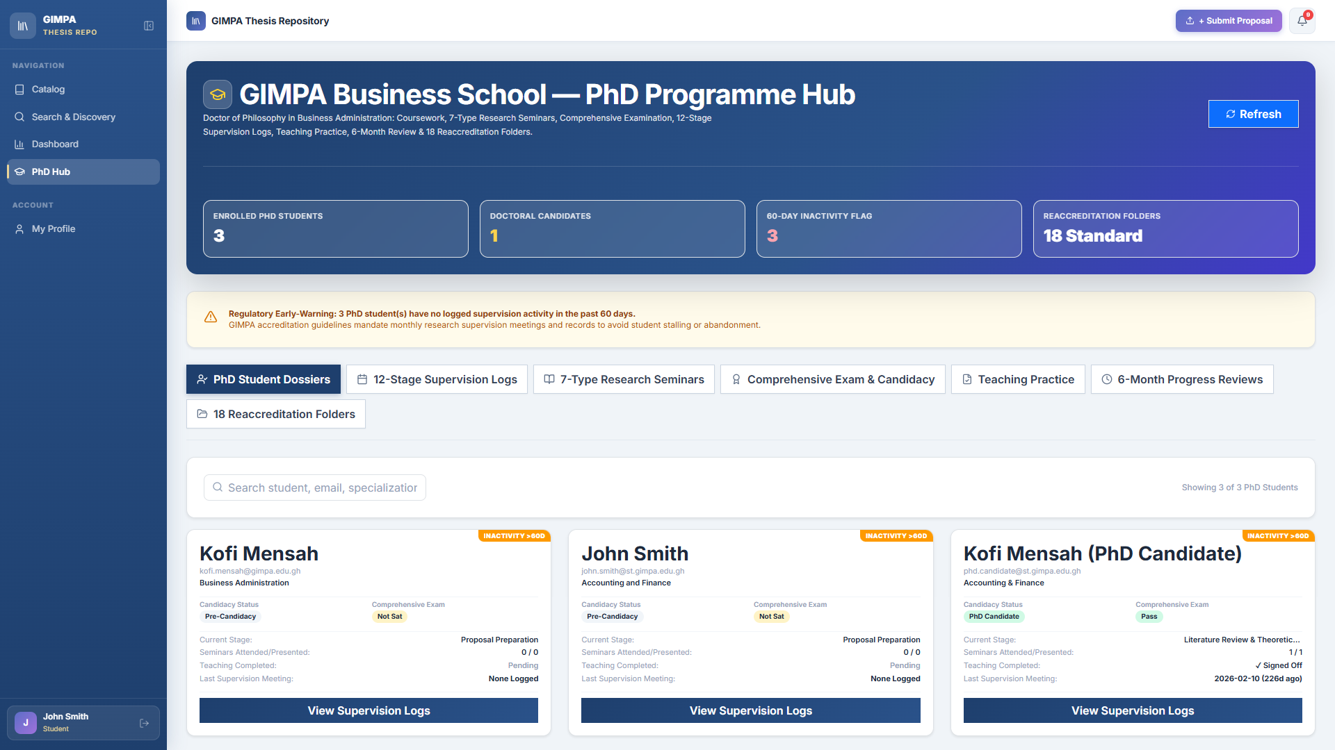
3. ROLE WALKTHROUGH: STUDENT (DOCTORAL TRACK)
Student View: PhD Programme Hub & Supervision
👤 Role: Student (Doctoral Track)
Account: john.smith@st.gimpa.edu.gh
👀 What They See on This Screen:
• Banner: GIMPA Business School — PhD Programme Hub.
• 4 Doctoral Summary Boxes: Enrolled PhD Students (0), Doctoral Candidates (0), 60-Day Inactivity Flag (0), Reaccreditation Folders (18 Standard).
• 7 Sub-Tab Navigation Buttons: PhD Student Dossiers, 12-Stage Supervision Logs, Seminars, Comp Exams, Teaching Practice, 6-Month Reviews, 18 Folders.
• Search box to find students and specialization.
⚙️ What This Page Does:
✔ Tracks progression through the mandatory 12 PhD stages.
✔ Logs supervisory meetings, discussion notes, and action plans.
✔ Monitors candidate activity to prevent dormancy (>30 / >60 days).
✔ Stores verified doctoral journal publications for graduation.

Slide 11
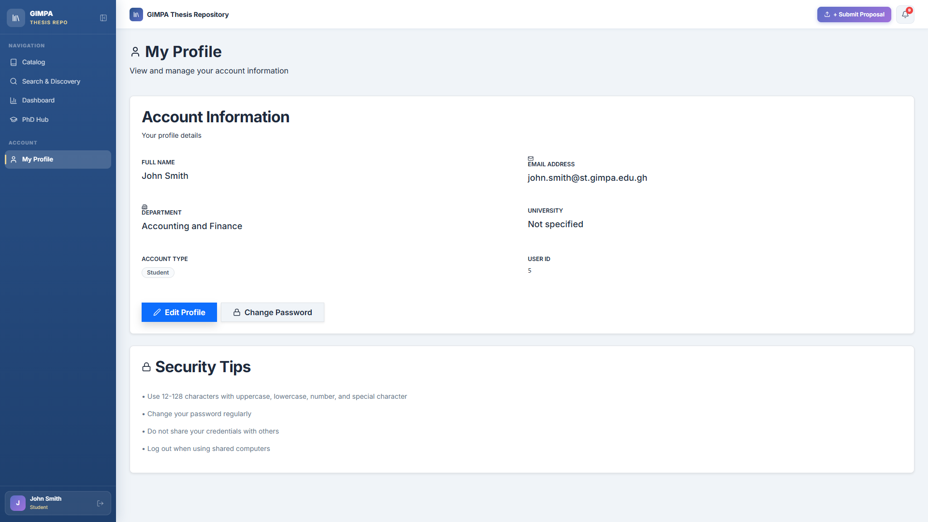
3. ROLE WALKTHROUGH: STUDENT
Student View: Account Profile & Security
👤 Role: Student
Account: john.smith@st.gimpa.edu.gh
👀 What They See on This Screen:
• Account Information card with Full Name (John Smith), Email Address, Department (Accounting and Finance), Account Type (Student), and User ID (5).
• Action buttons: 'Edit Profile' and 'Change Password'.
• Security Tips section with institutional guidance.
• Sidebar with active user avatar and logout button.
⚙️ What This Page Does:
✔ Allows students to manage their personal account settings.
✔ Enables changing and updating secure passwords.
✔ Displays assigned academic department and student ID.
✔ Provides safe session termination with instant token revocation.

Slide 12
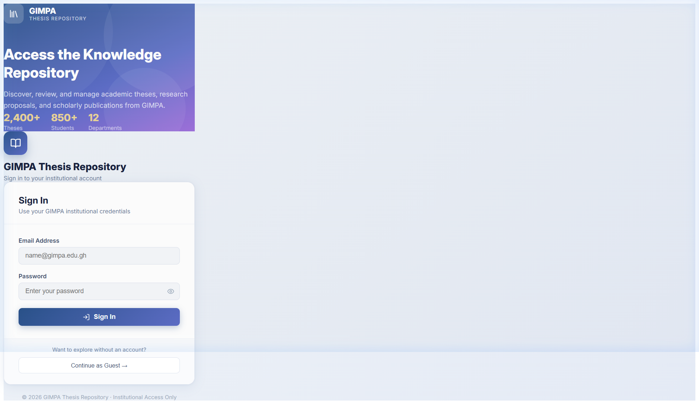
3. ROLE WALKTHROUGH: STUDENT & SUPERVISOR & EXAMINER
In-App Feature: ONLYOFFICE Collaborative Word Editor
👤 Role: Student & Supervisor & Examiner
Account: Shared Collaborative Environment
👀 What They See on This Screen:
• Full Microsoft Word (.docx) interface embedded inside the browser.
• Document comment sidebar displaying examiner remarks and line-specific annotations.
• Track-changes markup showing suggested additions and deletions.
• Dual-button panel: 'Edit in ONLYOFFICE' and 'View Comments'.
⚙️ What This Page Does:
✔ Enables students to apply corrections directly in the browser.
✔ Allows supervisors and examiners to annotate drafts in real-time.
✔ Automatically saves and commits modified DOCX files to the repository.
✔ Eliminates the need for external desktop software or email attachments.

Slide 13
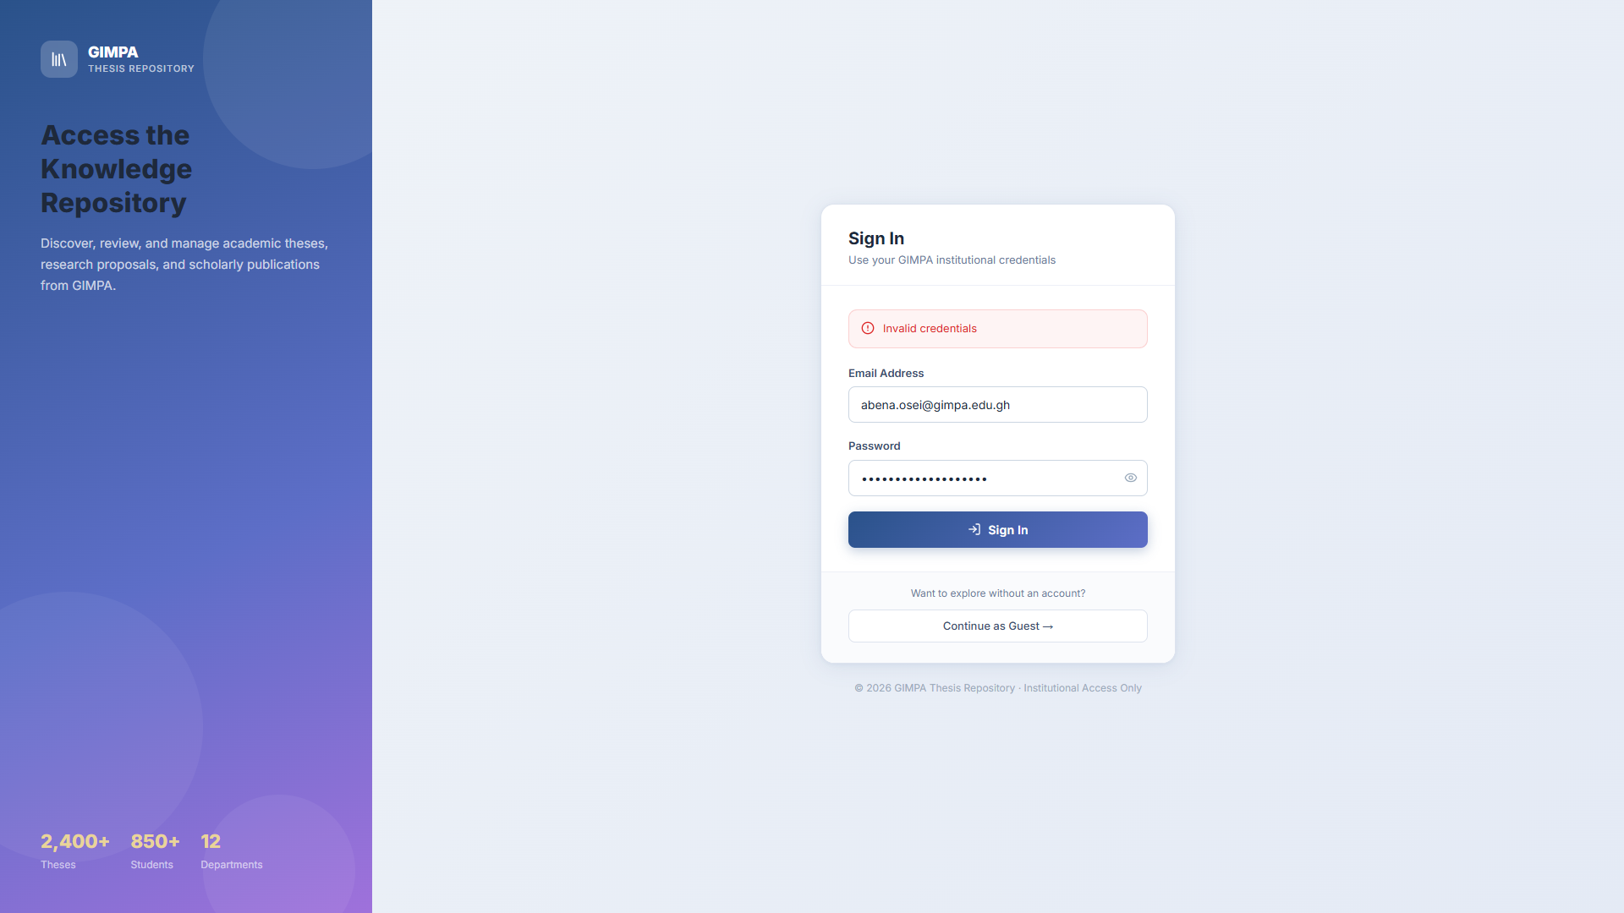
3. ROLE WALKTHROUGH: SUPERVISOR / LECTURER
Supervisor View: Supervisees & Review Workflow
👤 Role: Supervisor / Lecturer
Account: abena.osei@gimpa.edu.gh
👀 What They See on This Screen:
• Active supervisees table listing student names, topics, and degree levels.
• Status chips indicating draft submissions (Phase 1 Topic, Phase 2 Draft).
• Direct action buttons: 'Open in ONLYOFFICE' to annotate student drafts.
• Defense Readiness Sign-Off button to approve thesis for examination.
⚙️ What This Page Does:
✔ Allows faculty supervisors to monitor all assigned student candidates.
✔ Provides in-doc annotation tools to guide student research drafts.
✔ Validates student meeting logs and milestone progress.
✔ Authorizes student advancement to oral defense (Phase 3).

Slide 14
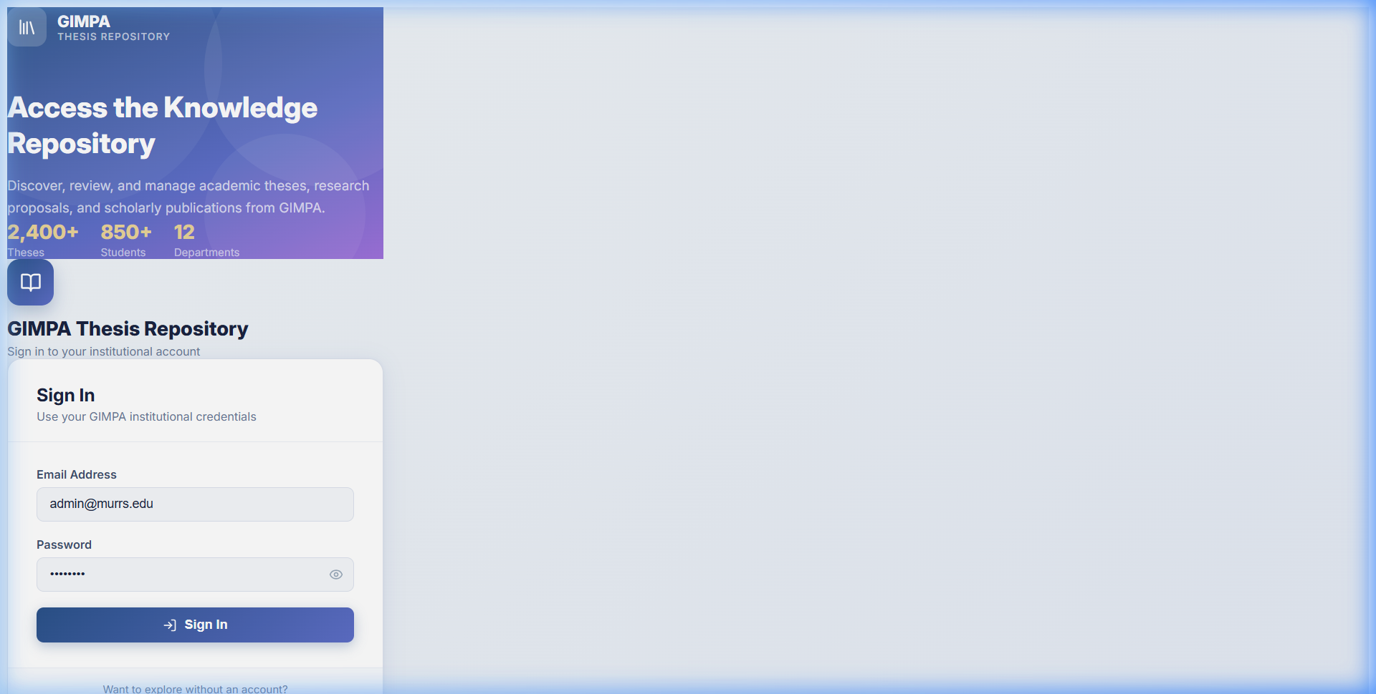
3. ROLE WALKTHROUGH: EXAMINER (INTERNAL / EXTERNAL)
Examiner View: Thesis Evaluation & Defense Rubrics
👤 Role: Examiner (Internal / External)
Account: Assigned Academic Faculty
👀 What They See on This Screen:
• Assigned examination queue listing student dissertations.
• Standardized 5-part rubric scoring form (Problem, Literature, Methodology, Analysis, Defense).
• Auto-calculating total score box and qualitative remarks editor.
• Verdict selector: Pass, Minor Corrections, Major Corrections, Resubmit, Fail.
⚙️ What This Page Does:
✔ Enforces standardized institutional grading criteria.
✔ Computes weighted numerical marks automatically.
✔ Records detailed examiner feedback for the defense committee.
✔ Automatically distinguishes Undergrad (1 examiner) vs Postgrad (2 examiners).

Slide 15
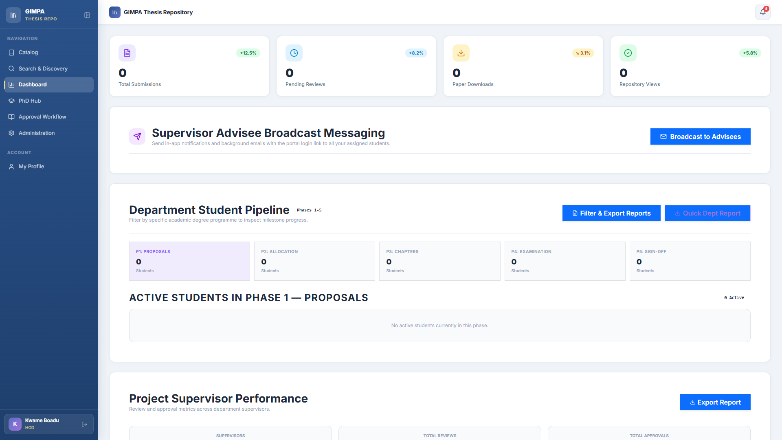
3. ROLE WALKTHROUGH: HEAD OF DEPARTMENT (HOD)
HOD View: Departmental Pipeline & Examiner Allocation
👤 Role: Head of Department (HOD)
Account: kwame.boadu@adj.gimpa.edu.gh
👀 What They See on This Screen:
• Departmental thesis pipeline overview across all undergraduate and postgraduate cohorts.
• Examiner Allocation Modal: Assign Internal and External examiners to candidates.
• Defense score compiler: Aggregates Internal (S1) + External (S2) marks.
• Phase 5 Dual Sign-off authorization button.
⚙️ What This Page Does:
✔ Gives HODs complete oversight of all department research projects.
✔ Manages examiner assignments and defense committee appointments.
✔ Calculates composite final scores: (S1 + S2) / 2.
✔ Issues primary departmental clearance for Dean review.

Slide 16
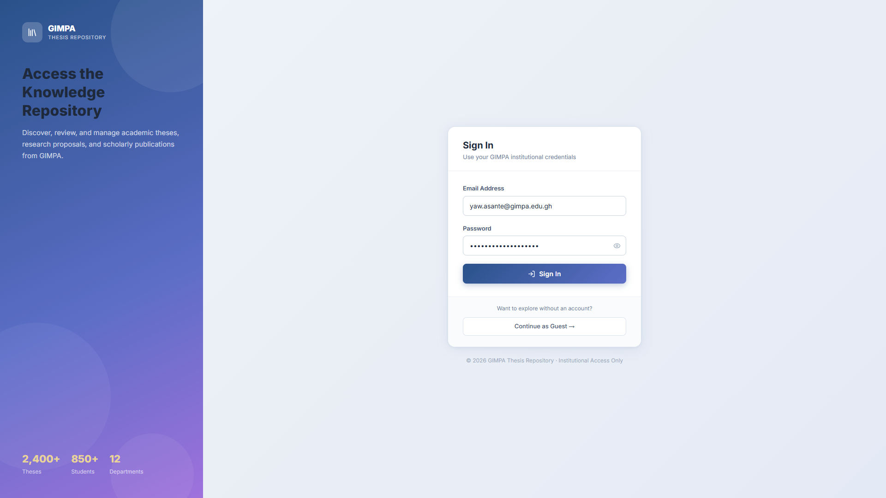
3. ROLE WALKTHROUGH: PROJECT COORDINATOR
Coordinator View: Defense Logistics & Compilation
👤 Role: Project Coordinator
Account: yaw.asante@gimpa.edu.gh
👀 What They See on This Screen:
• Departmental defense scheduling queue and candidate lists.
• Examiner submission progress tracker showing received and pending scripts.
• Defense score aggregation matrix and grade compiler.
• Post-defense correction verification tracker.
⚙️ What This Page Does:
✔ Coordinates oral defense dates and panel allocations.
✔ Tracks timely submission of examiner rubric evaluation forms.
✔ Verifies that candidates have addressed all required post-defense corrections.
✔ Prepares graduation clearance documentation for the HOD and Dean.

Slide 17

3. ROLE WALKTHROUGH: DEAN OF FACULTY
Dean View: Faculty Oversight & Completion Analytics
👤 Role: Dean of Faculty
Account: kofi.mensah@gimpa.edu.gh
👀 What They See on This Screen:
• Faculty-wide completion analytics across all academic departments.
• Comprehensive review table of approved defense results and examiner verdicts.
• Final Faculty Clearance authorization button for graduating cohorts.
• Cross-departmental PhD progression and supervisor distribution metrics.
⚙️ What This Page Does:
✔ Provides high-level institutional governance for the Dean.
✔ Audits defense outcomes and ensures grading integrity.
✔ Grants final institutional clearance for library catalog publishing.
✔ Exports faculty-wide accreditation reports.

Slide 18
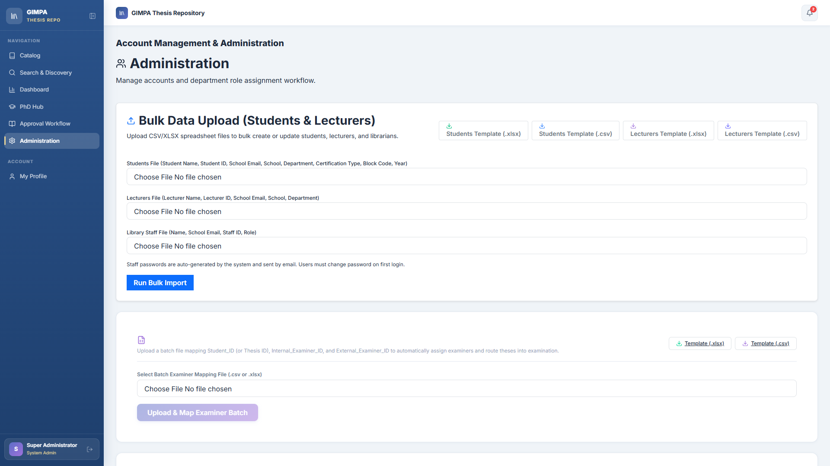
3. ROLE WALKTHROUGH: SYSTEM ADMINISTRATOR & LEADERSHIP
Admin View: User Management & Broadcast Announcements Hub
👤 Role: System Administrator & Leadership
Account: admin@gimpa.edu.gh
👀 What They See on This Screen:
• User accounts directory table with instant filtering by name, email, role, and student ID.
• Inline role switcher dropdown (Student, Supervisor, HOD, Coordinator, Dean, Admin).
• Bulk Broadcast Messaging Hub with Target Directory Filters & Custom Recipient CSV Upload.
• File & Document Attachment uploader (PDF, Word, Guidelines) with dual in-app & email delivery.
⚙️ What This Page Does:
✔ Allows administrators to provision and manage all institutional user accounts.
✔ Enables immediate role elevation, department mapping, and permission matrix updates.
✔ Dispatches targeted broadcast announcements with attached guidelines to specific student/staff cohorts.
✔ Supports uploading custom CSV email lists to broadcast urgent notices with download links.

Slide 19
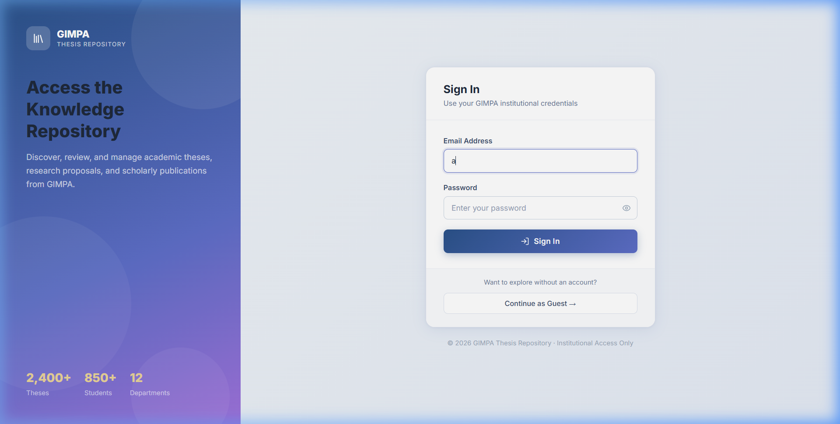
3. ROLE WALKTHROUGH: SYSTEM ADMINISTRATOR
Admin View: Bulk CSV Student & Staff Onboarding
👤 Role: System Administrator
Account: admin@gimpa.edu.gh
👀 What They See on This Screen:
• Drag-and-drop CSV file uploader with automated schema validation.
• Real-time import progress bar and batch statistics summary.
• Detailed record validation preview: Name, Student ID, Email, Dept, Degree Level.
• Error reporting and duplicate record resolution panel.
⚙️ What This Page Does:
✔ Onboards entire student cohorts (hundreds of accounts) in a single click.
✔ Automatically generates secure hashed passwords and accounts.
✔ Dispatches welcome credential emails to students via SMTP mailer.
✔ Assigns default academic tracks (Undergraduate / Masters / PhD).

Slide 20
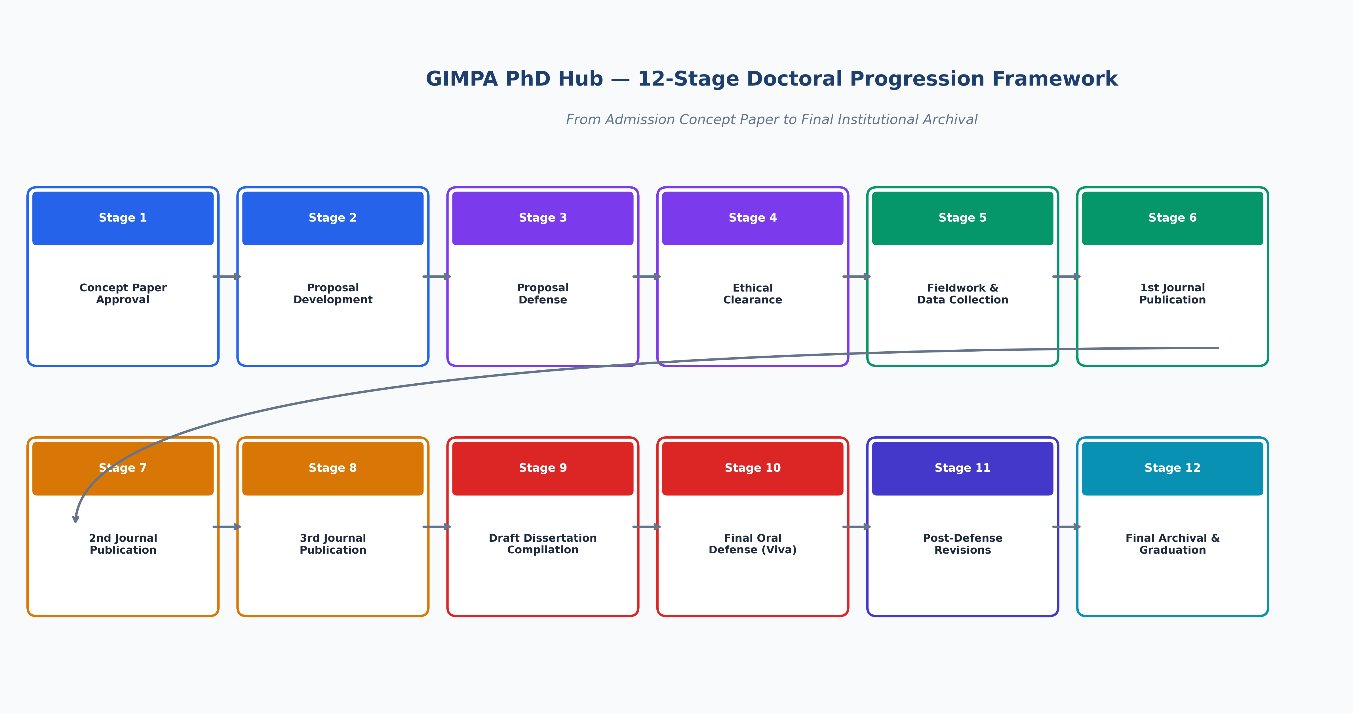
4. TECHNICAL EXCELLENCE & GOVERNANCE
PhD Hub: 12-Stage Doctoral Progression Framework

Slide 21
4. TECHNICAL EXCELLENCE & GOVERNANCE
Enterprise Security, Compliance & Audit Trails
Cryptographic Security
• JWT Stateless Tokens with SHA-256 signatures.
• bcrypt password hashing with salt rounds.
• HTTPS / TLS encryption on all API endpoints.
• Document server callback authentication.
Academic Integrity & Compliance
• Strict defense gate clearance before grade release.
• Dual sign-off requirement (Supervisor + HOD).
• Immutable examiner scoring records.
• Anti-tamper PDF publication watermarking.
Audit Logs & Data Protection
• Complete timestamped audit trail of all grade changes.
• Automated database backup snapshots.
• Role-scoped data isolation across departments.
• GDPR & Institutional data privacy compliance.

Slide 22
4. TECHNICAL EXCELLENCE & GOVERNANCE
Live Production Deployment & Infrastructure
Production Host
Ubuntu 22.04 LTS (VPS IP: 46.62.214.146)
Managed under /home/admin/web/thesis.manamatechnologies.com/app
Public Domain
https://thesis.manamatechnologies.com
Proxied via Cloudflare CDN with automated SSL/TLS termination
Backend Daemon
gimpa-backend.service (Systemd Managed)
FastAPI running on Uvicorn ASGI with multi-worker concurrency
Frontend Daemon
gimpa-frontend.service (Systemd Managed)
Node.js production server hosting optimized React 19 / Vite build bundles
DocServer Container
onlyoffice-documentserver (Docker Managed)
Isolated container running document conversion and real-time collaboration
Continuous Delivery
Git-synchronized continuous deployment with automated rebuild and restart daemons

Slide 23
TRANSFORMING GIMPA RESEARCH EXCELLENCE
Key Institutional Outcomes & Summary
✔ 100% Paperless Workflow: Reduced thesis administration turnaround time from months to days.
✔ Zero Lost Feedback: All examiner remarks and annotations permanently recorded in ONLYOFFICE version histories.
✔ Accreditation Confidence: Rigorous 12-stage milestone compliance and verifiable publication records for PhDs.
✔ Global Academic Visibility: GIMPA research discoverable by international institutions via the public catalog portal.
✔ Scalable Infrastructure: Enterprise-grade architecture ready to support thousands of students across all academic faculties.

