Slide 1





Our Team
Harsha Siriki
Blockchain Developer, Front End Developer
Recent Graduate
Gagan Veginati
Machine Learning Developer
Graduate Student, Boston University
Alexandra Ciupahina
Team Lead, MLOps Architect
Slalom Consulting

Slide 2

Search
Decentralized
MLOps with Forte
Introducing a decentralized MLOps governance platform built on Forte’s tooling, leveraging its Rules Engine and O2 Oracle API to manage ML model lifecycle decisions on-chain. Our proposal also envisions a unified model registry and monetization layer, empowering developers to share or commercialize ML models through a token.

Slide 3
What is
MLOps?
MLOps (Machine Learning Operations) is a set of practices and tools that aim to automate, monitor, and govern the entire lifecycle of machine learning models — from development to deployment and maintenance. It combines principles from DevOps with ML-specific needs such as model versioning, model evaluation, and continuous monitoring for quality control in Production.

Slide 4
Problem Statement
MLOps today is hindered by centralized control, limited transparency, and fragmented tooling. These issues manifest in:
Poor auditability of model lifecycle decisions and events
Risky centralized governance mechanisms such as in the cloud
Minimal monetization paths for niche model developers in this competitive LLM landscape
As AI becomes more critical to business and society, there is a need for robust, transparent, and decentralized governance of machine learning systems.

Slide 5
Proposed Solution
We propose a decentralized MLOps platform built atop Forte, where model lifecycle decisions are governed algorithmically through the Rules Engine, and interactions with off-chain ML pipelines and metrics are managed via the O2 Oracle API.
Forte’s Rules Engine replaces traditional smart contracts with a policy-driven logic layer. Rules are defined to evaluate incoming model metrics (e.g., accuracy, precision, model drift scores) and compare them against predefined thresholds. These rules automatically determine:
Whether a model should be promoted or deprecated
Whether retraining is required
Whether the model remains eligible for monetization
Decision outputs (e.g., Pass/Fail flags) are recorded as on-chain events by updating Trackers with Forte. These can be used to inform model re-training, promotion and deprecation off-chain.

Slide 6
Architecture Overview
MLOps Tasks (Cloud, local scripts): Train, monitor and promote models, then submit metrics and metadata via SDK
Python SDK: Provides a simple, high-level interface for data scientists to send metrics and rule definitions through the O2 Oracle and Rules Engine API. These can be passed as Python dictionaries directly from in the ML code as part of MLOps task runs using modules from our SDK or JSON config files.
Forte O2 Oracle API: Transfers data between ML systems and the blockchain
Forte Rules Engine: Applies governance policies to on-chain model metrics
Blockchain Layer: Stores model events, decision flags, and registry entries
ML Universe: Access models via inference APIs and pay via native token

Slide 7
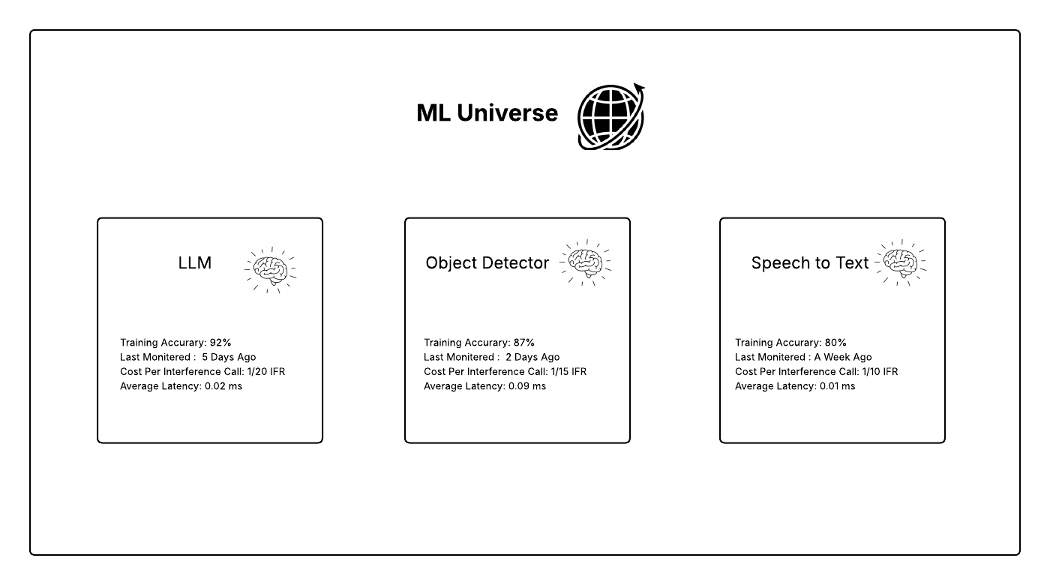

Slide 8
Benefits
Built on Forte: Utilizes powerful native tooling like the Rules Engine and O2 Oracles
No Code or Pipeline Migration Required: the O2 Oracle bridges the gap between off-chain tasks and outputs and the blockchain, so MLOps tasks and training jobs can continue to run where they are without migration to other platforms using our high-level SDK
Transparent Governance: All decisions are algorithmic and recorded on-chain
Developer-Friendly SDK: Data scientists don’t need blockchain or Javascript expertise
Privacy-Aware: Supports both open and private model governance
Economic Incentives: Monetization aligned with contribution and usage
Models as Assets: Treats ML models as IP-backed digital assets (RWAs)

Slide 9

Project Roadmap
Proof-of-Concept (POC)
Build Forte Rules Engine logic and O2 Oracle-based metric ingestion on a sample MLOps use-case
Minimum Viable Product (MVP)
Phase 1: Develop a user-friendly Python SDK that wraps O2 Oracle API calls and Rules creation for easy ML pipeline integration
Phase 2: Develop Decentralized Model Registry
Phase 3: Launch ML Universe monetization layer using a derivative of Forte’s native token (wrapped token) with the proposed name $INFER

Slide 10
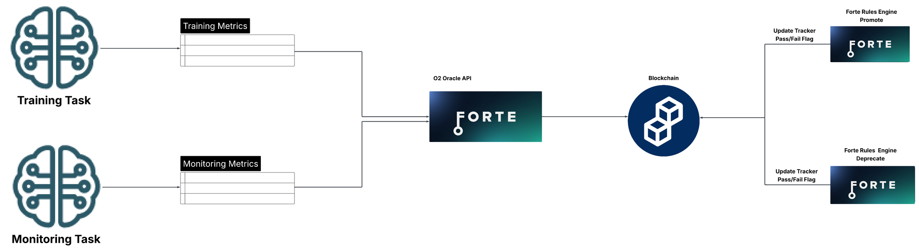
O2 Oracle API for Metric Ingestion
The O2 Oracle API is used to securely transmit model performance metrics and metadata from cloud-based ML pipelines to the Forte blockchain. This API supports:
Metric submission (e.g., validation accuracy, latency, drift)
Metadata logging (e.g., training data info, model version, timestamps)
Decision flag retrieval, allowing pipelines to react to governance outcomes
The Oracle layer ensures integrity and synchronization between off-chain ML environments (eg. Sagemaker, Jupyter Notebooks, VertexAI) and the blockchain.

Slide 11
Decentralized Model Registry
Every model governed would be registered on-chain to our “ML Universe”, with entries controlled via policy. This registry:
Tracks model metadata, version history, and decision outcomes
Allows developers to publish models as open or private
Creates an immutable audit trail of decision events across the full ML lifecycle
Models published as open source can participate in a per-inference monetization system. Users would pay for model access using a derivative of Forte’s native cryptocurrency, rewarding developers for their contributions. This model supports general-purpose foundational models and niche applications such as:
Domain-specific language models
Specialized object detection models
Open-source ML primitives

Slide 12
ML Models as Real-World Assets (RWAs)
In the ML Universe, each trained machine learning model is treated as a Real-World Asset (RWA)—a tokenized digital representation of valuable intellectual property (IP). By anchoring these assets on-chain with governance metadata, access policies, and monetization flags, the platform:
Provides verifiable ownership and version history
Enables secure IP rights management
Facilitates on-chain licensing and inference-level revenue models
This framing aligns the platform with broader trends in RWA tokenization, bridging the world of data science with decentralized finance and digital asset infrastructure.

Slide 13
Permissioning & Access Control
Through Forte’s policy framework, in future releases, it may be possible for access to model data and events to be fully customizable:
Private metric tables can be restricted to specific users or organizations
Public flags (e.g., model approved/rejected) remain available for transparency
Token-based or ACL-based controls can manage who sees and uses model information
Encrypted metadata or external references can support privacy-sensitive use cases

