Slide 1

Lex Brunett

Slide 2


What is Power BI?
Power BI is a Microsoft data analysis tool that transforms raw data into interactive visual reports. It connects, models, and visualizes data to derive valuable insights.
https://powerbi.microsoft.com/

Slide 3




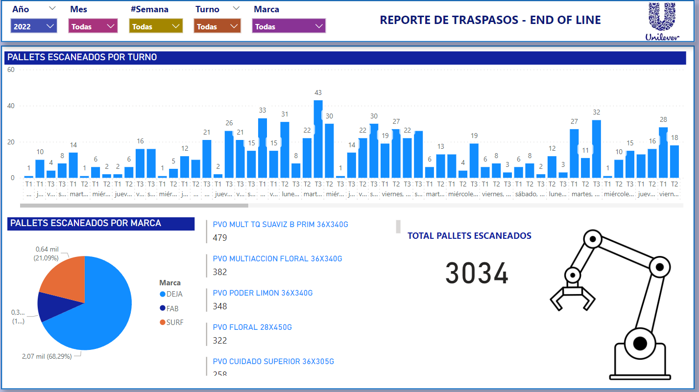
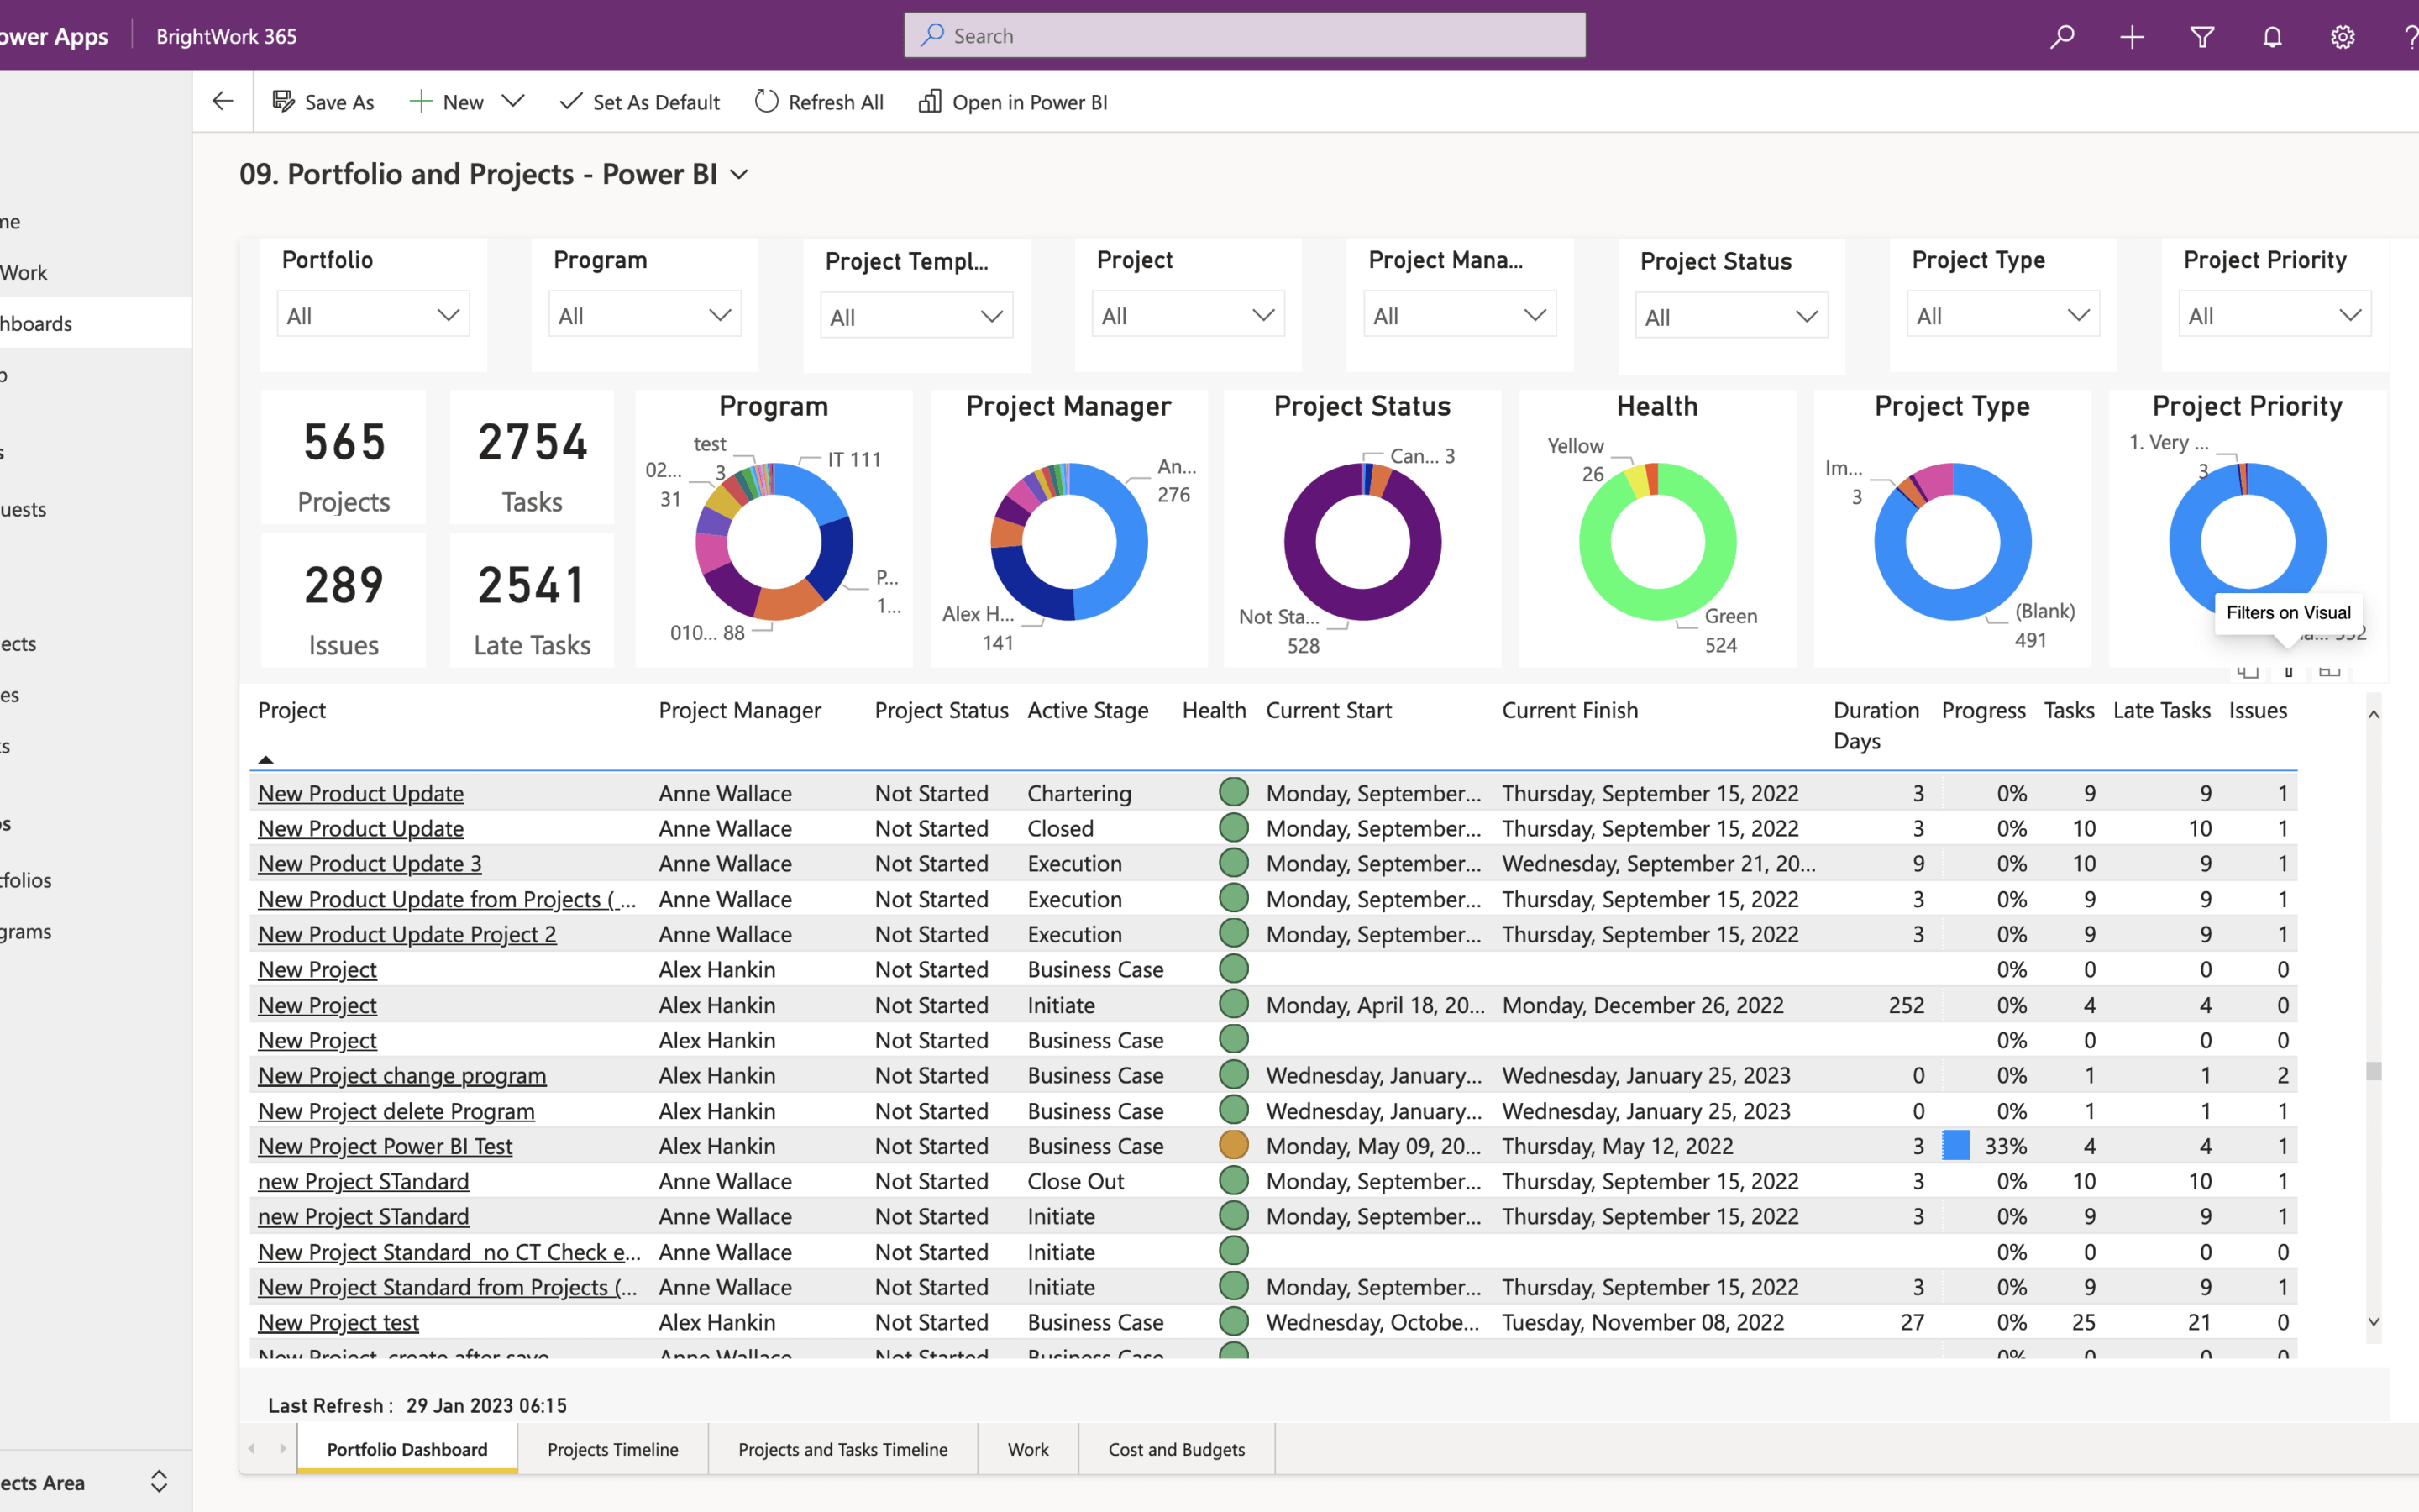
What does Power BI do?
Transform data into stunning visuals and share them with colleagues on any device.
Visually explore and analyze data—on-premises and in the cloud—all in one view.
Collaborate on and share customized dashboards and interactive reports.
Scale across your organization with built-in governance and security.

Slide 4
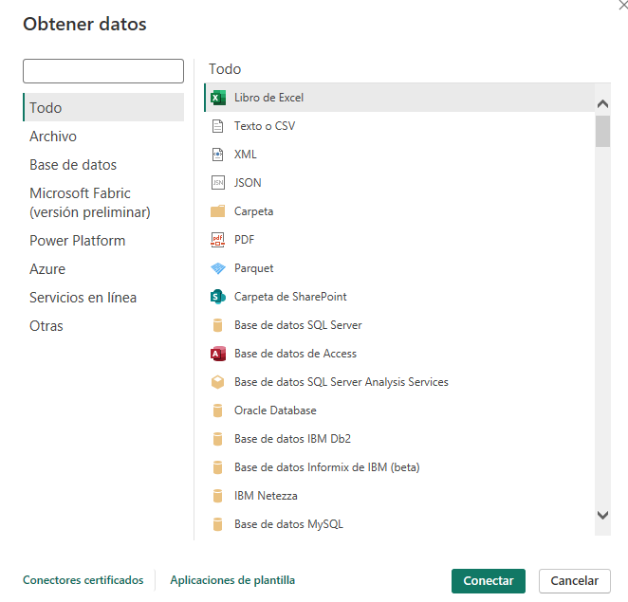
Step 1 - Connect Data
Manually Uploading Datasets or from online source.
Click on "Get Data" to import datasets.
Choose your data source, whether it's Excel, databases, or cloud services, etc.
Click on "Get Data" to begin observing raw data

Slide 5
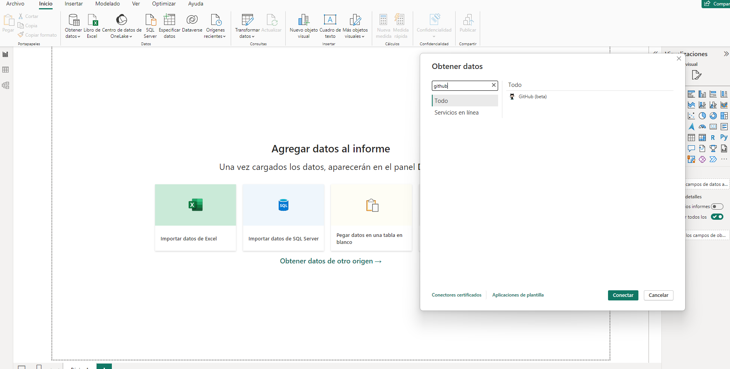
Step 1 - Connect Data
In this example we choose “GitHub”:
1.Once we select the data source.
2.Select the “Connect” Button.

Slide 6
Step 2: Access the Query Editor
Data Cleansing and Transformation:
The Query Editor provides a suite of tools to clean, reshape, and refine your data.
Column Organization:
Arrange columns, rename them, or change data types to enhance the structure of your dataset.
Real-time Previews:
Instantly visualize the impact of transformations on your data through the real-time data preview feature.
Ensuring Data Quality:
Validate changes to guarantee that your data meets the required standards before applying them to your Power BI model to ensure your data is finely tuned for effective analysis within Power BI.

Slide 7
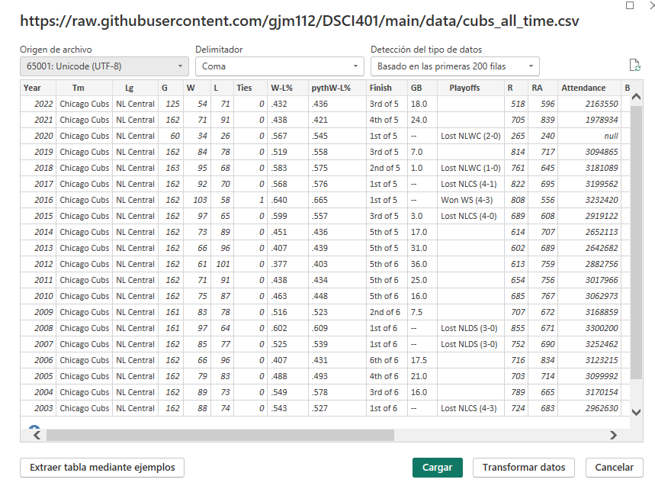
Step 2: Access the Query Editor
Paste the link of the Data from the source chose from the last slide.
-Once the data loads is possible to change the character separated value (this example use comma) and how is the type of the data.
-Click on the Charge Date button.

Slide 8
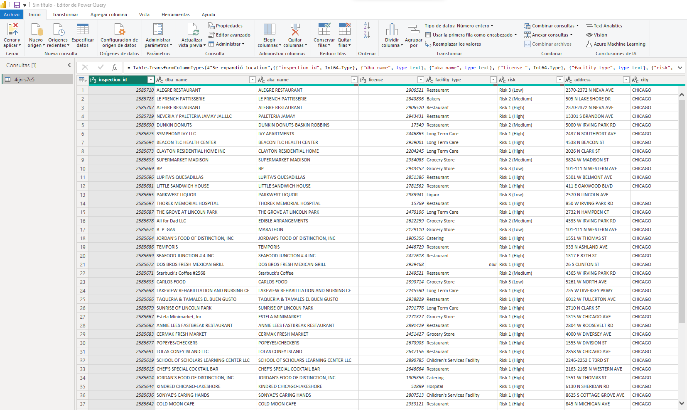
Step 3: Managing Raw Data with DAX
After getting data from source:
-Analize filters to find NA or blanks values to delete columns or replace values.
-Once all data checked (depending on case more Datasets added), click the Close and apply button.

Slide 9
Step 3: Managing Raw Data with DAX
DAX (Data Analysis Expressions) is a powerful formula language used in Power BI to manipulate and transform data. It allows for complex calculations and aggregations.
In the Query Editor, locate and select the columns containing NA (Not Available) values.
Use the "Replace Values" or "Remove Rows" options to handle NA values. You can replace them with a specific value, using rules, or remove rows with NA values altogether.
Within the Query Editor, you can rearrange columns by dragging and dropping them to the desired position.
Use additional transformation functions such as renaming columns, changing data types, or filtering rows to further organize your data.
Navigate to the "Home" tab in Power BI and click on "Transform Data."

Slide 10
Step 4: Creating Relationships Between Queries:
Identify Common Fields:
Determine common fields (columns) in different datasets that can serve as key identifiers.
Access "Relationships" View:
Navigate to the "Home" tab and click on "Relationships" to access the dedicated view in Power BI.
Define Relationships:
Establish connections between identified common fields to create relationships.
Integrate Data:
Ensure effective data integration across datasets, allowing seamless analysis and maintaining consistency and accuracy
Choose Relationship Types:
Select the appropriate relationship type (one-to-one, one-to-many, many-to-many) based on your data structure.

Slide 11
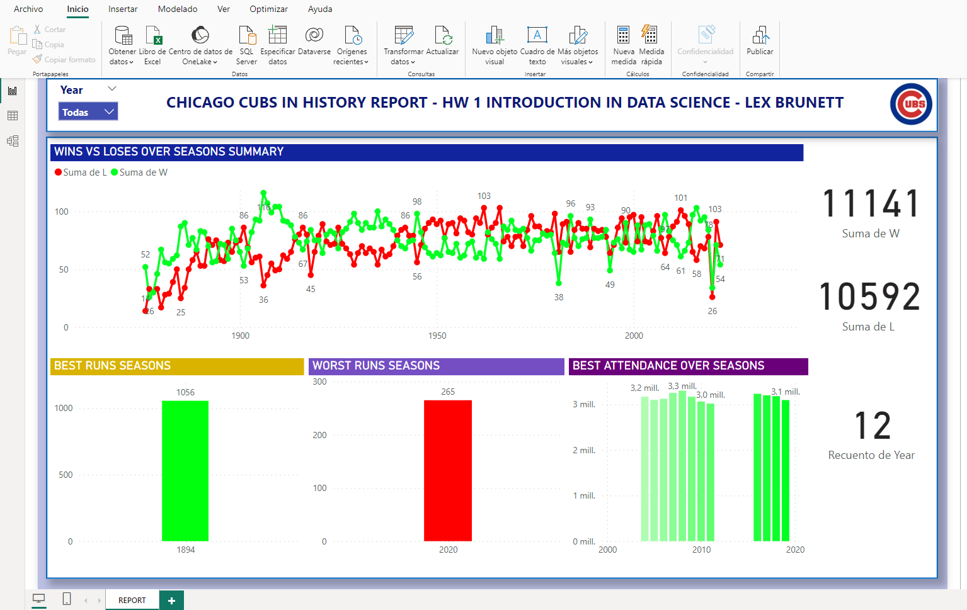
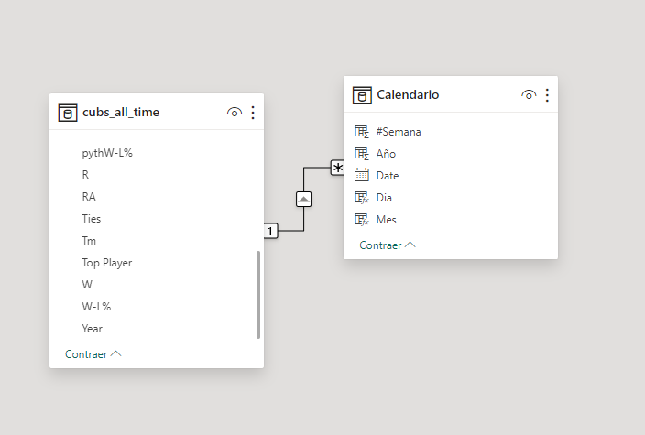
Step 4: Creating Relationships Between Queries:
After getting data from source:
-Once Data Applied, check the relationships button to make the corresponding relations between variables (dates, KPI, Etc.)

Slide 12
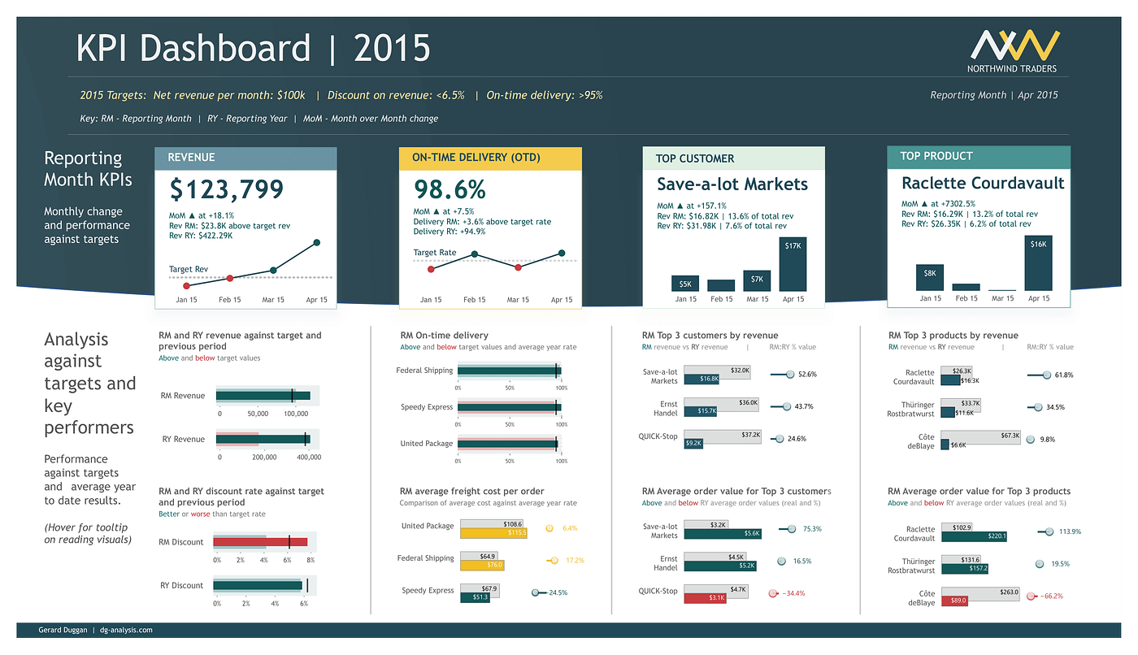
Step 4.5 - Recommendations
Create a Calendar Table
Use Tables for KPI calculation
Relationships for better filtering in the report.
Report data can be updated!!

Slide 13
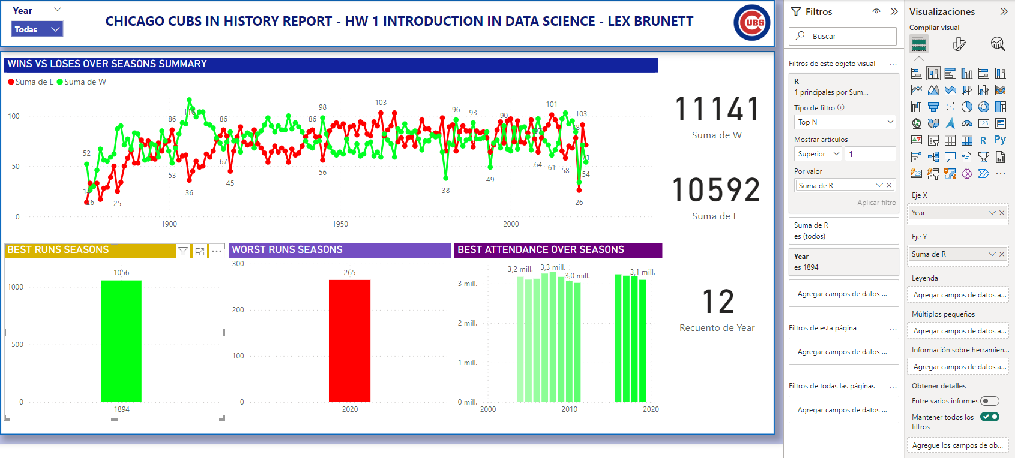
Step 5 – Report and Filters
Make the graphics desired to the report (histograms, Parettos, Scatter plots, Matrices. Etc.
Is possible to create filters as visual objects to filter by year, country, wins, etc.
In the other hand is possible to create filters for a unique visual object such as Top N, more than X value, unique year.

Slide 14
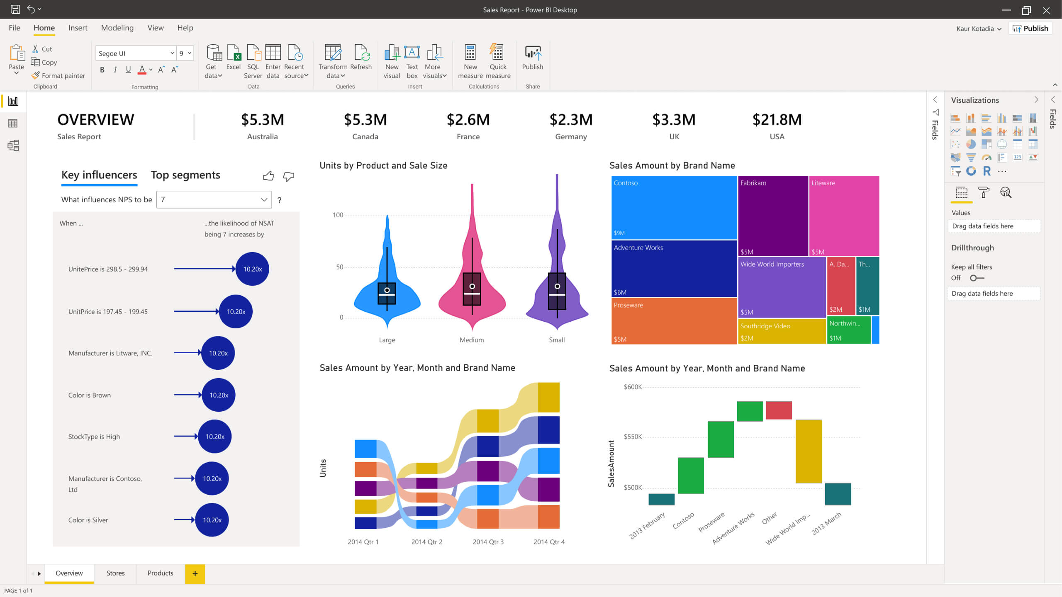

GitHub Repository
https://github.com/LexoBrunett/PowerBi_Tutorial_BIOI_LexBrunett

