Slide 1

Lex Brunett

Slide 2


What is Power BI?
Power BI is a Microsoft data analysis tool that transforms raw data into interactive visual reports. It connects, models, and visualizes data to derive valuable insights.
https://powerbi.microsoft.com/

Slide 3




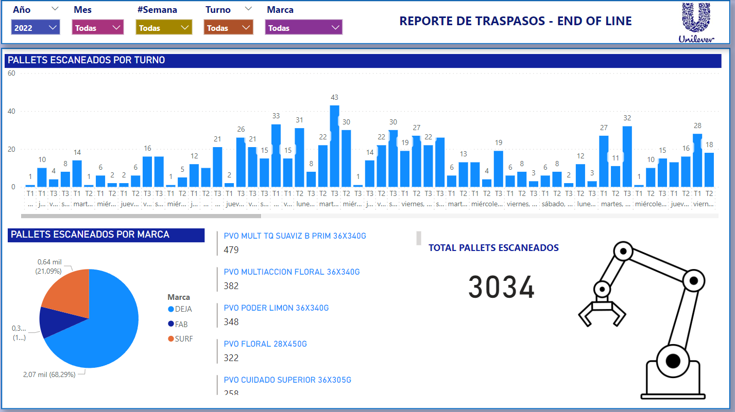
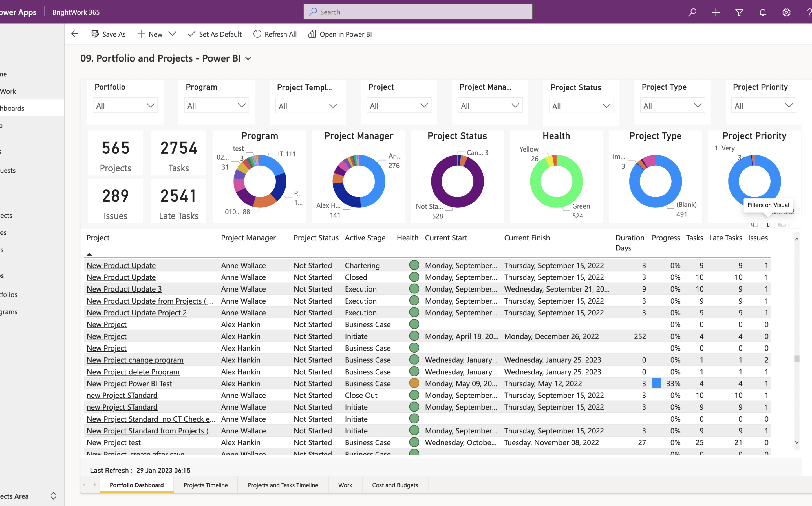
What does Power BI do?
Transform data into stunning visuals and share them with colleagues on any device.
Visually explore and analyze data—on-premises and in the cloud—all in one view.
Collaborate on and share customized dashboards and interactive reports.
Scale across your organization with built-in governance and security.

Slide 4
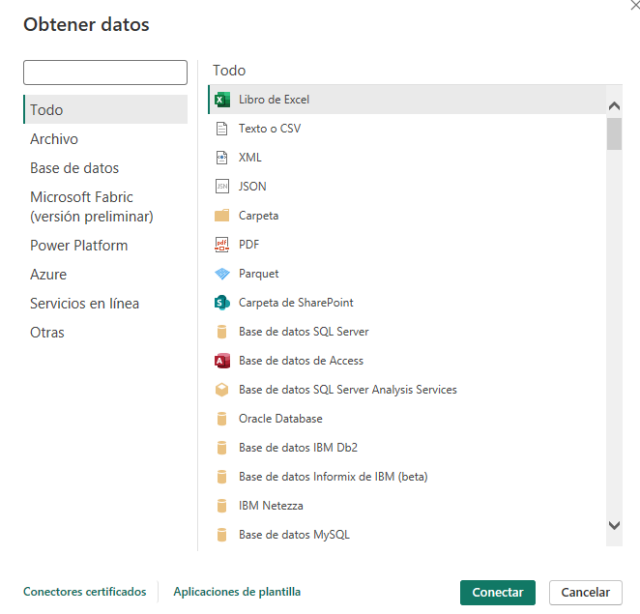
Step 1 - Connect Data
Manually Uploading Datasets or from online source.
Click on "Get Data" to import datasets.
Choose your data source, whether it's Excel, databases, or cloud services, etc.
Click on "Get Data" to begin observing raw data

Slide 5
Step 2: Access the Query Editor
Data Cleansing and Transformation:
The Query Editor provides a suite of tools to clean, reshape, and refine your data.
Column Organization:
Arrange columns, rename them, or change data types to enhance the structure of your dataset.
Real-time Previews:
Instantly visualize the impact of transformations on your data through the real-time data preview feature.
Ensuring Data Quality:
Validate changes to guarantee that your data meets the required standards before applying them to your Power BI model to ensure your data is finely tuned for effective analysis within Power BI.

Slide 6
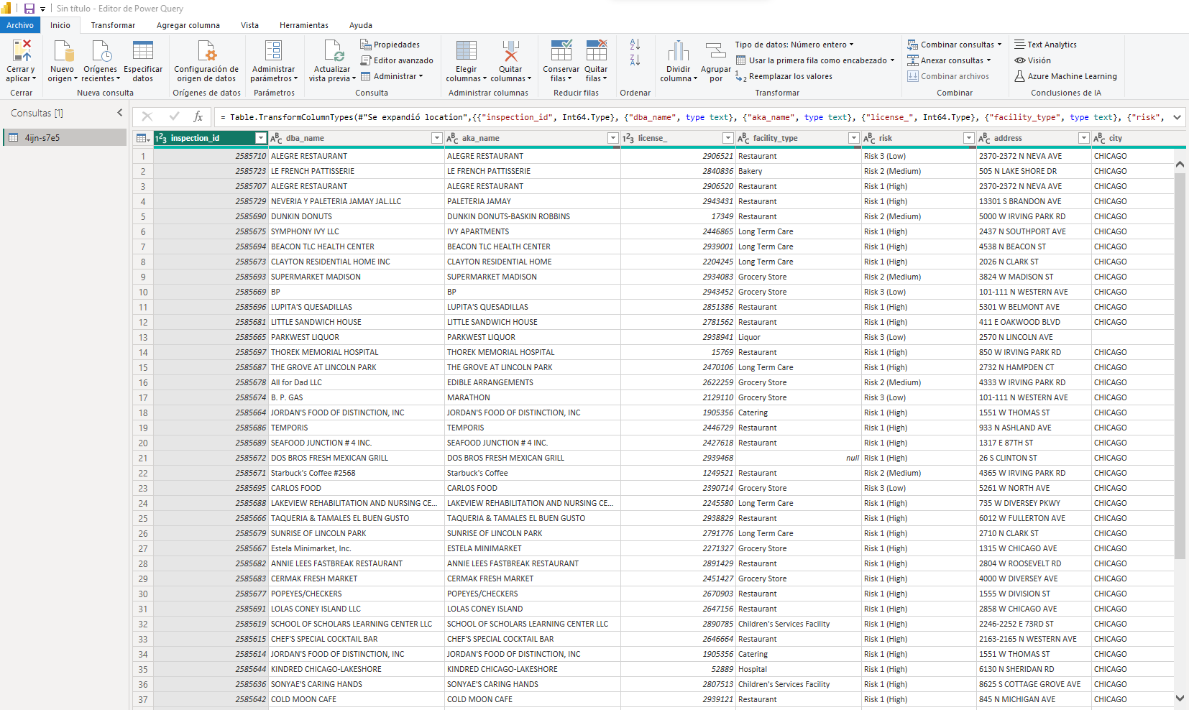
Step 3: Managing Raw Data with DAX
After getting data from source:
-DAX is an language for managing queries in PowerBi
-In this section, is necessary to observe, filter NA, delete Columns, etc.

Slide 7
Step 3: Managing Raw Data with DAX
DAX (Data Analysis Expressions) is a powerful formula language used in Power BI to manipulate and transform data. It allows for complex calculations and aggregations.
In the Query Editor, locate and select the columns containing NA (Not Available) values.
Use the "Replace Values" or "Remove Rows" options to handle NA values. You can replace them with a specific value, using rules, or remove rows with NA values altogether.
Within the Query Editor, you can rearrange columns by dragging and dropping them to the desired position.
Use additional transformation functions such as renaming columns, changing data types, or filtering rows to further organize your data.
Navigate to the "Home" tab in Power BI and click on "Transform Data."

Slide 8
Step 4: Creating Relationships Between Queries:
Identify Common Fields:
Determine common fields (columns) in different datasets that can serve as key identifiers.
Access "Relationships" View:
Navigate to the "Home" tab and click on "Relationships" to access the dedicated view in Power BI.
Define Relationships:
Establish connections between identified common fields to create relationships.
Integrate Data:
Ensure effective data integration across datasets, allowing seamless analysis and maintaining consistency and accuracy
Choose Relationship Types:
Select the appropriate relationship type (one-to-one, one-to-many, many-to-many) based on your data structure.

Slide 9
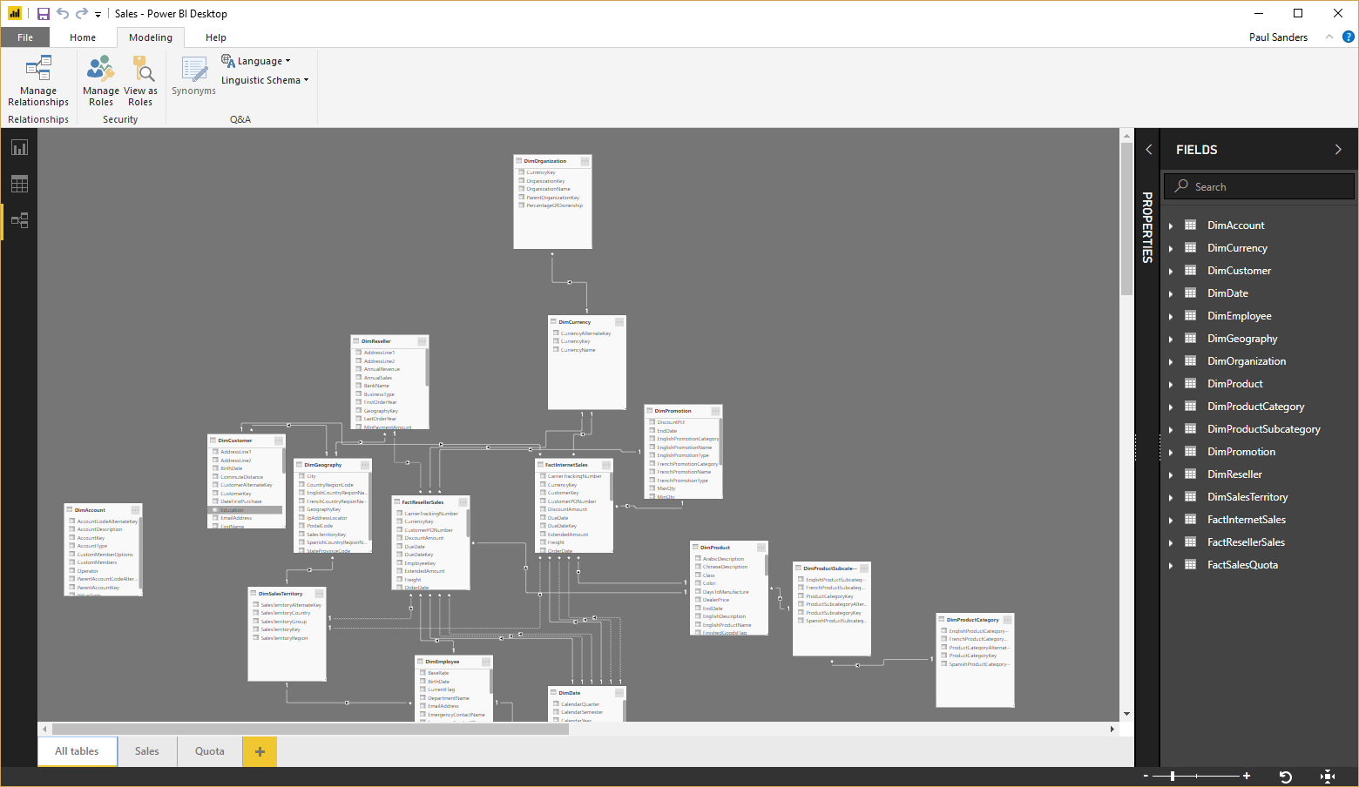
Step 4: Creating Relationships Between Queries:

Slide 10
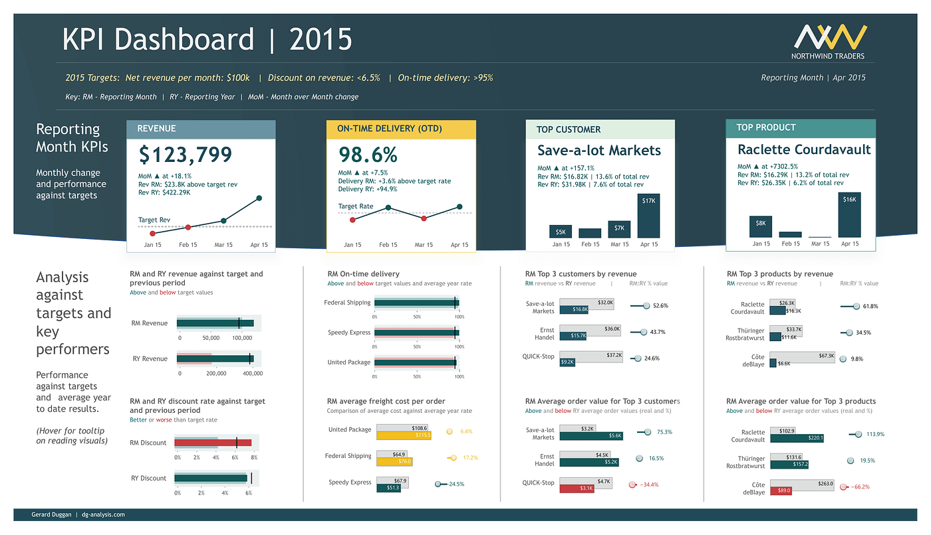
Step 4.5 - Recommendations
Create a Calendar Table
Use Tables for KPI calculation
Relationships for better filtering in the report.
Report data can be updated!!

Slide 11
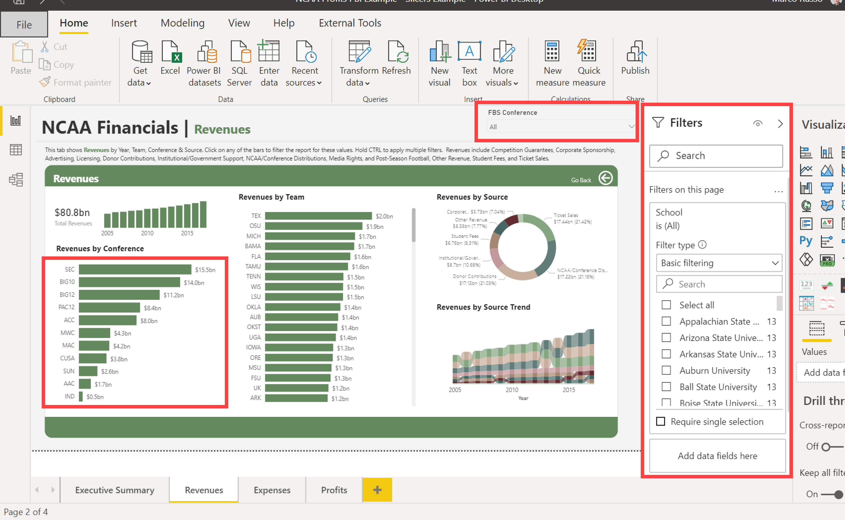
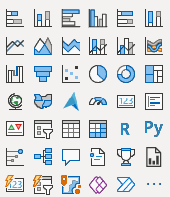
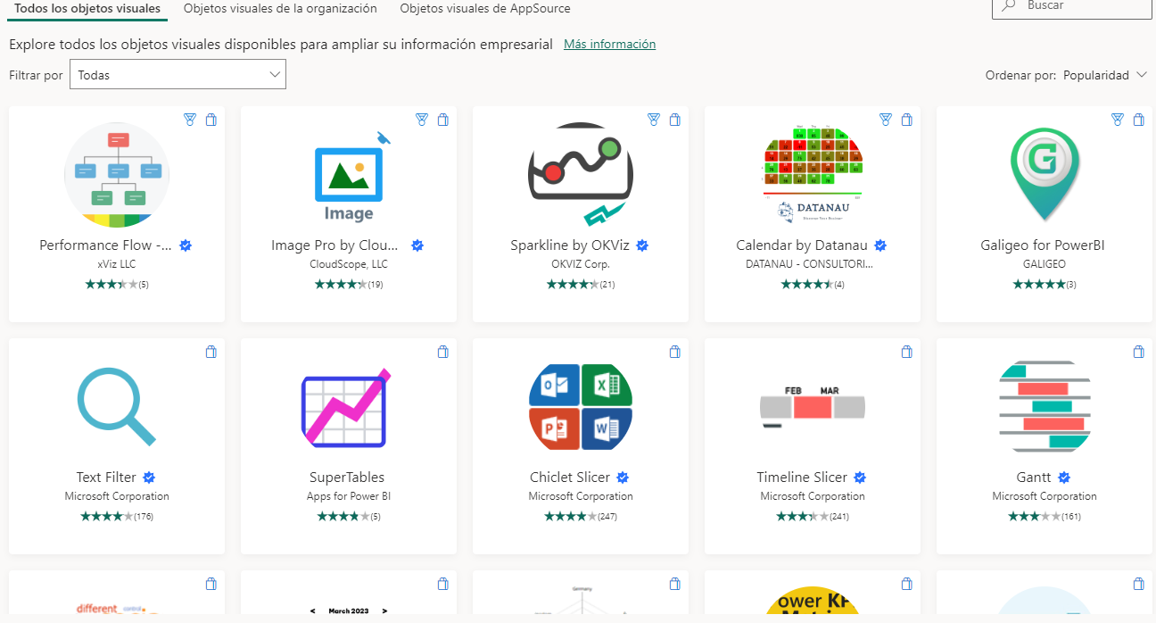
Step 5 – Report and Filters
A visual Object can have an own filter.
Relationships help to improve calculation
when we filter.

Slide 12
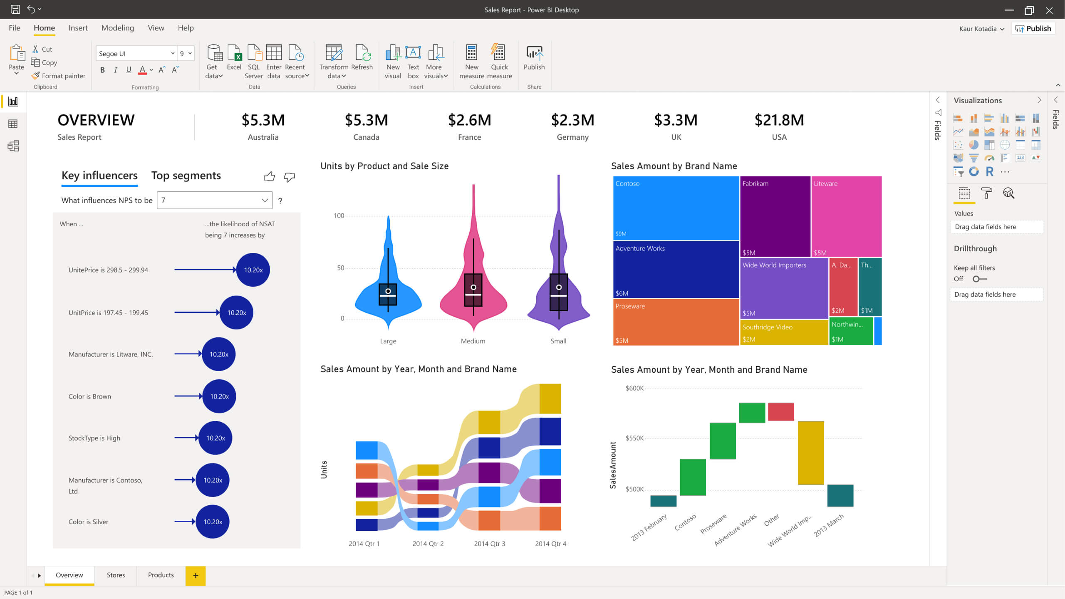

GitHub Repository
https://github.com/LexoBrunett/PowerBi_Tutorial_BIOI_LexBrunett

