Slide 1

phstemplates: An R package for templates in Public Health Scotland
NHS-R Conference 2020 Alan Yeung

Slide 2
Acknowledgements
Transforming Publishing team in PHS who developed the actual content of this work
I just wrote some R code around it

Slide 3
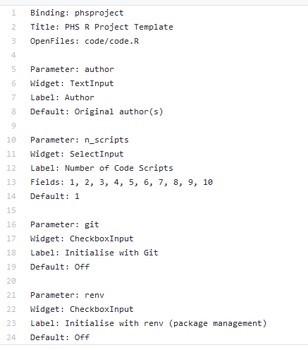
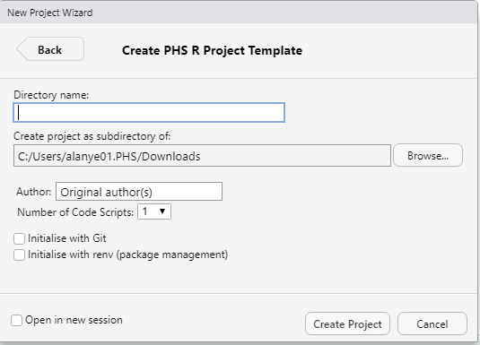
What is phstemplates?
Currently contains the following templates:
Project structure
R script
PHS reports
Can be accessed using the menus in RStudio
dcf file

Slide 4
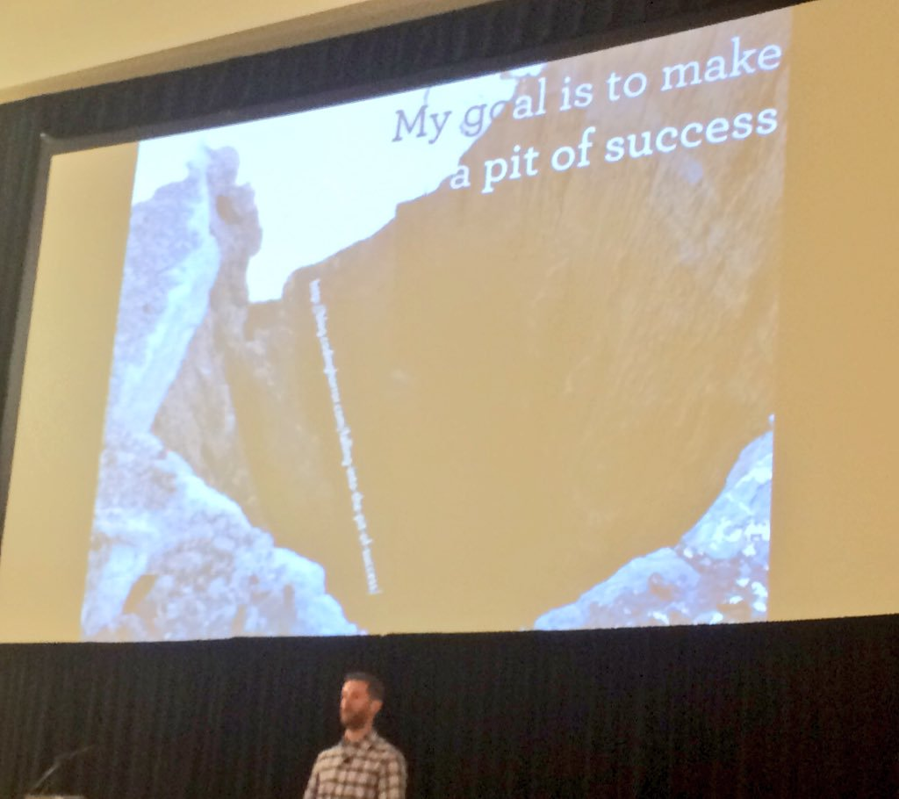
Why phstemplates?
Remove some of the pain of adopting best practice (particularly for beginners)
Make it easier to follow a reproducible workflow
Collaboration, portability, resilience
Security
Improve discoverability of R work/tools being developed in PHS
Figure: Hadley and the pit of success.

Slide 5
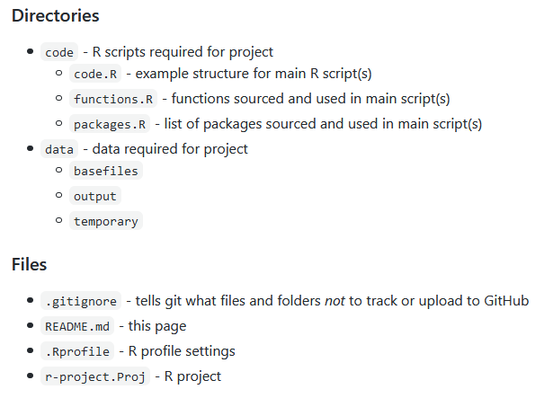
Project Template
Project template and R script template that aims to instil best practice
Intended to be flexible
Mostly simple code
dir.create()
writeLines()
Figure: phstemplates project folder structure.
https://github.com/Public-Health-Scotland/phstemplates

Slide 6
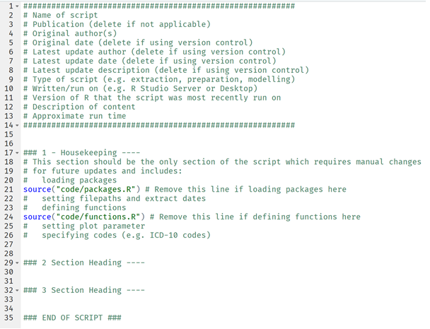
R Script Template
Figure: R script template.

Slide 7


Report Templates
RMarkdown with output as word_document
References a style document
Uses a few ‘tricks’ for customisation
<Div custom-style = "Publication subtitle"> … </Div>
<span custom-style = "highlight"> … </span>
Requires RStudio v1.2 which provides pandoc v2
Page breaks
flextable
Officer package
Front cover
Table of contents

Slide 8
Planned Developments
Polishing up:
Vignettes for RMarkdown templates
Unit tests, code coverage, etc
Additional features/templates:
ioslides template
shiny template
Leaflet template for making maps
More report templates

Slide 9
Contributing
This is an open-source project so all contributions welcome! e.g. documentation, issues, feature suggestions, adding templates
Clone the repo using git
Create your own branch
Add your input
Push to Github
Put in a pull request on git
For creatives, a hex logo might be nice!

Slide 10
Demo
Project template
New R script with template
Report templates

Slide 11

Thanks for listening
https://github.com/Public-Health-Scotland/phstemplates
Alan Yeung
https://github.com/alan-y

