Slide 1

NHS Presentation- Applied Survival Analysis
EDNA MWENDA

Slide 2
Introduction
What is survival analysis?
Survival analysis is a branch of statistics for analyzing the expected duration of time until one or more events happen, such as death in biological organisms and failure in mechanical systems. It can also be defined as the study of survival times and what affects them(times). Since survival analysis deals with predicting the time when a specific event is going to occur. It is also known as failure time analysis or analysis of time to death.

Slide 3
Survival Times
Examples of survival times include time from birth until death, time from entry into a clinical trial until death or disease progression, or time from birth to development/ age of onset of breast cancer.
NB: In survival analysis, the time to the occurence of an event is very important. It is the end and be all for this subject.

Slide 4
Applied Survival Analysis
This is survival analysis in real life, in real life scenarios and applications. Survival analysis models are important in Engineering, Insurance, Marketing, Medicine, and many more application areas.
Some of the aliases of survival analysis from other fields include;
Reliability analysis
Duration analysis
Event history analysis
Time-to-event analysis
Eg; A survival model can be used in predicting the number of days a person with cancer will survive or predicting the time when a mechanical system is going to fail.

Slide 5
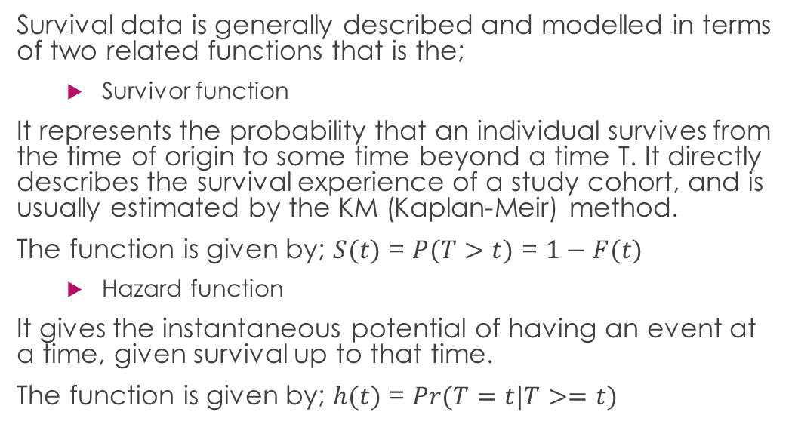
Functions used in Survival Analysis
Survival data is generally described and modelled in terms of two related functions that is the;
Survivor function
It represents the probability that an individual survives from the time of origin to some time beyond a time T. It directly describes the survival experience of a study cohort, and is usually estimated by the KM (Kaplan-Meir) method.
The function is given by; $S(t)$ = $P(T>t)$ = $1−F(t)$
Hazard function
It gives the instantaneous potential of having an event at a time, given survival up to that time.
The function is given by; $h(t)$ = $Pr(T=t|T>=t)$

Slide 6
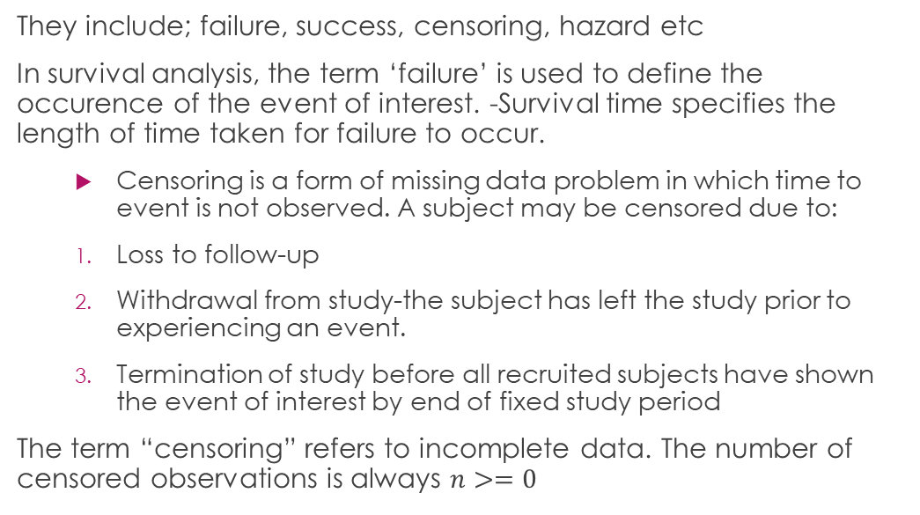
Other terms used in survival analysis
They include; failure, success, censoring, hazard etc
In survival analysis, the term ‘failure’ is used to define the occurence of the event of interest. -Survival time specifies the length of time taken for failure to occur.
Censoring is a form of missing data problem in which time to event is not observed. A subject may be censored due to:
Loss to follow-up
Withdrawal from study-the subject has left the study prior to experiencing an event.
Termination of study before all recruited subjects have shown the event of interest by end of fixed study period
The term “censoring” refers to incomplete data. The number of censored observations is always $n>=0$

Slide 7
Types of censoring
Right censoring - occurs when a subject leaves the study before an event occurs or the study ends before the event has occurred. There are 3 types of right censoring;
Fixed type I censoring-occurs when failure hasn’t happened during the termination of the study period.
Random type I censoring- occurs during the study period and not at a fixed time i.e completely random dropout (eg emigration).
Type II- study ends when a fixed prespecified no. of events amongst the subjects has occurred.
Left censoring is when the event of interest has already occurred before enrolment. This is very rarely encountered.
Interval censoring- occurs if a subject true but unobserved survival time is within a known time interval.

Slide 8
Objectives
To estimate the survivor function using Kaplan-Meir
To interpret the survivor function
To compare the distribution of survival times in diferent groups
To assess the relationship of the explanatory variable to the survival times

Slide 9
Non-parametric modelling of survival distribution
Here;
The distribution form of data is NOT necessary. We consider these approaches;
Kaplan-Meier estimator of the survivor function
Nelson-Aalen estimator of the cumulative hazard
Actuarial estimator (life table estimator)

Slide 10
Case study - The Lung dataset in the survival R package
The R package named survival is used to carry out survival analysis. This package contains the function Surv() which takes the input data as a R formula and creates a survival object among the chosen variables for analysis. Then we use the function survfit() to create a plot for the analysis.
First you install/and load the required packages
data(lung) lung %>% head(n=5)
## inst time status age sex ph.ecog ph.karno pat.karno meal.cal wt.loss ## 1 3 306 2 74 1 1 90 100 1175 NA ## 2 3 455 2 68 1 0 90 90 1225 15 ## 3 3 1010 1 56 1 0 90 90 NA 15 ## 4 5 210 2 57 1 1 90 60 1150 11 ## 5 1 883 2 60 1 0 100 90 NA 0

Slide 11
Understanding the data
The following are the variables and what they mean in the lung dataset;
inst: Institution code
time: Survival time in days
status: censoring status 1=censored, 2=dead age:
Age in years sex: Male=1 Female=2
ph.ecog: ECOG performance score (0=good 5=dead) ph.karno: Karnofsky performance score (bad=0-good=100) rated by physician
pat.karno: Karnofsky performance score as rated by patient
meal.cal: Calories consumed at meals
wt.loss: Weight loss in last six months

Slide 12
Let’s get coding
library(survminer)
## Warning: package 'survminer' was built under R version 4.0.3
## Loading required package: ggpubr
## Warning: package 'ggpubr' was built under R version 4.0.3
data<- Surv(lung$time, lung$stat) head(data, n=10)
## [1] 306 455 1010+ 210 883 1022+ 310 361 218 166
The + behind the survival times represents censored data points at that time.

Slide 13
Estimating survival distribution using the Kaplan-Meier method
km_fit <- survfit(Surv(time, status) ~ 1, data = lung) #quantile(km_fit,probs= 1-c(0.7,0.6)) summary(km_fit, times = c(1,5,10,20*(1:10)))
## Call: survfit(formula = Surv(time, status) ~ 1, data = lung) ## ## time n.risk n.event survival std.err lower 95% CI upper 95% CI ## 1 228 0 1.000 0.00000 1.000 1.000 ## 5 228 1 0.996 0.00438 0.987 1.000 ## 10 227 0 0.996 0.00438 0.987 1.000 ## 20 220 7 0.965 0.01219 0.941 0.989 ## 40 217 3 0.952 0.01419 0.924 0.980 ## 60 213 6 0.925 0.01740 0.892 0.960 ## 80 205 6 0.899 0.01995 0.861 0.939 ## 100 196 8 0.864 0.02271 0.821 0.910 ## 120 189 6 0.837 0.02446 0.791 0.887 ## 140 184 5 0.815 0.02575 0.766 0.867 ## 160 176 8 0.780 0.02751 0.728 0.836 ## 180 160 13 0.722 0.02981 0.666 0.783 ## 200 144 9 0.680 0.03113 0.622 0.744
To fit the survival curve, we use the function survfit to compute the Kaplan-Meier estimate.

Slide 14
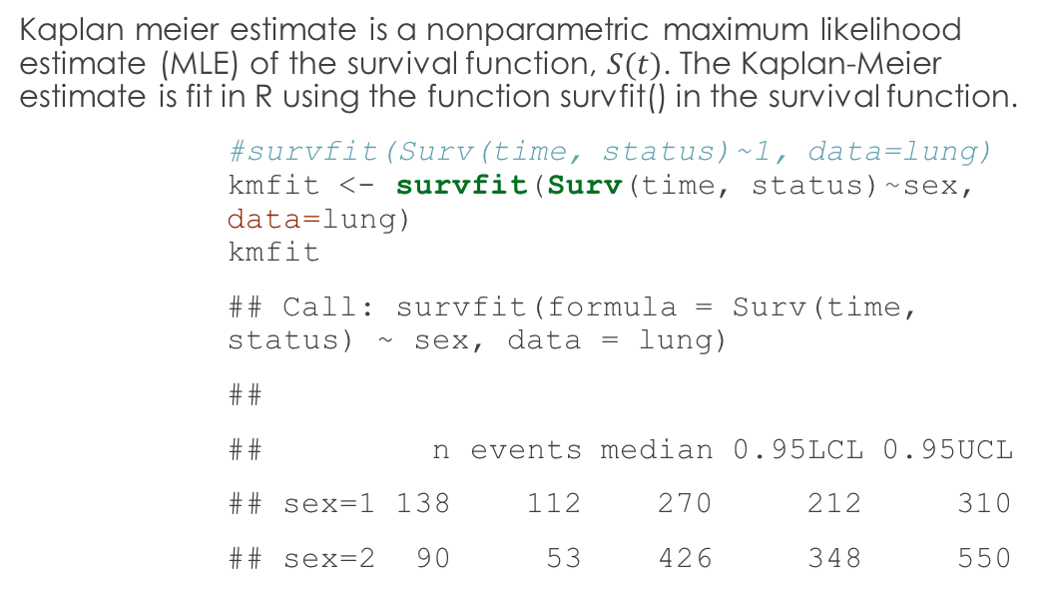
The Kaplan-Meier survival estimator
Kaplan meier estimate is a nonparametric maximum likelihood estimate (MLE) of the survival function, $S(t)$. The Kaplan-Meier estimate is fit in R using the function survfit() in the survival function.
#survfit(Surv(time, status)~1, data=lung) kmfit <- survfit(Surv(time, status)~sex, data=lung) kmfit
## Call: survfit(formula = Surv(time, status) ~ sex, data = lung) ## ## n events median 0.95LCL 0.95UCL ## sex=1 138 112 270 212 310 ## sex=2 90 53 426 348 550

Slide 15
Comparing survival times for different groups
In this example, we compare the male and female lung cancer patients.

Slide 16
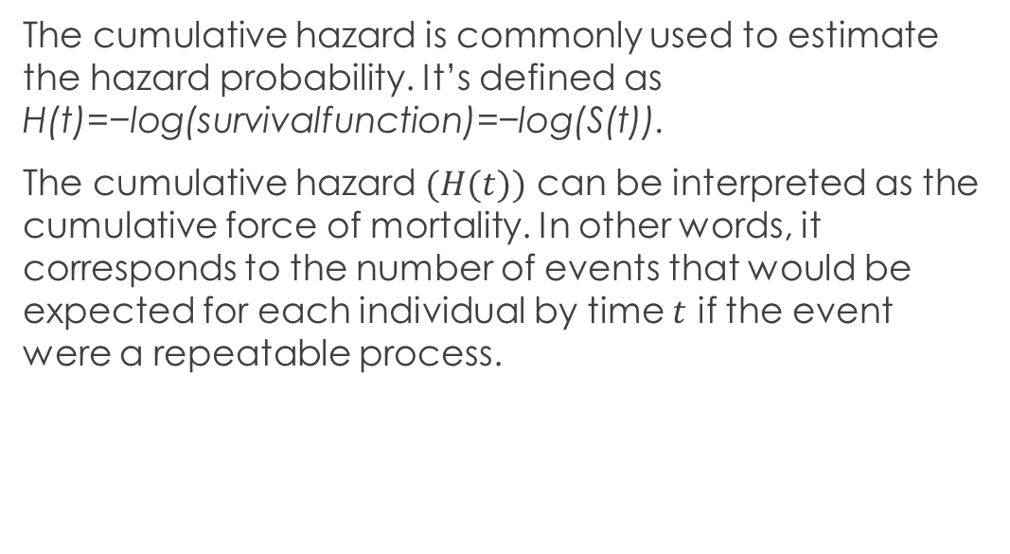
Cumulative Hazard
The cumulative hazard is commonly used to estimate the hazard probability. It’s defined as H(t)=−log(survivalfunction)=−log(S(t)).
The cumulative hazard $(H(t))$ can be interpreted as the cumulative force of mortality. In other words, it corresponds to the number of events that would be expected for each individual by time $t$ if the event were a repeatable process.

Slide 17
Model selection
We use the p-value of the Log-Rank test to compare the groups using pval = TRUE.
The log-rank test is the most widely used method of comparing two or more survival curves.
The null hypothesis is that there is no difference in survival between the two groups.
The log rank test is a non-parametric test, which makes no assumptions about the survival distributions. Essentially, the log rank test compares the observed number of events in each group to what would be expected if the null hypothesis were true (i.e., if the survival curves were identical). The log rank statistic is approximately distributed as a chi-square test statistic.

Slide 18
REFERENCES
[Analytics Vidhya] https://www.analyticsvidhya.com/blog/2014/04/solving-survival-model/
[NCBI] (https://www.ncbi.nlm.nih.gov/pmc/articles/PMC3059453/)
[Rstudio] (https://rviews.rstudio.com/2017/09/25/survival-analysis-with-r/)
[More] (https://stat.ethz.ch/R-manual/R-patched/library/survival/html/ovarian.html)

Slide 19
Thank youuu!!!

