Slide 1
NHS R Community: officeR
9 November 2020

Slide 2
Who am I?
Analyst in NHSE/I
Produce lots of slide packs!
Work with SUS data and weekly activity returns data on hospital activity
Use Excel, SQL and RStudio

Slide 3
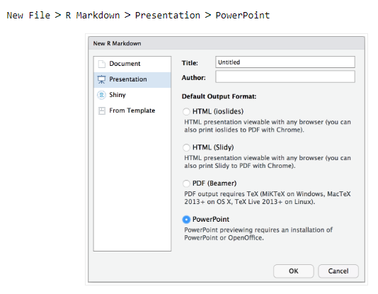
Why use officeR?
If you are not able to update RStudio to see the PowerPoint option on Markdown files
To produce PowerPoint slides
To create Word documents
Reproducibility; add images, tables, graphs and text from r

Slide 4
R packages
Data from NHSRdatasets
Inputting lookup file and exporting the Excel files with readxl and writexl
Wrangling the data with reshape2, zoo, tidyverse and lubridate
Producing the slides with scales, gridExtra, officeR, rvg and magrittr

Slide 5
Process
Data is brought from the NHSRdatasets package and combined with the template PowerPoint and the Excel lookup to create the slides
Attendance, breach and admissions data from NHSRdatasets
Wrangling in r
PPT
Organisation lookup
NHSE/I PowerPoint template

Slide 6

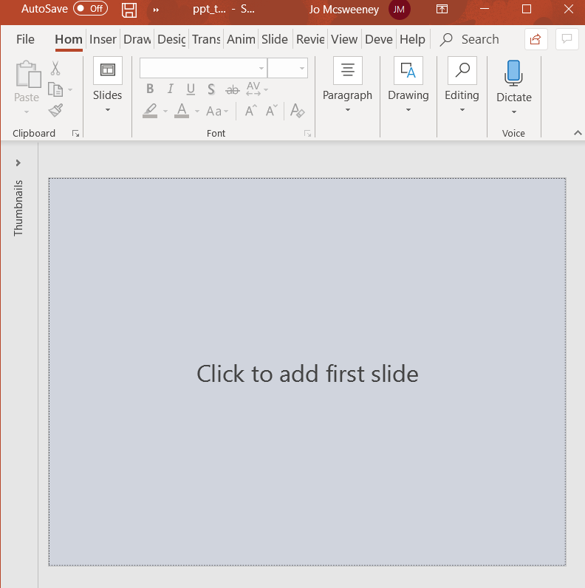
Load your PowerPoint template
this_ppt <- read_pptx(path = paste(file_path, 'ppt_template.pptx', sep = '/'))
x <- read_pptx() loads the standard PowerPoint in officeR
In the global environment you will see 2 variables added.
They are a list of 0 because no slides are added.

Slide 7

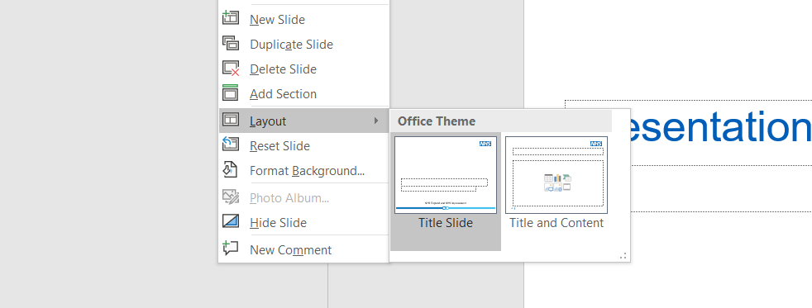
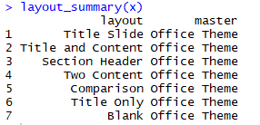
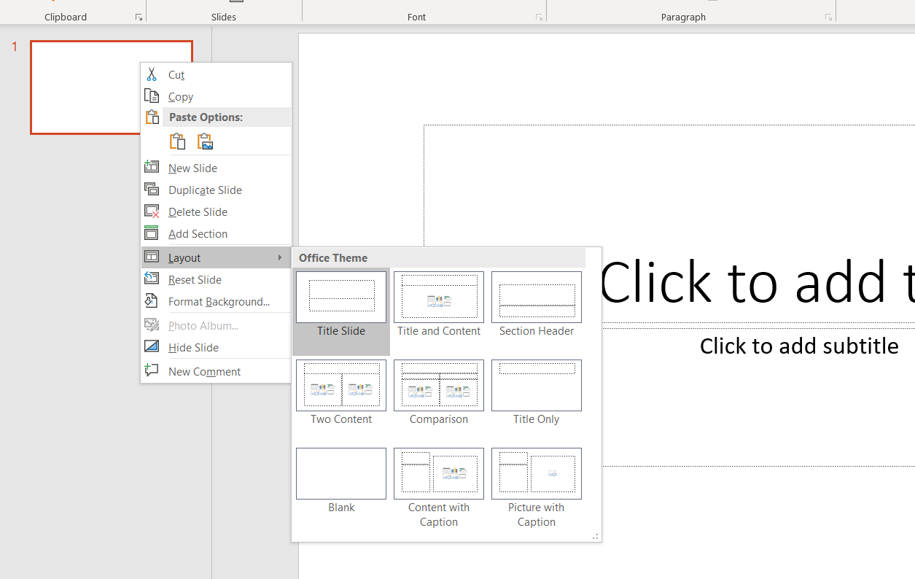
Choose your layout
layout_summary(this_ppt) what different layouts are available?
layout_summary(x) what different layouts are available?
?ph_location_type() where can I put my object?
'body', 'title', 'ctrTitle', 'subTitle', 'dt', 'ftr', 'sldNum'

Slide 8
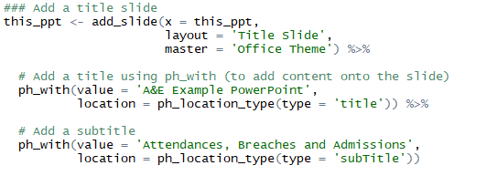
Add your slide
Use the add_slide function to add slides and ph_with to add content onto the slide
value is the text, image, picture or graph
location is where to put the object

Slide 9
A&E Example PowerPoint
Attendances, Breaches and Admissions

Slide 10
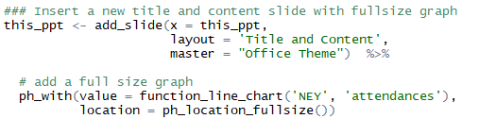
Add a graph
function_line_chart was created to plot a line graph of the selected organisation name and measure
ph_location_fullsize shows the chart on a full slide

Slide 11
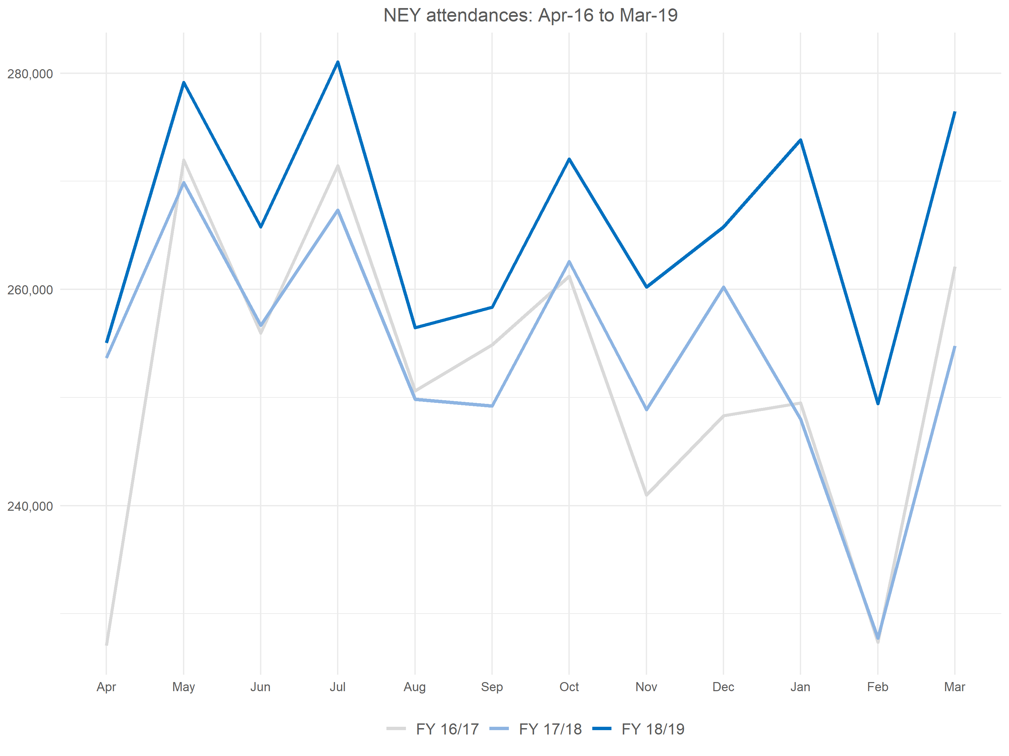

Slide 12
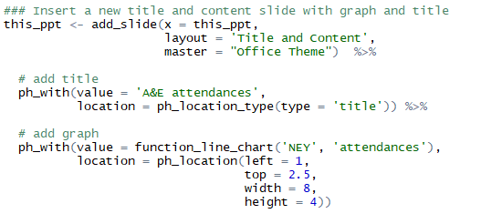
Add a charts with a title
The ph_location function can be used to place and size the object

Slide 13
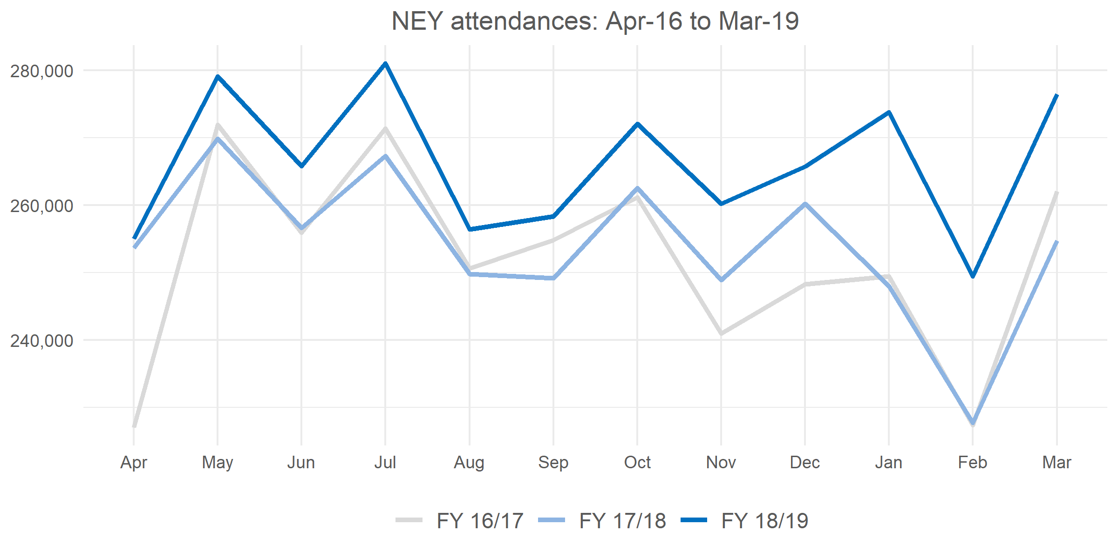
A&E attendances

Slide 14
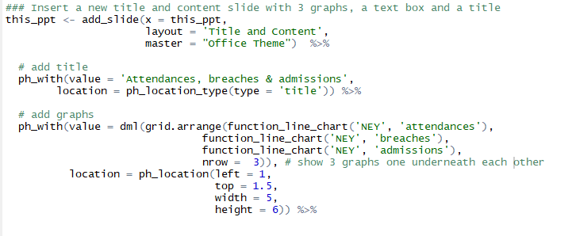
Add multiple charts
The grid.arrange function can be used to put multiple graphs in one area; use the nrow to identify the number of rows
The newer version of the rvg requires the dml function is also used

Slide 15
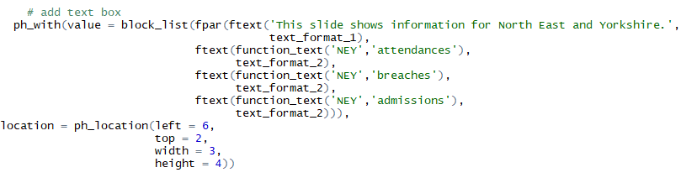
Add text
function_text was created to find the maximum value and date for the selected organisation name and measure
The features of the text can be stated in the ftext function

Slide 16
Attendances, breaches & admissions
NEY attendances: Apr-16 to Mar-19
280,000
260,000
This slide shows information for North East and Yorkshire. The maximum number of attendances is 281,043; this was in Jul-2018. The maximum number of breaches is 37,664; this was in Jan-2019. The maximum number of admissions is 58,722; this was in Jan-2019.
240,000
Apr
May
Jun
Jul
Aug
Sep
Oct
Nov
Dec
Jan
Feb
Mar
FY 16/17
FY 17/18
FY 18/19
NEY breaches: Apr-16 to Mar-19
35,000
30,000
25,000
20,000
Apr
May
Jun
Jul
Aug
Sep
Oct
Nov
Dec
Jan
Feb
Mar
FY 16/17
FY 17/18
FY 18/19
NEY admissions: Apr-16 to Mar-19
55,000
50,000
45,000
Apr
May
Jun
Jul
Aug
Sep
Oct
Nov
Dec
Jan
Feb
Mar
FY 16/17
FY 17/18
FY 18/19

Slide 17
Attendances, breaches & admissions
Airedale NHS Foundation Trust attendances: Apr-16 to Mar-19
6,000
This slide shows information for Airedale. The maximum number of attendances is 6,312; this was in May-2018. The maximum number of breaches is 722; this was in Mar-2019. The maximum number of admissions is 1,581; this was in Jan-2019.
5,500
5,000
4,500
Apr
May
Jun
Jul
Aug
Sep
Oct
Nov
Dec
Jan
Feb
Mar
FY 16/17
FY 17/18
FY 18/19
Airedale NHS Foundation Trust breaches: Apr-16 to Mar-19
700
600
500
400
300
Apr
May
Jun
Jul
Aug
Sep
Oct
Nov
Dec
Jan
Feb
Mar
FY 16/17
FY 17/18
FY 18/19
Airedale NHS Foundation Trust admissions: Apr-16 to Mar-19
1,600
1,400
1,200
1,000
Apr
May
Jun
Jul
Aug
Sep
Oct
Nov
Dec
Jan
Feb
Mar
FY 16/17
FY 17/18
FY 18/19

Slide 18
What else?
flextable can be used to create and format tables
Images using external_img
Lists using unordered_list
Hyperlinks using ph_hyperlink
ph_add_text to insert text with links
For more information see David Gohel’s PowerPoint generation page: https://cran.univ-paris1.fr/web/packages/officer/vignettes/powerpoint.html

