Slide 1

Using R to understand the Impact of SARS-CoV-2 on Paediatric Patients
Dr Richard Issitt B.Sc. (Hons) PgDip, DClinP, FCCP, AACP
Research Fellow, British Heart Foundation
Senior Paediatric Perfusionist, Great Ormond Street Hospital
Clinical Lead, Digital Research Environment
Honorary Lecturer, Institute of Cardiovascular Science, UCL
10th November 2020

Slide 2

Bring your data
Industry partner
Invite your multi-disciplinary team
Programme director
Academic
Doctor
Researcher
Clinician
Secure, self-service, cloud-based data analysis platform for biomedical research, precision medicine and healthcare
Lab
Social
Longitudinal
Genomic
Imaging
Clinical
Sensor
Time Series
Service KPI

Slide 3
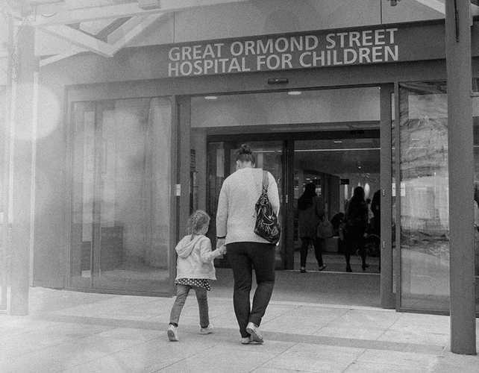
Specialist Children’s Hospital
Do we see the same over-representation of BAME as in adults?
Are there differences in inflammatory markers and other parameters in patients with COVID-19?
Is vitamin D level determined by disease severity in COVID-19 patients when adjusted by patients age, gender and ethnicity?
If vitamin D is associated with inflammation and COVID-19 is also associated with inflammation what is the direct and indirect effect of vitamin D on inflammation?

Slide 4
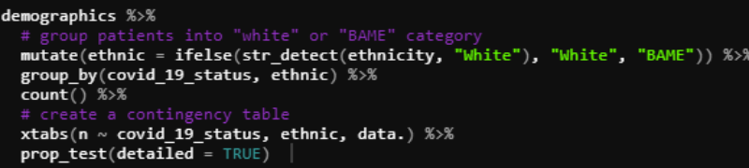
Table 1. Comparison of demographic and clinical characteristics of COVID-19 positive and negative patients during the study period.
 | COVID-19 positive n = 32 | COVID-19 negative n = 25 | P
Age (years) | 9.3 [5.9 – 11.8] | 5.9 [0.2 – 10.3] | 0.12
Weight (kg) | 35.8 [20.6 – 46.3] | 14 [4.9 – 41] | 0.006
Sex (male) | 17 (53) | 13 (52) | 1
Ethnicity - Caucasian - BAME | 11 (34) 21 (66) | 8 (32) 17 (68) | 1 1 1
PIM-3 at admission | 1.4 [1.2 – 6.1] | 2.9 [1.3 – 4.35] | 1
C-Reactive Protein (mg/L) - On Admission - Maximum during admission | 229 [67.8 – 276] 262 [71.8 – 315] | 29 [11.8 – 103] 61 [24.5 – 181] | 0.013 0.015
Total Vitamin D levels (nmol/L) | 34 [18 – 61] | 43 [27 – 55] | <0.001
Calcium level (mmol/L) - total calcium level - ionized calcium level | 2.04 [1.96 – 2.16] 1.16 [1.12 – 1.22] | 2.11 [1.99 – 2.24] 1.19 [1.1 – 1.27] | 0.43 0.76
Vitamin D deficiency (<50 nmol/L) | 22 (69) | 16 (64) | 0.66
Results are reported as numbers (percentage) or median (interquartile range) BAME=Black, Asian and minority ethnic, PIM-3=pediatric index of mortality score 3
All R scripts using tidyverse suite and statistical comparisons using the rstatix package: pipe friendly!
Although the majority of patients seen in all groups were BAME, there was no significant difference in the proportions in each group.

Slide 5
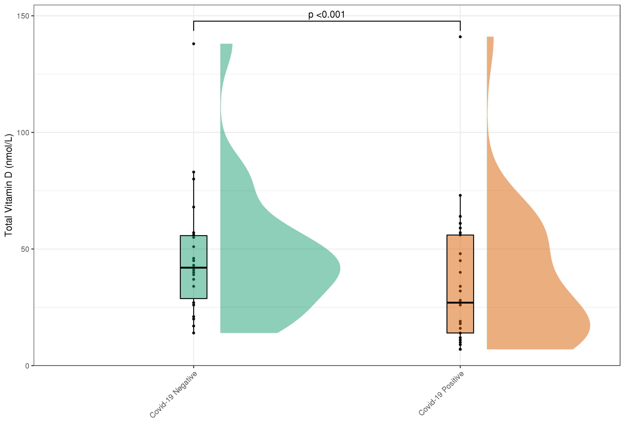
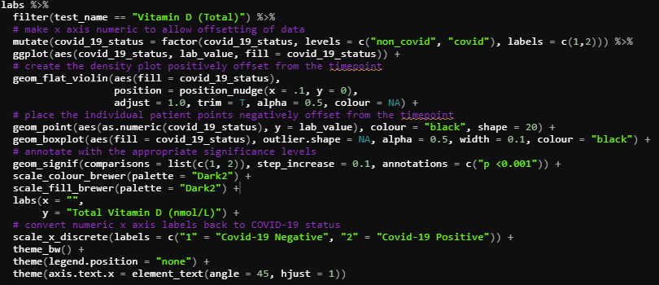
Raincloud Plots:
Packages used:
Cowplot, PupillometryR, plotrix, ggsignif and ggpubr
Significantly lower Vit D in COVID-19 patients
Lab
Social
Longitudinal
Genomic
Imaging
Clinical
Sensor
Time Series
Service KPI
Bring your data

Slide 6
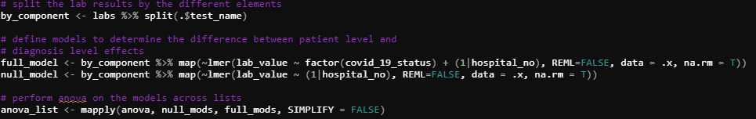
 | COVID-19 | COVID-19 | p
 | Positive | Negative
Alanine Transaminase (U/L) | 41.5 [29 – 74] | 31 [23 – 54] | 0.52
Albumin (g/L) | 32 [27 – 36] | 29 [25 – 34] | 0.02
AntiDNAase B (U/mL) | 310 [80.8 – 402] | 69.6 [69.6 – 508] | 0.58
AntiStreptolysin O (IU/mL) | 285 [134 – 384] | 64.4 [12.7 – 317] | 0.31
Aspartate Transaminase (U/L) | 70 [43 – 100] | 56 [34 – 76] | 0.34
C-Reactive Protein (mg/L) | 28 [10 – 74] | 22 [8 – 51] | 0.002
Creatine Kinase (U/L) | 63.5 [35 – 214] | 409 [96.5 – 895] | 0.09
Creatinine (µmol/L) | 23 [14 – 46] | 24 [15 – 52] | 0.31
D-Dimers (µg/L) | 1876 [1043 – 3618] | 1964 [582 – 4514] | 0.13
Ferritin (µg/L) | 788 [445 – 1863] | 397 [284 – 650] | 0.5
Fibrinogen (g/L) | 3.65 [2.4 – 4.8] | 2.4 [1.8 – 3.7] | <0.001
Interleukin-6 (pg/mL) | 50 [50 – 152] | 50 [50 – 50] | 0.4
Interleukin-10 (pg/mL) | 50 [50 – 50] | 50 [50 – 50] | 0.58
Lactate Dehydrogenase (U/L) | 848 [654 – 1136] | 923 [764 – 2106] | 0.002
Lymphocytes (x10*9/L) | 1.44 [0.64 – 2.49] | 1.71 [0.75 – 3.25] | 0.25
Neutrophils (x10*9/L) | 3.90 [1.46 – 8.60] | 3.34 [1.68 – 6.84] | 0.34
NT-pro-Brain Natriuretic Peptide (pg/mL) | 3550 [626 – 6992] | 9004 [6522 – 21736] | 0.06
Prothrombin time (seconds) | 12 [11.3 – 13] | 12.1 [11.4 – 13.5] | 0.2
Total bilirubin (µmol/L) | 6 [3 – 10] | 9 [4 – 21] | 0.053
Triglycerides (mmol/L) | 2.48 [1.65 – 3.56] | 1.85 [1.43 – 2.72] | 0.37
Troponin I (ng/L) | 54 [13 – 157] | 147 [50 – 310] | 0.11
Urine Total Protein (g/L) | 0.12 [0.12 – 0.62] | 0.13 [0.11 – 0.51] | 0.72
White Blood Cells (x10*9/L) | 8 [3.38 – 13.2] | 7.47 [3.15 – 11.8] | 0.73
Patients have variable parameters depending upon the nature of any underlying diseases, age and individual variations.
Linear mixed effects regression models with a random effect to account for within-patient measurements were fitted to analyse laboratory measurements. COVID-19 diagnosis was used as fixed effects. P-values were obtained by likelihood ratio tests of the null model with the random effect against the model with COVID-19 diagnosis.
Use the lme4 package
Lab
Social
Longitudinal
Genomic
Imaging
Clinical
Sensor
Time Series
Service KPI
Bring your data

Slide 7
How does Vitamin D fit with disease severity?
Use multivariable linear regression:
lm(Vitamin D ~ age + sex + severity score + inflammatory marker + ethnic group)

Slide 8

How does Vitamin D fit with disease severity?
We know that vitamin D level is associated with COVID-19.
We know that inflammation is associated with COVID-19.
We think there might be collider bias…..
Indirect vs direct effects using mediation analysis with the mediation package

Slide 9

How does Vitamin D fit with disease severity?
Compare:
1) Vitamin D ~ COVID-19
2) COVID-19 ~ Vitamin D
3) Inflammation ~ Vitamin D + COVID-19
Mediate between 2 and 3 with:
Treatment: COVID-19
Mediator: Vitamin D
No evidence that Vitamin D mediates a higher inflammatory response in COVID-19 patients

Slide 10
Summary and Future Work
Using R we:
used rstatix for pipe friendly statistical comparisons
used multivariable linear regression analysis of vitamin D levels
used lme4 for linear mixed effects models to compare repeated laboratory measures
used meditation for direct and indirect effects of vitamin D levels on inflammation
created Raincloud plots for informative visualisations with
Cowplot
PupillometryR
plotrix
ggsignif
ggpubr
Where next?
Concentrate on the newly identified Paediatric Inflammatory Syndrome PIMS-TS!

Slide 11
How do we become a “Research Hospital”?
Bring the expertise, people and ideas to work with data and digital technologies.
DRE visits to every specialty to assess their data needs; what can the DRE do to make research, easier, quicker and more secure than ever before.
“
POWERED BY ANALYTIXAGILITY

