Slide 1
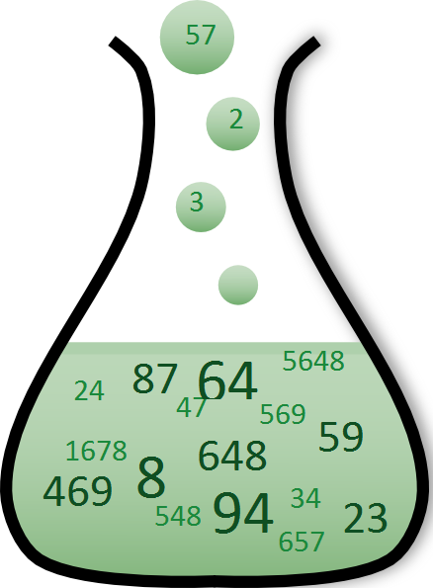
Simply Impactful
A celebration of simple tools and tech to deliver user needs
Martine Wauben, Lead Data Scientist
NHS-R Conference 2020

Slide 2

Who am I?
DHSC Data Science Hub
Take on data science projects for policy development (visualisation, machine learning, text analysis, etc.)
Build communities across Health & Social Care system's data science teams
Data Science profession: Learning & Development opportunities for analysts
@MHWauben

Slide 3
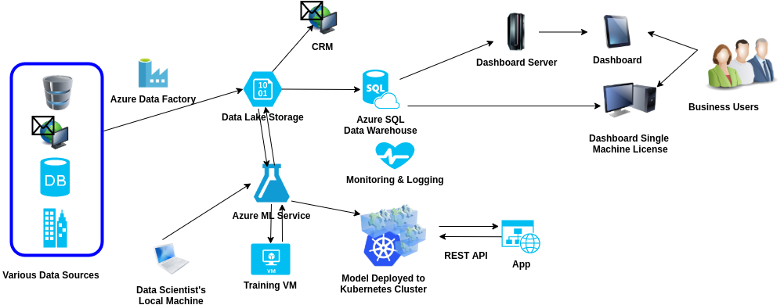
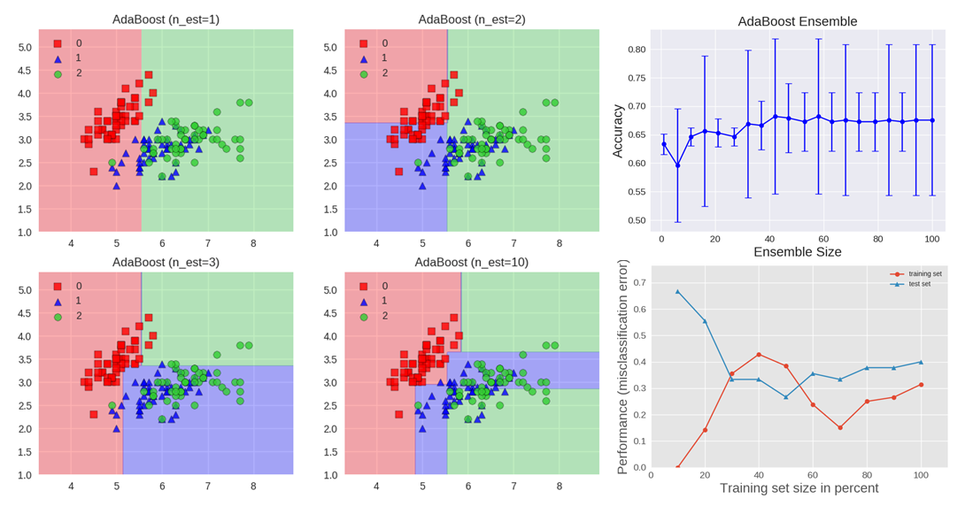
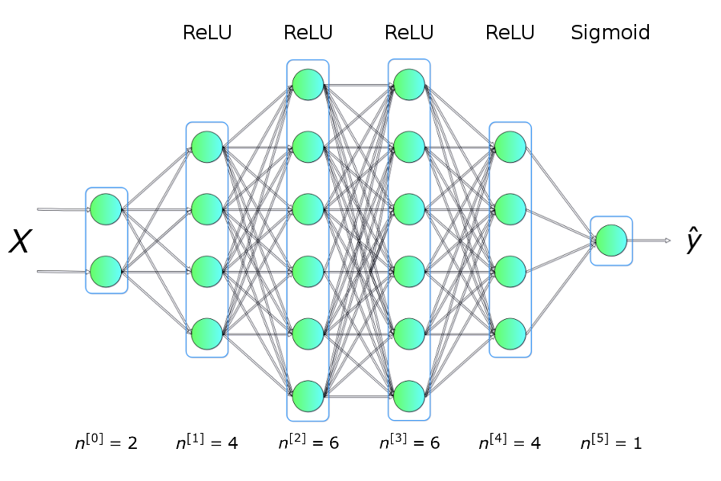
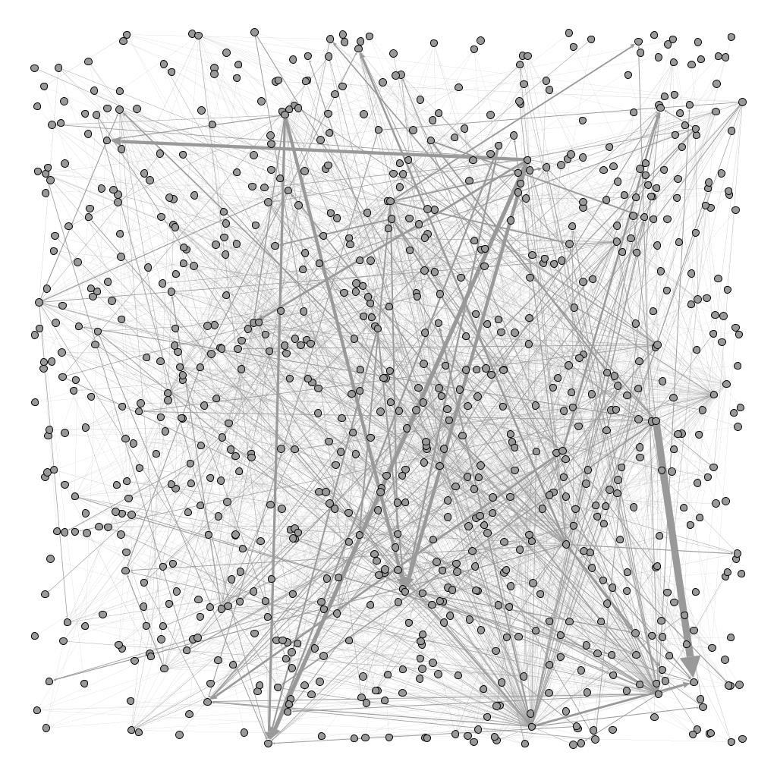
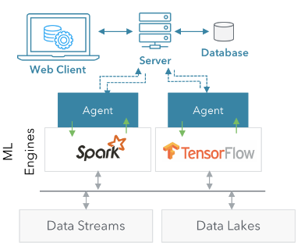
"Data Science".. What you imagine
Notes:
When people say data science, it conjures visions of complex mathematical models, unintelligible jargon, black box predictions, and reams and reams of code.

Slide 4
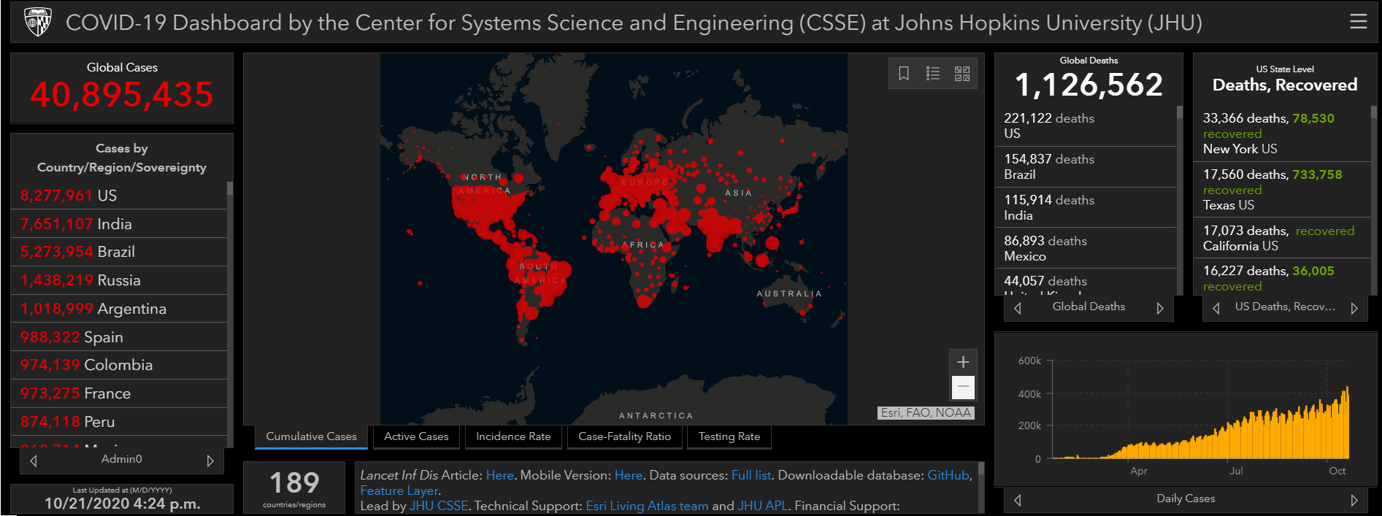
"Analysis"… What the customer wants
Clear, clean, and correct visuals / numbers that communicate insights
Getting them fast
THAT is our Minimum Viable Product!
Notes:
However, data scientists are fundamentally analysts. And analysis help your "customer" make decisions: in my case, policy decisions; in yours, clinical or operational ones. And what non-analytical customers usually need to make decisions, is fundamentally this.
Delivering these two simple things is absolutely necessary if we want to deliver something useful.
I argue that most of the time, fancy, whizzy AI does not deliver these things, and actually a simple tool or visualisation does this job much better. There is a reason the Johns Hopkins University COVID dashboard was visited so much in the early days of the pandemic!

Slide 5






Delivering that MVP
Fast
Fast and Reliably
For ad-hoc, one-off analysis requests, it makes sense to use familiar and near-universal tools.
Excel, PowerBI, Tableau, etc.
However, famously has limits in our high-volume, high-velocity data times...
If an analysis will have to be repeated or delivered on very short timelines, automate and version control
SQL, R & RShiny
Consider this a simplification: less time on manual steps and QA
Notes:
There are two ways to deliver those needs.
You can focus on going fast. For ad-hoc, one-off requests, it might be the right choice to just focus on getting it done quickly. Lots of commonplace tools specialise in this. However, as we painfully found out recently, tools like Excel have limits. They are also quite painful to quality assure, which means you get mistakes, compromising on the "correct" part of the ask.
If you want to go fast and be reliable, you need a different toolkit. I believe automation and version control are actually simplification steps. It means you don't have to re-do loads of manual work and QA every single time you have to re-do your work, and you don't have to flail around looking for the right final_final_final_v3 file.

Slide 6
Example: March 2020
Hundreds of questions:
How do case and death numbers and rates in different countries compare?
Can we adjust for each country's "phase" of the pandemic, since the virus was introduced to different countries at different times?
How do government interventions affect these curves?
Etc. Etc.
How to simplify into one MVP?
Notes:
To illustrate this point, I'd like to take you back to the context in March this year.
Everybody had hundreds of questions, many of which around what we could learn from the international picture. What could I deliver that would simplify some of this uncertainty, and provided a good chunk of international context that we commonly needed?

Slide 7
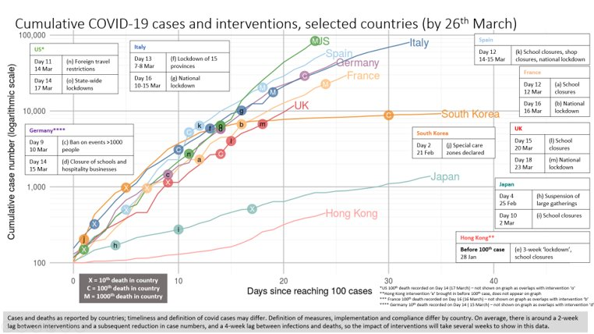
Minimum Viable Product
A visualisation of cases, deaths, and interventions;
That allows domain experts to gain insights quickly;
And is flexible enough to respond to last-minute request changes;
Every single day
Notes:
I distilled all these questions into a single MVP, with 4 features that I could deliver using R.
We drew data from the Johns Hopkins University, and created our own list of government interventions. We set up a pipeline that took that data, cleaned it, and produced the graphs we needed. We could then quality assure the pipeline. As a result, my colleagues could re-run that script every day and in 30 seconds get their plots out.
To account for the wide variety of last-minute requests, we created parameters for this pipeline: things like which countries to include, what start point to use, and which types of interventions to display. My colleagues only had to know how to change the paramters, and could use the pipeline without knowing much R at all.

Slide 8


Automated workflow: toolkit
Read JHU and intervention data
readr
readxl
Prepare data
dplyr
tidyr
Functions
Draw visualisation
ggplot2
ggrepel
Add interactivity
shiny
Publish
Github
shinyapps.io
Notes:
This sounds complicated, but this is an exhaustive list of the R libraries I needed. Most, if not all, of these will be familiar to even beginner R users.
This project was a great example of the value of simple functions. For example, we had to do some cleaning of the country names to display how we needed them to. However, we had two JHU spreadsheets: one for cases, and one for deaths. But making the country cleaning step a function, we could QA it once, and then apply it to both spreadsheets to ensure we got consistent results out.
Once we had those parameters, the next logical step was to improve user-friendliness and service use. Shiny lets you turn input parameters into actual drop-down menus and tickboxes. Publishing code on Github, and publishing the tool on shinyapps.io, meant that all documentation was neatly kept together and the tool could be accessed from any browser. This means that, even if I'm on holiday, anybody else can pick it up and use it!

Slide 9
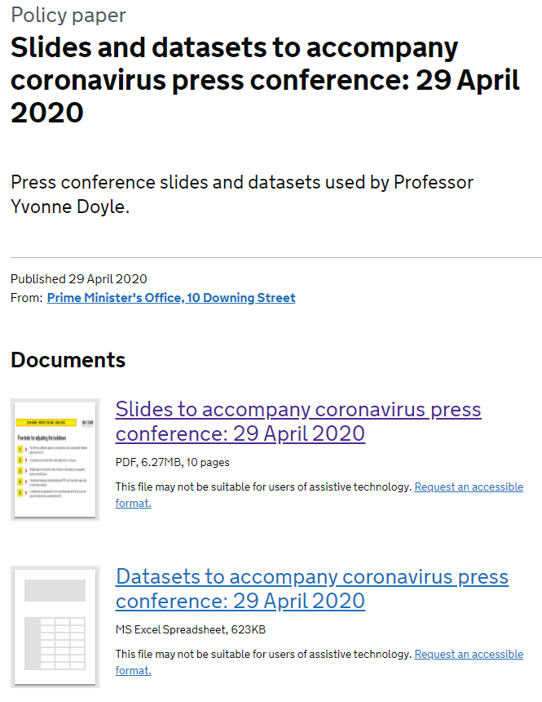
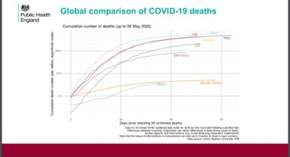
Available to you
Tool: https://dhsc-datascience.shinyapps.io/international-cases-deaths/
Code: https://github.com/DataS-DHSC/international-cases-deaths
Notes:
The fruit of this work is publicly available! You're very welcome to try it out for yourself. Moreover, all the code is available, so you can check for yourself that I didn't need reams of code nor loads of fancy packages to build it.

Slide 10
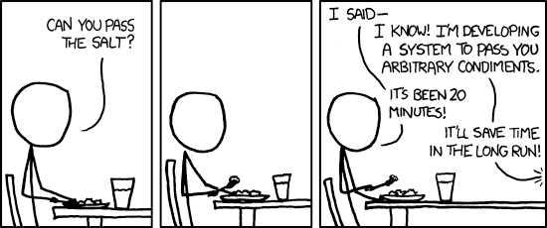
Simple tools
NOT
BUT
Whizzy
Cutting-edge
Mathematically complex
Addresses user need
Provides continuous service
Facilitates insight
and has impact
Notes:
So, why a simple tool? Why not add hundreds of fancy features and forecasts?
This project wasn't whizzy or fancy or even very "data science". But it was necessary, reliable, and useful. Simple tools, precisely targeted to a problem, have real impact. And that's what data science teams should strive to do.

Slide 11

Questions?
Contact me: @MHWauben
https://github.com/DataS-DHSC
Notes:
If anybody has questions, I'm very keen to hear from you!
Also, we have a Github page if you'd like to have a look at what else we have published.

