Slide 1
Hosting RShiny Server On Ubuntu Behind NGINX
Lee Coulson – Senior Analyst, NHS Devon CCG

Slide 2
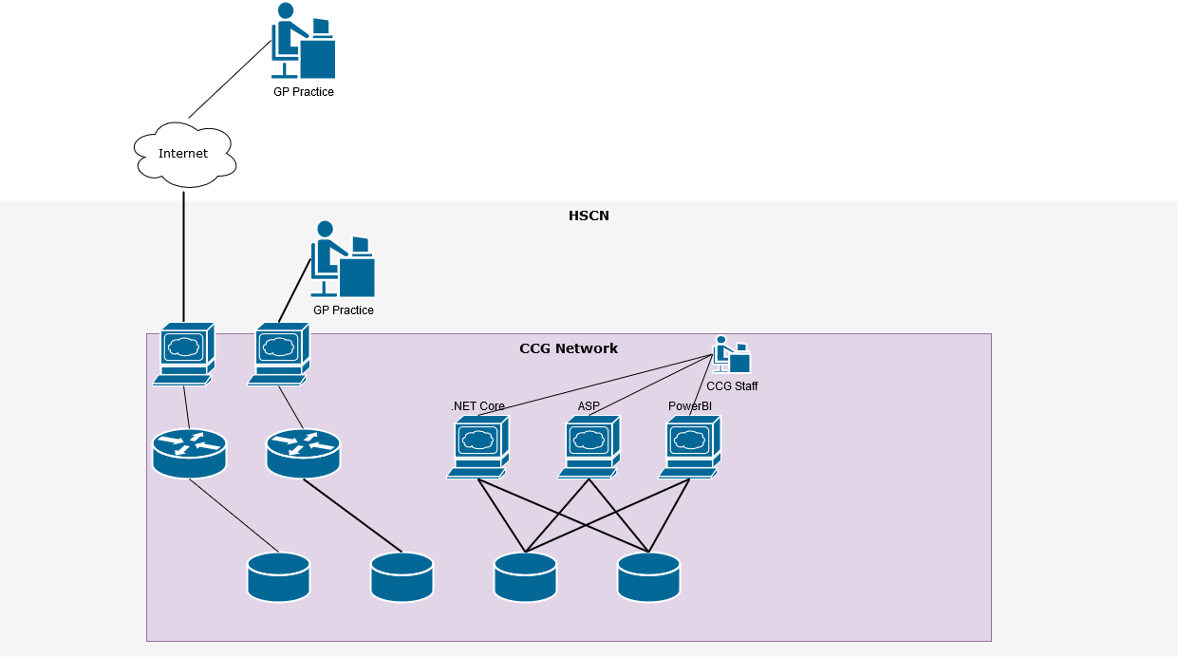
Overview Of Network Topology

Slide 3
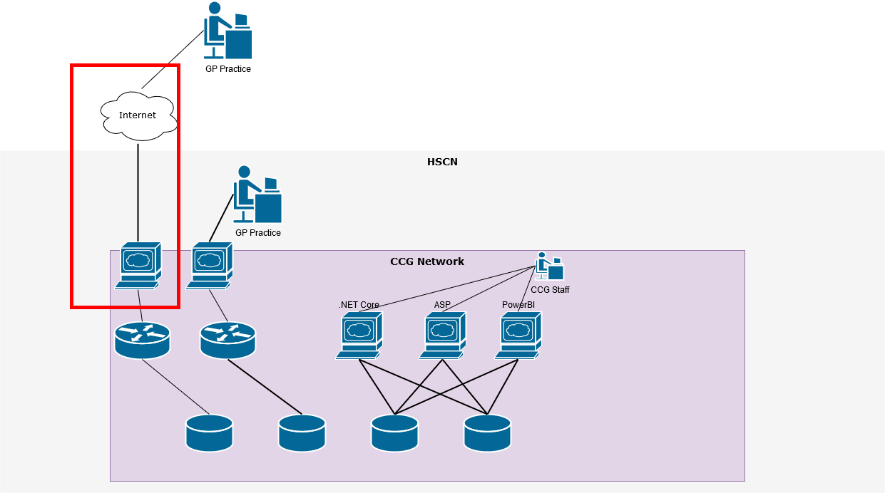
Overview Of Network Topology

Slide 4
Pre-requisites For Hosting Own Shiny Server
Friendly IT team
Clear separation of roles and responsibilities
Hosting Server
Knowledge of Linux
Appropriate permissions (eg Sudo / root)
Relevant user guides
If hosting publicly:
Knowledge of NGINX / other webserver
Certificate Management for https (LetsEncrypt)
Permissions to add subdomain(s) in NHS DNS
Penetration testing
Notes:
Friendly IT team – set up server, install OS, wire up access to database server, other servers
Clear separation of roles and responsibilities – who does what, in Devon I administer Ubuntu server, install updates new software etc. IT do networking and routing and firewall and security
Hosting Server – We use Ubuntu, although ShinyServer available in lots of Linux flavours. Will need Docker or some other virtual machine if hosting on windows. Will need to map ports so it’s not sandboxed.
Knowledge of Linux – Be able to open and edit files and directories. Setup and edit permissions. Create and edit services.
Appropriate permissions (eg Sudo / root) Installing any pre-requisite applications for R packages.
Relevant user guides
Knowledge of NGINX / other webserver
Certificate Management for https (LetsEncrypt)
Permissions to add subdomain(s) in NHS DNS
Penetration testing

Slide 5
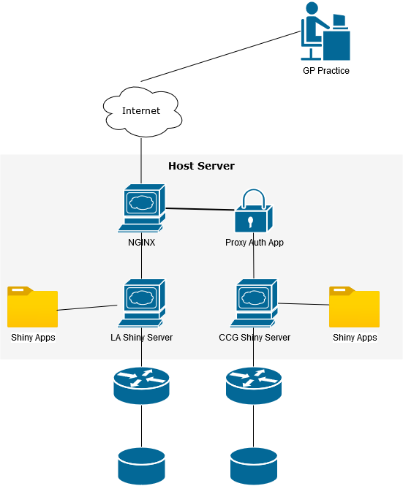
Server Concept Diagram
Notes:
Request comes in to NGINX
https – Re-direct to https, letsencrypt for certificates. Performs https termination. Caching etc. Routing based on URL
Rshiny doesn’t provide SSL in free version, nor authentication and authorisation
We therefore use local
We are running 2 Shiny servers in one, listening on different ports. Separate directory structures

Slide 6
Shiny-Server Setup
Install database drivers if needed
Install NGINX / webserver
Configure NGINX
Install base R
Install Shiny package in base R
Install Shiny Server
Configure Shiny Server
Install and configure auth proxy if necessary
Wire them all up!
Notes:
If hosting on intranet you might not want / need webserver.
Can do NGINX / Shiny in any order
Shiny server takes roughly 30 mins to get up and running

Slide 7
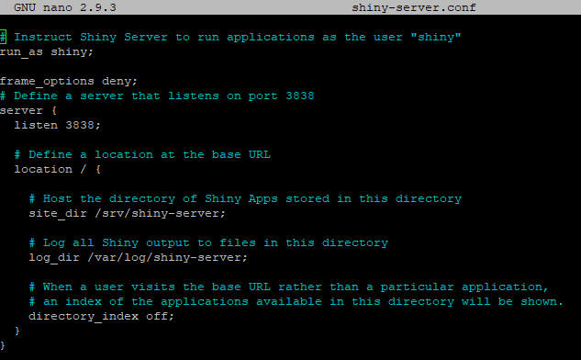
Default Configuration
/etc/shiny-server/shiny-server.conf
Notes:
Config file follows the same format as NGINX
Server block, listen on what port, add constraints for host server
Location block redirects etc.
Site directory and log directory – shiny user has access in default config, if you move need to assign permissions
Add additional server blocks

Slide 8
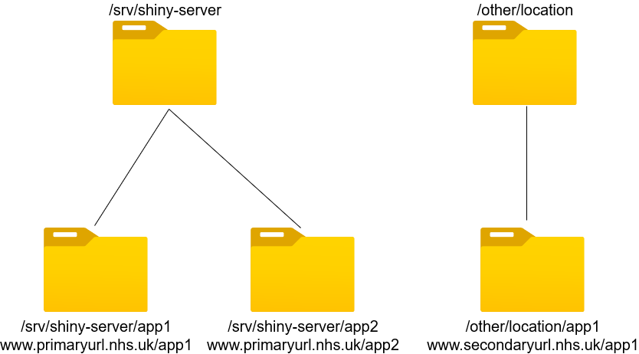
Hosting Multiple Apps
Notes:
Simply drop apps into directories and they can be browsed automatically via URL on the path (Case sensitive?)
To update apps simply overwrite existing files – no need to restart shiny server process.
Sites available vs /srv/shiny-server
If you have initialisation code in your app (ie. non reactive) not in your UI or Server block add restart.txt file in folder. Then just resave that file for full restart
Must have R packages installed on Server that are used by apps. Install into root R library so accessible to all users
Quick demo of example sites if time

Slide 9
Further work
Penetration testing!
Add more functionality to internal proxy – SSO
Run different apps in different Linux containers

Slide 10
References
https://rstudio.com/products/shiny/shiny-server/
https://docs.rstudio.com/shiny-server/
https://www.nginx.com/
https://support.rstudio.com/hc/en-us/articles/213733868-Running-Shiny-Server-with-a-Proxy
https://letsencrypt.org/

Slide 11
Thank you for listening Any questions?

