Slide 1
Planning for recovery from COVID-19 in Wales Rapid development of a multifaceted profile on health and wellbeing
Beth Patterson & Rhys Powell
10th November 2020

Slide 2
Background

Slide 3
Planning for recovery: a joined up Public Health Wales response
Systemised Intelligence to inform policy and other public health decision-making on COVID-19
Identify wider health and wellbeing impacts
Identify options for minimising harm to public health
Understand public acceptance and compliance of COVID-19 measures
Monitor trends in health and wellbeing (indirect)
Objectives
Health, wellbeing and wider determinants
COVID-19 Health impact assessment
National Public Engagement survey
International Horizon Scanning
Profile of broader health trends
Profile of broader health trends
Tools
COVID-19 Recovery profile in Wales
Notes:
With planning for recovery from COVID-19 in Wales, PHW set in place a model for a joined-up response with a number of objectives around identifying and minimising impacts on health; compliance to lockdown restrictions – and monitoring health and wellbeing trends (indirect impacts of COVID-19).
There were various tools identified to meet these objectives – including an impact assessment; public engagement survey.
Our team was tasked with producing a profile of health and wellbeing trends (mostly indirect impacts of COVID-19).

Slide 4
The Recovery profile brief
Trends on health and wellbeing as a result of COVID-19
Easily accessible
Rapid development
Conducive to expansion and update
Bring data together in one easily accessible place
Cater to multiple audiences
Provide meaningful insights
COVID-19 Recovery profile in Wales
Notes:
The tool needed to provide a way to:
-Be easily accessible and include publicly available trends on health and wellbeing
-Be rapidly developed in an unfolding pandemic scenario
-Conducive to expansion and update – quickly adding/refreshing content
-Bringing many data sources into one place (in place of needing to visit multiple tools)
-Cater to local users (find their local data) and executives who may need a summary of high-level messaging
-Provide added public health value –highlighting important patterns and detailing important caveats (help the user to interpret the data effectively)

Slide 5
Scope of health indicators to be included
Deaths
Other harms
Interruptions in health services
Wellbeing
Wider determinants of health
COVID-19 Recovery profile in Wales
Notes:
The scope of the tool is quite broad…
-includes deaths (COVID-19, other causes, excess deaths)
-other harms – service use, A&E attendances, hospital admissions and GP attendances
-Interruptions to health services – pausing of some screening services, immunisations
-wellbeing – behaviours, mental wellbeing
-wider determinants of health (ONS data on the economy and employment).

Slide 6
Live demo
Notes:
https://publichealthwales.shinyapps.io/COVID19_Recovery_Profile_PHWO/

Slide 7
Project approach

Slide 8
Recovery profile approach
Is the data updated regularly?
Is time series data available?
Product brief
Identify sources of data in domains
Assess whether suitable for inclusion
Is it coherent with other products?
Internal sources
Direct access to SQL DB
Data analysis
Data access & manipulation
External
sources
‘Read in’ to R
Data manipulation / cleaning
Pattern insights
Data visualisation
COVID-19 Recovery profile in Wales
Notes:
Indicator production:
consider the indicators and whether they were suitable
Relevant, updated, time series?
Consider where data comes from, SQL server database or external
Analyse the data, output it and visualise, interpret data to add meaning

Slide 9
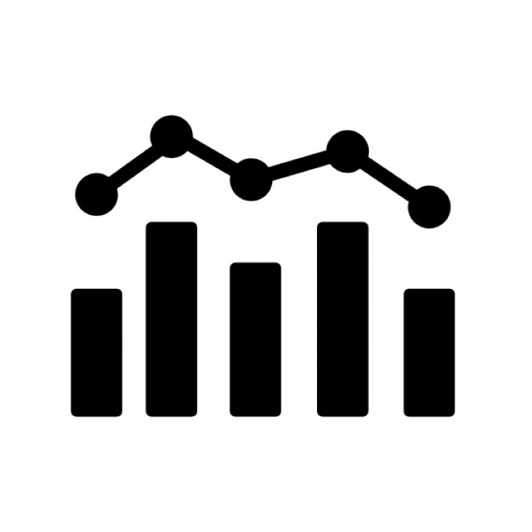
Modular build of RMarkdown
Indicator 1
Indicator 2
Analysis R script per indicator/data source
Analysis R script per indicator/data source
Data .rds file
Data .rds file
MASTER RMD – calls in individual chart RMDs
RMD including shiny inputs and outputs
RMD including shiny inputs and outputs
Notes:
Took a modular approach in order to allow rapid development of multiple indicators
Indicators were built in isolation – allows multiple analysts to work on multiple indicators – helped with rapid expansion version control
Each indicator consists of three parts: 1 data script, 1 data file .rds and 1 chart rmd script
unique naming system for files, R objects and functions e.g. mort1, to ensure there is no clashing names that could cause R to fall over (excess deaths was mort5)
Master script that pulls each chart and any supporting documents in to create the final profile (very short script)

Slide 10
Example build:
Indicator 5
Excess deaths in Wales

Slide 11
Commonly used packages
Dplyr
odbc
aweek
ggplot2
plotly
shiny/shinydashboard
shinyWidgets
Data manipulation
SQL connection
Working with weeks / dates
Chart creation
Transform charts to interactive
To create interactive elements
For technical guide toggle
COVID-19 Recovery profile in Wales
Notes:
This is a list of some of the more commonly used packages in the profile, and what they were used for

Slide 12

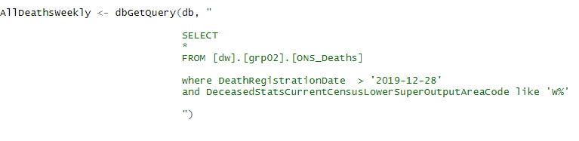

Data analysis stage - R script
Example build: indicator 5 - excess deaths in Wales
1. Load packages
2. Read data from SQL server
3. Manipulate data using dplyr & base R
Notes:
First load in any required packages
Read in the data suing the appropriate function (odbc and dbGetQuery for SQL/read_excel and read.csv for local and on online spreadsheets)
Once you have the data, manipulate it using packages such as dplyr and base R. Some example uses include:
Dplyr – Filter/subset to cut data down, mutate to classify, summarise for counts and calcs.
It is also possible to build functions/packages for more complex things such as EASR, which we have done for use in other indicators.

Slide 13
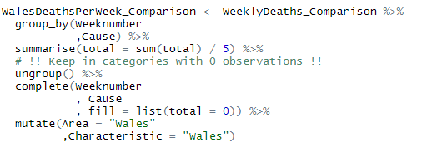
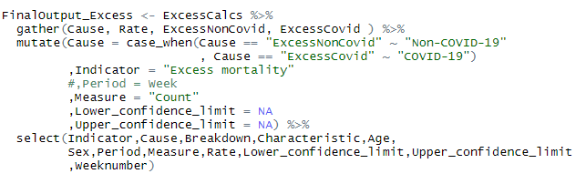
Data analysis stage - R script
Example build: indicator 5 - excess deaths in Wales
4. Perform calculations / statistical analysis
5. Format output data with agreed columns
6. Export data as .rds file
Notes:
Once the basic data is ready, perform any calculations or statistical analysis as required
Once we have the data needed for output, format it into a more usable format. This gives the exported data a clearer structure and made it more presentable for use in the download data feature in the online tool
Export the data as a .rds file to the folder the data script is in

Slide 14
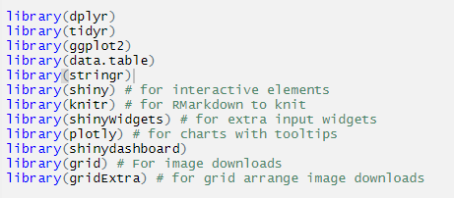
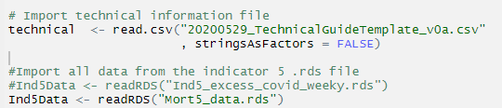
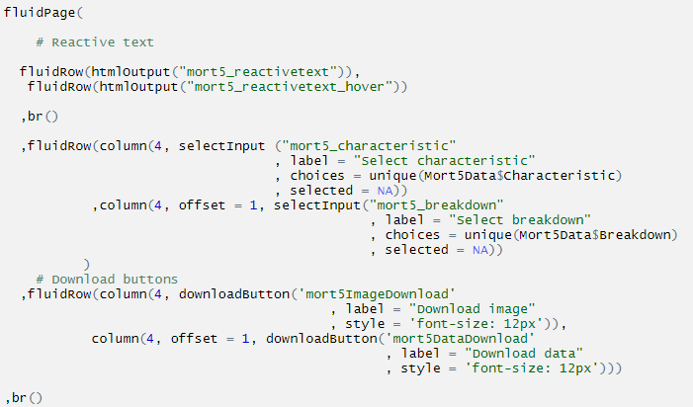
Visualisation stage – chart RMD script
Example build: indicator 5 - excess deaths in Wales
1. Load packages
2. Read in data .rds and any other files needed
}
Text elements
}
Choose area type e.g. local authority or health board
3. Create layout & interactive elements
}
Choose area from that group e.g. Cardiff
}
Download buttons for image
}
Download buttons for data file
Notes:
Load any required packages
Read in the .rds file created by the data script and any other files needed
Create the layout and any interactive elements such as drop down selections. This is just giving the overall structure, designing how the output will look.

Slide 15
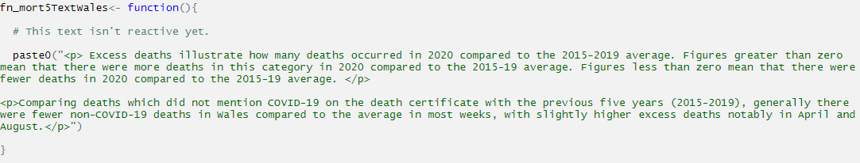
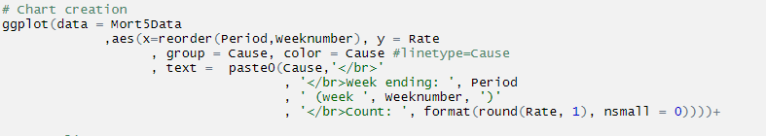
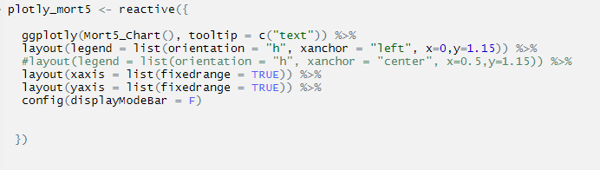
Visualisation stage – chart RMD script
Example build: indicator 5 - excess deaths in Wales
All elements were created as FUNCTIONS
4. Create blocks of text
5. Create chart with ggplot
6. Convert chart to interactive using plotly
Notes:
With a structure in place, it needs to be populated with content. We first create the text.
Next we create the chart using ggplot
Then if it is a line chart, convert it to plotly to add interactivity such as tooltips.
All these were created as functions so the word document can call them. If you are just having an online tool this would not be necessary.

Slide 16
Master RMD script build
Notes:
All the work prior to this, culminates in being called to populate this script. This is key to a modular approach and was a goal for our team to learn how to do correctly to make profile creation easier and more manageable.

Slide 17
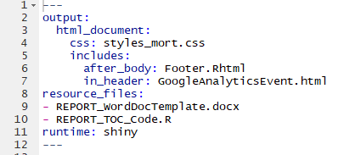

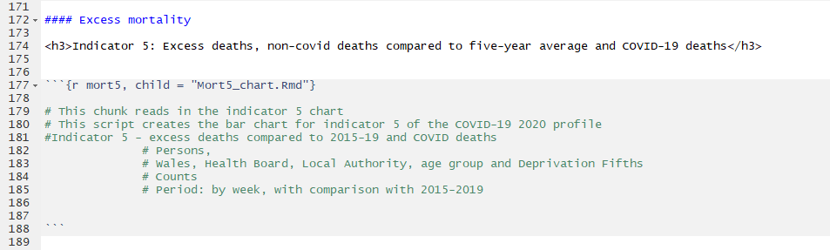
Call in chart as a child script
Master script
Styling using css
Set up of master script
Shiny for interactivity
Creates tabs
Call in excess mortality chart RMD as ‘child’ script
Notes:
First setup the master scripts YAML as you would with any other R output.
The tabset allow us to have a tabbed format.
Each indicator has it’s own chunk which calls in the chart .rmd using the child command. This tells the script to run that chart rmd and populate the results here.
This is the process that allows us to work easily on multiple indicators at once, and keep overall script size more manageable

Slide 18
Creating the Word report

Slide 19
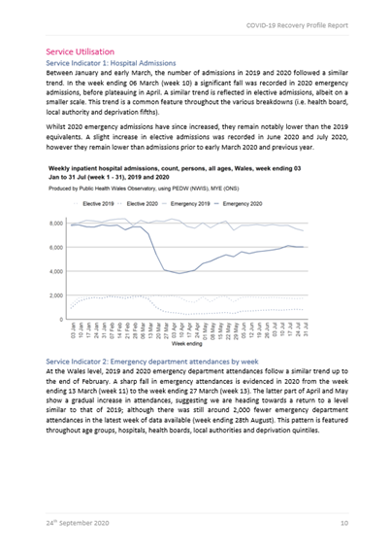
Call in chart as a child script
Word report set-up
Word doc template (.docx)
For styling
Individual charts
(via functions)
R code to create ‘table of contents’
Word doc RMD
Master RMD script
Notes:
The word document works in a similar way to the profile, calling in individual elements to create a whole
The charts etc. are called from their respective chart rmds via functions
A Word document template is used to define styling (headers, font etc.)
And a separate R code is used to create the table of contents
These are all pulled into the word document Rmd
This is then referenced in the Master script, and the script runs when a user presses the download button

Slide 20
What did we learn?

Slide 21
Improvements to ways of working
Direct connections to data sources
Effective functional programming e.g. use of R objects for easier updates
Standardising outputs
Formalising checks on incoming data items
Proactive problem sharing using Slack and Trello
Modularisation
COVID-19 Recovery profile in Wales
Notes:
Where possible, connect directly to data source
Made greater use of functional programming, such as using R object for data that could change each time such as date cut-offs
Standardised outputs and naming so they can be easily adapted
Build in checks that will flag issues with underlying data
Be more proactive in sharing problems and solutions, greater use of live communication such as Slack and Trello.
Clear instructions/commenting throughout, easy to pick up/swap

Slide 22
Reflections on this approach
Reactive and timely release of data
Multifaceted
Data refresh largely automated
Time-saving downloadable Word report
Focus on important insights and highlighting key messages
COVID-19 Recovery profile in Wales
Notes:
We are able to be more reactive to user demand and release data faster than ever
We have been able to incorporate different facets of life that all have an influence on public health to provide a more complete picture
The capacity required for data refresh has been greatly reduced
Spend more time on development as a result
Able to generate a word report automatically, no more copy and paste
As we can include narrative, not just charts, able to shine a light on important insights and highlight key messages

Slide 23
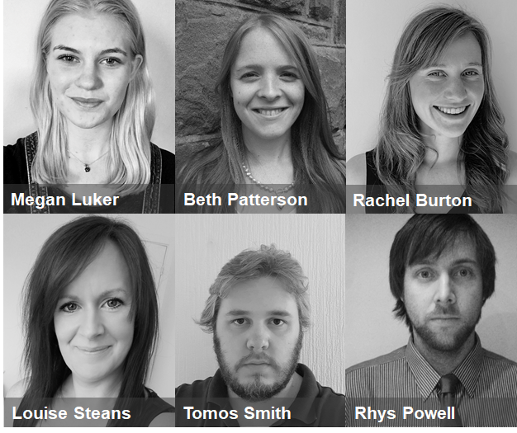

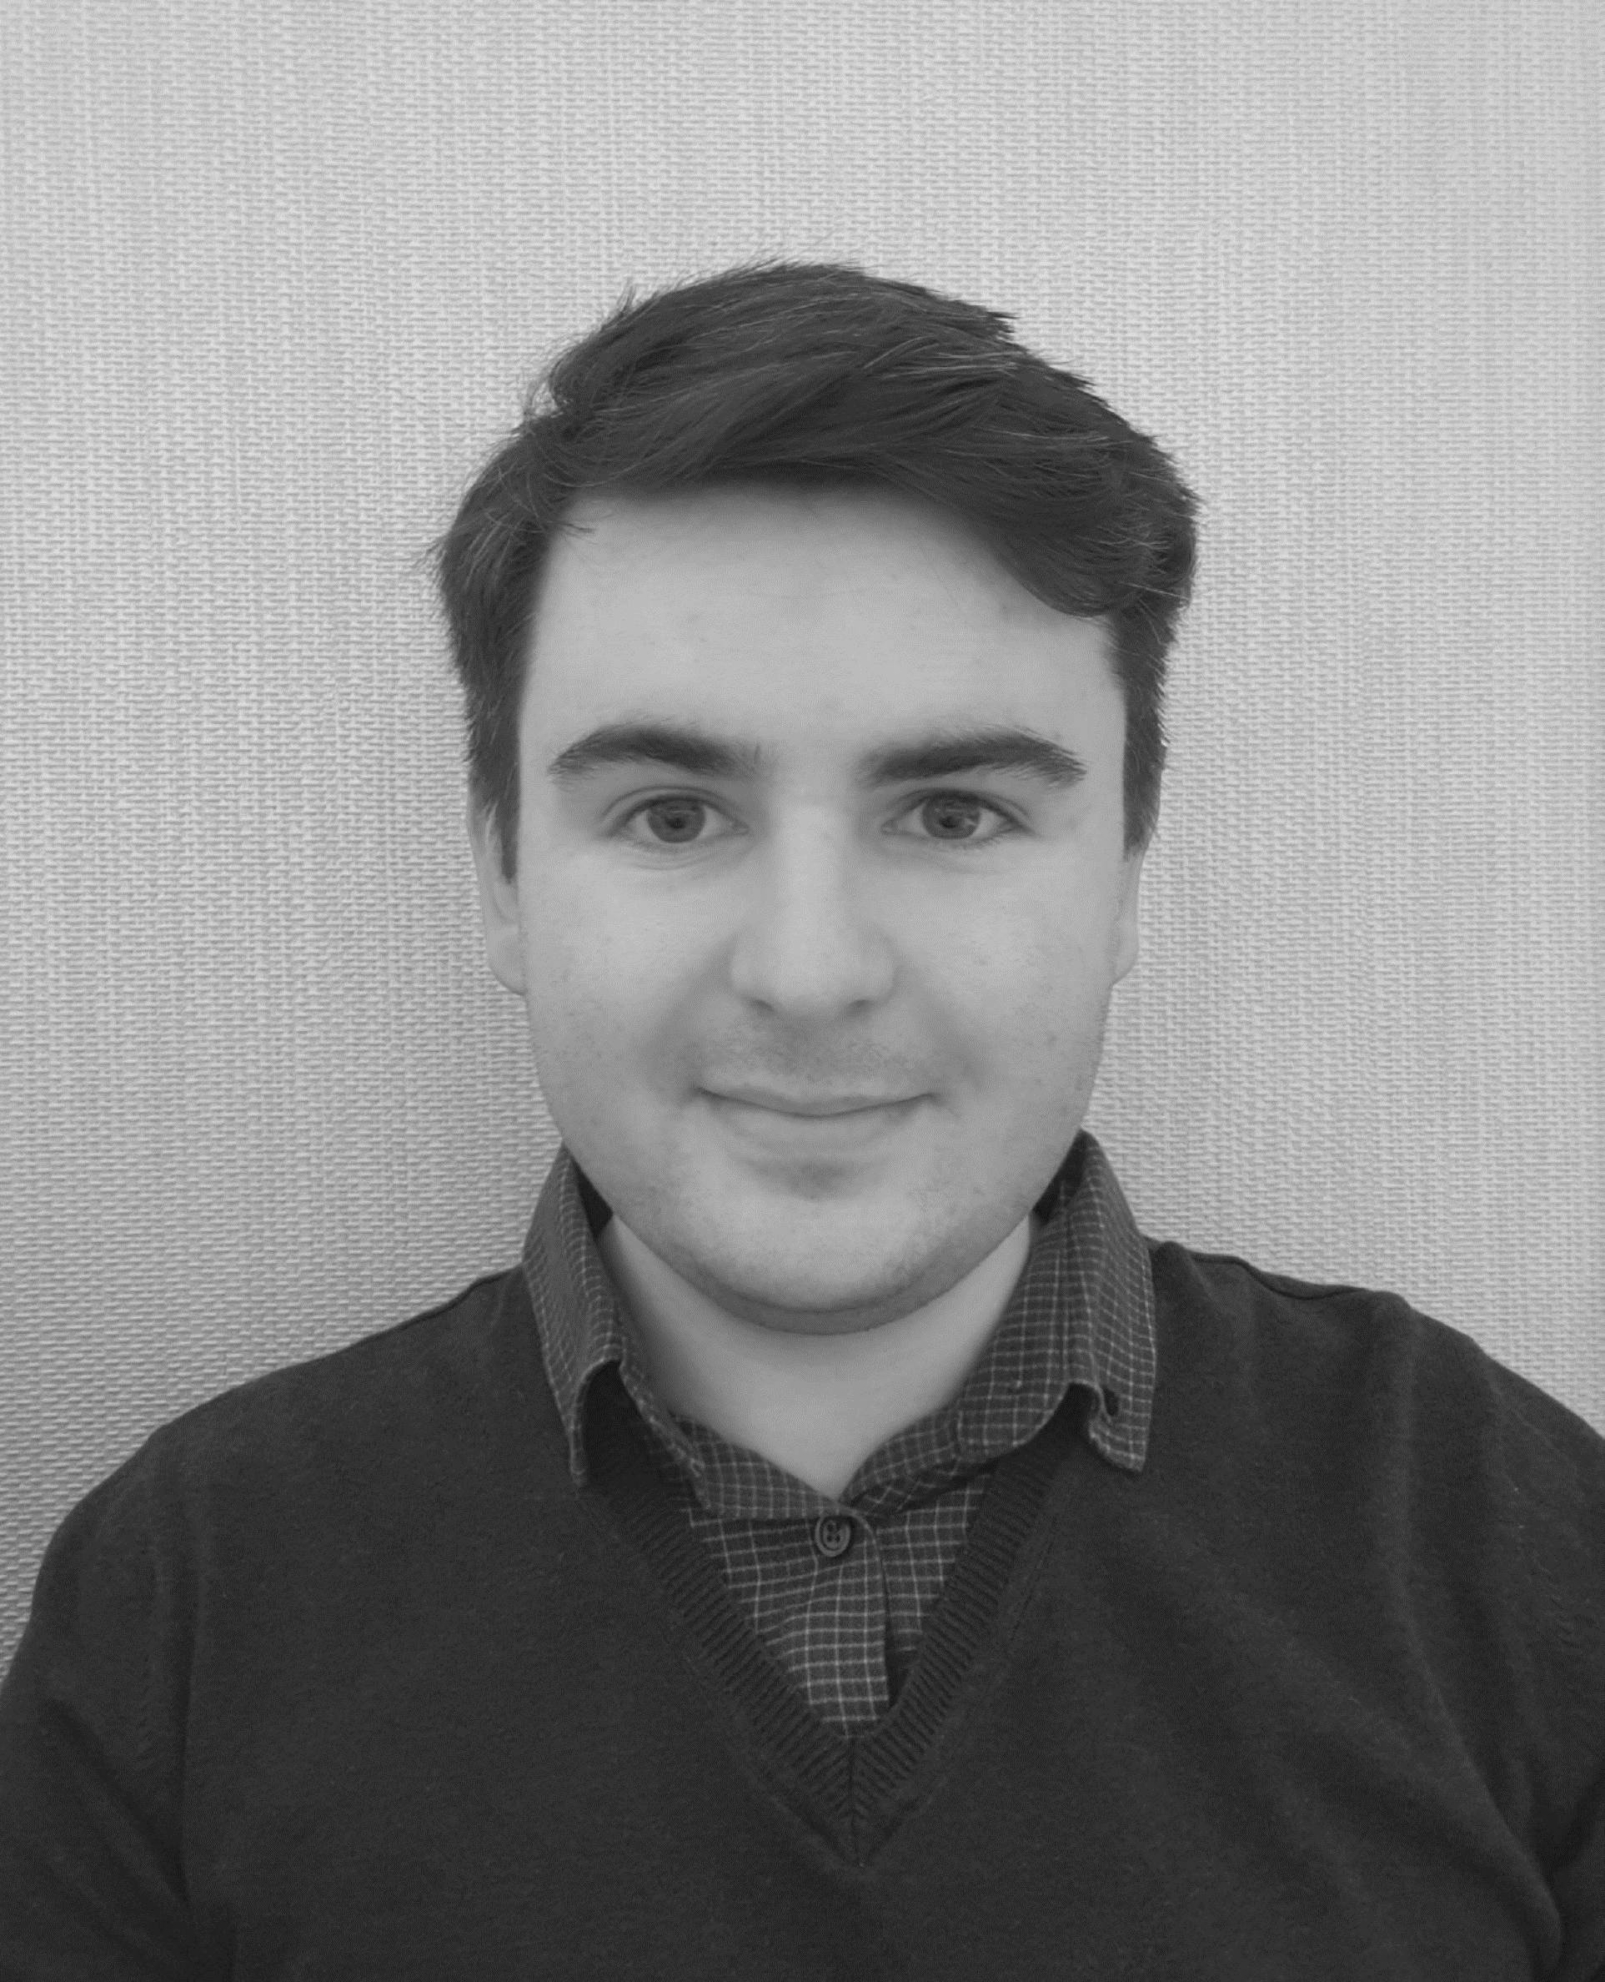
The project team
Cari Evans
Matthew Jones
& Victoria Middleton
https://publichealthwales.shinyapps.io/COVID19_Recovery_Profile_PHWO/
Contact us: publichealthwalesobservatory@wales.nhs.uk
Notes:
Link to profile: https://publichealthwales.shinyapps.io/COVID19_Recovery_Profile_PHWO/
Contact us: publichealthwalesobservatory@wales.nhs.uk
Thank you!

