Slide 1

phsmethods: an R package for Public Health Scotland
Ciara Gribben
Senior Information Analyst
9th November 2020

Slide 2




Introduction
Public Health Scotland (PHS) formed on 1st April 2020.
It combined NHS Health Scotland, the Information Services Division (ISD) and Health Protection Scotland (HPS).
The Transforming Publishing Programme (TPP) aims to modernise the way in which PHS produces and presents statistics.

Slide 3


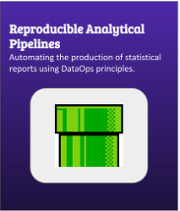
Introduction
Over the last few years, ISD has embraced open source software (mainly R).
TPP have been at the forefront of much of this:
creating style guides,
introducing version control;
working with analysts to convert PDF reports into Shiny applications;
introducing Reproducible Analytical Pipelines
producing R packages.
Recently TPP has widened our aim: not only to further the use of R, but to ensure it’s adopted in a consistent manner across PHS.

Slide 4
Why create phsmethods?
Analysts working across PHS have to perform a range of repetitive tasks to produce their statistics.
These tasks can’t always be done by existing R packages.
Examples
Assigning dates to financial years in YYYY/YY format | ‘21012017’ to ‘2016/17’
Formatting improperly recorded postcodes | ‘g207al’ to ‘G20 7AL’
Returning quarters in plain English | ‘26032020’ to ‘Jan to Mar 2020’

Slide 5

Why create phsmethods?
Every analyst has their own way of completing these tasks.
This wastes time and effort and is frustrating for analysts with coding skills.
More importantly it also causes a lack of consistency across teams - how can we be sure that every method actually does the same thing?
?
=
Output
Data
Code
Output
Data
Code

Slide 6


What is phsmethods?
An internal R package for Public Health Scotland
It contains a selection of functions to make routine data manipulation easier.
None deal with any statistical methodology and were deliberately chosen to be non controversial.
phsmethods

Slide 7
The Functions
Function Name | Description
age_group() | Categorises ages into groups
chi_check() | Assesses the validity of a CHI number
chi_pad() | Adds a leading zero to nine-digit CHI numbers
file_size() | Returns the names and sizes of files in a directory
fin_year() | Assigns a date to a financial year in the format YYYY/YY
match_area() | Converts geography codes into area names
postcode() | Formats improperly recorded postcodes
qtr(), qtr_end(), qtr_next(), qtr_prev() | Assigns a date to a quarter in various formats

Slide 8
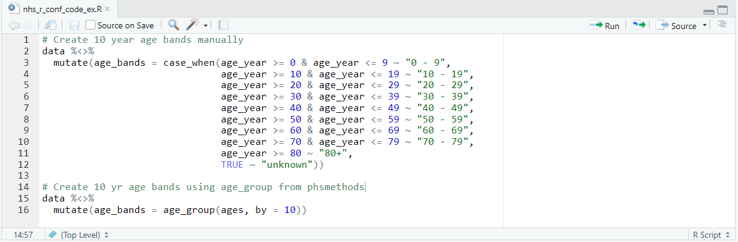
Example: age_group()

Slide 9
Process of creating initial functions
The original functions were created by members of TPP.
We wrote one function each and then peer reviewed each others functions before the first release.
Two members of TPP volunteered to maintain the package and we sought another maintainer from outwith TPP.

Slide 10
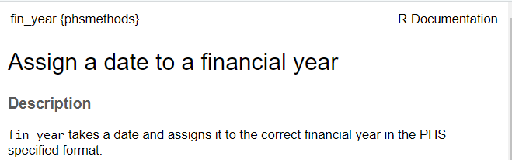



Features of phsmethods
While phsmethods is not on CRAN, we included many of the features expected from a CRAN package:
function documentation;
unit tests;
continuous integration;
code coverage;
releases.

Slide 11
Contributing to phsmethods
There are guidelines for contributing to phsmethods.
Proposed contributions should be submitted as GitHub issues for the maintainers to consider.
If approved, the contributor makes a branch and submits a pull request.
This process should stop time and energy being spent on something which can’t be accepted, and prevent duplication of effort if multiple people have the same idea.

Slide 12
Benefits of phsmethods
Contributing functions is rewarding for analysts with existing skills.
For analysts with lower levels of knowledge it’s a good chance to build their R skills as it’s not expected that they have experience of package development or of version control, only that they know how to write an R function. The maintainers are there to help them learn the rest.
The functions are easy to incorporate into an Rmarkdown document making producing publications easier.
As the package is used more widely the result will be wider adoption of R and consistent coding standards throughout PHS.

Slide 13
Current State
11 contributors
349 commits
3 releases
109 views (in last 2 weeks)
6 open issues

Slide 14
What next?
5 functions in development
Plans to build in ggplot functions to help analysts produce chart that are consistent and fit into the PHS look and feel.

Slide 15

Thanks
phsmethods package– https://github.com/Public-Health-Scotland/phsmethods
Ciara Gribben, Senior Information Analyst – ciara.gribben@phs.scot

