Slide 1
R Shiny in Transformation

Slide 2

A team journey
NHS Transformation Unit is an internal, wholly NHS owned consultancy in the North-West

Slide 3
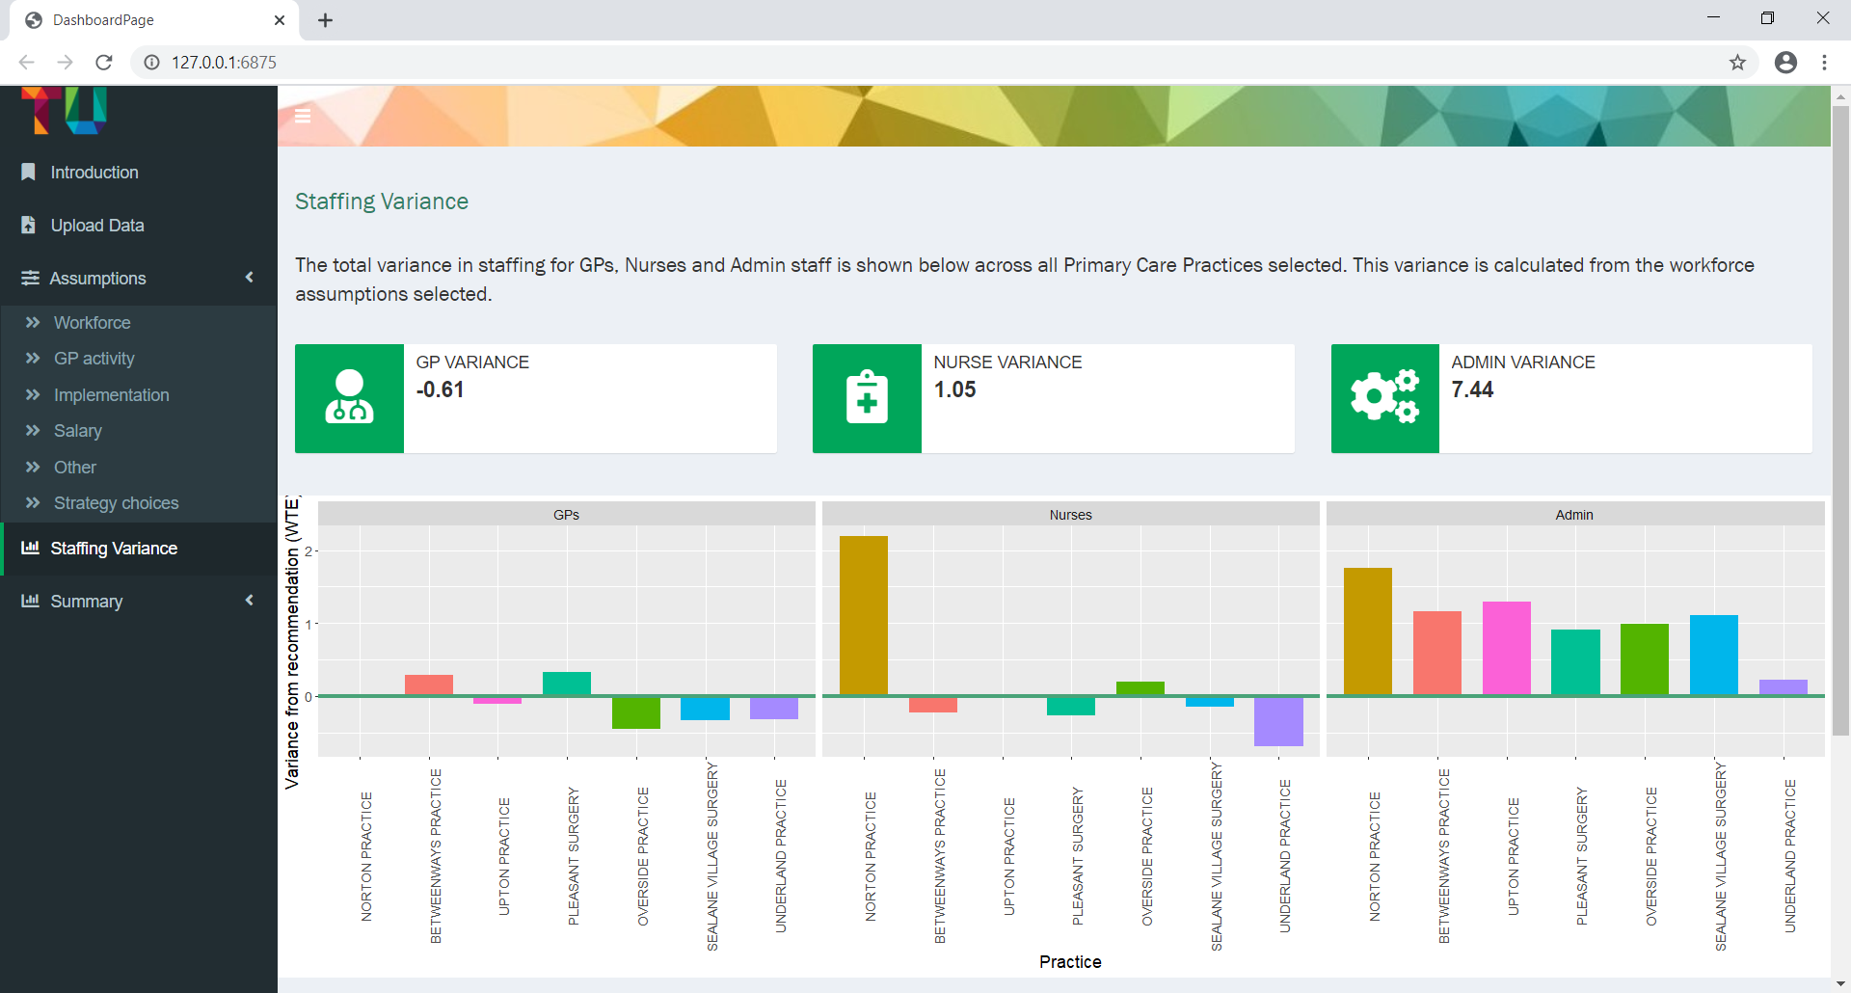
First steps

Slide 4
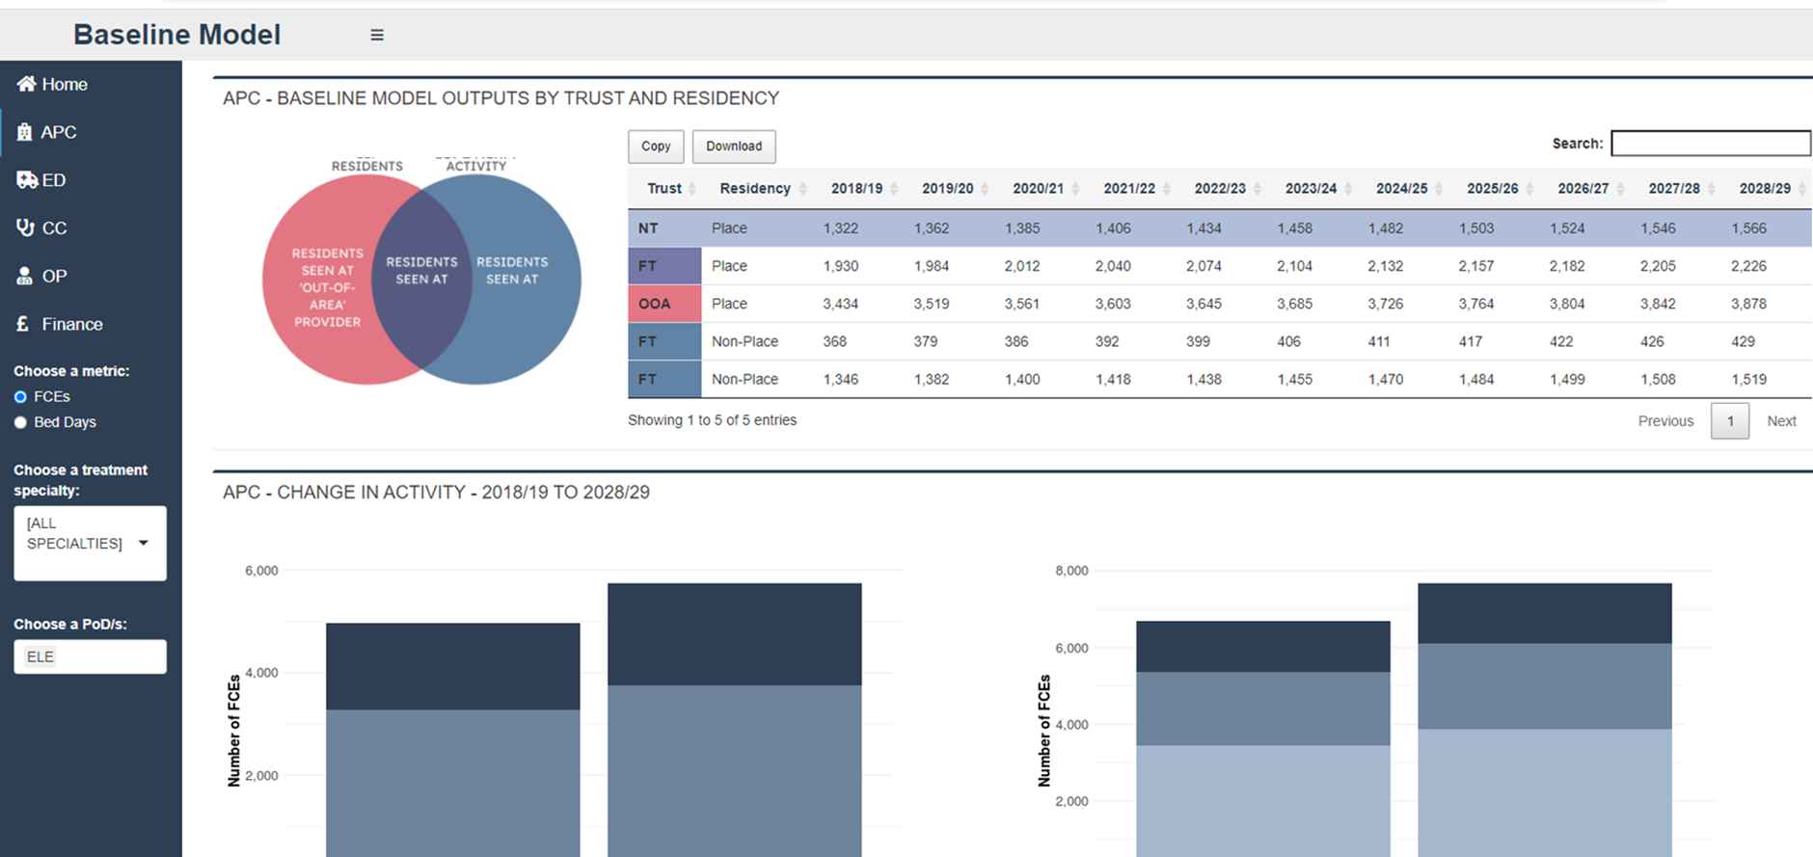
Reconfiguration tooling

Slide 5
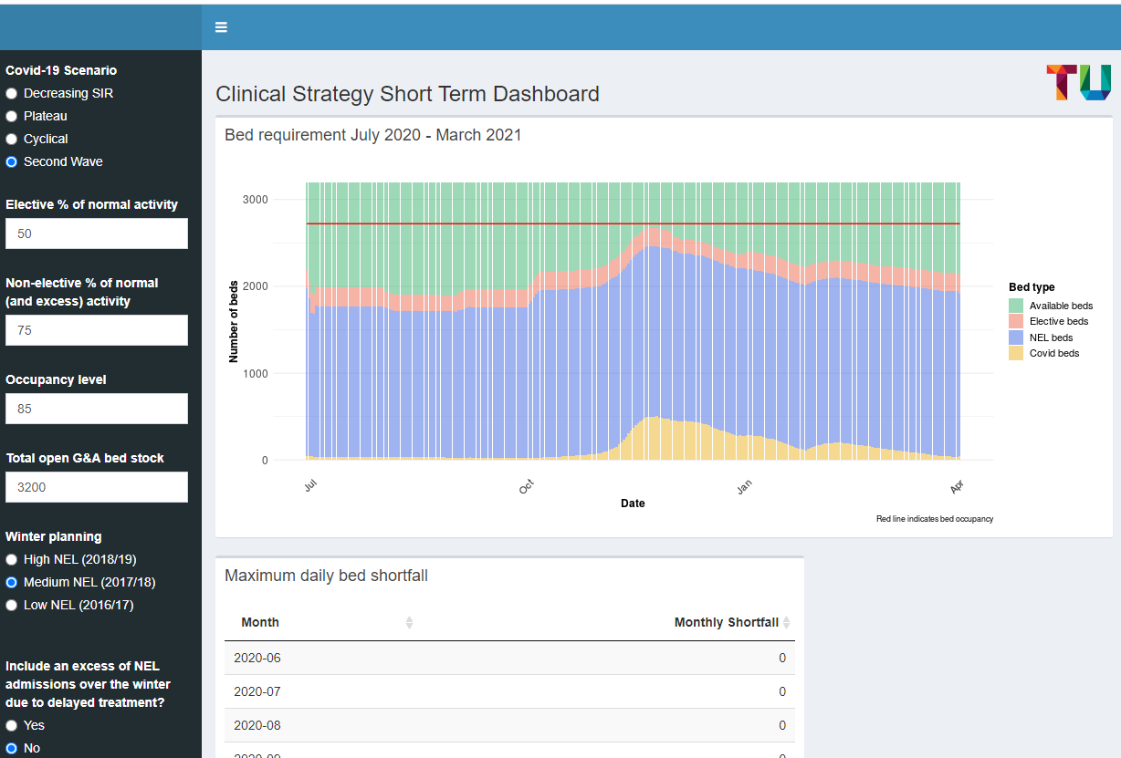
Covid-19 & Winter planning

Slide 6
Benefits
Collaborative
Flexible & interactive
Enables a broader spectrum of analytical methods
Shareable
Open source

Slide 7
Resources for getting started with R Shiny
Tutorial for R Shiny beginners (video): https://shiny.rstudio.com/tutorial/
Tutorial for R Shiny beginners (text-based): https://ourcodingclub.github.io/tutorials/shiny/
Examples of work done elsewhere: https://shiny.rstudio.com/gallery/#user-showcase

Slide 8
Thanks for listening -
Any questions?

