Slide 1







A Journey through Emerging Trends
Navigating the Tech Landscape
Lex Romo
February 25, 2024

Slide 2



OUTLINE
Executive Summary
Introduction
Methodology
Results
Visualization – Charts
Dashboard
Discussion
Findings & Implications
Conclusion
Appendix

Slide 3

EXECUTIVE SUMMARY
Programming and Database Trends Survey:
The Programming and Database Trends Survey aimed to explore the current landscape of technology preferences and trends among professionals in the industry.
Key Objectives:
The primary goal was to identify prevalent programming languages and database technologies, understand the reasons behind their current and future popularity, and provide actionable insights for businesses and professionals.
Demographics:
The survey collected feedback from a varied set of professionals, predominantly within the technology sector.
Overall Findings:
The survey revealed a dynamic landscape with clear trends in programming languages and databases, indicating the industry's continuous evolution. Professionals showcased a keen interest in adapting to emerging technologies

Slide 4

INTRODUCTION
Objective:
Explore the evolving technology landscape.
Initiative:
Undertook a comprehensive survey analysis.
Primary Goal:
Identify prevalent programming languages and database technologies.
Insights:
Move beyond surface observations to comprehend underlying forces guiding choices.

Slide 5

METHODOLOGY
Survey Design:
Designed a comprehensive online survey with 84 questions.
Questions covered programming languages & databases currently used, programming languages & databases wanting to learn next year, education level, country, age, gender, years of coding & employment to name a few.
Target Audience:
Participants included professionals in the technology sector.
Data Collection:
Data used is from the Stack Overflow developer survey.
Source
Sample Size:
Collected responses from an extensive pool of 11,398 participants.

Slide 6
RESULTS
Gender Distribution:
Male: 92.5%
Female: 6.5%
Other: 1%
Top 2 Responders by Country:
United States: 3,127
India: 897
Programming Language Trends:
JavaScript remains the most utilized language, followed by HTML/CSS and SQL.
Database Trends:
MySQL currently holds the top position, but PostgreSQL is gaining traction.
Skill Preferences:
Desired skills exhibit a shift, with Python ranking higher than SQL in aspirations.
Niche Skill Insights:
Surprising preferences include Bash/Shell surpassing Python, and MongoDB making a notable leap.
Programming Language Trends:
C++ Decline:
C++ currently sits at 10th place but is projected to drop out of the top 10 in the coming year.
Gender Representation Analysis:
On the next slide, we'll investigate the potential bias introduced by the overwhelming male representation in reported programming language and database preferences.

Slide 7
Exploring the Implications of Gender Distribution
Potential Bias in Preferences:
The overwhelming male representation may introduce a bias in the reported programming language and database preferences. Understanding whether these preferences are reflective of the entire industry or specific to this demographic is essential.
Impact on Skill Aspirations:
Analyzing how the gender composition influences skill aspirations can provide insights into potential gender-related trends. For instance, are certain skills more aspired by one gender over another?
Consideration for Inclusive Strategies:
Recognizing the gender disparity prompts a consideration for more inclusive strategies in future surveys. How can we encourage a broader representation to ensure a comprehensive understanding of the diverse tech community?
Industry-Wide Generalizability:
Evaluating the generalizability of our findings to the broader tech industry is vital. Are the trends observed in this survey consistent with industry-wide patterns, or do they primarily reflect the preferences of a specific demographic?
Understanding the impact of gender distribution on our survey results not only enhances the accuracy of our insights but also informs strategies for future surveys to ensure a more inclusive representation.

Slide 8
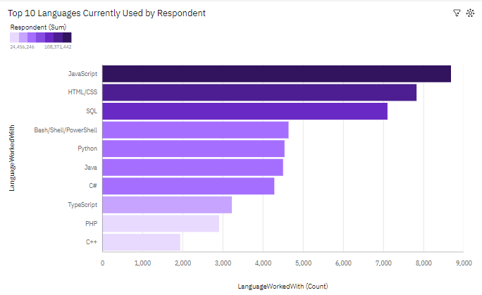
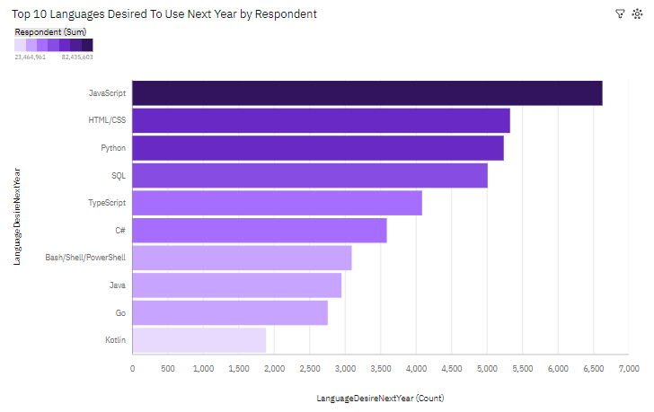
PROGRAMMING LANGUAGE TRENDS
Current Year
Next Year

Slide 9
PROGRAMMING LANGUAGE TRENDS FINDINGS & IMPLICATIONS
Findings
JavaScript emerges as the most utilized and sought-after programming language
Presently, SQL holds a higher ranking than Python; nevertheless, individuals place it third in terms of their desired languages to learn.
Notably, Bash/Shell secures the fourth position, surpassing Python in preference.
As of now, C++ holds the 10th position; however, it is projected to drop out of the top 10 in the coming year
Implications
JavaScript Dominance:
For Individuals: Prioritizing JavaScript proficiency is crucial for career growth and aligning with industry demands. Recognition of JavaScript underscores its importance in web development and the creation of interactive user experiences
SQL vs. Python:
Although SQL currently holds a higher ranking, the desire to learn Python suggests its growing significance. Individuals may benefit from acquiring skills in both languages to enhance their versatility.
For Businesses: Recognizing the popularity of Python as a desired language indicates its increasing relevance. Businesses may consider fostering a balanced skill set among their teams, incorporating both SQL and Python expertise.
Bash/Shell Preference:
The unexpected preference for Bash/Shell emphasizes the importance of automation and scripting skills, particularly for system-level tasks.
Acknowledging the popularity of Bash/Shell may influence hiring decisions and training programs, particularly in roles involving system administration and automation.
C++ Decline:
Those skilled in C++ should consider diversifying their skill set to remain competitive in the evolving tech landscape.

Slide 10
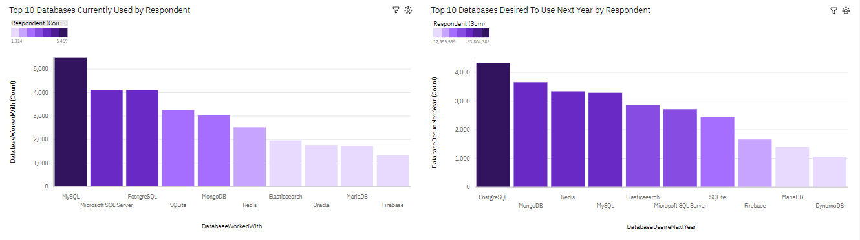
DATABASE TRENDS
Current Year
Next Year

Slide 11
DATABASE TRENDS FINDINGS & IMPLICATIONS
Findings
At present, MySQL stands as the most utilized database, but it drops to the 4th position in the following year.
PostgreSQL, presently holding the 3rd rank, unexpectedly claims the top spot the next year as the most sought-after SQL database for work.
MongoDB, currently at the 5th rank, makes a notable leap to the 2nd position in the upcoming year.
Implications
MySQL Fluctuation:
Awareness of MySQL's shift from the top spot to the 4th position indicates potential changes in database preferences. Individuals may need to stay adaptable and diversify their database skills.
The fluctuation in MySQL's ranking may prompt businesses to assess the ongoing relevance of this database in their technology stack and consider alternative solutions.
PostgreSQL's Surprising Rise:
The unexpected rise of PostgreSQL to the top spot signifies a growing preference for this database. Individuals with PostgreSQL skills may find increased opportunities.
MongoDB's Notable Leap:
MongoDB's significant jump from the 5th to the 2nd position highlights its increasing importance. Individuals with MongoDB skills may find their expertise in higher demand.
The upward trajectory of MongoDB suggests a trend toward favoring this NoSQL database. Businesses may consider incorporating MongoDB into their data management strategies and updating training programs accordingly.

Slide 12

DASHBOARD
Cognos Dashboard

Slide 13
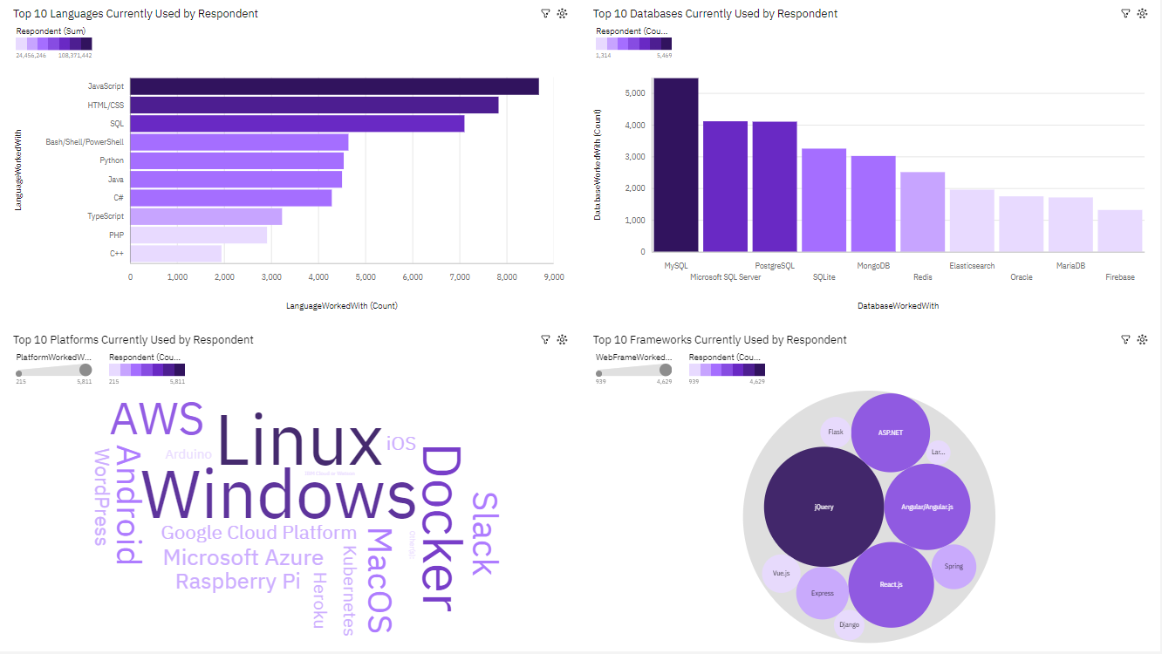
DASHBOARD - Current Technology Usage

Slide 14
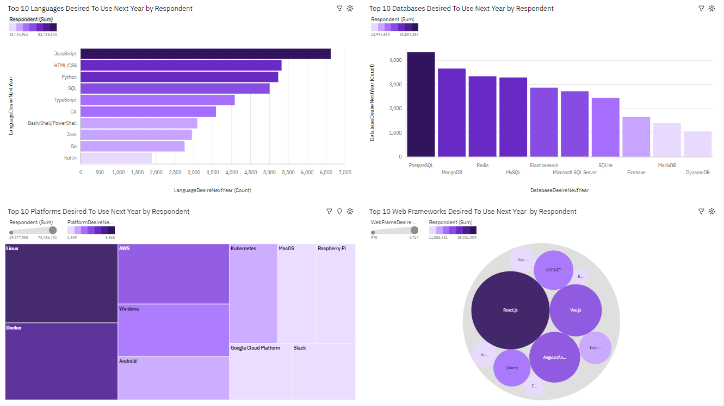
DASHBOARD - Future Technology Trend

Slide 15
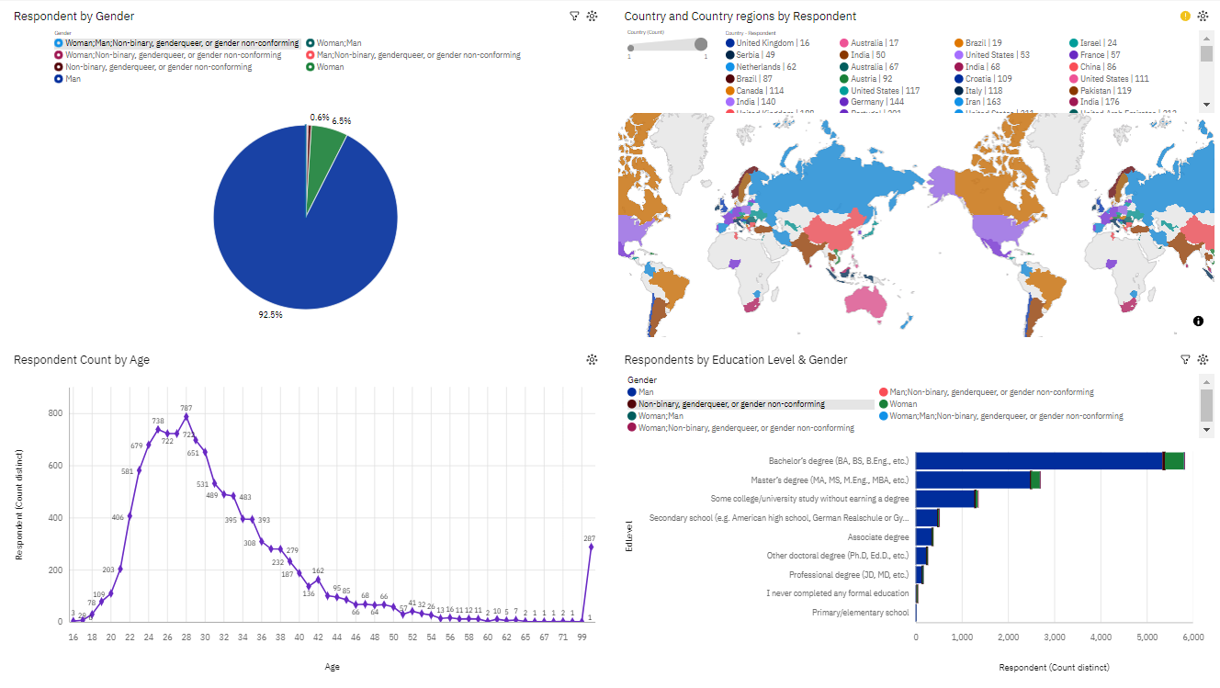
DASHBOARD - Demographics

Slide 16
DISCUSSION
I invite your thoughts and insights on these trends.
How might our organization or individual career paths benefit from these findings?
Let's open the floor for discussion.

Slide 17
OVERALL FINDINGS & IMPLICATIONS
Findings
Dynamic Nature of Language Preferences:
Programming language preferences exhibit dynamic shifts, with JavaScript consistently leading and emerging languages gaining traction.
Significant Changes in Database Choices:
Database preferences undergo substantial changes, such as PostgreSQL claiming the top spot and MySQL experiencing a decline.
Desired Skills vs. Current Usage:
The misalignment between desired skills and current language usage, such as SQL ranking higher than Python, indicates evolving skill demands.
Implications
Individuals and organizations need to stay agile in adapting to evolving language trends to remain relevant in the tech landscape.
Businesses should reassess their database choices, considering the rise of certain databases and potential shifts in project requirements.
Individuals should strategically invest in skills that align with industry demands, balancing current usage with emerging preferences.

Slide 18

CONCLUSION
Our journey through the programming and database trends landscape has unveiled a number of insights that holds significant implications for individuals in the tech domain.
The database arena, marked by PostgreSQL's surprising ascent and MySQL's notable decline, calls for a strategic reassessment of our database choices.
The unexpected preferences, such as Bash/Shell surpassing Python and MongoDB making a remarkable leap, prompt us to acknowledge the importance of niche skills in shaping the technological landscape.
As we navigate these findings, it becomes evident that strategic decision-making is paramount for success in the tech industry.
Our collective journey through these insights lays the foundation for informed decision-making, both for individuals seeking to enhance their skill portfolios and businesses shaping their technology strategies.

Slide 19

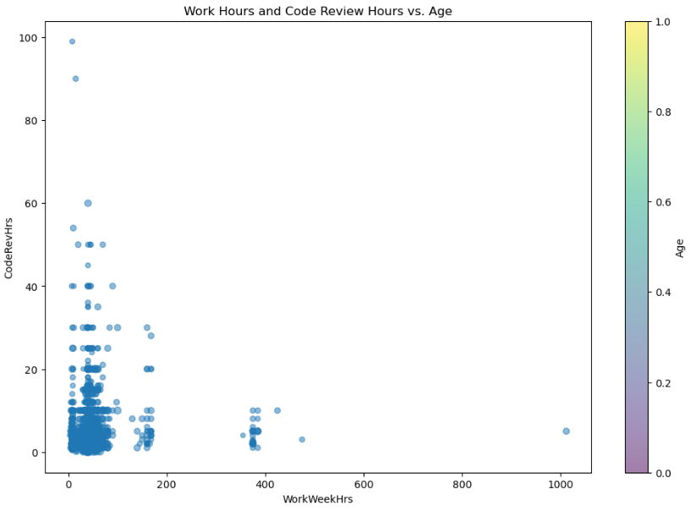
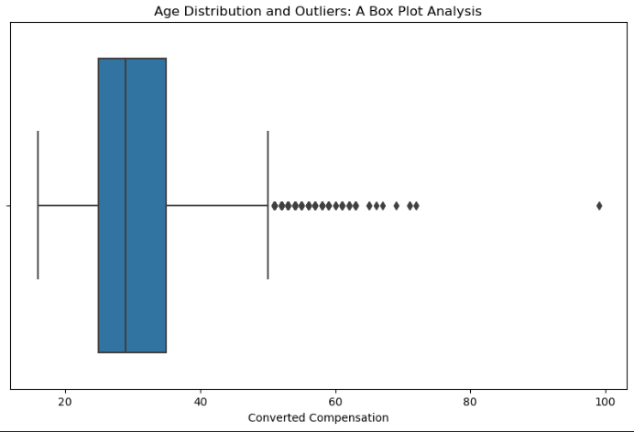
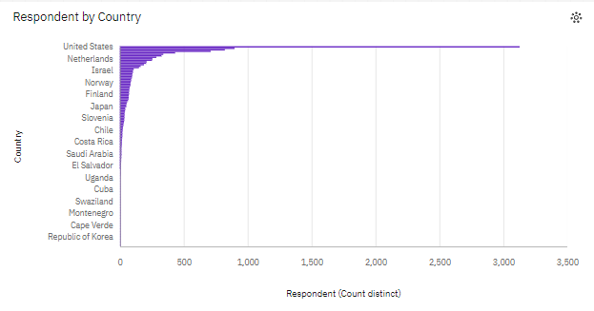
APPENDIX
Relevant additional charts created during the analysis phase.

Slide 20
JOB POSTINGS

Slide 21
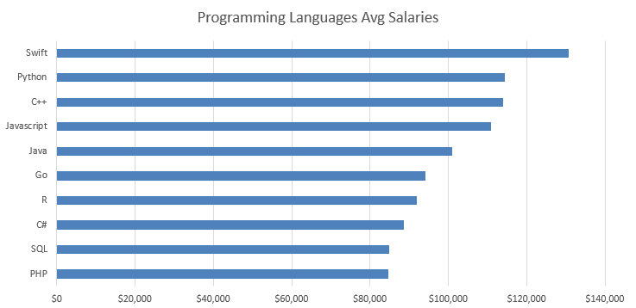
POPULAR LANGUAGES

