Slide 1
Clustering Example - Postcodes

Slide 2
Problem Statement
Dataset that contains ‘postcode’ as a variable
Domain knowledge says that geographic location likely to be a contributor to the outcome variable.
Have thousands of different postcodes so not meaningful for classification models.
Next level ’up’ would be ‘state’ and there are only 8 of those so doesn’t capture the nuance of different postcodes
Solution? Build our own postcodes!

Slide 3
OVERVIEW of Today's session
Demo Walkthrough

Slide 4
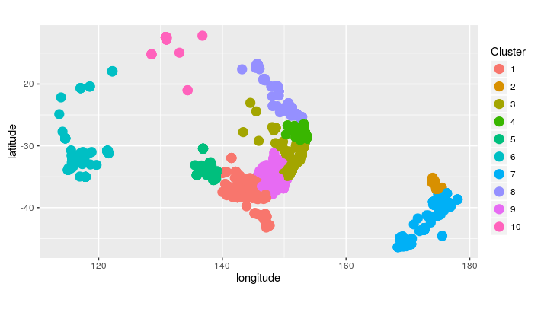
Some images ANZ – 10 Clusters

Slide 5
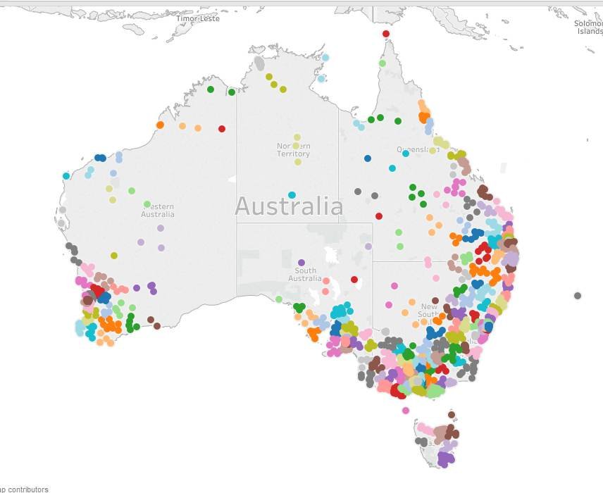
Some images – AUS 200 Clusters

Slide 6
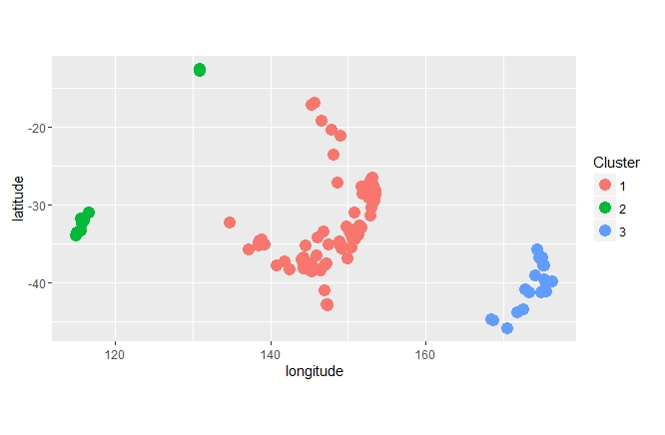
Some images – ANZ 3 Clusters

Slide 7
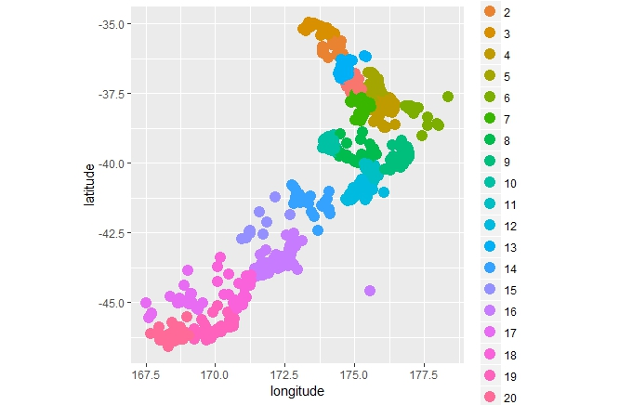
Some images – NZ 20 Clusters

Slide 8
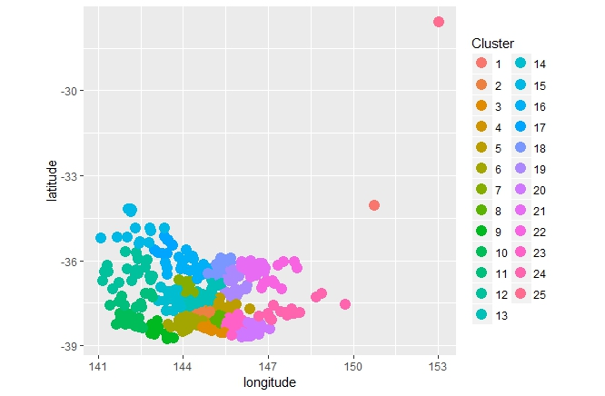
Some images – VIC 25 Clusters

