Slide 1
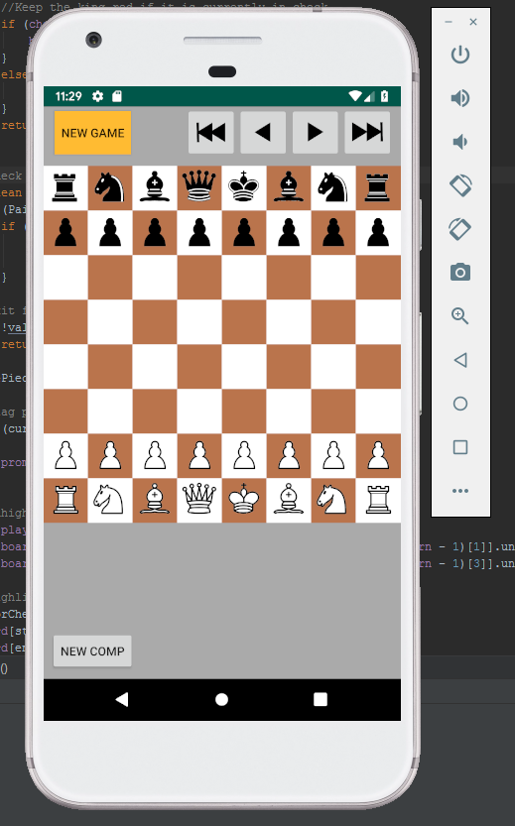
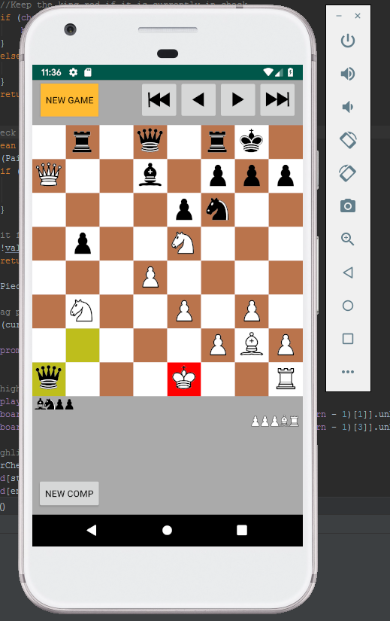

Slide 2
MainActivity
Evaluator
Engine
Book
Board
Player
Promotion
Captured
Square
Piece
King, Queen, Rook, etc.

Slide 3
What comes next? Engine Improvement
Depth (currently at 4)
  Transposition Table
  Multithreading?
  Efficiency
Mid/Late game piece locational values
Pawn positions (connected, stacked, etc.)
Book openings
End game mating

