Slide 1
Densmordle:
Project Architecture
Leyandra Burke, Damla Duendar, Melissa Ferranti, Daralyn Wen

Slide 2
User Interface flowchart
Return to game select mode
Start
Image of a classroom appears in default web browser
correct
Winning music plays
Regular
User makes a guess
incorrect
Keep guessing
correct
Winning music plays
Select game mode:
Regular, Timed or Limited
(or Quit)
Image of a classroom appears in default web browser
Timed
User makes a guess
ran out of time
Timed mode over
incorrect
Keep guessing
correct
Winning music plays
Quit
Image of a classroom appears in default web browser
Limited
User makes a guess
ran out of guesses
Losing music plays
Scores displayed
incorrect
Keep guessing

Slide 3
Breaking Down the Code

Slide 4
Breakdown of Code Into Related Categories
Classrooms
Checking Input
Game Modes
AllRooms.txt
InputHandling.h
RegularMode.h
RegularMode.cpp
RoomInfo.h
CheckInput.h
RoomInfo.cpp
CheckInput.cpp
TimedMode.h
MakeRooms.h
TimedMode.cpp
MakeRooms.cpp
LimitedMode.h
GenerateRandomClassroom.h
LimitedMode.cpp
GenerateRandomClassroom.cpp

Slide 5
Category: Classrooms
AllRooms.txt
In this .txt file, each line is a different classroom with a respective link to an image. This allows for easy updating when new rooms are added or the links are changed
RoomInfo (class)
See UML diagram to the left
MakeRooms (function)
This function reads from the AllRooms.txt file and creates RoomInfo objects, storing pointers to these RoomInfo objects in an array
GenerateRandomClassroom (function)
This function takes an array of pointers to RoomInfo objects, generates a random number, finds the index in that array, opens the image of the classroom on a webpage and returns a pointer to the name of the classroom (building and number)
UML Diagram for the RoomInfo class
RoomInfo
- room_number: char[3]
- building_name: char[3]
- picture_link: string
+ RoomInfo(number: char[3], building: char[3], link: string)
+ GetLink()
+ classroom: char[8]

Slide 6
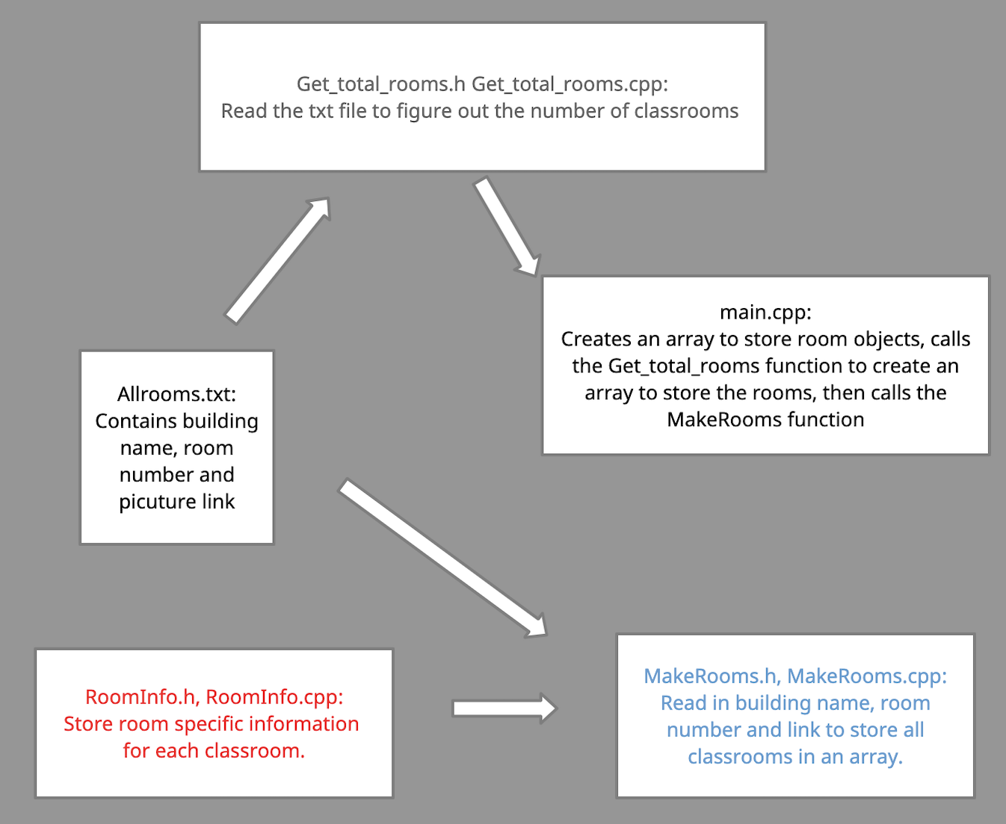
Category: Classrooms
General connection between files related to classrooms

Slide 7
Category: Checking Input
InputHandling (class)
This file holds the class, Invalid_Input, which is the same one as used in PA4
CheckInput
validBuilding (function)
Checks if the building entered is really a BU building abbreviation; also checks that user enters a space between the building and the number
validNumber (function)
Checks if a character entered is actually a number character, returns true or false
validRoomNumber (function)
Calls the validNumber function and throws Invalid_Input if validNumber returns false
checkAns (function)
Color codes the response with corresponding red, yellow and green backgrounds
UML Diagram for the Invalid_Input class
Invalid_Input
+ Invalid_Input(in_ptr: string)
+ msg_ptr: const string
- Invalid_Input()

Slide 8
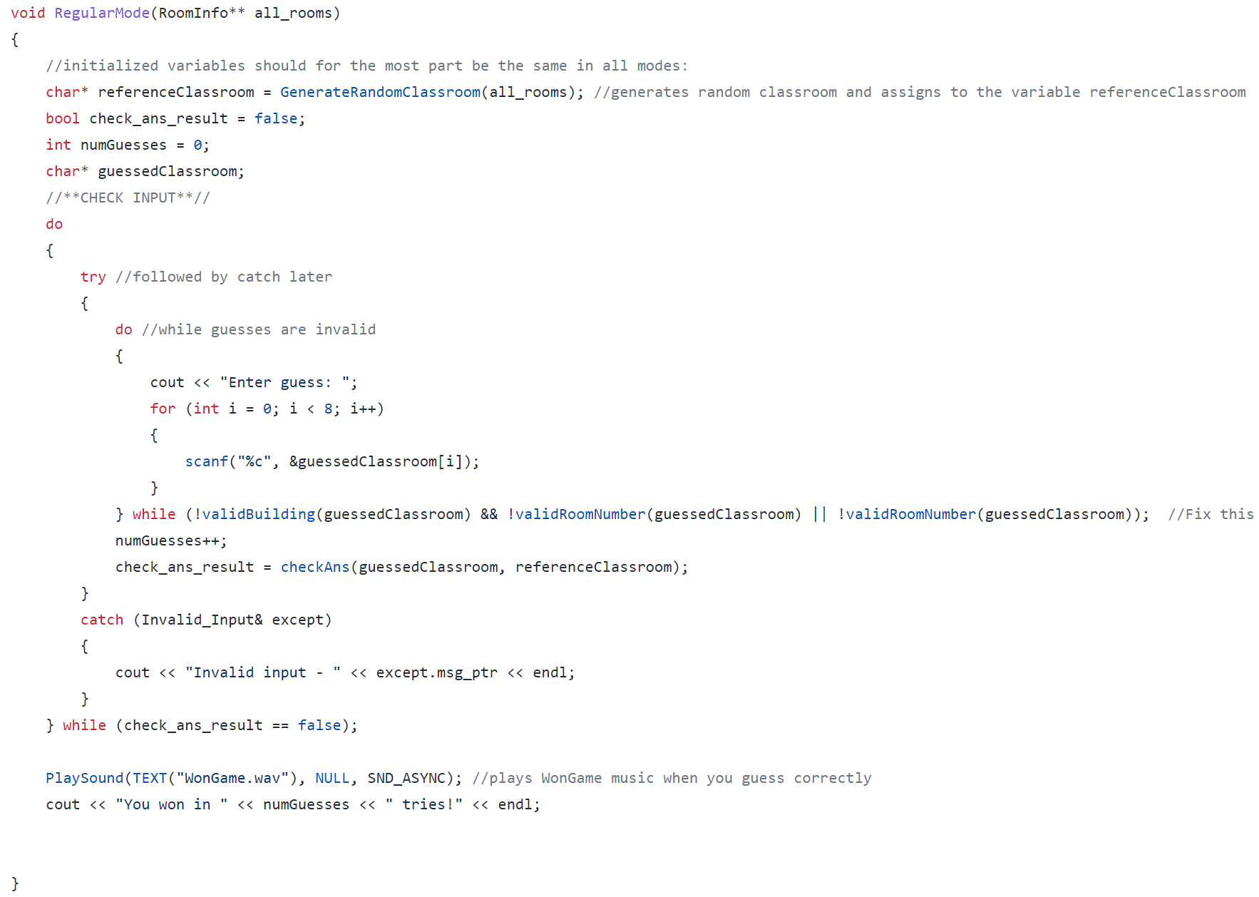
Category: Modes
RegularMode (function)
Shown on right. This structure was the basis for Timed and Limited modes
TimedMode (function)
Had some extra checking and use of asynchronous function
LimitedMode (function)
Had some extra checking and tracking of numbers

