Slide 1




Designing a Quiz System Using Assembly Language
01
Microprocessor and Interfacing

Slide 2

Team Members
Tenzin Khorlo 19BCE2599
Lhendup Dorji 19BCE2600
Aryan 19BCE2395
Aman Yadav 19BCE2605

Slide 3

AIM OF THE PROJECT
-> Creating a simple interactive quiz game using Assembly Language Program.

Slide 4

Overview of Project
Quiz system is a game concept. In this game, we have set 10 questions.
For each right answer 1 mark will be increased and for each wrong answer 1 mark will be decreased from total points.
At the end of the quiz, total marks will be shown.
We are trying to implement it using Assembly Language in Emulator8086.

Slide 5
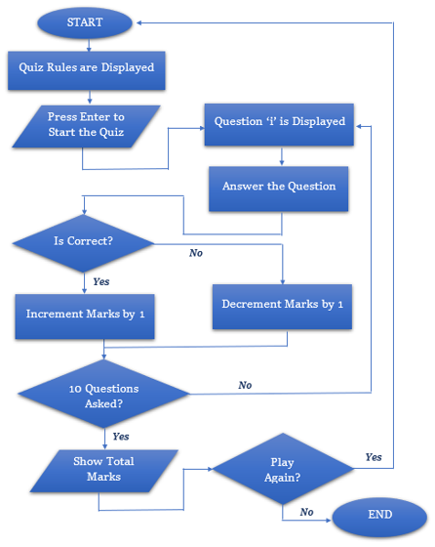

BLOCK DIAGRAM

Slide 6
Hardware Components
Software Details
-> Windows Operating system version 7 or higher.
-> emu8086 emulator.
-> PC with windows operating system installed.

Slide 7
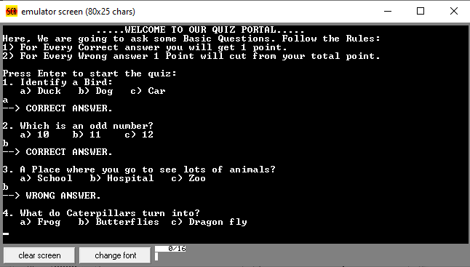
OUTPUT (Screen shots):
CASE 1: When There are more Correct Answers

Slide 8
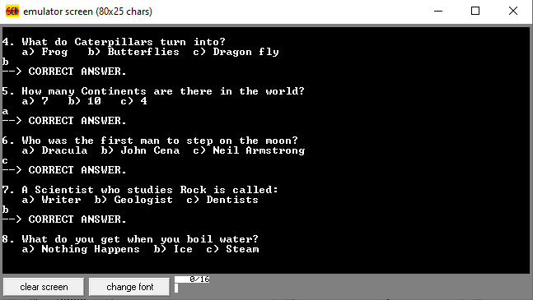

Slide 9
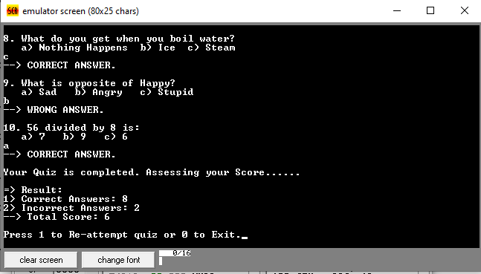

Slide 10
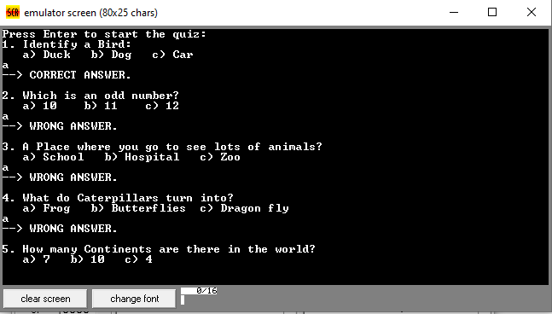
CASE 2: When there are more Wrong Answers

Slide 11
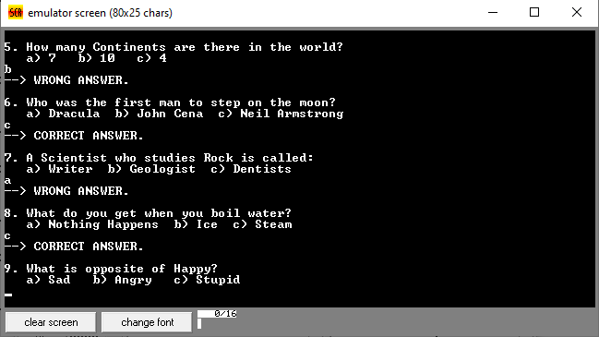

Slide 12
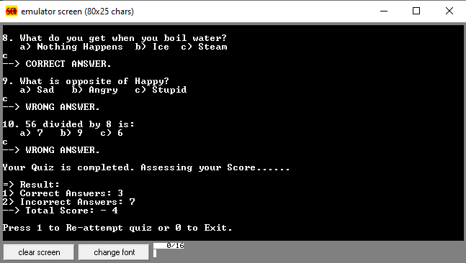

Slide 13
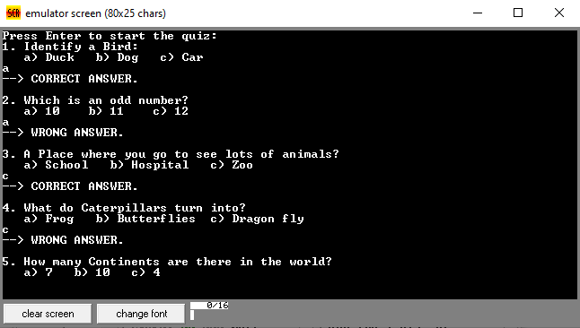
CASE 3: When Correct and Wrong Answers are equal

Slide 14
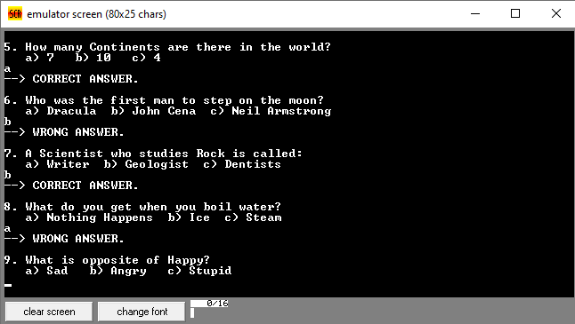

Slide 15
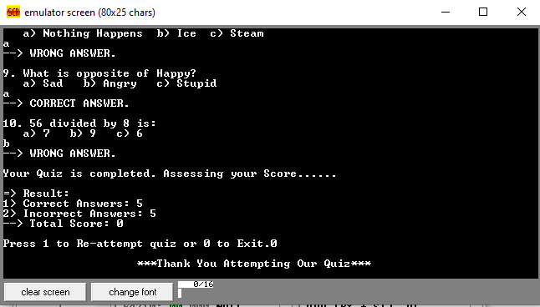

Slide 16
















THANK YOU!

