Slide 1
Python | R
Cheat-sheet
FTDI | MDSI | DATA SCIENCE PRACTISES
LHOGESHWARAN PURUSHOTHAMAN | 13313491

Slide 2
# Load data to dataframe from common data file formats and in-built data structures
Csv, tsv, txt, etc. Excel formats From built-in datastructure | df = pandas.read_csv(’/path/to/file.csv’, sep=‘,’) df = pandas.read_excel(‘/path/to/file.xlsx’, sheet_name=‘my_datasheet’) dict1 = {‘name’:[‘John’, ‘Larry’, ‘Chris’], ‘age’:[24, 23, 26]} df = pandas.DataFrame(dict1)
# Inspect the dataframe
Snapshot of the dataframe structures, features, etc. | # Inspect specific column by adding column name like df[‘col1’].head() df.head(); df.tail(); df.columns; df.shape; df.info(); df.describe(); df.nunique(); type(df)
# Cleaning data
Drop columns Drop missing values Alter column datatype | # df = df.SomeMethod(arg) same as df.SomeMethod(arg, inplace=True) df = df.drop(columns=[‘name’, ‘age’]) df = df.dropna() df[‘age’] = df[‘age’].astype(str)
# Feature-engineering
Column names to list Column values to list Filter by column value Create new features | col_ls = df.columns.tolist() name_ls = df[‘name’].unique().tolist() df = df[df[‘name’ == ‘ Larry’] df[‘Sex’] = [‘M’, ‘F’, ‘M’] df[‘name_lower’] = df[‘name'].apply(lambda x: ‘ ‘.join(x.lower() for x in x.split())) ^{[1]}
# Visualize
Unique items count (df) Count of items (col) | df.nunique().plot.bar(rot = 0) ^{[2]} ax = seaborn.countplot(x=‘name’, data=df, palette=‘YlOrBr’) ^{[3]}
# Functions
Define some calculations as function that can be reused easily. | def func_name(arg1, arg2=1): ’’’Usage: func_name(int, int). Default value of arg2 is 1. Result returned as tuple (int, int). tup[0] is multiplied value of arg1 and arg2. tup[1] is squared value of tup[0].’’’ calc1 = arg1*arg2 calc2 = calc1*calc1 out = (calc1, calc2) return out

Slide 3
# Write dataframe to to file
Csv, tsv, txt, etc. Excel formats | df.to_csv(‘/path/to/file.csv’) df.to_excel(‘/path’to’file.xlsx’, sheet_name=‘df_1’)
# Looping
 | for i in range(len(df)): mean_age = df['age'].mean() if df['age'].iloc[i] >= mean_age: print(str(df['name'].iloc[i]) + ' is ' + str(np.round((df['age'].iloc[i] - mean_age),1))+ ' years older than group mean age.’) ^{[4]}
# Deleting, copying variables/dataframes
Delete unnecessary variables to avoid ’out of memory errors‘ Copying dataframes | # Delete mean_age calculated during looping del mean_age # This is one of the most error-prone actions by beginner python programmers!! ^{[5]} # This creates a copy of original df. Any changes to df reflects automatically in df_copy. df_copy = df # This creates a duplicate of original df. df_dup is independent of changes to df. df_dup = df.copy()
# Some common packages, Installing, Importing
Common packages To install the packages in the system Import the package within the python interactive module | numpy, pandas, matplotlib, seaborn, bokeh, scikit-learn # On the command line interface (CLI) $ pip install PackageName # Importing package inside python import module (same as) from module import * from module import method (same as) import module.method

Slide 4
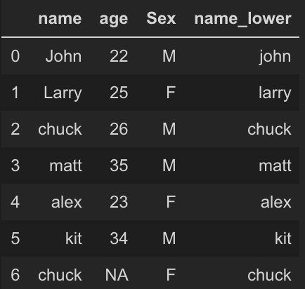

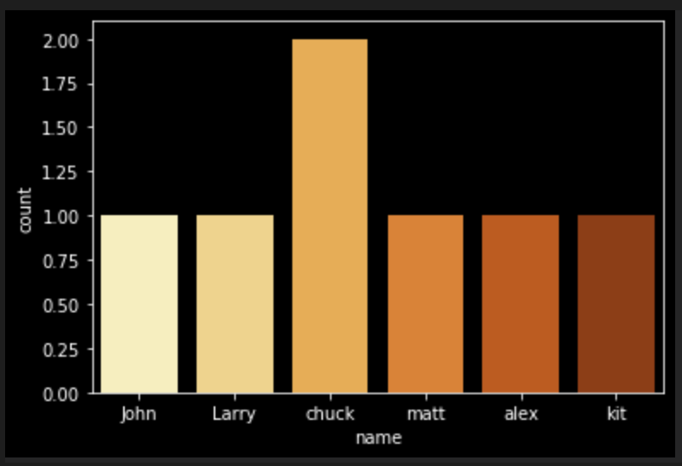
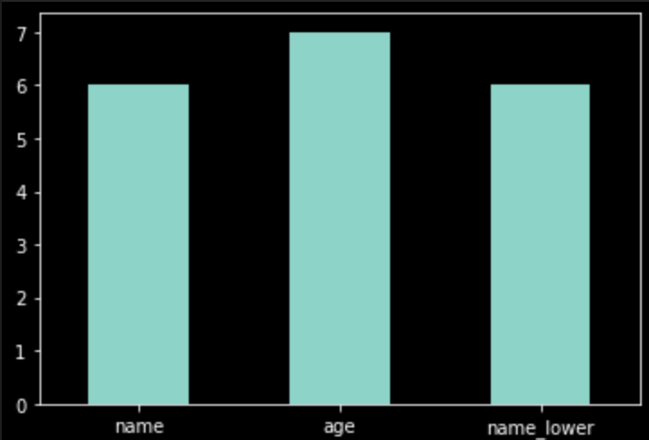
Appendix
^{[1]}
^{[2]}
^{[3]}

Slide 5
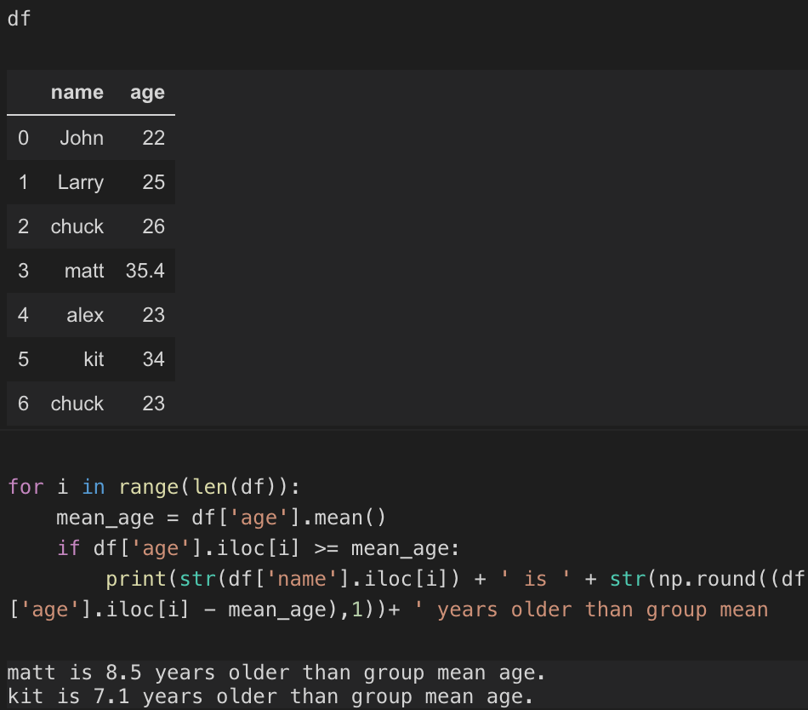
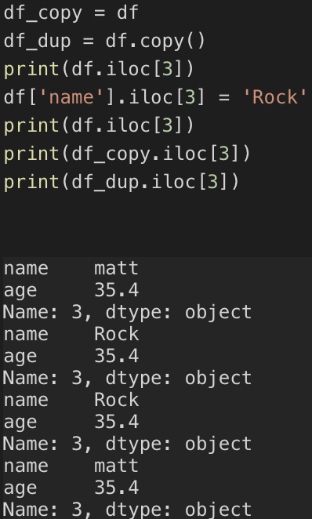
^{[4]}
^{[5]}

