Slide 1
IFB104 — Building IT Systems Topic 2 — How to Use Pre-defined Functions
School of Electrical Engineering and Computer Science
Semester 2, 2018

Slide 2
Housekeeping
Workshop attendance in Week 1:
TUE 9:00am-11:00am S309 - 27
TUE 9:00am-11:00am S636 - 16
TUE 11:00am-1:00pm P504 - 35
TUE 11:00am-1:00pm D301 - 30
TUE 3:00pm-5:00pm Q218 - 25
TUE 3:00pm-5:00pm P504 - 30
WED 9:00am-11:00am Q224 - 31
WED 9:00am-11:00am P413A - 22
WED 11:00am-1:00pm D301 - 33
WED 1:00pm-3:00pm Q216 - 39
WED 3:00pm-5:00pm D304 - 24
WED 3:00pm-5:00pm P504 - 27
WED 5:00pm-7:00pm P504 - 25
FRI 9:00am-11:00am P506 - 30
FRI 12:00pm-2:00pm S409 - 27
FRI 12:00pm-2:00pm S405 - 30
FRI 2:00pm-4:00pm O303 - 32
FRI 4:00pm-6:00pm P502 - 35

Slide 3

Assessment
Weekly tests start appearing this week on Blackboard under Assessment
They will appear each Monday afternoon and must be submitted by Sunday at 11:59pm
Remember, there’s an assessment item every week in this teaching unit, so set aside a regular time for it
You can save your answers but you can only submit the tests once
Don’t leave it until the last minute — teaching staff and the IT Helpdesk will not be answering emails late on Sunday nights!
Make sure you have submitted successfully — if in doubt, try again!
See the online instructions for how to successfully submit tests via Blackboard:
https://qutvirtual4.qut.edu.au/group/student/it-and-printing/qut-blackboard/assessment-on-qut-blackboard/tests-and-surveys

Slide 4

Assessment
Just because (most of) the tests are multiple choice doesn’t make them easy
They are not memorisation questions
In most cases you need to do some work in IDLE or by browsing the Python documentation to figure out the answers
When the results are released, click on the mark in MyGrades to see which questions you got right and wrong
The solutions are not released online — If you can’t figure out the correct answer email ifb104.query@qut.edu.au

Slide 5
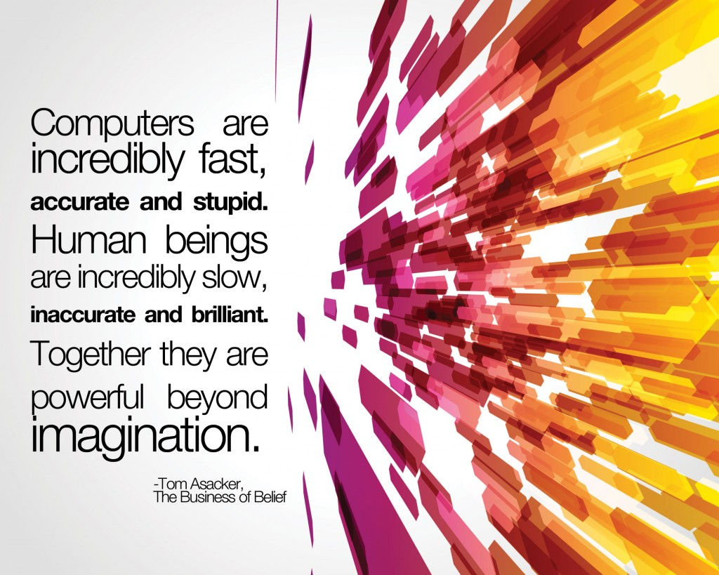
The challenge of building IT systems
Information Technology is about getting a computer to do some work for us
But computers are stupid!
They only do what they are told
And they can do simple actions only
Their power is due to their ability to do simple actions very quickly

Slide 6

The challenge of building IT systems
Therefore we have to express what we want a computer to do as a ‘program’ or ‘script’ in a language that the computer can follow
In this unit we do this using Python as a simple scripting language for teaching purposes
In later IT units you may use industrial-strength programming languages such as Java, C#, C++, etc
This week we introduce several Python features that allow us to do some fun workshop exercises with graphics, and look more deeply at “sequences” of values

Slide 7
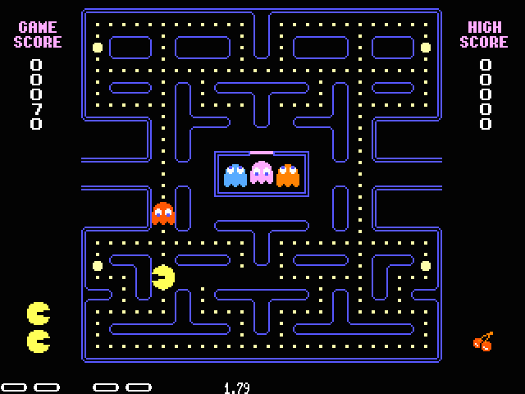
Preview of this week’s topic: Let’s draw Pacman!
This week we’ll learn how to do things by calling built-in functions and vary their behaviour by providing arguments to them
Some functions will perform actions for us and others will do calculations and return results
To illustrate the concept, let’s start by drawing a picture by calling some “turtle graphics” functions
Demonstration file: pacman.py

Slide 8
Part A — Recap of Expressions

Slide 9
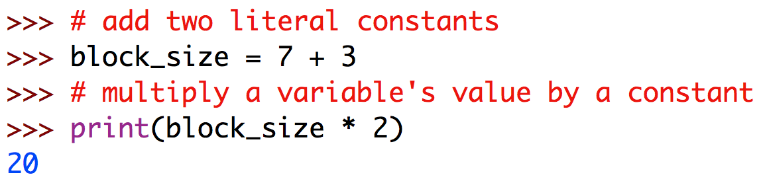
Three different ways of expressing operations on data values
We have seen that we can perform various operations on data values to produce new values
The data values may be expressed directly, as ‘literal constants’, or may have been stored previously in a named ‘variable’
However, only a small number of operations have special symbols like * and + (because we don’t have very many special characters on our keyboard!) so most are expressed by writing the operation’s name ...

Slide 10
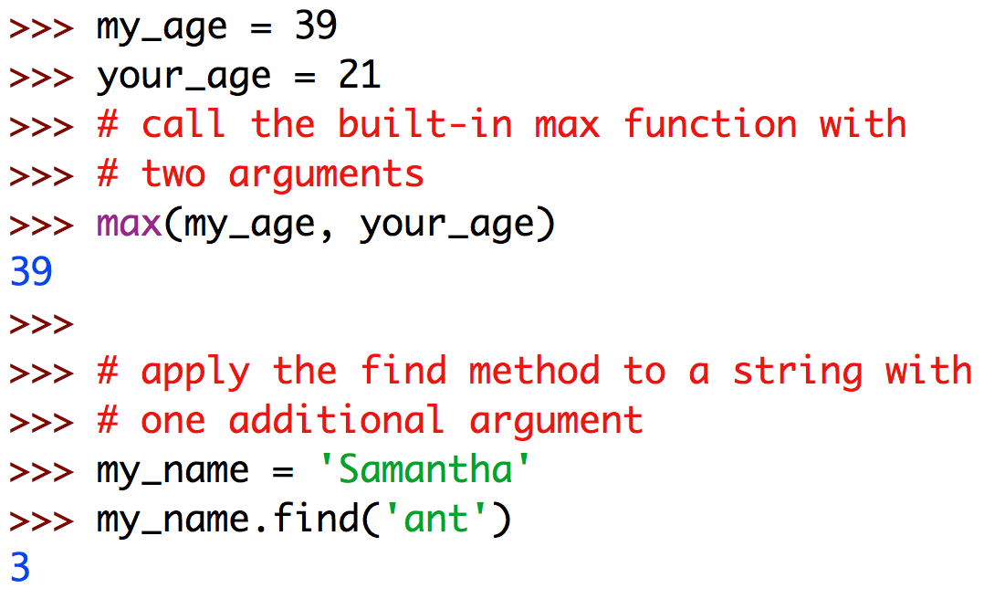
Three different ways of expressing operations on data values
Built-in functions are called by following their name with all the arguments enclosed in brackets
“Methods” are special functions applicable to values of certain types (“classes”) and are called with the first argument preceding the function name using “dot notation”

Slide 11
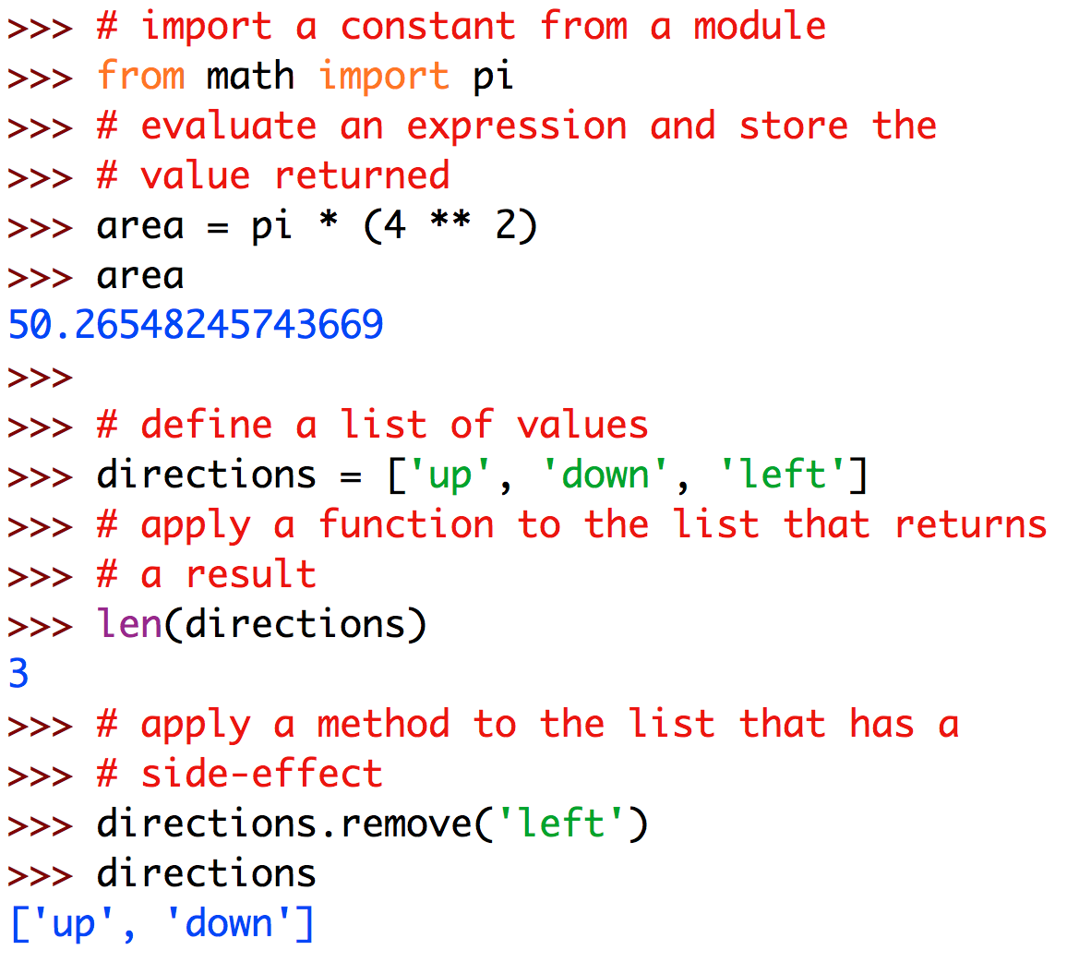
Two different reasons for calling a function (or method)
Most functions/methods accept some arguments and return a new value, which itself can be used in a larger expression, assigned to a variable, or printed to the screen
However, some functions produce a side-effect on variables or the computing environment and return nothing
An attempt to access the value returned by a pure side-effecting function gets the special value None
And some functions do both (e.g., Turtle’s stamp method both draws an image and returns an identifier)

Slide 12
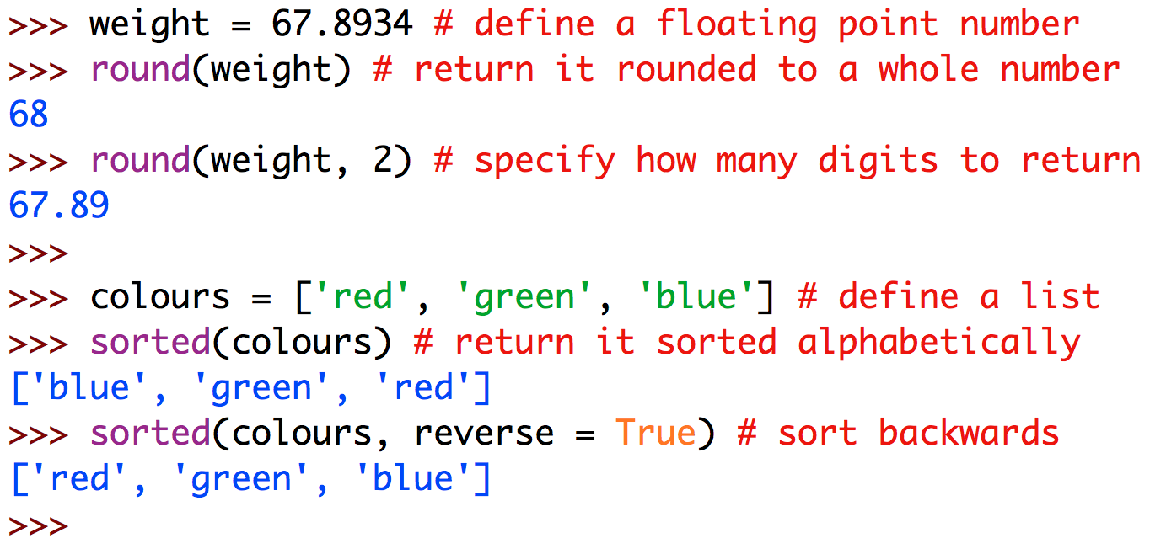
Optional and named arguments
Some functions, like the built-in round function, allow certain arguments to be optional
Some functions, like the built-in sorted function, allow us to specify which arguments we wish to provide by their name

Slide 13
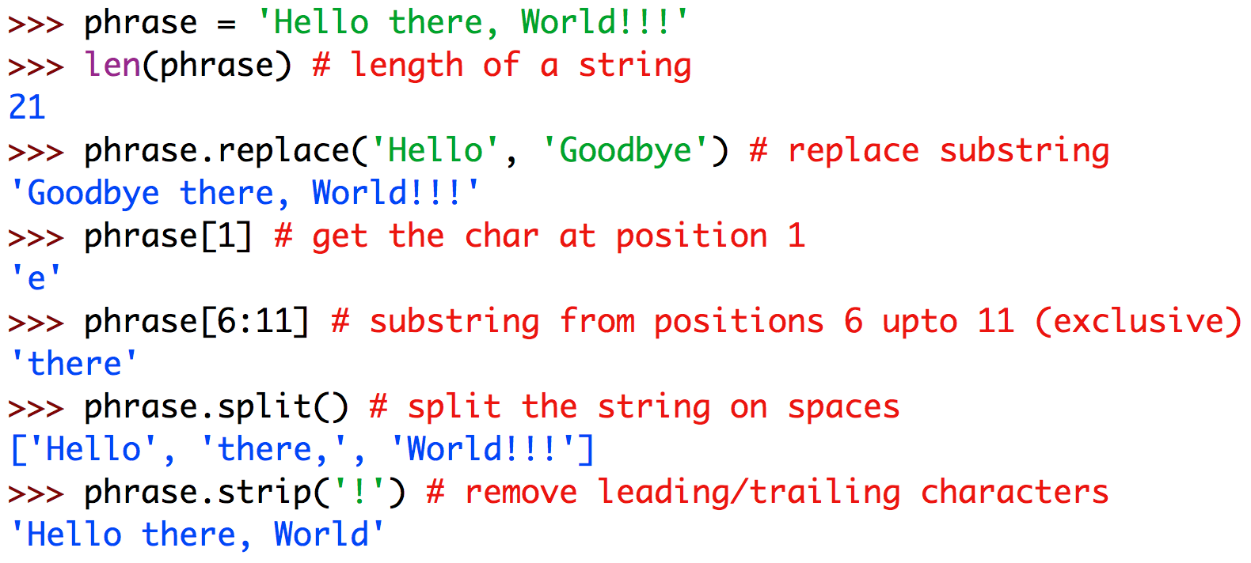
More character string operations
We have seen that simple numeric operations such as +, *, etc, work with character strings
Some other commonly-used string operations are shown on the right
All of these operations return a new string, leaving the original one unchanged
If you want to keep the new string you need to assign it to a variable
There are many, many more!
Find them in the Python Standard Library manual, Section 4.7

Slide 14
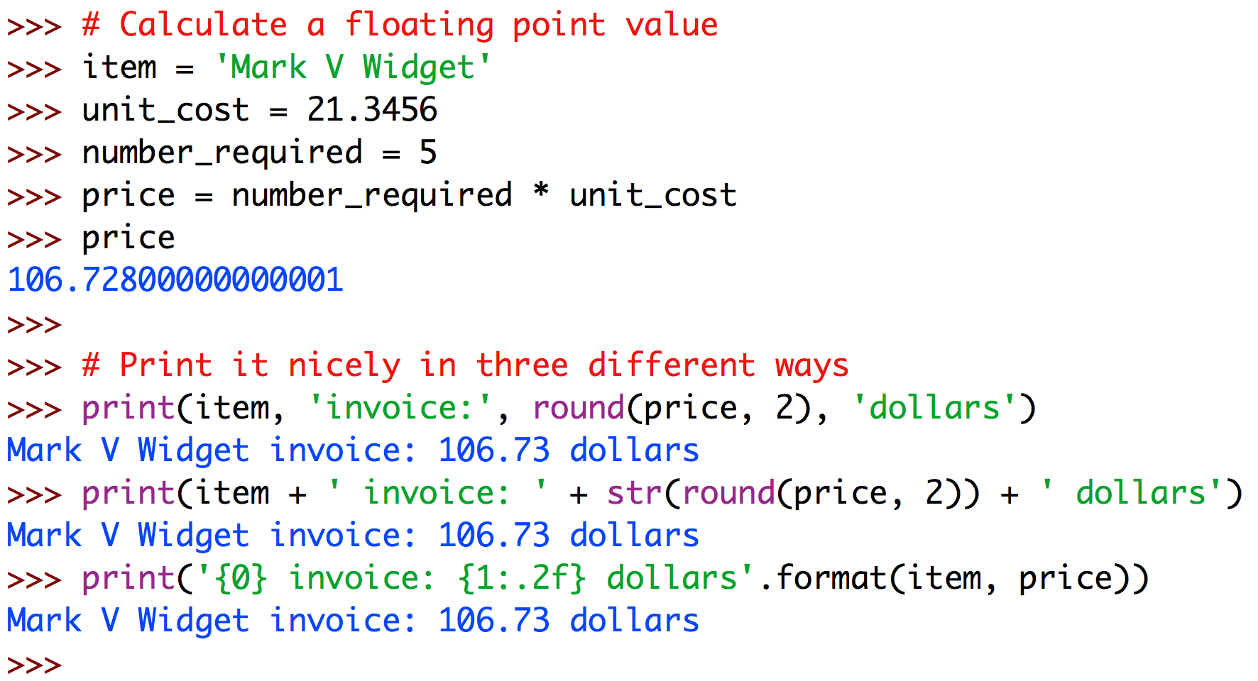
Nice formatting of numbers
When preparing to print long floating-point numbers we can modify them by deleting the fractional part (using int) or rounding them (using round)
Leading and trailing zeros are not shown
To achieve more precise control over how many digits are shown we can use the string format method
The string to be printed can contain numbered placeholders for values, starting at 0
The placeholder can specify formatting, especially the number of digits after the decimal point

Slide 15
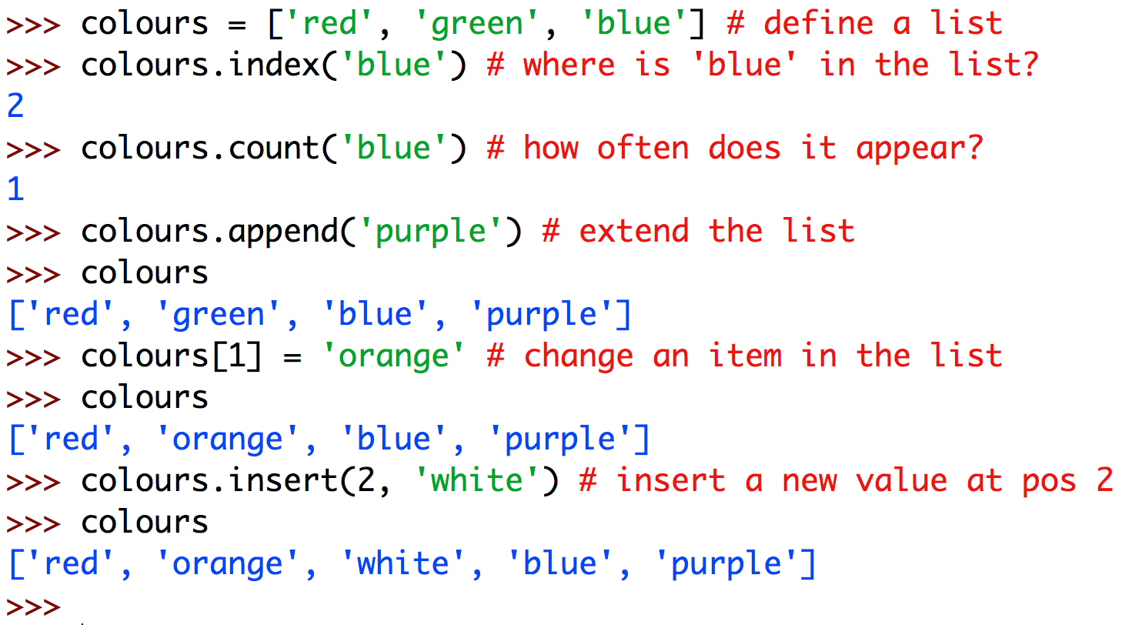
Lists
Lists are similar to strings but they can be a sequence of any type of values, not just characters
As with strings, many list operations return values
But unlike strings, some list operations change the value of the list variable they are applied to
See Section 4.6 of the Python Standard Library for many operations applicable to lists

Slide 16
Some more commonly-used list operations
L[n] | returns the n^{th} item in list L, counting from zero
L[m:n] | returns the subsequence of list L from position m, inclusive, to position n, exclusive
len(L) | returns the length of list L
max(L) | returns the largest value in list L
sum(L) | returns the sum of numbers in a numeric list L
L.append(i) | adds item i onto the end of list L (note that this operation changes L ‘in place’ rather than returning a value)
L.sort() | sorts the items in list L (again this changes the variable’s value in place)

Slide 17
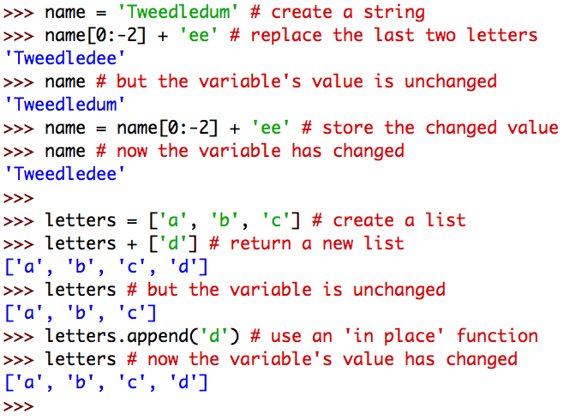
Mutable versus immutable values
Strings are immutable (unchangeable) values
All string operations return new strings
To update a string variable we must assign a new value to it
Lists are mutable values
Some list operations return new lists
Other list operations change the list ‘in place’
It’s often hard to remember which is which, so keep the Python Standard Library manual handy!
Demonstration file: sequences_revisited.py

Slide 18
Part B — Random Numbers

Slide 19
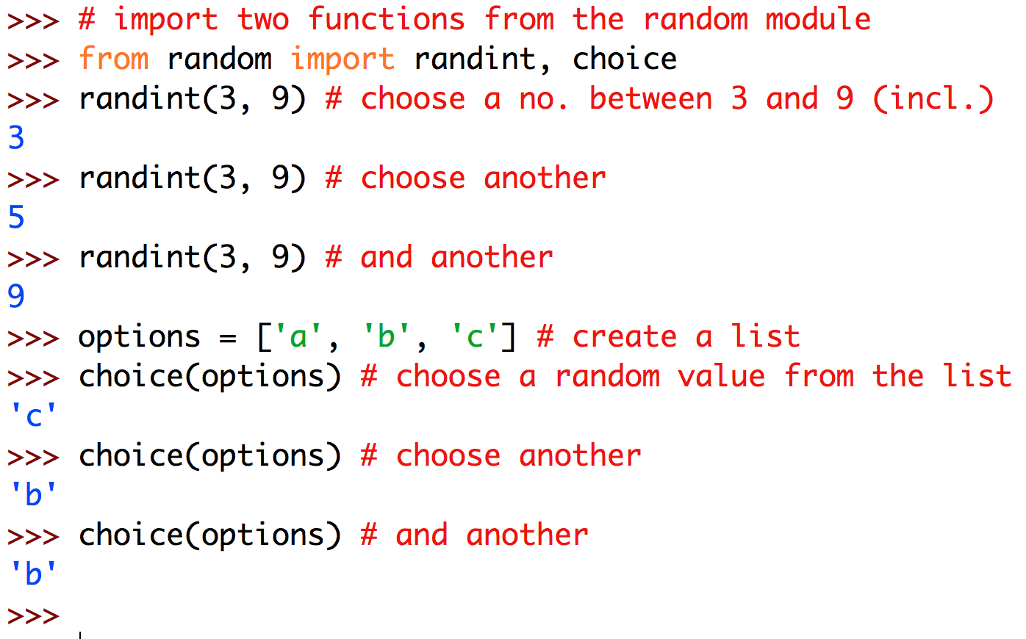
The random module
So far we have been looking at ‘core’ features of the Python language
To extend the language’s capabilities we can import additional modules containing extra functions
Before using an external module we must import the functions we want to use
A module that helps us create simple game-like programs is the random module for creating random numbers and choosing random values from lists
See Section 9.6 of the Python Standard Library manual for more detail
Demonstration file: random_numbers.py

Slide 20
Part C — Doing the Same Thing Many Times

Slide 21
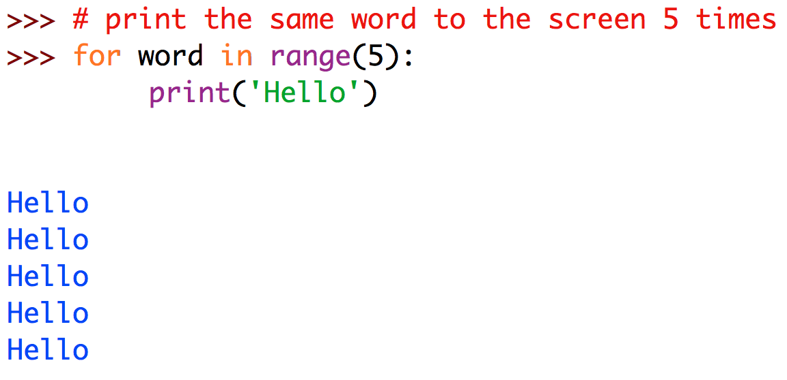
Doing the same thing many times
The computational power of computers derives from their ability to rapidly repeat simple actions
We will explore repeated, or “iterative”, calculation in depth in a later lecture
For now we just want to repeat the same action a fixed number of times
The for statement repeats any actions indented below it for a specified range of iterations
Demonstration file: panic_button.py

Slide 22
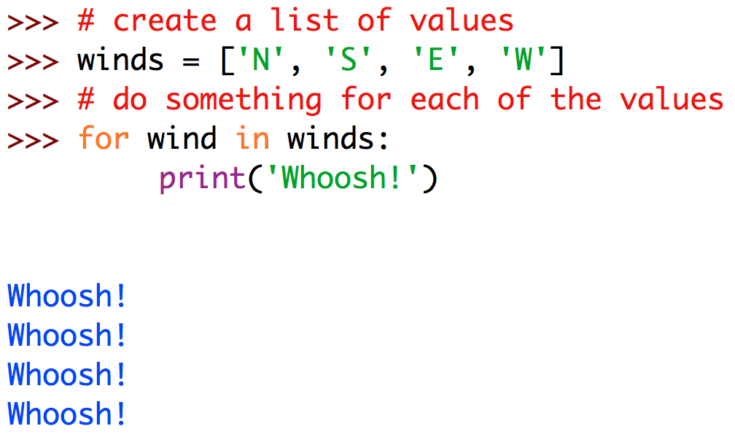
Doing something for each item in a list
Alternatively we can do an action for however many values there are in a list
For this reason we often refer to Python’s for statements as “for each” statements

Slide 23
Part D — Fun with Graphics

Slide 24
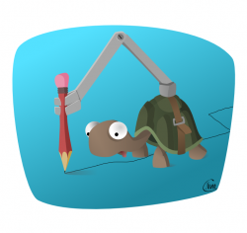
Turtle graphics
Another module we will use a lot is called turtle and allows us to draw things!
Pictures are drawn by moving a pen-carrying ‘turtle’ (i.e., cursor) around the screen
The turtle can move forward a certain number of pixels (‘picture elements’)
The turtle can walk in a circle
The turtle can turn left or right by a certain angle, measured in degrees
The turtle can raise and lower its pen
The turtle can also be sent to a specific x-y coordinate
There are many pre-defined functions in the turtle module
See Section 24.1 of the Python Standard Library manual for full details
Demonstration file: squiggly_lines.py

Slide 25
Some commonly-used turtle functions
setup(), done() | create/release the drawing canvas
forward(n) | move forward n pixels
pendown(), penup() | start/stop drawing
goto(x, y) | go to absolute coordinate (x, y)
left(d), right(d) | turn left/right by d degrees
setheading(a) | turn to face angle a (default: 0°is east)
circle(r) | walk in a circle of radius r pixels (by turning left, i.e., anti-clockwise)
dot(d) | draw a dot of diameter d pixels at the current position (even if the pen is up)
begin_fill() … end_fill() | fill the shape drawn between these two statements with the current colour
color(c) | set the pen colour to c (c can be a string)
hideturtle(), showturtle() | make the turtle invisible/visible

Slide 26
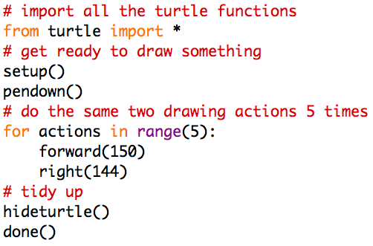

Drawing complex pictures
By combining our abilities to draw simple shapes, choose random values, and repeat actions multiple times, we can start to draw complex patterns by telling the computer how to move the pen around the canvas
Demonstration files: random_Scrabble.py, shooting_gallery.py

Slide 27
Homework
Complete any of this topic’s workshop exercises you don’t do in class
Don’t forget to do the first online test in Blackboard under Assessment (worth a whopping 2%!)
Before next week’s lecture read about function definitions in Python

