Slide 1
1v1 Me
Made by:
Bryan Juniano
Lin Hong

Slide 2
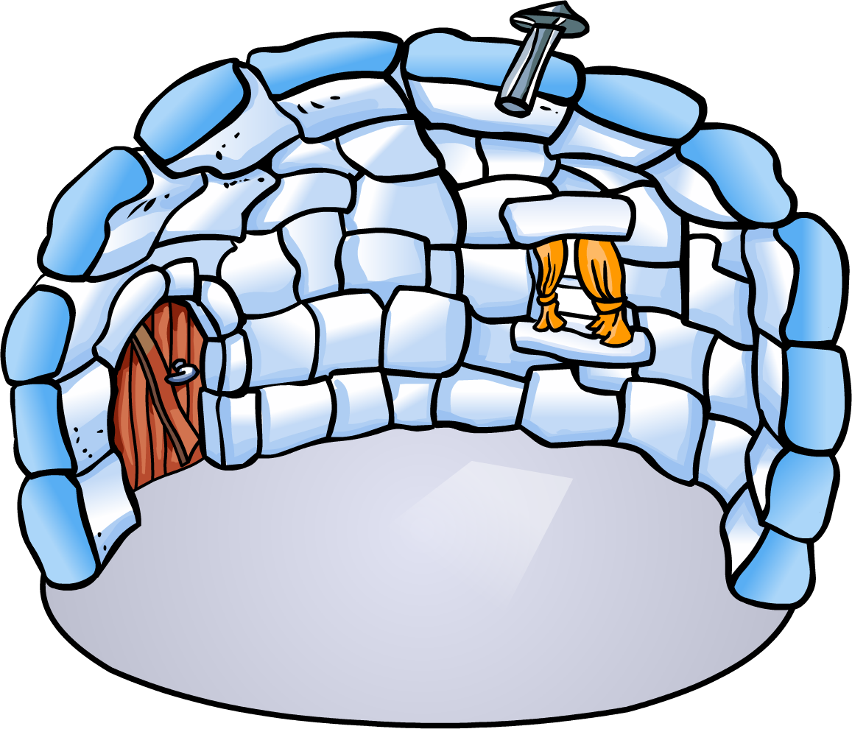


Scenario
My igloo is better than urs
No is not
1v1 me m8
Ok lol gonna rek you

Slide 3
Problem Statement:
Don’t know where to host 1v1
Don’t know whose igloo is the best
Nobody plays Club Penguin
Nobody can watch what could possibly be the best Club Penguin showdown

Slide 4
Solution
1v1 Me IRL

Slide 5
Features
Find specific matches
Taunt people with the messaging system
Organise all sorts of tournaments
Find your placing in the world (possibly)

Slide 6
Some stats
There have been over 8 registered users of our app
6 (virtual) matches have taken place since the launch of our app
Graph of traffic over time
Connected users
Time

Slide 7
Acknowledgement
Mrs Neo
Edmodo
Google
Django
Club Penguin

Slide 8
Thank you!

