Slide 1
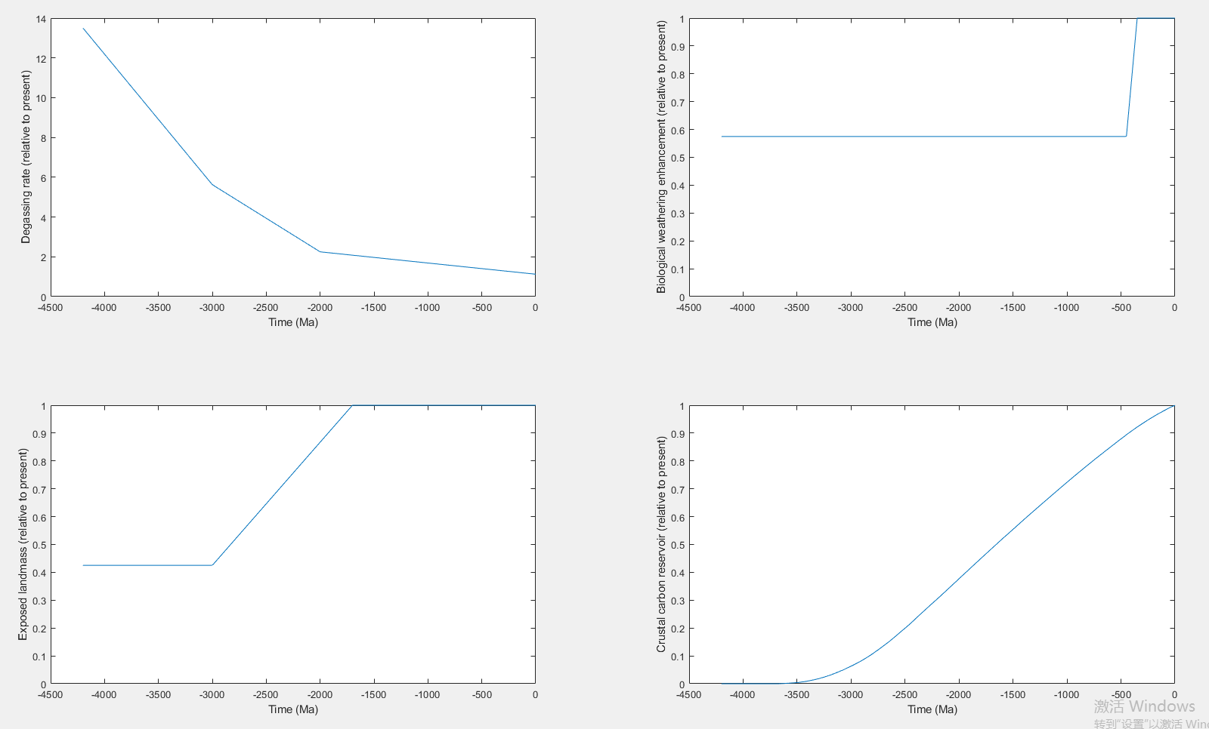
Model Forcings?
Is it because no sensitivity analysis was done that the results are different from those in the paper?

Slide 2
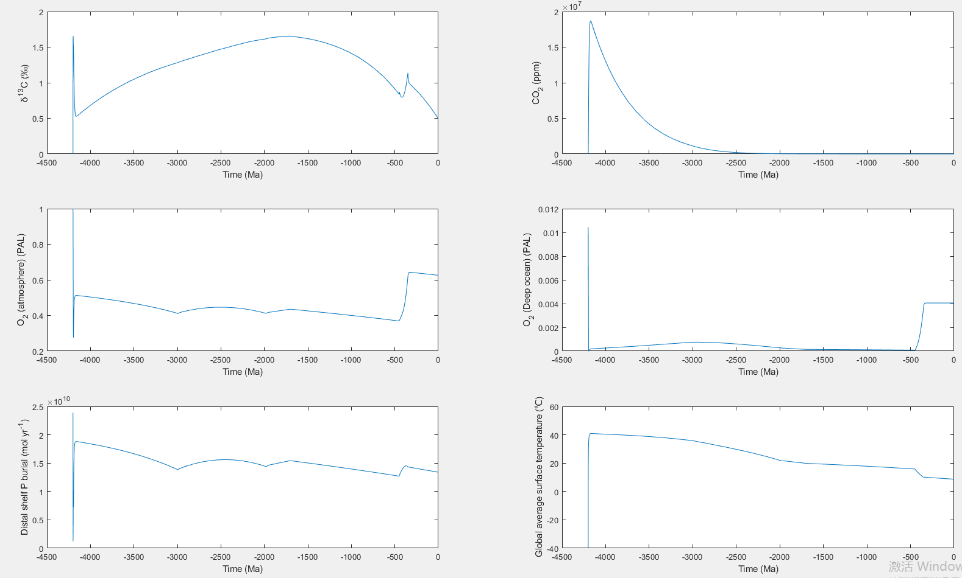
Model output with a fixed carbonate carbon reservoir.

Slide 3
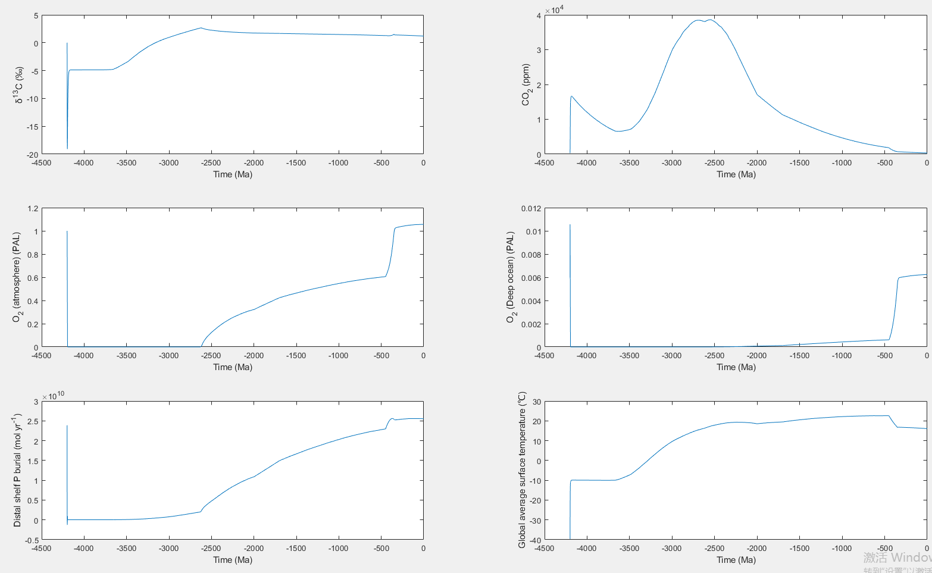
When the C parameter increases with time

Slide 4
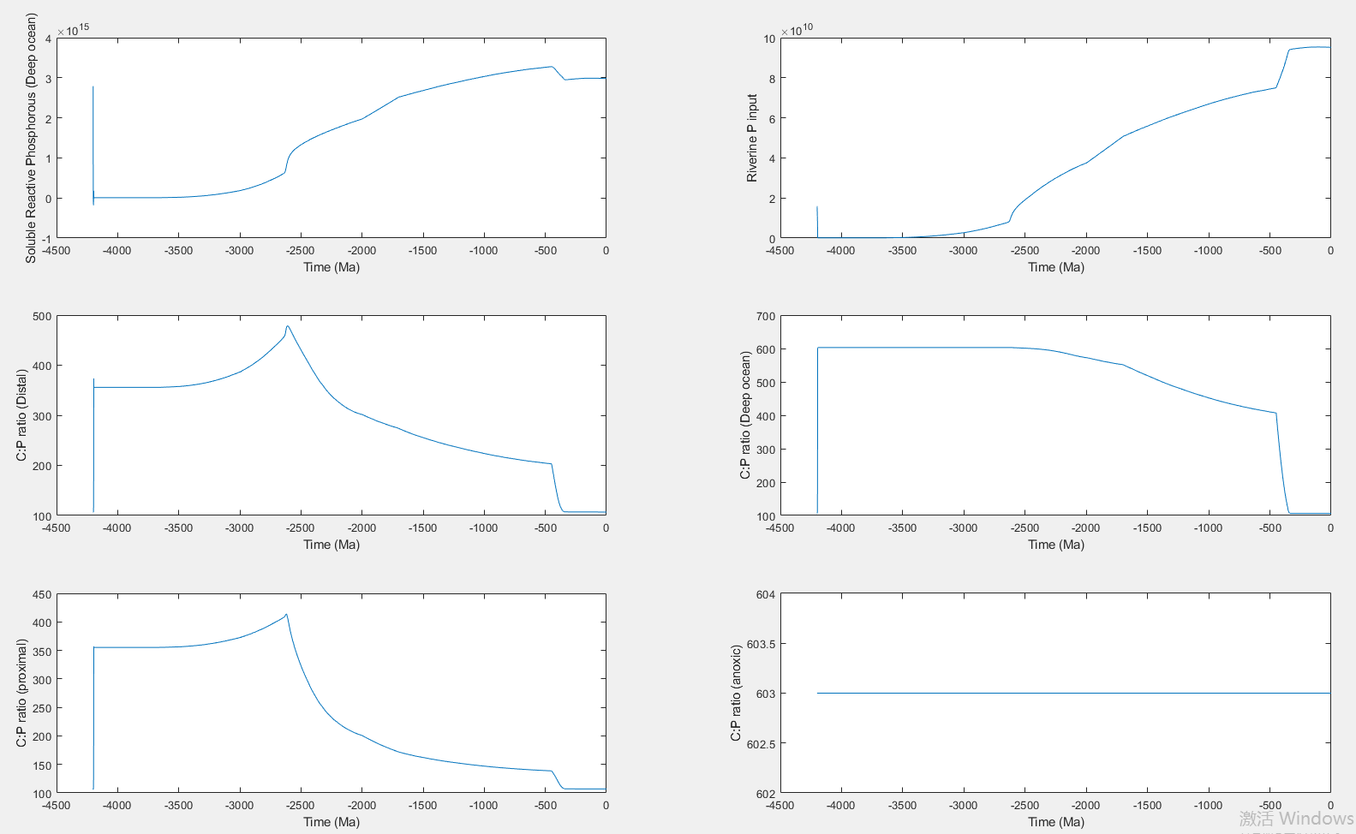
When CP ratio increases, P is released, promoting oxidation events. After oxidation events, P is buried and re-fixed in sediments, and CP ratio decreases

Slide 5
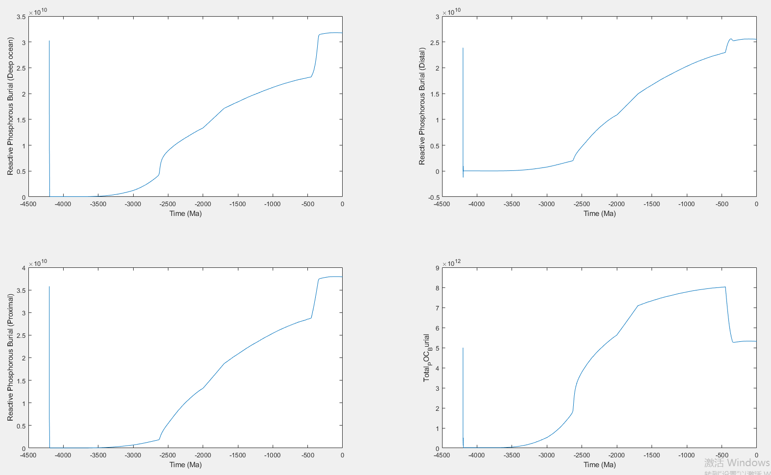

Slide 6
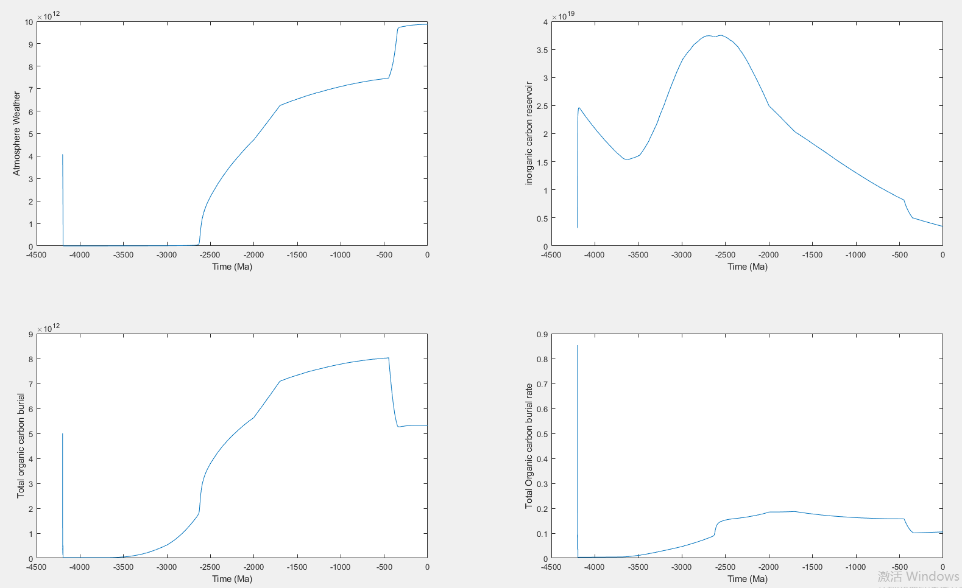

Slide 7
At present, I can only briefly understand the meaning of the individual indicators in the state results and the possible reasons for their changes. But how are they calculated? What parameters are they controlled by? How do I modify parameters? These problems can not be solved.

