Slide 1


Household Goods
Management System
Zongyao Li ，Sam Kuo，Yichen Hao，Joan Wu
Group 4
2021/04

Slide 2


Problems
solution
01
What the Problems we found?
online shopping--- uncertain arriving time
realize forgot to buy something after going home
3. not sure what items should buy and the amount ---over-purchasing/ purchasing enough
4. Covid-19-- avoid an infectious epidemic

Slide 3

Problems
solution
01
Solution
Make each shopping trip be efficiency and reduce the chance to be infections

Slide 4
02
related work，project scope
Relate work
Two relative applications pay for services
1、Items & Storage & Inventory
Function: record household purchase
Disadvantages: limit information , cannot compute consumption
2、MyStuff2 Pro
Function：note upcoming purchase list
Disadvantages：does not keep track, cannot provide reminder

Slide 5
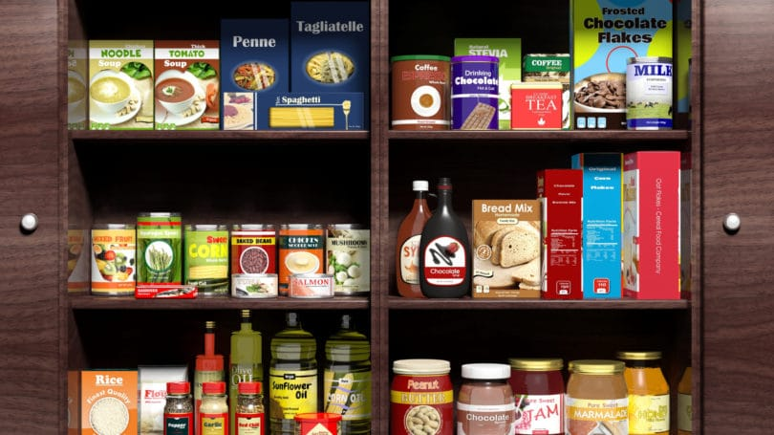
02
related work，project scope
Project scope
Review question： forgot purchase items & over-purchase
Forgot purchase items：remind user
Over-purchase items ： forgot have already bought： check household supplies

Slide 6
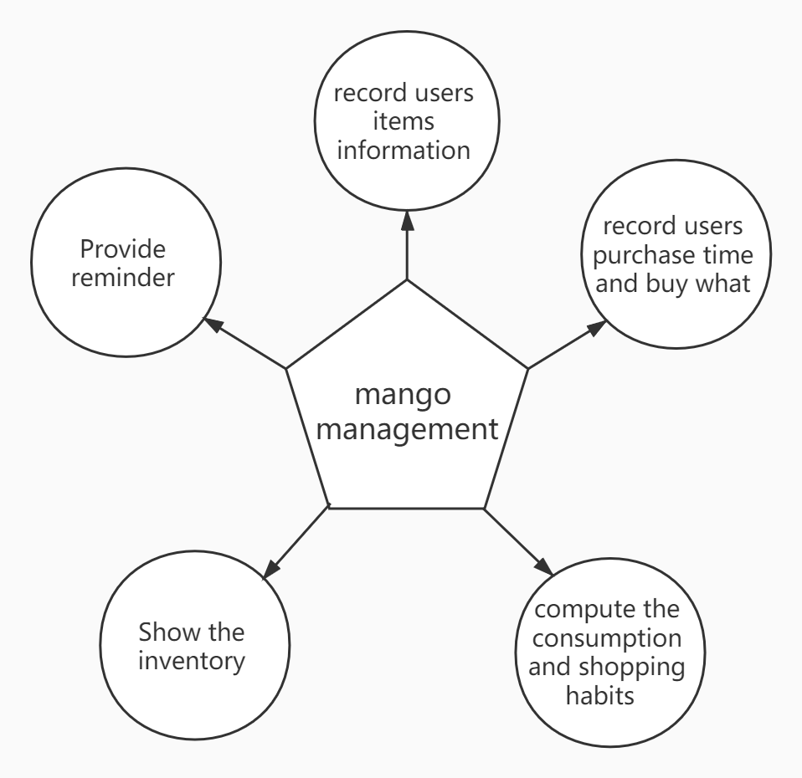
02
related work，project scope
Project scope
What the project to do ：
record users items information
Record users purchase time and buy what
Compute the consumption and shopping habits
Show the inventory
Provide reminder

Slide 7
03
Operating System and Language
Low learning cost
Efficient
Multiplatform

Slide 8


03
Operating System and Language
Spring boot
Java based
Old and stable
Rich study resources
Uni-App
Vue.js: html-like framework
Cross platform development

Slide 9
03
Estimate User’s Consumption
A customized shopping list for users.
Show the item if remaining product < weekly consumption.
Compute weekly consumption.
Which data should we use?
Changes of numbers of remaining items – cost too many space
Purchasing history

Slide 10

03
Estimate User’s Consumption
Method 1
N purchasing histories
$m_{i}$: amount of item the user bought in the $i_{th}$ shopping
$t_{i}$: the date of the $i_{th}$ shopping
Average consumption = $\frac{\sum_{1}^{N−1}{m_{i}}}{t_{N}−t_{1}}×7$
Not practical if:
User has a sudden needs
User stop purchasing the item for a long time and buy it again

Slide 11

03
Estimate User’s Consumption
Method 2:
N purchasing histories
$m_{i}$: amount of item the user bought in the $i_{th}$ shopping
$t_{i}$: the date of the $i_{th}$ shopping
$x_{i}$: average consumption during the period of $i_{th}$ to ${i+1}_{th}$ shopping. $x_{i}=\frac{m_{i}}{t_{i+1}−t_{i}}$
$\overline{x}$: the average consumption. $\overline{x}=\frac{\sum_{1}^{N−1}{x_{i}}}{N−1}$
$σ$: deviation of average consumption. $σ=\sqrt{\frac{|x_{i}^{2}−{\overline{x}}^{2}|}{N}}$
If ${|\overline{x}−x}_{i}|>2∗$ $σ$, disregard the purchasing history.
Allow user to customize their own consumption
Add an item into shopping if # of remaining < weekly consumption.

Slide 12
03
Difficulties
Front-end:
Cross domain request
The process of switching pages
Bar Code Scanning:
Few resources for bar code scanning
Looked for applicable webservice (free)
API for bar code scanning in Uni-App

Slide 13
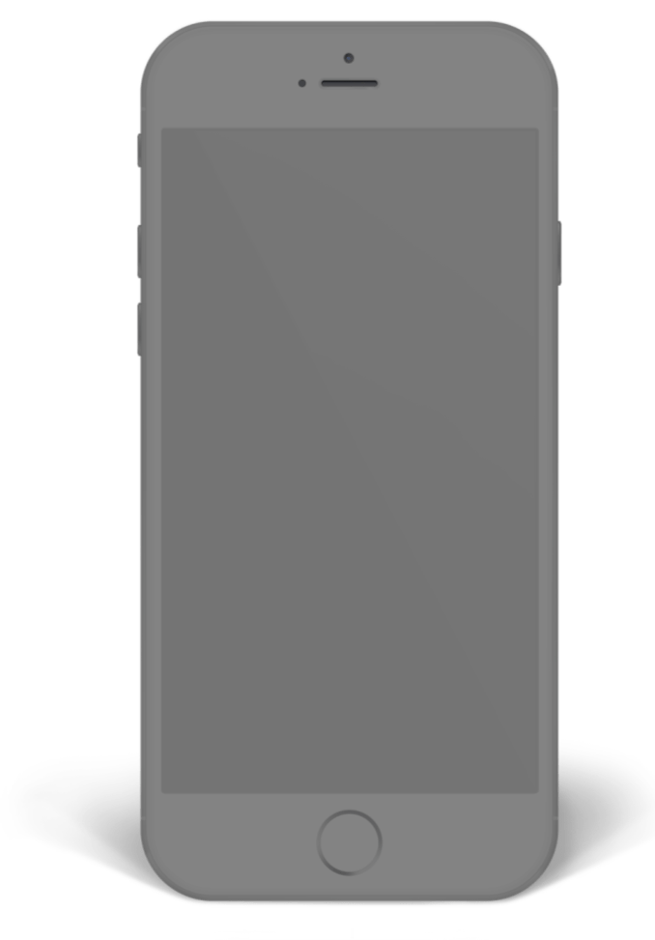
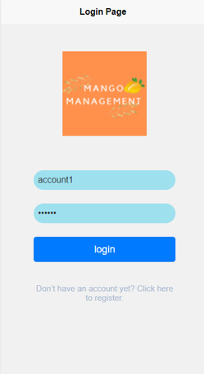
Page function demo
Application Show
Database display
The program will be executed in the environment of the local server
Real machine demo

Slide 14
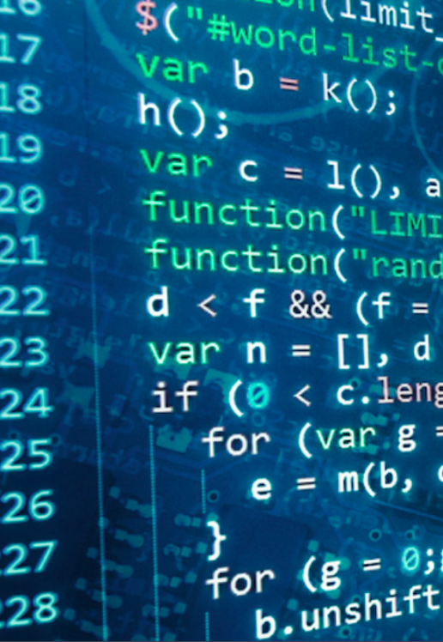
04
Future Work
Geofence function
email
arrives near the mall
Use email and SMS to remind purchase content
Wifi prompt function
Overall cost
connects to the mall’s WiFi
Remind the estimated overall cost of the next purchase

