Slide 1
DERT

Slide 2
Paper Details
Paper Title: End-to-End Object Detection with Transformers
Publication Date: 28 May 2020
Publisher: Nicolas Carion , Francisco Massa , …
Affiliation: Fackbook AI

Slide 3
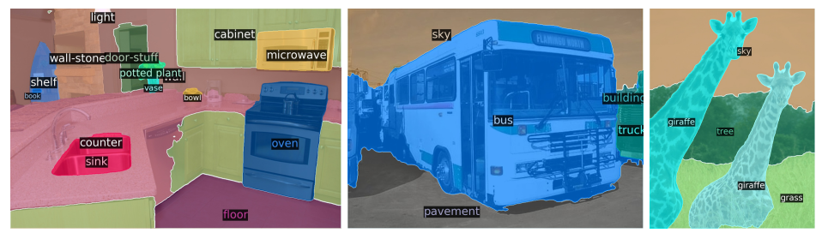
Objectives
end-to-end object detection
Notes:
The goal of object detection is to predict a set of bounding boxes and category labels for each object of interest. Example Qualitative results for panoptic segmentation

Slide 4
Motivation
detectors do set prediction task in an indirect way
simplify the pipeline
Transformer in other fields
Bridge the gap
Notes:
defining surrogate regression and classification problems on a large set of proposals, anchors or window centers. Thhey streamline the training pipeline by viewing object detection as a direct set prediction problem.

Slide 5
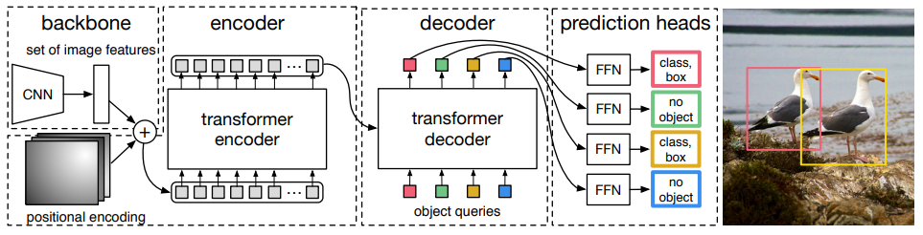
Overall Architecture
Backbone
Transformer Encoder
Transformer Decoder
Prediction feed-forward network
Notes:
a CNN backbone to
extract a compact feature representation, an encoder-decoder transformer, and
a simple feed forward network (FFN) that makes the final detection prediction.

Slide 6
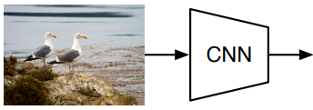


Overall Architecture
Backbone
Notes:
The input images are batched together, and we apply 0-padding to ensure they all have the same dimensions (H0, W0) as the largest image of one batch

Slide 7
Overall Architecture
Backbone
ImageNet-pretrained ResNet model
ResNet-50 → DETR-DC5
two different backbones
dilated C5 stage
ResNet-101 → DETR-DC5-R101
Notes:
The modification increase the feature resolution by
adding a dilation to the last stage of the backbone and removing a stride from
the first convolution of this stage.
This modification increases the resolution, improves the performance for smaller object, but it has 16xhigher cost in encoder which leads 2x computational cost.

Slide 8


Overall Architecture
Backbone
Transformer Encoder
Transformer Encoder
1x1 convolution
collapse the spatial dimensions
Notes:
Basically why we need this input is that it can generate the global connenction.

Slide 9
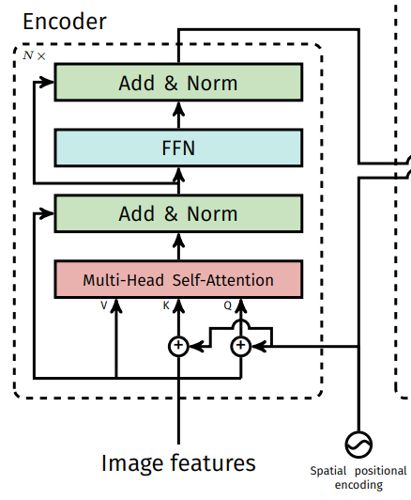
Overall Architecture
Backbone
Transformer Encoder
X 6
Notes:
Two-dimensional Positional Encoding to make the model permutation variant. We use a stack of 6 layers which is also the layer number used in the encoedr part of the paper Attention is all you need.

Slide 10



Overall Architecture
Backbone
Transformer Encoder
positional encodings
Notes:
Attention scores. Adding a softmax you will receive attention probabilties. Input matrix X (T token * Din dimension) , the valur matrix W-val (Din dimension * Dout dimension)

Slide 11
Overall Architecture
Backbone
Transformer Encoder
positional encodings
Absolute Encoding
Relative Encoding
Notes:
1) With absolute encodings, a (fixed or learned) vector Pp,: is assigned to each pixel p. 2) The main idea is to only consider the position difference between the query pixel (pixel we compute the representation of) and the key pixel (pixel we attend) instead of the absolute position of the key pixel

Slide 12
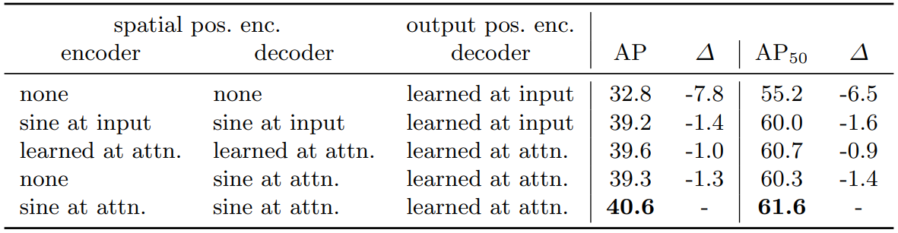
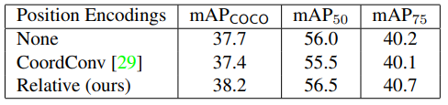
Overall Architecture
Backbone
Transformer Encoder
positional encodings
Absolute Encoding
Relative Encoding
Notes:
Effects of different position encodings in Attention Augmentation on the COCO object detection task using a RetinaNet AA-ResNet-50 backbone. 1) The position-unaware version 2) CoordConv for which we concatenate (x,y,r) coordinate channels to the inputs of the attention function, 3) two-dimensional relative position encodings

Slide 13
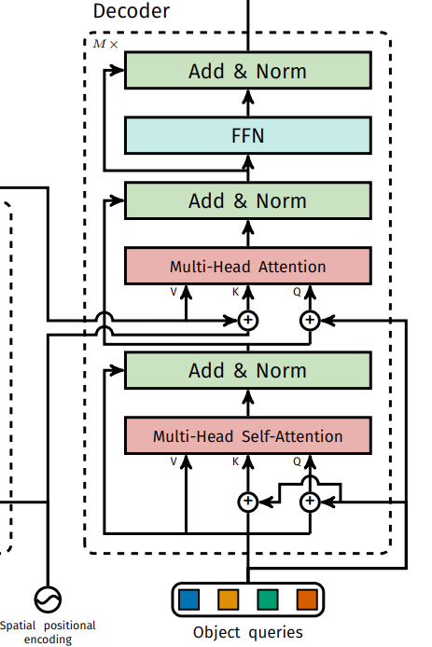
Overall Architecture
Backbone
Transformer Encoder
Transformer Decoder
width 256.
X 6
Notes:
The decoder follows the standard architecture of the transformer, transforming N embeddings of size d using multi-headed self- and encoder-decoder attention mechanisms.

Slide 14

Overall Architecture
Backbone
Transformer Encoder
Transformer Decoder
N input embeddings
different
learnt positional encodings
Notes:
Their model decodes the N objects in parallel at each decoder layer, while Attention is all you need author uses an autoregressive model that predicts the output sequence one element at a time.
similarly to the encoder, they add them to the input of each attention layer.
The N object queries are then independently decoded into box coordinates and class labels by a feed forward network

Slide 15
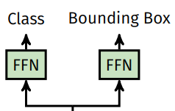
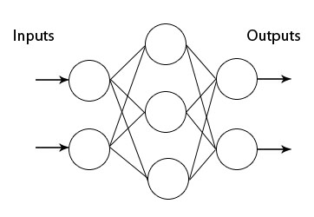
Overall Architecture
Backbone
Transformer Encoder
Transformer Decoder
Prediction feed-forward network
ReLU activation function
Prediction
Linear projection layer
Hidden dimension d
Notes:
Actually I have a question here.lll

Slide 16
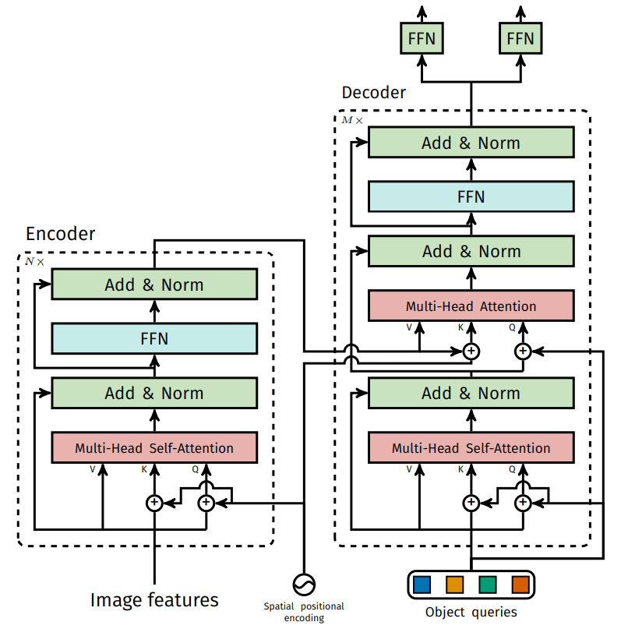
Overall Architecture

Slide 17
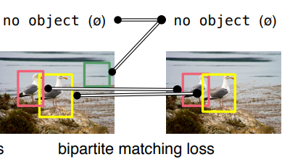
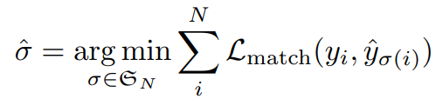
Prediction Loss
Bipartite matching

Slide 18
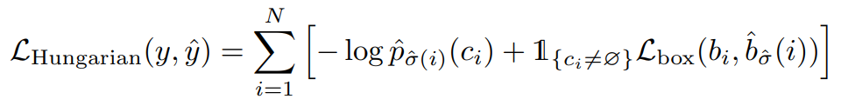

Prediction Loss
Bipartite matching
Hungarian Algorithm
Trick : we down-weight the log-probability term when ci = ∅ by a factor 10 to account for class imbalance
Classification loss
l1 bounding box distance loss
GIoU loss
Notes:
yi = (ci , bi) where ci is the target class label bi is a vector that defines ground truth box center coordinates and its height and width relative to the image size.
They use a linear combination of a negative log-likelihood for class prediction and a box loss defined later

Slide 19
Experiments
Dataset
Training

Slide 20
Experiments
Dataset
COCO 2017
Average 7 instance in an image (maximal 63 instances)
AP refers to bbox AP

Slide 21
Experiments
Dataset
Training
Whole Architecture
Data Process
Backbone
Transformer
Losses

Slide 22
Experiments
Dataset
Training
Whole Architecture
AdamW with improved weight decay 10^(-4), maximum gradient norm

Slide 23
Experiments
Dataset
Training
Whole Architecture
Data Process
Scale augementation resize images
Notes:
the shortest
side is at least 480 and at most 800 pixels while the longest at most 1333

Slide 24
Experiments
Dataset
Training
Whole Architecture
Data Process
Backbone
Backbone batch normalization weights and statistics are frozen during training
Learning rate 10^(-5)
Notes:
We fine-tune the backbone using learning rate of 10−5

Slide 25
Experiments
Dataset
Training
Whole Architecture
Data Process
Backbone
Transformer
Learning rate 10^(-4)
Dropout 0.1
Notes:
We train the transformer with a learning rate of 10−4 . Additive dropout of 0.1 is applied after every multi-head attention and FFN before layer normalization.

Slide 26

Experiments
Dataset
Training
Whole Architecture
Data Process
Backbone
Transformer
Losses
Notes:
the shortest
side is at least 480 and at most 800 pixels while the longest at most 1333

Slide 27
Panoptic segmentations
Predicting Box
Mask Head
Notes:
Predicting boxes is required for the training to be possible, since the Hungarian matching is computed using distances between boxes.

Slide 28
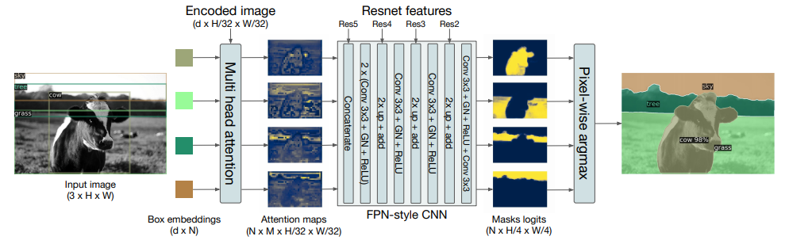
Panoptic segmentations
Predicting Box
Mask Head
Notes:
It takes as input the output of transformer decoder for each object and computes multi-head (with M heads) attention scores of this embedding over the output of the encoder, generating M attention heatmaps per object in a small resolution. n. To make the final prediction and increase the resolution, an FPN-like architecture is used. This head is trained either jointly, or in a two steps process (first train DETR for boxes, then freeze all the weights and train the mask for 25 epochs)

Slide 29
Compensation
1
2

