Slide 1
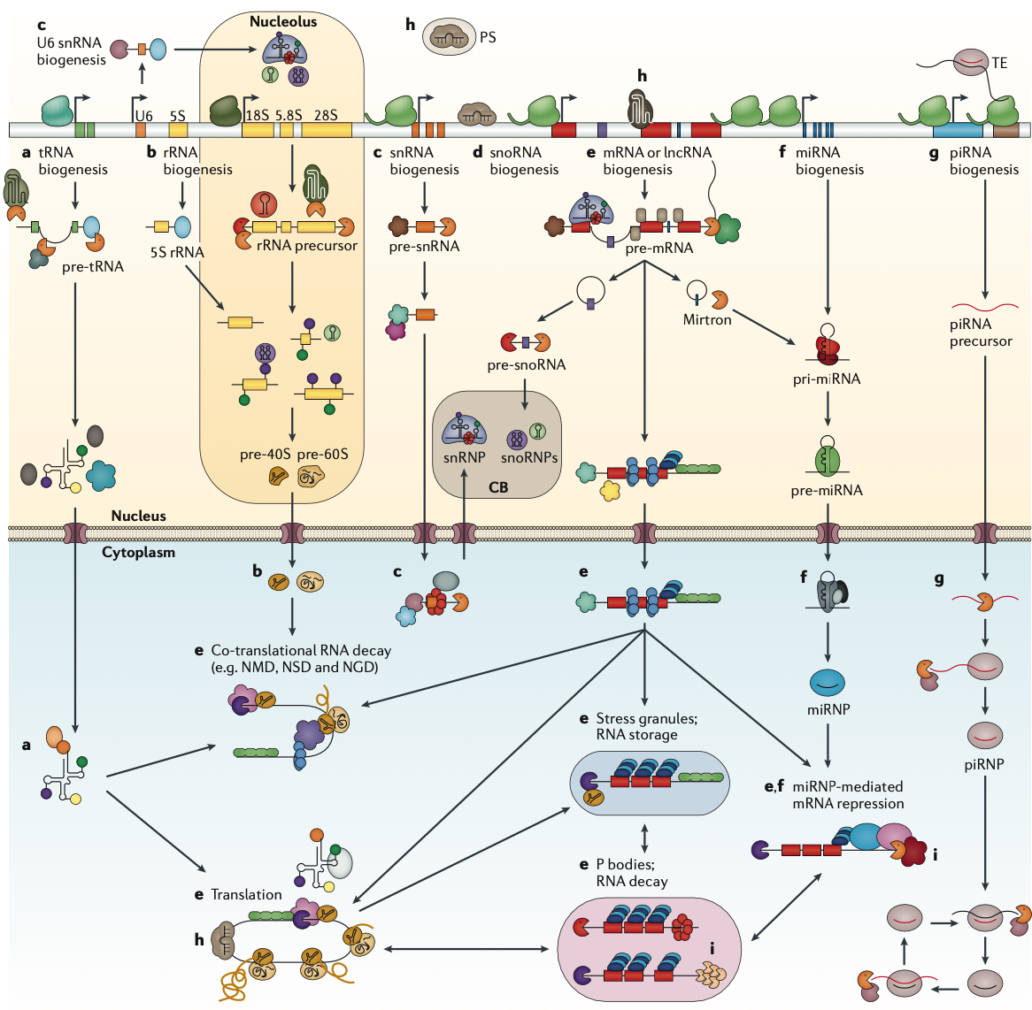
Background:RNA-binding proteins have diverse functions in organisms
methylation (M)
pseudouridylation (ψ)
deamination (I)
Nucleic acid modification
Expression of genetic information
Gene silencing or repression
LncRNA
tRNA
mRNA
rRNA
snRNA
piRNA
miRNA
Guide
gene regulation
Gerstberger，S.，Nat Rev Genet 15

Slide 6
Result:Train dataset and test dataset
Dataset
RNA-binding
Not RNA-binding
Train dataset
PDB+Uniprot
Uniprot
9743RBP
9443RBP
Randomly select
Filter
< 60 amino acids (aa)
> 4000 aa
contain ‘ X | x ’ and ‘ J | j ’
9443NRBP
9743NRBP
Filter
< 60 amino acids (aa)
> 4000 aa
RNA info(GO)
contain ‘ X | x ’ and ‘ J | j ’
72437protein
Test dataset
Mmseq Similarity 50%
9743RBP
300RBP
Randomly select
9743protein
9743protein
9743NRBP
300NRBP
Mmseq Similarity 25%

Slide 7
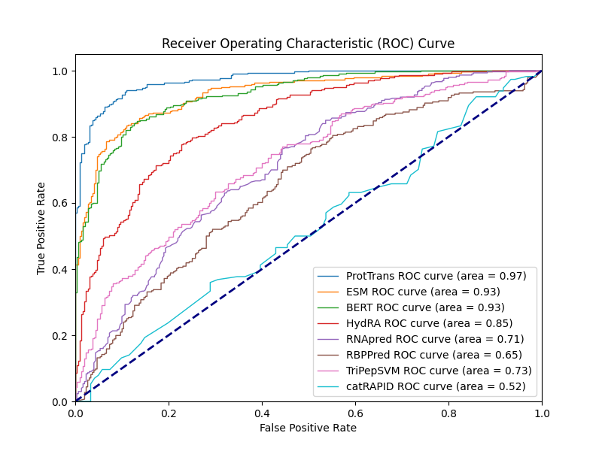
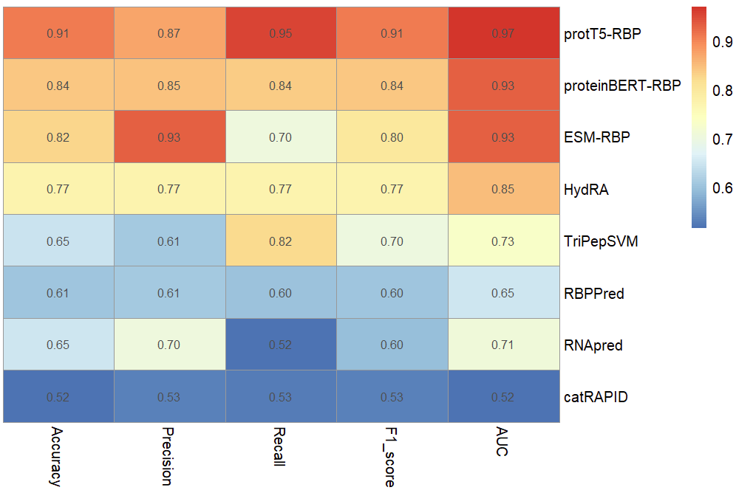
Result:Model performance on our test set
Accuracy: Proportion of correctly predicted samples.
Precision: Proportion of actual positives among predicted positives.
Recall: Proportion of correctly predicted positives among all actual positives.
F1 Score: Harmonic mean of precision and recall.
AUC: Area under the ROC curve; higher AUC indicates better model performance.

Slide 8
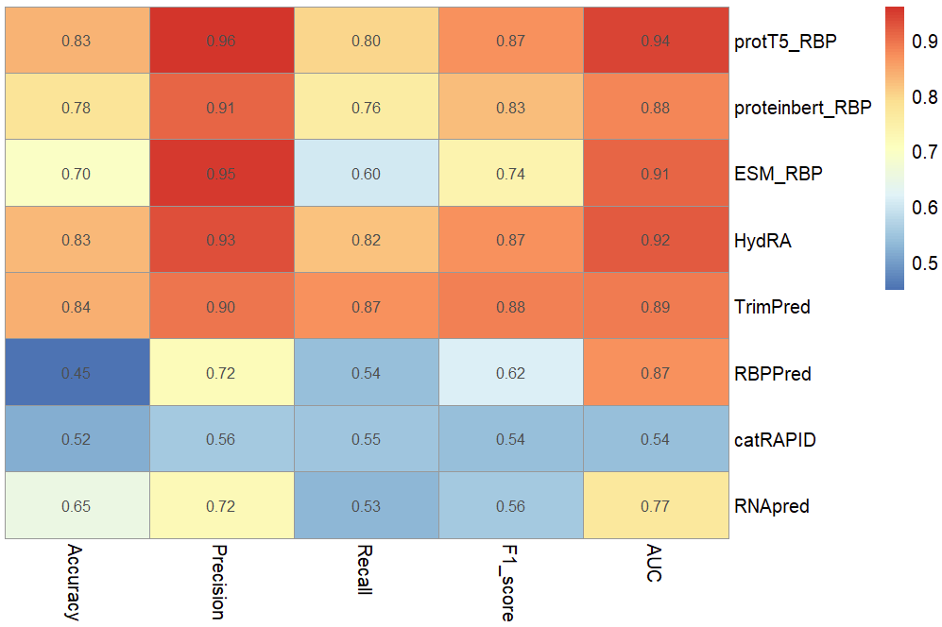
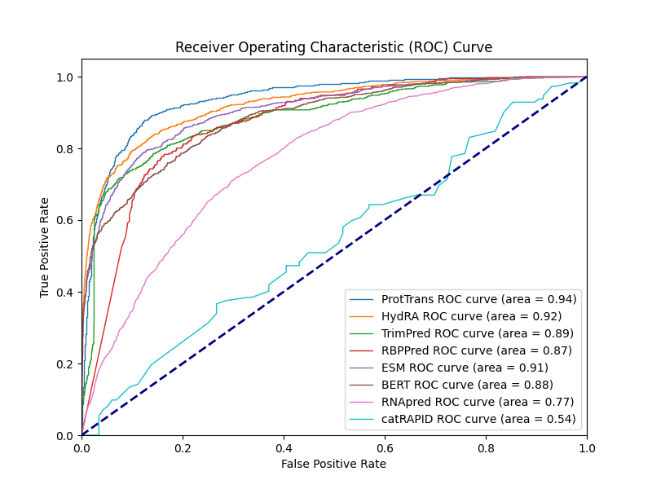
Result:Model performance on other test set
Collect test dataset
TrimPred、RBPPred、RNApred、catRAPID
4876 sequences
MMseq2
Similarity 50%
Our train dataset
3371 sequences

