Slide 1
Machine learning applied to hyperspectral images
Authors:
Louis Guo (louis.guo)
Ilan Guenet (ilan.guenet)
Raphaël Ramelet (raphael.ramelet)

Slide 2
Table of content
1. Introduction
2. Load data
3. Preprocessing
4. Transformers
5. Multiclass classification (Indiana and Salinas)
6. Impact of the gaussian blur
7. Performance of the best classifier

Slide 3
Introduction

Slide 4
Problem to solve
Develop a hyperspectral image classification pipeline
Be able to segment our pictures into given categories
Have satisfactory and consistent results to support the coherence of our proposal

Slide 5
Load data

Slide 6
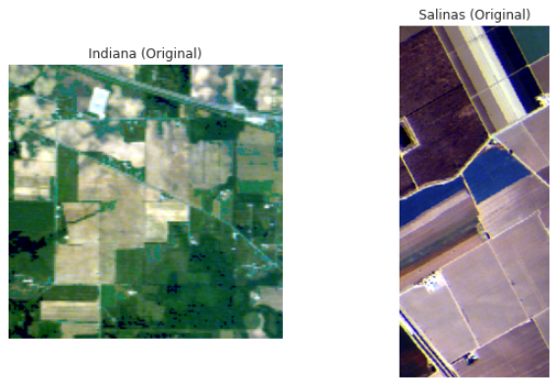
Hyperspectral Images

Slide 7
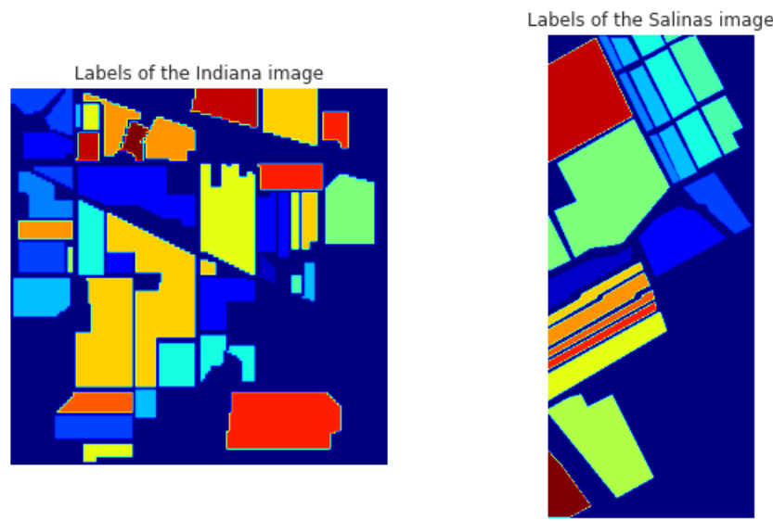
Labels

Slide 8
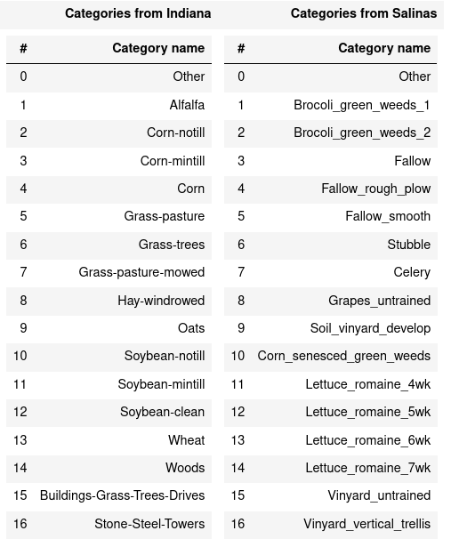
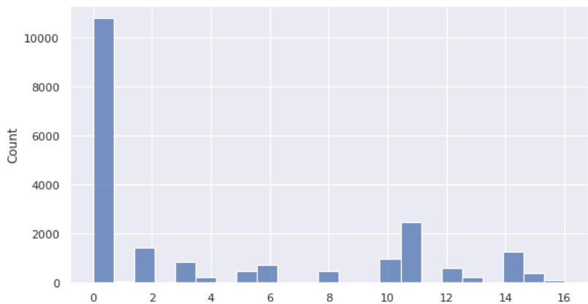
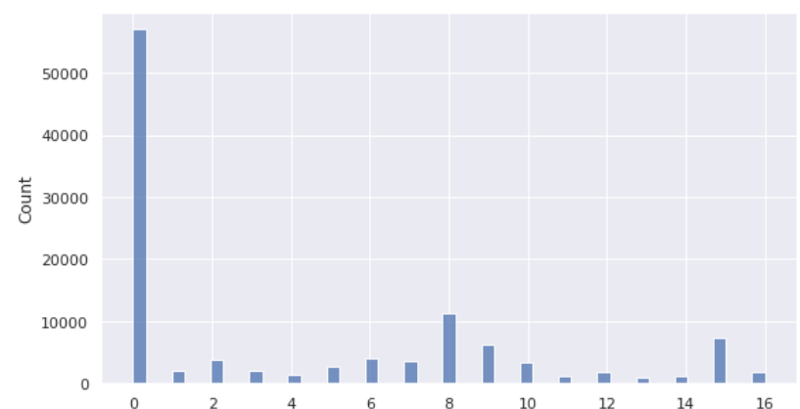
Unbalanced categories
Number of occurrences of each category on Indiana
Number of occurrences of each category on Salinas

Slide 9
Preprocessing

Slide 10
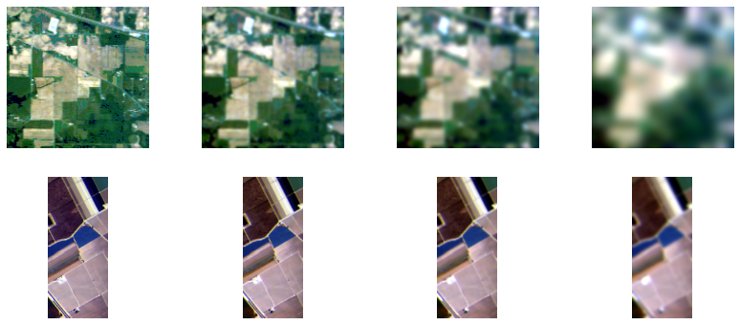
Gaussian blur
Result of a gaussian blur applied images:
Sigma 0
Sigma 1
Sigma 2
Sigma 5

Slide 11
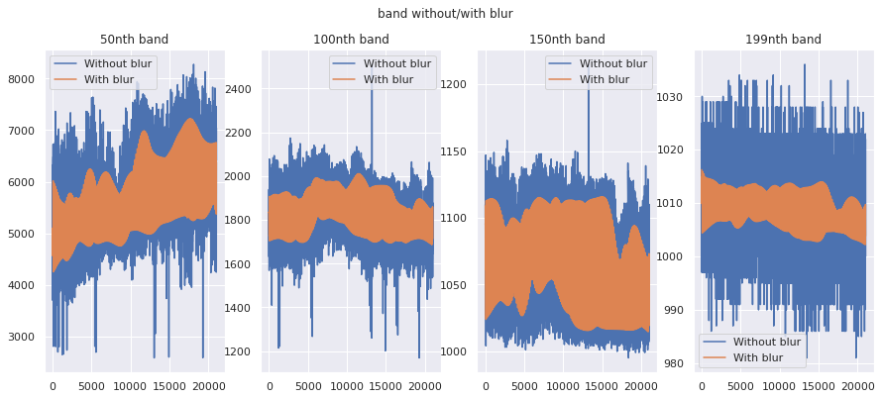
Why using a gaussian blur as a preprocessing step?
Hyperspectral images have noise (instrumental noise)
can be partly removed by using smoothing techniques
smooth spikes
Lower variance

Slide 12
Transformers

Slide 13

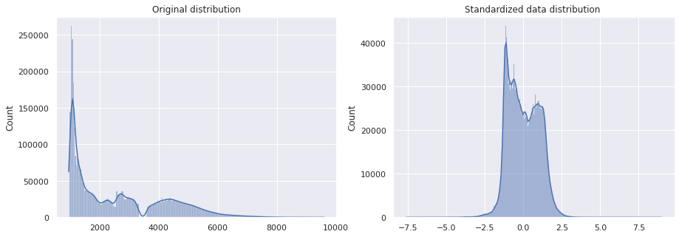
Standard Scaler
scale the data to look like a standard normal distributed data
Some algorithms assume that all features are centered around 0 and have variance in the same order (e.g. the RBF kernel of SVM).

Slide 14
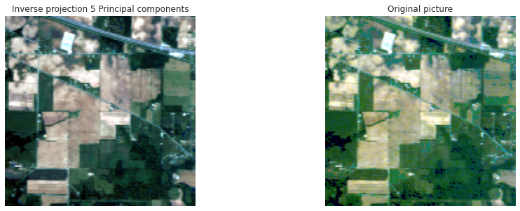
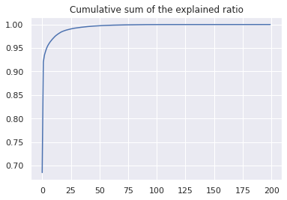
Dimension reduction (PCA)
Project data in a new space
Most of the information is contained in the first principal components
The last components hold the information of noise
Select the number of principal components based on a threshold

Slide 15
With vs Without the 'other' category

Slide 16
Scores with and without the `other` category
LinearSVC:
Accuracy with: 0.86, without: 0.96
f1 macro average score with: 0.79, without: 0.97
f1 weigthed average score with: 0.86, without: 0.96
RandomForest:
Accuracy with: 0.98, without: 1.00
f1 macro average score with: 0.90, without: 1.00
f1 weigthed average score with: 0.98, without: 1.00

Slide 17
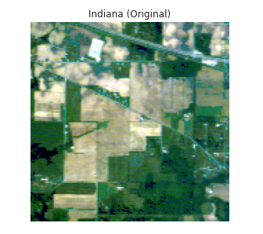
Multiclass classification (Indiana)

Slide 18
Linear SVC (Indiana)
One Versus All
N predicters
Based on SVM (support vector machine algorithm)
Find hyperplane that best divide samples

Slide 19
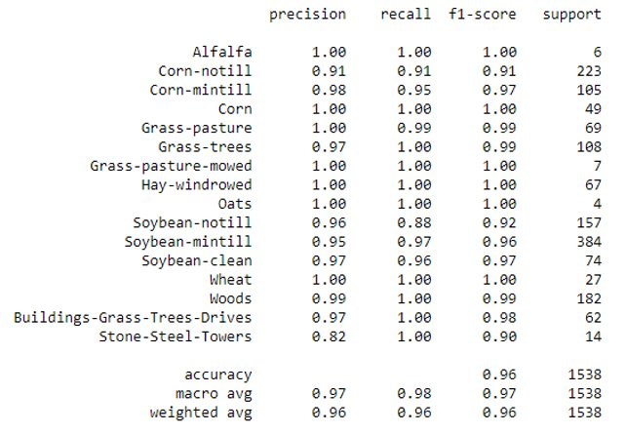
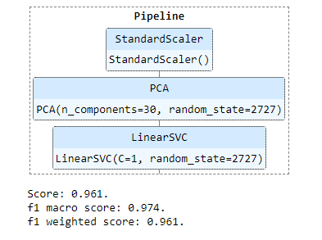
Linear SVC (Indiana)
Final score
Score according to each category.

Slide 20
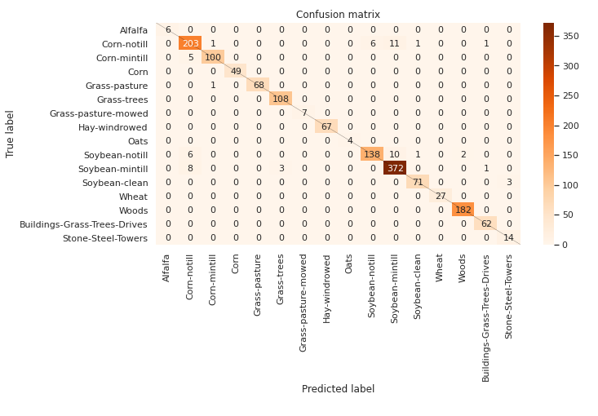
Linear SVC (Indiana)
The confusion matrix

Slide 21
Random Forest (Indiana)
Inherently multiclass
Collection of decision trees
The class with the most votes along the decision trees wins

Slide 22
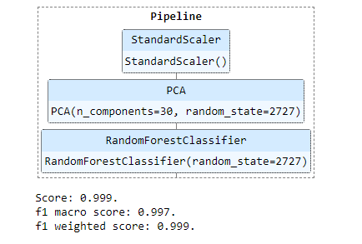
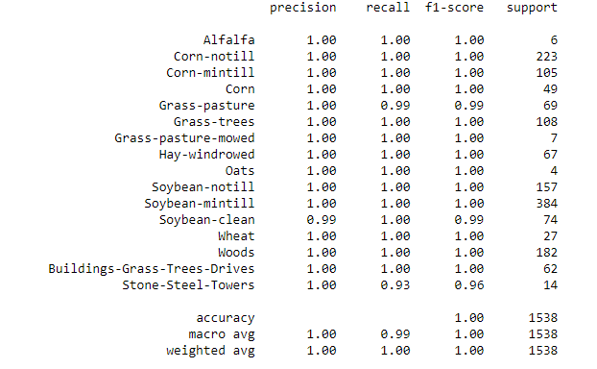
Random Forest (Indiana)
Final score
Score according to each category.

Slide 23
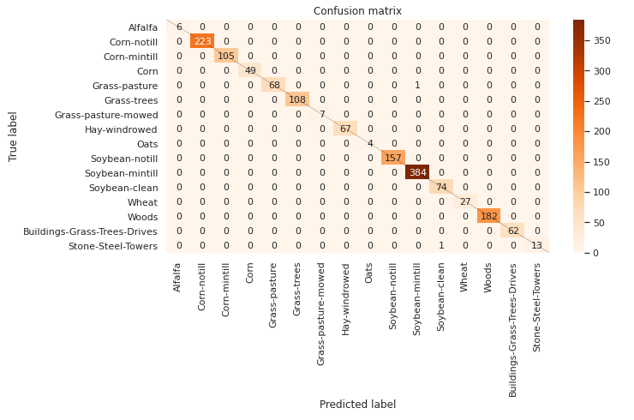
Random Forrest (Indiana)
The confusion matrix

Slide 24
K Nearest Neighbours (Indiana)
Inherently multiclass
no real training step
Naively, assigns according to the majority class in the neighbor-hood of the points
Can be weighted by the distance

Slide 25
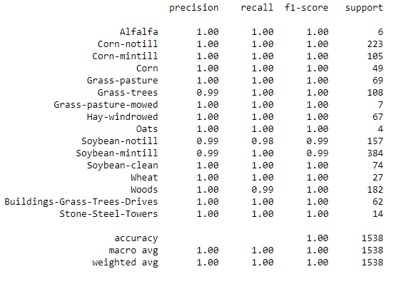
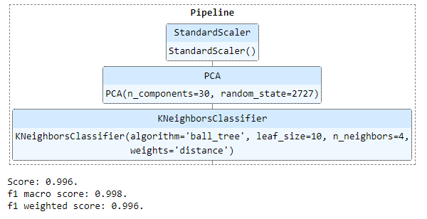
K Nearest Neighbours (Indiana)
Final score
Score according to each category.

Slide 26
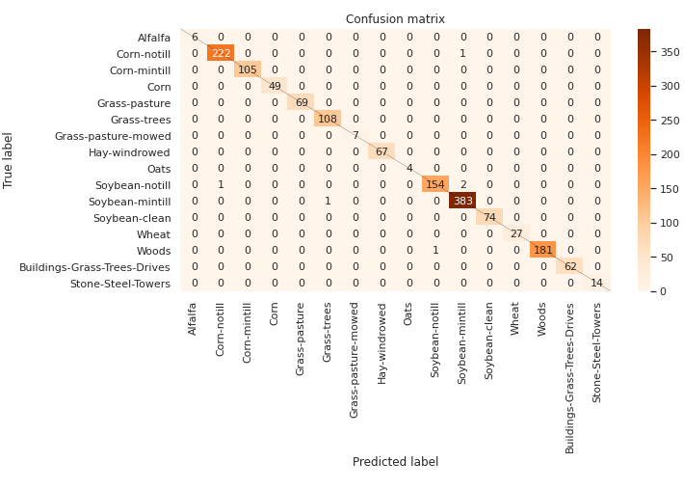
K Nearest Neighbours (Indiana)
The confusion matrix

Slide 27
SVC (Indiana)
One Versus One
N * (N - 1) / 2 predicters
Based on SVM (support vector machine algorithm)
Best with RBF (radial basis function) kernel

Slide 28
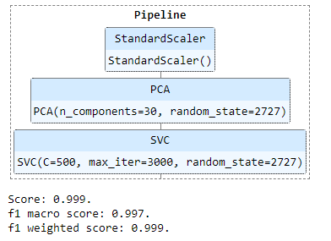
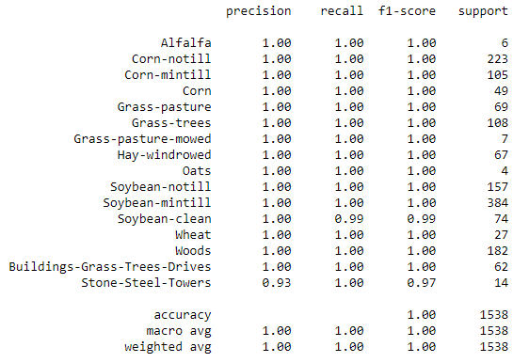
SVC (Indiana)
Final score
Score according to each category.

Slide 29
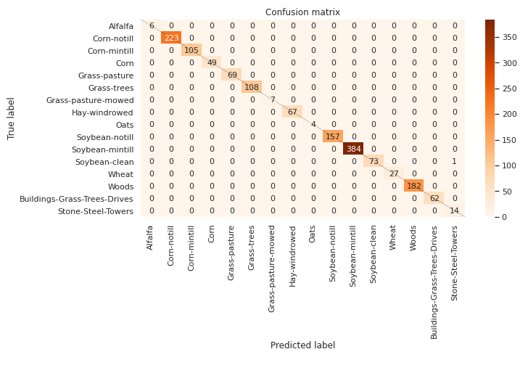
SVC (Indiana)
The confusion matrix

Slide 30
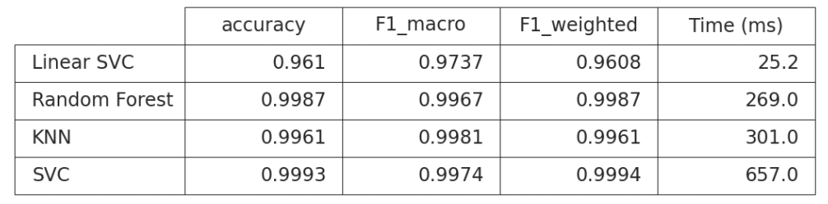
Benchmark (Indiana)
Scores and time per classifier:

Slide 31
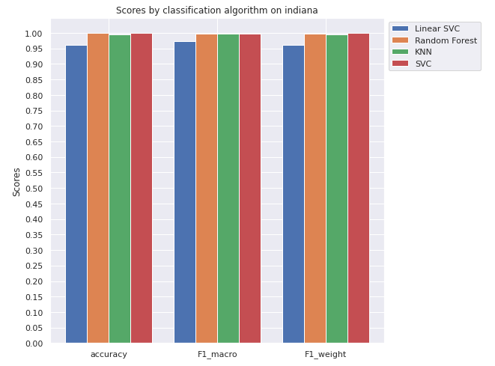
Benchmark (Indiana)

Slide 32
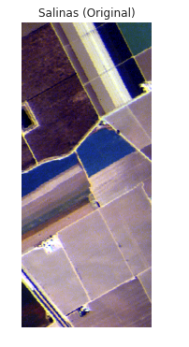
Multiclass classification (Salinas)

Slide 33
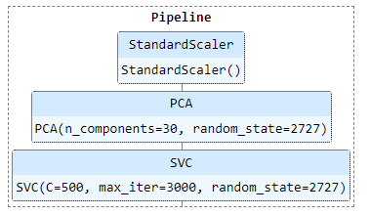
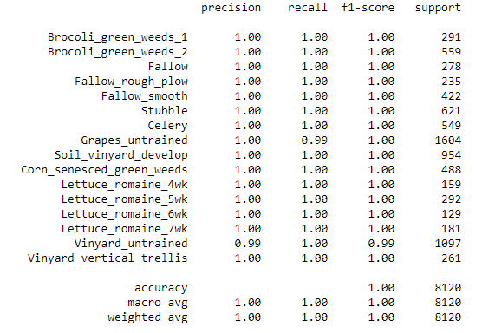

SVC (Salinas)
Final score
Score according to each category.

Slide 34
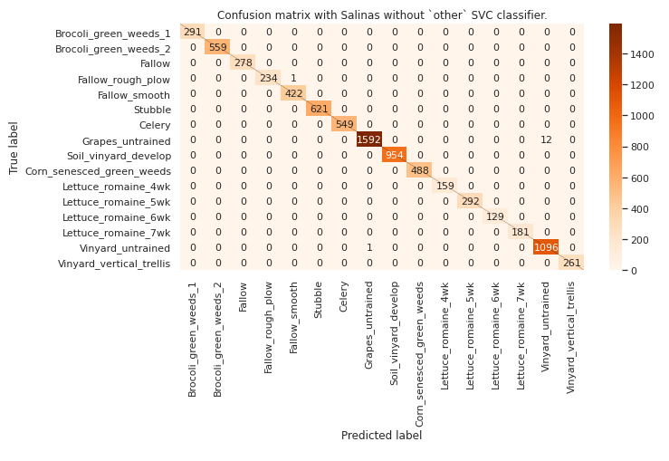
SVC (Salinas)
The confusion matrix

Slide 35
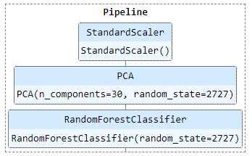
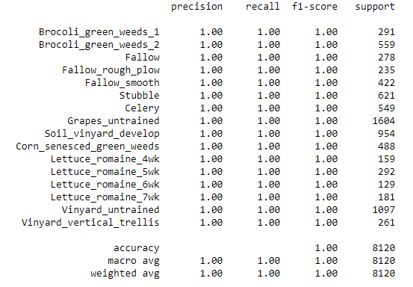

Random Forest (Salinas)
Final score
Scores of the classifier:

Slide 36
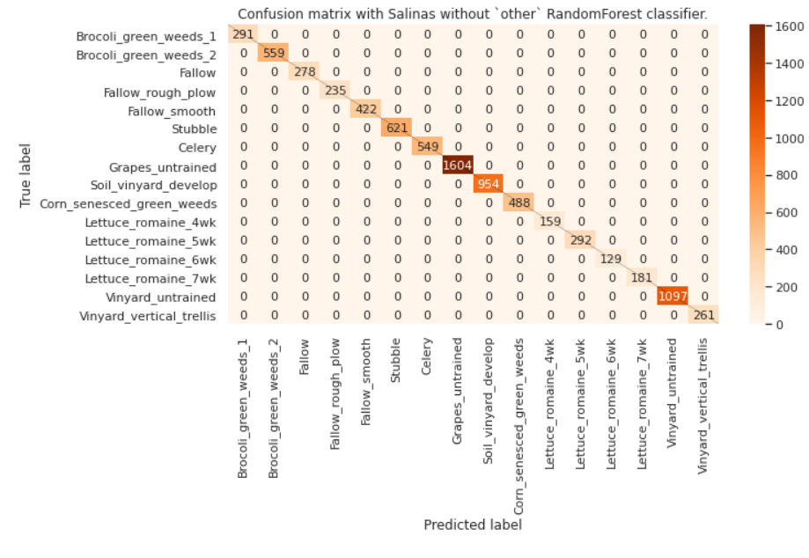
Random Forest (Salinas)
The confusion matrix

Slide 37
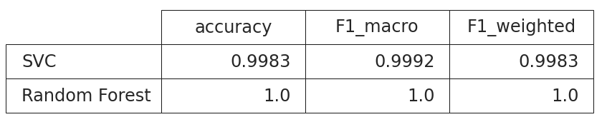
Benchmark (Salinas)
Score per classifier.

Slide 38
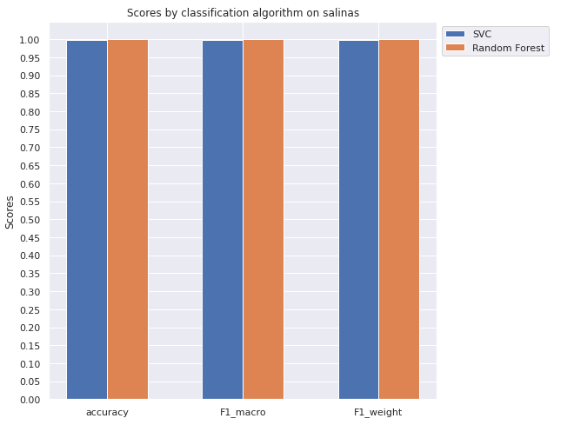
Benchmark (Salinas)

Slide 39
Impact of the gaussian blur

Slide 40
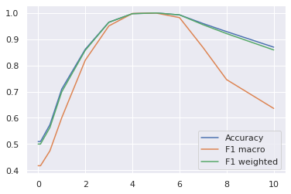
Scores depending on the strength(sigma) of the gaussian blur

Slide 41
Performance of the best classifier

Slide 42
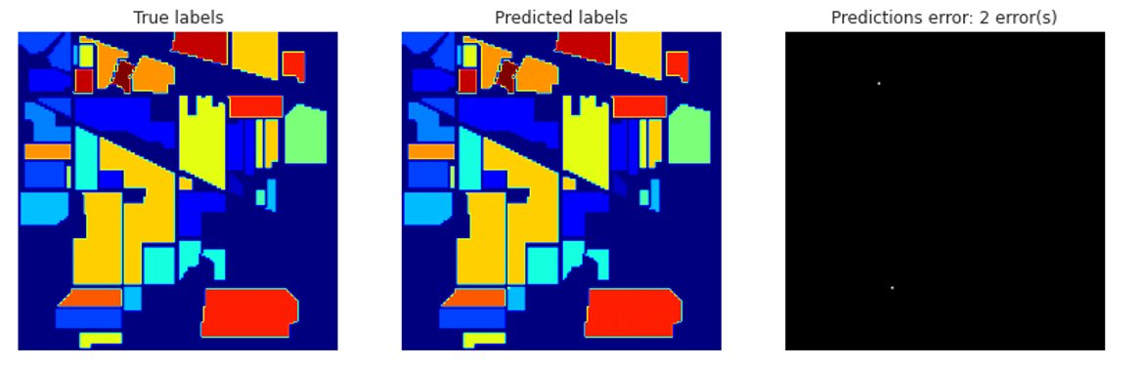
Random Forrest on Indiana
2 errors were made by the classifier.

Slide 43
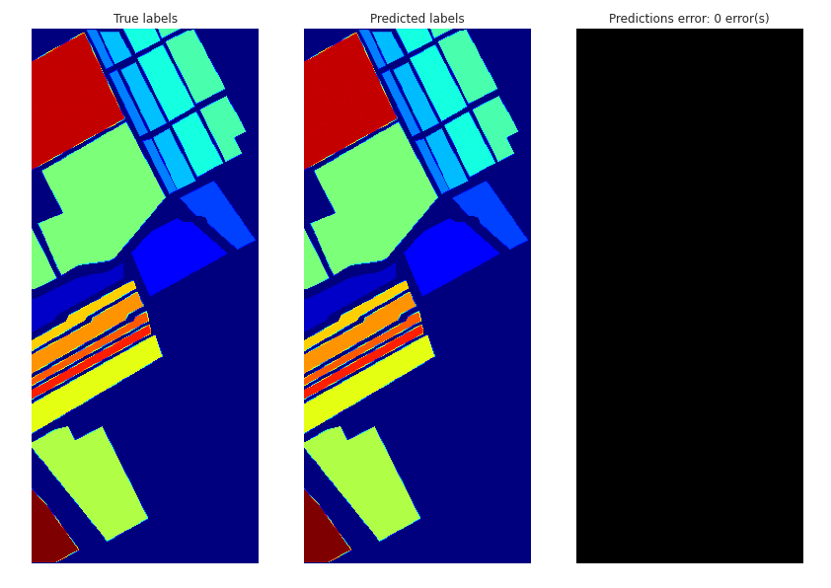
Random Forrest on Salinas
No errors were made by the classifier.

Slide 44

Conclusion

