Slide 1
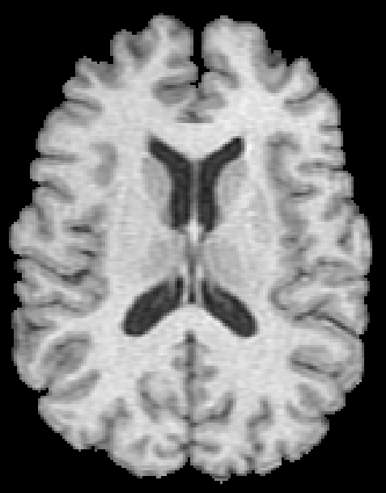
Cortical Tissue
White Matter
Ventricles

